Slide 1
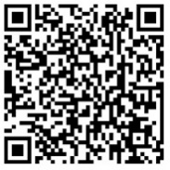
Clinical presentation of RSV disease in young children
symptoms, disease severity, diagnosis, and treatment
Access these and additional slides offered as part of an RSV communications toolkit at: bit.ly/RSVInfoToolkit
Version: February 2026

Slide 2



A clinical overview of respiratory syncytial virus (RSV)
To properly manage illness and inform communities about disease, clinicians need to be able to answer these questions:
 | What is RSV? how it impacts the respiratory system
 | What does RSV look like in young children? symptoms and severe disease
 | How is RSV currently managed? diagnosis, treatment, and prevention
Notes:
RSV is the top cause of severe respiratory infections and hospitalizations in young infants—with prevention interventions not yet widely available.
To properly manage illness and inform communities about disease, clinicians need to know: What is RSV? What does RSV look like in young children? And how is RSV currently managed?

Slide 3



What is RSV?
RSV is so common that almost all children contract the virus before 2 years of age
Often mild, like a cold, but can be severe (or deadly) for infants. | Sneezing, coughing, touching contaminated surface and then eyes, nose, or mouth | Infection-induced immunity not fully protective Repeated lifelong infections | Any child can get severely ill and be hospitalized. Most with severe disease are born full term and have no underlying health conditions Additional factors that increase risk: Premature birth Comorbidities (e.g., prematurity, underlying heart/ lung disease) Living in socioeconomically disadvantaged areas
PRESENTATION
TRANSMISSION
IMMUNITY
PEDIATRIC POPULATIONS AT RISK OF SEVERE DISEASE
Notes:
RSV is a virus that is easily spread throughout a community.
Virtually everyone gets RSV at some point in their lives, usually by two years of age.
RSV disease is often mild, like a cold, but can be severe (or deadly) for infants.
Transmission can occur through sneezing, coughing, and transference from contaminated surfaces.
Repeated infections can occur over a lifespan since infections induce only partial immunity
Although any child can get severely ill or hospitalized due to RSV, children are at highest risk if they are under 6 months of age, have co-morbidities like heart and lung disease and prematurity, or live in a socioeconomically disadvantaged area.

Slide 4
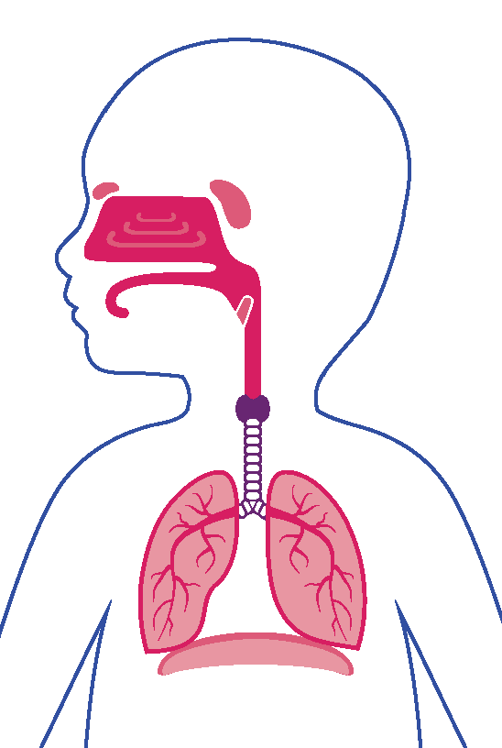
RSV affects the lungs and breathing passages
Symptoms typically occur 3-5 days after infection and can last 5-10 days
RSV infects the respiratory epithelial cells of the respiratory system and triggers a host inflammatory response.
Symptoms often start in the upper respiratory tract and are typically mild. In many cases, RSV can also infect the lower respiratory tract.
UPPER RESPIRATORY TRACT
 |  | for
Runny nose | Coughing | Low-grade fever
Nasal congestion | Wheezing | Apnea (pause in breathing)
Earache/otitis media | Fast breathing | Poor feeding
 |  | Dehydration
UPPER RESPIRATORY SYMPTOMS
LOWER RESPIRATORY SYMPTOMS
GENERAL SYMPTOMS
LOWER RESPIRATORY TRACT
Notes:
RSV infects the respiratory epithelia cells of the upper and lower respiratory system and triggers a host inflammatory response.
Symptoms typically occur between 3 and 5 days after infection. Symptoms can last up to 10 days and viral shedding can occur for up to 2 weeks.
RSV infection in children is typically mild with upper respiratory symptoms similar to the common cold, such as runny nose, nasal congestion, earache, and low-grade fever.
RSV is much more serious if it becomes a lower respiratory infection.
Lower respiratory symptoms include coughing, wheezing, fast breathing, and apnea (or pauses in breathing).
Apnea most commonly affects very young infants.

Slide 5

Severe RSV disease
Infants under 6 months of age are most at risk for lower respiratory tract infection
Infant airways are small and can easily be obstructed by mucous and inflammatory products. This can lead to severe complications and outcomes.
In infants with lower respiratory tract infections
Up to 20% experience apnea
Up to 85% experience fast breathing
Mucus
Inflammation
HEALTHY BRONCHIOLE
More air
INFLAMED BRONCHIOLE
Less air
Notes:
RSV disease is much more likely to progress to the lower respiratory tract in infants due to their small airways.
One in five children may experience apnea and up to 85% will have fast breathing. Despite this, only a quarter of cases in young infants with lower respiratory tract infections will have low oxygen saturation.
Dehydration is also common in infants because they are unable to feed, experience nasal congestion, or have decreased appetites.

Slide 6
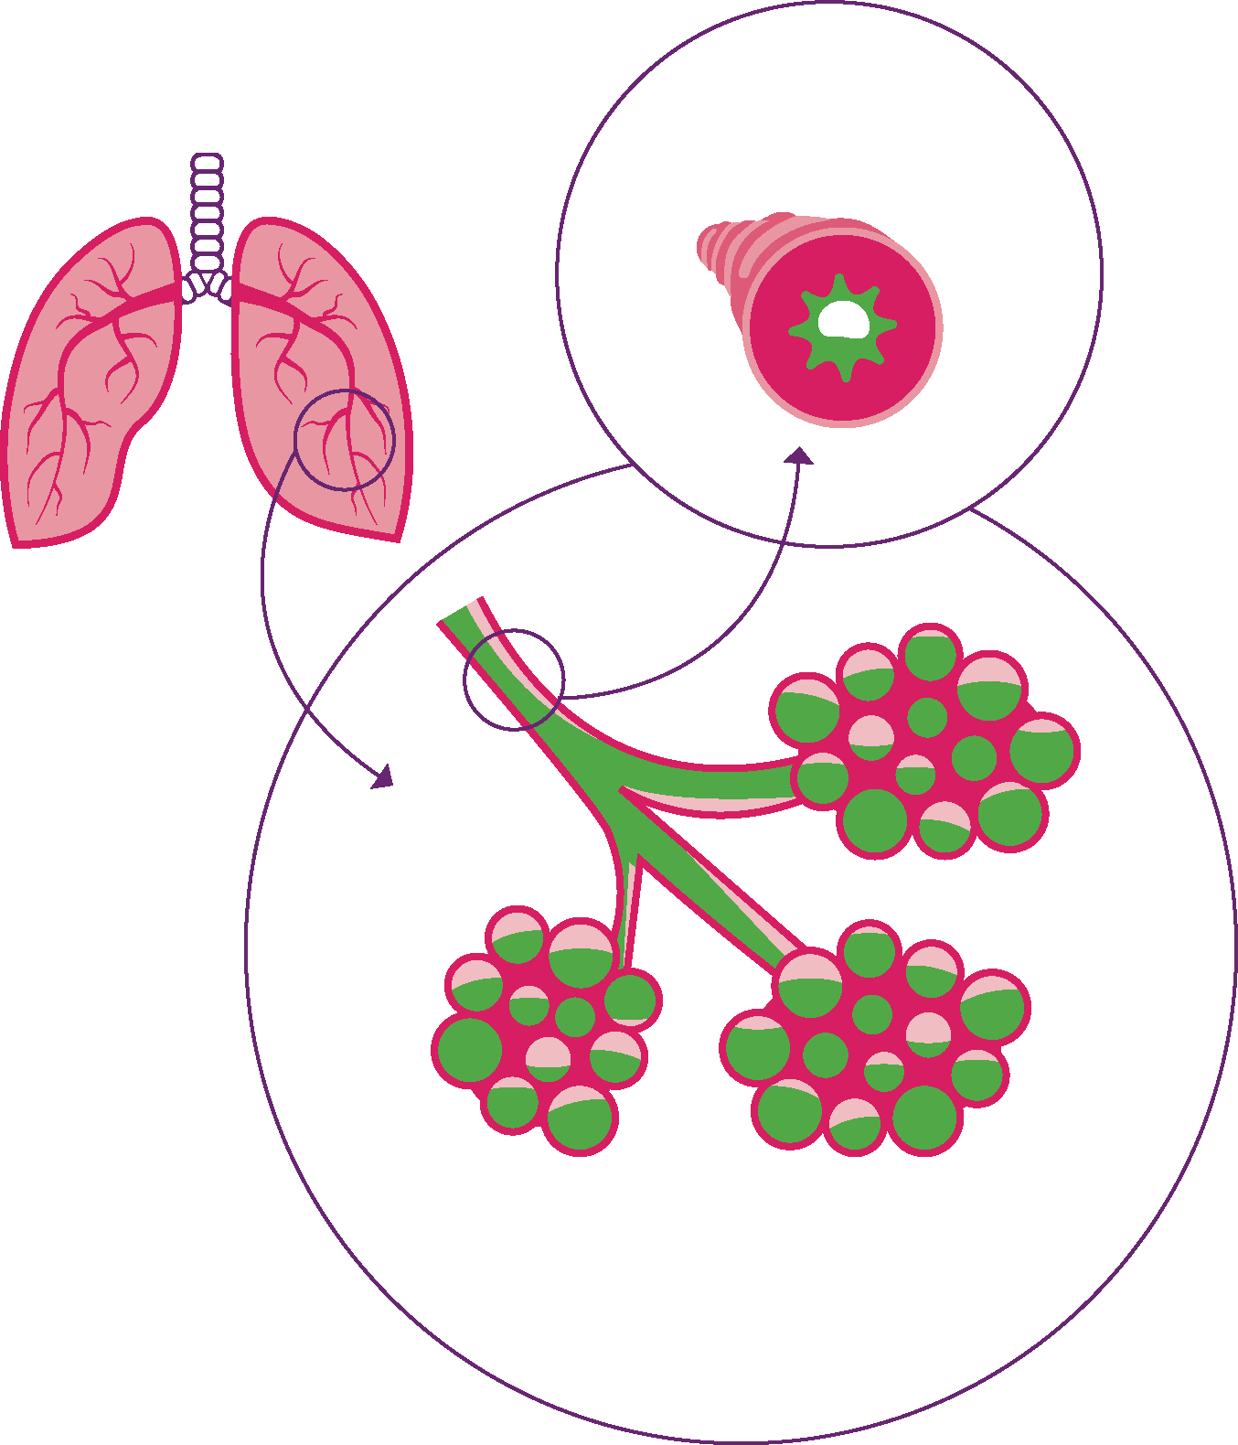
Common complications of severe RSV disease
Bronchiolitis
Inflammation of the bronchioles (small airways)
Causes wheezing and difficulty breathing
May appear as chest wall indrawing (retractions), faster breathing, nasal flaring, change in lip color
Mucus and inflammation
Pneumonia
Inflammation of the lung, with fluid often filling terminal air sacs 0r alveoli
Can see scattered interstitial infiltrates on chest x-ray
Fluid and inflammation in the alveoli
Helpful videos
American Academy of Pediatrics. Signs & Symptoms of RSV in Babies | AAP. https://www.youtube.com/watch?v=_2qh31Wndls. YouTube. October 26, 2022.
Zero to Finals. Understanding bronchiolitis. https://www.youtube.com/watch?v=xM2U8tkZgas. YouTube. September 27, 2020.
Notes:
A common complication of RSV includes bronchiolitis. This is caused by inflammation of the bronchioles, or small airways, which results in difficulty breathing and may include the presence of wheezing.
Clinically, bronchiolitis may appear as chest wall indrawing (retractions), faster breathing, nasal flaring, and/or change in lip color.
Another common complication of RSV is pneumonia, or inflammation of the lung with fluid often filling the air sacs or alveoli.
Many videos depicting what bronchiolitis and RSV in babies can look like are available online. This slide includes links to a couple of them, if helpful.

Slide 7
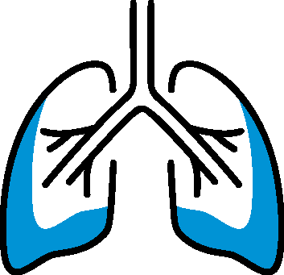

Signs that young children need medical attention
Hospitalization more likely to occur when RSV progresses to the lower respiratory tract
Lower respiratory symptoms require medical attention. Their presence or severity can help determine the need for hospitalization.
 | MATERNAL VACCINE
Difficulty breathing Rapid respiratory rate (> 60 breaths/min) Chest wall appears to suck inward when inhaling Wheezing or grunting can be heard | Unable to drink or nurse due to breathing too fast Dehydration due to inability to feed Infant is weak or appears tired due to increased work of breathing May have grey or blue skin or blue fingernails due to low oxygen levels
RESPIRATION-RELATED
GENERAL
PHYSICAL EXAMINATION IS IMPORTANT: Low oxygen saturation occurs only in a minority of young infants and is not a reliable diagnostic for lower respiratory tract infection.
Notes:
There are multiple signs that a child infected with RSV needs to seek medical attention, and the presence or severity of these can help clinicians determine whether a child should be hospitalized.
Danger signs include issues with respiration such as,
Difficulty breathing such that infant cannot easily cry.
Rapid respiratory rate (in young infants, typically >60 breaths/minute)
Chest wall seems to suck inward when inhaling.
Can hear wheezing or grunting from infants
Other more general signs include
Inability to drink or nurse due to breathing too fast
Dehydration due to inability to feed
Baby is weak or appears tired.
May have grey or blue skin or blue fingernails due to low oxygen levels.
Physical examination of the young infant is very important. Despite the high percent of infants that experience rapid breathing (85%) as a symptom of lower respiratory tract infection, only a quarter will present with low oxygen saturation—and, in fact, some who do have severe disease will even present with normal oxygen saturation—so it’s important to note that pulse oximetry cannot be used as a reliable diagnostic for severe disease.

Slide 8



RSV can be deadly
Although premature birth and underlying health issues increase risk for severe disease, risk factors for death are much broader.
In fact, most global RSV deaths occur
in infants born full term | before 3 months of age | in low- and middle-income areas | outside the healthcare system
Notes:
Indeed, premature birth and underlying health issues such as heart and lung disease can increase the risk for severe RSV disease.
But most deaths globally and in low- and middle-income economies are in infants born full term and before 3 months of age.
Sadly, these infants most often die outside of the healthcare system.

Slide 9



How do clinicians diagnose RSV?
Testing is needed to confirm RSV infection
 | In many settings, bronchiolitis in young infants is a strong marker for RSV; however, laboratory testing is required to confirm the diagnosis.
 | Diagnosis can be made by rapid antigen (Ag) tests or RT-PCR tests Antigen tests are less sensitive than RT-PCR but may still be helpful.
 | Diagnosis helps to enable providers to determine treatment and need for hospitalization decrease unnecessary use of antibiotics raise awareness of disease among community and health care workers identify outbreaks in the community refine seasonality of virus
Notes:
RSV shares symptoms with many other respiratory viruses like influenza, rhinovirus, and COVID-19, so diagnosis cannot be made by clinical signs and symptoms. Despite this, in many settings, bronchiolitis in young infants is a strong marker for RSV.
Laboratory testing using rapid antigen tests or real time-polymerase chain reaction (RT-PCR) tests is needed to confirm an RSV diagnosis.
Tests that detect antigen are less sensitive that RT-PCR tests, but PCR tests are not available in all settings, so rapid antigen testing is still an important diagnostic tool.
Taking a test to determine whether one has RSV helps clinicians target treatment and may help curb inappropriate use of antibiotics, but tests may not be available in some settings.
Diagnosing RSV can also help educate community members and health care workers alike about RSV, which in many settings is not a familiar or well-known disease.
Testing can also help identify community outbreaks and refine the seasonality of virus circulation.
Even without a test, providing supportive care is very important.

Slide 10


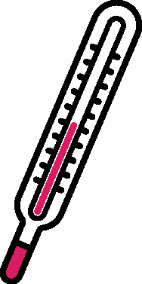
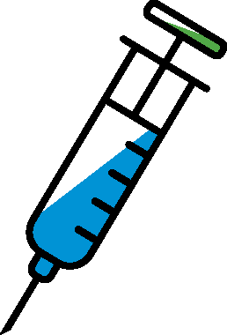
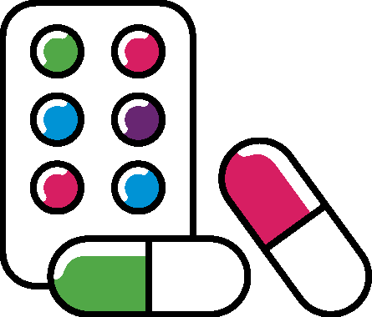
Current treatment for young infants is limited to supportive care Supportive care is critical to manage infection
IMPORTANT: Provide respiratory support including oxygen, possibly ventilation | Assess skin turgor (tightness, elasticity) and urine output Consider IV fluids if marked respiratory distress | Manage with acetaminophen which also helps to decrease respiratory effort and maintain hydration | DO NOT GIVE steroids or adrenaline/ epinephrine | Inappropriate antibiotic use poses antimicrobial resistance threat
RESPIRATORY SUPPORT AND MONITORING
HYDRATION
FEVER
STEROIDS
ANTIBIOTICS
KEEPING BABIES WARM, CLEAN, AND CLOSELY OBSERVED IS IMPORTANT.
Notes:
Current treatment measures are limited to supportive care.
Providing oxygen is the most important supportive care intervention.
Other supportive care tools include IV fluids for dehydration and acetaminophen (like Paracetamol or Panadol) to manage fever.
Important to keep babies warm, clean and closely observed
Overall, supportive care is complicated by scarce resources in many parts of the world.
No antiviral medications are licensed for RSV.
Neither steroids nor epinephrine/aerosolized adrenaline have proven to be helpful.
Inappropriate antibiotic use to treat a widespread virus like RSV also compounds the growing crisis of antimicrobial resistance.

Slide 11
Conclusions: understanding RSV disease
RSV is the top cause of severe respiratory infections and hospitalizations in young infants—with prevention interventions not yet widely available. It’s critical that clinicians know:
RSV is typically mild but can be severe and lead to death, particularly in young infants. | Lower respiratory symptoms require medical attention and potentially hospitalization; RSV can be hard to distinguish from other respiratory illnesses. | Supportive care is critical to managing RSV disease, particularly in the absence of diagnostic tools and/or preventative products.
Notes:
RSV is the top cause of severe respiratory infections and hospitalizations in young infants—with prevention interventions not yet widely available. It’s also not well-known in all settings, despite the huge burden of illness it presents. In the face of that, it’s crucial that clinicians understand that:
RSV is typically mild but when it progresses to a lower respiratory tract infection—most common in infants under 6 months of age—it can be severe and lead to death.
RSV can be hard to distinguish from other respiratory illnesses based on symptoms alone. Any signs of lower respiratory illness should be evaluated by a medical professional, who can determine what type of treatment is best and whether hospitalization is needed.
Supportive care is critical to managing RSV disease, particularly when diagnostic tools are not accessible and while the global community waits for broader availability of preventative products like monoclonal antibodies and maternal vaccines.

