Slide 1
I-LEAD WORKSHOP
Facilitator Notes
This
This is the master slide-deck for DAY ONE of the I-LEAD Workshop for facilitators. It is intended to make the process of preparing and conducting the workshop easier, and the decks are designed to be customizable to your context.
Make a copy of this deck to keep as a backup.
Throughout the deck you will see facilitator instructions written in red text on the slides. The intent is that you replace this text with relevant details specific to your workshop. You will also find instructions and helpful guidance in red text in the speaker notes, along with a more comprehensive explanation of the content on the slides.
The red text in the speaker notes should be removed when you are ready to share the final deck with the workshop participants.

Slide 2
WELCOME TO THE I-LEAD WORKSHOP!
Month Day Year // update to correct date//
WIFI: // add Wi-Fi details //
Password: // add Wi-Fi password//

Slide 3
Agenda
Time | Session Title | Duration (minutes)
9.00am | Welcome and housekeeping | 30
9.30am | Welcome remarks | 45
10.15am | The I-LEAD roadmap for the week, icebreaker, and pre-test | 50
10.45am | TEA / COFFEE | 30
11.15am | Leading and managing an Informatics-Savvy Health Organization (ISHO) | 30
11.45am | What is the rapid ISHO Assessment? | 30
12.15pm | LUNCH | 70
1.30pm | Country presentation of rapid ISHO assessment | 30
2:00pm | Q&A and discussion about key areas of focus for the week | 60
3.00pm | Review of country presentation template for the week | 30
3.30pm | Complete ISHO section of the country presentation template | 60
4.30 pm | Group Photo followed by Day One reflections and wrap-up | 20

Slide 4
Opening Remarks
// Add names of the people who will be making the opening remarks //
Notes:
Suggest limiting opening remarks to two key players: those hosting the workshop and the ministry of health
Identify the speakers before the workshop and provide them with a workshop brief so they can plan their remarks
Set time limit for speakers to 10 mins each.

Slide 5


WORKSHOP
ROADMAP
// Presenters name //
Notes:
Introduce all facilitators – lead and support facilitators – along with their roles during that training i.e. <<facilitator's name>> will be leading the workshop, <<facilitator's name>> will lead workstream 2 on day 2 etc.

Slide 6
I-LEAD Roadmap – Daily Outputs
Day 1
  ISHO rapid assessment review and country presentation initiation
Day 2
  Prioritized lists of gaps & opportunities for capacity strengthening across the 3WS
Day 3
  Documented key problem(s) and process for addressing them
Day 4
  Documented list of solution options
  ranked according to country priorities
Day 5
  Documented high-level action plan
Notes:
The aim of this I-LEAD workshop is to help you, as key stakeholders in digital health in our country, develop a high-level action plan for designing or adapting your digital health ecosystem and implementing sustainable digital health systems to scale.
Throughout this week the content presented and activities facilitated will help you – as multi-disciplinary teams – to develop and implement skills that will enable you to efficiently and effectively plan your digital health system ecosystem and implement sustainable digital health interventions.
Today's activity (DAY 1) will focus on helping you reflect on where you, as a country, are with digital health readiness using the ISHO rapid assessment framework and the data you have gathered in preparation for this workshop.

Slide 7
I-LEAD Roadmap – Daily Inputs and Outputs
Achieve consensus on maturity levels (strengths and gaps) based on ISHO framework pillars; Collaboratively identify country priorities & develop country presentation
Pre
I-LEAD
Learning Inputs
Informatics Savvy Health Organization (ISHO) and Assessment
Country ISHO presentation and discussion
Country I-LEAD slide deck initiation
Informatics Problem Solving (Thinking Hats, Systems Thinking)
Marshmallow Challenge (Design Thinking)
Workstream Breakout Sessions per ISHO pillar
Draw Toast - Process for definition of current state to future state
Data use for decision making and a unified a data ecosystem
Data sharing and protection
I-LEAD slide deck presentation
Action plans and next steps
Jeopardy Game
Communities of Practice (HELINA, RECAINSA, AeHIN)
Day 1
Day 2
Day 3
Day 4
Day 5
Planning and Decision-Making Process (PDMP)
Value Claims of Digital Health Systems
I-LEAD slide deck development
I-LEAD
Country Outputs
  Agreed Rapid ISHO and country
  I-LEAD slide deck initiation
  Prioritized lists of gaps & opportunities for capacity strengthening across the 3WS
  Documented key problem(s) and process for addressing them
  Documented list of solution options
  ranked according to country priorities
  Complete I-LEAD slide deck, action plan and next steps
Post
I-LEAD
Prioritize strategies for PHI advancement; Apply frameworks that have been used at I-LEAD; Champion data modernization; Implement strategies as projects
Notes:
The I-LEAD process has three phases: Slide focused on Phase 2
Phase 1: pre workshop preparations start with an live virtual introductory session for future participants which focuses on establishing what information/data required to complete the ISHO rapid assessment during Day 1 of the workshop and why, when and how this data will be gathered pre workshop.
Phase 2: the I-LEAD workshop itself – of which you are a participant. On DAY 1 of the workshop you will focus on carrying out a rapid ISHO assessment using the data / information that you have all collected about digital health readiness in your various areas of work. The workshop facilitators are here to help you as you work through this process. DAYS 2-5 of the workshop will provide you with skills, and time to test them out through groups activities, that will allow you as a multi-disciplinary group to develop a high level action plan for implementing a strong digital ecosystem comprised on sustainable digital health systems implemented to scale.
Phase 3:

Slide 8
What will the end results of this workshop be?
A presentation slide deck that contains details about the key problems identified from the and the activities completed during the week. ​

Slide 9
How will the end results of this workshop support you going forward?

Slide 10
What engagement rules would you propose for this workshop? Here are some examples…
Active listening
Keep laptops and phones away
What else?
…
…
…

Slide 11
Ice-breaker: "Safe spaces"
Write it down
One paper: your job title
Another paper: what you bring to the discussion (skills, perspectives, experience)
Notes:
Safe Spaces Icebreaker: “Who We Are & What We Bring”
You will need to have large post-it notes or pieces of paper and pens for this activity
Prepare Your Papers:
On one piece of paper, write your job title.
On a separate piece of paper, write what you feel you bring to the discussion — your skills, perspectives, or experience.
Seating:
Sit on your job title paper!
Combine and Shuffle:
Place all other papers (value/skills) in a central pile so they are anonymous.
Facilitator Reads Aloud:
The facilitator randomly picks papers and reads them aloud, highlighting the variety of roles and contributions in the room.
Debrief (Optional):
Invite participants to reflect briefly on the diversity of perspectives and how everyone’s input is valued.

Slide 12

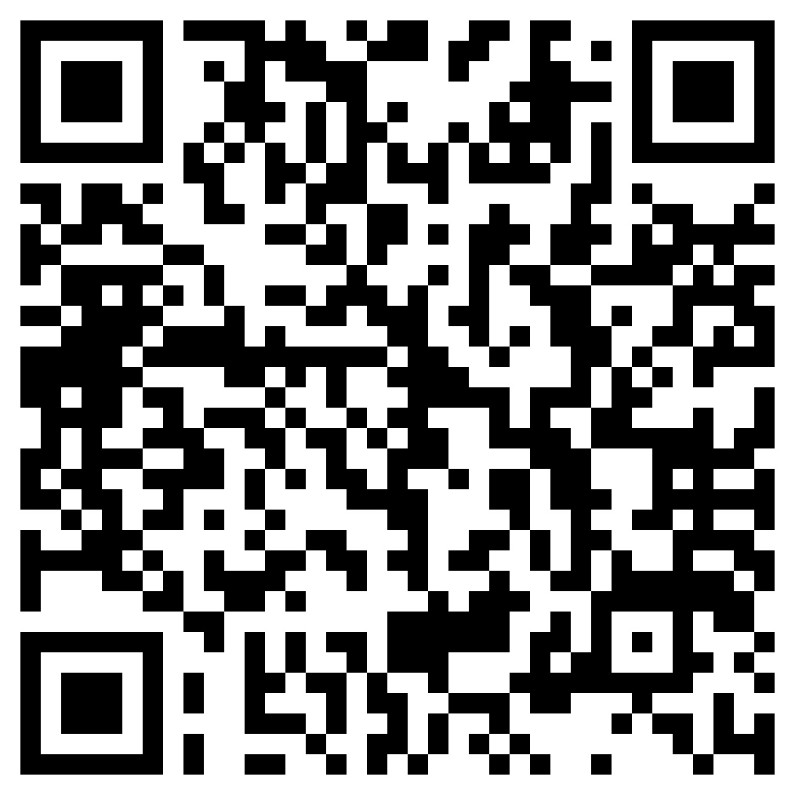
PRE-TEST
// Replace this QR code with the one generated for your evaluation form. //
Notes:
Determine the need and use of the pre-test as per the run of show. Upload pre-test on Google or Microsoft Forms or any other online survey tool
This should take approximately 10 minutes for participants to complete.

Slide 13
Pre-test Questions
Link to pre-test: https://path.box.com/s/dmn85ary82kfba8gs6imetzq2wbgwqpq
Notes:
Link: upload the questions to upload on an online survey tool

Slide 14

COFFEE / TEA BREAK
20 minutes

Slide 15
Learning Objectives – Day 1
By the end of today’s sessions, the participants should be able to:
Describe core capabilities of an Informatics-Savvy Health Organization (ISHO)
Conduct an inter-departmental country baseline ISHO assessment
Notes:
Day 1 Output: Guided inter-departmental country baseline ISHO assessment​

Slide 16
Leading and Managing an ISHO
(Informatics-Savvy Health Organization)
// Presenter names //

Slide 17
When well-planned, designed, implemented, managed, and used, digitalization promises to:
Digital health:
“the systematic application of information and ICTs, computer science, and data to support informed decision-making by individuals, the health workforce, and health systems, to strengthen resilience to disease and improve health and wellness.”
WHO, 2020
Improve health care outcomes, access, and quality and patient safety
Reduce health care costs, duplication, and waste
Optimize resource allocation
Empower individuals and communities to be informed consumers
Decrease the time it takes from disease detection to reporting to response
Improve the completeness, timeliness, and accuracy of data
Allow real-time data for outbreak investigation and control
Train health professionals
Hasten translation of research findings into practice and policy
Digitalization is essential for every organization in public health, from the Ministry of Health (MoH) and its departments to National Public Health Institutes to regional and district health offices and hospitals, health centers, and health posts.
Notes:
The terms digitization, digitalization, and digital transformation are often used interchangeably but they refer to distinct concepts in the journey toward a more digital organization or system. Here's a clear breakdown:
1. Digitization
Definition:
The process of converting analog or physical information into a digital format.
Examples:
Scanning paper health records into a PDF format.
Converting handwritten prescriptions into electronic documents
Key point:
It’s about data — turning something non-digital into digital.
2. Digitalization
Definition:
The use of digital technologies to improve or automate existing processes.
Example:
Using electronic medical records (EMRs) to replace paper records in clinics.
Automating appointment scheduling with SMS reminders
Key point:
It’s about processes — using digital tools to make existing workflows more efficient.
3. Digital Transformation
Definition:
A strategic shift in how an organization operates, delivers value, and engages stakeholders, enabled by digital technologies. It often involves rethinking business models, organizational culture, and user experience.
Example:
A health system reimagining service delivery with telemedicine, mobile diagnostics, and real-time health data dashboards.
Moving from reactive care to proactive, data-driven health interventions.
Key point:
It’s about strategy and culture — not just tools or processes, but a full organizational shift enabled by digital technologies.

Slide 18
Digitization:
Definition:
The process of converting analog or physical information into a digital format.
What it means:
Turning analog health data into digital formats.
Examples:
Scanning paper health records into a PDF format.
Converting handwritten prescriptions into electronic documents.
Digitalization:
Definition:
The use of digital technologies to improve or automate existing processes.
What it means:
Using digital tools to improve existing health service processes..
Example:
Using electronic medical records (EMRs) to replace paper records in clinics.
Digital transformation:
Definition:
A strategic shift in how an organization operates, delivers value, and engages stakeholders, enabled by digital technologies. It often involves rethinking business models, organizational culture, and user experience..
What it means:
A strategic overhaul of how care is delivered and health system goals are achieved, using digital technologies.
Example:
A health system reimagining service delivery with telemedicine, mobile diagnostics, and real-time health data dashboards.
Moving from reactive care to proactive, data-driven health interventions.
Notes:
The terms digitization, digitalization, and digital transformation are often used interchangeably but they refer to distinct concepts in the journey toward a more digital organization or system. Here's a clear breakdown describing how this applies specifically in the health system context:
1. Digitization in Health Systems
What it means:
Turning analog health data into digital formats.
Examples:
Scanning paper patient records into PDFs.
Digitizing X-ray films or lab reports for storage in a computer system.
Entering handwritten data from paper registers (e.g., immunization logs) into Excel.
Value:
Makes health data easier to store, retrieve, and share — but doesn't change how care is delivered.
2. Digitalization in Health Systems
What it means:
Using digital tools to improve existing health service processes.
Examples:
Replacing paper-based outpatient registers with an electronic medical record (EMR) system.
Using an app for community health workers to submit patient data instead of reporting on paper.
Implementing automated stock tracking for medical supplies.
Value:
Improves accuracy, speed, and efficiency of routine health system functions — same processes, better tools.
3. Digital Transformation in Health Systems
What it means:
A strategic overhaul of how care is delivered and health system goals are achieved, using digital technologies.
Examples:
Redesigning care models to offer telemedicine for rural patients, supported by AI triage tools.
Integrating climate data with disease surveillance systems to enable early warnings for malaria outbreaks.
Empowering patients with mobile apps for self-care, digital health IDs, and real-time access to their health data.
Shifting from reactive, facility-based care to proactive, data-driven population health management.
Value:
Transforms how care is conceptualized, delivered, and experienced — with digital at the core of health strategy, leadership, and culture.

Slide 19
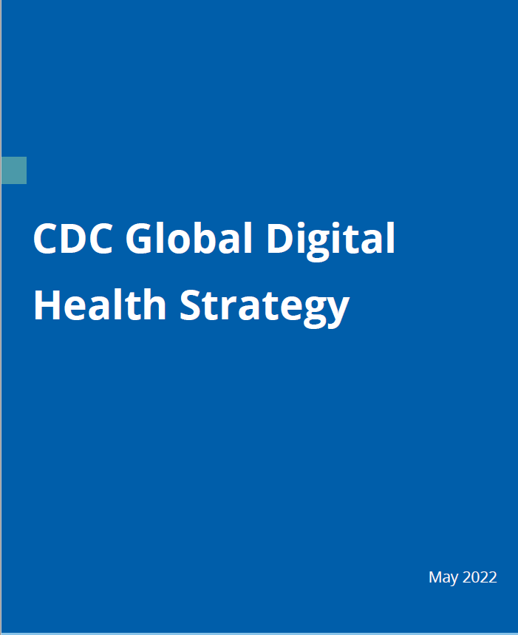

Digital Strategies
// Customize this slide: Insert a link and image of your country's relevant digital health strategies and policies //
More than 120 Member States have developed eHealth/Digital Health strategies and policies.
Notes:
Customization: Add images, links and references to your own country policies and strategies.

Slide 20
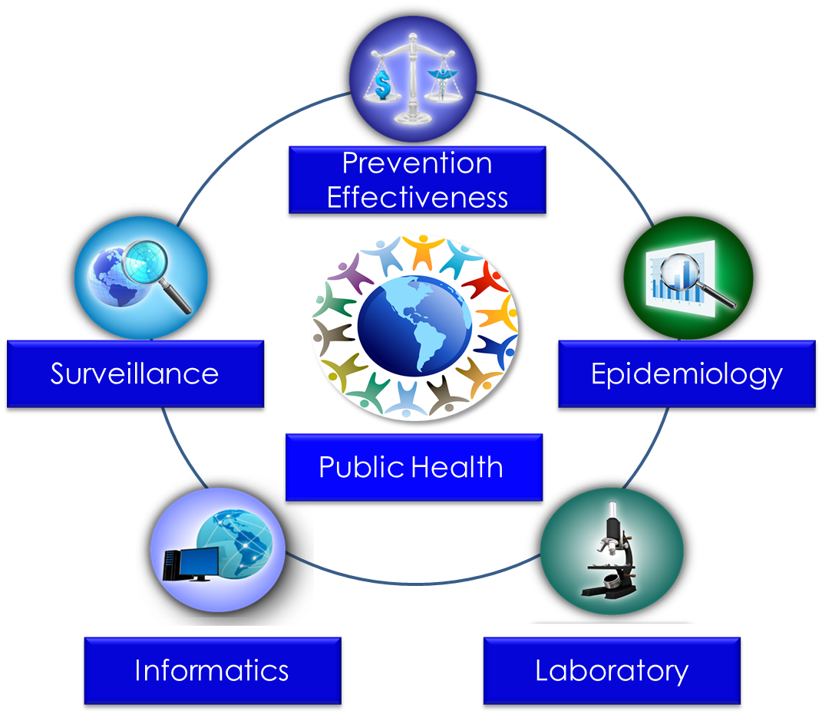
Public Health Core Sciences
Notes:
Informatics of one of the core sciences of public health

Slide 21
As science-based organization, we approach and support digital health through the science of informatics
“Public health informatics (PHI) is the systematic application of information and computer science and technology to public health practice, research, and learning.*”
PHI is the science that underlies eHealth/Digital Health for public health and should be integrated within MoH/NPHIs structures the same way as epidemiology, laboratory, and surveillance sciences.
Public Health Informatics
* Yasnoff WA, O’Carroll PW, Koo D, Linkins RW, Kilbourne EM. Public health informatics: improving and transforming public health in the information age. J Public Health Manag Pract. 2000 Nov;6(6):67-75.

Slide 22
Mission: Achieve digital transformation in every public health organization through informatics. In other words, make them informatics-savvy!
Serves as the overarching strategy (e.g., for TripleIG)
Supports organization’s informatics strategy development aligned to national strategy. (Can be at regional, district, or facility level)
Links to and advances the science of informatics
Serves as an informatics maturity assessment tool
Science/data-driven (Informatics), people-centric (-Savvy), and organization-focused (Health Organization) strategy
What is an
Informatics-Savvy Health Organization (ISHO)?

Slide 23

Informatics-Savvy Health Organization (ISHO)
ISHOs – obtain, effectively use, and securely exchange information electronically to improve public health practice and population health outcomes
3 core capabilities:
  Organization-wide informatics vision, policy, and governance;
  Skilled workforce; and
  Effective information systems.
ISHO
Policy and Governance
Effective information systems
Skilled Workforce

Slide 24
I-LEAD: Eight Governing Principles
Training as a means to problem solving
I-LEAD is just the beginning of the journey (VSOT, community)
Guide problem solving with ISHO pillars, 4 thinking hats
Get the right people to solve the right problem
Stakeholder needs drive workshop planning and implementation
Encourage collaboration by design
Design workshop to build “muscle” memory
Adapt workshop to emergent needs

Slide 25
ISHO Capability 1: Vision, Policy, & Governance
Well-articulated informatics vision, strategies, and metrics for how the organization obtains and uses information and ICTs
Organization-wide approach to standards and interoperability
Policies to ensure privacy, confidentiality, and security
Defined governance and leadership structure for decision-making including focal unit and leader for informatics and funding for positions and training
Effective collaborations with public and private partners, communities, and information technology departments

Slide 26
Vision, Policy and Governance Example
An example of existing country who have a strong vision, policy and governance and flow to achieving this – what's best practice
Notes:
// use Ethiopia as an example for Africa // Ask CDC teams for examples for Asia and South America

Slide 27
ISHO Capability 2: Skilled Workforce
Workforce strategies for improving informatics knowledge and skills
Trained informaticians through competency–based academic program or applied program or / and continuing education
Informatics positions in the civil service

Slide 28
EXAMPLE: Africa CDC Three-tiered Training Framework to Develop Public Health Informatics Capacity in Africa*
* The applied training is modeled around the Field Epidemiology and Training Program (FETP)
Tier | Program Level | Applied Training | Academic Training
1 | Basic | 2 weeks to 6 months Introduction | Certificate
2 | Intermediate | 6-24 months project-based | Diploma, Bachelors
3 | Advanced | Fellowship, 24 months 80% practicum | Masters, PhD, DrPH
Africa CDC’s AES-Public Health Informatics Fellowship Program is a driver of its Digital Transformation
*Africa CDC Framework for Public Health Workforce Development, 2019.

Slide 29
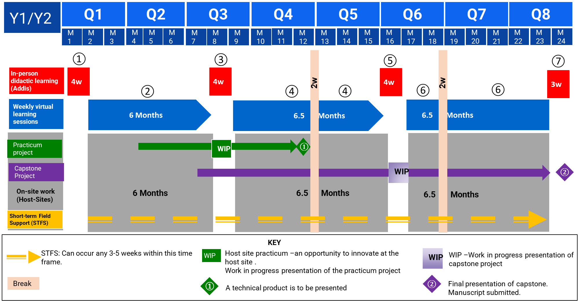
EXAMPLE: Africa Epidemic Service-Public Health Informatics Program: 2-year Structure

Slide 30
ISHO Capability 3: Effective Information Systems
Effectively meet the information needs, workflows, and practices of public health programs
Developed using sound project management principles and methods
Based on rigorously defined requirements and user-centered design
Use globally recognized vocabulary, messaging, and other standards for interoperability with internal and external systems
Effectively assure data integrity and adhere to security protocols and procedures
Evaluated with end user metrics

Slide 31
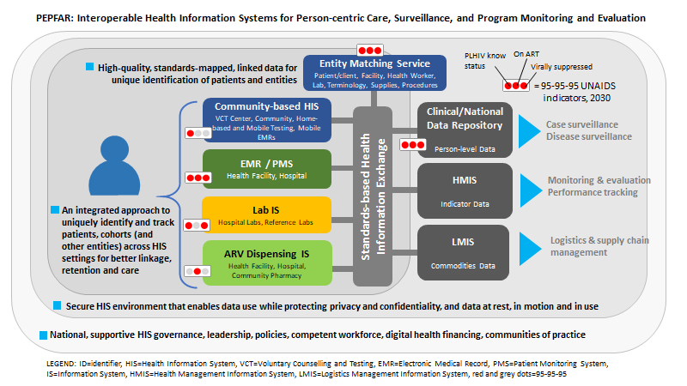
EXAMPLE: Interoperable Health Information Systems for Person-Centric Care, Surveillance, and Program Monitoring and Evaluation*
* President’s Emergency Plan for AIDS Relief (PEPFAR) COP22 Guidance Fig. 6.6.8.2., Pg. 546

Slide 32
Focus on:
Resilient public health systems
Country ownership & sustainability
Data-driven decision-making and data security
Notes:
Next slide on ACDC

Slide 33
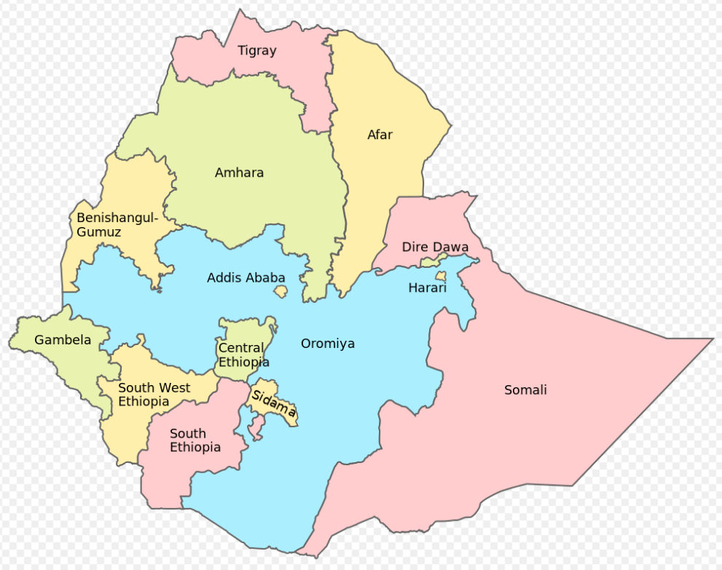
Country Profile
Customize this slide: This is an example – replace with your own country-specific information to provide the broader context
Population in 2023: 107.3 Million
Rural population: 80%
12 Regions and 2 chartered cities
LE at birth: Male 66; Female 70
Triple burden of diseases (Communicable, NCDs, and Injuries)
HIV Prevalence of 0.9%; urban (2.9%), rural (0.4%); females (1.2%), males (0.6%)
Notes:
Suggestions:
Key demographics
HIV epidemic profile
Other disease profiles
ICT/Digital Infrastructure

Slide 34
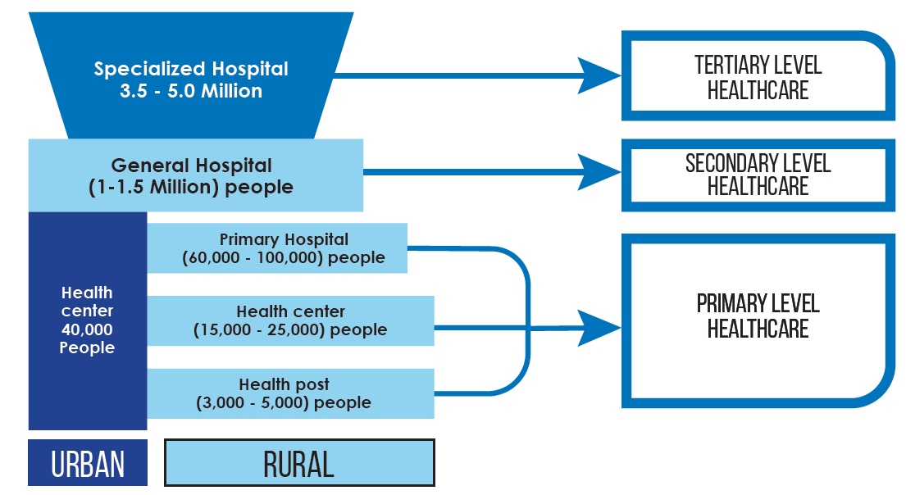
Health service organization and work force
Customize this slide: Replace with example from your country
Three Tier System: Primary, Secondary and Tertiary Care
In 2022/23: 432 Hospitals; 3,826 Health Centers; 17,569 Health Post
Health work force in 2022/23: MD 17,665; Nurses 103,107; Health Officers 33,172; Pharmacist 32,374; Medical Lab 20,673; Health Extension Workers (HEW) 42,926.
Population to MD Ratio- 5,737
Population to Nurse Ratio- 983
Population to HEW Ratio- 2,361

Slide 35
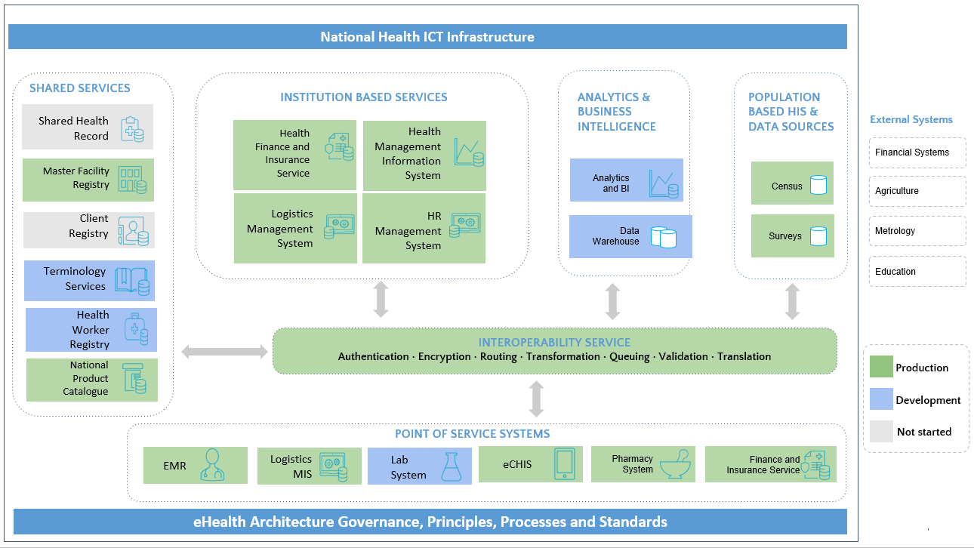
Customize this slide: Replace with relevant example from your country
Notes:
// country-specific information from MoH or M ICT //

Slide 36
Summary of progress to date
// Customize this slide: replace with a summary of what has been done in your country to date to lay the foundation for what's next i.e. relevant trainings, activities etc. //

Slide 37
Rapid ISHO Assessment
Notes:
// This session should take approximately 30 minutes //

Slide 38
Who are the different stakeholders you need in the room?
MOH, Ministry of IT, Ministry of Communications, Ministry of Infrastructure, Ministry of Finance, educational institutions.
Brainstorm which other stakeholders are required for your context.
Notes:
// Are the different stakeholders represented in the room? If not, why not? //

Slide 39
ISHO Assessment Tool
Public Health Informatics Competencies
Capability Maturity Model
ISHO Assessment Tool

Slide 40
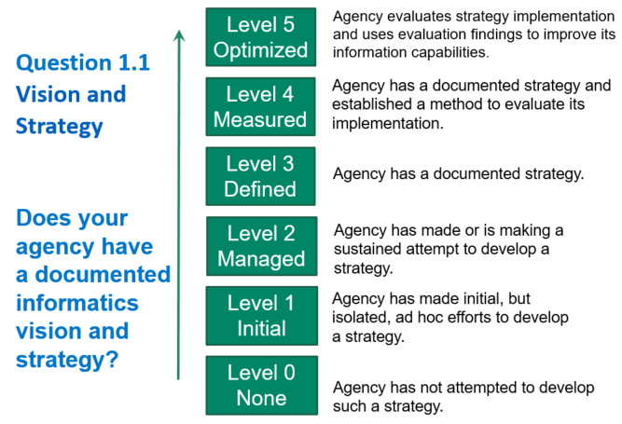
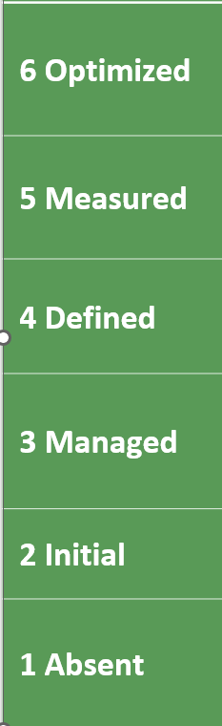
Mark Paulk, William Curtis, Mary Beth Chrissis, & Charles Weber. Capability Maturity Model for Software (Version 1.1) (CMU/SEI-93-TR-024). Pittsburgh, PA: Software Engineering Institute, Carnegie Mellon University, 1993.

Slide 41
 | Expedited | In-depth
Self-Assessment | X | X
SWOT | X | X
Maturity continuum | X | X
Target | MoH, NPHIs, Province, District, Facility | MoH, NPHIs, Province, District, Facility
Above-site | X | X
Site-level | X | X
Regulatory burden | none | X (protocol-based)
Stakeholders | Limited participation of country (MoH) team, iSMEs, desk review | Broad-based country team led by MoH & including donors, partners and other stakeholders
Time commitment | 2 hrs – 1 day | 3-4 months
Limitations | Contributors bias; difficult to compare year to year or with other countries | Higher resource (personnel, cost) commitment, length of time to complete
Conducting ISHO assessments

Slide 42
Based on core informatics competencies organized around ISHO pillars
Core Essential Elements (CEEs) = 31
  Policy and governance = 12
  Skilled workforce = 6
  Information systems = 13
Scored on a 6 level Capability Maturity Model (CMM) continuum
Aligned to global frameworks and best practices
Time: 2 hours to 1 day
Administration: self, interviewer, or hybrid
Delivery: In-person, virtual, or blended
Above-site ISHO
Assessment
Tool

Slide 43
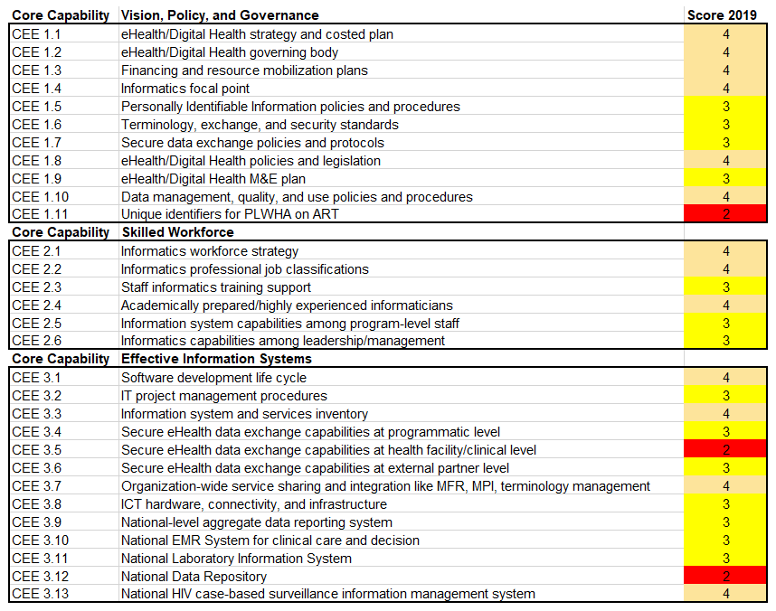
EXAMPLE: Above site level ISHO Assessment Heat Map – 2018/19 Baseline
Notes:
// This is an example of what a completed ISHO Assessment Heat Map looks like at the baseline i.e. before //

Slide 44
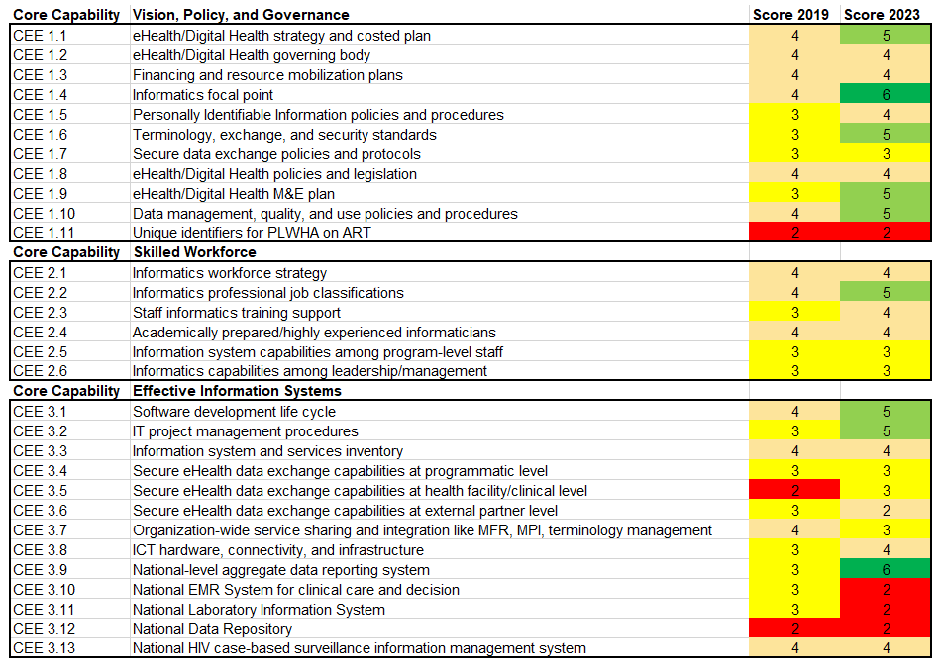
EXAMPLE: Above site level ISHO Assessment Heat Map - 2023
Notes:
// This is an example of what a completed ISHO Assessment Heat Map looks like after intervention i.e. after //

Slide 45
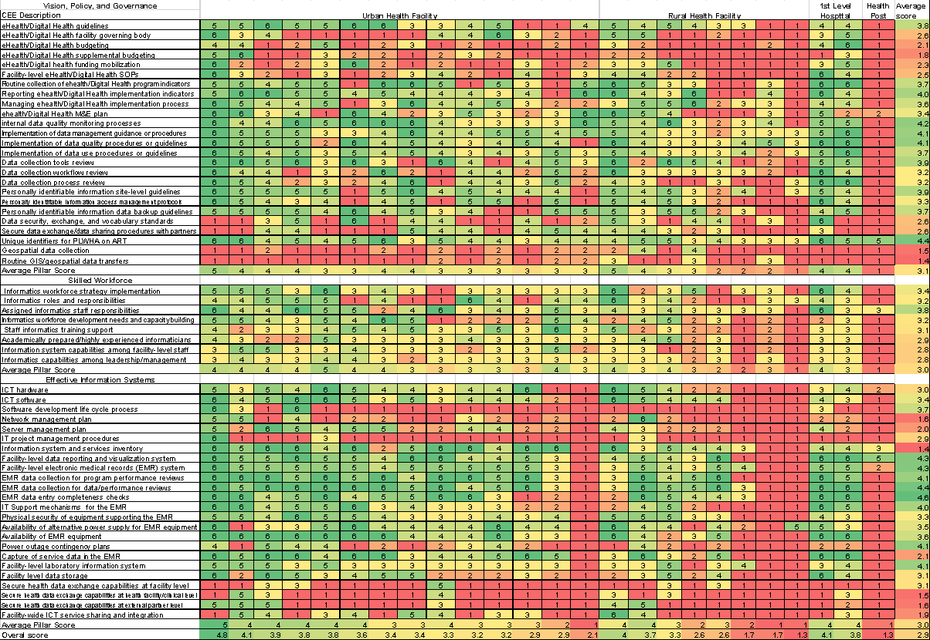
ISHO
Site-level Assessment Results
EXAMPLE
Notes:
// This is one example of what the site level assessment tool might look like //

Slide 46
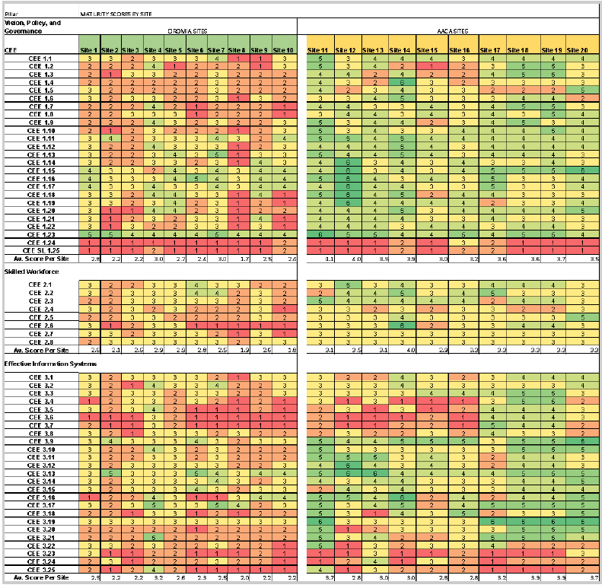
Example Region 1
Example Region 2
Example
In-depth ISHO
Site-level Assessment Results
Notes:
// This is another example of what the site level assessment tool might look like //
THIS IS WHAT THE PARTICIPANTS SHOULD PRODUCE BY THE END OF DAY ONE

Slide 47
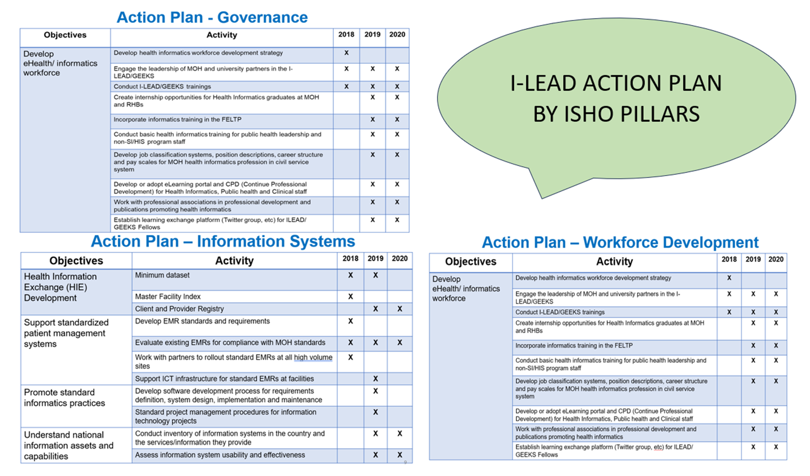
Notes:
// This is an example of what we are working towards – a set of action plans according to the three ISHO pillars //
THIS IS WHAT THE PARTICIPANTS SHOULD PRODUCE BY THE END OF THE WEEK

Slide 48
Summary
Policy & Governance
Skilled Workforce
Effective Information Systems
Informatics Knowledge & Skills
Inter-operability
Planning
Policies
Workforce Strategy
Systems
Governance & Standards
Informatics Cadre
Standard Practices
Assess
Plan
Implement
Review and refine

Slide 49


Institutionalization and Sustainability
EXAMPLE: Ethiopia
Digital Health and Implementation Science Center at the University of Gondar
Center closely working with MOH and partners in the ISHO assessment and in continuous implementation of the roadmap
Center institutionalization for sustainability of ISHO and other digital health implementation activities
Engaging master’s & Ph.D. students and in-service personnel for sustainable workforce pipeline
Notes:
// this is an example from Ethiopia – use as a starting point for a discussion on what has been done or what needs to be done in your country //

Slide 50
Quick
Feedback
Notes:
// You can use a tool like Mentimeter for this activity – by submitting their answers participants will create a word cloud summarizing the ISHO assessment outcome//

Slide 51
Key
Takeaways
Data are the lifeblood of public health and this is enabled by ICT.
Public health organizations need to be ISHOs: ones that can obtain, effectively use, and securely exchange information electronically to improve population health outcomes.
ISHOs have 3 capabilities: policy and governance; skilled workforce; and information systems.

Slide 52
Key
Takeaways
cont.
Knowledgeable leadership is key for setting a clear vision and guiding an ISHO transformation.
ISHO assessment provides baseline for identifying strengths and weaknesses, while ongoing assessments track progress.
Investing in capacity development like I-LEAD equip public health professionals with the necessary informatics skills critical for long-term success.

Slide 53

LUNCH
60 MINUTES

Slide 54
ISHO Assessment Results
Participants : Replace the next slides (54 to 63) with your actual assessment results.
Notes:
Facilitators: You will need to have copies of these slides before the workshop for inclusion in this deck. Presentation will be delivered by preselected country representatives.

Slide 55
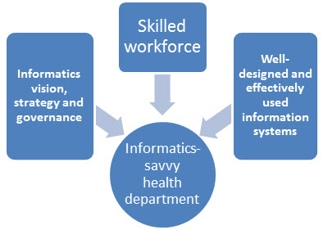
Baseline ISHO Assessment (Expedited)
Building an Informatics-Savvy Organization

Slide 56
ISHO Self-assessment Results: Vision & Governance
Capabilities | Score
1.1) Does the organization have a defined, documented, and adopted eHealth/Digital Health Strategy and costed plan?
1.2) Does the organization have a governing body for eHealth/Digital Health planning and coordination that guides major decisions aligned with the strategic plan and following documented processes?
1.3) Does the organization have a financing plan that includes a resource mobilization plan to support staffing needs, infrastructure, and information systems?
1.4) Does the organization have a focal point for informatics (e.g., an informatics unit, a Chief Informatics Officer) with cross-organization responsibilities and authorities, including those related to the organization’s information vision, strategies, and policies?
1.5) Has your organization established policies and procedures to ensure privacy, confidentiality, and security (storage, transmission, use) of personally identifiable information (PII)?
1.6) Do the organization’s information systems use nationally recognized terminology, exchange, and security standards?
1.7) Has the organization adopted protocols, policies, frameworks, and procedures to support secure data exchange and sharing with internal and external partners?
1.8) Do eHealth/Digital Health policies and legislation exist and are they enforced?
1.9) Does the adopted eHealth/Digital Health strategy have a Monitoring and Evaluation Plan?
1.10) Does the organization have policies and procedures in place for data management, quality, and use?
1.11) Does your organization have unique identifier to identify PLWHA on antiretroviral therapy (ART)?

Slide 57
ISHO Self-assessment Results: Vision, Policy & Governance
Item | Description | Maturity score
CEE 1.1 | Costed digital health strategy
CEE 1.2 | Digital health policies and legislation
CEE 1.3 | Digital health governing body
CEE 1.4 | Financing and resource mobilization plans
CEE 1.5 | Digital health M&E plan
CEE 1.6 | Data management and data quality (or data quality assurance) policies and procedures
CEE 1.7 | Data governance policies and procedures
CEE 1.8 | Secure data exchange policies and protocols
CEE 1.9 | Informatics focal point
CEE 1.10 | Personally Identifiable Information policies and procedures
CEE 1.11 | Information System Standards
CEE 1.12 | Policies governing the use of artificial intelligence in public health informatics

Slide 58
ISHO Self-assessment Results: Skilled Workforce
Capabilities | Score
2.1. Workforce Strategy: Does the MoH have a workforce strategy that describes its needed informatics capabilities and/or positions and have action plans for recruiting, hiring and/or developing existing staff to meet those needs?
2.2. Job Classifications for Informatics Professionals: Does the MoH have appropriate job classifications, including position descriptions and pay scales, for informatics professionals?
2.3 Training: Does the MoH support staff members across a broad range of job classifications to participate in informatics training?
2.4 Informatics Professionals: Does the MoH have highly experienced or academically prepared informaticians in key roles at department and/or program levels, with backgrounds and training commensurate to their responsibilities?
2.5 Informatics Knowledge and Skills (Program Level): Do staff members at the program level (e.g., epidemiologists, medical officers, public health nurses, data analysts) have the skills to effectively use information systems and tools, and the knowledge of how to identify and document needed system improvements?
2.6 Informatics Knowledge and Skills (Program Managers): Do managers/supervisors of large information system programs have knowledge and skills of informatics principles, concepts, methods, and tools gained through education, training or experience?

Slide 59
ISHO Self-assessment Results: Skilled Workforce
Item | Description | Maturity score
CEE 2.1 | Informatics workforce strategy
CEE 2.2 | Informatics professional job classifications
CEE 2.3 | Staff informatics training support
CEE 2.4 | Competent informaticians in key roles
CEE 2.5 | Information system capabilities among key personnel
CEE 2.6 | Informatics capabilities among leadership/management
CEE 2.7 | Geospatial Capabilities

Slide 60
ISHO Self-assessment Results: Information Systems
Capabilities | Score
3.1) Does the organization practice a standard software development life cycle (SDLC) process for requirements definition, system design, implementation, maintenance, and system disposition?
3.2) Has the organization adopted and documented standard project management procedures for information technology projects?
3.3) Has the organization conducted an inventory of its information systems and the services/information they provide?
3.4) Does the organization have capabilities to securely send, receive, and process electronic health data and/or messages between programmatic information systems?
3.5) Does the organization have the capability to securely send and receive electronic health data with health facilities/clinical partners?
3.6) Does the organization have the capability to receive and process electronic data and/or messages sent from external partners, including the private sector?
3.7) Do programs share relevant services across the organization, such as an integrated provider registry, master facility list, master person index, terminology management, integration engine, and other applicable services?
3.8) Does the organization have sufficient hardware, software, networking, connectivity, and ICT support infrastructure in place to ensure its operation and maintenance are in line with industry standards?
3.9) Does the organization have an aggregate data reporting system (ADRS) at national level?
3.10) Does the organization have a national Electronic Medical Records system (EMR)?
3.11) Does the organization have a national Laboratory Information System (LIS)?
3.12) Does the organization have a National Data Repository (NDR)?
3.13) Does the organization have a national HIV Case-Based Surveillance (CBS) information management system (IS)?

Slide 61
ISHO Self-assessment Results: Information Systems
Item | Description | Maturity score
CEE 3.1 | Software development life cycle
CEE 3.2 | IT project management procedures
CEE 3.3 | Health Information system and services inventory
CEE 3.4 | Electronic Medical Records (EMR) system coverage
CEE 3.5 | EMR Interoperability
CEE 3.6 | Laboratory Information System
CEE 3.7 | National Data Repository
CEE 3.8 | National-level aggregate data reporting system
CEE 3.9 | Integrated Disease Surveillance and Response
CEE 3.10 | Secure digital health data exchange capabilities across health programs
CEE 3.11 | Organization-wide service sharing and integration
CEE 3.12 | Unique Patient Identifier (UPI)

Slide 62
Key Issues/Gaps to be Addressed from the Assessment

Slide 63
Recommendations

Slide 64
Feedback on the ISHO Self-assessment Tool
Utilities and Limitations

Slide 65
ISHO Assessment Results Q&A

Slide 66
Discussion about key areas of focus for the week based on ISHO rapid assessment outcomes

Slide 67
I-LEAD slide deck part 2

Slide 68
END OF DAY EVALUATION
// Replace this QR code with the one generated for your evaluation form. //
Notes:
Upload pre-test on Google or Microsoft Forms or any other online survey tool

Slide 69
End of day evaluation questions
Communications leading up to I-LEAD were clear.
  Strongly disagree
  Disagree
  Neutral
  Agree
  Strongly agree
I was satisfied with today’s sessions overall.
  Strongly disagree
  Disagree
  Neutral
  Agree
  Strongly agree
The Leading and managing an Informatics-Savvy Health Organization (ISHO) session was relevant to my department/country’s needs.
  Strongly disagree
  Disagree
  Neutral
  Agree
  Strongly Agree
Do you have any additional feedback on the Leading and managing an Informatics-Savvy Health Organization (ISHO) session? (Optional)
The Rapid ISHO Assessment session was relevant to my department/country’s needs.
  Strongly disagree
  Disagree
  Neutral
  Agree
  Strongly Agree
Do you have any additional feedback on the Rapid ISHO Assessment session? (Optional)
How useful were the following sessions for your country's needs? Not useful, useful, very useful
  Leading and managing an Informatics-Savvy Health Organization (ISHO)
  Rapid ISHO Assessment
Link to EOD evaluation: https://path.box.com/s/ve2wudlqp2y4cm9cmbozgq2fhpn69wyw
Notes:
Link: upload the questions to an online survey tool

Slide 70
Day One – Wrap up
Q and A on any of the sessions today
What to expect on Day Two
Day One reflections:
  What did you expect ?
  Did this meet those expectations?
  What can we do differently?

Slide 71

GROUP PHOTO

Slide 72
Acknowledgement: Global Informatics-Savvy
Community of Practice*
Country assessments
Angola
Botswana
Cameroon
Democratic Republic of Congo
Dominican Republic
Ethiopia
Kenya
Namibia
Nigeria
South Africa
Uganda
Vietnam
Zimbabwe
Priya Rajamani
Daniel Rosen
Xen Santas
William F. Stephens
James Tobias
Herman Tolentino
Andre Verani
Samuel Wambugu
Alicia H. Warner
Brian Womack
Tadesse Wuhib
Wu Xu
Steven Yoon
Terry Zagar
Jan MacGregor
Phiona Marongwe
Lisa Murie
Manish Kumar
Neranga Liyanaarachchige
Muzna Mirza
Katherine Norwood
Patrick O’Carroll
Tom Oluoch
Yakubu Owolabi
Nancy Puttkammer
Dave Ross
Anne Schloegel
Meredith Silver
Vivian Singletary
Ed Baker
Paul Biondich
Wendy Blumenthal
Bill Brand
Kelley Chester
Nicolas De Kerorguen
Cameron England
Jennifer Fritz
Jeneice George
Kari Guida
Rebecca Johnson
James Kariuki
Bryant Karras
Ramesh Krishnamurthy
Judith A. Lipshutz
Marty LaVenture
*A group of public health professionals across the globe who share a commitment to become better at applying informatics – or be informatics-savvy - to improve patient and population health outcomes.
Notes:
// Acknowledge the contributions of all the individuals and organizations who have contributed to this knowledge and the countries who have done assessments to date and contributed their learnings back to ILEAD //
8/26/2024
72

Slide 73
References
Federal Democratic Republic of Ethiopia Ministry of Health. The Digital Health Booklet. September, 2021.
Federal Democratic Republic of Ethiopia Ministry of Health. National Health Data Access and Sharing Directive. May, 2020.
Federal Democratic Republic of Ethiopia Ministry of Health. Standard for Electronic Health Record System (EHRs) in Ethiopia. July, 2021.
Federal Democratic Republic of Ethiopia Ministry of Health. eHealth Apps Inventory: Analysis Document. August, 2018.
PEPFAR 2022 Country and Regional Operational Guidance (pages 536-561). PEPFAR COP/ROP 2021 Guidance (state.gov)
Seventy-first World Health Assembly Resolution 71.7 (2018) on Digital Health.
National eHealth Strategy Toolkit. https://www.itu.int/dms_pub/itu-d/opb/str/D-STR-E_HEALTH.05-2012-PDF-E.pdf. 2012.
Yasnoff WA, O’Carroll PW, Koo D, Linkins RW, Kilbourne EM. Public health informatics: improving and transforming public health in the information age. J Public Health Management and Practice 2000 Nov;6(6):67-75.
Baker, Edward L., and Stephen N. Orton. "Practicing management and leadership: vision, strategy, operations, and tactics." Journal of Public Health Management and Practice 16.5 (2010): 470-471. (Link here)
Baker, Edward L., et al. "What Is “Informatics?” Journal of Public Health Management and Practice 22.4 (2016): 420-423. (Link here)
LaVenture, Martin, et al. "Building an informatics-savvy health department: Part I, vision and core strategies." Journal of Public Health Management and Practice 20.6 (2014): 667-669. (Link here)
LaVenture M, Brand B, Ross DA, Baker EL. Building an informatics-savvy health department, part II: operations and tactics. J Public Health Manag Pract. 2015;21(1):96-99.
Brand, Bill, et al. "The information imperative for public health: a call to action to become informatics-savvy." Journal of public health management and practice: JPHMP 24.6 (2018): 586. (Link here)
LaVenture, Martin, Bill Brand, and Edward L. Baker. "Developing an Informatics-Savvy Health Department From Discrete Projects to a Coordinating Program Part II." Journal of Public Health Management and Practice 23.6 (2017): 638-640. (Link here)
Brand, Bill, Martin LaVenture, and Edward L. Baker. "Developing an informatics-savvy health department: from discrete projects to a coordinating program—Part III, ensuring well-designed and effectively used information systems." Journal of Public Health Management and Practice 24.2 (2018): 181-184. (Link here)
Puttkammer N, Vumbugwa P, Liyanaarachchige N, Wuhib T, Habte D, Salih EMN, Dibaba L, Zagar TR, & Brand B (2024). Data for public health action: Creating informatics-savvy health organizations to support integrated disease surveillance and response. In McNabb SJN, Shaikh A, & Haley C (Eds.), Modernizing Global Health Security to Prevent, Detect and Respond (pp 329-356). Elsevier.
Additional reading: common terms used in digital health extracted from the course references Digital Health: Planning National Systems hosted by USAID (Link here)
Centers for Disease Control and Prevention and University of Washington's Center for Public Health Informatics. Competencies for Public Health Informaticians. Atlanta, GA: US Department of Health and Human Services, Centers for Disease Control and Prevention. 2009.
Mark Paulk, William Curtis, Mary Beth Chrissis, & Charles Weber. Capability Maturity Model for Software (Version 1.1) (CMU/SEI-93-TR-024). Pittsburgh, PA: Software Engineering Institute, Carnegie Mellon University, 1993. http://resources.sei.cmu.edu/library/asset-view.cfm?AssetID=11955
African Union Health Information Exchange Guidelines and Standards. African Union Health Information Exchange Guidelines and Standards – Africa CDC

Slide 74
Key
Takeaways
Notes:
Slide templates to use as needed

Slide 75

BREAKOUT SLIDE
Notes:
Slide templates to use as needed

Slide 76

Q&A SLIDE
Notes:
Slide templates to use as needed

Slide 77

READOUT + REFLECTIONS
SLIDE
Notes:
Slide templates to use as needed

