Slide 1
I-LEAD WORKSHOP
Facilitator Notes
This
This is the master slide deck for DAY TWO of the I-LEAD Workshop for facilitators. It is intended to make the process of preparing and conducting the workshop easier, and the decks are designed to be customizable to your context.
Make a copy of this deck to keep as a backup.
Throughout the deck you will see facilitator instructions written in red text on the slides. The intent is that you replace this text with relevant details specific to your workshop. You will also find instructions and helpful guidance in red text in the speaker notes, along with a more comprehensive explanation of the content on the slides.
The red text in the speaker notes should be removed when you are ready to share the final deck with the workshop participants.

Slide 2
WELCOME TO THE I-LEAD
WORKSHOP – DAY TWO
Month Day Year // update to correct date//
WIFI: // add wifi details //
Password: // add wifi password//

Slide 3
AGENDA
Time | Session Title | Duration (minutes)
9 am | Welcome and housekeeping | 10
9:10 am | Review of ISHO rapid assessment process and outcomes | 60
10:10am | Informatics problem solving: Four Hats for Problem Solving | 20
10.30am | Informatics problem solving: Systems Thinking and Design Thinking | 40
11:10am | TEA/COFFEE | 20
11:30am | Using Design Thinking for Informatics Problem Solving Activity – Marshmallow challenge | 40
12:15pm | LUNCH | 60
1.15pm | WORKSTREAM SESSIONS includes tea/coffee break 1. Information Systems and Technology 2. Informatics Health Policy and Governance 3. Health Informatics Workforce | 120
3.15pm | Workstream Feedback | 30
3:45pm | Day Two reflections and wrap-up | 20

Slide 4
I-LEAD Roadmap – Daily Outputs
Day 1
  ISHO rapid assessment review and country presentation initiation
Day 2
  Prioritized lists of gaps & opportunities for capacity strengthening across the 3WS
Day 3
  Documented key problem(s) and process for addressing them
Day 4
  Documented list of solution options
  ranked according to country priorities
Day 5
  Documented high-level action plan
Notes:
The aim of this I-LEAD workshop is to help you, as key stakeholders in digital health in our country, develop a high-level action plan for designing or adapting your digital health ecosystem and implementing sustainable digital health systems to scale.
Throughout this week the content presented and activities facilitated will help you – as multi-disciplinary teams – to develop and implement skills that will enable you to efficiently and effectively plan your digital health system ecosystem and implement sustainable digital health interventions.
Today's activity (DAY 1) will focus on helping you reflect on where you, as a country, are with digital health readiness using the ISHO rapid assessment framework and the data you have gathered in preparation for this workshop.

Slide 5
I-LEAD Roadmap – Daily Inputs and Outputs
Achieve consensus on maturity levels (strengths and gaps) based on ISHO framework pillars; Collaboratively identify country priorities & develop country presentation
Pre
I-LEAD
Learning Inputs
Informatics Savvy Health Organization (ISHO) and Assessment
Country ISHO presentation and discussion
Country I-LEAD slide deck initiation
Informatics Problem Solving (Thinking Hats, Systems Thinking)
Marshmallow Challenge (Design Thinking)
Workstream Breakout Sessions per ISHO pillar
Draw Toast - Process for definition of current state to future state
Data use for decision making and a unified a data ecosystem
Data sharing and protection
I-LEAD slide deck presentation
Action plans and next steps
Jeopardy Game
Communities of Practice (HELINA, RECAINSA, AeHIN)
Day 1
Day 2
Day 3
Day 4
Day 5
Planning and Decision-Making Process (PDMP)
Value Claims of Digital Health Systems
I-LEAD slide deck development
I-LEAD
Country Outputs
  Agreed Rapid ISHO and country
  I-LEAD slide deck initiation
  Prioritized lists of gaps & opportunities for capacity strengthening across the 3WS
  Documented key problem(s) and process for addressing them
  Documented list of solution options
  ranked according to country priorities
  Complete I-LEAD slide deck, action plan and next steps
Post
I-LEAD
Prioritize strategies for PHI advancement; Apply frameworks that have been used at I-LEAD; Champion data modernization; Implement strategies as projects
Notes:
The I-LEAD process has three phases: Slide focused on Phase 2
Phase 1: pre workshop preparations start with an live virtual introductory session for future participants which focuses on establishing what information/data required to complete the ISHO rapid assessment during Day 1 of the workshop and why, when and how this data will be gathered pre workshop.
Phase 2: the I-LEAD workshop itself – of which you are a participant. On DAY 1 of the workshop you will focus on carrying out a rapid ISHO assessment using the data / information that you have all collected about digital health readiness in your various areas of work. The workshop facilitators are here to help you as you work through this process. DAYS 2-5 of the workshop will provide you with skills, and time to test them out through groups activities, that will allow you as a multi-disciplinary group to develop a high level action plan for implementing a strong digital ecosystem comprised on sustainable digital health systems implemented to scale.
Phase 3:

Slide 6
Learning Objectives – Day 2
By the end of today’s sessions, the participants should be able to:
Discuss the Four Thinking Hats
Prioritize gaps and opportunities for capacity strengthening across the three workstreams
Notes:
Day 2 Output: Prioritized lists of gaps & opportunities for capacity strengthening across the 3WS

Slide 7
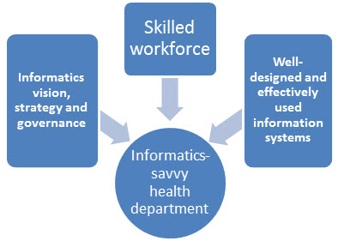
Review process and outcomes:
Baseline ISHO Assessment (Expedited)
Building an Informatics-Savvy Organization
Notes:
// Facilitator to guide feedback session from Day One’s working session – limited to 60 minutes //

Slide 8
Using Systems And Design Thinking For Informatics Problem Solving
// add speaker names and titles here //

Slide 9

Introduction to informatics problem solving

Slide 10


CURRENT STATE
PROBLEM
FUTURE STATE
…a recognized gap between current state and future state.

Slide 11

PROBLEM SOLVING
CURRENT STATE
FUTURE STATE
…a systematic (step-by-step, logical) approach to bridge the gap between current state to future state.
Notes:
Systems thinking is an approach to problem-solving that views issues as part of a larger, interconnected whole rather than in isolation. It emphasizes understanding relationships, feedback loops, and root causes, rather than just symptoms. By looking at the bigger picture, prioritizing effectively, and engaging multiple perspectives, systems thinking helps identify more sustainable, impactful solutions to complex challenges.
Linear thinking looks at problems in a straight cause-and-effect chain, often addressing symptoms in isolation.
Systems thinking looks at problems as part of a dynamic whole, emphasizing patterns, feedback loops, and underlying structures that shape outcomes over time.
In short: linear thinking asks “what caused this?” while systems thinking asks “how do the parts interact to create this?”

Slide 12

As problem solvers, we can become a part of the problem or a part of the solution.

Slide 13
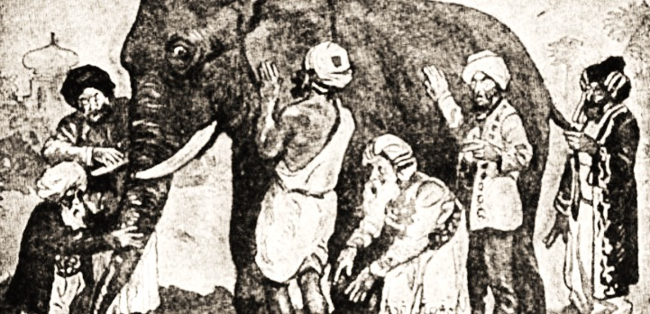
THE SIX BLIND MEN AND THE ELEPHANT
Notes:
You may have heard this fable from India. Six blind men heard of a fantastic creature called an elephant. Each of them touched a different part of the animal. The first person, whose hand landed on the trunk, said, "This being is like a thick snake". For another one whose hand reached its ear, it seemed like a kind of fan. As for another person, whose hand was upon its leg, said, the elephant is a pillar like a tree-trunk. The blind man who placed his hand upon its side said the elephant, "is a wall". Another who felt its tail, described it as a rope. The last felt its tusk, stating the elephant is that which is hard, smooth and like a spear. Only by incorporating all of their perspectives could they understand what the elephant was.

Slide 14

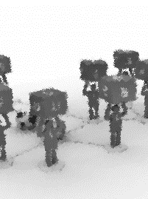

Why We are Vulnerable to Failure in Problem Solving?
Psychological (self)
Illusion – things are better
Bias towards preconceptions
Ignore what other people do
Ignore real problems
Organizational
Complexity
Fragmented information
Information filtering
Organizational silos
Dispersed responsibility
Political
Systemic decision-making flaws
Imbalance of power
Vested interests
Conflict of interest
Governmental dynamics
Watkins, Michael D., and Max H. Bazerman. "Predictable surprises: The disasters you should have seen coming." Harvard business review 81.3 (2003): 72-85.

Slide 15
Problem Solving Realities – 1
We cannot solve all problems at the same time.
Some problems are more important than others.
Some problems are easier to solve than others.
Complex problems can usually be broken down into simpler ones.

Slide 16
Problem Solving Realities – 2
Some problem-solving activities carry a lot of risk.
Some problem-solving activities may bring rewards.
We may not be looking at the real problem.
We may be looking at just a small part of the problem.
We may not be the right person (alone) to solve the problem.

Slide 17
DESIGN THINKING GROUP EXERCISE
// add facilitator name here //

Slide 18
The Marshmallow Challenge
Build the tallest free-standing structure.
  You may not suspend it from the ceiling.
  It will be measured from the tabletop to the top of the marshmallow.
The entire marshmallow must be on top.
  Cutting or eating any part of the marshmallow disqualifies the team
Use as much or as little of the kit as you wish.
  You may NOT use kit packaging (bags, boxes, etc.) as part of your structure.
Teams are free to break the spaghetti, cut up the tape and string.
  You will not receive any new materials during the challenge.
Teams cannot hold on to the structure when the time runs out. Those touching or supporting the structure at the end of the exercise will be disqualified.
Link to video
// See facilitator notes for the checklist and appendix at the end of the deck for the process//
Notes:
Marshmallow Challenge Checklist
Team ________
Round 1, structure height in cm.: _______
Round 2, structure height in cm.: _______
Marshmallow Challenge Checklist
20 sticks of uncooked spaghetti (note in humid conditions the spaghetti sticks might absorb moisture)
1 marshmallow
1 yard of string
1 yard of adhesive tape
Phone camera to take picture of team and structure
Checklist document (this Word document)
Rules of the Game
Read instructions carefully.
Check your kit for completeness of materials.
There are two rounds to the game.
Round 1 lasts 20 minutes.
Round 2 lasts 15 minutes
Watch the timer!
Build a free-standing structure using only the materials provided in the kit. Do not use this paper or the kit bag or container!
Discuss with your team the best strategy to build the tallest structure with the marshmallow at the top of the structure. The team with the tallest free-standing structure with the whole marshmallow on top wins the game. The height will be measured upward from the surface of the table to the top of the marshmallow.
Teams may break the spaghetti and cut the tape and string as needed to create the structure.
Teams should not hold the structure in place when the time stops.
Touching or supporting the structure when the timer stops disqualifies the team.

Slide 19
DESIGN THINKING GROUP EXERCISE FEEDBACK

Slide 20
Key takeaways
Systems thinking is a way of looking at problems as part of a bigger picture, focusing on connections and causes rather than isolated events.
Not all problems can or should be solved at once; prioritization is essential.
Complex problems often need to be broken into simpler, manageable parts.
Problem solving carries varying degrees of risk and potential reward.
Misidentification is common; we may not be addressing the real problem.
Solving complex issues often requires collaboration; one person alone may not have the full perspective or capacity.
Notes:
Principles of effective systems thinking:
Prioritize wisely – recognize that not all problems need solving at the same time; focus on the most critical or impactful ones.
Differentiate complexity – some problems are easier to solve, while others require breaking down into simpler parts.
Balance risk and reward – consider the potential costs and benefits before engaging in problem-solving actions.
Identify the real issue – step back to ensure you’re addressing the root cause, not just the symptoms.
See the whole system – avoid narrow focus; place the problem in its wider context to understand interconnections.
Work collectively – acknowledge that solving complex problems usually requires diverse perspectives and collaboration.

Slide 21
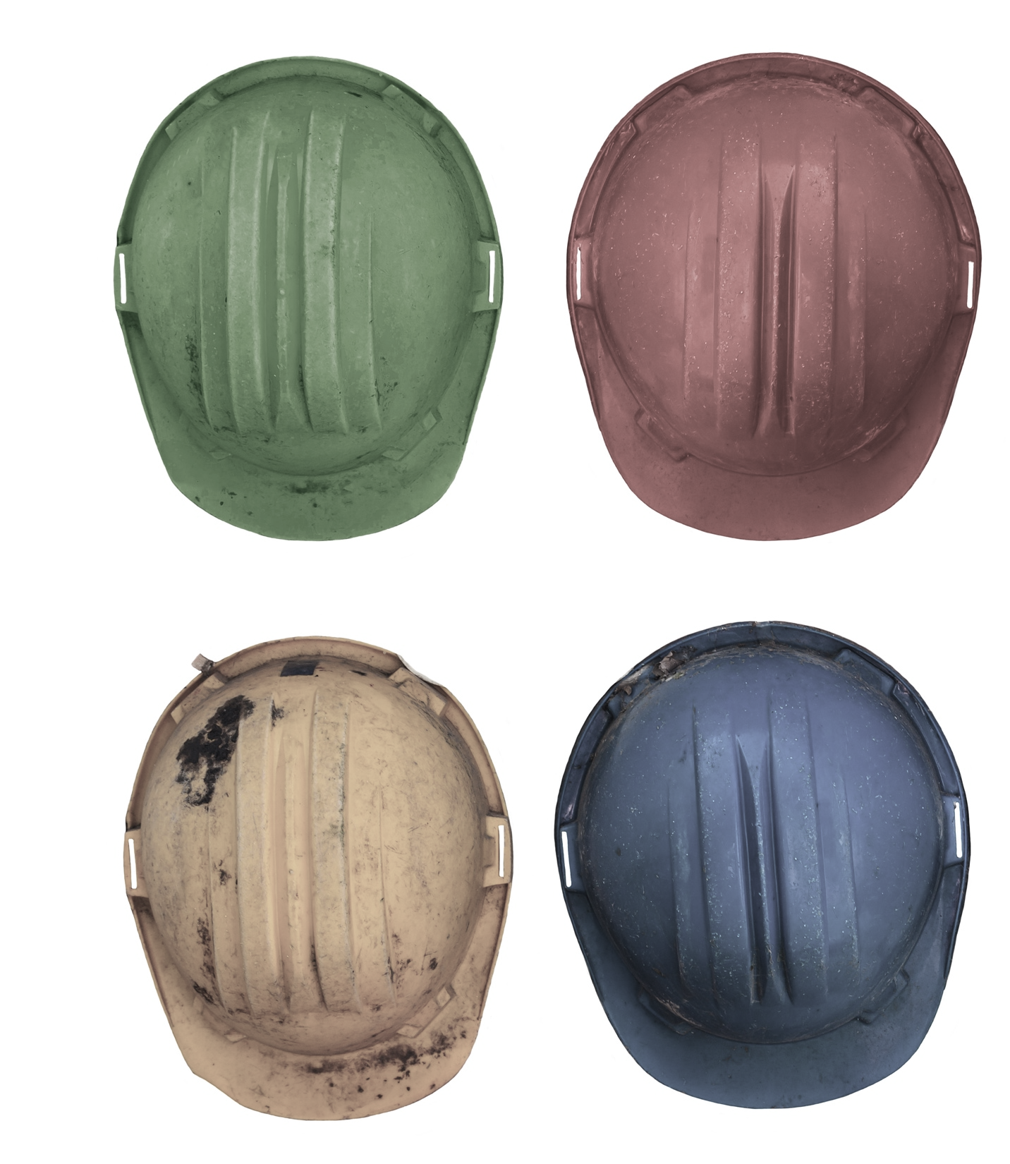
FOUR THINKING HATS
Knowing what questions to ask
Systems Thinking
Design Thinking
Evaluative Thinking
Strategic Thinking
Notes:
During this session, you will need four hats or caps that are different colours to represent the "Four Thinking Hats". After each section there is a quick quiz to evaluate the participants' understanding of the key concepts. The person who answers the quick quiz question correctly gets to wear (and keep?) the coloured hat/cap.
All of these thinking hats are interconnected. And after getting to know and use all of them, it would not be hard to think of which perspective to apply next.
At the root of all the hats is the thinking. The thinking allows you to ask questions specific to each hat or common between hats, to synthesize a better picture of current state, potential future states and pathways to the future states from current state. The future state may come as different levels of success or failure and it may be beneficial to develop a picture of where you want to be and where you don’t want to be.

Slide 22
Four thinking hats and the problem solver
Opens up opportunities for creative and responsive solutions
Promotes out of the box thinking
Enables the problem solver to ask the right questions
Enables the problem solver to gain deeper understanding of the problem situation

Slide 23
Asking the right questions – systems thinking
What is (are) the underlying process(es) and entities that contribute to generation of the problem(s)?
What is (are) the underlying process(es) and entities that could serve as points of intervention? Leverage points?
What are the perspectives by stakeholders (blind men) on these process(es) and entities at play? (also strategic thinking)
How can we avoid unintended consequences?
How do we improve relationships, meaningful interdependence across the stakeholder space? (also design and strategic thinking)
What is the “system” story here?

Slide 24
Asking the right questions – design thinking
How do I know I am solving the right problem? (also systems thinking)
What perspectives are at play in this situation? How can conflicting perspectives here be correct? (embracing ambiguity in sociotechnical systems)
How do we co-create innovative solutions that inspire and promote trust? (trust by design, data travels at the speed of trust)
In testing solutions that we co-create how do we create a safe space to fail? How do we create fail-fast experiments? Practice empathy by prototyping?

Slide 25
Asking the right questions – strategic thinking
What goals are being articulated? How do I resolve conflicting goals?
Which problem(s) do I need to solve first? (also systems thinking)
What is the value of solving this problem to all stakeholders? (also evaluative, design, systems thinking)
How will I position myself for successfully solving this problem?
What is the big picture where this problem resides? What is the relevance of solving this problem in that big picture?
Who else in the organization is solving this problem? How do we establish partnerships to leverage “shared” knowledge and resources?

Slide 26
Asking the right questions – evaluative thinking
What are my blind spots? (how not to be part of the problem)
How do I know what I think I know about the processes and entities in focus?
How do I know what I know is true / valid? What are the perspectives at play? (also systems, design thinking)
What new things did I learn from understanding the process(es) and entities in focus?
Are we solving the right problem? (also systems and design thinking)
Am I arriving at a conclusion prematurely?

Slide 27
Quick Quiz
STRATEGIC THINKING: ​
​What does Strategic Thinking focus on?
Options:
Identifying immediate problems and quick fixes
Looking at long-term goals, opportunities, and big-picture direction
Expressing emotions and gut feelings about a situation
Listing facts and objective data without interpretation
Notes:
Facilitators: You will need to have 4 hats or caps of different colours to represent each of the types of thinking for the next set of quick quizzes.
The first person to answer correctly gets to wear (and keep) the Strategic Thinking hat:
Question:
In the Four Thinking Hats approach, what does Strategic Thinking focus on?
Options:
a) Identifying immediate problems and quick fixes
b) Looking at long-term goals, opportunities, and big-picture direction
c) Expressing emotions and gut feelings about a situation
d) Listing facts and objective data without interpretation
(Correct answer: b)
You can emphasise these learnings by using the following scenarios as examples:
Question (Scenario):
Your country is planning to introduce a new digital health system for tracking childhood vaccinations.
The Ministry of Health team is discussing different approaches:
Option A: Focus on fixing the most urgent data quality issues in the paper-based system.
Option B: Explore how the digital system could be scaled nationwide to strengthen immunization coverage and align with the country’s 5-year health strategy.
Option C: Share how staff feel frustrated with the current reporting burden.
Option D: List all the current data collection tools in use.
Which option best reflects Strategic Thinking in the Four Thinking Hats approach?
(Correct Answer: Option B)
Debrief: Strategic thinking looks at the big picture and future direction. It’s not just about solving today’s paper-based problems but about how the digital system supports long-term goals.
Scenario 2 – Interoperability:
A country is reviewing how its new digital health platform can connect with other systems. The team suggests:
Option A: List all current technical standards (HL7, FHIR, etc.) in use.
Option B: Ask how the platform could support long-term interoperability across different health programs (HIV, maternal health, immunization).
Option C: Fix immediate bugs in the software so reports can be generated faster.
Option D: Express concern about how confusing multiple logins are for health workers.
Which option best reflects Strategic Thinking?
(Correct Answer: Option B)
Debrief: Strategic thinking goes beyond immediate fixes or technical lists. It considers how today’s system decisions will enable a cohesive, connected health ecosystem in the future.
Scenario 3 – Sustainability & Financing:
During planning, the Ministry needs to ensure the digital health tool can be maintained beyond donor funding. The team proposes:
Option A: Identify how to train staff on data entry this year.
Option B: Explore opportunities to integrate the tool into national budgets and long-term health financing plans.
Option C: Gather feedback from health workers about their daily workload.
Option D: Collect statistics on how many facilities currently lack internet connectivity.
Which option best reflects Strategic Thinking?
(Correct Answer: Option B)
Debrief: Strategic thinking is about sustainability — ensuring the system can survive and grow once donor funds run out. It’s about securing the long-term viability of digital health investments.

Slide 28
Quick Quiz
EVALUATIVE THINKING: ​
​ Who or what is at the center of evaluative thinking?
Notes:
The first person to answer correctly gets to wear the Evaluative Thinking hat:
(Correct answer: Yourself)

Slide 29
SYSTEMS THINKING
Systematic problem solving
// add speaker names and titles here //

Slide 30
What is systems thinking?
An introduction by Dr. Russell Ackoff
https://youtu.be/FhcfjE7tJDY?si=KWvdFZlF3OKvPCnQ

Slide 31
What is a system?
Any group of interacting, interrelated, or interdependent parts that form a complex and unified whole.
A system has a specific purpose.

Slide 32
What is systems thinking?
Systems thinking utilizes habits, tools, and concepts to develop an understanding of the interdependent structures of dynamic systems.

Slide 33
What happens typically
Sense of urgency in organizations to fix problems quickly has led people to take short-sighted actions that result in unintended, adverse, and sometimes devastating effects.
Focus on what is wrong instead of the desired outcome/future state
It is not unusual for people to acknowledge that they seem to be solving and re-solving the same problems over and over again

Slide 34
How can systems thinking help?
By using systems thinking, “undiscussables”, “sacred cows”, assumptions, and biases can finally be surfaced publicly.
It is safe for “difficult” stories and “truths” to be shared without the typical finger pointing or defensiveness that often happens around high-stake issues by using “archetypes”.
Notes:
archetypes are recurring patterns that drive systems

Slide 35
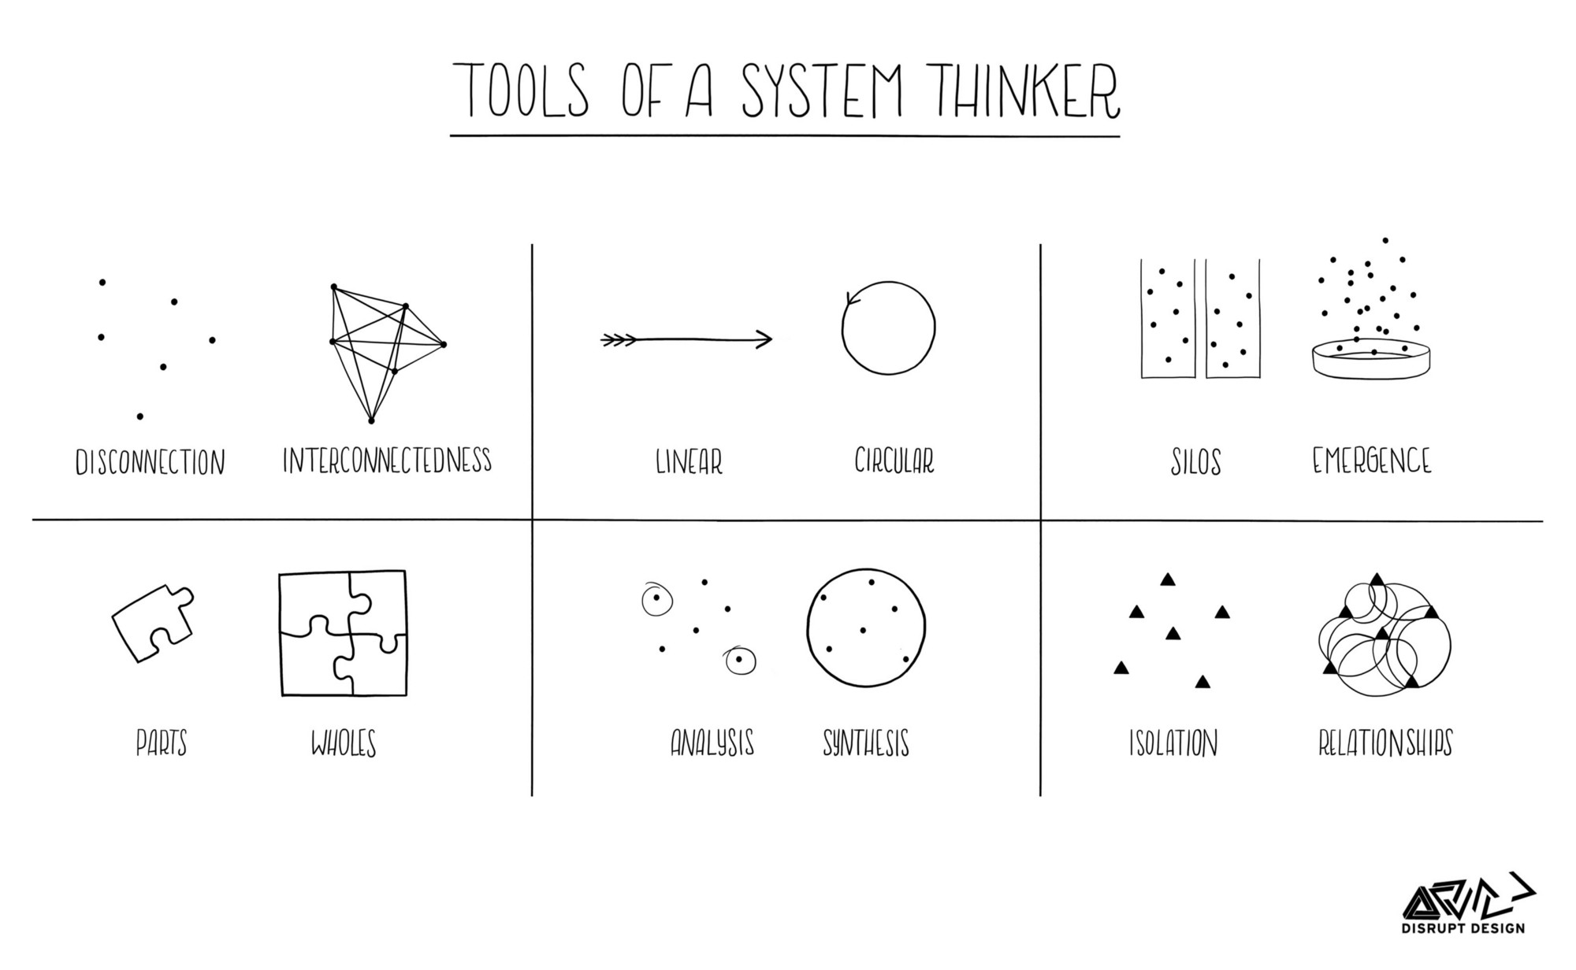

Notes:
Let’s look at some of the tools of a systems thinker:
Turning disconnection into interconnectedness
Shifting from linear thinking to circular, or iterative, thinking
Changing silos into emergence of ideas, processes and systems
Thinking not about parts, but of parts as a whole
Instead of just doing analysis on separate data streams, being able to synthesize across data streams
And instead of working in isolation, working in relationships.

Slide 36
Systems dynamics – disease epidemic
Infection rate
Recovery
rate
Susceptible Population
Sick
Population
Recovered
Population
Access to health care
Effective treatment
Contact rate
Infectivity
Population density
Total population
Transportation network
Notes:
Let’s look at systems dynamics in the context of a disease epidemic.
[click] You have a susceptible population [click] of which a portion becomes sick [click], and some portion of the sick population recovers.
[click] the change between the susceptible population and sick population gives you the infection rate. [click], which is influenced by the contact rate, total population and infectivity. [click] The contact rate is affected by factors such as population density and the transportation network.
[click] The change between sick and recovered is the recovery rate. [click] Recovery rate is impacted by access to health care and effective treatment.
[click] Each of these is also influenced by other factors in the broader system.
[click] And some portion of the recovered population may lose immunity and become part of the susceptible population again.

Slide 37
Systems dynamics – EMR implementation
Onboarding rate
All health facilities eligible for EMR
Facilities with functioning EMR
Capable staff
Good software
Infrastructure
Budget
Leadership support
Clear job description
Good system design
Appropriate training
Notes:
Now let’s look at an EMR implementation example of systems dynamics.
[click] You start with all health facilities eligible for and EMR [click] of which a portion install and use an EMR.
[click] the change between the eligible facilities and those with a functioning EMR gives you the onboarding rate. [click], which is influenced by the staff, software, infrastructure and budget. [click]
The contact rate is affected by factors such as population density and the transportation network.
[click]leadership and support [click] impacts all of these factors.
[click] Capable staff is impacted by things like a clear job description and training, while good software is dependent on a good system design.
[click] Each of these is also influenced by other factors in the broader system.
[click] And some portion of the facilities with a functioning EMR may regress and become an eligible facility again.

Slide 38
Key elements of systematic problem solving
Identify problem
  “You have to ask the right questions”
Disassemble the problem into smaller units (if possible)
  Discover underlying or contributing causes
  Look for patterns
  Identify biases
  Quantify assumptions
Develop/identify solutions to sub-problems
  Prioritize problem/solutions
  Establish dependencies and critical path items
Implement solutions and monitor
  Quick implementation/fail fast
Evaluate/modify/redo
  Iterative process to improve outcome

Slide 39
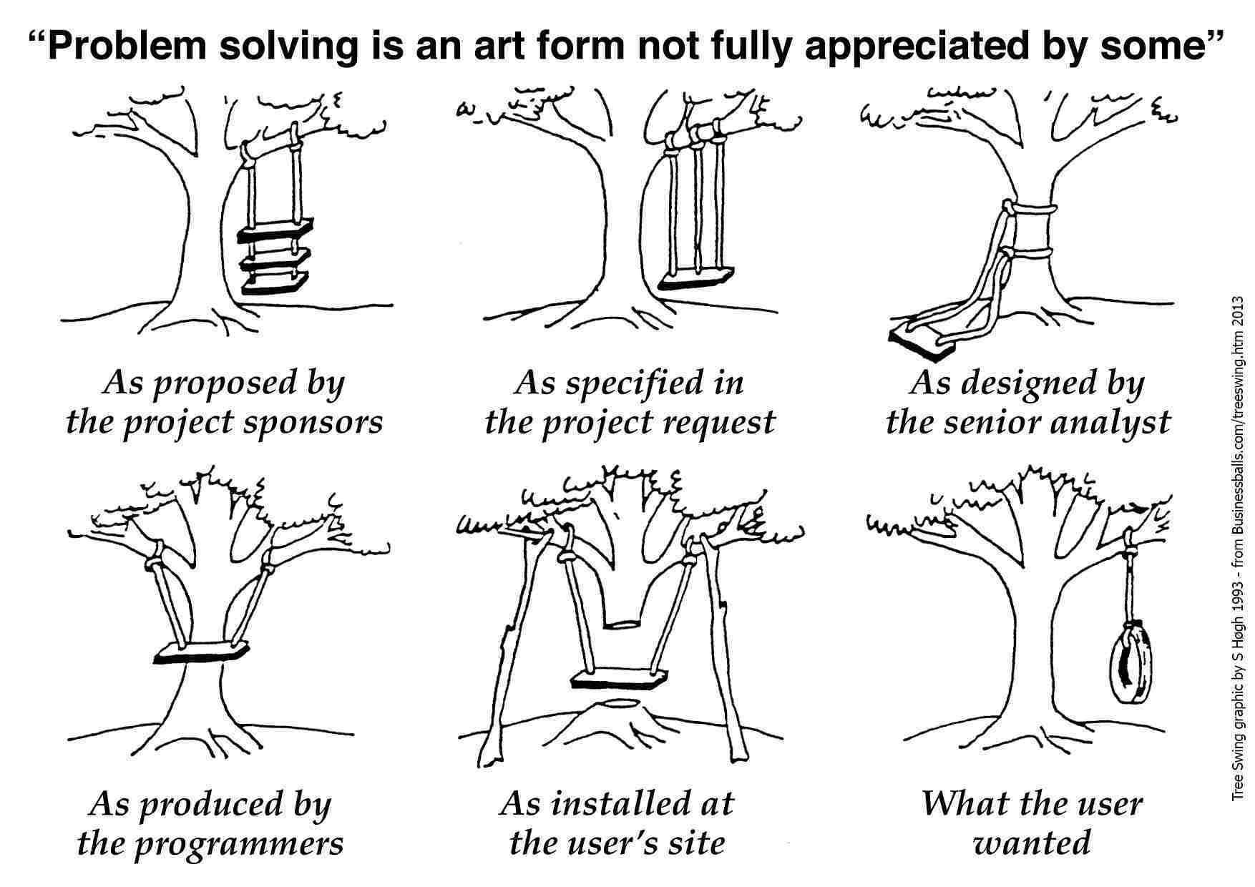
As proposed by MoH and funders
As described in the project proposal
As designed by the implementing partner
As developed by the programmers
As installed at the user facility
Notes:
I’ll end on a funny but true note. [click though the following slides and read them]

Slide 40
As proposed by MoH and funders
As described in the project proposal
As designed by the implementing partner
As developed by the programmers
As installed at the user facility

Slide 41
As proposed by MoH and funders
As described in the project proposal
As designed by the implementing partner
As developed by the programmers
As installed at the user facility

Slide 42
As proposed by MoH and funders
As described in the project proposal
As designed by the implementing partner
As developed by the programmers
As installed at the user facility

Slide 43
As proposed by MoH and funders
As described in the project proposal
As designed by the implementing partner
As developed by the programmers
As installed at the user facility

Slide 44
As proposed by MoH and funders
As described in the project proposal
As designed by the implementing partner
As developed by the programmers
As installed at the user facility

Slide 45
As proposed by MoH and funders
As described in the project proposal
As designed by the implementing partner
As developed by the programmers
As installed at the user facility

Slide 46
Quick Quiz
SYSTEMS THINKING: ​
​What question would you—as a systems thinker—have asked at the beginning of your problem solving process?
Notes:
The first person to answer correctly gets to wear the Systems Thinking hat:
Question:
In the Four Thinking Hats approach, what does Systems Thinking focus on?
Options:
a) Understanding how different parts of a system interact and influence each other
b) Listing individual tasks that need to be completed
c) Choosing the fastest solution to a problem
d) Sharing personal opinions and feelings about the issue
Correct Answer: A
You can emphasise these learnings by using the following scenarios as examples:
Scenario – Health Data Flow
A Ministry of Health team is addressing challenges with delayed malaria case reporting. During the discussion, they suggest:
Option A: Train health workers to send reports more quickly.
Option B: Review how community health workers, facilities, district offices, and the national HMIS are all linked, and identify bottlenecks across the whole reporting chain.
Option C: Focus only on fixing the reporting form at facility level.
Option D: Ask health workers how they feel about the current reporting tools.
Question:
Which option best reflects Systems Thinking?
Correct Answer: Option B
Debrief (facilitator note): Systems Thinking looks at the whole system and the interconnections between parts. Instead of focusing narrowly on one level (like facilities) or one solution (like training), it examines the broader reporting flow to see where changes will have the most impact.
Scenario 2 – Interoperability
A country is struggling because its digital health systems (immunization registry, HIV patient tracker, and lab information system) do not “talk” to each other. The team proposes:
Option A: Create a new reporting template for each program separately.
Option B: Focus on how these systems interact as part of the wider health information ecosystem, and develop a plan for interoperability.
Option C: Upgrade servers for the immunization system only.
Option D: Ask staff in one program how satisfied they are with their current system.
Correct Answer: Option B
Debrief: Systems Thinking emphasizes connections and interdependencies. Instead of optimizing one system in isolation, it looks at the whole ecosystem to ensure long-term efficiency and impact.
Scenario 3 – Resource Allocation
The Ministry has limited funding to support digital health systems. During planning, the team suggests:
Option A: Buy more tablets for one donor-funded project.
Option B: Consider how infrastructure, training, connectivity, and maintenance all fit together, and prioritize investments that strengthen the digital health system as a whole.
Option C: Focus only on paying internet costs for one year.
Option D: Collect stories from health workers about their daily struggles with reporting.
Correct Answer: Option B
Debrief: Systems Thinking looks at the bigger picture of resources and trade-offs. Instead of choosing a quick fix, it asks how different investments interact and how to build a balanced, resilient system.

Slide 47

COFFEE / TEA BREAK
20 minutes

Slide 48
DESIGN THINKING:
Using a human-centered approach to understand user needs to develop innovative and effective solutions
EMPATHY
IDEATE
DEFINE
PROTOTYPE
TEST
LEARN
AND
ITERATE

Slide 49

WHAT IS DESIGN THINKING ?
Design thinking is a process
for creative problem solving.
----IDEO definition
Notes:
Design thinking is a process for creative problem solving. ----IDEO definition

Slide 50
Small
Diverse
Teams:
Subject Matter Experts
Non Experts !
Epidemiologists
Experts in Adjacent Fields
Economists & Finance
Senior staff & Junior Staff
Statisticians
Policy / Comm
Designers
Data Management
Artists and Writers
Geographers --- others….
Notes:
Design thinking requires teams that are small enough to be nimble, but include enough diversity to approach problems and solutions from many angles.

Slide 51
MINDSETS:
Curiosity
Imagination
Mind of a Child
Encourage ideas – Yes And
Wildest ideas
Defer Judgment
Build on the ideas of others
Build for extreme users
Creative Confidence
Bias toward action
Fail-Fast
Iteration and Improvement
Notes:
Approaching problem solving from a design thinking perspective also requires problem solvers to use a variety of mindsets. The goal is to get a wide variety of potential solutions to think through rather than only trying to identify the one true path.

Slide 52
DESIGN THINKING ITERATION CYCLE:
EMPATHY
LEARN
AND
ITERATE
DEFINE
TEST / FAIL
FAST
IDEATE
PROTOTYPE

Slide 53
EMPATHY
EMPATHY
LEARN
AND
ITERATE
DEFINE
Requires imagination
Requires us to walk in the shoes of another human
How do we do this?
We can ask questions—but how much do we really understand the life of another?
TEST / FAIL
FAST
IDEATE
PROTOTYPE
Notes:
Requires imagination
Requires us to walk in the shoes of another human
How do we do this ?
We can ask questions ---but how much do we really understand the life of another ?
Requires Imagination
We must be willing to ‘walk a mile’ in the shoes of a person
We can ask questions – but
How much do we really understand ?
Needs, insights, point-of-view

Slide 54
DEFINE
EMPATHY
LEARN
AND
ITERATE
DEFINE
TEST / FAIL
FAST
IDEATE
PROTOTYPE
Notes:
At the turn of the 20th century, there were a lot of people trying to build a commercially-viable automobile. Henry Ford once allegedly said, “If I had asked people what they wanted, they would have said faster horses.” But Mr. Ford realized that slow horses wasn’t the problem he needed to solve. he realized that what consumers needed was reliable transportation that was relatively inexpensive to produce and maintain. By properly defining the problem, he was able to invent the Model T and bring it to market.

Slide 55
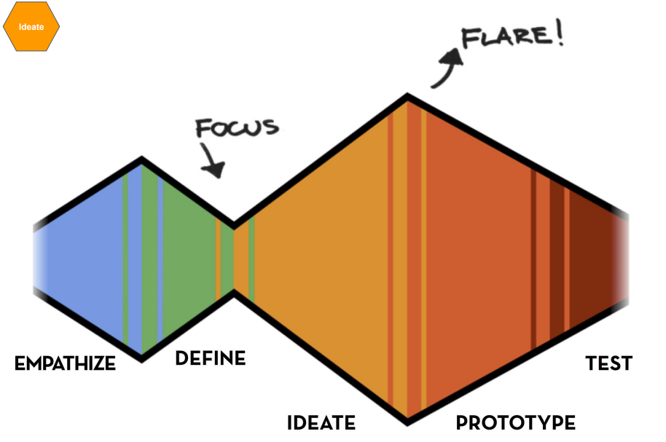
EMPATHY
LEARN
AND
ITERATE
DEFINE
Brainstorming—defer judgement
Avoid jumping to solutions
Convergent and divergent thinking
Mind mapping
Bias toward action
Idea selection separated from initial ideation
TEST / FAIL
FAST
IDEATE
PROTOTYPE
IDEATE
Source: Stanford University Design School
Notes:
Ideating is the process of creating ideas. You can do so by:
Brainstorming – defer judgment
Avoid jumping to solutions
Convergent and Divergent thinking….
Yes And
Mind Mapping
Bias toward Action
Idea Selection separated from initial ideation
Design thinking has cycles of focus and flare. When you empathize, you generate requirements (flare), then you focus when you use those requirements to define the problem. When you ideate, you brainstorm solutions, then you prototype and test to focus those solutions.

Slide 56
EMPATHY
LEARN
AND
ITERATE
DEFINE
Prototyping as a verb
Build—less talking, more building/action
Action to talk ratio should be high in favor of action
Build quickly with cheap materials
The prototype is not as important as the process
TEST / FAIL
FAST
IDEATE
PROTOTYPE
PROTOTYPING
Notes:
Prototyping as a verb
-Build --- less talking, more building / action
-Action to talk ratio should be high in favor of action
-Build quickly with cheap materials
-The prototype is not as important as the process
Less talking and more doing
Action to talk ratio should be high in favor of Action
Build quickly with cheap materials
Prototyping is a verb not a noun
The prototype is not nearly as important as the process
Do not get married to a prototype
Iterate and build and rebuild prototypes based upon feedback from real users

Slide 57
Test your prototypes with real users
Typical users
Extreme users
Test fast
Fail fast
Iterate
EMPATHY
LEARN
AND
ITERATE
DEFINE
TEST / FAIL
FAST
IDEATE
PROTOTYPE
TEST
Notes:
Test your prototypes with users
Typical users
Extreme users
Test fast
Fail Fast
Iterate
Test your prototypes and test them quickly with real users
Extreme users
Test Fast
Fail Fast

Slide 58
EMPATHY
FAIL
ITERATE
LEARN
AND
ITERATE
DEFINE
TEST / FAIL
FAST
IDEATE
PROTOTYPE
Notes:
When you start testing prototypes, many will fail. With each failure you learn more about what might work. Keep iterating solutions until you find one that works.

Slide 59


Notes:
While the idea of a light bulb existed long before Thomas Edison started tinkering with it, no one had come up with an actually usable bulb because they burned out very quickly. Edison and his team tested over 3000 designs between 1878 and 1880 before they had a commercially viable light bulb. They continued to build and test prototypes over the next few decades.

Slide 60
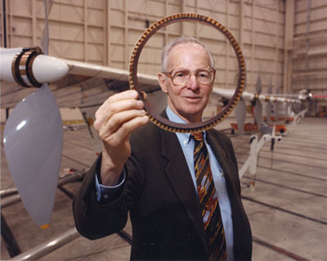
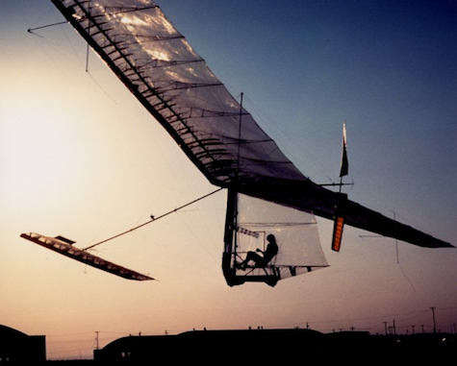
Paul MacCready
(Caltech, NASA )
“You are solving the wrong problem.”
Source: https://uxmag.com/articles/you-are-solving-the-wrong-problem
Notes:
In 1959, Henry Kremer offered 100,000 pounds to anyone could fly across the English Channel using only human power. That’s more than $2.5 million today. For years, people tried and failed. It looked impossible until Paul MacCready decided everyone was solving the wrong problem. he decided that the problem wasn’t flying a human-powered plane over the English Channel without crashing, but building a plane that could crash, be quickly repaired and take off until he reached the other side. Eighteen years after that challenge was issued, MacCready flew the Gossamer Albatross across the Channel and collected the prize.

Slide 61
WHERE IS YOUR PLACE
FOR FAILING ?
“FAILURE SUCKS,
BUT INSTRUCTS”
Diego Rodriguez (IDEO)
Source: http://metacool.typepad.com/metacool/2007/11/heard-at-work.html

Slide 62
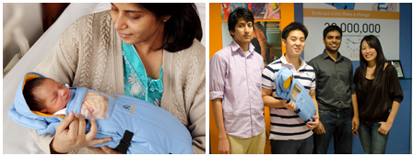
Embrace Infant Warmer
Stanford: http://extreme.stanford.edu/projects/embrace
Embrace Innovations: https://www.embraceinnovations.com/
Slate: http://www.slate.com/blogs/the_eye/2013/11/04/embrace_infant_warmer_creative_confidence_by_tom_and_david_kelley.html
Notes:
As part of a design program, 4 graduate students were tasked with creating a cheaper incubator because an alarming number of pre-term infants were dying in Nepal and incubators are too expensive for hospitals to purchase enough. -- After going to Nepal, they realized that most preterm infants were born in rural areas far from the nearest hospital and many died before reaching an incubator. They reframed the problem of “cheaper incubators” to form the Embrace infant warmer.
Typical incubator had $20,000 cost ---- Embrace Infant Warmer = $25 cost
22 projects in 10 countries –saving thousands of infant lives ---
https://www.embraceglobal.org/

Slide 63
Quick Quiz
DESIGN THINKING: ​
Question:
In the Four Thinking Hats approach, what does Design Thinking focus on?
Options:
Identifying emotions and gut reactions
Developing creative, user-centered solutions to meet real needs
Listing system constraints and bottlenecks
Setting long-term strategic goals
Notes:
The first person to answer correctly gets to wear the Design Thinking hat:
Question:
In the Four Thinking Hats approach, what does Design Thinking focus on?
Options:
a) Identifying emotions and gut reactions
b) Developing creative, user-centered solutions to meet real needs
c) Listing system constraints and bottlenecks
d) Setting long-term strategic goals
Correct Answer: b
Debrief: Design Thinking is about creativity and innovation : generating ideas that are practical, human-centered, and responsive to user needs.
You can emphasise these learnings by using the following scenarios as examples:
Scenario 1 – Health Worker Experience
A digital health team wants to redesign a mobile reporting app because usage rates are low. The team suggests:
Option A: Collect statistics on how many reports are submitted late.
Option B: Sit with health workers to understand their daily workflow and co-create ideas to make the app easier to use.
Option C: Write a new national policy on mobile reporting standards.
Option D: Focus on buying more smartphones for clinics.
Correct Answer: Option B
Debrief: Design Thinking starts with empathy and puts the end-user at the center. By understanding health workers’ real challenges, the team can design a tool they will actually use.
Scenario 2 – Patient Access
The Ministry is developing a digital appointment system to reduce missed clinic visits. The team proposes:
Option A: Look at how scheduling links to broader national health strategies.
Option B: Focus only on upgrading the server to handle more appointments.
Option C: Gather reports on how many clinics lack internet access.
Option D: Interview patients and families to learn what stops them from attending appointments, then brainstorm creative solutions.
Correct Answer: Option D
Debrief: Design Thinking focuses on understanding user needs and barriers and then prototyping solutions that directly address them.
Scenario 3 – Innovation in Data Use
A country wants to improve how data is used at the facility level. The team suggests:
Option A: Train facility managers to analyze monthly reports.
Option B: Mandate that all facilities must submit an annual data use plan.
Option C: Work with facility staff to brainstorm simple, visual dashboards they would find useful, test a prototype, and refine it based on feedback.
Option D: List all the current software tools used for reporting.
Correct Answer: Option C
Debrief: Design Thinking is about prototyping and iterating with users. Instead of pushing top-down solutions, it encourages co-creation to ensure tools fit the real working environment.

Slide 64
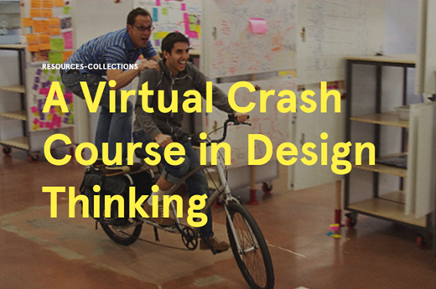
https://www.youtube.com/watch?v=pmjyZPibH14
Stanford Design School, Virtual Crash Course in Design Thinking: https://www.ncbi.nlm.nih.gov/pmc/articles/PMC5665524/
Notes:
Additional resources: 1 hour 20 minute video from Stanford University
https://www.youtube.com/watch?v=pmjyZPibH14

Slide 65
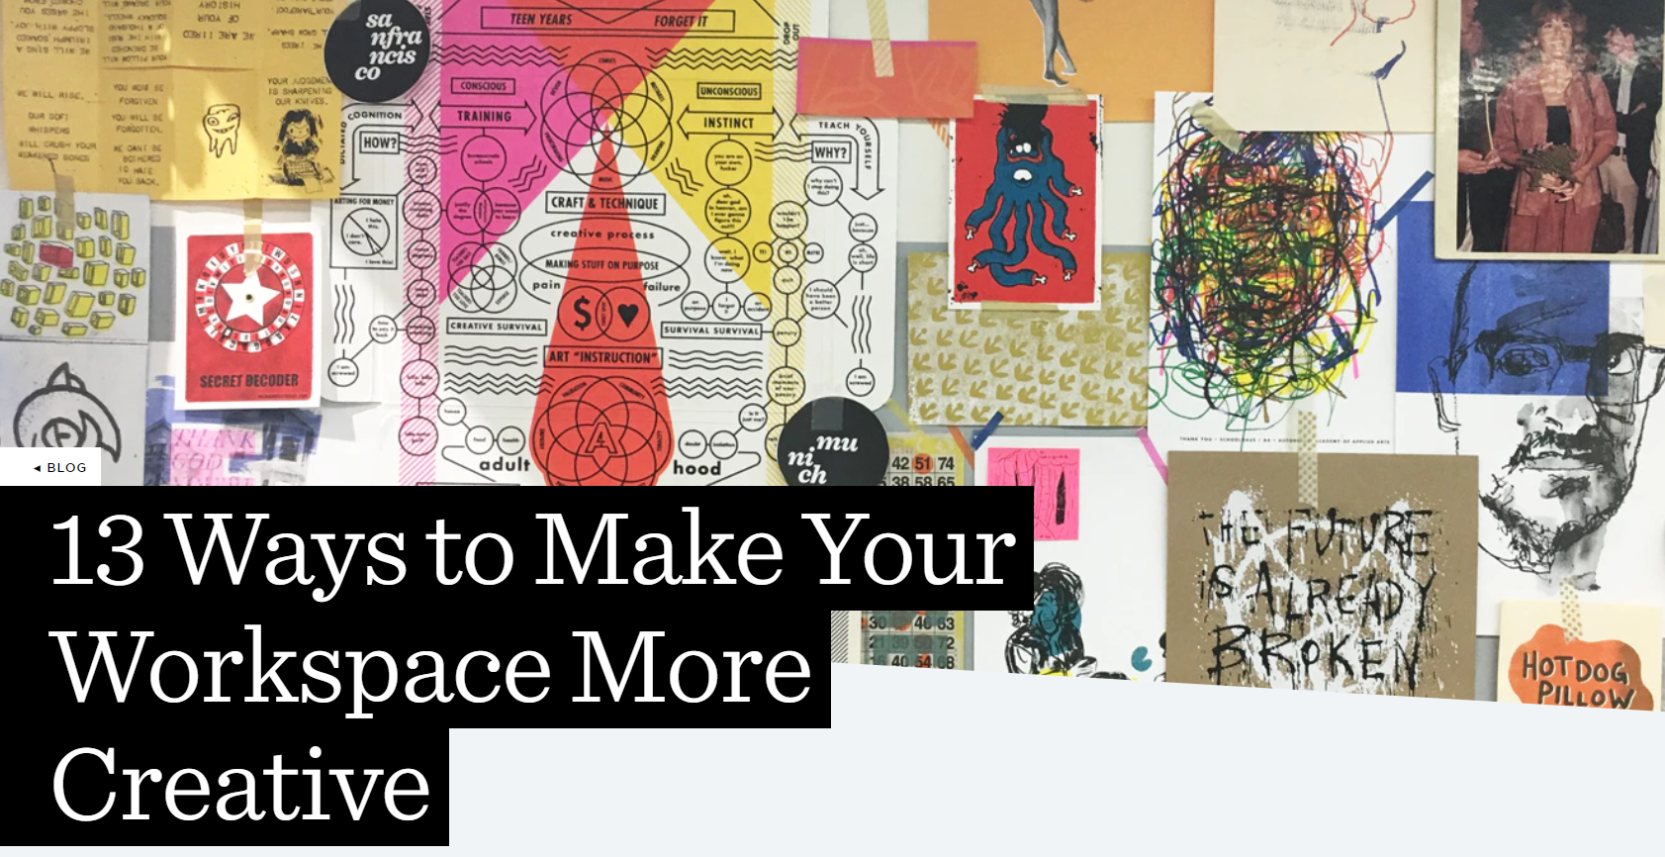
IDEO: Creative Spaces
Install a communal table or other gathering space
Make things moveable
Display your values
Hide the clocks
Situate joy
Put creative tools in the way
Activate empathy
Use nature to support well-being
Cultivate permission
Provide spaces for projects
Introduce some play
Source:
https://www.ideo.com/blog/13-ways-to-make-your-workspace-more-creative
Notes:
Additional resources:
https://www.ideo.com/blog/13-ways-to-make-your-workspace-more-creative
1. Install a communal table or other gathering space
2. Make things moveable
3. Display your values
4. Hide the clocks
5. Situate joy
6. Put creative tools in the way
7. Build a home-y kitchen
8. Activate empathy
9. Use nature to support well-being
10. Cultivate permission
11. Provide spaces for projects
12. Introduce some play
13. Think about a landscape of creative spaces

Slide 66

LUNCH
60 MINUTES

Slide 67

WORKSTREAMS BREAKOUT SESSIONS
Informatics health policy and governance
Health Informatics workforce
Information Systems and Technology
GOAL: Produce a prioritized lists of gaps & opportunities for capacity strengthening relevant to your workstream area
Notes:
Facilitator Notes
Duration: 2 hours
Participants will be assigned to a workstream group aligned with the three ISHO pillars and their respective areas of expertise.
Each workstream will break out into a separate space, with a designated facilitator to guide the discussion.
The output for this session wlll be a prioritized lists of gaps & opportunities for capacity strengthening relevant to each of the three workstreams: this will feed into the action plan that is the final output of this course.
A separate slide deck is provided for each workstream to support the session.
After the session, all groups will reconvene in plenary to share back key points and insights.
Ensure that the participants assign note takers and agree on a person who will deliver the feedback when the workstreams reconvene in plenary.
/

Slide 68
IDEO: Creative Spaces
Install a communal table or other gathering space
Make things moveable
Display your values
Hide the clocks
Situate joy
Put creative tools in the way
Activate empathy
Use nature to support well-being
Cultivate permission
Provide spaces for projects
Introduce some play
Source:
https://www.ideo.com/blog/13-ways-to-make-your-workspace-more-creative
Notes:
Additional resources:
https://www.ideo.com/blog/13-ways-to-make-your-workspace-more-creative
1. Install a communal table or other gathering space
2. Make things moveable
3. Display your values
4. Hide the clocks
5. Situate joy
6. Put creative tools in the way
7. Build a home-y kitchen
8. Activate empathy
9. Use nature to support well-being
10. Cultivate permission
11. Provide spaces for projects
12. Introduce some play
13. Think about a landscape of creative spaces

Slide 69
WORKSTREAMS FEEDBACK SESSION
Notes:
// 30 minutes – 10 minutes per workstream to provide feedback //

Slide 70

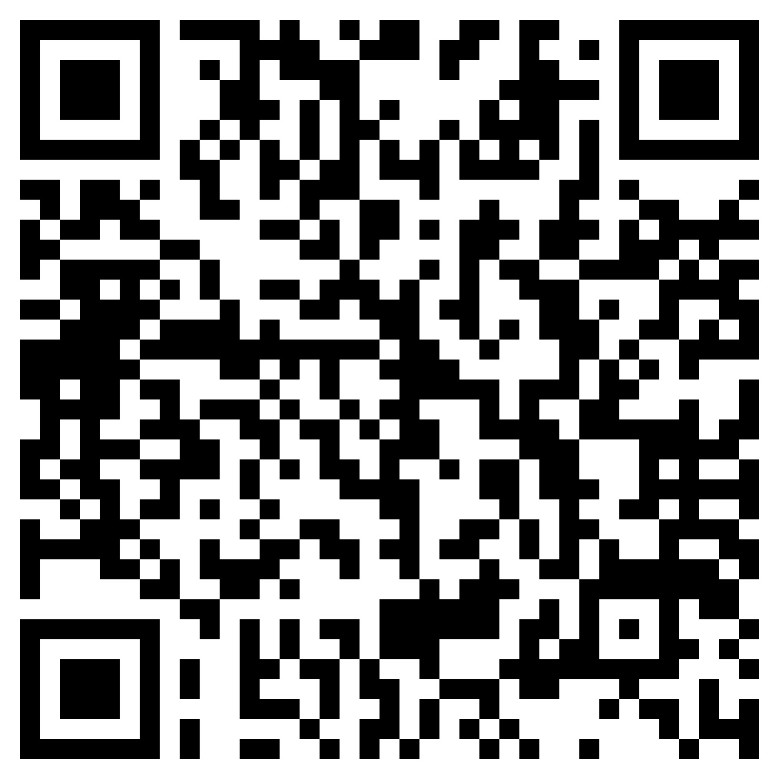
END OF DAY EVALUATION
Link to EOD evaluation: https://path.box.com/s/ve2wudlqp2y4cm9cmbozgq2fhpn69wyw
// Replace this QR code with the one generated for your evaluation form. //

Slide 71
End of day 2 evaluation questions
(Upload to online survey tool like Google forms)
The Four Thinking Hats session was relevant to my department/country’s needs.
  Strongly disagree
  Disagree
  Neutral
  Agree
  Strongly Agree
Do you have any additional feedback on the Four Thinking Hats session? (Optional)
Which workstream breakout session did you participate in?
  Informatics health policy and governance
  Health Informatics workforce
  Information Systems and Technology
How useful were the following sessions for your country's needs? Not useful, useful, very useful
  Using Systems and Design Thinking for Informatics Problem Solving
  Four Thinking Hats
  Workstream breakout session
I was satisfied with today’s sessions overall.
  Strongly disagree
  Disagree
  Neutral
  Agree
  Strongly agree
The Using Systems and Design Thinking for Informatics Problem Solving session was relevant to my department/country’s needs.
  Strongly disagree
  Disagree
  Neutral
  Agree
  Strongly Agree
Do you have any additional feedback on the Using Systems and Design Thinking for Informatics Problem Solving session? (Optional)
Link to EOD evaluation: https://path.box.com/s/ve2wudlqp2y4cm9cmbozgq2fhpn69wyw
Notes:
Link: upload the questions to an online survey tool

Slide 72
Day Two – Wrap Up
Q and A on any of the sessions today
What to expect on Day Three
Day Two reflections:
  What did you expect?
  Did this meet those expectations?
  What did you learn?
Day Two evaluation – 10 minutes to complete the feedback form

Slide 73
Key Takeaways
Notes:
Slide templates to use as needed

Slide 74
BREAKOUT SLIDE
Notes:
Slide templates to use as needed

Slide 75

Q&A SLIDE
Notes:
Slide templates to use as needed

Slide 76

READOUT + REFLECTIONS
SLIDE
Notes:
Slide templates to use as needed

Slide 77
Appendix
Session Guide: Marshmallow challenge
Notes:
// 30 minutes – 10 minutes per workstream to provide feedback //

Slide 78


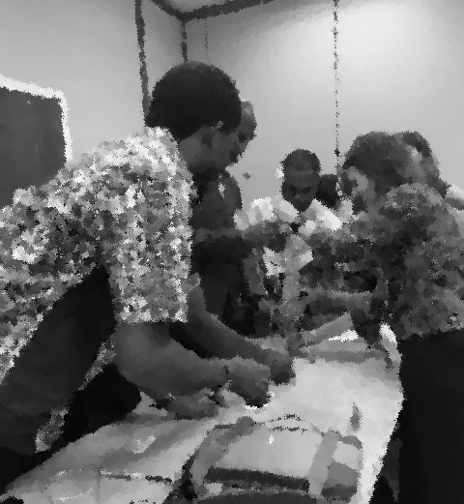


Process for Marshmallow Challenge
I-LEAD Training

Slide 79
Application of Lessons Learned
Team work
Communication
Problem solving, systems thinking
Design thinking (fail fast, learn fast)
Notes:
This activity not only serves as a fun and engaging team-building exercise but also illustrates valuable lessons in innovation and problem-solving

Slide 80
Rules Slide
Read instructions carefully.
Check your kit for completeness of materials.
There are two rounds to the game.
  Round 1 lasts 20 minutes.
  Round 2 lasts 15 minutes
Watch the timer!
Build a free-standing structure using only the materials provided in the kit. Do not use the checklist paper!
Discuss with your team the best strategy to build the tallest structure with the marshmallow at the top of the structure. The team with the tallest free-standing structure with the marshmallow on top wins the game.

Slide 81
Marshmallow Challenge Kit
20 sticks of uncooked spaghetti (note in humid conditions the spaghetti sticks might absorb moisture)
1 marshmallow
1 yard of string
1 yard of adhesive tape
Phone camera to take picture of team and structure
Checklist document (Word Document)
Measuring tape to measure height of structure
Phone timer app / stopwatch

Slide 82
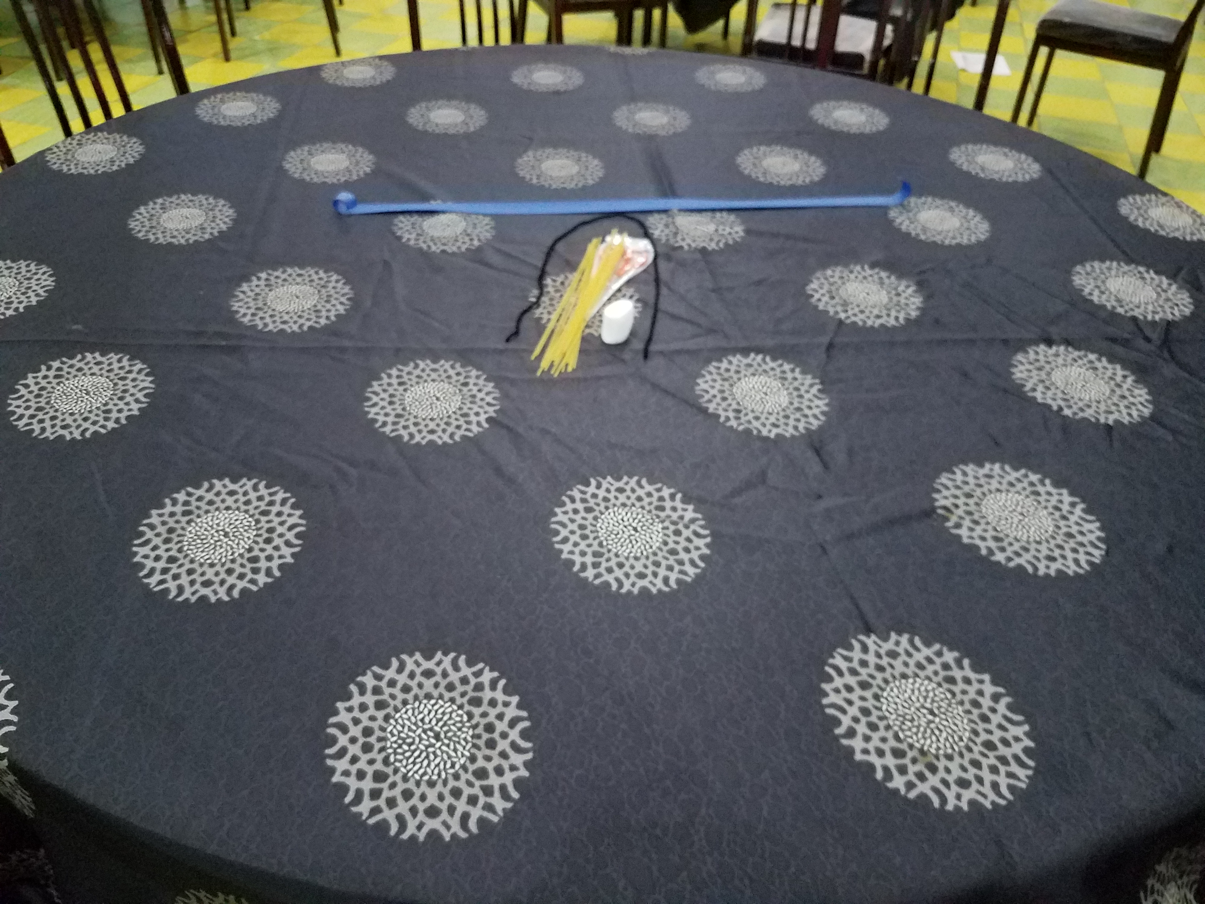
Kit at the center of the team’s table
Adhesive tape
Yarn
Spaghetti
Marshmallow

Slide 83
Timer Slide – Round 1
5 minutes
10 minutes
ROUND 1
1
5
2
8
10
7
3
9
6
4

Slide 84
Timer Slide – Round 2
5 minutes
10 minutes
ROUND 1
5
ROUND 2
2
8
10
7
3
9
1
6
4

Slide 85
Organization
Large room with table for each team
Team size: 3-10 per team
Two rounds
Timeline
  First round: 15 minutes
  Second round: 10 minutes
Reflection from teams afterwards
Notes:
The time spent on each round can be adjusted if needed, as can the materials.

Slide 86
Process
Instruct teams to proceed to their tables.
Briefing on checklist and rules of the game.
Start round 1
  After timer stop, record all free-standing structures.
  Ask teams to go around and observe the structures developed by other teams.
Start round 2
  After timer stop, record all free-standing structures.
Show Marshmallow Challenge Video by Tom Wujec
Notes:
Have materials assembled before each round to avoid spending time on this during the session.

Slide 87
Team Reflection with Facilitators (10 minutes)
Process, team maturity
How did the team function?
What were your team’s strengths?
What were your team’s frustrations?
Design thinking (empathy, walking in other people’s shoes)
What was difficult for the team to overcome to do design thinking?
How can you improve the practice of design thinking in the team?
Notes:
Debrief Questions
What is your marshmallow? What is the end goal - i.e., keeping the marshmallow on the top of the structure?
Emphasize design thinking and team work - how did you think about the end goal? How did that change over rounds? How did you bring in design thinking and iteration?
How did you approach team work and what worked well?

Slide 88

Marshmallow Challenge – Recap (7 minutes)

