Slide 1
I-LEAD WORKSHOP Facilitator Notes
This
This is the master slide deck for BREAK OUT SESSION - WORKSTREAM 1 – Information Systems and Technology - ON DAY TWO of the I-LEAD Workshop for facilitators. It is intended to make the process of preparing and conducting the workshop easier, and the decks are designed to be customizable to your context.
Make a copy of this deck to keep as a backup.
Throughout the deck, you will see facilitator instructions written in red text on the slides. The intent is that you replace this text with relevant details specific to your workshop. You will also find instructions and helpful guidance in red text in the speaker notes, along with a more comprehensive explanation of the content on the slides.
The red text in the speaker notes should be removed when you are ready to share the final deck with the workshop participants.

Slide 2
Day Two Breakout Session
Workstream 1: Effective Information Systems
Notes:
// 2 hour session in total – at least 30 minutes introduction – 30 minutes group discussion and 60 minutes for group activity//

Slide 3

Informatics-Savvy Health Organization (ISHO)
ISHO
OpenHIE Framework
HIE Implementations based on your country experience
Skilled Workforce
Policy and Governance
Effective information systems

Slide 4
Learning Objectives
  Given country context, understand the use and functionalities of OpenHIE architectural services and interoperability layer and discuss challenges related to their implementation
  Gain an understanding about factors enabling a successful HIE implementation
  Group exercise related to HIE and or interoperability implementation to help address challenges

Slide 5
Health Information Exchange

Slide 6

Agenda
Why Health Information Exchange (HIE)?
The Framework
Registry Services
The Interoperability Layer
OpenHIE Strategy

Slide 7
The Power of Communication
Notes:
Systems talking to each other will get the right people the right information at the right time to optimize patient care and outcomes.

Slide 8

Source: https://theosophical.files.wordpress.com/2014/12/telephone-game.jpg
Notes:
There can be serious and even fatal consequences in health miscommunications! Systems need to “speak the same language” and information needs to mean the same thing as it travels across systems. It comes down to having all the key component of HIE set up to deliver accurate data efficiently.

Slide 9




Why Health Information Exchange?
I’m not going to order blood work for Joe because he visited St. Francis Hospital yesterday and they ordered it.
I didn’t receive a sample for Joe in the Viral Load Information System. The transmission from the EMR says that he had his blood drawn and it will be sent with the batch that arrived today.
In the last 3 months, the Zima national health dashboard is showing that HIV rates are skyrocketing among the elderly in Lulu province. We must investigate!
I see that Dr. Smith noted Joe’s penicillin allergy care at Mercy Health Facility last year, so I will prescribe something else.
Simon
Farmer Lab Hub
Dr. Oshar
Zima Ministry of Health
Dr. Patty
Farmer Health Facility
Country of Zima
Notes:
In the fictitious country of Zima, health information systems are fully integrated, and they have a national dashboard that supports leaders and decision makers.
What problems are being solved in these scenarios? (Ask participants this questions and let them respond.)
Care coordination.
Eliminate redundant testing (cost saving).
No complications or hospital stays (life saving and cost saving).
Outbreak detection.
Specimen tracking and preservation.

Slide 10

The Framework
OpenHIE
Notes:
Modular framework, “building block” approach, pick and choose the components that are relevant to your context and add components according to your country’s timeline and strategic plan to “plug and play”.

Slide 11
Business Domain & Registry Services | Layer 1
Business domain components support speciﬁc health system business domains that potentially combine data from multiple point-of-service and point-of-care systems. Registry services uniquely identify and track unique patients, facilities, healthcare products and terminology that are used for exchange.
Interoperability Services | Layer 2
The second layer of the architecture acts as a secure gateway between the business domain and registry services and the points of service.
Point of Services | Layer 3
Point of service systems, such as electronic medical records (EMR) systems, that are used by clinicians and by health workers to enter and use a patient’s person-centric shared health information.
Source: Framework - OpenHIE (ohie.org)

Slide 12
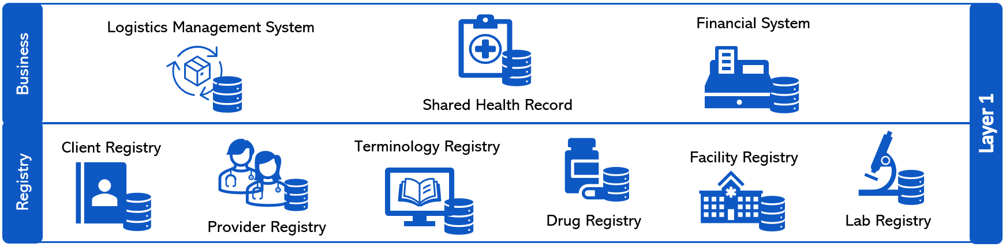


Source: Framework - OpenHIE (ohie.org)
Notes:
Countries will list out implemented solutions for their architectural components and the interoperability Layer and their benefits and challenges; we will have a poster for each component of focus (terminology services, client registry, health worker registry, drug registry, and interoperability layer) for them to use; then we will assess the commonalities and pick 3 top common challenges for the strategic planning activity.

Slide 13
Registry Services
Terminology Registry
  Standardizes the data across systems.
  Set of common vocabularies to use across system (ICD-10/11, HCPCS/CPT, etc.).
  Ensures data that are exchanged across systems mean the same thing. – Semantic Interoperability
  Improves patient care and reporting via accurate information.
Client Registry
  Source of truth for patient demographics.
  Supports patient identity management.
  Maintains all patients and their demographic information.
  Enables unique and accurate identification of patients across health information systems.
Notes:
There is an essential need for unambiguous and consistent meaning of information across information systems.

Slide 14
Interoperability Layer
Governance rules
Authentication
Single point of entry
Asynchronous workflows
Efficient message processing
Message transformation
Performance monitoring
Risk mitigation
Notes:
Governance rules – which systems have access which services, added security.
Single point of entry – allows requests to be logged and routed.
Message transformation – simplifies requirements and modifications on the point of service system side.

Slide 15
OpenHIE Strategy
Components are indicated for each layer, but your country decides which components are relevant to and/or prioritized for your context.
Use your country’s existing solutions or determine which new/advanced software solutions to use for each component.
Your country selects the format for data exchange or messaging standard(s).
  – Structural Interoperability
Build out the exchange/add components based on your country’s priorities and timeline.

Slide 16
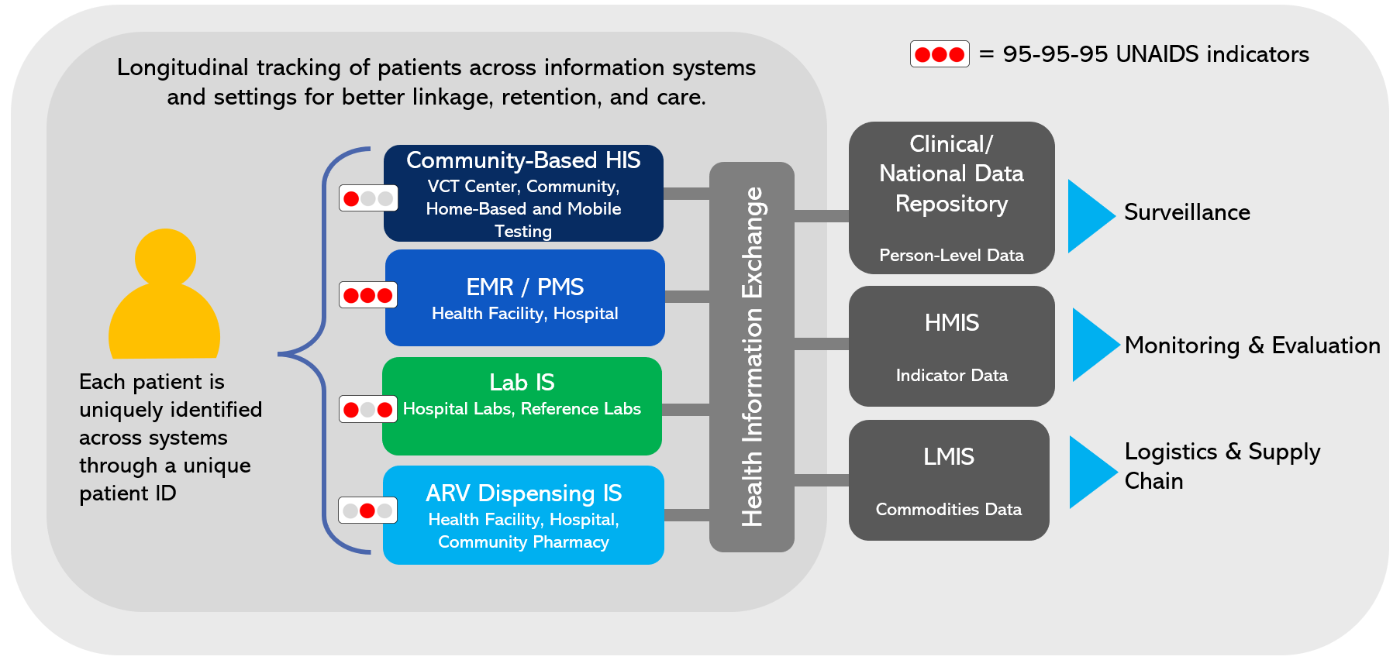
Person-Centric Interoperable Health Information Systems
LEGEND: ID=identifier, HIS=Health Information System, VCT=Voluntary Counseling and Testing, EMR=Electronic Medical Record, PMS=Patient Monitoring System, IS=Information System, HMIS=Health Management Information System, LMIS=Logistics Management Information System, Red and Grey Dots=95-95-95
Notes:
This is the where we need to be - supporting PEPFAR programs with patient care, reporting, surveillance, program monitoring and evaluation, and informed decisions and policies.

Slide 17
Key HIE Implementation Steps
Planning and need assessment: ICT gaps and regulatory to address security and privacy issues
Design and Development: Governance structure and technical architecture (system design and standards)
Implementation: ITC tool selection, system configuration for integration, and data migration
Testing and Training: System testing and user training
Go-Live: Piloting and deployment of the system
Post implementation support and maintenance: monitoring and improvement of the system

Slide 18
GROUP DISCUSSION
Health Information Exchange
Notes:
Slide templates to use as needed

Slide 19
Activity Objectives
Discuss the common challenges in planning and implementing workforce development in your country
Analyze the sustainable workforce development strategies
Identify priority areas and potential solutions to feed into the action plan that you will produce at the end of this week
Notes:
Use the three slides below (20 , 21 and 22) to prompt discussion amongst the participants.
The group should summarize key points as they will be providing feedback to the plenary after this breakout session (No more than 10 minutes of feedback!)
To ensure smooth and concise reporting back to the plenary:
Appoint a spokesperson in advance to share your group’s key points. This person should feel confident summarizing discussions clearly and keeping within the time limit (no more than 10 minutes).
Assign a note-taker or two at the start of the breakout to capture the main discussion points, decisions, and any action items.
Agree on the structure for feedback early – for example, 2–3 main themes, key challenges, and top recommendations.
Keep it concise and focused – highlight insights, commonalities, and differences rather than retelling the full discussion.

Slide 20
What OpenHIE component systems is your country using and what are the benefits and challenges of each of these components (challenges might be use case-specific)?
What is the current state of each component? (planning,testing, production)

Slide 21
What are the benefits and challenges your country has encountered with each of the following component systems?
Client registry
Terminology registry
Facility registry
Provider registry
Interoperability layer

Slide 22
What priority use cases are your countries exploring and how they tie to challenges?
What is the current state of each use case? (planning, testing, production)
Notes:
We may not need this slide as the use cases may organically come out when discussing challenges

Slide 23
Group Activity
List your component systems/the technology used
List the benefits and challenges of each component system
The group will prioritize 1-2 challenges
Develop strategies and a roadmap to address the challenges
Get ready to present the strategies and roadmap to the plenary group
Notes:
Introduction to Group Activity
Each country team to discuss and report specific challenges related to OpenHIE architectural components implementation by addressing the questions on the slides or the board.
Share the status of the Health Information Exchange or interoperability implementation.
This information generated from this discuss can be used to address your country priorities.

Slide 24
Feedback to plenary
To ensure smooth and concise reporting back to the plenary:
Appoint a spokesperson in advance to share your group’s key points. This person should feel confident summarizing discussions clearly and keeping within the time limit (no more than 10 minutes).
Assign a note-taker or two at the start of the breakout to capture the main discussion points, decisions, and any action items.
Agree on the structure for feedback early – for example, 2–3 main themes, key challenges, and top recommendations.
Keep it concise and focused – highlight insights, commonalities, and differences rather than retelling the full discussion.

