Slide 1
I-LEAD WORKSHOP
Facilitator Notes
This
This is the master slide deck for BREAK OUT SESSION - WORKSTREAM 2 – Informatics Health Policy and Governance - ON DAY TWO of the I-LEAD Workshop for facilitators. It is intended to make the process of preparing and conducting the workshop easier, and the decks are designed to be customizable to your context.
Make a copy of this deck to keep as a backup.
Throughout the deck you will see facilitator instructions written in red text on the slides. The intent is that you replace this text with relevant details specific to your workshop. You will also find instructions and helpful guidance in red text in the speaker notes, along with a more comprehensive explanation of the content on the slides.
The red text in the speaker notes should be removed when you are ready to share the final deck with the workshop participants.

Slide 2
DAY TWO BREAKOUT SESSION
WORKSTREAM 2
Informatics Health Policy and Governance
Notes:
// This session should take approximately 2 hours including a 20 minute tea/coffee break. //

Slide 3

Informatics-Savvy Health Organization (ISHO)
ISHO
Digital Health Governance
Data Governance
Cybersecurity
Policy and Governance
Skilled Workforce
Effective information systems

Slide 4





The governance process
Stakeholders Mapping
Define Objectives & Goals
Establish Governance Framework
  Governance Committee
  Roles Definition
  Collection & Storage
  Processing & Integration
  Interoperability
  Develop Policies
  Enforce Standards
  Ownership definition
  Participation
  Synergy
Planning & Strategy Development
Assigning Roles & Responsibility
Policy Creation & Enforcement
Collaboration
Data Management
Continuous Improvement
  ● Iterative Improvements ● Capacity Building

Slide 5
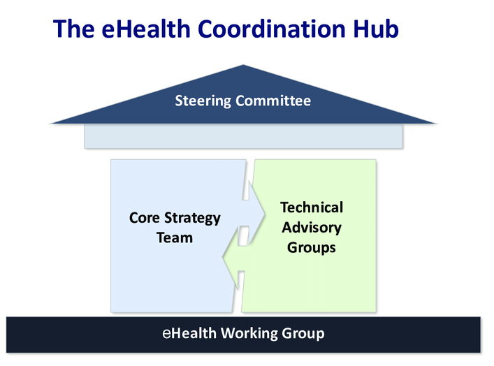
Background – Digital Health Governance
Digital health governance is the proper use of technology for improving the health and well-being of people at individual and population levels, as well as enhancing the care of patients through intelligent processing of clinical and genetic data.
It also involves the proper use of technology to ensure compliance with external standards set by government agencies, industry associations, and other stakeholders.

Slide 6
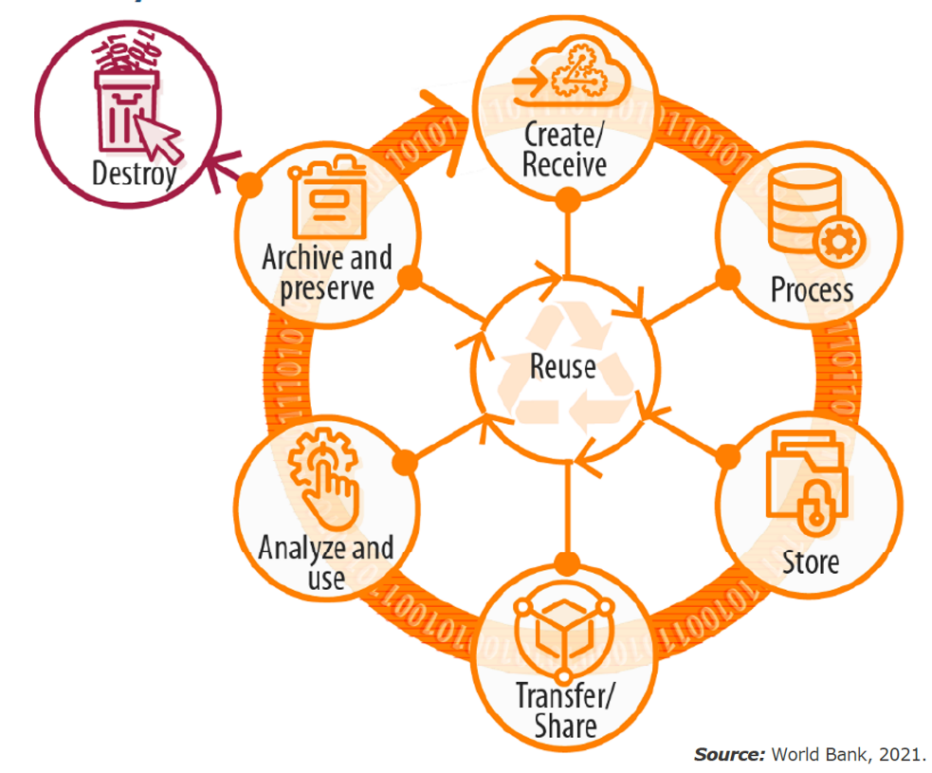
Background – Data Governance
Notes:
Data governance is a principled approach to managing data during its life cycle, from acquisition to use to disposal.
Data governance means setting internal standards (data policies) that apply to how data is generated, stored, processed, and disposed of.
It governs who can access what kinds of data and what kinds of data are under governance.
It also involves complying with external standards set by government agencies, industry associations, and other stakeholders.

Slide 7
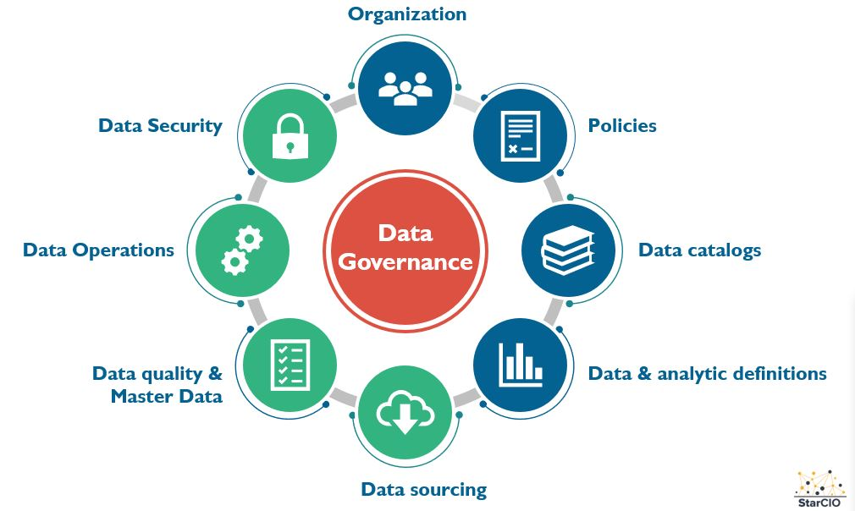
Key Components of Data Governance
Notes:
The strategic mechanism that connects these components is stakeholders’ engagement

Slide 8
Why Data Governance?
Reduced costs
Ownership and shared responsibility
Data-driven decision-making
Regulatory Compliance
Operational Efficiency
Improved data quality
Collaboration
Data security
Improved data management
Better decision-making

Slide 9
Where Data Governance Fits – Data Integration
  Governance defines standards for data formats, transformation rules, and approved data sources to ensure consistency and interoperability.
  Establishes data lineage tracking so it’s always clear where data came from and how it was altered.
  ETL (Extract, Transform, Load): Tools to extract data from various sources, transform it into a usable format, and load it into a central repository.
  Data Ingestion: Real-time or batch processing capabilities to bring in data from diverse sources such as databases, cloud storage, IoT devices, and APIs.

Slide 10
Where Data Governance Fits – Data Storage
  Data Warehouses: Centralized repositories designed for query and analysis, often optimized for read-heavy operations.
  Data Lakes: Storage systems that hold large amounts of raw data in its native format until needed for analysis.
  Databases: Traditional relational databases or NoSQL databases for specific data types and access patterns.
  Governance sets classification rules (e.g., public, internal, confidential) and determines where different types of data can be stored.
  Ensures storage complies with retention policies and legal requirements for jurisdiction-specific data hosting.

Slide 11
Where Data Governance Fits – Data Management
  Metadata Management: Tools for managing data about data, including data catalogs, lineage, and governance policies.
  Data Quality: Ensuring accuracy, completeness, and reliability of data through validation and cleansing processes.
  Master Data Management (MDM): Processes and tools to ensure the consistency and accuracy of key business data across the organization.
  Governance dictates metadata standards so all data assets are well-described, searchable, and traceable.
  Sets data quality metrics and validation processes, ensuring all teams use the same definitions and business rules.
  Defines MDM processes so there’s one trusted source of truth for critical data entities (e.g., patients, facilities).

Slide 12
Where Data Governance Fits – Analytics and Business Intelligence (BI)
  Data Analytics: Tools for statistical analysis, machine learning, and predictive modeling.
  Business Intelligence (BI): Dashboards, reporting tools, and visualization platforms to help end-users interpret data.
  Governance ensures that analytical outputs are based on trusted, approved datasets and that sensitive data is anonymized or aggregated where required.
  Sets usage guidelines for dashboards and reports to prevent misuse or misinterpretation of data.

Slide 13
Where Data Governance Fits – Data Sharing and Collaboration
  APIs and Data Feeds: Facilitating data sharing between systems and organizations.
  Collaboration Tools: Enabling multiple users to work together on data projects, share insights, and collaborate on data analysis.
  Governance defines data sharing agreements, licensing terms, and consent requirements before data leaves the organization.
  Sets interoperability standards for APIs and controls how external partners can use shared data.

Slide 14
Challenges Encountered
Interconnected policies and guidelines
Synergy between different stakeholders
Ownership (DPRS, NACA, NASCP other agencies)
Technology &
Data Security risks

Slide 15
Privacy, Confidentiality, and Cybersecurity in Public Health for Decision-Makers

Slide 16
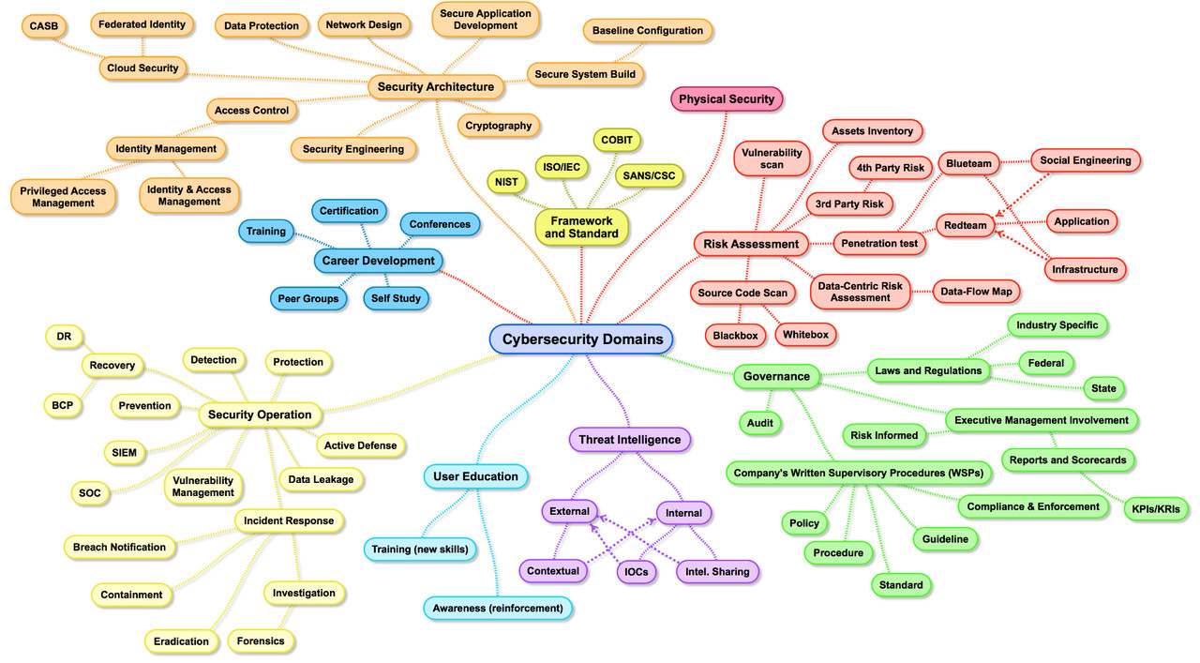

Notes:
Facilitator notes: Key takeaway from this slide is: This is a very complex subject – we are only going to touch on key areas for leaders. (Do not try and speak to all the points!!)

Slide 17
CIA triad
  Ensuring that information is not made available or disclosed to unauthorized individuals, entities, or processes
  Non-repudiation
  Subjects cannot deny creating, writing or modifying data, software, hardware, email, etc.
Data Confidentiality
DATA
Property of being accessible and usable upon demand by an authorized entity
  Protecting the accuracy and completeness of assets
Data Availability
Data Integrity
Access Control, Authentication, and Public Key Infrastructure
By Bill Ballad, Tricia Ballad, Erin Banks · 2010

Slide 18
People, Process, Technology
The Security of our Information; the Confidentiality, Integrity and Availability is provided by People, Process, and Technology
  People: Staff, customers, contractors, service providers, etc.
  Processes: Identity management, data handling, helpdesk queries, procurement, etc.
  Technology: Firewalls, anti-virus software, IDS, IPS, encryption, etc.
People
Processes
Technology

Slide 19

Why does cybersecurity matter for public health?
Healthcare is a top target for cyberattacks due to the sensitive personal data it holds.
Electronic medical records (EMRs) contain valuable PII that criminals exploit for identity theft and fraud.
IoT health devices (like remote monitors) are often poorly secured, making them easy targets.
Ransomware attacks are rising: hackers lock access to data and demand payment to release it.
Notes:
The global health sector is one of the most targeted industries for cyberattacks, especially as it has an immense amount of personal information in health records, while the criticality of health organizations provides leverage to ransomware attackers. - USAID, Digital Financial Services (DFS) - USAID cybersecurity sectoral briefs
Healthcare facilities collect and store large volumes of valuable data, including personally identifiable information (PII), which is a prime target for cyberattacks.
PII contained in electronic medical records is a prime target for cybercriminals, who use this data to facilitate other crimes.
Internet of Things (IoT) health devices are especially vulnerable to attacks. Design and manufacturing of many health IoT devices do not incorporate strong security, making them highly vulnerable to cyberattacks. For example, relatively cheap IoT devices can help doctors monitor patients’ vital signs remotely or facilitate telehealth services.
Attackers increasingly use ransomware to target this valuable data. In a ransomware attack, cyber criminals block victims’ access to their own data and will release it only if the victim pays a ransom.

Slide 20


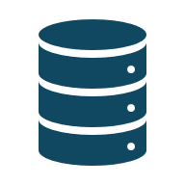
Different Risks for Health Data
The worst practices are observed in most establishments. Here are a few concrete examples:
Staff
No designated data security lead
  Unqualified individuals repair computers with sensitive data
  PII accessed without confidentiality agreements
  No regular training on privacy or security
Paper records
  ART registries left visible to visitors
  PII stored in unlocked drawers or rooms
  Staff take photos of files due to limited access
  Uncontrolled printouts and forms with full identifiers
Access control of databases
Shared EMR logins among multiple users
Passwords saved on shared devices
No routine account audits or permission updates
No tracking of suspicious activity (e.g., mass downloads)
Overly broad access—non-clinical staff can view health data
Notes:
The worst practices are observed in most establishments. Here are a few concrete examples:
Staff
Nobody is responsible for data security in most organizations
Use of local ICT “business centers” or friends to fix broken computers with PII on them
Allowing individuals to access PII without having signed a data confidentiality agreement
No routine training on data security or privacy protection best practice
Paper data
Leaving ART registries open and in plain sight of visitors
PII files not stored in locked drawers/rooms
Data entry staff photograph registries and files b/c they don’t have access during the workday
Ad hoc printouts not controlled or destroyed
Forms capture names as well as unique identifiers
Paper data
Leaving ART registries open and in plain sight of visitors
PII files not stored in locked drawers/rooms
Data entry staff photograph registries and files b/c they don’t have access during the workday
Ad hoc printouts not controlled or destroyed
Forms capture names as well as unique identifiers

Slide 21
Examples of Risks in Public Health
Data Breaches: Unauthorized access to patient records can lead to identity theft and fraud.
Ransomware Attacks: Malicious software encrypts files, disrupting hospital operations and patient care.
Medical Device Vulnerabilities: Exploitable weaknesses in connected devices may harm patients or disrupt healthcare services.
Supply Chain Attacks: Cyberattacks targeting suppliers can impact the availability and safety of essential healthcare supplies.
Phishing and Insider Threats: Deceptive tactics and internal vulnerabilities can compromise confidential information, affecting healthcare professionals and patients.

Slide 22
Other Risks: More Real Examples
Infrastructure
  Not using up-to-date or configured professional antivirus, anti-malware, firewalls
  Not encrypting EMR data
  Bring your Own Device or loose device management
  Use of personal unencrypted internet hotspots for internet access
  No remote wipe/remote lock on data collection devices
  Copying PII data set on mobile devices without encryption (oops, USB lost with all PLHIVs on ART)
  Sharing unencrypted PII data via email or personal cloud accounts
  No backing-up data, other than the back-up on the same computer
  No SSL on web-based databases
Software development & maintenance environments
  Need testing, QA, and (ideally) IV&V to find security vulnerabilities before deployment
  Build in privacy protections into software requirements - such as siloing of data, audit trails, access and usage flags, and validation requirements
  Test servers, backups and test data protected as much as production environments
Sustainability
  After POP, database of PII is handed to an entity (NGO or government) with insufficient capacity to maintain

Slide 23
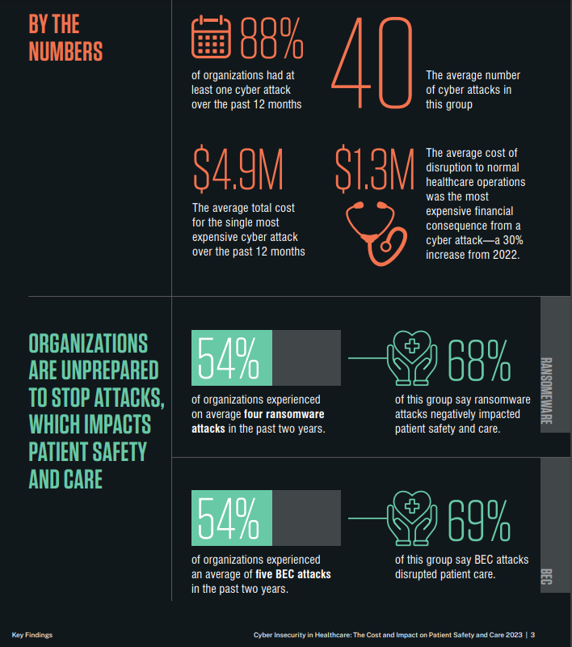
Cybercrime Can Kill Patients
According to a recent survey of IT security professionals in the healthcare industry, 54 percent responded that cyberattacks against their organizations had resulted in an increase in severity of patient illnesses, and 23 percent said that these attacks had increased mortality rates. https://www.proofpoint.com/sites/default/files/threat-reports/pfpt-us-tr-cyber-insecurity-healthcare-ponemon-report.pdf

Slide 24
Cybersecurity Frameworks, Regulations and Standards

Slide 25
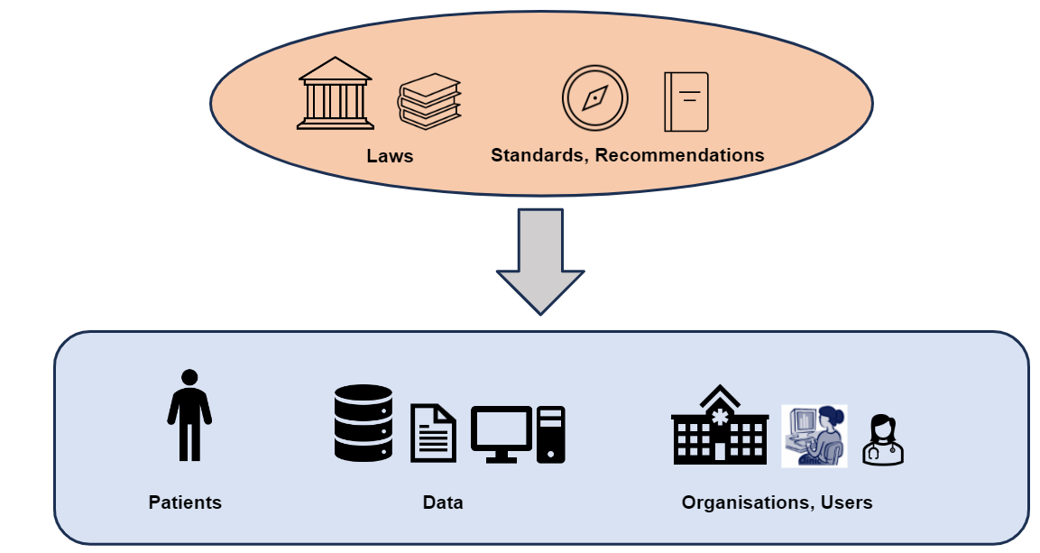
Regulations and Standards – their importance

Slide 26
Examples of regulations, standards and guidelines
General Data Protection Regulation (GDPR) European Union
International Organization for Standardization
27002; 27799
(ISO)
Interim Guidelines on
protecting the confidentiality and security of HIV information
(UNAIDS - PEPFAR)
Open Worldwide Application Security Project
(OWASP)
International
Health Insurance Portability and Accountability Act
(HIPAA)
USA
Clarifying Lawful Overseas Use of Data Act
(CLOUD Act)
USA
National Institute of Standards and Technology (NIST) cybersecurity framework
USA
Cybersecurity Maturity Model Certification
DOD - USA
(CMMC)
National
Protection Of Personal Information Act
(POPI Act)
South Africa
Data Protection Regulation
Nigeria
Cyber and Data Protection Act, 2021
Zimbabwe
Customize this slide: Add your country specific information here
Notes:
Facilitator note : add examples relevant to your country here

Slide 27
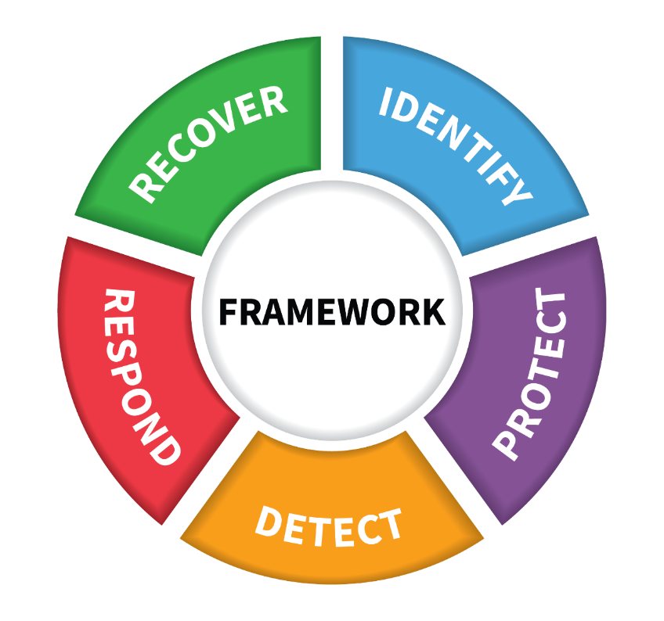
Why regulations and frameworks?
Cybersecurity regulation functions
www.nist.gov
PRIVACY, CONFIDENTIALITY, AND SECURITY IN PUBLIC HEALTH | MODULE 2: REGULATIONS AND FRAMEWORKS

Slide 28
The role of leaders/decision makers in cybersecurity governance and risk management

Slide 29
The role of leaders in cybersecurity governance and risk management
5
1
Risk Assessment and Management
Setting the Cybersecurity Vision
6
Risk Mitigation and Controls Implementation
2
Establishing Cybersecurity Governance Structure
Incident Response Preparedness
7
3
Allocating Resources and Budgets
8
Promoting a Security-Aware Culture
Ensuring Regulatory Compliance
4
9
Staying Abreast of Cyber Threats

Slide 30




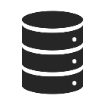

Building a Cybersecurity Culture
Leadership Support
Involvement of IT and Security Teams
06
Rewarding Secure Behaviors
Education and Training
01
Leading by Example
Clear Policies and Guidelines
05
Continuous Improvement
Regular Reminders
Integration into Onboarding
02
Engaging Communication
04
Reporting Channels
Gamification
03
Measurement and Metrics
Phishing Simulations

Slide 31










Training employees to recognize and respond to cyber threats
Cybersecurity Awareness Training
Multi-Factor Authentication (MFA):
01
02
10
Identifying Phishing Attacks
Safe Web Browsing
03
09
Mobile Device Security
Social Engineering Awareness
Reporting Procedures
Safe Email Practices
04
08
Incident Response Training
Password Security
Social Media Security
Physical Security Awareness
05
07
06

Slide 32
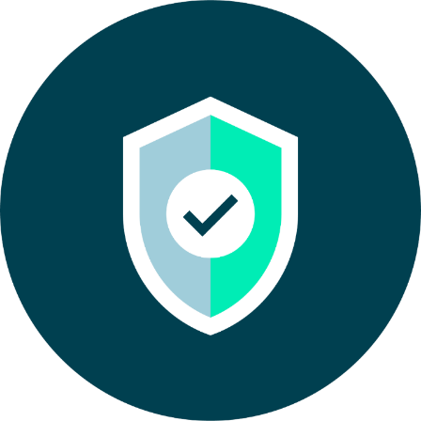
As a leader…
The role of leaders in establishing cybersecurity governance structures
Monitoring and measuring cybersecurity performance and risk metrics
Ensuring compliance with relevant data protection and privacy regulations
Navigating cybersecurity challenges in cloud computing, IoT, and AI adoption
Balancing security and innovation in digital transformation initiatives
Incorporating cybersecurity in the design of new digital products and services
Understanding the cost of cyberattacks and the value of cybersecurity investment
Advocating for adequate cybersecurity budgets and resource allocation
Evaluating the ROI of cybersecurity initiatives
Assessing the cybersecurity posture of vendors and partners
Implementing third-party risk management strategies
Minimizing cyber threats arising from the supply chain

Slide 33
Activity Objectives
Discuss the common challenges in planning and implementing for data governance and cybersecurity in your country
Analyze the sustainable strategies to address these
Identify priority areas and potential solutions to feed into the action plan that you will produce at the end of this week
Prepare to give short feedback to the plenary after this session
Notes:
Participants to identify key gaps / challenges and draft a roadmap for 1-2 priority areas to input to the action plan - to feedback to the plenary for a 10 minute feedback session
The group should summarize key points as they will be providing feedback to the plenary after this breakout session (No more than 10 minutes of feedback!)
To ensure smooth and concise reporting back to the plenary:
Appoint a spokesperson in advance to share your group’s key points. This person should feel confident summarising discussions clearly and keeping within the time limit (no more than 10 minutes).
Assign a note-taker or two at the start of the breakout to capture the main discussion points, decisions, and any action items.
Agree on the structure for feedback early – for example, 2–3 main themes, key challenges, and top recommendations.
Keep it concise and focused – highlight insights, commonalities, and differences rather than retelling the full discussion.

Slide 34
Feedback to plenary
To ensure smooth and concise reporting back to the plenary:
Appoint a spokesperson in advance to share your group’s key points. This person should feel confident summarizing discussions clearly and keeping within the time limit (no more than 10 minutes).
Assign a note-taker or two at the start of the breakout to capture the main discussion points, decisions, and any action items.
Agree on the structure for feedback early – for example, 2–3 main themes, key challenges, and top recommendations.
Keep it concise and focused – highlight insights, commonalities, and differences rather than retelling the full discussion.

