Slide 1
I-LEAD WORKSHOP Facilitator Notes
This
This is the master slide deck for BREAK OUT SESSION - WORKSTREAM 3 WORKFORCE ON DAY TWO of the I-LEAD Workshop for facilitators. It is intended to make the process of preparing and conducting the workshop easier, and the decks are designed to be customizable to your context.
Make a copy of this deck to keep as a backup.
Throughout the deck you will see facilitator instructions written in red text on the slides. The intent is that you replace this text with relevant details specific to your workshop. You will also find instructions and helpful guidance in red text in the speaker notes, along with a more comprehensive explanation of the content on the slides.
The red text in the speaker notes should be removed when you are ready to share the final deck with the workshop participants.

Slide 2
Day Two Breakout Session
Workstream 3: Workforce
Notes:
// This session should take approximately 2 hours including a 20 minute tea/coffee break. It consists of a short introduction – 5 to 10 minutes - and then the majority of the time is allocated to an activity/ Ensure that the group has a note taker and someone who will present back to the plenary – max 10 minutes. //

Slide 3

He who has a “why” to live can bear any “how.”
Friedrich Nietzsche

Slide 4
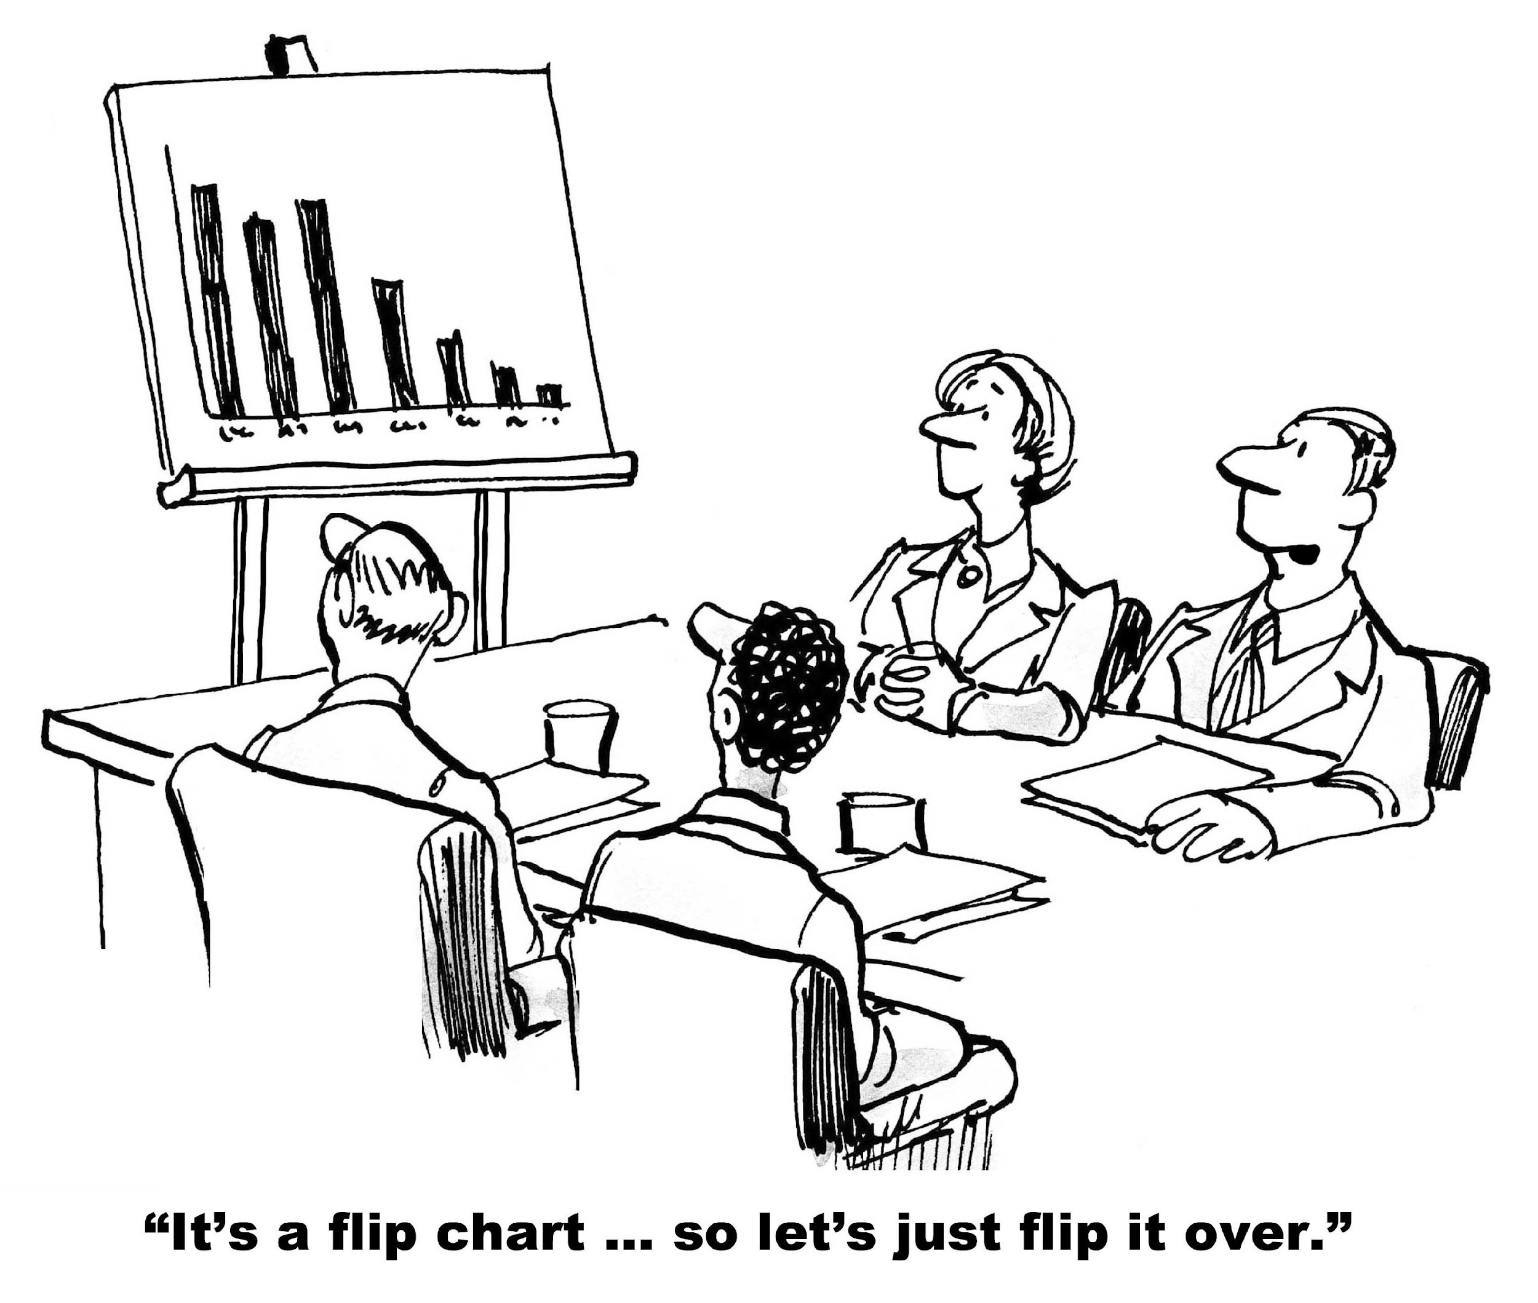
Why are you here?

Slide 5
Capability and Capacity Cycle
WHAT YOU HAVE
Emergent combination of attributes that enable an organization to solve informatics problems and create value from its information resources
enables development of
Capability
Capacity
WHAT YOU CAN DO WITH WHAT YOU HAVE
The extent to which an organization can adapt to change, generate new knowledge, and continuously improve performance as it creates value from information resources to improve population health
enables demonstration of

Slide 6
Systemic Capacity Building Pyramid
Capacity is multidimensional (hierarchy of needs)
Performance Capacity
enable effective use of
Tools
Personal Capacity
require
Skills
enable effective use of
require
Facility Capacity
Workload Capacity
Staff and Infrastructure
enable effective use of
supports
require
supports
Structures, Systems and Roles
Supervisory Capacity
Support Service Capacity
Structural Capacity
Role Capacity
Systems Capacity
Adapted from Potter and Brough, Systemic capacity building: a hierarchy of needs. Health Policy and Planning, 2004.
Notes:
Note the dependencies

Slide 7
Future State: Informatics Savvy Health Organization
1
Governance, Leadership, Policy Development
2
3
Effective Health Information Systems
Competent Workforce
Informatics Capacity Problem: A recognized gap between a current state and a future state
Current State: Gaps, Challenges, Resource Constraints

Slide 8
Vision, Strategy, Operations, Tactics (VSOT)
VISION
STRATEGY
OPERATIONS
TACTICS
Shared mental picture of end state
EXAMPLE
Change agents working effectively together to solve an [e-health capacity challenge] (fill in the blank)
Logic (first level of detail) for achieving the vision
EXAMPLE
I-LEAD: Inter-governmental learning and knowledge exchange, collaborative problem solving and strategy development
Programmatic execution of strategies
EXAMPLE
I-LEAD workshop
Technical Assistance TDY
Web-based Virtual Conferences
GEEKS Program Implementation
Very detailed, more visible, coordinated actions linked to budgets, timetables, roles, responsibilities (project plans)
EXAMPLE: ILEAD workshop
Organized sessions and rooms
Expert speakers and lectures
Group discussions
Games and other learning activities
Timetable
I-LEAD prep team
Based on Baker, Edward L., and Stephen N. Orton. "Practicing management and leadership: Vision, strategy, operations, and tactics." Journal of Public Health Management and Practice 16.5 (2010): 470-471.
Notes:
Why you need to start with the vision is because you need to develop strategies, then operations and tactics to ensure that your project will be a success!

Slide 9
“We spend more time shoveling coal than steering the ship. We want to shift our energy to looking at the data and navigating where we are going.”
- Robert Kagarise, Director of Population Health Informatics and IT for the Delaware Valley Accountable Care Organization

Slide 10
Vision, Strategy, Operations, Tactics (VSOT)
VISION
STRATEGY
OPERATIONS
TACTICS
Shared mental picture of end state
EXAMPLE
Change agents working effectively together to solve an [e-health capacity challenge] (fill in the blank)
Logic (first level of detail) for achieving the vision
EXAMPLE
I-LEAD: Inter-governmental learning and knowledge exchange, collaborative problem solving and strategy development
Programmatic execution of strategies
EXAMPLE
I-LEAD workshop
Technical Assistance TDY
Web-based Virtual Conferences
GEEKS Program Implementation
Very detailed, more visible, coordinated actions linked to budgets, timetables, roles, responsibilities (project plans)
EXAMPLE: I-LEAD workshop
Organized sessions and rooms
Expert speakers and lectures
Group discussions
Games and other learning activities
Timetable
I-LEAD prep team
Based on Baker, Edward L., and Stephen N. Orton. "Practicing management and leadership: Vision, strategy, operations, and tactics." Journal of Public Health Management and Practice 16.5 (2010): 470-471.
Notes:
Why you need to start with the vision is because you need to develop strategies, then operations and tactics to ensure that your project will be a success!

Slide 11

As we start increasing our levels of expertise in informatics problem solving…
A little knowledge that acts is worth more than much knowledge that is idle.
Kahlil Gibran, “The Prophet”

Slide 12



Group Activity
Developing and Sustaining Digital Health Workforce in LMICs – Day 2 WFD Track

Slide 13
Activity Objectives
Discuss the common challenges in planning and implementing workforce development in your country
Analyze the sustainable workforce development strategies
Identify priority areas and potential solutions to feed into the action plan that you will produce at the end of this week

Slide 14
Feedback to plenary
To ensure smooth and concise reporting back to the plenary:
Appoint a spokesperson in advance to share your group’s key points. This person should feel confident summarizing discussions clearly and keeping within the time limit (no more than 10 minutes).
Assign a note-taker or two at the start of the breakout to capture the main discussion points, decisions, and any action items.
Agree on the structure for feedback early – for example, 2–3 main themes, key challenges, and top recommendations.
Keep it concise and focused – highlight insights, commonalities, and differences rather than retelling the full discussion.

Slide 15
Station Rotation and “Core Themes”
Station 1: WFD strategies and their value
  Q: What are the key WFD strategies that should be implemented? Indicate the value/s of the strategies you discuss.
Station 2: Challenges in WFD
  Q: what are the main challenges in WFD in your country.
Station 3: Sustaining WFD activities
  Q: How can the WFD activities can be sustained in your setting
Station 4: Measuring value of the WFD activities
  Q: How can we measure the value of WFD activities in your country?
Station 1
Station 4
Station 2
Station 3

Slide 16
Session outline
Introduction to the session (5 mins)
  Station 1: WFD strategies and their value
  Station 2: Challenges in WFD
  Station 3: Sustaining WFD activities
  Station 4: Measuring value of the WFD activities
  Round 1 (10 mins)
  Round 2 (10 mins)
  Round 3 (5 mins)
  Round 4 (5 mins)
  Review round (10 mins)
  Extra Round (Newspaper Headline) 10 mins
Discussion and Reflection ( 30 minutes)
Notes:
Round 1 (10 mins), have the groups brainstorm around the station prompts, and record on flipcharts.
Round 2 (10 mins), the groups rotate to the next station, review the previous group’s inputs, then add to those inputs.
Round 3 (5 mins), the groups rotate to the next station, review the previous group’s inputs, then add to those inputs.
Round 4 (5 mins), the groups rotate to the next station, review the previous group’s inputs, then add to those inputs.
Review round (10 mins) The groups rotate to their original station and review the other groups’ inputs. Then, they prepare a brief summary to present.
Extra Round – Newspaper Headline (10 mins) If there is time in the agenda, each group will create 1-2 newspaper headlines of what would happen if one of the inputs was implemented or not addressed as part of the summary presentation.
Discussion and Reflection (30 mins) – Summary presentation, discussion and reflection

Slide 17
Feedback to plenary discussion
To ensure smooth and concise reporting back to the plenary:
Agree on the structure for feedback early – for example, 2–3 main themes, key challenges, and top recommendations.
Keep it concise and focused – highlight insights, commonalities, and differences rather than retelling the full discussion.

