Slide 1
I-LEAD WORKSHOP
Facilitator Notes
This
This is the master slide deck for DAY THREE of the I-LEAD Workshop for facilitators. It is intended to make the process of preparing and conducting the workshop easier, and the decks are designed to be customizable to your context.
Make a copy of this deck to keep as a backup.
Throughout the deck you will see facilitator instructions written in red text on the slides. The intent is that you replace this text with relevant details specific to your workshop. You will also find instructions and helpful guidance in red text in the speaker notes, along with a more comprehensive explanation of the content on the slides.
The red text in the speaker notes should be removed when you are ready to share the final deck with the workshop participants.

Slide 2
WELCOME TO THE
I-LEAD WORKSHOP – DAY THREE
Month Day Year // update to correct date//
WIFI: // add wifi details //
Password: // add wifi password//

Slide 3
AGENDA
Time | Session description | Duration (minutes)
9am | Welcome and housekeeping | 10
9.10am | Draw Toast activity | 30
9.40am | Current to future state: Strategy development and execution | 45
10.30am | TEA / COFFEE | 20
10.50am | Current to future state: breakout activity and feedback | 100
12.30pm | LUNCH | 60
1.30pm | Data Use for Decision Making | 30
2pm | Health Information Exchange: Supporting a Unified Data Ecosystem for System Strengthening | 45
2.45pm | TEA / COFFEE | 15
3.00pm | National Data Repositories: Supporting Country-owned Real-World Data (RWD) Systems | 60
3.30pm | Policy, Process, and Design of Data Integration and Data Sharing Agreement and Data Protection | 30
4pm | Day Three reflections and wrap-up | 20

Slide 4
I-LEAD Roadmap – Daily Outputs
Day 1
  ISHO rapid assessment review and country presentation initiation
Day 2
  Prioritized lists of gaps & opportunities for capacity strengthening across the 3WS
Day 3
  Documented key problem(s) and process for addressing them
Day 4
  Documented list of solution options
  ranked according to country priorities
Day 5
  Documented high-level action plan
Notes:
The aim of this I-LEAD workshop is to help you, as key stakeholders in digital health in our country, develop a high-level action plan for designing or adapting your digital health ecosystem and implementing sustainable digital health systems to scale.
Throughout this week the content presented and activities facilitated will help you – as multi-disciplinary teams – to develop and implement skills that will enable you to efficiently and effectively plan your digital health system ecosystem and implement sustainable digital health interventions.
Today's activity (DAY 1) will focus on helping you reflect on where you, as a country, are with digital health readiness using the ISHO rapid assessment framework and the data you have gathered in preparation for this workshop.

Slide 5
I-LEAD Roadmap – Daily Inputs and Outputs
Achieve consensus on maturity levels (strengths and gaps) based on ISHO framework pillars; Collaboratively identify country priorities & develop country presentation
Pre
I-LEAD
Learning Inputs
Informatics Savvy Health Organization (ISHO) and Assessment
Country ISHO presentation and discussion
Country I-LEAD slide deck initiation
Informatics Problem Solving (Thinking Hats, Systems Thinking)
Marshmallow Challenge (Design Thinking)
Workstream Breakout Sessions per ISHO pillar
Draw Toast - Process for definition of current state to future state
Data use for decision making and a unified a data ecosystem
Data sharing and protection
I-LEAD slide deck presentation
Action plans and next steps
Jeopardy Game
Communities of Practice (HELINA, RECAINSA, AeHIN)
Day 1
Day 2
Day 3
Day 4
Day 5
Planning and Decision-Making Process (PDMP)
Value Claims of Digital Health Systems
I-LEAD slide deck development
I-LEAD
Country Outputs
  Agreed Rapid ISHO and country
  I-LEAD slide deck initiation
  Prioritized lists of gaps & opportunities for capacity strengthening across the 3WS
  Documented key problem(s) and process for addressing them
  Documented list of solution options
  ranked according to country priorities
  Complete I-LEAD slide deck, action plan and next steps
Post
I-LEAD
Prioritize strategies for PHI advancement; Apply frameworks that have been used at I-LEAD; Champion data modernization; Implement strategies as projects
Notes:
The I-LEAD process has three phases: Slide focused on Phase 2
Phase 1: pre workshop preparations start with an live virtual introductory session for future participants which focuses on establishing what information/data required to complete the ISHO rapid assessment during Day 1 of the workshop and why, when and how this data will be gathered pre workshop.
Phase 2: the I-LEAD workshop itself – of which you are a participant. On DAY 1 of the workshop you will focus on carrying out a rapid ISHO assessment using the data / information that you have all collected about digital health readiness in your various areas of work. The workshop facilitators are here to help you as you work through this process. DAYS 2-5 of the workshop will provide you with skills, and time to test them out through groups activities, that will allow you as a multi-disciplinary group to develop a high level action plan for implementing a strong digital ecosystem comprised on sustainable digital health systems implemented to scale.
Phase 3:

Slide 6
Learning Objectives – Day 3
By the end of today’s sessions, the participants should be able to:
Describe the concepts of current state vs future state
Describe the importance of using health data for decision-making
Describe what is meant by a Unified Data System
Output for Day 3: Documented key problem(s) and process for addressing them
Notes:
Day 3 Output: Documented key problem(s) and process for addressing them

Slide 7
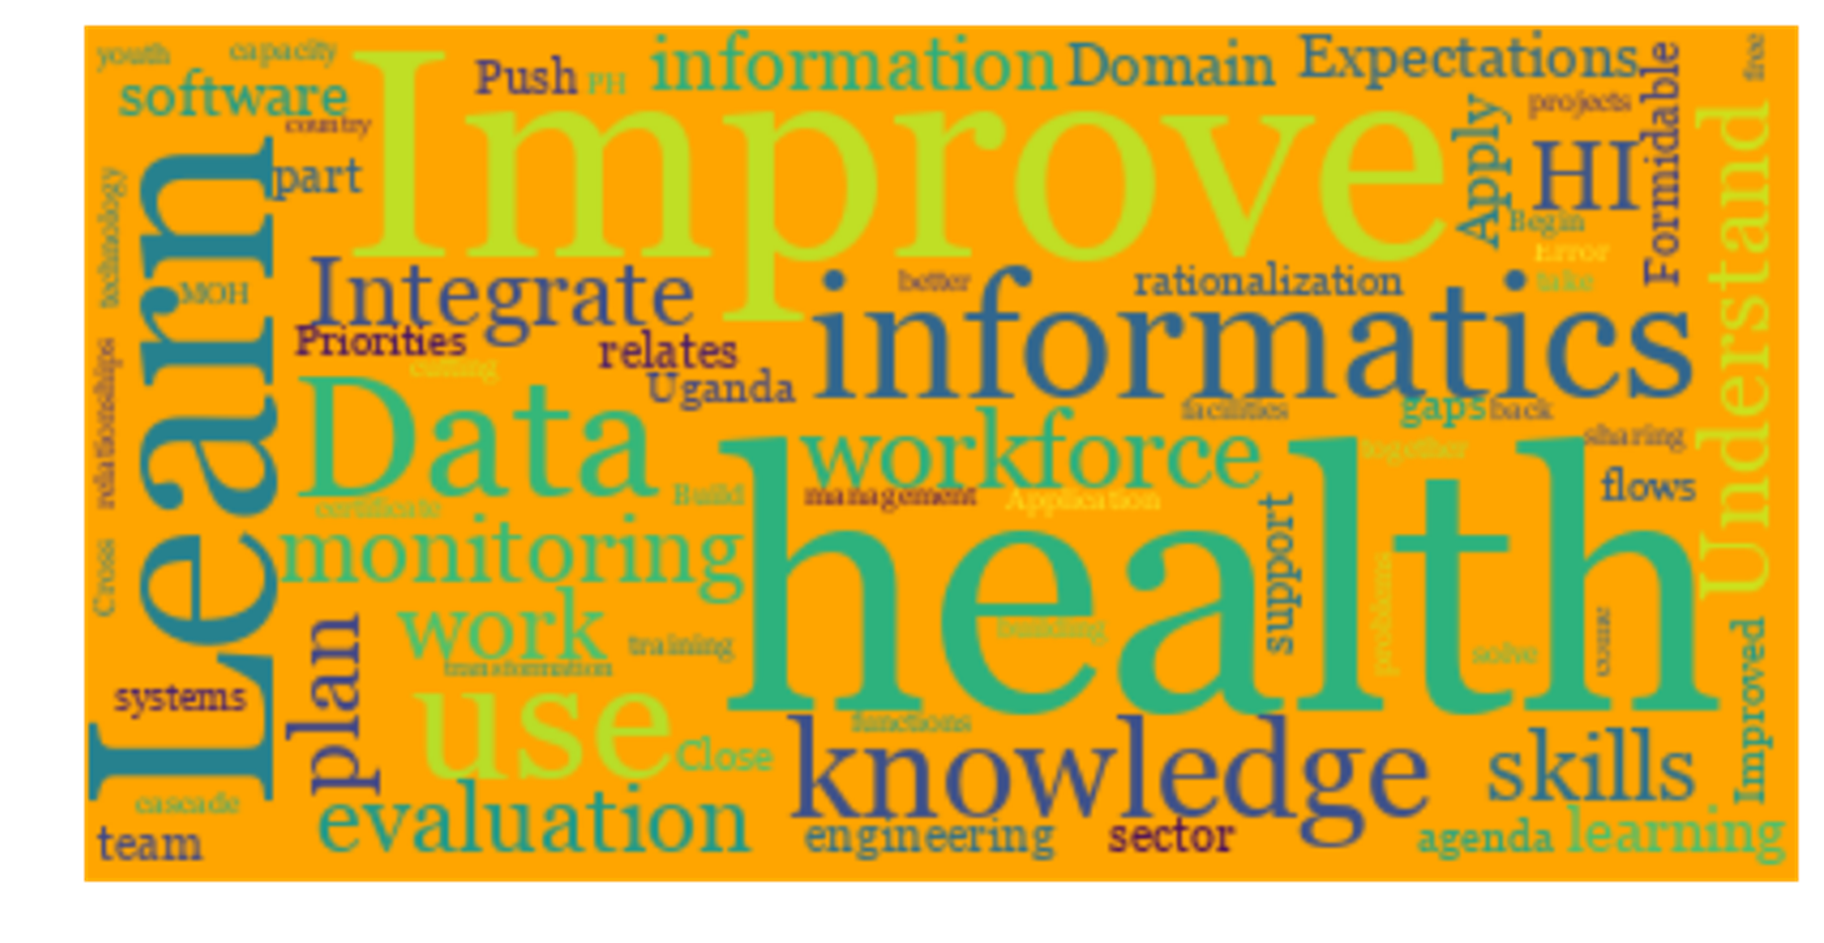
Draw Toast https://www.youtube.com/watch?v=_vS_b7cJn2A
Notes:
Refer to Drwa Toast Guide and process in appendix at the end of this presentation
// Video is approximately 9 minutes long - provides another 20 minutes afterwards for the activity.
You will need to provide participants with paper and pens or markers //
Source: http://www.drawtoast.com/
Activity: “Draw a Day in Your System”
Objective: Help participants recognize complexity, interconnections, and feedback loops in everyday processes.
Instructions:
Choose a process: Ask participants to pick a simple daily task (e.g., making tea, commuting to work, or preparing a report).
Draw it: On a blank sheet, draw all the steps and elements involved in that process. Encourage them to include:
People or roles involved
Tools, resources, or information flows
Decisions or feedback loops
Identify interactions: Ask participants to highlight where steps influence each other, create bottlenecks, or depend on external factors.
Share & discuss: In small groups, have participants share their drawings. Facilitate discussion around:
Surprising interconnections
Points of fragility or delay
Opportunities to improve the system
Time: 20 minutes
Tip: Emphasize that there’s no “right” drawing—it’s about seeing complexity and relationships, not creating an artistic masterpiece.
As an alternative, here is a more light-hearted activity:
Activity: “Crazy Coffee System”
Objective: Explore complexity and interconnections in everyday processes in a fun, light-hearted way.
Instructions:
Pick a task: Ask participants to choose a simple daily task (e.g., making coffee, sending a WhatsApp message, or getting to work).
Draw it, exaggerated: Spend 3–4 minutes drawing the process—but encourage humor and exaggeration! Add unexpected “obstacles” like a cat stealing the coffee, a missing pen, or Wi-Fi going down.
Connect the dots: Quickly draw arrows showing how each step, person, or tool affects the others. Highlight funny or surprising dependencies.
Share the quirks: In pairs or small groups, each participant shares the funniest or most surprising connection in their drawing.
Time: 20 minutes total (4 min drawing, 3 min connecting, 3 min sharing).
Key takeaway: Systems thinking isn’t just about serious diagrams—recognizing interconnections, feedback loops, and bottlenecks can be playful and insightful.

Slide 8
Key Takeaways
Even simple tasks involve multiple interconnected steps, people, and tools.
Small changes in one part of a system can create ripple effects elsewhere.
Bottlenecks, dependencies, and feedback loops are often hidden until you visualize them.
Humor and exaggeration can help reveal overlooked connections and make learning memorable.
Systems thinking encourages seeing the “whole picture” rather than focusing on individual parts.

Slide 9
Current State to Future State
Strategy Development and Execution

Slide 10

Strategy development and execution is iterative system design and problem solving.
Problem solving is about narrowing the recognized gap between what is (current state) and what could be (future state, vision).
The process of narrowing the gap is iterative and requires systems, evaluation, design, and strategic (SEDS) thinking.

Slide 11

Current State to Future State: I-LEAD Broad Strokes
PROBLEM SOLVING
CURRENT STATE
FUTURE STATE
…a systematic (step-by-step, logical) approach to bridge the gap between current state to future state.

Slide 12
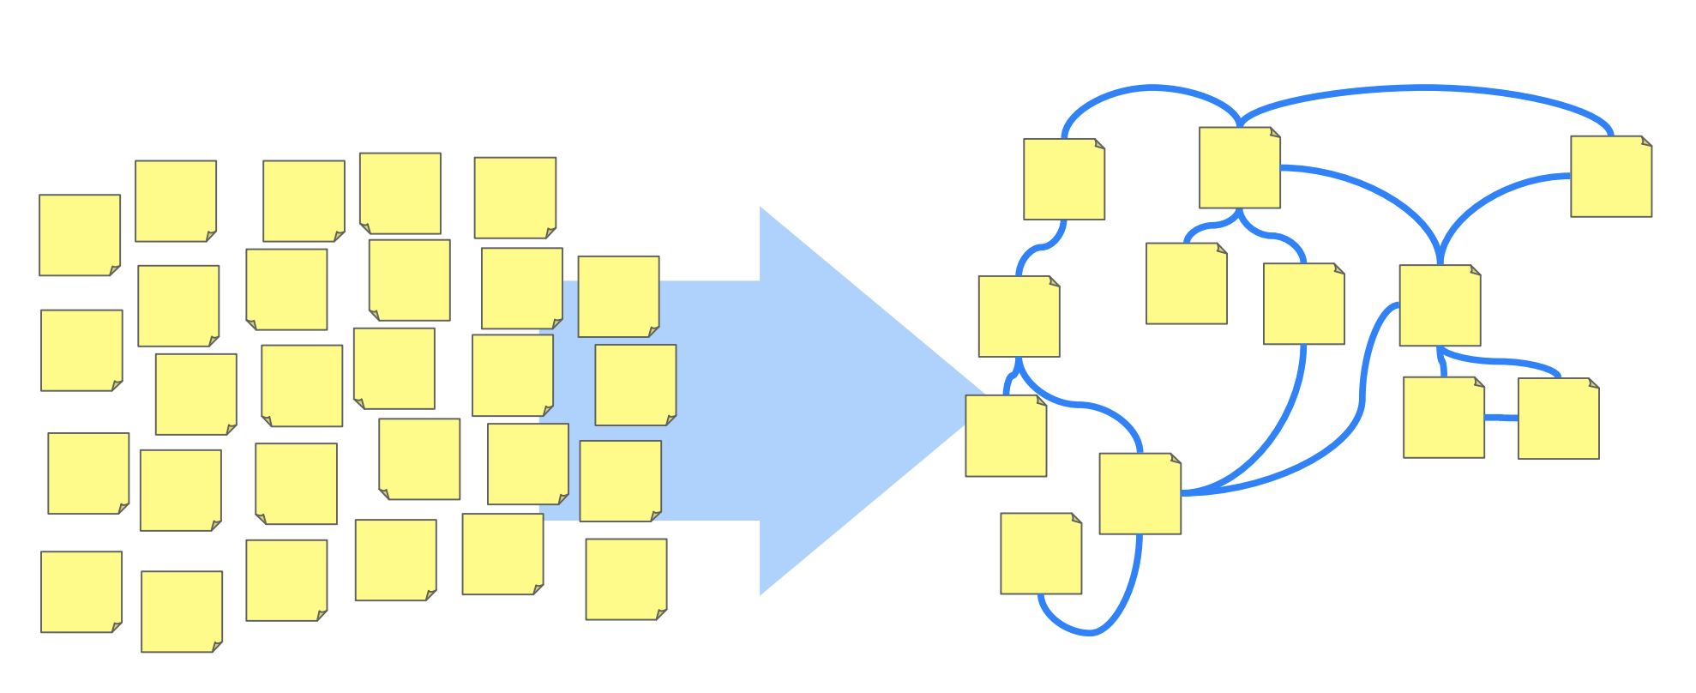
4 P’s of Strategy (Mintzberg)
Plan
Pattern
Position
Perspective
Intended Courses of Action (COAs) to deal with a situation
Purposeful action (Drucker, 1974), Design for action (Moore, 1959)
Military – Design of engagements (battles) to win a war (many battles [projects])
Ploys (the other P)– deception, misdirection
Game theory – choices player makes in every possible situation (alternative futures)
Management – Unified, comprehensive, integrated plan
Greek, strategos – “the art of the army general”
Deliberate strategy (intended strategy)
Sticky Note Ninja
Mintzberg, Henry. "The strategy concept I: Five Ps for strategy." California Management Review 30.1 (1987): 11-24.

Slide 13
Group work for PLAN
Brainstorm on priority (top 3) goals based on ISHO gaps, shared priority goals
  Can expand this exercise to other goals later in-country
Design Courses of Action (COA) as sequence of steps, pathways, process sticky notes
  Start with current state gaps
  COA should lead to a value claim (metrics and measures to be developed)
  Create milestones – indicators for achieving value claim (3, 6, 9 months for 1 year then expand to 2, 3 years)
  If difficult decision to be made with a few COAs, use PDMP

Slide 14
4 P’s of Strategy (Mintzberg)
Plan
Pattern
Position
Perspective
Pattern in a stream of actions, consistency in behavior
Successful approaches merging into a pattern of action (I-LEAD and GEEKS)
Emergent strategy (realized strategy)
“What is tactical today may be strategic tomorrow”
Realized strategy
Unrealized strategy
Deliberate (intended) strategy
Successful patterns of action
Emergent strategy
Mintzberg, Henry. "The strategy concept I: Five Ps for strategy." California Management Review 30.1 (1987): 11-24.

Slide 15
Group Work: Questions for PATTERN
What activity or activities is/are currently successful or providing a “level of value”?
What other activity or activities might be related to this?
Are there conflicts or synergies between these activities? (Types of Fit).
What developments or trends should we watch out for that will negatively or positively impact these activities? How do we respond to these developments or trends (think control or influence)?

Slide 16
Deliberate strategy vs. emergent strategy
No plan of operations extends with certainty beyond the first encounter with the enemy’s main strength.
– Moltke, the Elder (1800-1891, German Field Marshall)
Notes:
Winston Churchill (1874 — 1965): “Plans are of little importance, but planning is essential.”
Dwight D. Eisenhower (1890 — 1969): “Plans are worthless, but planning is everything.”

Slide 17
4 P’s of Strategy (Mintzberg)
Plan
Pattern
Position
Perspective
Locating an organization (or system) in an “environment” (ecosystem, domain)
Strategy as a mediating (matching) force between organization and environment
Occupying the “niche” generates value (returns from positioning in a domain)
An organization’s choice of “niche” and its decision rules to cope with that “niche”
Chess – revealed in opening moves
E-health architecture
Beyond competition – collective strategy among organizations
Group Work: Collaborative Positioning
Mintzberg, Henry. "The strategy concept I: Five Ps for strategy." California Management Review 30.1 (1987): 11-24.

Slide 18
4 P’s of Strategy (Mintzberg)
Plan
Pattern
Position
Perspective
An organization’s ingrained perception of the world
What personality is to an individual – a Google or Apple (pacesetters), an IBM (marketing and ideology - Watson), a McDonald’s (productive efficiency)
Commitment to ways of acting and responding, driving force
Psychologists: mental frame or cognitive structure
Anthropologists: Culture
Sociologists: Ideology
Kuhn: Paradigm of a community
Perspective is shared, collective mind
Group Work: Conversation on team “personality”, “perspective(s)”
Mintzberg, Henry. "The strategy concept I: Five Ps for strategy." California Management Review 30.1 (1987): 11-24.

Slide 19
Strategic Thinking as “Seeing” (Mintzberg)
Seeing ahead (vision for the future, foresight)
Seeing behind (hindsight)
Seeing above (big picture, forest)
Seeing below (trees, forest from below)
Seeing beside (lateral thinking, creativity in the present)
Seeing beyond (creating the future yet to unfold, disruption)
…and seeing it through.
Mintzberg H (2018). Strategic Thinking as Seeing. URL: http://www.mintzberg.org/blog/strategic-thinking-as-seeing.

Slide 20
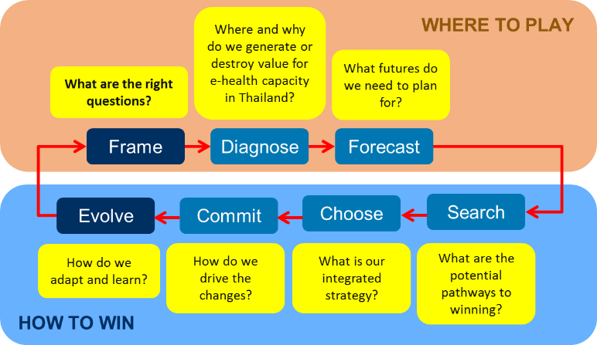
Strategy Development Questions – Where to Play, How to Win
Country X?
Adapted from Chris Bradley, Angus Dawson, and Antoine Montard. Mastering the Building Blocks of Strategy. McKinsey Digital, 2013. URL: http://www.mckinsey.com/business-functions/strategy-and-corporate-finance/our-insights/mastering-the-building-blocks-of-strategy

Slide 21

Strategies take on
value only as
committed people
infuse them
with energy.
Philip Selznick, sociologist

Slide 22
Strategic Planning Produces 2 Things
Positions on strategic factors that deliver value to key stakeholders and enable achievement of organizational objectives
Projects and programs (systems of interrelated activities) that will concretely achieve these objectives
Strategic Factor: What stakeholders (we) from “want” (benefit, value) from a relationship with an organization (them) – “wants” are bidirectional (requires systems and design thinking [empathy, walking a mile in other people’s shoes]).
Kenny, Graham (2018). 6 steps to make your strategic plan really strategic. URL: https://hbr.org/2018/08/6-steps-to-make-your-strategic-plan-really-strategic

Slide 23
Examples of Positions and Strategic Factors – Organization A (MOH)
Strategic Factor (Want) | Financial and technical support for scaling up and increasing effective use of national EMR (*)
Value of Strategic Factor | Key to achieving vision of health record for every citizen
Related Goals | Increase visibility of national EMR through data use Develop e-health workforce capacity
Resources controlled | Human resources to advance effective use of EMR in health facilities Develop e-health workforce capacity to support e-health development and implementation
Positions | Greater involvement in national EMR scale up effort – support EMR improvement effort to improve coverage of MOH programs and services Greater alignment of national EMR with e-government architecture and governance mechanisms Increased efforts for e-health workforce capacity development
* Can substitute EMR with another HIS or program

Slide 24
Examples of Positions and Strategic Factors – Organization B (Funder)
Strategic Factor (Want) | Financial and technical support for scaling up and increasing effective use of national EMR
Value of Strategic Factor | Integral to 95-95-95 indicator measurements (HIS investments by PEPFAR at the minimum should demonstrate this)
Related Goals | Measure progress of HIV/AIDS epidemic control using data from EMRs and related systems (implies data sharing and exchange across various HIS) Scale up national EMR to improve national measurement capacity and capability Transition ownership, funding and management of EMR to Organization A
Resources controlled | Funding – through Cooperative Agreement with various partners EMR implementation resources (including human resources)
Positions | Provide Support national EMR improvement and scale up effort, with an eye to handing over ownership and sustainment to Organization A Identify gaps in implementation and general informatics workforce capacity to enable Organization A to succeed in improvement scale up and integration efforts

Slide 25
Strategy In Practice (Porter)
Creation of a unique and valuable position
Requires making trade-offs, choosing what not to do
Involves creating a “fit” among activities
Aims to develop operational effectiveness in each activity: Faster, better, cheaper, fewer inputs, fewer defects
Porter, M. What is Strategy? Harvard Business Review, 1996.

Slide 26


COFFEE / TEA BREAK
20 MINUTES

Slide 27
BREAKOUT GROUPS: MOVING FROM CURRENT TO FUTURE STATE
GOAL: Produce a document outlining key problem(s) and a process for addressing them
Notes:
// Facilitator: Guide the participants to use the skills from the sessions above to produce a document outlining the current state – listing key problems – the future state – what a solution will look like – and a process to get from current to future state. //

Slide 28

LUNCH
60 MINUTES

Slide 29
USING HEALTH DATA FOR DECISION MAKING
// Add facilitator name //
Notes:
Acknowledgement:
Marieke Verschuuren
Senior consultant, WHO Regional Office for Europe
For more information, please contact:
Marieke Verschuuren
Senior consultant
verschuurenm@who.int

Slide 30

We all know that data are important for good policy-making…

Slide 31
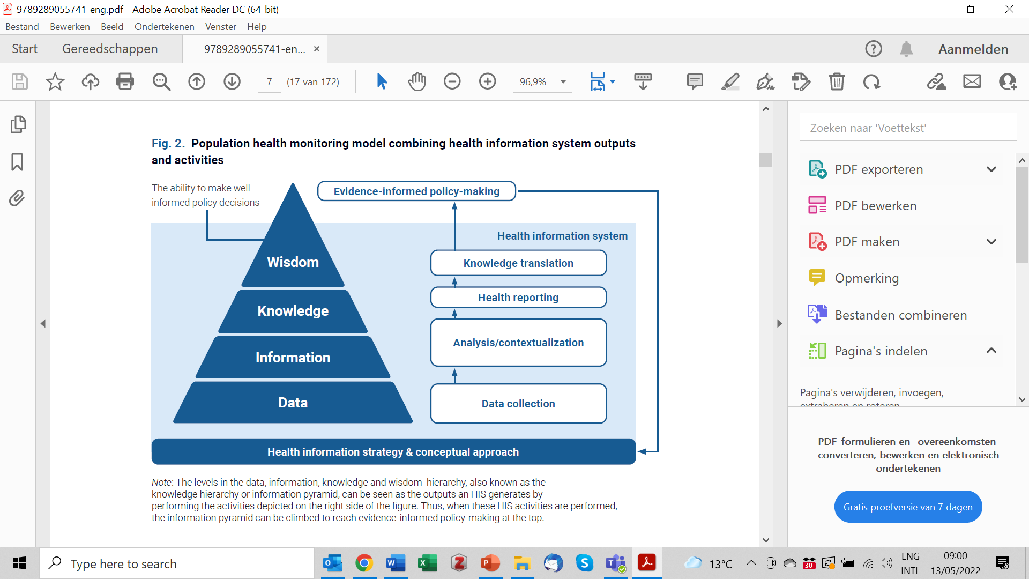

… yet data are not being used optimally
We are stuck at the bottom of the pyramid

Slide 32



What are the main problems?
No mechanisms to feed data into the policy-making process
Lack of comprehensive analyses
Problems with data access

Slide 33
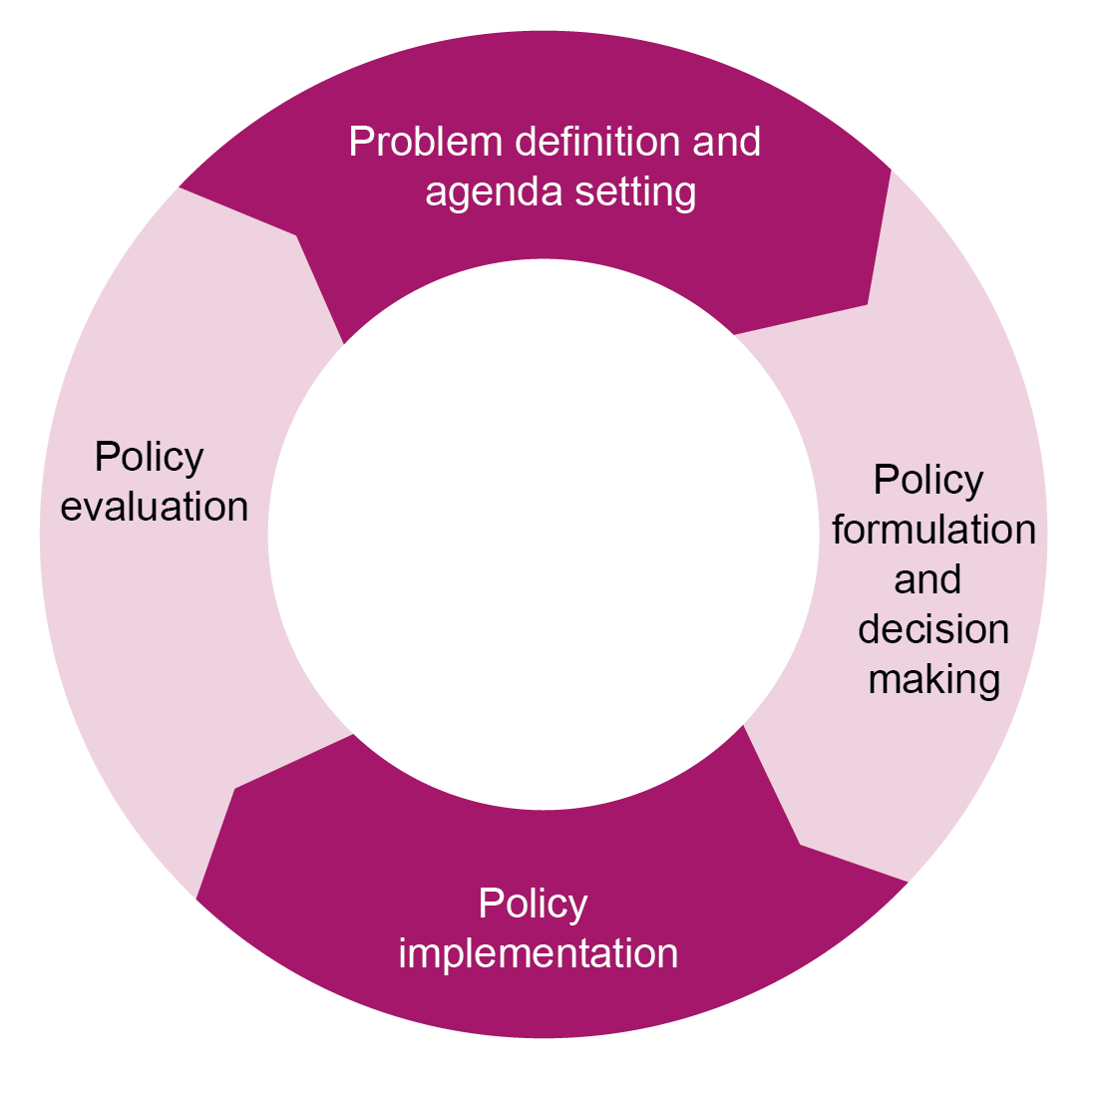
Data can support decision making at multiple levels and with multiple purposes
What are the biggest/most urgent health problems?
Data can support:
Strategic priority setting and policy-making (at the national and subnational level)
Planning and resource allocation (at the national, subnational and facility level)
Quality control and performance improvement (at the facility level)
Benchmarking (between multiple facilities)
Are we reaching the goals that we set out to achieve?
How can we best tackle these?
The policy cycle

Slide 34
Problems with data access - 1
What do we see?
Digital tools are designed and implemented without considering the secondary use of health data
  For example, electronic health records are implemented that meet the needs of health administrators but not of healthcare staff/managers.
  Healthcare staff do not see the added value and consequently make less effort to ensure that complete and high-quality data are entered.
What are the solutions?
When developing digital tools, consider the secondary use of health data from the start
Involve the end-users of the data in development and implementation

Slide 35

Regional digital health action plan for the WHO European Region 2023–2030
Guiding principles
2. Understand health system challenges, including health needs and trends, and acknowledge the needs and expectations of citizens and health workers.
3. Recognize the need for policy decision-making based on data, evidence, and lessons learned while allowing for continuous learning, adaptation, and innovation.
4. Leverage digital transformation to reimagine the future of health systems.
5. Recognize that institutionalization of digital health requires a long-term commitment and an integrated care approach
1. Place the individual at the centre of trustworthy care delivered digitally.

Slide 36
Problems with data access - 2
What do we see?
Procedures for accessing data are too restrictive, complicated and/or unclear.
What are the solutions?
The data protection legislation should strike the right balance between personal and public interests.
Procedures for accessing health data should be clear and transparent. Ideally data can be obtained for free, or otherwise for a reasonable processing fee.
Right to Health
Right to Privacy

Slide 37
How do people feel about sharing their health data?
“The findings of this review suggest that the use of health data for purposes other than treatment enjoys support among people living in EU asked in these studies, as long as the data are expected to further the common good.”
Source: Skovgaard LL, Wadmann S, Hoeyer K. A review of attitudes towards the reuse of health data among people in the European Union: The primacy of purpose and the common good. Health Policy. 2019 Jun;123(6):564-571. doi: 10.1016/j.healthpol.2019.03.012. Epub 2019 Mar 21. PMID: 30961905; PMCID: PMC6558994.
People are generally supportive
But not unconditionally:
  Purpose matters (underlying values)
  People want transparency and information on what their data is being used for
  People want their data to be anonymised and safe
  People want to be engaged in the development of regulatory frameworks for secondary health data use
Source: TEHDAS Joint Action. Healthy Data, an online citizen consultation about health data reuse – intermediate report (2022). https://tehdas.eu/results/tehdas-consultation-people-support-health-data-use-with-solid-safeguards/
Notes:
https://www.ncbi.nlm.nih.gov/pmc/articles/PMC6558994/#:~:text=The%20findings%20of%20this%20review,to%20further%20the%20common%20good
Literature synthesis of 29 studies.

Slide 38
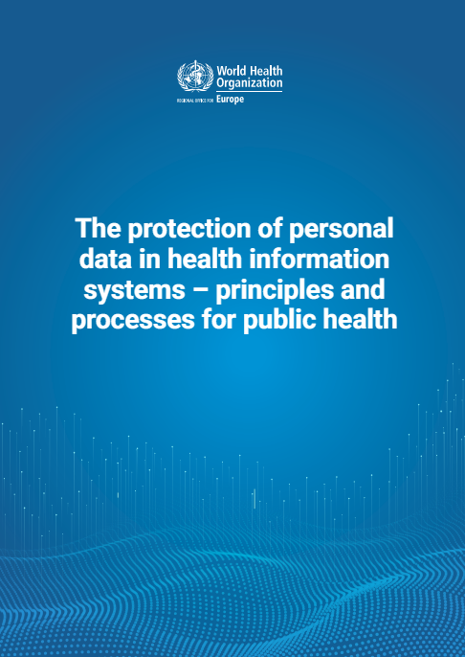
Guidance data protection
Available in English and Russian
World Health Organization. Regional Office for Europe. (‎2021)‎. The protection of personal data in health information systems- principles and processes for public health. World Health Organization. Regional Office for Europe. https://iris.who.int/handle/10665/341374. License: CC BY-NC-SA 3.0 IGO

Slide 39
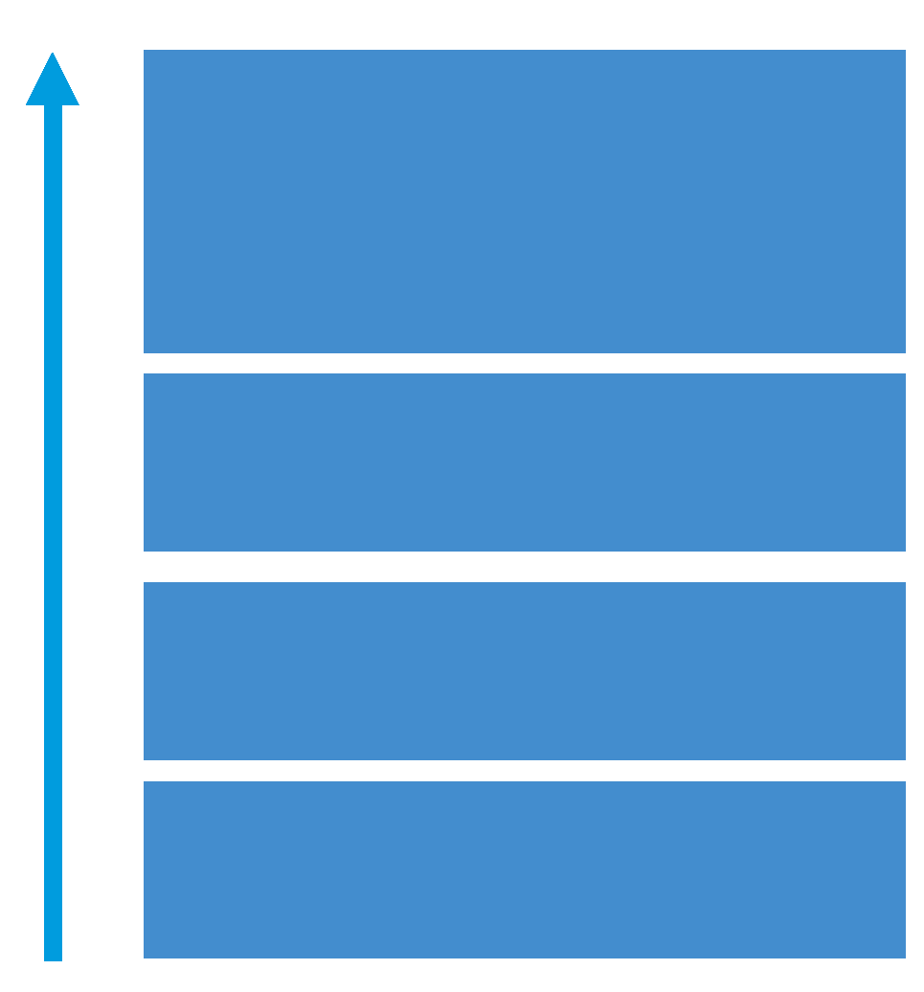
Lack of comprehensive analyses-1
What do we see?
A lack of capacity for analysis
What are the solutions?
Take all the HIS functions into account in strategic planning: only collecting the data is not enough!
Ensure institutionalisation of gained skills and expertise (e.g., shared documentation/archiving, skilled staff to train colleagues)

Slide 40
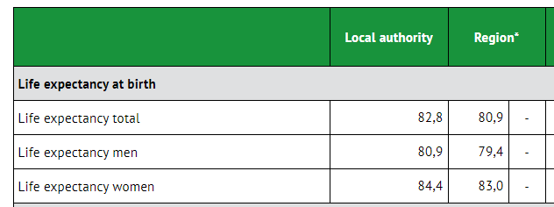
Lack of comprehensive analyses-2
What do we see?
Available analyses often are not useful for policy-making
What are the solutions?
As a manager/decision-maker: know what you need
As an analyst/health reporter:
  Make use of existing guidance for making impactful health reports
  Leverage the available skills and expertise in international projects/networks

Slide 41
How can you make an impactful health report?
Need for context!!
Let’s look at an example…
Notes:
https://www.ncbi.nlm.nih.gov/pmc/articles/PMC6558994/#:~:text=The%20findings%20of%20this%20review,to%20further%20the%20common%20good
Literature synthesis of 29 studies.

Slide 42
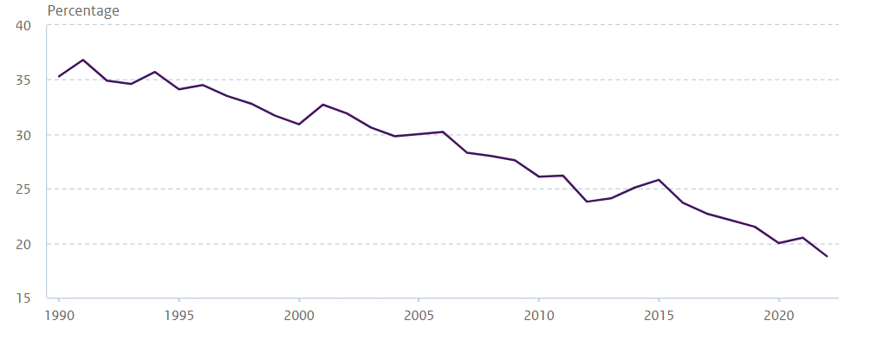
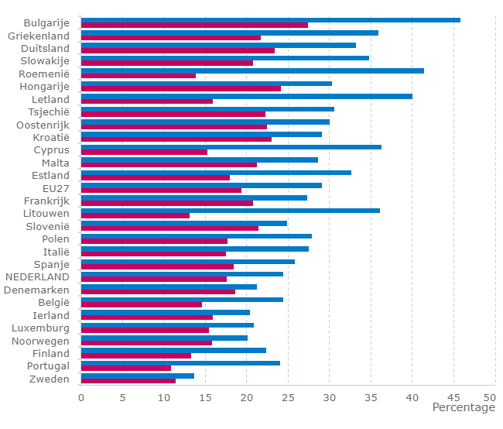
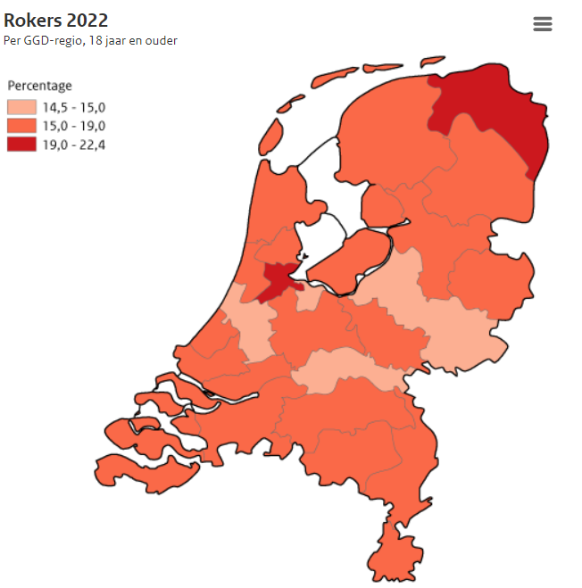
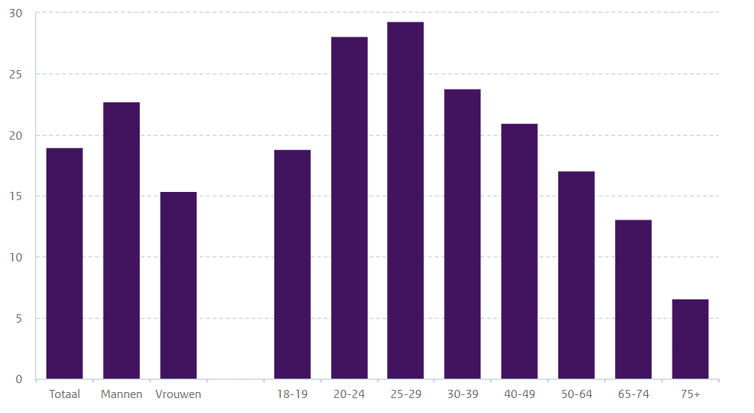
19% of people aged 18+ in the Netherlands smoke
But: how does that compare:
In time?
Between subgroups?
Between subnational units?
Between countries?
M
T
F

Slide 43
How can you make an impactful health report?
Need for context
  Through comparative analyses
  Through answering the WHY & WHAT questions by integrating the analyses with data and information from other disciplines and domains
    WHY do we see the patterns that we see?
    WHAT can we do about it?
Notes:
https://www.ncbi.nlm.nih.gov/pmc/articles/PMC6558994/#:~:text=The%20findings%20of%20this%20review,to%20further%20the%20common%20good
Literature synthesis of 29 studies.

Slide 44
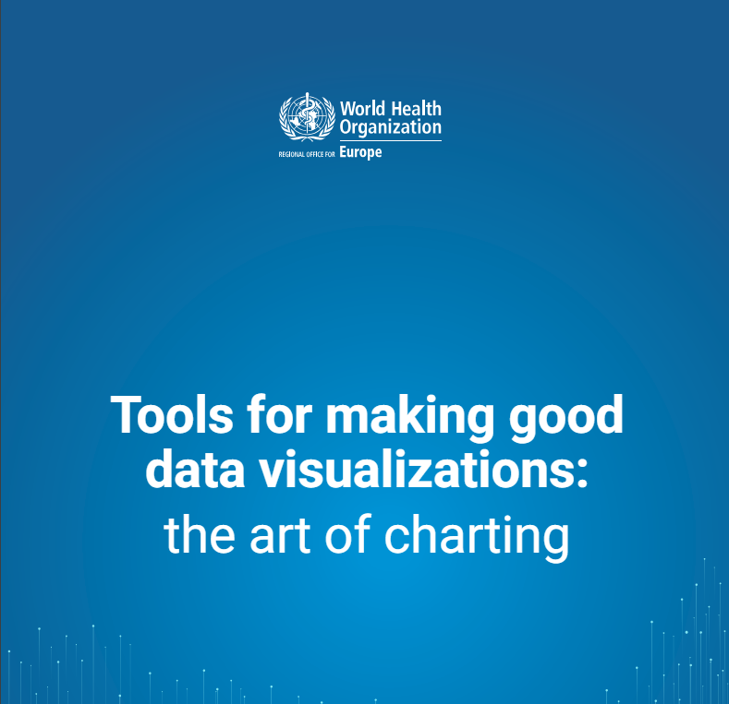

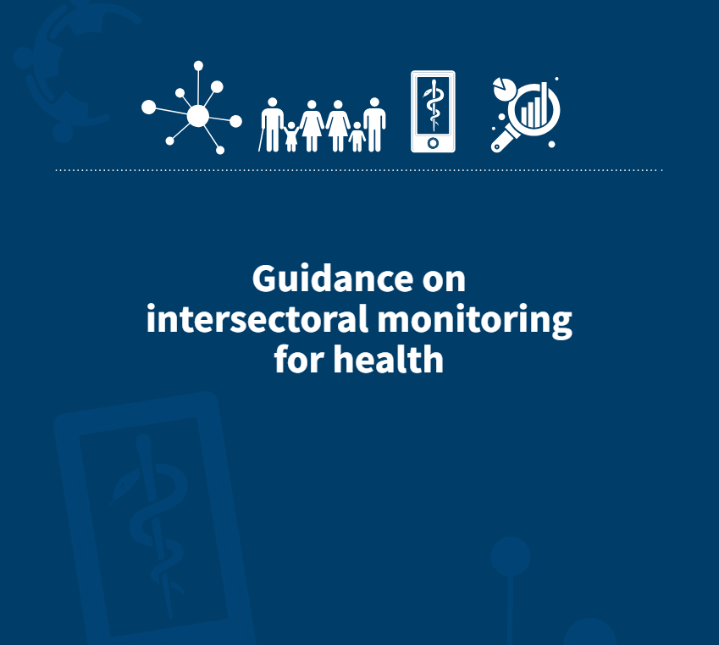
Check out our guidance
Available in English and Russian
World Health Organization. Regional Office for Europe. (‎2021)‎. Tools for making good data visualizations: the art of charting. World Health Organization. Regional Office for Europe. https://iris.who.int/handle/10665/342568. License: CC BY-NC-SA 3.0 IGO
World Health Organization. Regional Office for Europe. (‎2021)‎. Guidance for creating impactful health reports. World Health Organization. Regional Office for Europe. https://iris.who.int/handle/10665/349091. License: CC BY-NC-SA 3.0 IGO
World Health Organization. Regional Office for Europe. (‎2023)‎. Guidance on intersectoral monitoring for health. World Health Organization. Regional Office for Europe. https://iris.who.int/handle/10665/370453. License: CC BY-NC-SA 3.0 IGO

Slide 45
No mechanisms to feed data into the policy-making process
What do we see?
Often, available data are not used by policymakers
Contacts between policymakers and researchers take place mostly on an ad-hoc basis
What are the solutions
Policymakers should be aware of existing data and information products. And researchers should help them with this.
Policymakers and researchers live in different worlds. Personal interaction is needed to create a common understanding of what is needed and what is possible.
Institutionalize the use of data for health policy-making.
Notes:
Institutionalize the use of data for health policy-making.
Ideally through laws/regulations, for example regulating that the annual health reports need to be shared with parliament.
Involvement of multiple stakeholders helps guarantee continuity, also when arrangements are based more on gentlemen’s agreements

Slide 46

We need to think of the health information system as a pyramid
Then we can reach the top and take well-informed policy decisions!

Slide 47
Key Takeaways
Health data are a common good
We have an obligation to make the best possible use of health data, as this will benefit society as whole.
We need to do this in a secure way and engage with citizens: trust is essential.
Always consider how the data can be made accessible for secondary use (from the start!)
A table is not a health report
Data need context (= turning the data into information and knowledge):
  comparative analyses
  integration with knowledge from other domains
  options for action
  Evidence-informed policy will not happen without interaction
Researchers and policy-makers need to talk to each other
Dedicated effort is needed to make sure that researchers and policy-makers speak one language

Slide 48
HIE: SUPPORTING A UNIFIED DATA ECOSYSTEM FOR SYSTEMS STRENGTHENING
// Add facilitator name //
Notes:
Acknowledgement : Djibril Camara
Learning Objectives
Explain Unified Data System in context of Health Information Exchange (HIE).
Describe key challenges to HIE implementation across countries.
Discuss a case study about Unified Data Ecosystem.

Slide 49
What is a Unified Data Ecosystem?
A Unified Health Data Ecosystem refers to an integrated, comprehensive framework where health data from various sources (hospitals, clinics, laboratories, public health databases, etc.) is seamlessly collected, managed, and made accessible across the healthcare continuum.
Key characteristics: integration, centralized management, comprehensive data access, and security.

Slide 50
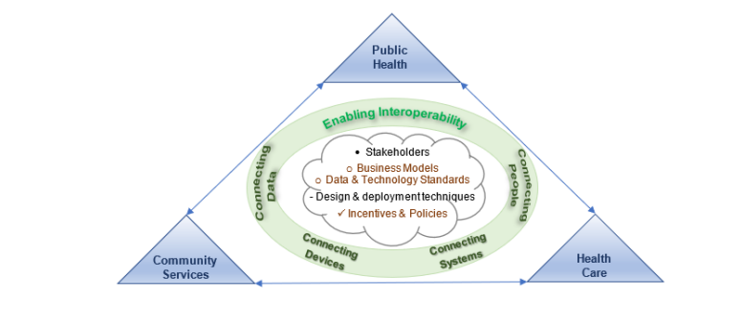
A unified health information system framework of connecting devices, data, and systems
He, W., Zhang, J. Z., Wu, H., Li, W., & Shetty, S. (2022). A unified health information system framework for connecting data, people, devices, and systems. Journal of Global Information Management, 30(11), 1-19, Article 39

Slide 51
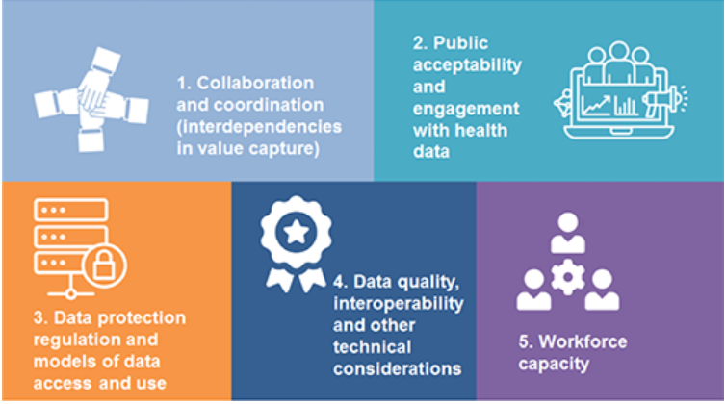
Building Blocks of Supportive Health Data Ecosystems
Notes:
Rand Corporation:

Slide 52
Benefits of Interoperable Unified Data System
Enhanced Data Access: Real-time data availability across different systems.
Improved Decision-Making: Data-driven insights leading to better decisions.
Cost Efficiency: Reducing redundancy and streamlining operations.
Increased Collaboration: Facilitating cross-organizational data sharing and teamwork.

Slide 53

What is the Role of Interoperability?
Interoperability is a cornerstone of a unified data system that breaks down data silos, where interoperable systems facilitate the integration of disparate data sources into a single platform
Notes:
SOURCE: https://legacy.himss.org/resources/interoperability-healthcare
What is Interoperability?
It is the ability of different information systems, devices and applications (systems) to access, exchange, integrate and cooperatively use data in a coordinated manner,
within and across organizational, regional and national boundaries, to provide timely and seamless portability of information and optimize the health of individuals and populations globally.
Health data exchange architectures, application interfaces and standards enable data to be accessed and shared appropriately and securely
across the complete spectrum of care, within all applicable settings and with relevant stakeholders, including the individual.

Slide 54
What are the Four Levels of Interoperability?
Foundational
INTEROPERABILITY LEVELS
Structural
Semantics
Organizational
Notes:
SOURCE: https://legacy.himss.org/resources/interoperability-healthcare
Four Levels of Interoperability
Foundational (Level 1): Establishes the inter-connectivity requirements needed for one system or application to securely communicate data to and receive data from another
Structural (Level 2): Defines the format, syntax and organization of data exchange including at the data field level for interpretation
Semantic (Level 3): Provides for common underlying models and codification of the data including the use of data elements with standardized definitions from publicly available value sets and coding vocabularies, providing shared understanding and meaning to the user
Organizational (Level 4): Includes governance, policy, social, legal and organizational considerations to facilitate the secure, seamless and timely communication and use of data both within and between organizations, entities and individuals. These components enable shared consent, trust and integrated end-user processes and workflows
What is Health Information Exchange and Data Sharing?
Health information exchange, or HIE, provides the capability to electronically move clinical information among disparate healthcare information systems and maintain the meaning of the information being exchanged. The goal of health information exchange is to facilitate access to and retrieval of clinical data to provide safe, timely, efficient, effective and equitable patient-centered care. HIE can also be used by public health authorities to assist in the analysis of the health of populations.

Slide 55
Main Interoperability Roadblocks
Technical Challenges: Different data formats, legacy systems, and incompatible platforms.
Standardization Issues: Lack of uniform data standards across systems.
Data Security and Privacy Concerns: Ensuring data is secure while being shared across platforms.
Organizational Resistance and Governance Barriers: Change management and the need for cultural shifts.
Human Factors: Lack of technical skills
Resource constraints: Lack of adequate funding and infrastructure
Notes:
Main roadblocks to achieving health data interoperability:
1. Technical Challenges
Legacy systems: Older software often uses proprietary formats that don’t communicate well.
Lack of standards adoption: Different systems may use different content, vocabulary, or transport standards.
Data quality issues: Missing, inconsistent, or incorrectly coded data limits usability.
2. Organizational & Governance Barriers
Fragmented governance: Multiple authorities with different rules slow data sharing.
Lack of policies or enforcement: No standard protocols for access, security, or data ownership.
Limited coordination: Health programs and facilities often operate in silos.
3. Privacy, Security, and Legal Concerns
Data protection regulations: Strict privacy laws can make cross-system sharing complex.
Security risks: Fear of breaches can limit willingness to exchange data.
Consent management: Tracking and enforcing patient consent across systems is challenging.
4. Human and Cultural Factors
Resistance to change: Staff may be reluctant to adopt new workflows or technologies.
Limited technical skills: Insufficient training for users and implementers.
Lack of trust: Concerns over data misuse or misinterpretation.
5. Resource Constraints
Funding limitations: Infrastructure, maintenance, and training are costly.
Connectivity issues: Poor internet or network reliability in low-resource settings.
Maintenance and support: Lack of ongoing technical support can stall interoperability efforts.

Slide 56
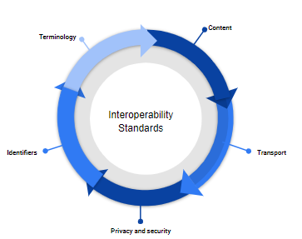
What are Interoperability Standards?
Standards provide a common language and a common set of expectations that enable interoperability between systems.
Notes:
Categories of Health Standards – Summary
Vocabulary / Terminology: Standardized codes and terms used to describe health concepts consistently, e.g., ICD-10 for diagnoses, LOINC for lab tests.
Content: Standards that define how health information is structured and represented, enabling interoperability, e.g., HL7 V2.x, CDA, FHIR.
Transport: Standards specifying how health data is exchanged between systems, e.g., DICOM for medical imaging.
Privacy and Security: Guidelines and technical measures to protect the confidentiality, integrity, and availability of health data.
Identifiers: Systems for uniquely identifying patients, providers, and other entities to ensure accurate data linkage, e.g., Master Patient Index, Provider Identification Numbers.
Health standards can be grouped into key categories. Vocabulary/terminology standards like ICD-10 and LOINC ensure consistent naming of diagnoses, lab tests, and other health concepts.
Content standards such as HL7 V2.x, CDA, and FHIR define how health information is structured for interoperability.
Transport standards like DICOM specify how data is exchanged between systems, while privacy and security standards safeguard the confidentiality and integrity of health information.
Finally, identifiers such as Master Patient Indexes and Provider Identification Numbers uniquely identify patients and providers to ensure accurate data linkage.

Slide 57

OpenHIE Framework Approach
https://ohie.org/
Notes:
Modular framework, “building block” approach, pick and choose the components that are relevant to your context and add components according to your country’s timeline and strategic plan to “plug and play”.

Slide 58
What is Health Information Exchange?
Purpose: Enables secure sharing of health data across systems, facilities, regions, or countries.​
How it works: OpenHIE gathers information from multiple systems into a single, unified HIE, standardizing data around:​
  Who the patient is​
  Who provided the care​
  Where the visit occurred​
  What happened during the visit​
Notes:
Health Information Exchange (HIE) with OpenHIE
Purpose: Enables secure sharing of health data across systems, facilities, regions, or countries.
How it works: OpenHIE gathers information from multiple systems into a single, unified HIE, standardizing data around:
Who the patient is
Who provided the care
Where the visit occurred
What happened during the visit
Additional features: Integrates medical supply data to support better decision-making.
Impact: Improves care quality, safety, continuity, and enables more effective use of health information for populations.

Slide 59
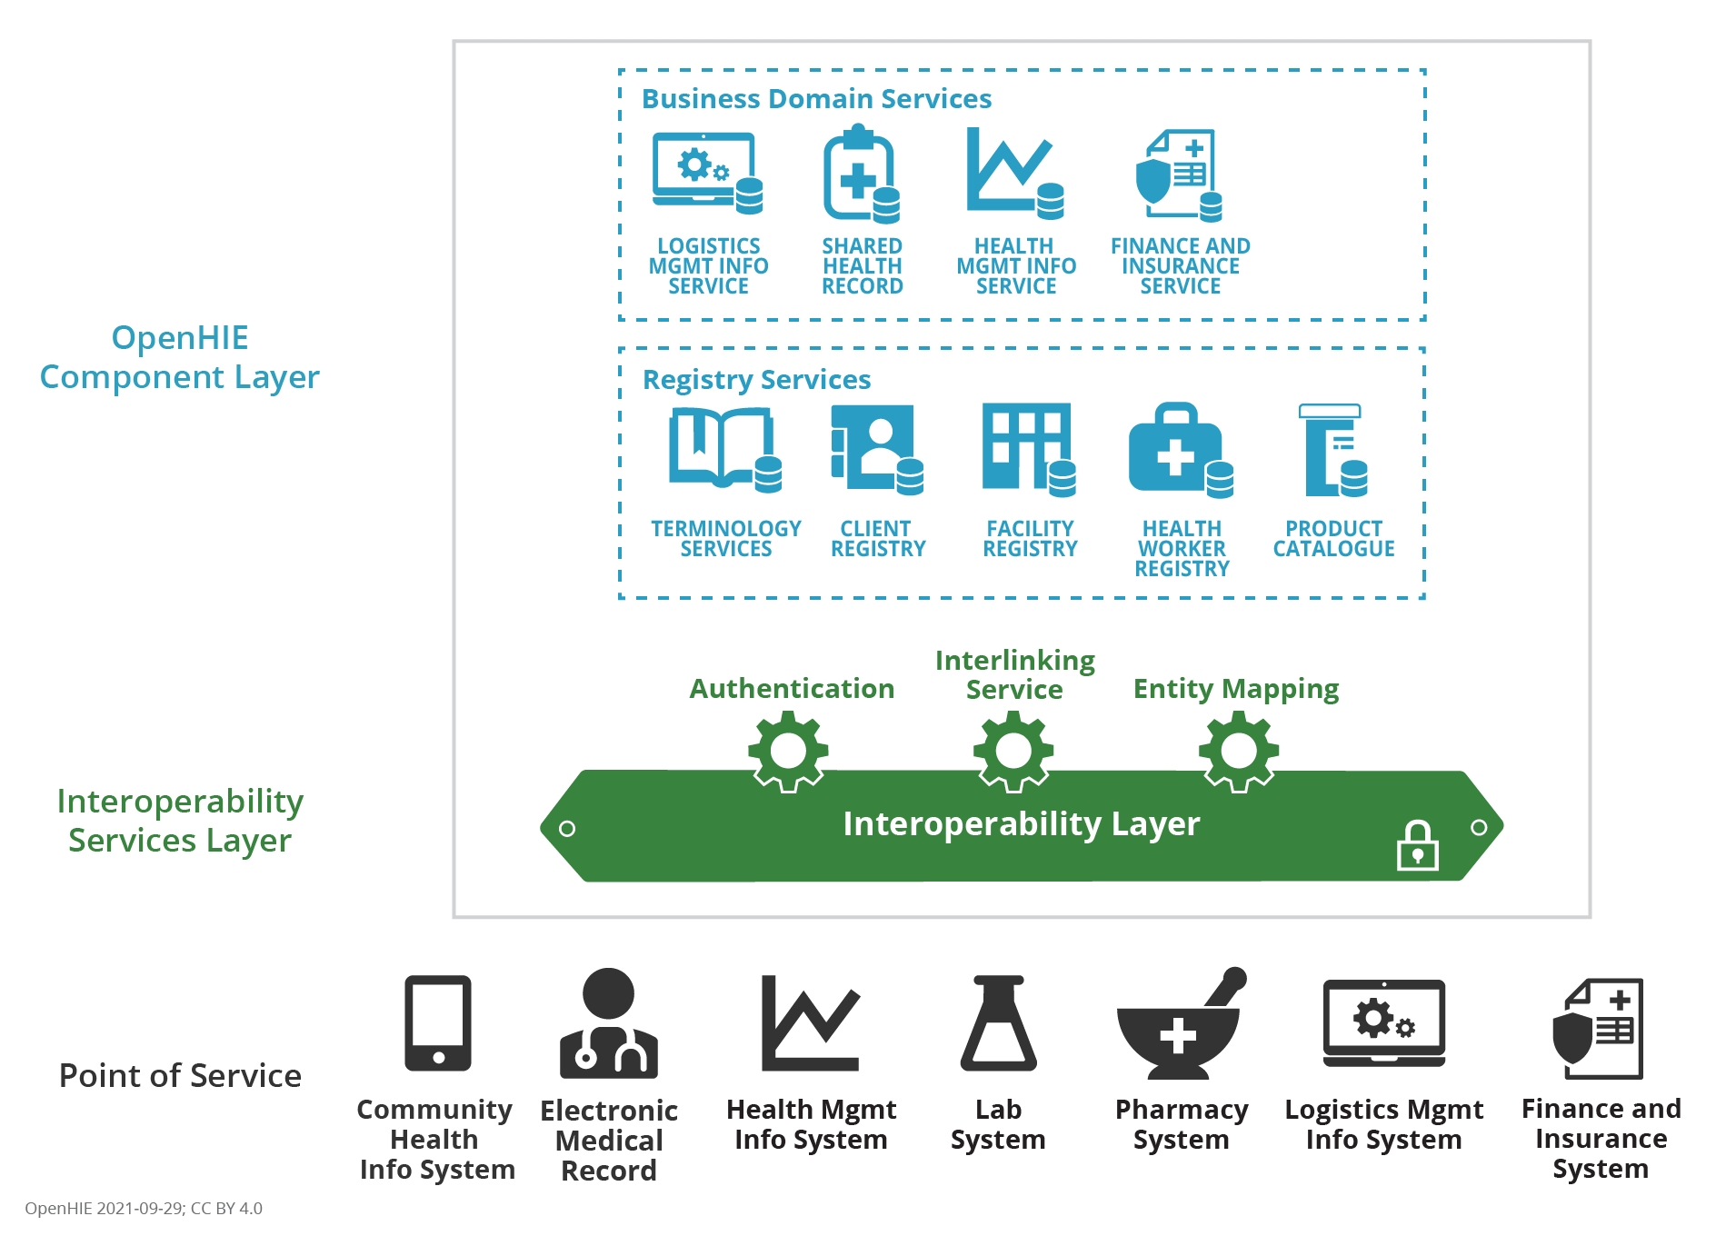
The OpenHIE Architecture
SOURCE: https://guides.ohie.org/arch-spec/architecture-specification/overview-of-the-architecture
Notes:
SOURCE: https://guides.ohie.org/arch-spec/architecture-specification/overview-of-the-architecture
A Health Information Exchange (HIE), the shared infrastructure in the large gray box of the OpenHIE Architecture Diagram makes the sharing of health data across information systems possible. Like a universal translator, an HIE normalizes data and secures the transmission of health information throughout databases, between facilities, and across regions or countries.
OpenHIE’s architecture is made up of software components, all interacting/interoperating to ensure that health information from various point-of-service systems is gathered into a health information exchange. To accomplish this, the exchange normalizes the context in which health information is created across multiple dimensions including:

Slide 60
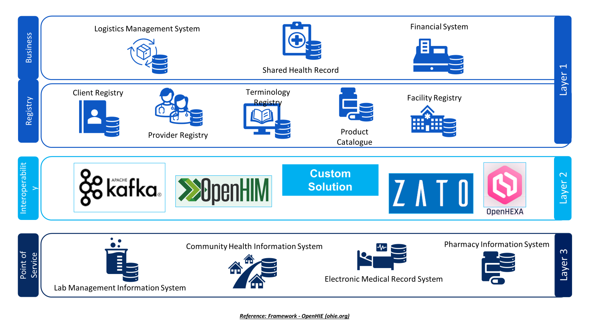
Business Domain & Registry Services Layer 1
Business domain components support speciﬁc health system business domains that potentially combine data from multiple point-of-service and point-of-care systems. Registry services uniquely identify and track unique patients, facilities, healthcare products and terminology that are used for exchange.
Interoperability Services Layer 2
The second layer of the architecture acts as a secure gateway between the business domain and registry services and the points of service.
Point of Services Layer 3
Point of service systems, such as electronic medical records (EMR) systems, that are used by clinicians and by health workers to enter and use a patient’s person-centric shared health information.
Source: Framework - OpenHIE (ohie.org)
Notes:
// This is an example of technologies that can be used as components within the OHIE architecture – this can be customised for the country by adding specific software applications / registries that are in use eg. DHIS2 functioning as the HMIS and Fcaility Register//

Slide 61
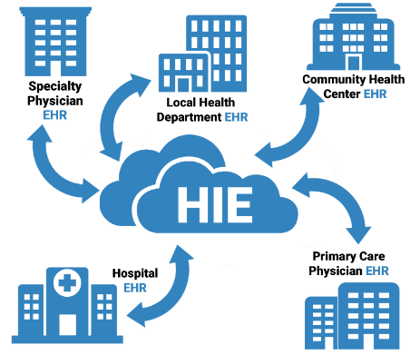
Common Challenges of Key HIE Artifacts Implementation

Slide 62
Client Registry Implementation Challenges
Data Quality: Ensuring the accuracy and completeness of patient data requires ongoing data validation, frequently changing demographic data, and multiple required data points needed for record matching
Governance, Privacy, and Security: Protecting patient data and ensuring compliance with privacy and local regulations and standards is critical
Scalability: to accommodate increased volumes of patient data and users.
Calibration and performance monitoring of the biometrics system to reduce the rate of false positives and false negatives
Notes:
Facilitator notes: this is an opportunity to call on the group for WS1 (from the Day Two workstream sessions) to provide additional input.

Slide 63
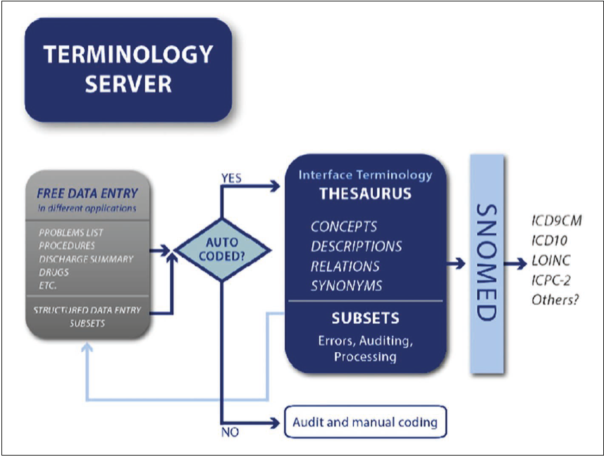
Terminology Service Implementation Challenges
Governance and Leadership through terminology Working Group
Educating users on the effective use of terminology services
Maintenance as terminologies have a life cycle, e.g., code retirement, changing context, updating, and new releases
Quality as multiple granularities, which are a level of detail found in a terminology, often depend upon its purpose.
Hosting the server on the cloud or on- premises
Notes:
Facilitator notes: this is an opportunity to call on the group for WS1 (from the Day Two workstream sessions) to provide additional input.

Slide 64
Challenges with Interoperability Layer Implementation
Poor planning associated with a lack of prioritization
Deciding on the IL to select based on
    Security feature
    Task scheduling
    Mediator/ adopter
    User friendliness
    Costing, Open source versus proprietary
Proliferation of Interoperability Layers in countries
Governance
Prevalence of outdated and legacy systems that are difficult to integrate
Capacity development
Notes:
Facilitator notes: this is an opportunity to call on the group for WS1 (from the Day Two workstream sessions) to provide additional input.

Slide 65

Factors for Successful HIE Implementation
Comprehensive planning and needs assessment
Engaging all stakeholders in the planning process
Paying closer attention to interoperability and data standards
Prioritizing security, compliance, and Governance
Capacity development, including user training

Slide 66

Sustainability of Unified Data System
HIS Workforce development and strengthening
Country ownership and in the driver’s seat
Having an Enterprise Architecture approach to foster interoperability between different digital health intervention software and applications (global goods)
Establishment and maintenance of data governance bodies, structures, and processes
Create a mechanism for continuous feedback and iteration
Notes:
An enterprise architecture (EA) is a conceptual blueprint that defines the structure and operation of organizations. The intent of enterprise architecture is to determine how an organization can effectively achieve its current and future objectives. Enterprise architecture involves the practice of analyzing, planning, designing and eventual implementing of analysis on an enterprise
Global goods are often “free and open-source software and digital health content”, that can be adapted and reused for the global health sector to meet the needs of various countries and contexts

Slide 67
Key Takeaways
Interoperability enables seamless data exchange across systems, regions, and organizations.​
Real-time access to data supports better decision-making and improves care quality.​
Standards create a common language, ensuring systems can communicate and understand each other.​
OpenHIE Architecture unifies data from multiple sources, standardizes context, and brings relevant information to the point of care.​
Collaboration and efficiency are enhanced through shared, integrated information.
Notes:
Unified Health Data Ecosystem is an integrated framework that centralizes and securely manages health data from multiple sources, enabling comprehensive access and seamless use across the healthcare continuum.
An Interoperable Unified Data System provides real-time, cross-system data access that improves decision-making, reduces redundancy and costs, and enables seamless collaboration across organizations
Interoperability in Health Data uses standards that create a common language and expectations, enabling systems to interoperate effectively within a unified health data ecosystem.
OpenHIE provides one architectural framework for a Health Information Exchange – see openhie.org for more information

Slide 68
COFFEE / TEA BREAK
20 MINUTES

Slide 69
GROUP EXERCISE: NATIONAL DATA REPOSITORIES
// Add facilitator name //
Notes:
// approximately 30 minutes //

Slide 70

INTERACTIVE SESSION
Supporting Country-owned Real-World Data (RWD) Systems

Slide 71
Session Objectives
Define and agree on the common terms
Discuss the utility of the data arising from the country-owned systems for patient care, surveillance, and reporting
Discuss the value of strengthening the country-owned data systems
Identify the learning opportunities and collaborative possibilities
Summarize the collective input on strengthening the country-owned RWD systems

Slide 72
Setting the scope of the session
What do you mean by “country-owned”?

Slide 73
Station Rotation and “Core Themes”
Station 1: Country-owned RWD Systems - Benefit of strengthening the data systems
  Q: What are the benefits of strengthening country-owned data systems?
Station 2: Challenges in strengthening country-owned data systems
  Q: What are the challenges with the systems to support patient care, surveillance and PEPFAR reporting? Focus: System
Station 3: Strengthening for sustainability
  Q: How do you ensure the sustainability of the country-owned data systems?
Station 1
Station 3
Station 2
Notes:
Session Guide: Supporting Country-Owned Real World Data (RWD) Systems
Session Date/Time
Description
Hindsight is twenty-twenty, and one way to predict and ensure an outcome is to think about it from a future perspective. Thinking of the goals each country team wants to achieve, participants will create news headlines and stories about intended projects after completion from three different points of view:
Wildly successful,
Somewhat successful, and
Failure.
Each news story will detail the critical events that contributed to the eventual outcome, challenges (overcome or not), and the impact that the project’s success (or lack thereof) had on individuals, groups and the country as a whole. Each story should include Who, What, When, Where, Why, and How.
Terminal Performance Objectives
By the end of this session, participants from each country will be able to:
Define and agree on the common terms
Discuss the utility of the data arising from the country-owned systems for patient care, surveillance and reporting
Discuss the value of strengthening the country owned data systems
Identify the learning opportunities and collaborative possibilities
Summarize the collective input on strengthening the country-owned RWD systems
To prepare
Before:
Study your outputs from the preceding session on Country-Specific Re-engineering, Design, Development, Implementation, Evaluation Issues
Review the outcomes of the Bring Your Own Difficult Decision session on Day 2 (June 12)
Assign roles (timekeeper, session moderator, station facilitators)
In the training room, hang large tear-sheets or place easels far enough apart that groups can talk without disturbing each other.
In each station, write the prompts at the top of the paper:
Station 1: Country-owned RWD Systems - Benefit of strengthening the data systems
Q: What are the benefits of strengthening country-owned data systems?
Station 2: Challenges in strengthening country-owned data systems
Q: What are the challenges with the systems to support patient care, surveillance and PEPFAR reporting? Focus: System
Station 3: Strengthening for sustainability
Q: How do you ensure sustainability of the country-owned data systems?
Assign a facilitator to each station. This person will stay at that station for the duration of the activity and provide prompts/leading questions if the groups get stuck.
Divide participants into 3 groups (randomly or otherwise) and assign each group to a station.
Give each group markers (you can assign each group a specific color of marker to track each group’s inputs).
You can also provide Post-It notes to allow groups to organize ideas more easily.
Session Execution
Round 1 (10 mins), have the groups brainstorm around the station prompts.
Round 2 (5 mins), the groups rotate to the next station, review the previous group’s inputs, then add to those inputs.
Round 3 (5 mins), the groups rotate to the next station, review the previous group’s inputs, then add to those inputs.
Review round (10 mins) The groups rotate to their original station and review the other groups’ inputs. Then, they prepare a brief summary to present.
Extra Round (10 mins) If there is time in the agenda, each group will create 1-2 newspaper headlines of what would happen if one of the inputs was implemented or not addressed as part of the summary presentation.
Discussion and Reflection (15 mins) – Summary presentation, discussion and reflection

Slide 74
Session outline
Introduction to the session (5 mins)
  Station 1: Value of strengthening country-owned data systems
  Station 2: Challenges in strengthening country-owned data systems
  Station 3: Strategies to strengthen country-owned data systems
  Round 1 (10 mins)
  Round 2 (5 mins)
  Round 3 ( 5 mins)
  Review round (10 mins)
  Extra Round (Newspaper Headline) 10 mins
Discussion and Reflection ( 15 minutes)
Notes:
Session Guide: Supporting Country-Owned Real World Data (RWD) Systems
Session Date/Time
Description
Hindsight is twenty-twenty, and one way to predict and ensure an outcome is to think about it from a future perspective. Thinking of the goals each country team wants to achieve, participants will create news headlines and stories about intended projects after completion from three different points of view:
Wildly successful,
Somewhat successful, and
Failure.
Each news story will detail the critical events that contributed to the eventual outcome, challenges (overcome or not), and the impact that the project’s success (or lack thereof) had on individuals, groups and the country as a whole. Each story should include Who, What, When, Where, Why, and How.
Terminal Performance Objectives
By the end of this session, participants from each country will be able to:
Define and agree on the common terms
Discuss the utility of the data arising from the country-owned systems for patient care, surveillance and reporting
Discuss the value of strengthening the country owned data systems
Identify the learning opportunities and collaborative possibilities
Summarize the collective input on strengthening the country-owned RWD systems
To prepare
Before:
Study your outputs from the preceding session on Country-Specific Re-engineering, Design, Development, Implementation, Evaluation Issues
Review the outcomes of the Bring Your Own Difficult Decision session on Day 2 (June 12)
Assign roles (timekeeper, session moderator, station facilitators)
In the training room, hang large tear-sheets or place easels far enough apart that groups can talk without disturbing each other.
In each station, write the prompts at the top of the paper:
Station 1: Country-owned RWD Systems - Benefit of strengthening the data systems
Q: What are the benefits of strengthening country-owned data systems?
Station 2: Challenges in strengthening country-owned data systems
Q: What are the challenges with the systems to support patient care, surveillance and PEPFAR reporting? Focus: System
Station 3: Strengthening for sustainability
Q: How do you ensure sustainability of the country-owned data systems?
Assign a facilitator to each station. This person will stay at that station for the duration of the activity and provide prompts/leading questions if the groups get stuck.
Divide participants into 3 groups (randomly or otherwise) and assign each group to a station.
Give each group markers (you can assign each group a specific color of marker to track each group’s inputs).
You can also provide Post-It notes to allow groups to organize ideas more easily.
Session Execution
Round 1 (10 mins), have the groups brainstorm around the station prompts.
Round 2 (5 mins), the groups rotate to the next station, review the previous group’s inputs, then add to those inputs.
Round 3 (5 mins), the groups rotate to the next station, review the previous group’s inputs, then add to those inputs.
Review round (10 mins) The groups rotate to their original station and review the other groups’ inputs. Then, they prepare a brief summary to present.
Extra Round (10 mins) If there is time in the agenda, each group will create 1-2 newspaper headlines of what would happen if one of the inputs was implemented or not addressed as part of the summary presentation.
Discussion and Reflection (15 mins) – Summary presentation, discussion and reflection

Slide 75
Policy, Process, and Design of Data Integration - Data Sharing Agreement and Data Protection
// Add facilitator name //
Notes:
Acknowledgment:
Viktor Ivakin
i-LEAD workshop
Istanbul, May 15, 2024
ICAP

Slide 76
Outline
Policy, Process, and Design of Data Integration (DI)
What is the problem with health data
What is DI
How DI works
DI use cases
DI architecture design patterns
Best practices for healthcare DI
Requirements Elicitation Approach for DI
Key problems with DI in Central Asia Region
Data Sharing Agreement (DSA)
Why Share Data
DSA goals
DSA standard content
Data Protection (DP)
What is DP?
Legal bases
Personal and sensitive data
Main legal principles
Key Components of DP

Slide 77
Policy, Process, and Design of
Data Integration

Slide 78
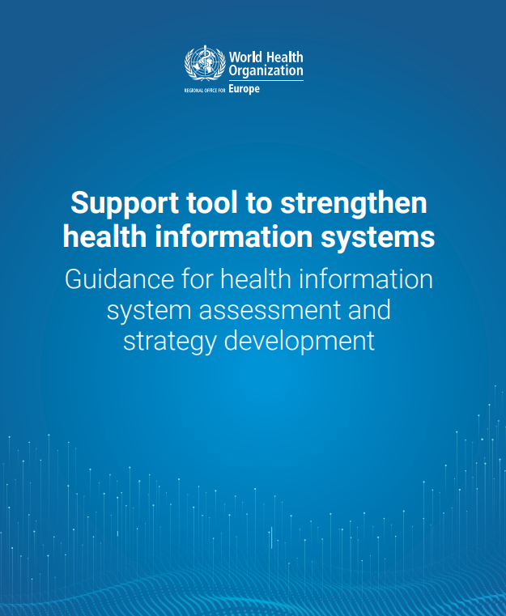
What are the challenges?
Results from assessments carried out in 13 Member States of the WHO European Region
Lack of data from private health-care facilities
Unclear roles and responsibilities for data exchange
Limited data linkage
Fragmentation and lack of interoperability
Limited use of health information for decision-making
An HIS is often understood to be the same as an EHR system
https://iris.who.int/bitstream/handle/10665/342126/9789289055741-eng.pdf?sequence=3

Slide 79
Do these data integration challenges resonate with you?

Slide 80
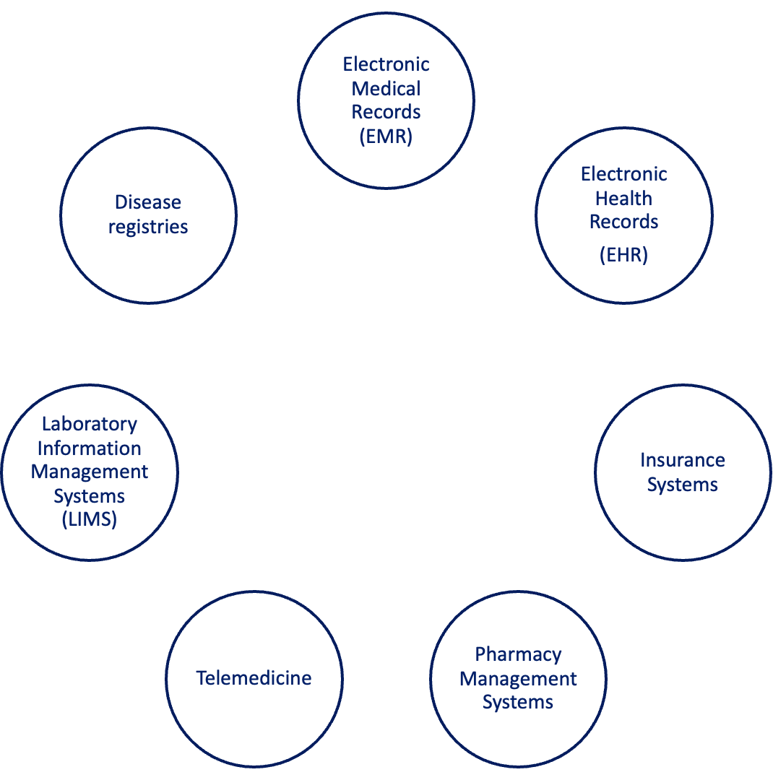
Healthcare Data Sources
Numerous Sources with Varied Data Owners, Producers, and Processors

Slide 81
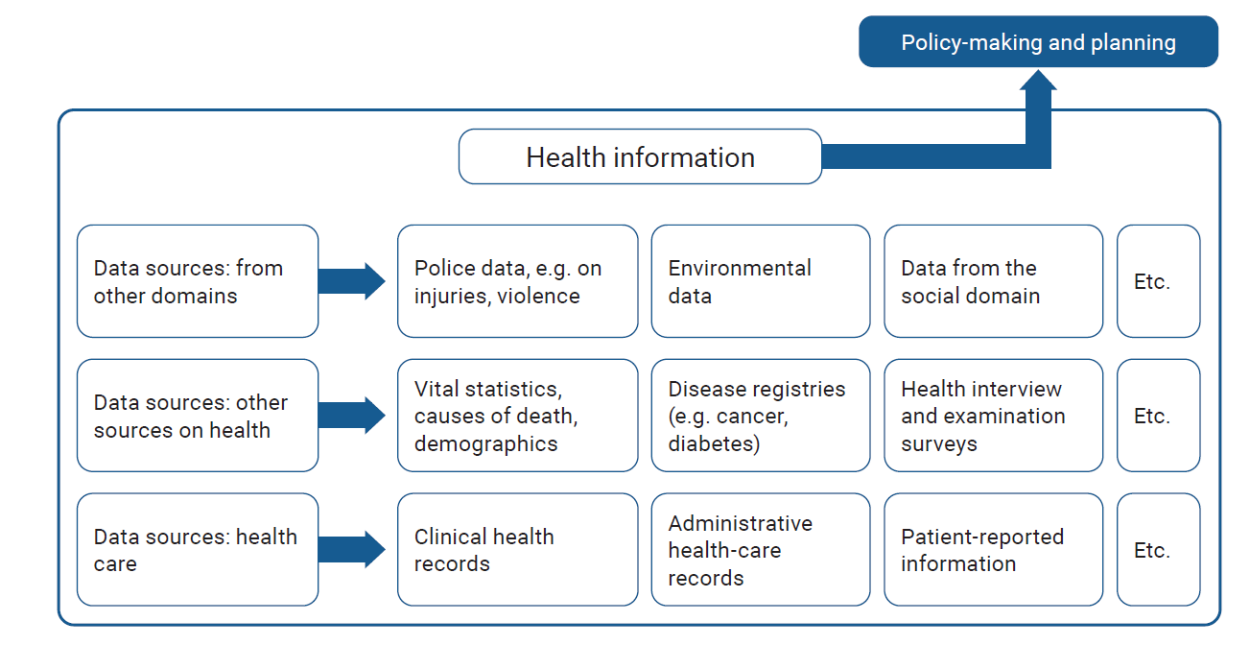
What is data integration?
Data integration refers to the process of combining and harmonizing data from multiple sources into a unified, coherent format that can be used for various analytical, operational, and decision-making purposes*.
Source: Support tool to strengthen health information systems: guidance for health information system assessment and strategy development. Copenhagen: WHO Regional Office for Europe; 2021. Licence: CC BY-NC-SA 3.0 IGO.
Source: *https://www.ibm.com/topics/data-integration

Slide 82
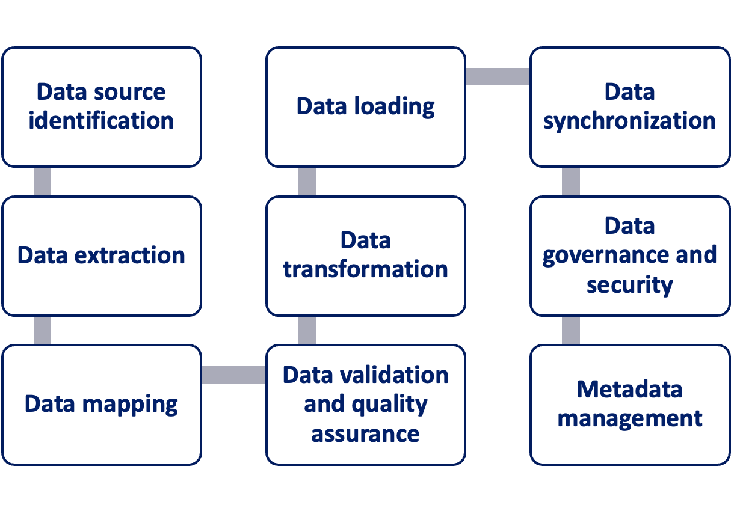

How data integration works
Data access and analysis
Source: https://www.ibm.com/topics/data-integration

Slide 83
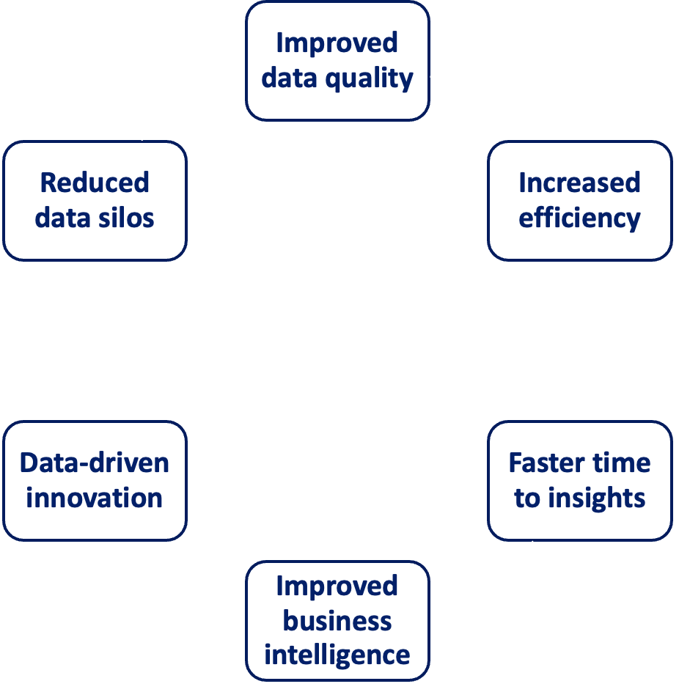





Benefits of data integration
Data integration use cases
Data warehouse
Data lake
Customer 360° view
Business intelligence and reporting

Slide 84
Data integration architecture design patterns
Extract, Transform, Load (ETL)
  Extracts data from multiple sources, transforms it for analytics, and loads it into a database or data warehouse.
Extract, Load, Transform (ELT)
  Extracts data from the source system, loads the raw data into a data lake or warehouse and then transforms the data within these environments.
Change Data Capture (CDC)
  Records a history of real-time data changes in the source system for near-to-real-time data updates in the target environment.
Application Programming Interface (API)
  Uses a set of rules and parameters to enable communication between different software, allowing data to be integrated and shared in real time.
Event-Driven Architecture
  An architectural approach where specific changes in the state of a software system trigger the transmission of ‘events,’ which are then picked up and processed by other services within the system. You get real-time responses, enhancing system dynamism and flexibility.

Slide 85




Extract
Transform
Load
Extract, Transform, Load (ETL) process is the most common used design pattern
ETL processes
MongoDB
PostgresDB
Data Warehouse
Flat files

Slide 86
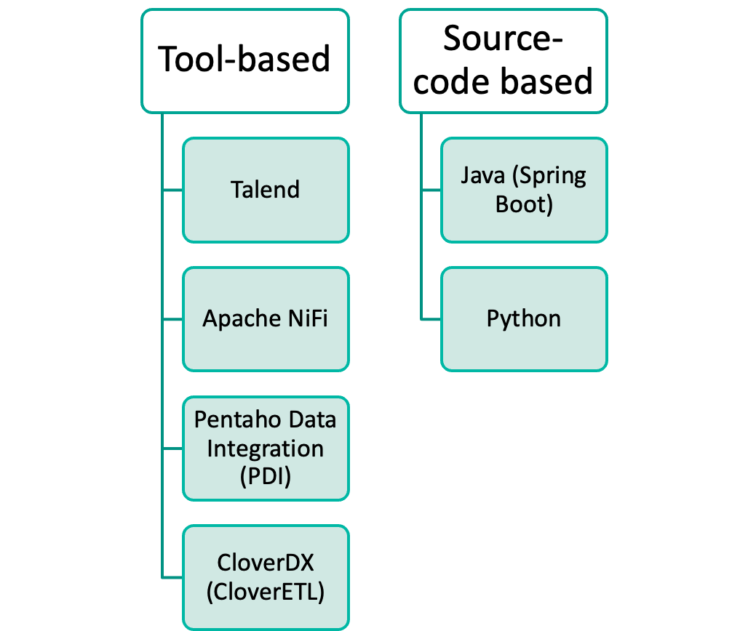
ETL tools
ETL Tools
“Appropriate ETL tools and architecture patterns enable the development of healthcare data exchange efficiently, thereby advancing medical informatics research in general. Choosing the right tools and architecture pattern is critical, because once an architecture is in place, it is very hard (and expensive) to change. The shown implementations with tools and architecture patterns are adaptable for further ETL projects with a similar purpose”
Source: Ka Yung CHENG, Santiago PAZMINO, and Björn SCHREIWEIS (2022). ETL Processes for Integrating Healthcare Data - Tools and Architecture Patterns, pHealth 2022, http://dx.doi.org/10.3233/SHTI220974

Slide 87
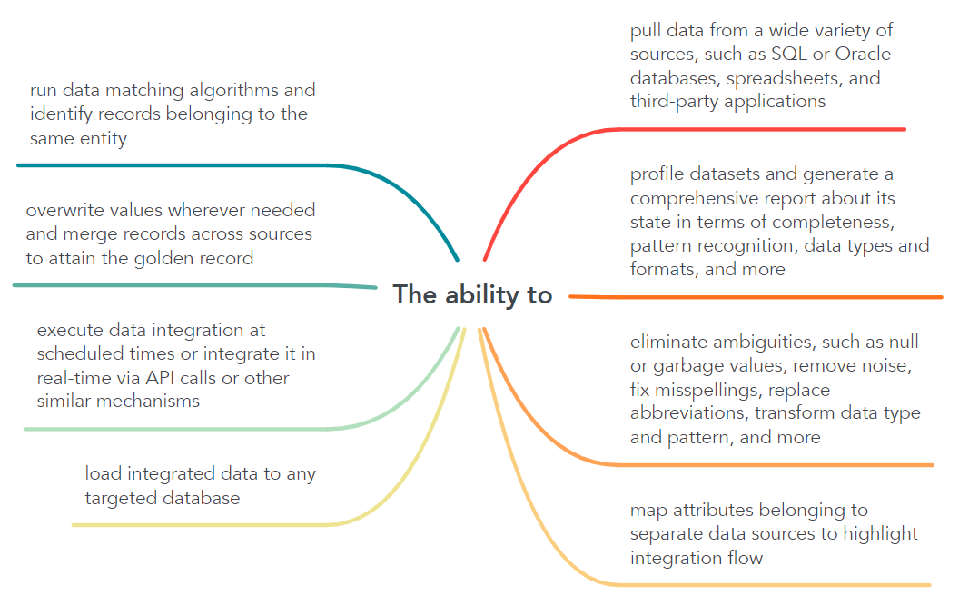
Key abilities for a data integration tool

Slide 88
Requirements Elicitation Approach (1)
Data Acquisition
The system must acquire
Data Processing
The system must process
Data Storage
The system must store
Data Analysis
The system must analyze
  data from different heterogeneous source systems
  structured data based on interoperability standards from IT and the health care domain
  at least one of the following: EHR data, EMR data
  multimedia data from various domains
  (meta) data from heterogeneous sources
  data by mapping it to multiple terminology standards
  unstructured data using NLP methods
  data by mapping between local terminologies to at least one of the following: national terminology standards, international terminology standards
  data by mapping it to all the following: standardized semantics, vocabularies, ontologies.
  process (semi)structured data to a common exchange format
  data from various sources based on at least one of the following: standardized rules, standardized process
  data according to a multidimensional data model
  biomedical data decentralized from clinical EHR data
  the original data
  the data in such a way that they can be retrieved via queries
  the data for data cleansing
  the data to report all of the following: missing values, outliers
  the data for consistency checks
  unstructured data using NLP methods
  The system must provide various data analysis technique
Source: Kinast B, Ulrich H, Bergh B, Schreiweis B. Functional Requirements for Medical Data Integration into Knowledge Management Environments: Requirements Elicitation Approach Based on Systematic Literature Analysis, J Med Internet Res 2023;25:e41344, URL: https://www.jmir.org/2023/1/e41344, DOI: 10.2196/41344

Slide 89
Requirements Elicitation Approach (2)
Data Lineage
The system must
Data Traceability
The system must track
Metadata Management
The system must
Data Security
The system must provide
  iterate data integration if at least one of the following change: *source data, *data sources, *clinical context, *analyzed requirements
  provide a patient identification service
  provide an audit trail if the source data change during the course of audits
  provide information to identify a service’s location
  create all of the following when integrating data: *transfer property file, *log file
  data to the primary data
  provide a link to the original data
  data via the data indexes of the source systems
  data via pipeline management
  the reproducibility of query results at different points in time
  data to all of the following: *the location of sources, *associated source data documents
  data to check the correspondence between the copy and the original (including metadata)
  provide metadata management tools
  store metadata into a semantic MDR
  support all of the following: *structural metadata mappings, *structural metadata transformations
  process metadata from multiple sources according to a metadata model
  a registry service to identify and access all of the following: *organizations, *devices, *software
  all of the following: *user authentication, *use authorization
  encryption and decryption for (cross-institutional) data transfer
  data privacy and security in accordance with at least one of the following: legal regulations, ethical regulations
  PID^{b} to disconnect medical data from identifying data
Source: Kinast B, Ulrich H, Bergh B, Schreiweis B. Functional Requirements for Medical Data Integration into Knowledge Management Environments: Requirements Elicitation Approach Based on Systematic Literature Analysis, J Med Internet Res 2023;25:e41344, URL: https://www.jmir.org/2023/1/e41344, DOI: 10.2196/41344

Slide 90
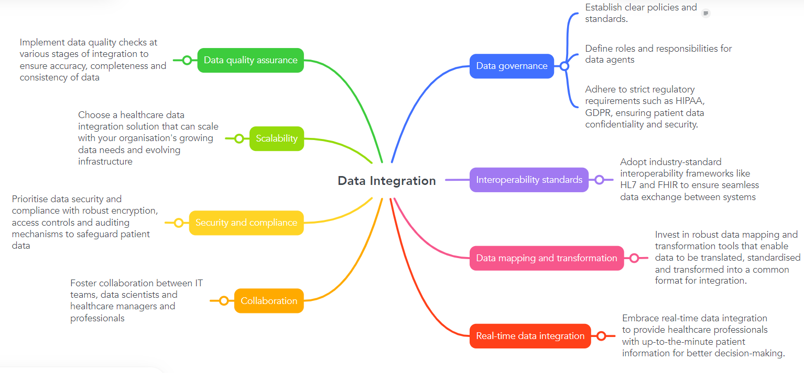
Best practices for healthcare data integration

Slide 91
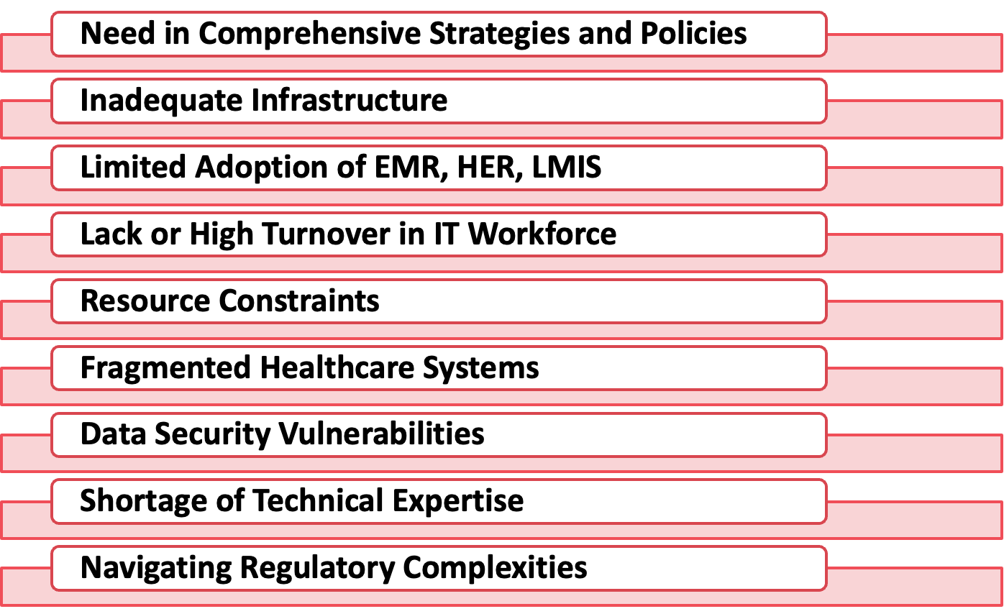
Key Challenges For Data Integration

Slide 92
Key Takeaways
Definition: Data integration combines and harmonizes data from multiple sources into a unified, usable format for analysis, operations, and decision-making.
Benefits: Enables comprehensive insights, informed decisions, and efficient operations.
Best Practices: Ensure data quality, scalability, security, governance, interoperability standards, real-time integration, data mapping and transformation, and promote cross-team collaboration.

Slide 93
Data Sharing Agreement (DSA)

Slide 94
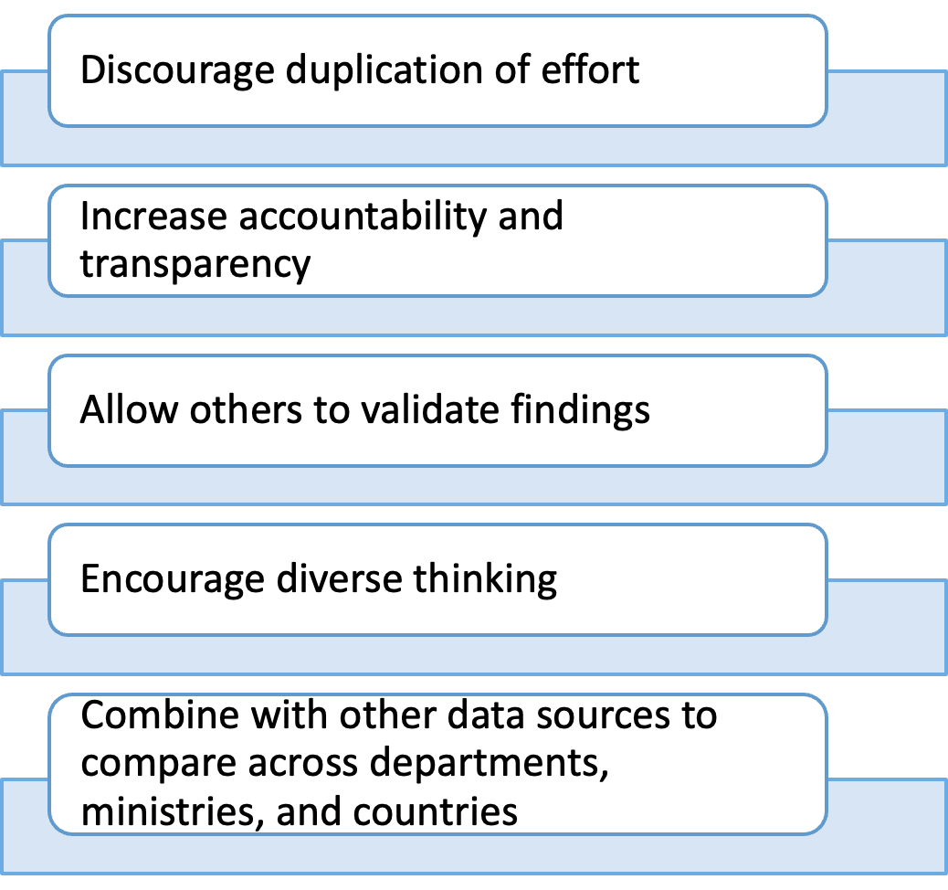
Why Share Data?

Slide 95

Data sharing agreement (DSA)
A data sharing agreement is an agreement between two or more parties that outlines which data will be shared and, most importantly, how the data can be used. A data sharing agreement can prevent data misuse, data abuse, and unregulated data dissemination.

Slide 96
Data sharing agreement (DSA)
DSA goals
Who can access the data?
Why are data being shared?
                Scope of use
What types of data are accessible?
Limited, de-identified, sensitive data?
Ensure privacy and confidentiality
Ensure compliance with applicable laws
Standard content
Define entitles’ roles and responsibilities
Specify which data can be shared, when, and under what circumstances
      Plan for data structure and delivery
      Enumerate acceptable data uses and prohibitions
Specify safeguards for data privacy and security
  Personal Health Information
  Policies for data breaches and grievances

Slide 97
Data Protection

Slide 98
What is Data Protection (DP)? (1)
Data protection (DP) is commonly defined as the laws, rules and strategies designed to protect people’s privacy.
Privacy is the ability of an individual or group to seclude themselves or information about themselves and thereby express themselves selectively.
In the field of data protection, privacy is generally referred to through the concept of informational self-determination.

Slide 99
What is Data Protection? (2)
DP is an area dominated by law
DP applies when personal data are involved
DP is about protecting people
Not research institutions
Not researchers
Not the data themselves (≠ security)
The risks of a privacy breach are high!

Slide 100
Legal bases
Informational self-determination is guaranteed by a number of fundamental texts:
Universal Declaration of Human Rights (art. 12)¹
European Convention on Human Rights (art. 8)²
Country Constitutions
¹ https://www.un.org/en/about-us/universal-declaration-of-human-rights
² https://www.echr.coe.int/documents/d/echr/convention_ENG

Slide 101
Personal data
All information relating to an identified person
Very broad notion: everything that can be related to a specific person is personal data!
The most common: name, date of birth, address, picture, etc.
But also: opinions, original ideas, a style of writing, the way of walking, etc.
Sensitive data
Personal data on: religious, ideological, political or trade-union related views or activities; health, the intimate sphere or the racial origin; social security measures; administrative or criminal proceedings and sanctions
Depending on the context and country, almost all data can be considered sensitive (name, photo, job, etc.)

Slide 102
Main legal principles
Lawfulness, fairness, and transparency
Purpose limitation
Data subject rights
Consent
Personal data breaches
Privacy by Design
Data Protection Impact Assessment
Data Protection Officer
Awareness and training
General Data Protection Regulation at https://eur-lex.europa.eu/legal-content/EN/TXT/PDF/?uri=CELEX:32016R0679&qid=1714305509484

Slide 103

Key Components of Data Protection
Data Risk Analysis
Data Encryption
Data Backup and Recovery
General Data Protection Regulation (GDPR) check list
Health Insurance Portability and Accountability Act (HIPAA) check list
Data Standards and Regulatory Compliance
Data Breach Prevention
Data Storage Management
Data Access Management

Slide 104
Key Takeaways
Data protection (DP) focuses on safeguarding individuals’ privacy and their right to control personal information (informational self-determination).
DP is legal and regulatory in nature, applying specifically to personal data, not to researchers, institutions, or the data itself.
Personal data encompasses any information that can identify a person, from basic identifiers (name, birth date, photo) to behavioral traits or creative expressions.
Sensitive data includes information on health, beliefs, race, political views, or other intimate aspects, and the definition can vary by context or jurisdiction.
The primary goal is protecting people, not just securing data.

Slide 105


END OF DAY EVALUATION
// Replace this QR code with the one generated for your evaluation form. //

Slide 106
End of day evaluation questions
Do you have any additional feedback on the HIE: Supporting a unified data ecosystem for systems strengthening session? (Optional)
The Policy, Process, and Design of Data Integration. Data Sharing Agreement and Data Protection session was relevant to my department/country’s needs.
  Strongly disagree
  Disagree
  Neutral
  Agree
  Strongly Agree
Do you have any additional feedback on the Policy, Process, and Design of Data Integration. Data Sharing Agreement and Data Protection session? (Optional)
How useful were the following sessions for your country's needs? Not useful, useful, very useful
  Current State to Future
  HIE: Supporting a unified data ecosystem for systems strengthening
  Policy, Process, and Design of Data Integration. Data Sharing Agreement and Data Protection
I was satisfied with today’s sessions overall.
  Strongly disagree
  Disagree
  Neutral
  Agree
  Strongly agree
The Current State to Future State session was relevant to my department/country’s needs.
  Strongly disagree
  Disagree
  Neutral
  Agree
  Strongly Agree
Do you have any additional feedback on the Current State to Future session? (Optional)
The HIE: Supporting a unified data ecosystem for systems strengthening session was relevant to my department/country’s needs.
  Strongly disagree
  Disagree
  Neutral
  Agree
  Strongly Agree
Link to EOD evaluation: https://path.box.com/s/ve2wudlqp2y4cm9cmbozgq2fhpn69wyw
Notes:
Link: upload the questions to an online survey tool

Slide 107
Day Three – Wrap up
Q and A on any of the sessions today
What to expect on Day Four
Day Three reflections:
What did you expect?
Did this meet those expectations?
What did you learn?

Slide 108
Key Takeways

Slide 109

BREAKOUT SLIDE

Slide 110

Q&A SLIDE

Slide 111

READOUT + REFLECTIONS
SLIDE

Slide 112

GROUP DISCUSSION SLIDE

Slide 113
Appendix – Draw Toast guide and process

Slide 114
Draw Toast - Process
Created with Jupyter Notebook

Slide 115
Guidelines on Brainstorming
Brainstorm, generate ideas of process (steps in your projects)
  Use sticky notes for generating ideas
  Reorder ideas by moving sticky notes
  Withhold judgment of “goodness” or “badness”
  Connect the dots with “Yes, and…”
Filter / prioritize / Validate
  Put unused sticky notes on the side (parking lot)
  Identify use cases for your product
  Identify value claims for your product (will use this for evaluation)
  Validate process (sticky notes sequence) with use cases

Slide 116
How to Use Tools
Pens, small sticky notes, large sheets, phone camera
Use small sticky notes for brainstorming, identifying stakeholders, resources, etc.
Mark your sticky note accordingly if it is a milestone (a course correction /evaluation opportunity)
Finalize process on large sheets or walls
Take a picture of your large sticky sheet(s) and your team

Slide 117




Timeline
Brainstorming: 10 minutes
Validation: 5 minutes
Finalize process: 5 minutes
Synthesize and reflect: 5 minutes

Slide 118

Questions to answer
Evaluation: What does success look like for your project?
Value claims:
  What value will my project deliver to various stakeholders?
Resources:
  What kind of project team should I have? Skills and knowledge needs?
  What are my resource and funding needs?

Slide 119
“Draw Toast” Guide

Slide 120
Steps
01 – View http://www.drawtoast.com web site video by Tom Wujec
02 – Individual work
  02a – Identify priority problem (current state/future state, what does success look like (noble vision, big picture)
  02b – Use sticky note or sheets to identify key components of the process
03 – Group work
  03a – Develop a shared approach based on individual work (perspectives)
  03b – Finalize the diagram (key components, links)
04 – Identify GEEKS project
  04a – Work with group to fill up GEEKS Project Application Form

Slide 121
Practical Tips – 1
Pick a high priority problem from key stakeholders.
Big picture allows everyone to see high level components. High level components can be prioritized (or sequenced) and further broken down into more granular components (GEEKS projects).
GEEKS Tier 2 is the “meat” of the GEEKS training program. Well-designed (scope, time, resources) and implemented projects will likely yield good results (outcomes).
Trainees should be able to tell the story behind their project as a short narrative. This narrative becomes part of Question 7 in the project application form (Project Description).

Slide 122
Practical Tips – 2
Watch out for interdependence and interconnections between projects.
Think about the ISO components for the project:
  What are the governance issues? (existing policies on standards, data security, privacy, confidentiality)
  What are the workforce needs?
  What value (claim) do we want from the information system?

Slide 123
Knowledge connections for “Draw Toast” – 1
Describes a process for problem solving (current state/future state), systems thinking (zoom out and in, process interdependence, linked stakeholders) and design thinking (iterative, value-driven approach, make country look good, end users happy).
Incorporates VSOT. The Strategy component should describe:
  Where to play (prioritization among and sequencing of components
  How to win (steps, resources, generate value, make everyone feel great, monitor and do course corrections)
  With whom (key players, roles and responsibilities)

Slide 124
Knowledge connections for “Draw Toast” – 2
Enables participants to carve out GEEKS projects out of major country priorities and then apply project management principles to develop effective GEEKS project design. Projects become part of operations and tactics for e-health development.

