Slide 1
I-LEAD WORKSHOP Facilitator Notes
This is the master slide deck for DAY FOUR of the I-LEAD Workshop for facilitators. It is intended to make the process of preparing and conducting the workshop easier, and the decks are designed to be customizable to your context.
Make a copy of this deck to keep as a backup.
Throughout the deck you will see facilitator instructions written in red text on the slides. The intent is that you replace this text with relevant details specific to your workshop. You will also find instructions and helpful guidance in red text in the speaker notes, along with a more comprehensive explanation of the content on the slides.
The red text in the speaker notes should be removed when you are ready to share the final deck with the workshop participants.
This

Slide 2
WELCOME TO THE I-LEAD WORKSHOP – DAY FOUR
Month Day Year // update to correct date//
WIFI: // add wifi details //
Password: // add wifi password//

Slide 3
Agenda
Time | Session Description | Duration
9am | Welcome and housekeeping | 10
9.10am | [Add relevant presentation given country context, e.g., AI, Digital Global Goods, Biometrics, etc.] | 45
10 am | Decision-Making in Complex Settings: Planning and Decision-Making Process | 45
10.45 am | TEA / COFFEE | 15
11.00 am | Activity: Bring Your Own Difficult Decision (BYODD) Plenary: Reflections and lessons learned from BYODD, e-health strategy /development | 120
1.00pm | LUNCH | 60
2 pm | The Value Claims of Digital Health Systems including tea/coffee | 60
3 pm | Activity: Work on country presentation template | 60
4 pm | Day four wrap up and evaluation | 20

Slide 4
I-LEAD Roadmap – Daily Outputs
Day 1
  ISHO rapid assessment review and country presentation initiation
Day 2
  Prioritized lists of gaps & opportunities for capacity strengthening across the 3WS
Day 3
  Documented key problem(s) and process for addressing them
Day 4
  Documented list of solution options
  ranked according to country priorities
Day 5
  Documented high-level action plan
Notes:
The aim of this I-LEAD workshop is to help you, as key stakeholders in digital health in our country, develop a high-level action plan for designing or adapting your digital health ecosystem and implementing sustainable digital health systems to scale.
Throughout this week the content presented and activities facilitated will help you – as multi-disciplinary teams – to develop and implement skills that will enable you to efficiently and effectively plan your digital health system ecosystem and implement sustainable digital health interventions.
Today's activity (DAY 1) will focus on helping you reflect on where you, as a country, are with digital health readiness using the ISHO rapid assessment framework and the data you have gathered in preparation for this workshop.

Slide 5
I-LEAD Roadmap – Daily Inputs and Outputs
Achieve consensus on maturity levels (strengths and gaps) based on ISHO framework pillars; Collaboratively identify country priorities & develop country presentation
Pre
I-LEAD
Learning Inputs
Informatics Savvy Health Organization (ISHO) and Assessment
Country ISHO presentation and discussion
Country I-LEAD slide deck initiation
Informatics Problem Solving (Thinking Hats, Systems Thinking)
Marshmallow Challenge (Design Thinking)
Workstream Breakout Sessions per ISHO pillar
Draw Toast - Process for definition of current state to future state
Data use for decision making and a unified a data ecosystem
Data sharing and protection
I-LEAD slide deck presentation
Action plans and next steps
Jeopardy Game
Communities of Practice (HELINA, RECAINSA, AeHIN)
Day 1
Day 2
Day 3
Day 4
Day 5
Planning and Decision-Making Process (PDMP)
Value Claims of Digital Health Systems
I-LEAD slide deck development
I-LEAD
Country Outputs
  Agreed Rapid ISHO and country
  I-LEAD slide deck initiation
  Prioritized lists of gaps & opportunities for capacity strengthening across the 3WS
  Documented key problem(s) and process for addressing them
  Documented list of solution options
  ranked according to country priorities
  Complete I-LEAD slide deck, action plan and next steps
Post
I-LEAD
Prioritize strategies for PHI advancement; Apply frameworks that have been used at I-LEAD; Champion data modernization; Implement strategies as projects
Notes:
The I-LEAD process has three phases: Slide focused on Phase 2
Phase 1: pre workshop preparations start with an live virtual introductory session for future participants which focuses on establishing what information/data required to complete the ISHO rapid assessment during Day 1 of the workshop and why, when and how this data will be gathered pre workshop.
Phase 2: the I-LEAD workshop itself – of which you are a participant. On DAY 1 of the workshop you will focus on carrying out a rapid ISHO assessment using the data / information that you have all collected about digital health readiness in your various areas of work. The workshop facilitators are here to help you as you work through this process. DAYS 2-5 of the workshop will provide you with skills, and time to test them out through groups activities, that will allow you as a multi-disciplinary group to develop a high level action plan for implementing a strong digital ecosystem comprised on sustainable digital health systems implemented to scale.
Phase 3:

Slide 6
Learning Objectives – Day 4
By the end of today’s sessions, the participants should be able to:
[Add relevant learning objective for country-specific presentation]
Describe the decision-making process
Using the matrix provided, document solution options ranked according to country priorities
Notes:
Day 4 Output: Documented list of solution options ranked according to country priorities

Slide 7
Insert slides
Insert slides on relevant presentation given country context
Some example presentations available in the resources section: Artificial Intelligence, Digital Global Goods, Biometrics and UID

Slide 8
Planning and Decision-Making Process

Slide 9
Planning and Decision-Making Process
Why is this important?
Organizations and teams need a structured process for planning and informing key decisions
This process helps get in front of major challenges
  Proactive instead of being reactive
Creates a framework for action, even without all the facts
Gets the team “out of the basement”

Slide 10
Decision-Making
Fundamentally, there are two types of decision making:
Intuitive Decision Making
Reaching a decision based on knowledge, judgment, experience, education, intelligence, boldness, perception and character
Used when time is short, and the speed of decision is important
Analytical Decision Making
Detailed and disciplined process that enables people to make decisions and meet organizational needs
Process includes methodical steps in receiving and analyzing a problem and executing the decision

Slide 11
What decision-making process does for you:
Standardizes a process (but not the decision)
Evaluates requests from leadership and determines action is needed
  Is it a good idea? Should we be doing this?
Incorporates experience and insight from both leaders AND staff
  Issues can be presented from a neutral perspective
  Allows for competing priorities from different groups
Documents a process that arrived at a specific decision

Slide 12
The Leader’s Role
Provides overall guidance and intent
  Gives a clear statement about what the organization must do and the desired end-state
  Specifies major tasks that must be accomplished
Remains personally involved throughout the process
Ultimately, approves the decisions
Challenges, motivates and guides planners to explore all dimensions of the planning task

Slide 13
The Process – Step 1: Receive the mission/task
Major Project Assigned
Develop Timeline
Receipt of mission or task
Map out the project
Develop, Analyze, And Compare Steps
Project leader assigned
Understand the requirement
  “A problem well stated is a problem half solved”
Assemble the team
Select Best Step
Publish Guidance, Execute, and Follow-up

Slide 14
The Planning Team
Make every attempt to include the following people on your planning team:
Facilitating Leader: Should be respected and recognized by the rest of the planning group
Subject Matter Experts: These people are required, but remember, expertise is narrow and restrictive
Generalists: Smart, experienced people but not necessarily SMEs for the subject at hand...helps with “cognitive diversity”
Planners: People knowledgeable about this analytical decision-making process

Slide 15
The Process – Step 2: Develop the timeline
Major Project Assigned
Develop Timeline
Map out the project
Develop, Analyze, And Compare Steps
Identify the time for when the decision
needs to be made (1/3 of total time)
needs to be executed (2/3 of total time)
Select Best step
Publish Guidance, Execute, and Follow-up

Slide 16
The Process – Step 3: Map out the Project
Major Project Assigned
Develop Timeline
Map out the project
Develop, Analyze, And Compare Steps
Mission Analysis
Select Best Step
Publish Guidance, Execute, and Follow-up

Slide 17
Mission Analysis
This is the essential front-end analytical piece
The group must determine:
  All the tasks (Specified, Implied, Essential)
  Limitations
  Facts and assumptions
Update the timeline
Leader provides clarification on intent and additional planning guidance

Slide 18
Mission Analysis - Tasks
Specified Tasks
  Specifically assigned by leadership
  May be stated in a plan/directive or assigned verbally
Implied Tasks
  Must be performed to accomplish a specified task or mission, but is not specifically stated elsewhere
  Derived from a detailed analysis of the other plans/directives, risks or needs, and current situation
Essential Tasks
  Specified or implied tasks that must be executed to accomplish the mission
  Essential tasks should be included in the re-stated mission statement

Slide 19


Mission Analysis – Identify Limitations
Constraints
Things we must do
Restraints
Things we cannot do

Slide 20
Mission Analysis – Facts and Assumptions
Facts
  Quantitative or easily verifiable
  Not opinions or views
Assumptions
  Must be likely to be true and necessary/relevant for the task
  Assertions of undocumented facts can be detrimental to planning
  The planning group should challenge assumptions

Slide 21
The Process – Step 4: Receive the mission/task
Major Project Assigned
Develop Timeline
Map out the project
Develop, Analyze, And Compare Steps
Select Best Step
Publish Guidance, Execute, and Follow-up

Slide 22
Action plans - Steps
Generate Steps
  Brainstorm at least two; seldom more than five
  Each should be independent and distinct from others
Analyze Steps
  List the advantages & disadvantages of each step
  Assess the suitability, feasibility, & acceptability of each step
  Develop the analysis matrix

Slide 23
Action plans/Steps Assessment
Determine whether each step is:
  Suitable: Does it accomplish the task within the leader’s guidance?
  Feasible
    Are the resources and people available to get it done?
    “Can it be done?”
  Acceptable
    Is it worth the risk or cost?
    “Should it be done?”
If the answer is “No” to any of the above, do not present as an option

Slide 24
Action plans/steps – Decision Making Analysis Matrix
Select the criteria or attributes to be evaluated. (objective - quantifiable/subjective – based on opinion or preference)
Build a matrix. Arrange the criteria in a column on the left and the step subjects or headers across the top in a row.
Prioritize the steps. Rank the steps according to each criteria. Best gets 1; next best gets 2; etc. (This is the assigned ordinal.) Repeat for each criteria. (The blue numbers).
Assign points. 1 (the best step for that particular criteria) gets 10 pts. Second best gets 8 points, third best gets 6 pts, fourth best gets 4 pts. (The red numbers.)
Do the math. Add up the points for each step across all criteria to get the total points (the purple numbers)
Pick the “best” step. The step with the highest total points is typically the preferred choice. However, consider other practical factors that may influence the final decision.

Slide 25
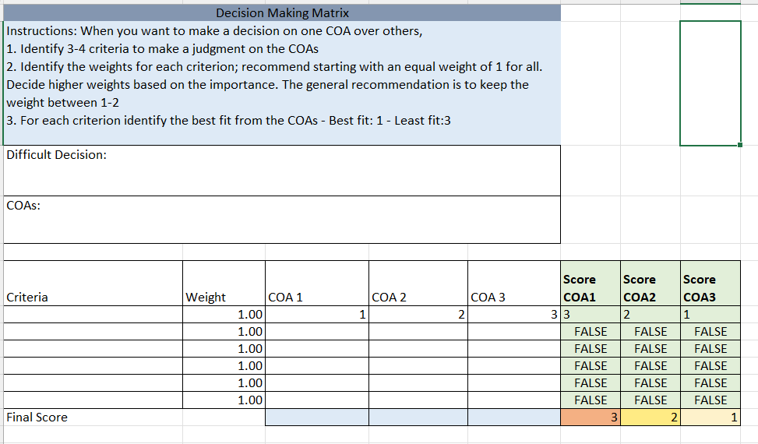
EXAMPLE: Decision Making Analysis Matrix

Slide 26
Example – Using Cloud Services
An organization wanted to make a decision on what cloud services they want to use for the next funding cycle
It was a difficult decision due to many reasons
The Director has requested recommendations for the most suitable services
He wanted the SMEs to consider funding constraints as well as the additional services the provider may have
The planning team developed 4 action plans/steps and 3 criteria to evaluate below options
  COA 1: Continue operating under the existing agreement (July 2023 – June 2024)
  COA 2: Establish new contract between MOH and an AWS Cloud reseller (must be complete before July 2028; 5-year plan)
  COA 3: Establish new contract between MOH and an AWS GovCloud reseller (must be complete before July 2028; 5-year plan)

Slide 27
The Process – Step 4: Action plans/steps
Major Project Assigned
Develop Timeline
Map out the project
Develop, Analyze, And Compare COA’s
X
Select Best COA
Publish Guidance, Execute, and Follow-up
Don’t jump to steps without determining what it is you want to do

Slide 28
The Process – Step 5: Selecting the step
Major Project Assigned
Develop Timeline
Map out the project
Develop, Analyze, And Compare Steps
Select Best Step
Publish Guidance, Execute, and Follow-up

Slide 29
Select the best action plan/step
Prepare the decision briefing for the leader using a standard template
  Slides & Oral briefing OR
  Written document
Leader selects best option that:
  Is most likely to achieve the desired end-state
  Maximizes probability of success
  Minimizes risk
Leader may choose a different option (That’s okay!)

Slide 30
The Process – Step 6: Communicate and Execute the Decision
Major Project Assigned
Develop Timeline
Map out the project
Develop, Analyze, And Compare Steps
Select Best Step
Publish Guidance, Execute, and Follow-up

Slide 31
Communicate the Decision
After the leader decides on a step, communicate the decision
Publish detailed, written guidance for others to follow
Evaluate progress
Report accomplishments back to the leader

Slide 32
Avoid these problems
Not getting a clear understanding of the problem before you assemble the planning team
Delaying planning to gather more information
  “A good plan now is better than a perfect plan later”
Not adhering to the timeline
Developing too many steps:
  At least 2; no more than 5

Slide 33

Apply decision-making process to your country teams’ work
During your group work, we encourage you to actively engage in the decision-making process.
As you collaboratively analyze and refine your definition of the problem (focus), identify action plans/steps and establish at least three clear criteria to evaluate these steps effectively.

Slide 34
Conclusion
Decision making must be done timely and usually without all the facts
Analytical decision making is a deliberate process that requires the leader’s personal involvement
Make a decision. If conditions change, you can adjust
How can you use this method in your strategic roles as mid-level leaders and managers?

Slide 35
Activity: Bring Your Own Difficult Decision (BYODD)
Builds on the current to future state plan developed on Day Three.
Brainstorm possible solutions
Produce a list of solution options ranked according to country priorities, using the Decision-Making Matrix.
Consider using global goods and/or DPGs as possible options
Notes:
// The output of this "Bring Your Own Difficult Decisions" activity that builds on the current to future state plan developed on Day Three. The aim is to guide participants to brainstorm possible solutions and produce a list of solution options ranked according to country priorities. They should use the Decision Making Matrix to do so. This will then be an input into the final activity on Day Five to produce an Action Plan. //
The "Bring Your Own Difficult Decisions" activity is aimed at asking participants to bring real-life challenging situations they are facing and collectively brainstorm solutions. This format encourages collaboration, perspective-taking, and the application of decision-making frameworks to tangible problems.
Pre-Activity:
Participants are asked to identify and briefly describe a difficult decision they are currently facing. They should be prepared to share the context, potential options, and any constraints they are aware of.
2. Activity Structure:
Introduction:
The facilitator explains the activity's purpose and the process.
Decision Sharing:
Participants take turns briefly presenting their difficult decisions. The focus is on clear and concise explanations rather than lengthy narratives.
Brainstorming:
For each decision, the group engages in brainstorming. Participants offer diverse perspectives, potential solutions, and considerations that the decision-maker might not have thought of. This could involve various decision-making models or simply open idea generation. Use the decision making matrix provided.
Action Planning:
After brainstorming, the group helps the decision-maker outline a few actionable steps they can take to move forward.
Reflection:
At the end of the activity, there is time for reflection. Participants can share what they learned from the process, both about the specific decision and about their own decision-making style.

Slide 36


COFFEE / TEA BREAK
20 MINUTES

Slide 37
Plenary:
Reflections and lessons learned from BYODD
Notes:
The "Bring Your Own Difficult Decisions" activity is aimed at asking participants to bring real-life challenging situations they are facing and collectively brainstorm solutions. This format encourages collaboration, perspective-taking, and the application of decision-making frameworks to tangible problems.
Pre-Activity:
Participants are asked to identify and briefly describe a difficult decision they are currently facing. They should be prepared to share the context, potential options, and any constraints they are aware of.
2. Activity Structure:
Introduction:
The facilitator explains the activity's purpose and the process.
Decision Sharing:
Participants take turns briefly presenting their difficult decisions. The focus is on clear and concise explanations rather than lengthy narratives.
Brainstorming:
For each decision, the group engages in brainstorming. Participants offer diverse perspectives, potential solutions, and considerations that the decision-maker might not have thought of. This could involve various decision-making models or simply open idea generation. Use the decision making matrix provided.
Action Planning:
After brainstorming, the group helps the decision-maker outline a few actionable steps they can take to move forward.
Reflection:
At the end of the activity, there is time for reflection. Participants can share what they learned from the process, both about the specific decision and about their own decision-making style.

Slide 38

LUNCH
60 MINUTES

Slide 39
Value Claims for Health Information Systems (HIS)
// Add facilitator name //

Slide 40
Solve 5+1 Informatics “Diseases”
Data to improve population health is…
not captured
not managed
not shared
not analyzed, visualized, reported
not used
Lack of learning (lack of evaluation and monitoring)
1
2
3
4
5
6
Adapted from Scholl W. Restrictive control and information pathologies in organizations. Journal of Social Issues, 1999.
Notes:
Because of these challenges and many blind-men-and-the-elephant situations in health informatics in global health, we often end up seeing these 5 diseases, where data we need to improve population health is:
Not captured
Not managed
Not shared
Not analyzed, visualized, reported
And not used
And assuming we are able to address some of the diseases above, we are not able to improve what we do because we lack evaluation and monitoring, which is an organizational learning disability.
These 6 diseases prevent us from creating value out of our information systems investments.

Slide 41
Information Value Cycle (IVC)
WISDOM
Organizational context
Information needs
Change management issues
Resources (financing, workforce, partnerships)
Information systems architecture
Vision, strategy, governance
Value Claims Across HIS Lifecycle
Inputs
Process
Outputs
Outcomes
Impact
PLAN
EVALUATE
CAPTURE
USE
Design and development
KNOWLEDGE
Implementation and maintenance
MANAGE
ANALYZE
Capture Methods
Data types and formats
Data standards
Data quality
Data security, privacy, confidentiality
Improve Population Health
Decision support
Resource allocation, improve performance
Situation awareness / amplified cognition
Disseminate health information
DATA
INFORMATION
Prescribe
Storage/Retrieval
Transformation
Exchange
Protection (security)
Integration
Value, Effort, Resources
Predict
Diagnose
Describe
Complexity
Adapted from (1) Taylor, R. S. (1982). Value-added processes in the information life cycle. Journal of the American Society for Information Science, 33, 341-346; (2) SB Thacker,et al. (2012) . Public health surveillance in the US: Evolution and challenges. MMWR Supplement, July 27, 2012, 61:3-9; (3) Types of analytics, https://www.scnsoft.com/blog/4-types-of-data-analytics; (4) Monitoring and Evaluation of Digital Health Interventions (WHO, 2016), http://www.who.int/reproductivehealth/publications/mhealth/digital-health-interventions/en/.
Notes:
To overcome these information management challenges and solve problems related to these challenges, we need ways of thinking that can help us diagnose where we can find and apply effective solutions to these challenges, or even prevent them from happening.
The Information Value Cycle is one such mental model. Each step in the IVC is an opportunity to create value that the succeeding steps can leverage. Failure to create this value upstream leads to problems downstream.
In the Planning step, we think ahead of how the information system will be used, who its stakeholders are going to be, what their information needs are, what is the organizational context in which it will be deployed, what potential change management issues we will encounter and what resources we need, including workforce and training, to support this information system.
In the Capture step, we study what methods of data capture we need to put in place, what data types and formats exist for the data we want to collect, what standards we can use and what data quality issues we will encounter for each kind of data and data source.
In the Manage step, we study what storage and retrieval methods would be most efficient and effective, what transformations we need to do so that other kinds of users can re-use the data. We also study how other users from outside organizations can access the data through information exchange. This exchange part can also be about studying how we bring other kinds of related data into our data repositories. We also have to think about how to protect the data we have from unauthorized access, thinking about privacy and security. And we think about how we can merge these different data sets.
In the Analyze step, we study ways to visualize, classify, aggregate, link these data. As we link data together, they become information and when applied in a particular context, they become knowledge. Knowledge representation is a sophisticated way to activate and enable use of information when it meets a certain context.
Then we get to the Use step, which is where we support activities that contribute to improving population health. The data we have collected can be used for decision support, either for public health or for clinical care, provide situation awareness, or we can use generated evidence for wider dissemination.
In the evaluate step, we study whether what we have created actually delivers value. We examine inputs, process, outputs, outcomes and impact for evidence of this value. The evaluate step is actually a part of planning so we can begin to envision what value we want to obtain from this information system.
But we often know the value generation models are not always well defined to start with. In model development stages, Developmental evaluation can help evolve the model as well as the evaluation framework.

Slide 42

Digital Health System Improvement and Value Claims
Health Workers / Professionals / Leaders
VALUE CLAIMS
Technology benefits
High quality system
High quality information
Human benefits
Save time and effort
Make timely decisions
Ownership and accountability
User satisfaction
Organizational benefits
High quality service delivery
Improved population health
Digital Health Systems Quality Improvement
System Implementation
(Demo, Scale-up, Integration)
System Design
(Prototype, Pilot)
System Use
INVESTMENTS
Time, Effort, Money
Notes:
Let’s start with what typically happens in systems development and implementation… (describe the life cycle briefly)
These processes requires usually massive investments in time, effort and money.
Because we want to achieve the promise of technology (net benefits)
We want to have a high quality system with high quality information.
This helps end users save time and effort, make timely decisions, exercise ownership and accountability for the system, and be satisfied with the use of the system.
This helps the organization deliver high quality service that enables good health outcomes.

Slide 43
Digital Health Systems Value Claims
Value claim: A statement of anticipated benefits from Digital Health intervention
Examples of value claims (high level):
Efficacy (performance under controlled situations)
Efficiencies (high return on investment)
Effectiveness (performance under real-world conditions)
Savings, economic benefit
Adapted from WHO, Monitoring and Evaluating Digital Health Interventions
Notes:
Here are high level examples of value claims we can make.

Slide 44
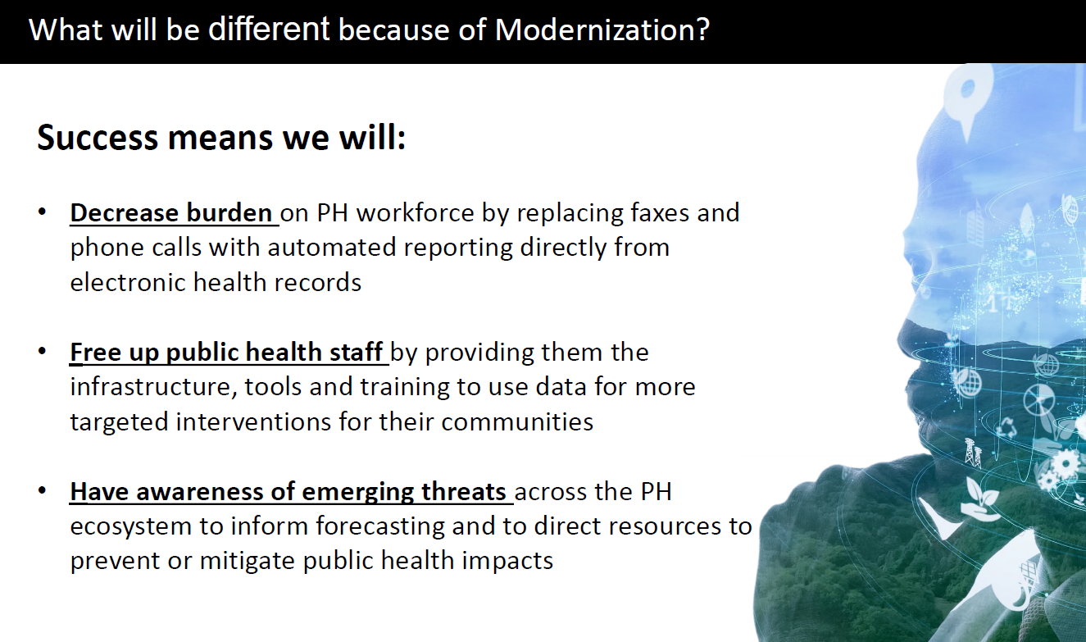
Example Value Claims
Adopted from Suzi Conner, CIO-CDC, Slide Presentation 9/29/2022 for I-LEAD

Slide 45
Designing Informatics Projects​
Know what problem the project is trying to address (the what) ​
Determine how much of the problem you can solve within a given amount of time (project scope)​
Know why this problem is important to address (the why)​
Determine the methods, steps and resources needed to address the problem (the how)​
Determine how you will measure incremental progress towards project goals (milestones)​
Apply interventions to determinants of implementation success​

Slide 46
Team Activity: Identifying Projects
Choose one priority strategy/problem
Identify a project or two to address that strategy /project
For each project:
  Describe what the project will accomplish (at a high level, the work that will be done)
  Identify value claims for your informatics project in line with its stage of maturity
    Identify stakeholders who would be interested in these value claims
    You can use the Information Value Cycle to develop your value claims
Monitoring and evaluation
  Identify what types of data you need to collect to prove value claims
  Identify what types of analysis (quantitative, qualitative, mixed) need to be done based on data collected to arrive at the answers
Notes:
Country presentations
Transcribe work from earlier in the week.
Expanded template (strategies you’re focusing on, projects, next steps)

Slide 47
Key Takeaways

Slide 48
COFFEE / TEA BREAK
20 MINUTES

Slide 49
Activity: Work on country presentation template

Slide 50


I-LEAD Country Presentation:
Highlights of Action Planning for Day 5 (Replace with Project Title(s) Here)
Country Name:
Country Team:
Use a Country Photo: Example is by Finding Dan | Dan Grinwis on Unsplash

Slide 51
Prioritized Key Issues/Gaps to be Addressed
Based on expedited ISHO Assessment – Will Inform Project(s) Selection
Issue/gap priority 1
Issue/gap priority 2
Issue/gap priority 3
Issue/gap priority 4
Issue/gap priority 5
Notes:
Please copy from the Country Presentation - Part I.

Slide 52
Narrative for the Comprehensive Recognized Issues/Gaps to be Addressed (from ISHO) + Project(s) Selection
The informatics problems, which are stated as a comprehensive narrative describing the all the issues/gaps between the current state and the desired future state in a context; which components/parts will you address with a GEEKS Tier 1 project if funds are available?
Narrative Area: Definition | Narrative Description
Current state: Describe current gaps, issues, deficiencies (e.g., informatics problems and potential root causes, consider ISHO results and key issues from pre-work)
Future state: If problem-solving is successful, we will have / see / achieve / deliver [value proposition statement] (what, where, when, for whom)
Context: Potential constraints or barriers (resources, capacity, governance and leadership, etc.)
Project 1 – Component Solution: Describe the component of the comprehensive issues/gaps Project 1 will address
Project 2 – Component Solution: Describe the component of the comprehensive issues/gaps Project 2 will address
Notes:
Add during the Tuesday group work (based on Current state to Future state)

Slide 53
Draw Toast Outputs: Process Steps
Important Note: Process steps identified as a part of the Draw Toast work can be translated to activities that you will use to populate the action plan.
Notes:
Add on Tuesday in group work
The draw toast outputs will not only describe the problem, but also help the team identify potential solutions.

Slide 54
Difficult Decision-Making Matrix
Did you encounter any difficult decisions during the problem solving and issue/gap prioritization process? If yes, include the results of your matrix here (copy and paste). If no, leave blank.
Difficult Decision (describe):
Options (list):
Criteria | Weight | Option 1 | Option 2 | Option 3 | Option 4 | Score Option 1 | Score Option 2 | Score Option 3 | Score Option 4
Notes:
If you encounter difficult problems (it becomes difficult when you have more than one possible decisions to make) the PDMP can help the team to make decisions using a structured and objective approach.
Please describe your PDMP results and how it helped you decide.

Slide 55
Project Title Development
Project | Component | Content
Case Based Surveillance and Interoperability (Example Project) | What (Goal) Who (Population) | Improving patient-level tracking of HIV sentinel events
 | How (Approach, Method) | Improving patient-level tracking of HIV sentinel events
 | Where (Setting, Location) | In selected health facilities in 11 regions in Ethiopia
 | Title | Improving patient-level tracking of HIV sentinel event in 11 Ethiopian regions through data exchange
Project 1 | What (Goal) Who (Population)
 | How (Approach/Method)
 | Where (Setting/Location)
 | Title
Project 2 | What (Goal) Who (Population)
 | How (Approach/Method)
 | Where (Setting/Location)
 | Title
Notes:
Fill out on Day 4

Slide 56

Action Plan
Take care of the minutes, and the hours will take care of themselves.

Slide 57
Project 1 Action Plan – Year 1
Project 1 Title:
ISHO Pillar | Objectives | Key Result* | Activities
Governance
Information Systems
Workforce development
* Key results – tangible, visible value claim OR metrics that measure the progress towards the objective

Slide 58
Project 2 Action Plan – Year 1
Project 2 Title:
ISHO Pillar | Objectives | Key Result* | Activities
Governance
Information Systems
Workforce development
* Key results – tangible, visible value claim OR metrics that measure the progress towards the objective

Slide 59
Other Critical Project(s) Considerations

Slide 60


END OF DAY EVALUATION
// Replace this QR code with the one generated for your evaluation form. //

Slide 61
End of day evaluation questions
I was satisfied with today’s sessions overall.
  Strongly disagree
  Disagree
  Neutral
  Agree
  Strongly agree
The [Insert session name] session was relevant to my department/country’s needs.
  Strongly disagree
  Disagree
  Neutral
  Agree
  Strongly Agree
Do you have any additional feedback on the [Insert session name] session? (Optional)
The Planning and Decision-Making Process session was relevant to my department/country’s needs.
  Strongly disagree
  Disagree
  Neutral
  Agree
  Strongly Agree
Do you have any additional feedback on the Planning and Decision-Making Process session? (Optional)
The Value Claims for Health Information Systems (HIS) session was relevant to my department/country’s needs.
  Strongly disagree
  Disagree
  Neutral
  Agree
  Strongly Agree
Do you have any additional feedback on the Value Claims for Health Information Systems (HIS) session? (Optional)
How useful were the following sessions for your country's needs? Not useful, useful, very useful
  [Insert session name]
  Planning and Decision-Making Process
  Value Claims for Health Information Systems (HIS)
Link to EOD evaluation: https://path.box.com/s/ve2wudlqp2y4cm9cmbozgq2fhpn69wyw
Notes:
Link: upload the questions to an online survey tool

Slide 62
Day Four – Wrap up
Q and A on any of the sessions today
What to expect on Day Five
Day Four reflections:
  What did you expect?
  Did this meet those expectations?
  What did you learn?

Slide 63

BREAKOUT SLIDE

Slide 64

Q&A SLIDE

Slide 65

READOUT + REFLECTIONS
SLIDE

