Slide 1
I-LEAD WORKSHOP
Facilitator Notes
This
This is the master slide deck for DAY FIVE of the I-LEAD Workshop for facilitators. It is intended to make the process of preparing and conducting the workshop easier, and the decks are designed to be customizable to your context.
Make a copy of this deck to keep as a backup.
Throughout the deck you will see facilitator instructions written in red text on the slides. The intent is that you replace this text with relevant details specific to your workshop. You will also find instructions and helpful guidance in red text in the speaker notes, along with a more comprehensive explanation of the content on the slides.
The red text in the speaker notes should be removed when you are ready to share the final deck with the workshop participants.

Slide 2
WELCOME TO THE I-LEAD WORKSHOP – DAY FIVE
Month Day Year // update to correct date//
Wi-Fi: // add Wi-Fi details //
Password: // add Wi-Fi password//

Slide 3
Agenda
Time | Session Description | Duration (minutes)
9am | Welcome and housekeeping | 10
09:10 | Country I-LEAD slide deck presentation | 30
9.40am | Activity : Developing the action plan | 60
10.40am | Feedback to plenary: Sharing Lessons Learned, Synthesis, and Next Steps/Action Steps | 30
11:10am | TEA / COFFEE | 20
11.30 am | Post Test | 30
12.00pm | Jeopardy ‘Test’ | 30
12.30am | Leveraging Peer Connections for Post-I-LEAD engagement: AeHIN, HELINA, RECAINSA communities | 30
1.00pm | Final wrap-up and certificate presentation | 30

Slide 4
I-LEAD Roadmap – Daily Outputs
Day 1
  ISHO rapid assessment review and country presentation initiation
Day 2
  Prioritized lists of gaps & opportunities for capacity strengthening across the 3WS
Day 3
  Documented key problem(s) and process for addressing them
Day 4
  Documented list of solution options
  ranked according to country priorities
Day 5
  Documented high-level action plan
Notes:
The aim of this I-LEAD workshop is to help you, as key stakeholders in digital health in our country, develop a high-level action plan for designing or adapting your digital health ecosystem and implementing sustainable digital health systems to scale.
Throughout this week the content presented and activities facilitated will help you – as multi-disciplinary teams – to develop and implement skills that will enable you to efficiently and effectively plan your digital health system ecosystem and implement sustainable digital health interventions.
Today's activity (DAY 1) will focus on helping you reflect on where you, as a country, are with digital health readiness using the ISHO rapid assessment framework and the data you have gathered in preparation for this workshop.

Slide 5
I-LEAD Roadmap – Daily Inputs and Outputs
Achieve consensus on maturity levels (strengths and gaps) based on ISHO framework pillars; Collaboratively identify country priorities & develop country presentation
Pre
I-LEAD
Learning Inputs
Informatics Savvy Health Organization (ISHO) and Assessment
Country ISHO presentation and discussion
Country I-LEAD slide deck initiation
Informatics Problem Solving (Thinking Hats, Systems Thinking)
Marshmallow Challenge (Design Thinking)
Workstream Breakout Sessions per ISHO pillar
Draw Toast - Process for definition of current state to future state
Data use for decision making and a unified a data ecosystem
Data sharing and protection
I-LEAD slide deck presentation
Action plans and next steps
Jeopardy Game
Communities of Practice (HELINA, RECAINSA, AeHIN)
Day 1
Day 2
Day 3
Day 4
Day 5
Planning and Decision-Making Process (PDMP)
Value Claims of Digital Health Systems
I-LEAD slide deck development
I-LEAD
Country Outputs
  Agreed Rapid ISHO and country
  I-LEAD slide deck initiation
  Prioritized lists of gaps & opportunities for capacity strengthening across the 3WS
  Documented key problem(s) and process for addressing them
  Documented list of solution options
  ranked according to country priorities
  Complete I-LEAD slide deck, action plan and next steps
Post
I-LEAD
Prioritize strategies for PHI advancement; Apply frameworks that have been used at I-LEAD; Champion data modernization; Implement strategies as projects
Notes:
The I-LEAD process has three phases: Slide focused on Phase 2
Phase 1: pre workshop preparations start with an live virtual introductory session for future participants which focuses on establishing what information/data required to complete the ISHO rapid assessment during Day 1 of the workshop and why, when and how this data will be gathered pre workshop.
Phase 2: the I-LEAD workshop itself – of which you are a participant. On DAY 1 of the workshop you will focus on carrying out a rapid ISHO assessment using the data / information that you have all collected about digital health readiness in your various areas of work. The workshop facilitators are here to help you as you work through this process. DAYS 2-5 of the workshop will provide you with skills, and time to test them out through groups activities, that will allow you as a multi-disciplinary group to develop a high level action plan for implementing a strong digital ecosystem comprised on sustainable digital health systems implemented to scale.
Phase 3:

Slide 6
Learning Objectives – Day 5
By the end of today’s sessions, the participants should be able to:
Use the knowledge and skills developed during the week to develop a high-level action plan to move from the current state to the desired future state.
Describe the regional groups and COPs that can be leveraged for future engagement.
Notes:
Day 1 Output: Guided inter-departmental country baseline ISHO assessment​

Slide 7
Country I-LEAD presentation
//add slide deck developed on Day 4 here//

Slide 8
Country I-LEAD presentation Q&A

Slide 9
Breakout: Developing The Action Plan
GOAL: Building on everything you have done this week, develop a high-level action plan to move from the current state to future state, according to the three ISHO pillars and in line with country priorities.

Slide 10

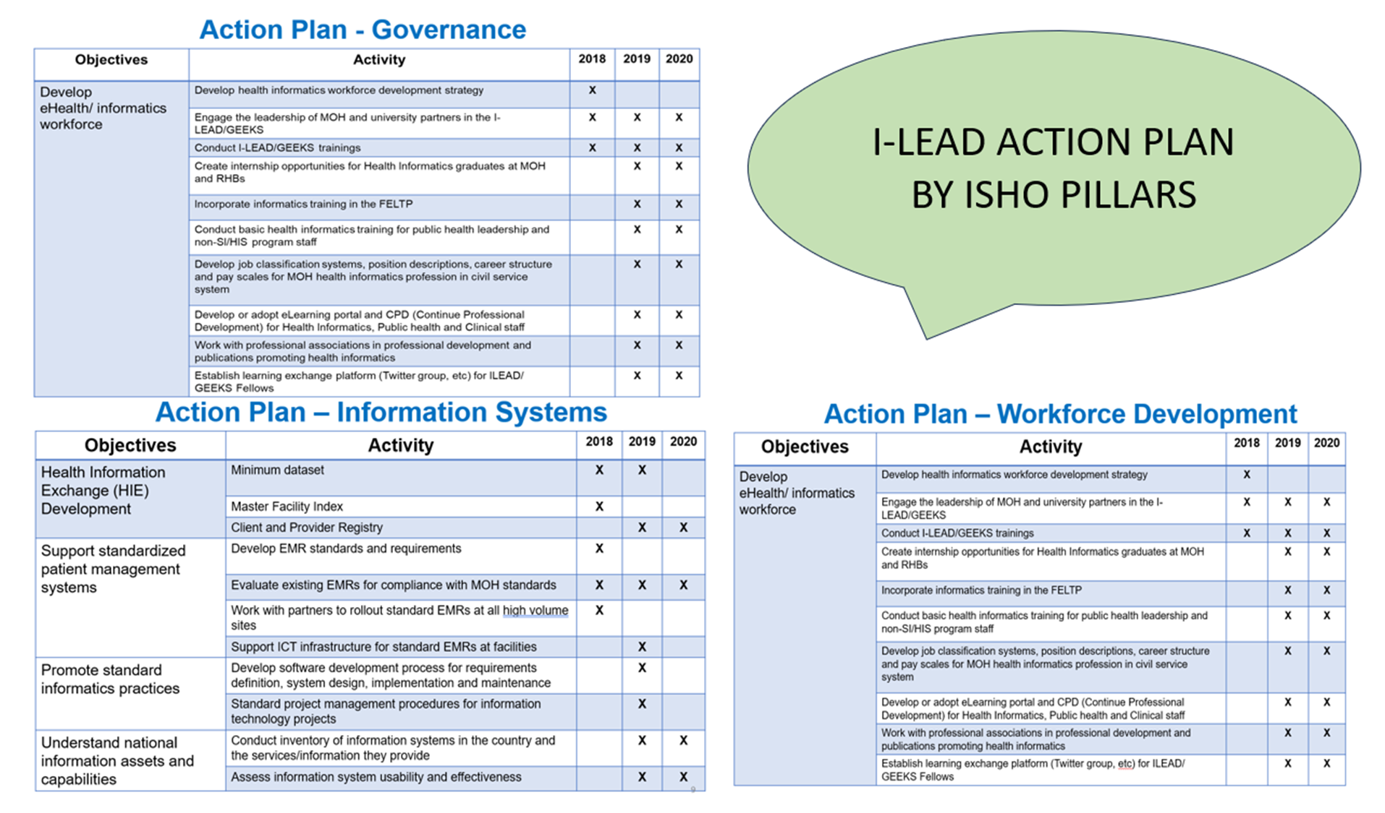
Notes:
// This is an example of what the break out groups must produce at the end of this session: a set of action plans according to the three ISHO pillars. The following slides can be used as templates by the three breakout groups.//

Slide 11
Action Plan Template - Governance
Objectives | Activity | Y1 | Y2 | Y3

Slide 12
Action Plan Template – Workforce Development
Objectives | Activity | Y1 | Y2 | Y3
Develop eHealth Informatics Workforce

Slide 13
Action Plan Template - Information Systems
Objectives | Activity | Y1 | Y2 | Y3

Slide 14
Feedback and Reflections
Action Plan

Slide 15

COFFEE / TEA BREAK
15 MINUTES

Slide 16

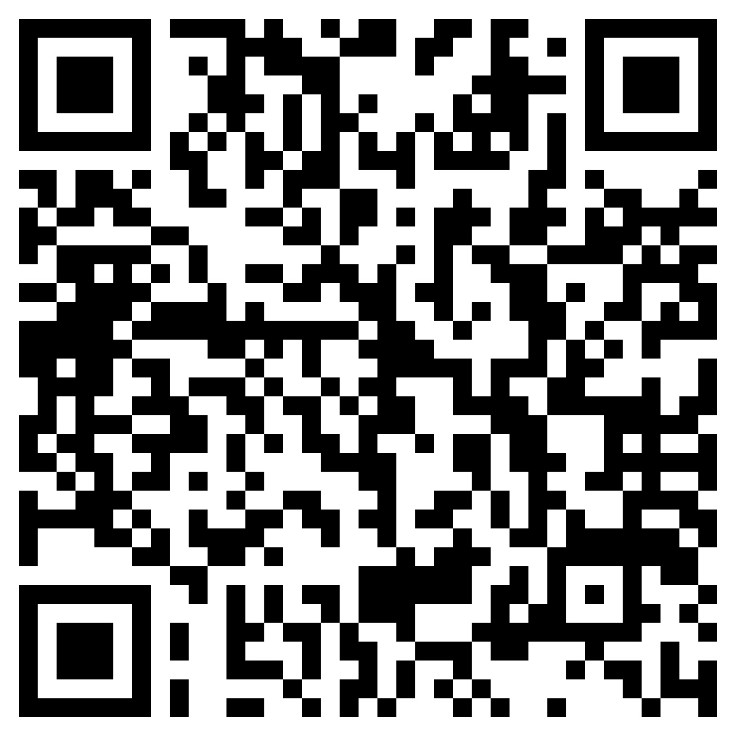
POST-TEST
// Replace this QR code with the one generated for your evaluation form. //

Slide 17
Post-test Questions
Link to post-test: https://path.box.com/s/dmn85ary82kfba8gs6imetzq2wbgwqpq
Notes:
Link: upload the questions to an online survey tool

Slide 18

JEOPARDY GAME
// Replace this QR code with the one generated for your jeopardy game. //
Notes:
// This popular and fun activity should take around 30 minutes. You will need to use this free online resource. //
https://jeopardylabs.com/build/

Slide 19
Jeopardy Game – preparing before launch
Instructions to facilitators:
Open the link to the jeopardy game: https://jeopardylabs.com/edit2/144326352
Enter password: I-LEAD
Review the questions and update as necessary
Click 'Save and Finish'
Link to jeopardy game: https://jeopardylabs.com/edit2/144326352
Password: I-LEAD
Notes:
Link: upload the questions to an online survey tool

Slide 20
Jeopardy Game – implementation
Instructions to part
Divide your participants into 3 – 5 groups (ensure in each group you have representation from day two workstreams: Information Systems and Technology, Informatics Health Policy and Governance, and Health Informatics Workforce)
Open the link to the jeopardy game: https://jeopardylabs.com/edit2/144326352
Enter password: I-LEAD
Select the number of teams from drop down menu, then click 'start'
The game will launch, allow teams to take turns to randomly select questions to answer, display the question, if they answer correctly award marks, if they miss, negative mark. Then you can pass the question to the next team if first team missed, then award/negative mark, otherwise you can skip the question till a later time.
Link to jeopardy game: https://jeopardylabs.com/edit2/144326352
Password: I-LEAD
Notes:
Link: upload the questions to an online survey tool

Slide 21

FINAL EVALUATION
// Replace this QR code with the one generated for your evaluation form. //

Slide 22
Final evaluation Questions
1. Overall, I feel: Strongly disagree, Disagree, Neutral, Agree, Strongly agree
This training addressed my organization/country’s needs related to health informatics.
The training increased my knowledge of health informatics.
The training increased my ability to solve health informatics problems in my context.
It was helpful hearing about health informatics problems and solutions in other countries.
The group discussions were productive.
During group work, I understood what I was supposed to do.
The presenters were engaging.
The training was well structured.
I will be able to apply skills and strategies I learned during I-LEAD in my daily work.
I-LEAD increased my team’s ability to solve health informatics problems collaboratively.
My team plans to implement the solutions and projects identified during I-LEAD.
This training addressed my organization/country’s needs related to health informatics.
The training increased my knowledge of health informatics.
The training increased my ability to solve health informatics problems in my context.
It was helpful hearing about health informatics problems and solutions in other countries.
The group discussions were productive.
During group work, I understood what I was supposed to do.
The presenters were engaging.
The training was well structured.
I will be able to apply skills and strategies I learned during I-LEAD in my daily work.
I-LEAD increased my team’s ability to solve health informatics problems collaboratively.
My team plans to implement the solutions and projects identified during I-LEAD.
What other content areas do you feel should be covered in future I-LEAD trainings? Please describe. (Optional)
Please share any other suggestions for improving this training. (Optional)
How satisfied are you with the training overall?
  Highly dissatisfied
  Dissatisfied
  Neutral
  Satisfied
  Highly satisfied
Link to EOD evaluation: https://path.box.com/s/ve2wudlqp2y4cm9cmbozgq2fhpn69wyw
Notes:
Link: upload the questions to an online survey tool

Slide 23


CATERING FEEDBACK
// Replace this QR code with the one generated for your evaluation form. //

Slide 24
Leveraging Peer Connections for
Post I-LEAD Engagement:
AeHIN, HELINA, & RECAINSA communities
// Add facilitator name/s //
Notes:
// For this section, the focus is on providing details of the regional networks that are key players in the digital health world that can provide opportunities for learning, knowledge sharing and networking for the course participants. Consider asking a representative from your region of they would like to participate – in person or virtually – to share information about their network. //

Slide 25




Slide 26
Asia eHealth Information Network https://www.asiaehealthinformationnetwork.org
//facilitators to coordinate with AeHIN about presenting pre workshop //

Slide 27

Pan African Health Informatics Association (HELINA) https://helina.africa/
//facilitators to coordinate with HELINA about presenting pre workshop //

Slide 28
RECAINSA https://recainsa.org/
//facilitators to coordinate with RECAINSA about presenting pre workshop //

Slide 29
Key
Takeaways
The regional digital health networks provide opportunities to:
  Learn
  Share knowledge
  Network with like-minded peers
  Get involved!

Slide 30

AWARD CERTIFICATES,
CLOSING REMARKS.

