Slide 1
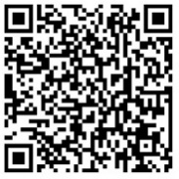
Expanding the reach of
RESPIRATORY SYNCYTIAL VIRUS disease prevention
New immunization tools to protect in early life
Presenter Names
Presentation date/location details
Last updated: January 2026
Access these and additional slides offered as part of an RSV communications toolkit at:
bit.ly/RSVInfoToolkit

Slide 2


Why focus on respiratory syncytial virus (RSV)? And why now?
RSV is the world's top cause of severe respiratory infections and hospitalization in young children. New immunization tools could help change that.
New tools for preventing RSV in early life have been licensed in many countries and are recommended for global use by the World Health Organization (WHO).¹
vaccine given in pregnancy
long-acting monoclonal
antibody (mAb) given to
young infants
An overdue chance to address an under-recognized cause of
Adding RSV to the immunization toolkit could
keep children out of the hospital
save many young lives
free up resources for other health priorities
millions of hospitalizations
thousands of deaths
strain on health systems and livelihoods
Now is the time to raise awareness and support global, regional, and country decision-making around RSV prevention, policy, and implementation preparedness.
¹ WHO position paper on immunization to protect infants against respiratory syncytial virus disease. Weekly Epidemiological Record. May 2025. Accessed at: https://www.who.int/publications/i/item/who-wer-10022-193-218
Notes:
Today, I’m here to talk about progress in the fight against respiratory syncytial virus, or RSV.
RSV has long been a significant, yet under-recognized, public health problem—and we’ve never had a better opportunity to address it than now.
This common virus is responsible for more acute lower respiratory infections and hospitalizations in infants and young children worldwide each year than any other pathogen.
Yet, many people have never even heard of RSV, unless they’re parents or health providers that must care for the children sickened by it.
New products that can prevent severe RSV disease in young children have been licensed in many countries and are recommended for global use by the World Health Organization (WHO). Other products also continue to be in development.
This is exciting because of a historic lack of an RSV vaccine and only one prevention option during the last decade—a monoclonal antibody used in very few children due to its high cost and burdensome schedule of administration.
The new products are designed to induce passive immunity, which results when a person is given antibodies that are either derived from someone else or are manufactured. They include:
A maternal RSV vaccine for delivery during pregnancy, for which Gavi has committed to support introduction.
Also, a long-acting monoclonal antibody (mAb) for delivery soon after birth or before/during the first RSV season.
RSV immunization is an important step toward defeating a virus that puts millions of children in the hospital, causes thousands of deaths, and strains health systems and livelihoods.
Getting there will take work, coordination, and venturing into new territory in some cases.
Countries will need to consider how RSV prevention could fit within their public health agendas.
The time is now to raise awareness and support such decision-making around RSV prevention, policy, and implementation preparedness—at global, regional, and country levels.

Slide 3

Agenda
 | RSV disease burden a huge, under-recognized, public health problem
 | New prevention products maternal vaccines & long-acting mAbs to protect the youngest children
 | The road to RSV prevention priorities and opportunities
Notes:
Today, we’ll discuss the basic considerations around RSV prevention, including
Disease burden
New products to prevent RSV disease in early life
And talk through a high-level overview of priorities and opportunities on the road to RSV prevention.
This discussion is meant to provide a foundation of understanding around these issues.

Slide 4
RSV disease burden
a huge, under-recognized public health problem

Slide 5
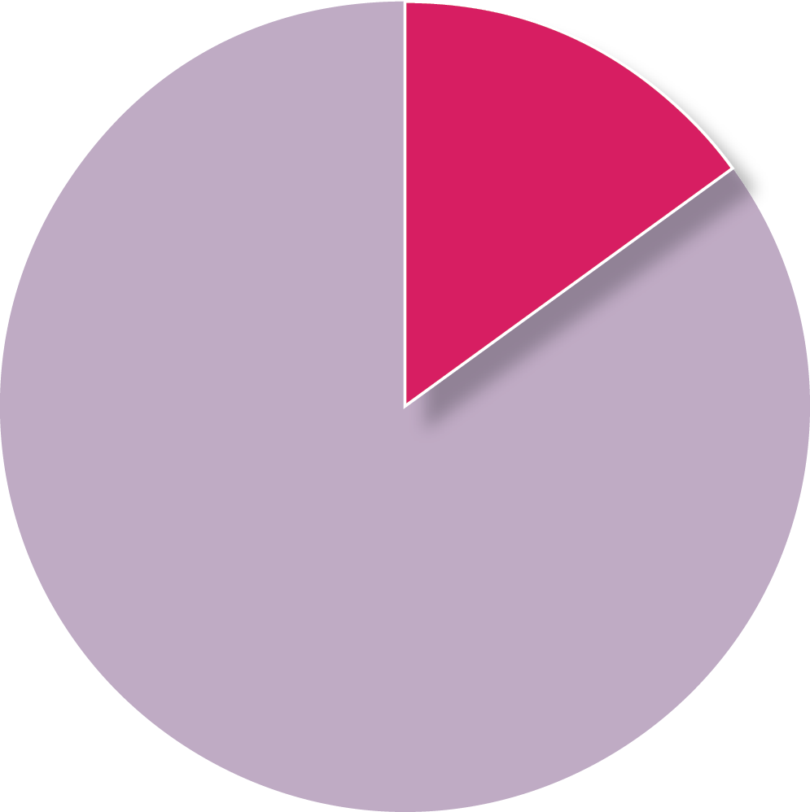
Pneumonia is the #1 cause of child mortality worldwide
PNEUMONIA IS RESPONSIBLE FOR
15% OF ALL-CAUSE <5 MORTALITY
(> 700,000 deaths per year)¹
Controlling RSV is critical in the larger pneumonia fight because it
is the most common cause of infant pneumonia and bronchiolitis
is a leading cause of pneumonia deaths in the first 6 months of life
causes up to 40% of severe pneumonia cases before 1 year of age²
increases vulnerability to pneumonia caused by other viruses and bacteria
Pneumonia
15%
Other causes
¹ Interim WHO-MCEE cause of death for children under-5 years (September 2019) updated using cause fractions from 2017 and applying them to UN-IGME estimates for 2018.² Pneumonia Etiology Research for Child Health (PERCH) Study Group. Lancet. 2019.
Notes:
The world has long been embroiled in the fight against pneumonia, which continues to be the #1 killer of children before their fifth birthdays each year worldwide.
That’s 15% of all-cause child mortality—or a life lost every 43 seconds.
As a leading cause of infant pneumonia, RSV is a big part of the pneumonia equation requiring solutions.
RSV causes up to 40% of all pneumonia cases before 1 year of age and is the leading cause of pneumonia deaths before 6 months of age worldwide.

Slide 6
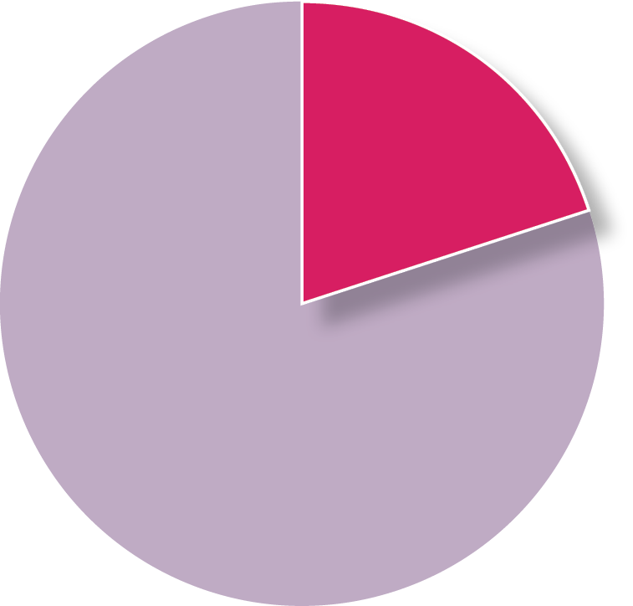
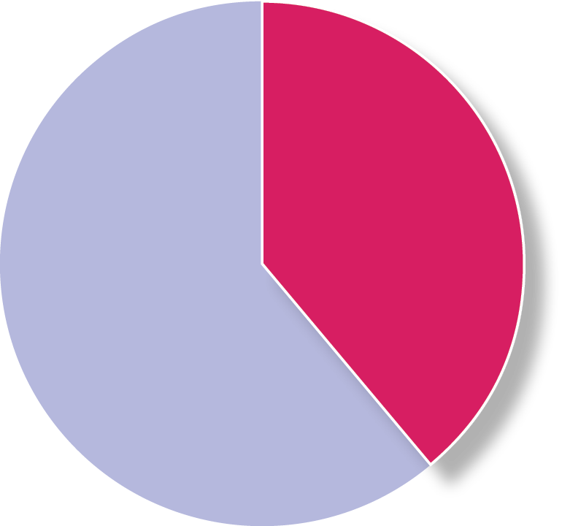
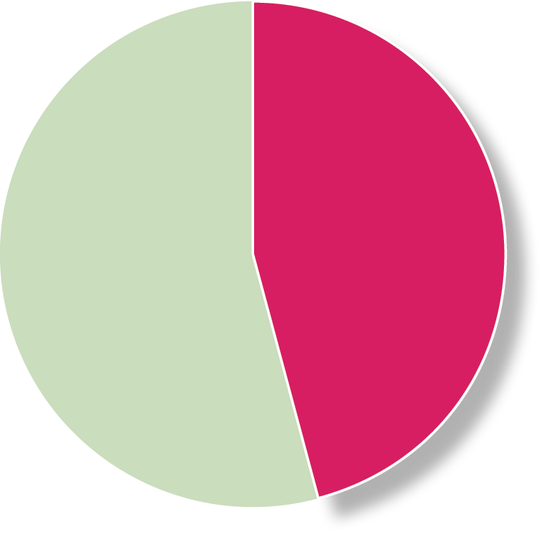
Annual global pediatric RSV disease burden (< 5 years of age)
LEADING CAUSE OF SEVERE RESPIRATORY INFECTION
LEADING CAUSE OF PEDIATRIC HOSPITALIZATION
IMPORTANT CAUSE OF PEDIATRIC MORTALITY
33 million
episodes
3.6 million
hospitalizations
101,000
deaths
< 6 months
20%
< 6 months
39%
< 6 months
46%
Nearly half of RSV deaths are before 6 months of age
6 months to 5 years
80%
6 months to 5 years
61%
6 months to 5 years
54%
TOTAL GLOBAL CHILD MORTALITY DUE TO RSV
3.6%
< 6 MONTHS
2.3%
< 5 YEARS
Reference: Li Y, et al. Lancet 2022.
Notes:
In 2022, the global annual RSV burden estimates were updated and published in the Lancet.
These estimates found that, in 2019, RSV was responsible for a staggering 33 million episodes of acute lower respiratory tract infection, approximately 3.5 million hospitalizations, and over 100,000 RSV deaths among children less than five years of age worldwide.
Overall RSV accounts for 2% of the global mortality burden in children under 5 years of age and 3.6% among children under 6 months of age.
RSV in children under 6 months of age accounts for 20% of acute lower respiratory infection episodes and almost half of all RSV deaths in children under 5 years of age.

Slide 7




What is RSV?
RSV is so widespread that almost all children contract the virus before 2 years of age.
Often mild, like a cold, but can be severe (or deadly) for infants. | Sneezing, coughing, quiet breathing, touching contaminated surface and then eyes, nose, or mouth | Infection-induced immunity not fully protective Repeated lifelong infections | Any child can get severely ill and be hospitalized. Most with severe disease are born full term and have no underlying health conditions Additional factors that increase risk: Premature birth Comorbidities (e.g., prematurity, underlying heart/ lung disease) Living in socioeconomically disadvantaged areas
PRESENTATION
TRANSMISSION
PARTIAL IMMUNITY
PEDIATRIC POPULATIONS AT HIGH RISK OF SEVERE DISEASE
Notes:
Virtually everyone gets RSV at some point in their lives, usually by two years of age.
RSV disease is often mild, like a cold, but can be severe (or deadly) for infants.
Transmission can occur through sneezing or coughing and transference from contaminated surfaces.
Repeated infections can occur over a lifespan.
Although any child can get severely ill or hospitalized due to RSV, children are at highest risk if they are under 6 months of age, have co-infections, or live in a socioeconomically disadvantaged area.

Slide 8
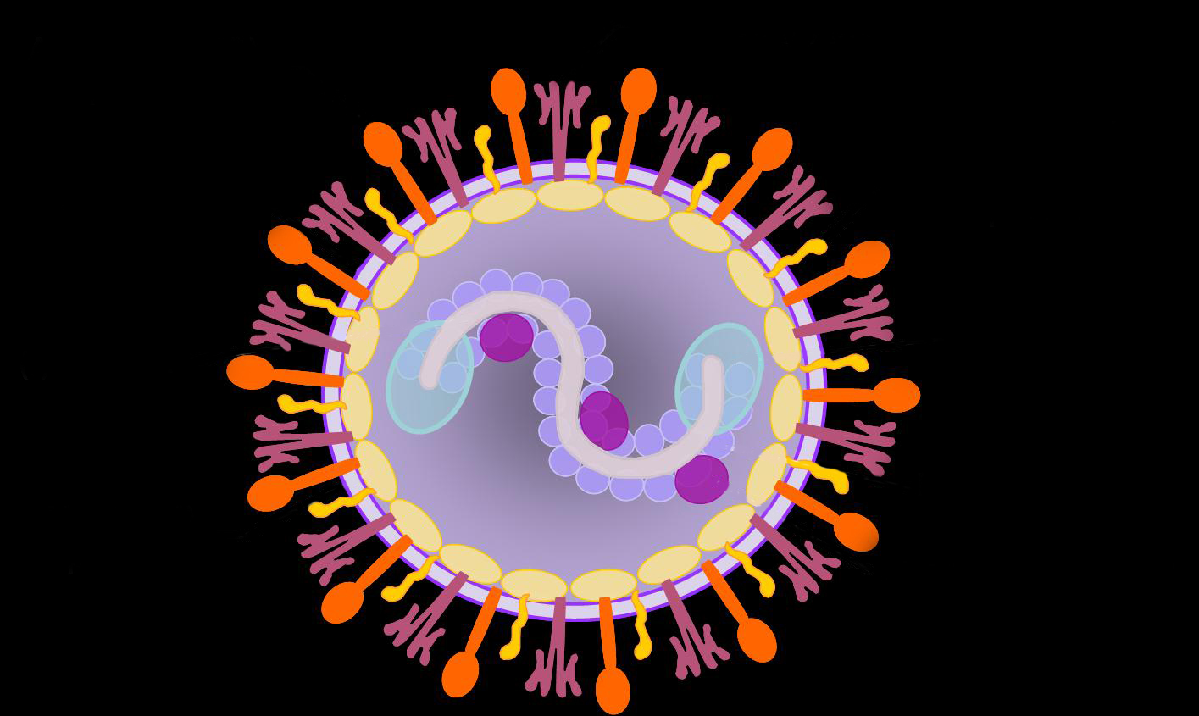
About the virus
Single stranded RNA virus.
Airway obstruction may occur due to sloughed epithelium and inflammatory cells with mucus and fibrin that get into small airways.
Immune target → RSV fusion (F) protein
  F protein on surface of virus fuses with host epithelial cells in the lung, enabling infection
  Similar to spike protein in SARS-CoV-2
Fusion (F) protein
Notes:
Just to touch on the science of the virus itself, RSV is an RNA virus, similar to the SARS-COV-2 virus that causes COVID-19.
The virus attacks cells in the upper and lower respiratory tracts, which causes the body to slough cells that build up in the airways causing mucus and making breathing difficult.
If this happens and you’re an infant with small airways, you’re in trouble.
The immune target is a protein on the surface of the virus called a fusion, or F, protein, which is the component of the virus that fuses to host epithelial cells, enabling the virus to infect the cell.
We’ll get more into why the F protein plays a key role in vaccine development later in the presentation.

Slide 9





RSV’s biggest risks are in the youngest children
6 months
1 IN EVERY 28 DEATHS
before 6 months of age globally is due to RSV¹
Most severe in first few months of life due to easily blocked small airways.
Reference: PERCH Study Group. Lancet. 2019.
Notes:
The first few months of life are the most vulnerable to RSV due to the ease with which an infant’s small airways can be blocked.
Serious complications of RSV include bronchiolitis and pneumonia and can lead to long-term complications for lung health.
To put things in perspective, RSV is responsible for 1 in every 28 deaths that occur before six months of age—a tragedy destined to continue until we do something about it.

Slide 10
98% of pediatric RSV mortality occurs in low- and middle-income economies¹
In children < 6 months of age, RSV is responsible for:
HIGH-INCOME
LOW-INCOME
Many children in low-income economies never make it to a hospital.²
4x
as many children
die from RSV
in the community than
in the hospital
24
hospital deaths
/ 1,000 RSV cases
109
community deaths
/ 1,000 RSV cases
<1
hospital deaths / 1,000 RSV cases
<1
community deaths / 1,000 RSV cases
The disparity in RSV mortality between
low- and high-income contexts is substantial.
¹ Li Y, et al. Lancet. 2022; ² Srikantiah P, et al. Clin Infect Dis. 2021.
Notes:
Over 98% of RSV deaths occur in low- and middle-income countries.
As this graphic shows, children in low-income countries are less likely to have access to adequate medical care, so are far more likely to die from RSV than children in high-income nations—an unacceptable disease burden disparity.
To break it down further, RSV deaths among children 6 months of age and younger in low-income settings are 4 times more likely to occur in the community than they are to occur in the hospital.
This is because the vast majority of children with severe RSV don’t make it to the hospital where they can receive supportive care, increasing their likelihood of dying.
Causes of deaths in the community are often unknown or unreported, and as such, RSV morbidity and mortality in these contexts is thought to be even greater than current estimates suggest.

Slide 11
Testing and surveillance—current status
PCR and antigen tests can diagnose RSV infection. Most RSV data are from high-income areas, though data are available from all WHO regions. RSV as common in low- and middle-income areas as high. More data needed on disease burden nuances at country levels. | Many places don’t test for RSV in clinical care. More RSV testing and surveillance needed, including in low- and middle-income areas. WHO is leveraging the Global Influenza Surveillance and Response System (GSIRS) to help, but additional efforts are needed
Notes:
RSV can be diagnosed via polymerase chain reaction (PCR) and antigen tests.
Traditionally, RSV isn’t tested for in hospitals or clinics or as part of clinical care on a routine basis.
This is true nearly everywhere, but even more so in low- and middle-income areas of the world.
Still, there have been studies and surveillance conducted in all WHO regions.
Where testing does occur, RSV is just as common in low- and middle-income areas of the world as in high-income ones.
One of several efforts making progress is WHO’s work leveraging the Global Influenza Surveillance and Response System (GSIRS) to support RSV surveillance and testing in 25 countries
More RSV testing and surveillance is needed overall, especially in low- and middle-income areas to understand the nuances of RSV in different settings.

Slide 12



Current treatment and prevention for young infants
SUPPORTIVE CARE (e.g., hydration, nutritional support, oxygen, and ventilation) No licensed antivirals for RSV Inappropriate antibiotic use poses antimicrobial resistance threat | MATERNAL VACCINE (NEW) Vaccination in pregnancy can prevent RSV disease in infant’s early months of life (WHO recommended and prequalified; recommended by Pan American Health Organization (PAHO) Technical Advisory Group; Gavi, the Vaccine Alliance to support). Progress is underway toward introduction in LMICs | PALIVIZUMAB (EXISTING) Short-lasting mAb that can prevent severe RSV in high-risk infants Use is limited to high-income countries Requires up to 5 monthly doses Expensive/ impractical for low- and middle-income markets NIRSEVIMAB & CLESROVIMAB (NEW) Long-acting mAb given soon after birth or before/during first RSV season (WHO recommended) Price and supply may be early barriers to global access, requiring market shaping to overcome
TREATMENT/MANAGEMENT
VACCINE PREVENTION
MONOCLONAL ANTIBODY (MAB) PREVENTION
Notes:
Current treatment measures are limited to supportive care, such as oxygen, and complicated by scarce resources in many parts of the world.
No antiviral medications are licensed for RSV.
Inappropriate antibiotic use to treat a widespread virus like RSV also compounds the growing crisis of antimicrobial resistance.
Until recently, the only available preventive agent for RSV had been a mAb called palivizumab.
It is recommended for use in limited settings in the highest-risk infants as a monthly injection with 5 doses administered during the RSV season.
As such, this product has been unaffordable and impractical for most countries, so its use has largely been limited to high-income markets.
In 2022, a new long-acting mAb called nirsevimab, achieved first approvals in Europe and then, in 2023, in the United States.
It is designed to be given to an infant soon after birth or before/during the first RSV season to protect in early life.
This showcases long-acting mAbs delivered in one dose as the wave of the future by providing longer lasting protection than palivizumab and reducing touch points for delivery.
In 2025, a second long-acting mAb called clesrovimab was approved by the US Food and Drug Administration, adding yet another tool to the RSV prevention arsenal.
In another groundbreaking development, a maternal RSV vaccine achieved initial licensures in the United States and Europe in 2023.
It is delivered to an expectant mother for the prevention of severe RSV disease in infants..
The vaccine demonstrated efficacy and a positive Benefit:Risk safety profile in Phase 3 clinical evaluation.
The maternal vaccine and nirsevimab are being used in a number of countries, but neither product is yet globally available.
Though not yet available globally, the maternal vaccine is on the pathway to global market entry.
Price and supply are expected to be early barriers to global access for the long-acting mAbs, however, and will likely require market shaping efforts to overcome.
Nevertheless, the mabs are an exciting and game changing class of prevention products against RSV.
In September 2024, WHO recommended maternal RSV vaccine and long-acting RSV mAbs for introduction in all countries, marking a key step in the policy pathway to their lifesaving use, especially in low- and middle-income markets where the vast majority of RSV deaths occur.
In March 2025, the maternal RSV vaccine achieved WHO prequalification, which is a requirement for the product to be eligible for Gavi financing and to be purchased by UN agencies like UNICEF for use in low- and middle-income markets.
The Pan American Health Organization (PAHO) Technical Advisory Group also recommends the maternal vaccine.
Both products could have a large impact in protecting infants in the first, most at-risk months of life.
Now, the WHO recommendation for RSV immunization is an opportunity to catalyze preparations for putting these products to lifesaving use more broadly, overcoming barriers to access and implementation, enabling informed product choice, and shortening the timeline for product availability in low- and middle-income markets
An important next step therein will be to accelerate the timeline to global market access.
In July 2025, Gavi committed to opening a funding window for establishing an RSV maternal vaccine program, paving the way for country introductions to begin.

Slide 13

Pneumonia Etiology Research for Child Health (PERCH) study
Top 10 causes of severe pneumonia before 5 years of age in 7 countries in Africa and Asia
RSV
31.1%
(28.4, 34.2)
Sites in Bangladesh, Gambia, Kenya, Mali, South Africa, Thailand, Zambia
Rhinovirus 7.5%
(5.3, 10.1)
hMPV 7.5%
(5.9, 9.5)
Parainfluenza 7.4%
(5.8, 9.3)
Influenza 2.0%
(1.1, 3.2)
Pneumococcus 6.7%
(5.1, 8.5)
H. influenzae
5.9%
(3.8, 8.5)
Staph
2.7%
(1.5, 4.3)
TB 5.9%
(3.9, 8.3)
P. Jirovecii
2.0%
(0.9, 3.3)
VIRUSES
BACTERIA
TB
FUNGI
Reference: PERCH Study Group; Lancet, 2019.
Notes:
Most information on the burden of RSV comes from prospective surveillance studies, PERCH being one of the largest studies of pediatric pneumonia in LMICs every conducted.
Conducted from 2011-2014, the PERCH study set out to determine the etiology of pneumonia in children hospitalized in 7 countries: 5 in Africa and 2 in Asia.
The study enrolled over 4,000 (4,232) children hospitalized with cases of severe and very severe pneumonia, and collected many specimens and performed multiple diagnostic tests.
The study included over 5,000 controls (5,325).
A unique analytic algorithm was used to identify the etiology of each pneumonia episode.
RSV was found to be the most common etiology among both severe and very severe pneumonia by orders of magnitude.
Although it may not look so at first glance, the area of the RSV circle is proportionally correct in comparison to the other disease circles. RSV makes up a staggering percentage of the pneumonia pie.
It was the most common etiology in children of all ages but particularly infants in the first year of life, where it accounted for close to 40% of all pneumonia cases.

Slide 14
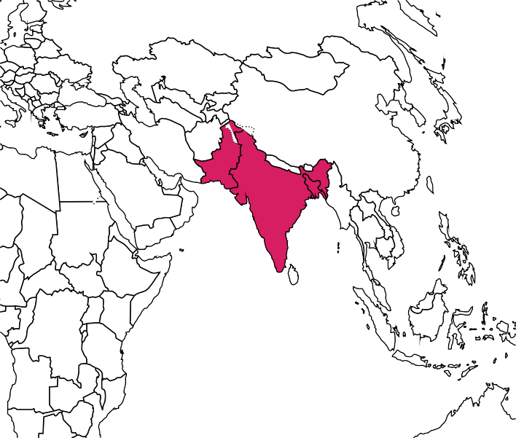
Aetiology of Neonatal Infections in South Asia (ANISA) study
Top 10 causes of community-acquired serious infections in neonates in 3 countries in South Asia
RSV
6.48% (5.81-7.59)
Ureaplasma spp
2.82 (1.93-3.77)
Other blood culture
2.57 (2.05-3.11)
Klebsiella pneumonaiae
1.79 (1.17-2.49)
Escherichia coli
1.71 (1.05-2.62)
Enterovirus or rhinovirus
1.36 (0.83-2.37)
Salmonella spp
1.28 (0.53-2.52)
Streptococcus pneumoniae
1.15 (0.70-1.98)
Group B Streptococcus
1.12 (0.65-1.71)
Sites in Bangladesh, India, and Pakistan
Staphyloccocus aureus
1.05 (0.63-1.68)
Reference: Saha, S. et al. Lancet, 2018.
0
1
2
3 4 5
Proportion of pSBI episodes (%)
6
7
8
Notes:
Another large study called ANISA took place from 2011 to 2014 at 5 sites in 3 South Asian countries, Bangladesh, India, and Pakistan.
The purpose was to estimate proportions of specific infectious causes of possible severe bacterial infections in children <2 months of age in comparison to healthy controls.
Surprisingly, RSV was identified as the most detected pathogen in children with possible serious bacterial infection in the first two months of life, identified in 6.5% of all infections.

Slide 15
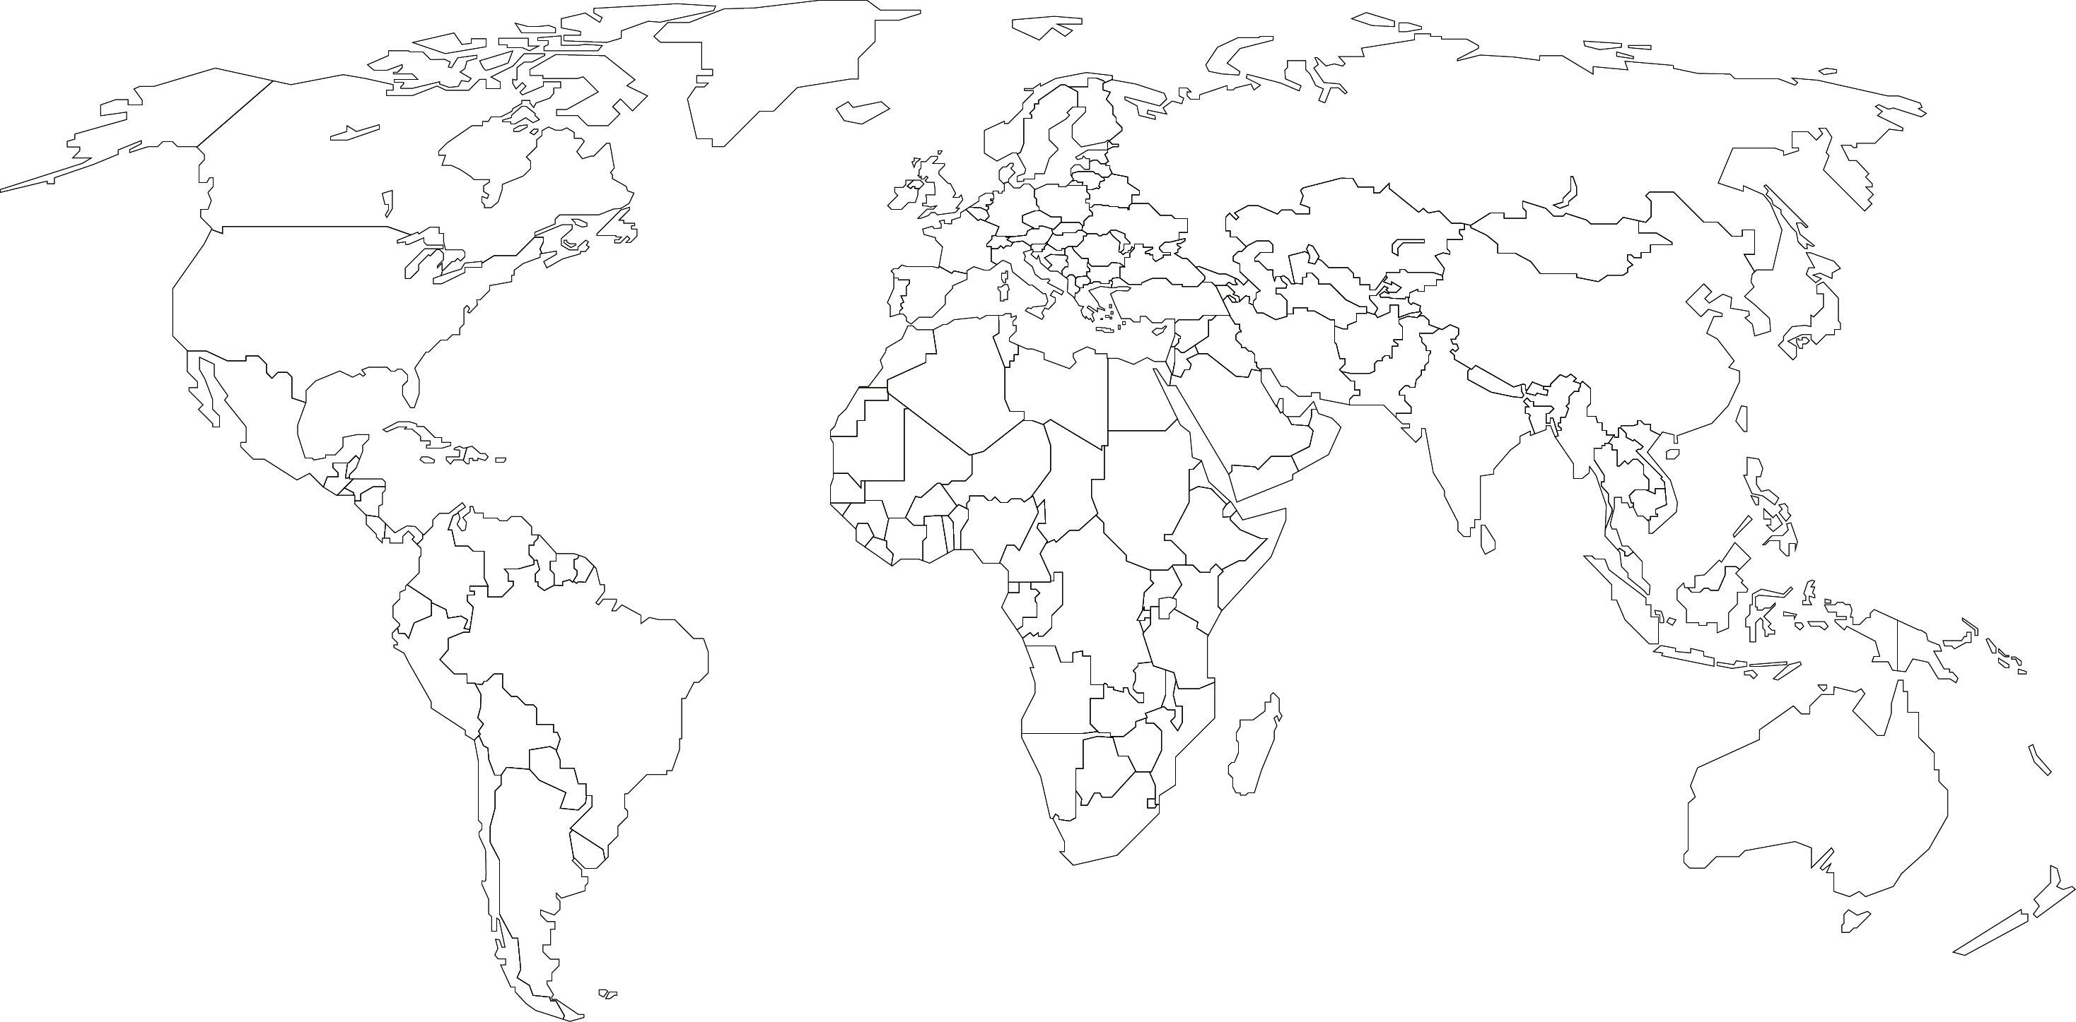
RSV prevention strategies may need to account for seasonality
Seasonal virus activity observed in many areas around the world but can be year-round in others.¹
Timing of seasonal RSV circulation can vary year-to-year, adding complexity to prevention efforts.
Some prevention and treatment strategies could be calibrated to times of year when people are most at risk.
TEMPERATE
well-circumscribed seasonality
EQUATORIAL
year round circulation
SUBTEMPARATE / SUBTROPICAL
seasonal peaks with
low level year-round circulation
¹Li Y et al, Lancet Global Health. 2019.
Notes:
In developing RSV prevention strategies, RSV seasonality will be an important consideration.
Seasonal RSV activity is observed in many areas.
Temperate regions have clear seasonality, usually during autumn and winter.
Subtemperate (or subtropical) areas have seasonal peaks with low-level, year-round circulation.
Equatorial areas have year-round circulation.
Timing of seasonal RSV circulation can vary year to year, adding complexity to prevention efforts.

Slide 16
RSV illness strains health systems and livelihoods
Impacts on livelihoods
Lack of prevention measures means that health systems and households must bear the costs of managing RSV cases and complications.
Economic burden is substantial in high-income countries, where most data has been generated.
Available data in low- and middle-income economies show substantial burden on health systems and households.
More health economics data are needed to inform decision-making around RSV prevention.
32%
OF TOTAL MONTHLY
HOUSEHOLD INCOME PER RSV EPISODE
Malawi¹
24%
Bangladesh²
OF MONTHLY INCOME
FOR FAMILIES PER
RSV HOSPITALIZATION
32%
OF MONTHLY INCOME FOR
POORER FAMILIES PER RSV
HOSPITALIZATION
Impacts on health system
$10M USD
MEDIAN ANNUAL DIRECT COST OF RSV HOSPITALIZATION
Bangladesh²
Gambia, Mali, Kenya, South Africa³
5-10%
OF HOSPITAL ADMISSIONS OF CHILDREN < 5 YEARS OLD DUE TO RSV
¹Baral R, et al. J Pediatric Dis Soc. 2020. ²Bhuiyan MU, et al. J Glob Health. 2017. ³PERCH Study Group. Lancet. 2019.
Notes:
RSV’s impacts go beyond just illness and death.
The historic lack of widely available prevention measures has meant that families and health systems have had to bear the brunt of the economic costs of managing RSV cases and complications.
Existing and emerging data show that RSV causes substantial economic burden on livelihoods and health systems across the spectrum of country income levels.
For example, the average cost for a single hospital inpatient visit for RSV has been estimated at 32% of a household’s monthly income in Malawi.
In Bangladesh, the median out of pocket cost of RSV hospitalization is around 24% of monthly household income. For poorer families, the percentage rises to 32%.
In terms of costs to health systems, the median annual direct cost of hospitalization in Bangladesh is around $10 million USD.
PERCH found that across 5 African countries, a range of 5-10% of hospital admissions among children younger than 5 years of age were due to RSV.
Overall, widespread RSV prevention could go a long way toward freeing up valuable resources for households and health systems.

Slide 17
New prevention products
maternal vaccines and long-acting mAbs to protect the youngest children

Slide 18
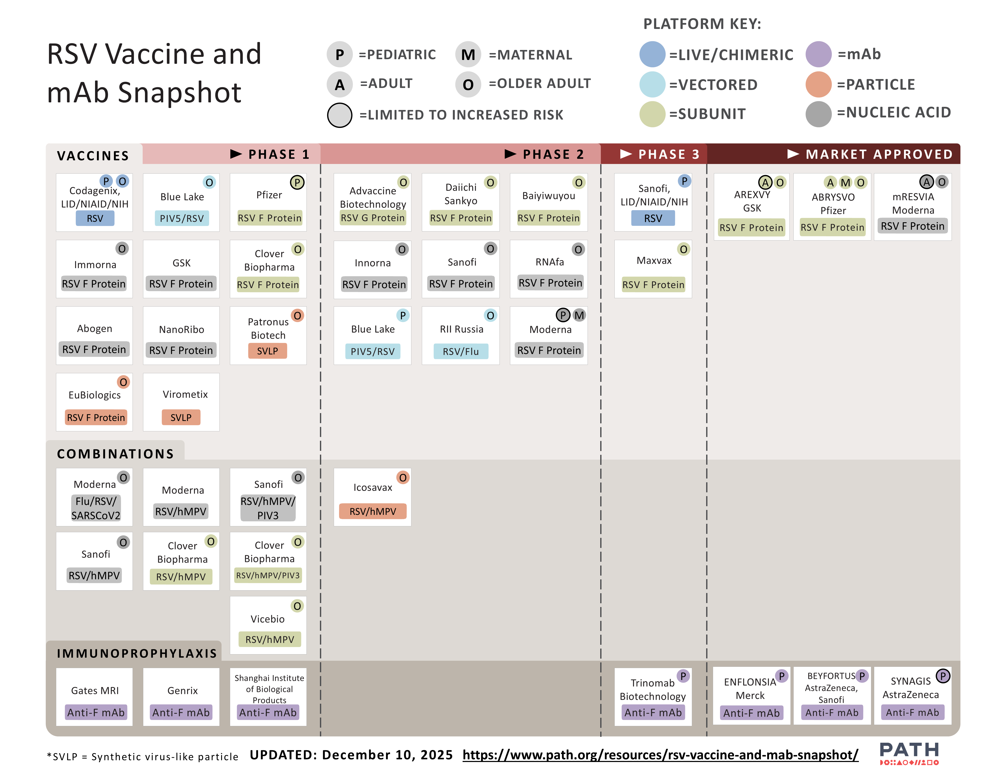
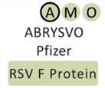
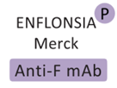
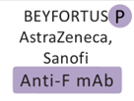
New hope of preventing RSV in infants—a product development renaissance
1956
RSV discovered
1960s
RSV vaccine development stalls
Formalin-inactivated, pediatric RSV vaccine candidate shown to cause enhanced respiratory disease in RSV-naïve infants during first natural infection
1998
Short-acting mAb licensed Palivizumab
2010s
Breakthroughs in RSV understanding spark product development renaissance
2013
Key technology—RSV pre-fusion (F) protein
Pre-fusion conformation of the F protein discovered as safe and promising immune target
Neutralizing antibodies target pre-F protein and prevent virus from fusing to and infecting host cells
Removes risk of causing enhanced disease
2022
Long-acting mAb first licensure Nirsevimab (pre-F)
2023
Maternal vaccine and vaccines for older adults first licensures; PAHO recommends maternal vaccine Recombinant pre-F vaccines
www.path.org/resources/rsv-vaccine-and-mab-snapshot/
2024
WHO recommends maternal vaccine and/or long-acting mAb for introduction in all countries
2025
Maternal RSV vaccine achieves WHO prequalification and commitment for Gavi support; second long-acting mAb licensure for clesrovimab
Maternal vaccine
WHO recommended and prequalified; Gavi-supported
Long-acting mAb (clesrovimab)
US Food and Drug Administration approval
Long-acting mAb (nirsevimab)
WHO recommended
Notes:
The medical community has been looking for ways to prevent severe disease from RSV for the past many decades, since the virus was identified in 1956. But it has faced obstacles in developing a vaccine.
Efforts stalled due to safety concerns after clinical trials for a vaccine candidate in 1966 resulted in exacerbated disease in RSV-naïve participants who were subsequently naturally infected.
The monoclonal antibody, Palivizumab, was licensed in 1998, but isn’t widely available in low- and middle-income economies due to cost and delivery barriers.
Now, however, a development renaissance of RSV prevention products has been underway—spurred by scientific breakthroughs in the 2010s that improved our understanding of RSV and led to the development of new technologies that are not at risk of causing enhanced disease.
So, let’s return to the F protein that we mentioned at the beginning of this talk.
In 2013, a key advancement was the identification of the pre-fusion conformation of the RSV F protein in the virus.
Neutralizing antibodies target the pre-F protein, preventing cells from being infected.
This new technology LED TO MORE EFFECTIVE PREVENTION PRODUCTS that provide longer lasting immunity—and resolves the safety risks seen with the formalin-inactivated approach of the 1960s.
For protection in infants and young children, emerging out of development are long-acting monoclonal antibodies and a maternal vaccine for delivery in pregnancy—all of which are based on the pre-F technology.
AstraZeneca’s long acting mAb, nirsevimab, first achieved licensure in 2022 in Europe and then in the US in 2023—though this product is expected to require market shaping for global access to be possible.
Another development in 2023 was that the US Food and Drug Administration approved GSK’s recombinant pre-F RSV vaccine, Arvexy, in May 2023 and later Pfizer’s Abrysvo in June 2023 for the prevention of lower respiratory tract disease caused by RSV in individuals 60 years of age and older.
These were the first licensures of any RSV vaccine ever.
In an exciting development for the global market, Pfizer’s pre-F RSV vaccine, Abrysvo, was first approved in the US and Europe for use in pregnancy and is now approved and being used in a number countries. It is not yet globally available though.
In September 2024, the World Health Organization’s Strategic Advisory Group of Experts on Immunization (WHO SAGE) recommended that all countries introduce maternal vaccination and/or long-acting monoclonal antibody (mAb) administration for the prevention of severe respiratory syncytial virus (RSV) disease in young infants. In May 2025, WHO published its first-ever position paper outlining these recommendations to protect children from RSV.
A WHO recommendation is a necessary step in the policy pathway to scale and support use of immunization products, especially in low- and middle-income markets where need is greatest.
The WHO recommendation is an opportunity to catalyze preparations for putting these products to lifesaving use more broadly, overcoming barriers to access and implementation, enabling informed product choice, and shortening the timeline for product availability in low- and middle-income markets.
In March 2025, the maternal RSV vaccine achieved WHO prequalification, which enabled the product to be eligible for Gavi financing and to be purchased by UN agencies like UNICEF for use in low- and middle-income markets.
In July 2025, Gavi committed to opening a funding window for establishing an RSV maternal vaccine program, paving the way for country introductions to begin.
Another long-acting RSV mAb candidate developed by MSD (Merck) called clesrovimab (trade name ENFLONSIA) received US Food and Drug Administration approval in June 2025.
Having a second available monoclonal antibody might lead to broader global market access for these effective products.

Slide 19

New products emerging for prevention in early life
 | Maternal vaccine | Monoclonal antibody
 | Vaccination in pregnancy can directly enhance the pregnant vaccinee’s immunity and increase natural antibody transfer to baby across the placenta for protection in early life. | Directly immunizing infants provides antibodies for critical protection in early life.
 | Pre-F protein in the vaccine induces antibodies that neutralize the virus. | mAbs are manufactured antibodies to the RSV pre-F protein that neutralize the virus.
 | Vaccination during defined gestational age window to optimize antibody transfer to infant. (Third trimester as defined in local context [WHO]; recommended windows vary by country and regulatory authority) | Soon after birth with other birth dose vaccinations (e.g., hepatitis B; BCG, OPV) or before/during first RSV season.
 | Given in one dose At least 5-6 months protection after birth | Given in one dose At least 5-6 months protection after administration (longer lasting than palivizumab)
RATIONALE
HOW IT WORKS
TIMING
PRODUCT CHARACTERISTICS
Notes:
Both approaches are designed to provide passive protection via antibodies to protect babies in the early, most vulnerable months of life.
The immune target for both approaches is the RSV surface fusion, or F, protein—the protein responsible for mediating fusion of the viral membrane with a host-cell membrane.
Maternal vaccines, designed to provide protection during pregnancy, is a way to generate antibodies that transfer to newborns settings but enhance maternal immunity.
Maternal vaccines boost the concentration of neutralizing antibodies that are then naturally transferred across the placenta to directly protect infants for months after birth.
Vaccination should be timed during pregnancy to maximize the antibodies transferred to baby.
Specific vaccination windows vary by country of license and WHO recommendation.
WHO globally recommends vaccination in the third trimester of pregnancy, as defined in the local context. The third trimester starts at 28 weeks gestational age in most settings but could be defined as starting earlier in some places.
Recommended windows can vary by country and regulatory authority.
Monoclonal antibodies are laboratory produced antibodies designed to attach to the F protein that the virus uses to infect the body.
What’s new about nirsevimab and other mAbs in development is that they have extended half-lives—so are longer lasting than their predecessor, palivizumab.
They are also designed to be given to the infant in one dose, improving delivery feasibility.
Delivery is soon after birth or before/during the baby’s first RSV season.

Slide 20
RSV maternal vaccine protection remains high through 6 months after birth
Phase 3 clinical study results
EFFICACY (%)
BIRTH THROUGH 90 DAYS
(CONFIDENCE INTERVAL)
EFFICACY (%)
BIRTH THROUGH 180 DAYS
(CONFIDENCE INTERVAL)
Severe medically attended RSV lower respiratory tract infection (LRTI) | (95% CI, 57.5% to 93.9%) | (95% CI, 50.6% to 82.5%)
Medically attended RSV-LRTI | (95% CI, 31.1% to 74.6%) | (95% CI, 31.4% to 62.8%)
82.4%
70.0%
57.6%
49.2%
No safety concerns overall were statistically significant.
Numerical imbalances with more premature births in the vaccine group compared to placebo group were observed in two upper-middle-income study countries. No increase in deaths.
Post-licensure safety & effectiveness studies are underway.
Overall, MATERNAL RSV vaccine benefits outweigh potential risks.
Reference: Munjal I Oral presentation at ReSViNET, February 15, 2024.
Notes:
Pfizer’s maternal vaccine demonstrated positive results Phase 3 clinical evaluation.
Notably, the Phase 3 trial infant data showed the vaccine’s efficacy against severe medically attended lower-respiratory tract infection to be more than 82% in the first 3 months after birth and 70% 6 months after birth.
These results show that the vaccine is able to provide protection to infants against severe RSV disease during the highest period of risk.
Given the high burden of RSV and that the virus is so widespread, such efficacy means that a large number of cases could be prevented, promising high potential for impact.
No safety concerns overall were statistically significant in the Phase 3 study; however, numerical imbalances with more premature births in the vaccine group compared to placebo group were observed in two upper-middle-income study countries.
Majority of preterm births were late preterm
No association with timing of vaccination and preterm births – most occurred more than 30 days after vaccination
No increase in deaths was seen with prematurity; fewer infant deaths in vaccinated arm compared to placebo.
WHO SAGE confirms the importance of post licensure safety & effectiveness studies.
Multiple regulatory approvals, modeling studies, and WHO recommendation support that maternal RSV vaccine benefits outweigh potential risks.

Slide 21
Long-acting mAb (nirsevimab) highly protective against RSV disease in infants at 150 days
Pooled Phase 2b (optimal dose) + Phase 3 clinical study results^{1,2}
EFFICACY (%)
(95% CONFIDENCE INTERVAL [CI])
OUTCOME MEASURED
78.5% (48.8–91.0)
Severe hospitalized RSV LRTI
80.6% (62.3–90.1)
Hospitalized RSV LRTI
78.6%
79.0% (68.5– 86.1)
Medically attended LRTI
Clinical trial in real-world setting (HARMONIE, 8,000 infants)³
  83% (95% CI, 67.8.92.0) efficacy against RSV-LRTI hospitalizations
  58% (95% CI, 39.7-71.2) efficacy against all-cause LRTI hospitalization
No safety concerns across clinical trials.
Jones JM, et al. MMWR Morb Mortal Wkly Rep. 2023.
Simões EAF, et al. Lancet Child Adolesc Health. 2023.
Drysdale SB, et al. N Engl J Med. 2023.
Notes:
A pooled analysis of Phase 2b and Phase 3 results study showed the vaccine’s efficacy over the first 150 days post vaccination to be 78.5% for severe hospitalized medically attended RSV LRTI, 80.6% for hospitalized RSV LRTI, and 79% for medically attended RSV LRTI.
Also important to note are the reductions in all cause respiratory illness hospitalizations and medically attended LRTI of any cause.
Also, there were fewer LRTI outpatient visits reported and a reduction in antibiotic prescribing.
In another clinical trial called HARMONIE, the mAb was tested in a real world setting with around 8,000 infants.
There efficacy was 83% against RSV LRTI hospitalizations and 58% against all-cause LRTI hospitalizations.
Sanofi / AstraZeneca also reported a positive safety profile in clinical trials with no safety concerns.
The mAb has a normal side effect profile similar to many other vaccines in widespread use.

Slide 22
Another long-acting RSV mAb—clesrovimab (Merck/MSD)
Protection increases as severity of disease increases
Phase 2b/3 clinical study in ~ 3,614 healthy preterm and full-term infants
 | Efficacy through 6 months (180 days) (95% confidence interval)
Severe medically-attended lower respiratory infection (MALRI) | 91.7% (62.9–98.1)
Hospitalization | 81.3% (62.5–90.7)
MALRI requiring ≥ 2 indicators of LRI/severity | 87.2% (75.1–93.4)
MALRI requiring ≥ 1 indicator of LRI/severity | 59.5% (43.3–71.1)
Acute respiratory infection | 50.0% (37.4–60.1)
Increasing disease severity
One dose protected against mild, moderate and severe RSV through 5 months,
with enduring efficacy through 6 months.
ClinicalTrials.gov identifier: NCT04767373 . Slide content provided by MSD.
Reference: Zar H, Presentation World Vaccine Congress Barcelona 2024.
Original slide developed by the World Health Organization and PATH. January 2026
Notes:
In more exciting news, another long-acting RSV mAb candidate developed by MSD (Merck) called clesrovimab was approved for infants by the US FDA in June 2025, following positive Phase 2b/3 clinical study results.
The mAb met its primary safety and efficacy endpoints.
The efficacy data show that it significantly Reduced Incidence of RSV Disease and Hospitalization in Healthy Preterm and Full-term Infants.
It’s particularly interesting to note here that the efficacy increased as severity of disease increased.
Having a second available monoclonal antibody may lead to broader global market access for these effective products.

Slide 23

RSV immunization product availability for Gavi-eligible countries
Gavi agrees to support maternal RSV vaccine programs
Vaccine
roll-out in Gavi-eligible countries
UNICEF tender
& Gavi
co-financing
MDV available & WHO prequalified
SDV
WHO prequalified
Estimated 2027 onwards
WHO (SAGE)
policy recommend-
ation
mAb
roll-out in Gavi-eligible countries
First product rollout in some HICs & UMICs
UNICEF tender
& Gavi
co-financing (contingent on affordable pricing & supply)
First regulatory approvals HICs of PFS
Estimated 2026
2025
MATERNAL
VACCINE
2024
2022-2023
2023-2024
Needs: Product presentation suitable for
Gavi-eligible countries &
price commitments made
WHO (SAGE)
policy recommend-
ation
First product rollout in some HICs
First regulatory approvals HICs of PFS
MONOCLONAL ANTIBODIES
Definitions: HIC = high-income country; PFS = pre-filled syringe; UMIC = upper- and middle-income country; WHO SAGE = World Health Organization Strategic Advisory Group of Experts; SDV = single-dose vial; MDV = multi-dose vial
Notes:
Initial licensures for both products are in and WHO SAGE recommended both products in September 2024. The maternal RSV vaccine is also now WHO prequalified, and Gavi has committed to supporting its introduction.
This progress is reason to get excited, but also to begin preparations for putting these products to broad, lifesaving use.
It is likely that the maternal vaccine will be available in a form suitable for LMICs first.
The single-dose vial presentation of the vaccine is now licensed and WHO prequalified.
To ensure that this product can be eligible for global procurement and made widely available, an important next step now is to accelerate the pathway to WHO prequalification for a multi-dose vial presentation that’s better suited for low- and middle-income markets, which could be as soon as 2026.
For the long-acting mAbs, it is not yet clear if the companies will submit the products for WHO prequalification, so this metric is not on the timeline at this time.
WHO prequalification is the process that facilitates registration of immunization products in low- and middle-income countries. It is required for UNICEF to procure and Gavi to fund vaccines on behalf of these countries.
Prequalification will hinge on product presentation being suitable for Gavi-eligible countries and eligible price commitments for Gavi markets.

Slide 24
The road to
RSV prevention
priorities and opportunities

Slide 25
Global access depends on support from Gavi, the Vaccine Alliance
Gavi is an international organization created in 2000 to improve access to new and underused vaccines for children living in the poorest parts of the world.
As of 2025, 54 countries are eligible for Gavi support.¹
In July 2025, Gavi’s board approved opening a funding window for RSV maternal immunization programs; first introductions into Gavi countries are expected late 2027/early 2028.
So far only the maternal vaccine is anticipated to be affordable within the predicted range.
GAVI SUPPORT FOR RSV MATERNAL IMMUNIZATION OR MAB
PRODUCTS CONTINGENT ON:
1. Availability of licensed product
WHO prequalification
SAGE recommendation
Cost within predicted range
Available funding
Renewed support for RSV in VIS 2025
¹ www.gavi.org/types-support/sustainability/eligibility ² https://www.gavi.org/news/media-room/gavi-board-focuses-health-impact-priority-guiding-principle-resource-constrained
Notes:
It is important to recognize that, due to RSV’s global nature, preventive products will have a dual market in both high- and low-income countries.
To afford these products in lower-income economies, Gavi, the Vaccine Alliance market shaping support is needed.
Since its inception, Gavi support has been instrumental in sharing the cost that countries pay for vaccines, resulting in more than 520 vaccine introductions and campaigns, dramatically boosting immunization against many important diseases.
54 countries are currently eligible for Gavi support.
In July 2025, the Gavi board approved the opening of a funding window to establish an RSV maternal vaccine program, paving the way for country introductions to begin in the near future.
It is not yet clear what the cost of these new products will be; however, we anticipate that the cost of goods for monoclonal antibodies will be higher than that of a vaccine.
To help bring the price of a maternal RSV vaccine down so that Gavi can afford to pay for it, the Gates Foundation has made a $27.5 million grant to Pfizer to support the development of a multidose vial for delivery of its RSV maternal vaccine in exchange for price and supply commitments to Gavi supported countries.

Slide 26

Delivering products will depend on coordination across two platforms
EPI
Maternal, newborn,
child health programs / antenatal care (ANC)
RSV prevention
Cross-cutting engagement across antenatal care, obstetric, pediatric, and immunization programs and experts will be needed, regardless of product(s) chosen.
Notes:
While maternal RSV vaccines and mAbs both offer protection for young infants, their target populations for administration differ and, therefore, will require different strategies for delivery.
Delivery strategies are likely to be via two platforms:
maternal and child health programs for maternal vaccine through antenatal care (ANC) services
and the Essential Program on Immunization (EPI) for mAbs given to infants
both programs will likely intersect at least to some degree for either product.
The path to country introduction for either intervention will vary widely based on the choice of product, delivery platform selected, hierarchy of care, RSV seasonality, and other factors.
RSV is a new disease target for many countries and implementing these products may involve some unfamiliar territory.
Therefore, global, regional, and country consideration and planning around what introduction will take needs to start now.

Slide 27
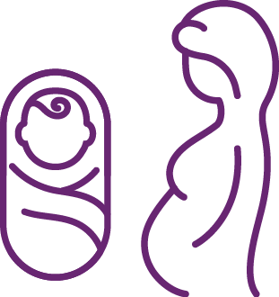
Programmatic considerations: likely
advantages
 | MATERNAL VACCINE | COMMON ACROSS PRODUCTS
Existing tetanus and other maternal immunization programs may be leveraged Opportunity to leverage resources to improve ANC and vaccine service delivery Offering RSV vaccine during ANC to protect infants may also benefit ANC coverage, uptake, and perceived quality of care Vaccine safety monitoring systems could also track pregnancy and other maternal/child health outcomes Gavi has committed to supporting introduction | Delivered similarly to BCG, hepatitis B, OPV birth dose vaccines Intramuscular injection, like many vaccines Robust immunization infrastructure and systems in place Skilled workforce familiar with nuances of immunization | Both products will protect babies during the most critical first six months of life Provide passive protection against RSV Only one dose needed, which simplifies delivery Potential to be cost-effective in low- and middle-income economies (context dependent)
MATERNAL VACCINE
LONG-ACTING MAB
COMMON ACROSS PRODUCTS
Notes:
An RSV maternal vaccine comes with several advantages.
Many countries can leverage prior experience delivering vaccines to pregnant individuals against diseases like tetanus.
These strategies, however, may require modifications to account for routine delivery needs, specific gestational age windows for administration, disease seasonality, and other RSV particularities.
Other benefits could include leveraging resources to improve ANC and vaccine service delivery; encouraging pregnant patients to attend more well-care visits; and establishing vaccine surveillance systems that also monitor pregnancy and other maternal and child health outcomes.
RSV mAbs also have advantages.
A RSV mAb could plug into routine birth-dose and routine childhood immunization programs already in place in many countries, including for BCG, Hepatitis B, and polio.
The EPI program, which is likely to lead delivery, already has a workforce skilled in immunization.
Both products are promising because they
Are given in one dose, simplifying delivery.
Are potentially cost-effective interventions according to modelling data.
And, most of all, will protect babies in the first, most critical months of life.

Slide 28
Programmatic considerations: potential
challenges
 | MATERNAL VACCINE | COMMON ACROSS PRODUCTS
ANC/EPI coordination and readiness needs may be uncharted in some countries (e.g., safety monitoring, logistics, training) Reaching pregnant women in a specific gestational age window and approaches to protect preterm infants that miss the window Expanding pregnancy registry surveillance/linking mother-infant records | Identifying and reaching infants born outside formal healthcare settings mAbs may be new policy and regulatory territory for some countries Cost and supply barriers to access Although designed to require only one dose, two doses may be needed based on weight | Seasonal dosing could be logistically challenging Awareness gaps or reluctance/hesitancy about new RSV products given to neonates or in pregnancy may affect demand/acceptability/uptake Additional services may strain certain health system components Competing priorities for immunization and maternal, child health programs
MATERNAL VACCINE
LONG-ACTING MAB
COMMON ACROSS PRODUCTS
Notes:
Countries will need to weigh these advantages with some challenges though.
For RSV maternal immunization, these challenges include:
ANC and EPI may need to coordinate in uncharted ways including, for example, coverage reporting, safety surveillance, logistics, and workforce training.
Reaching pregnant women within a specific gestational age window may be difficult and there’s a chance that infants delivered prematurely—those at greater risk for RSV—might miss that window.
Pregnancy registry surveillance will need to expand to accommodate vaccination safety monitoring and link mother-infant records.
RSV mAbs also comes with challenges, including
Identifying and reaching infants born at home or outside of the formal healthcare system.
Venturing into new policy and regulatory territory in some cases.
Navigating relatively high cost of goods contributing to price and supply barriers to access.
Several challenges apply to both interventions.
Seasonal dosing of both products could add logistical complexity.
Awareness gaps, reluctance, and/or hesitancy around RSV and its prevention products given either to newborns or in pregnancy may affect demand, acceptability, and uptake.
Adding RSV prevention services may strain certain health system components
Competing priorities for immunization and maternal, child health programs may be a challenge.

Slide 29

Adding RSV as a new disease target to the public health agenda
The goal will be for RSV prevention to complement other public health initiatives and strategies.
Immunization
Immunization Agenda 2030 goals (life course vaccination, tailored country programs, gender equity, new technologies)
Existing maternal immunization implementation (tetanus, pertussis, COVID-19)
Future maternal vaccines (Group B Streptococcus)
RSV
ANC
Implementing updated recommendations for 8 ANC contacts per pregnancy
ANC platform optimization
Quality of care improvement
Expanding reach/impact of
existing interventions
Notes:
Indeed, countries have many competing public health priorities and RSV would be a new disease target for many; however, RSV prevention has the potential to complement many of these priorities.
Listed here are just some initiatives where synergies and efficiencies could be achieved between RSV prevention and immunization or antenatal care strategies.
Overall, the goal will be to ensure that RSV prevention adds value, not burden, to already strained healthcare services and competing priorities.

Slide 30
Getting to public health impact
What success could look like | Improved infant health and survival through introduction and wide-scale use of RSV prevention tools (mAb and/or maternal immunization)
What’s needed to reach goal | Evidence-based decisions support RSV prioritization and product adoption | Health systems & services deliver RSV prevention product(s) routinely, efficiently, and equitably
OUTCOM Elements for achieving objectives | Evidence supports case for vaccine adoption Increased stakeholder awareness of RSV disease and forthcoming products Supportive policies and financing are in place | Coordination established between EPI and ANC programs around RSV prevention Operations and logistics in place to procure and deliver prevention product(s) as well as monitor implementation Implementers empowered to deliver prevention product(s) Capacity building underway to track vaccine safety and impact
GOAL
OBJECTIVES
OUTCOMES
Notes:
The pathway for RSV interventions to meet their full lifesaving potential will involve evidence-based decision-making that raises RSV prevention on public health agendas and supports health system readiness for equitable delivery.
Getting there will require evidence to be packaged, greater awareness and stakeholder buy-in around RSV prevention, and supportive policies and financing are in place.
Also important are collaboration across EPI and ANC, support for operations and logistics, a trained and empowered workforce (especially for ANC staff less familiar with delivering immunizations), and progress toward building safety monitoring system capacity.

Slide 31








Country decision-making and implementation
What preparations are needed?
The case for prioritizing RSV | Disease surveillance / safety monitoring
Product choice | Workforce readiness
Delivery platform(s) | Financing
Awareness / acceptance / demand | Global / country policy
Notes:
There are several domains and activities to think about as countries start to consider RSV prevention.
These include understanding the case for prioritizing RSV, including regional/local disease burden data and health economics factors such as cost-effectiveness, cost of illness, and cost of product delivery.
Determinants informing product choice, including product safety, efficacy, and cost/benefit.
The regulatory pathway and policy environment must be conducive to the selected product(s) approval and adoption—and may involve some uncharted territory.
Identifying optimal delivery platform(s), feasibility, and system readiness via EPI and/or ANC is key, including implementation/supply management strategies and leveraging existing systems to pave the way for vaccines intended for pregnant people.
Raising awareness about RSV and prevention products among key stakeholders such as policymakers, health providers, and parents will be essential.
Part of this will be understanding community perceptions/acceptance for new RSV interventions and designing and implementing effective communications strategies.
Making progress toward capacity building for safety monitoring and disease surveillance systems to track RSV product performance, as well as pregnancy outcomes will be needed over time.
Workforce readiness will also be an important factor, especially when it comes to ANC and EPI workers operating in conjunction with each other and taking on additional responsibilities and dividing labor.
Finally, equitable access will depend on financing being in place, which will hinge on fit within country public health budgets. Gavi has committed to supporting introduction of the maternal RSV vaccine.

Slide 32
Progress is underway but more work is needed
Areas of ongoing efforts include, but are not limited to:
Further characterizing disease burden, by region
Health economics research
Service delivery research and support
Awareness raising
Acceptance/demand research
Safety monitoring system reviews
Notes:
The good news is that valuable information is already available to inform evidence-based decision-making and more is emerging.
Listed here are just some categories of ongoing work right now. But the journey is ongoing and requires greater stakeholder engagement to reach the goal of RSV prevention.

Slide 33
What can countries be doing now?
Begin by thinking through decision-making and implementation questions.
Where does RSV prevention fit in our public health agenda amidst other priorities?
What additional information do we need to make decisions?
Which RSV prevention product(s) could best suit our context (e.g., cost/benefit)?
How can we optimize delivery and across which programs/platforms?
How can we best raise awareness and product acceptability (e.g., among healthcare workers, parents)?
Who needs to be engaged and informed (e.g., maternal, child health and EPI stakeholders)?
Who will be champions for RSV prevention and take the lead in raising awareness?
Notes:
So the question is, what’s next?
With new, lifesaving RSV prevention tools now licensed in many countries and recommended for global use by WHO, with Gavi’s commitment to support maternal RSV vaccine introduction, now’s the time for countries to start considering how best to take advantage of this public health opportunity.
These are just some of the questions to start thinking about and discussing.
RSV has been too long in the shadows, sickening and killing young children in the absence of effective interventions to prevent it on a broad scale. We are finally on the cusp of being able to change that.

Slide 34
Thank you!
Notes:
Never has the world had more hope of addressing RSV than now. Let’s not let this chance pass us by.

