Slide 1
Training guide
Budget tool for routine immunization at community level

Slide 2
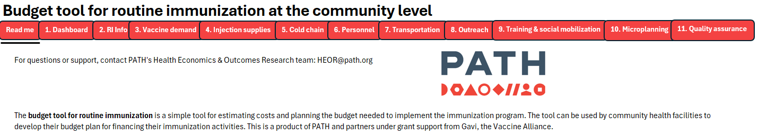
Budget tool overview
Placeholder for the QR code & link to the published tool
The budget tool for routine immunization is a simple tool to estimate costs and plan for budget need to implement immunization program. The tool can be used by community health facilities to develop their budget plan for financing their immunization activities. This is a product of PATH and partners under grant support from Gavi, the Vaccine Alliance.
Target users:
Health facilities at community level to estimate costs and plan for adequate budget need to implement routine immunization activities.
Health staff at upper levels to aggregate results from multiple community health facilities’ budget plans to have information on the budget need for upper level.

Slide 3
Training on the Budget tool – Overview
Objective: To build capability for healthcare/immunization staff at different levels so they can use the budget tool to develop budget plan for routine immunization to improve financing for immunization programs.
Highlights
The primary target users of the budget tool are healthcare staff at community level, but staff at upper levels (national, provincial, regional, district) should also receive training on this tool as they can aggregate results from lower levels to identify budget need of their catchment area.
It is highly recommended to engage country stakeholders at all levels in the whole process from pre to post trainings to develop the health system’s ownership and sustained use of the tool.
  Pre-training: engage all stakeholders in budget challenges realization; engage stakeholders at national and provincial/regional levels in adaptation of the tool to comply with local regulation, guidelines and cost norms.
  Trainings: conduct TOT training to staff at upper levels (provincial, regional, district)* and support the master trainers to conduct cascade trainings to staff at community level.
  Post-training: collect feedback from trainees, conduct supervision visits to support application of the tool and collect further feedback from users.
* It is recommended to engage stakeholders at national level from pre-training stage and have them as one of the trainers for the TOT training to build confidence for stakeholders at provincial and regional level in the use of the tool.

Slide 4
Pre-training stage – Sensitization and adaptation
Sensitization
It is important that the country stakeholders at different levels are aware of the challenges in budgeting for immunization so that they can better coordinate to address the problems. One validated approach is to conduct rapid assessment on budgeting landscape and disseminate results with all stakeholders. This would raise awareness of relevant stakeholders and create opportunities to engage them in the process to improve budgeting.
Limited financial resources for routine immunization (RI) is a common challenge which may root from unmatched budget allocation from upper level with budget need at community level due to lack of the capability and tools for healthcare workers (HCWs) to determine adequate resources need for their RI activities. The issue can be addressed by providing HCWs the budget tool training.
Adaptation
Before conducting training on the budget tool, supporting team should work with stakeholders at national and provincial/regional levels to adapt the generic budget tool to the country settings.
It is important that the country stakeholders are engaged in reviewing if formulas used in the tool for budget estimation conform with national/provincial/regional regulations and guidelines, such as calculation using vaccine index/wastage rate, fuel consumption index, etc.
Translation of the tool and user guide should be done. The navigation bar in the tool should be updated following translation.

Slide 5
Training implementation
There are two types of in-person trainings of the budget tool: TOT training and cascade training(s).
  TOT training: to create a pool of master trainers from national, provincial, regional level so that they can later on provide trainings to the lower levels to sustain capability building even when there is high turnover of staff.
  Cascade training(s): after the TOT training, the master trainers should be supported to lead the cascade training(s) to healthcare workers at community level.
  Both types of training can be conducted within a short interval and should involve health and finance staff at different levels. Examples of the trainings’ agenda and participants will be provided in later slides.
Before the training, work with finance people to pre-fill the tool with local cost norms and share the prefilled form with participants to:
  Demonstrate the format of inputs
  Save time finding information during the training such as vaccine index, unit price, etc.
The tool and user guide should be uploaded to a shared link to allow users to access the most updated tool and guide. In the training, remind users to always download the tool from the link every time they need to use it.
Highlight general rules for filling the tool:
  Fill in blue cells, select option in green cells, do nothing for gray cells
  Users can leave blank if not applicable, add rows as needed, but do not delete the whole row or column to avoid disruption of auto-calculations.
Trainers go through every table and sheet and refer the participants to the user guide as needed after the training.
There are chances that trainees are not familiar with concepts and activities such as microplanning and quality assurance. Trainers should obtain insights on these prior to the training in order to allocate more time to provide training on these activities as they are key to improve immunization.

Slide 6
Example of the plan for the TOT training
TOT TRAINING ON BUDGET PLANNING TOOL FOR ROUTINE IMMUNIZATION
Objectives:
To build capability for healthcare staff at provincial, regional and district level to use budget tool to develop budget plan for routine immunization and to be able to provide step-by-step guidance for facilities at community level (e.g. primary health centers)
Location & time: 1-day in-person training at province/region center
Participants:
  National level: officers from National Expanded Program on Immunization (EPI), MOH
  Provincial/Regional level: officers from Department of Health, EPI, or relevant entity in charge of disease control and/or immunization; review and approval bodies for immunization budget at this level.
  District level: leaders, immunization staff and planning/budgeting staff at District Health Centers and District budget approval bodies.
Preparation:
  Identify specific participants who will be trainers in the upcoming cascade trainings for community-level health centers and have them demonstrate training by the end of the TOT training.
  Vaccine wastage factors by districts and communities.
  Vaccine coverages/target by districts and communities.
  Participants bring laptops for hands-on practice during training.

Slide 7
Example of the plan for the TOT training
TOT TRAINING ON BUDGET PLANNING TOOL FOR ROUTINE IMMUNIZATION
Proposed agenda:
Time | Contents
5-10 minutes | Opening remarks
10-15 minutes | Introduction to the budget planning tool, highlight challenges in budgeting for immunization
90 minutes | Budget tool walk-through. Participants fill-in the tool by district
10-15 minutes | Break
60-90 minutes | Budget tool walk-through (cont.) Q&A
30-60 minutes | Break
120 minutes | Highlights for TOT trainers Preparation for TOT trainers - Q&A Training demonstration

Slide 8
Example of the plan for the cascade trainings
CASCADE TRAININGS ON BUDGET PLANNING TOOL FOR ROUTINE IMMUNIZATION
Objectives:
To build capability for healthcare staff at community health facilities to use budget tool to develop budget plan for routine immunization.
Location & time: half-day in-person training at each district center. Multiple cascade trainings to be conducted for multiple districts, each training covers all community health facilities at each district.
Participants:
  National level: 1-2 officers from National Expanded Program on Immunization (EPI), MOH
  Provincial/Regional level: 1-2 officers from Department of Health, EPI, or relevant entity in charge of disease control and/or immunization; review and approval bodies for immunization budget at this level.
  TOT trainers: 1 from provincial/regional level, 1 from district level
  District level: leaders, immunization staff and planning/budgeting staff at the District Health Center and District budget approval body.
  Community level: 2-3 persons from each community health facility, including leader, immunization staff, planning/budgeting staff.
Preparation:
  Vaccine wastage factors by communities.
  Vaccine coverages/target by communities.
  Participants bring laptops for hands-on practice during training.

Slide 9
Example of the plan for the cascade trainings
CASCADE TRAININGS ON BUDGET PLANNING TOOL FOR ROUTINE IMMUNIZATION
Proposed agenda:
Time | Contents
5-10 minutes | Opening remarks. Introduction to the budget planning tool, highlight challenges in budgeting for immunization
90 minutes | Budget tool walk-through. Participants fill-in the tool by community health facility
10-15 minutes | Break
60-90 minutes | Budget tool walk-through (cont.) Q&A

Slide 10
Post-training stage: Feedback and supervision
Collecting feedback on the budget tool and trainings for continuous improvement
After each training (TOT and cascade trainings), have the participants provide feedback to the tool and training using the online form (QR code and link provided at the end of the User guide).
Encourage the participants continue to provide feedback to the tool during their use in practice, using the same form in the provided QR code/link.
Put the tool and user guide to a public link and remind all participants always access the link for latest version of the tools.
Conducting supervision trips to support using the tool in practice
After the trainings, conduct supervision trips to community health facilities to support staff to develop budget plan for the upcoming budgeting cycle using the budget tool; collect further feedback and identify issues in practice if any.
It is very important that the national/provincial/regional entities have official endorsement on the use of the tool for RI budgeting.

Slide 11
User guide
Budget tool for routine immunization at community level

Slide 12
Budget tool overview
Placeholder for the QR code & link to the published tool
The budget tool for routine immunization is a simple tool to estimate costs and plan for budget need to implement immunization program. The tool can be used by community health facilities to develop their budget plan for financing their immunization activities. This is a product of PATH and partners under grant support from Gavi, the Vaccine Alliance.
Target users:
Health facilities at community level to estimate costs and plan for adequate budget need to implement routine immunization activities.
Health staff at upper levels to aggregate results from multiple community health facilities’ budget plans to have information on the budget need for upper level.

Slide 13
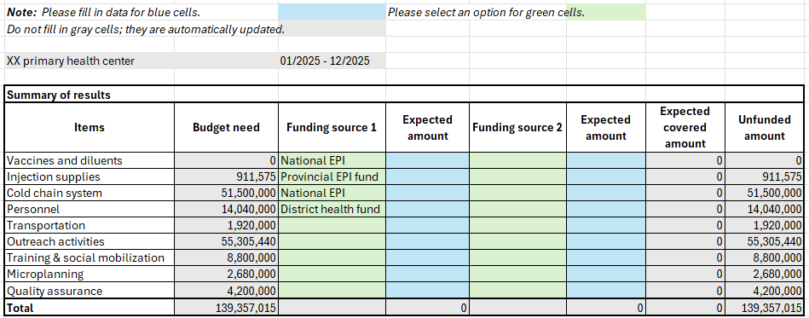
Budget tool overview
The tool includes 01 instruction sheet (Read-me) and 11 calculation sheets for all cost categories.
Users only need to fill out blue cells and select options in green cells. Some cells can be filled once to be applicable for several years.
Gray cells are automatically calculated and updated.
The red bar on the top of each sheet includes buttons to quickly navigate to other sheets. The name of the sheet being viewed are underlined in this red bar.
Users should navigate and fill the sheets from left to right of the red bar. On each sheet, users should fill in the information following the order of the numbered tables.
It is recommended to use Microsoft Excel not older than 2016 version to avoid software issue.
Users only complete blue and green cells
Gray cells are auto-calculated

Slide 14
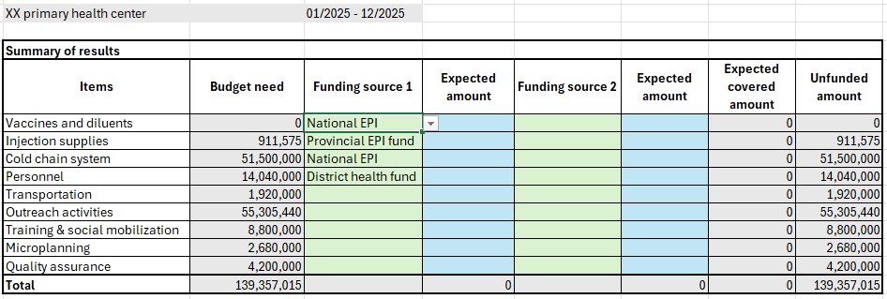
1. Dashboard
This is the results summary sheet. Gray cells will be automatically updated after completing other sheets.
After completing other sheets, users go back to Dashboard sheet to select the sources of funding and expected amount allocated. Users can select up to 2 sources of funding for each main cost category.
Results on total budget need, total expected funded amount, and total unfunded amount will be automatically calculated.
The results can be aggregated from different facilities to identify the budget need at upper levels such as district or provincial levels.
Click the arrow to select source of funding

Slide 15
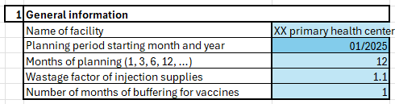
2. Routine immunization (RI) – Table 1
Users start by filling in the information about routine immunization at the facility. The inputs from this sheet will be used for auto-calculation in other sheets.
Step 1: Complete table 1 – General information, including:
Name of facility.
Planning period starting month and year: following the format mm/yyyy; i.e. month (1 or 2 digits) / year (4 digits). Example: 1/2025.
Months of planning: fill in number of months, usually 12.
Wastage factor of injection supplies: use the wastage factor determined by local authorities.
Number of months of buffering for vaccines: fill in number of months to buffer vaccines at the facility to avoid shortage.

Slide 16
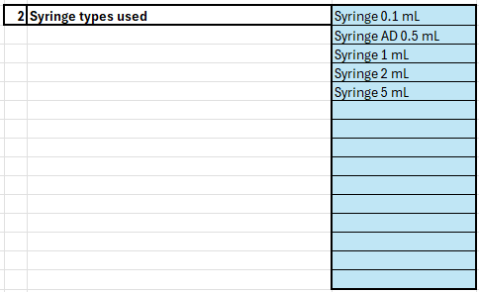
2. Routine immunization (RI) – Table 2
Step 2: Complete table 2 – Syringe types used:
Fill in the types of syringes used at the facility for RI including syringes for dilution.
Put each type of syringe in a row.

Slide 17
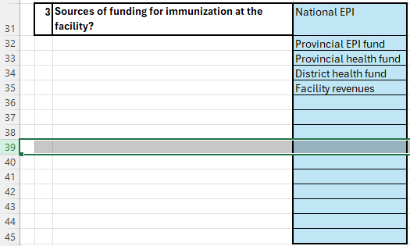
2. Routine immunization (RI) – Table 3
Step 3: Complete table 3 – Sources of funding for immunization at the facility:
Fill in the sources of funding for all immunization activities at the facility.
They can include EPI fund, operational budget of the health facility allocated from different levels, facility revenues, project grants, etc.
If more rows are needed, please insert new row by selecting the whole row in table 3, right click and select Insert.
To insert a row: click on a number on the farthest left to select the whole row, then right click and select Insert.

Slide 18
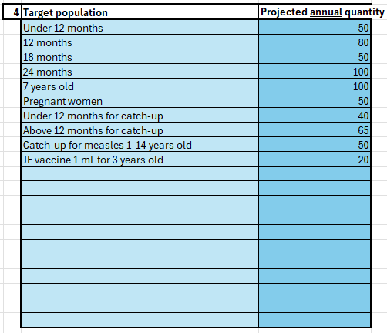
2. Routine immunization (RI) – Table 4
Step 4: Complete table 4 – Target population and Projected annual quantity:
Users need to fill in 02 columns: one for target population and one for projected annual quantity of each group of target population.
Target population: list all groups of target population for all types of vaccines in the routine immunization program provided at the facility, including groups planned for catch-up campaigns.
Projected annual quantity: fill in projected number of target population for each group in a whole year (the tool will automatically calibrate to the number of months of the planning provided in Table 1 in its calculation).

Slide 19
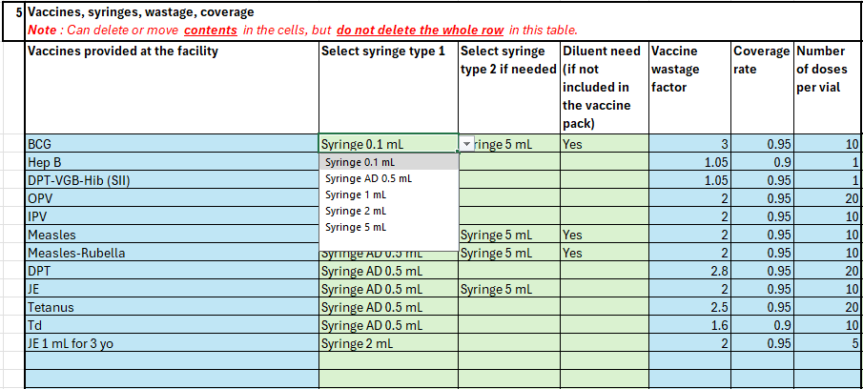
2. Routine immunization (RI) – Table 5
Step 5: Complete table 5 – Vaccines, syringes, wastage, coverage:
First, fill in all types of vaccine provided in the immunization program at the facility in the column “Vaccines provided at the facility”. When a new vaccine is included in the program, users add it to the next row in Table 5.
Then, select syringe in “Select syringe type 1” column for each type of vaccine by clicking the arrow on the right of each green cell and select the syringe type used for that specific vaccine. If the vaccine needs to be diluted prior to administering, select the syringe for dilution in “Select syringe type 2 if needed” column.
NOTE: Users must not delete any whole row in this table..
Select the cell, click the arrow to select the suitable type of syringe for the vaccine.

Slide 20
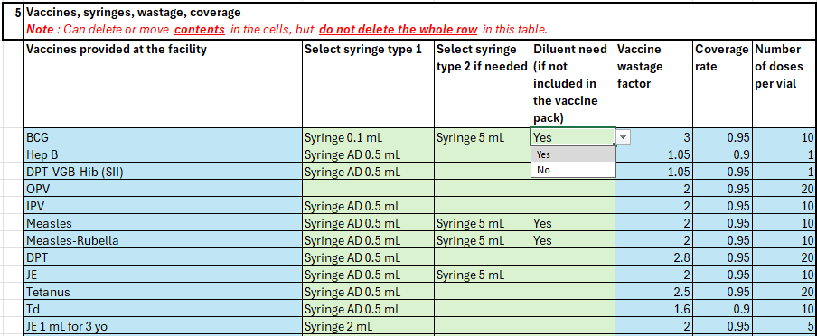
2. Routine immunization (RI) – Table 5 (cont.)
In the column “Diluent need”, users select Yes if the diluent is not included in the vaccine package and need to be purchased separately. If the diluent is already included in the vaccine package, users can leave this column blank or select No.
Next, fill in the vaccine wastage factor and coverage rate for each type of vaccine in the next two columns. Coverage rate is usually the target coverage that the facility need to achieve in the planned period.
Fill in the number of doses per vial for each type of vaccine.
Click to select “Yes” if need to purchase diluents separately to the vaccines.

Slide 21
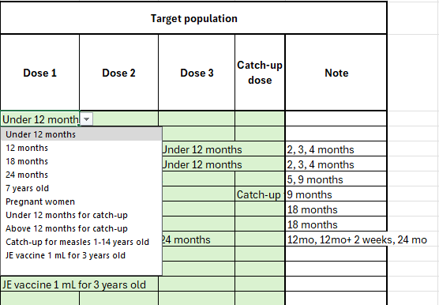
2. Routine immunization (RI) – Table 5 (cont.)
Next, also in Table 5, select the target population for each type of vaccine and for each dose. If the facility has plan for catch-up campaign(s), select target population for the catch-up dose.
The “Note” column is for putting any note for the filled in contents as needed.
After completing all tables in Sheet “2. RI info”, users move to Sheet “3. Vaccine demand”.
Click to select the target population according to the list provided previously in Table 4.

Slide 22
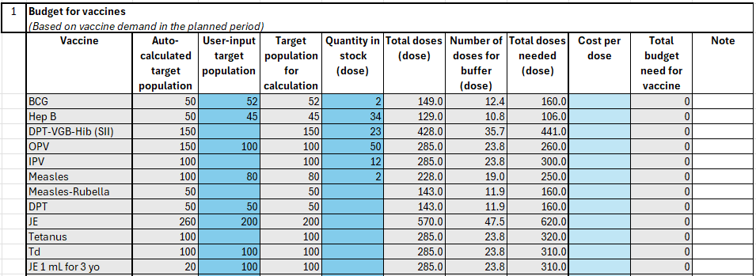
3. Vaccine demand – Table 1
Table 1 in Sheet “3. Vaccine demand” has 2 parts: projected number of doses needed and projected budget need for vaccines. Users do not need to complete the “Cost per dose” column to project budget need for vaccines if the facility receives all vaccines from upper level.
Columns in gray are not to be filled in as they are automatically updated after completing Sheet “2. RI Info”.
“User-input target population” column: users can adjust number of target population in practice by filling in this column and can add a note on this adjustment in the last column as needed. This column can be left blank if no adjustment is needed.
The “Target population for calculation” column reflects the numbers used to calculate vaccine demand. If there is adjustment in the target population, the adjusted numbers will be used. If not, the numbers in “Auto-calculated target population” will be used.
Next, users need to fill in the number of doses in stock for each vaccine in the column “Quantity in stock (dose)”.
The tool will automatically calculate the “Total doses” accounted for wastage and coverage, number of doses for buffer, and “Total doses needed” according to demand, buffer and vaccines in stock.
If the facility needs to procure vaccines, users need to complete “Cost per dose” column.

Slide 23
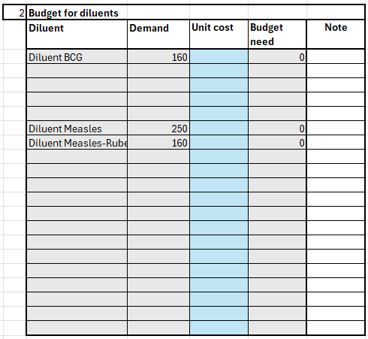
3. Vaccine demand – Table 2
Table 2 is projected Budget for diluents, only need to complete when the facility needs to purchase diluents for any type of vaccine if they are not included in the vaccine package. If no diluent procurement is needed, there is no need to complete Table 2.
The diluents need to be procured (if any) are those listed as “Yes” in Table 5 of Sheet “2. RI Info” and they will automatically appear in this Table 2 with auto-calculated quantity of demand. Users need to fill in the unit cost per dose for the diluents so that budget need can be calculated.

Slide 24
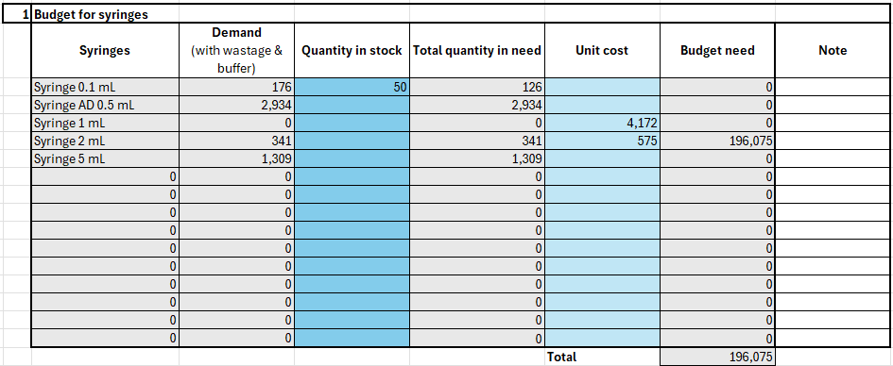
4. Injection supplies – Table 1
In Sheet “4. Injection supplies”, Table 1 is the budget for syringes.
Users do not need to fill in columns in gray (Syringes, Demand, Total quantity in need, and Budget need) as they are automatically updated.
Users need to fill in quantity of syringes in stock and unit cost of the type(s) of syringe the facility need to purchase.

Slide 25
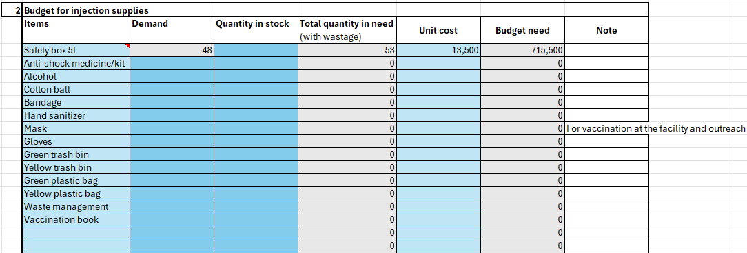
4. Injection supplies – Table 2
In table 2, list the needed injection supplies in column “Items”. Among the items already listed in the table, rows of unnecessary items can be left blank.
In “Demand” column: list the quantity needed for each type of injection supplies. The demand for the 5-liter safety box will be automatically calculated according to the number of syringes in Table 1 of this sheet.
Users fill in the number of items in stock. The tool will calculate the total quantity in need, accounted for quantity in stock and wastage rate.
Users fill in the unit cost. The tool will calculate budget need. Users can add notes about the unit of the items (e.g. box, kit, kilogram, etc.) or other notes as needed.

Slide 26
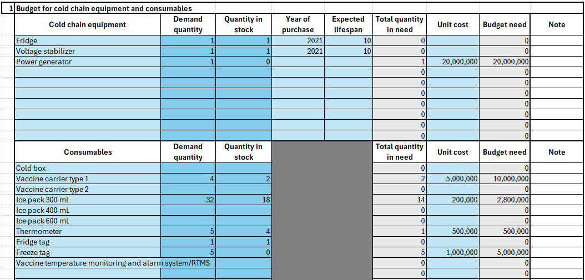
5. Cold chain system – Table 1
Table 1 projects budget for cold chain equipment and consumables. Among the listed items, rows of the unnecessary items can be left blank. Users can add more items besides those already listed.
Next, users need to fill in the quantity of items in need, in stock, the year of purchase, expected lifespan and the unit cost.
For equipment already purchased, users can fill in year of purchase and expected lifespan to plan ahead for budget when expiration is approaching.
Users can add notes about the unit of the items (e.g. box, pack, etc.) or other notes as needed.

Slide 27
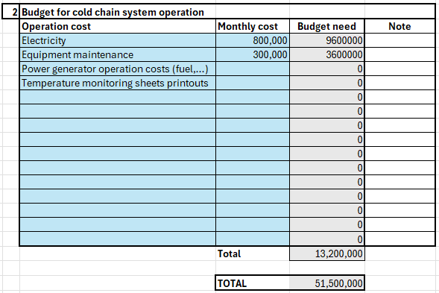
5. Cold chain system – Table 2
Table 2 projects budget for cold chain system operation. Users need to input monthly cost for the listed items (if applicable) and add more items as needed.
For electricity cost, users can estimate based on the vaccine fridge power consumption and electricity price per kW or based on an estimated proportion of the facility monthly electricity cost.
Monthly cost for equipment maintenance can be estimated based on the total costs for maintenance in a year divided by 12, if maintenance does not occur every month.
Power generator operation costs can include monthly fuel costs for the power generator.
Costs for printing temperature monitoring sheets can be left blank if not applicable, or if it is included in costs for printers, cartridges, and printing papers in Sheet “10. Microplannning”.
Users can add notes about the unit of the items or how monthly cost is calculated.

Slide 28
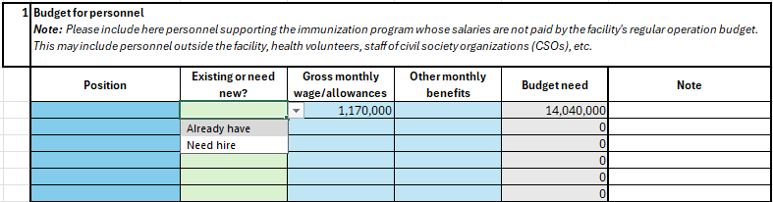
6. Personnel
Sheet “6. Personnel” is used for budgeting human resources need beyond the facility’s staff such as community volunteers, partners from civil society organizations who support immunization programs and activities.
Users should indicate whether there are people for these positions already or the facility needs new hire.
For 2 columns “Gross monthly wage/allowances” and “Other monthly benefits”, users need to fill in estimation per month, even if payment for such position may not be monthly. For example: health volunteers may get an allowance of $10/day and on average they support the program 4 days per month, which make their monthly allowances $40. In this case, users put 40 in the Gross monthly wage/allowance column for the health volunteer position.
If there is no wage, allowance, or other benefits, these rows can be left blank.
Users can add notes about positions needed for justification as needed.

Slide 29
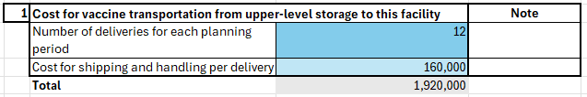
7. Transportation – Table 1
Table 1 estimates the cost to transfer vaccines from upper-level cold storage to this facility. If the facility does not need to pay for this cost, users can leave Table 1 blank.
If the facility needs to pay for vaccine transportation, users fill in number of deliveries during the planning period. For example, the planning period is 12 months (as in Table 1 in Sheet “2. RI Info”) and vaccine transportation from upper-level storage is once per month, users should put 12 next to the cell “Number of deliveries for each planning period”
Next, fill in the cost for shipping and handling per delivery. Note: vaccine transportation cost should include costs to maintain required temperature during transportation.
Users can add notes about the cost or number of deliveries as needed.

Slide 30
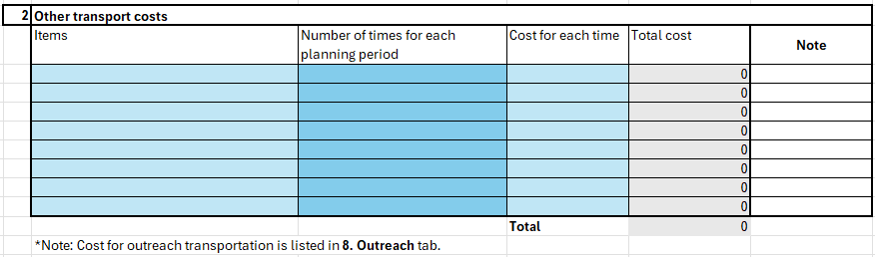
7. Transportation – Table 2
In Table 2, list any other transportation costs in column “Items”, which may include costs to transport vaccination waste, shipping costs of injection supplies and other travel costs not listed in any other sheets. If there is no other transport cost, table 2 can be left blank.
NOTE: Cost for outreach transportation will be listed in sheet “8. Outreach”. Therefore, users do not list them here to avoid duplication.
Next, users fill in number of times the cost for each item will incur in the planning period, and the cost for each time.
Users can add notes about the items, number of times and cost per time as needed.

Slide 31
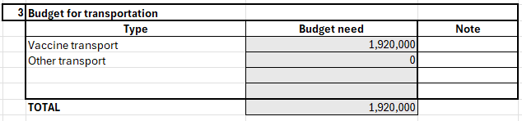
7. Transportation – Table 3
Table 3 will automatically summarize budget need for transportation using inputs from table 1 and 2.
Users can add notes about transportation costs as needed.

Slide 32
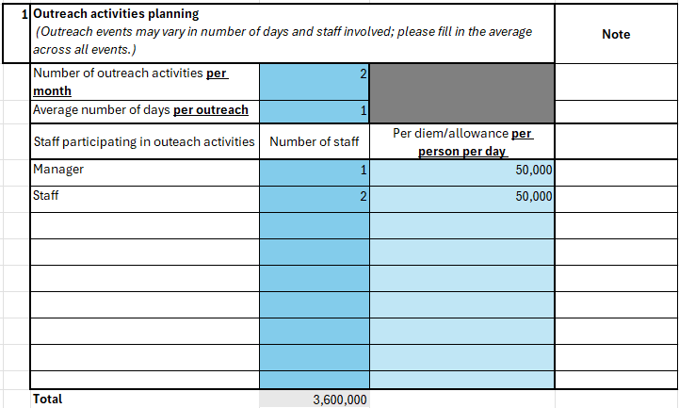

8. Outreach activities – Table 1 & 2
In Table 1, users fill in the plan for outreach activities during the planning period.
Note: number of days and staff may vary in different outreach events, please fill out the average number for the outreach events.
First, fill in number of outreach activities per month and average number of days per outreach.
Next, fill in positions participating in the outreach and number of staff for each position in the column “Number of staff”.
Fill in the allowance per person per day in the next column. If staff does not receive allowance/per diem for outreach activities, leave this column blank or put zero.
In Table 2, users fill in fuel price per liter, which will be used to calculate fuel costs in Table 3. If any car uses Diesel, input Diesel price as well; if not, the row can be left blank.

Slide 33
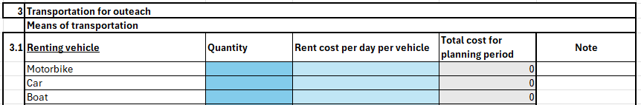
8. Outreach activities – Table 3
Table 3 is to estimate travel costs for outreach activities.
If the facility needs to rent vehicle(s) for outreach activities, users fill in the quantity of vehicle and rental price per day per vehicle to Table 3.1. If no renting is needed, leave Table 3.1 blank.
If using vehicle(s) owned by the facility, users fill in table 3.2 “Vehicle owned by the facility”. Fill in the number of vehicles in need and the quantity in stock:
  If the facility already has the vehicle, fill in year of purchase and expected lifespan.
  If the facility has not have the vehicle but has the plan to purchase, put zero in “Quantity in stock”, fill in the year planning to purchase, expected lifespan and projected price of vehicle.
  If only personal vehicles are used, no facility-owned vehicle or no plan to purchase vehicle for the facility, users can leave Table 3.2 blank.
Users can add notes about transportation for outreach as needed.

Slide 34
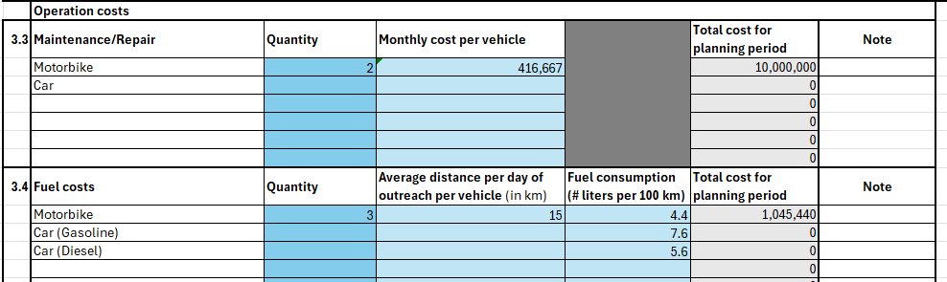
8. Outreach activities – Table 3 (cont.)
Next, users fill in operational costs for the vehicles, including maintenance and fuel costs.
In Table 3.3, users fill in number of vehicles receiving funding/reimbursement for maintenance in the column “Quantity”. In the next column, fill in monthly maintenance cost per vehicle. If maintenance is not done every month, users can estimate monthly cost by summing up maintenance cost in a year and dividing by 12. For example: all maintenance cost for one vehicle in a year is $120, monthly cost will be $120/12 = $10/month/vehicle – users put 10 in the column “Monthly cost per vehicle” in this example.
In Table 3.4, users fill in number of vehicles receiving funding/reimbursement for fuel, including rental, facility-owned and personal-owned vehicles.
Users fill in average distance (in km) per day of outreach per vehicle.
Fuel consumption level (fuel volume per 100km) should follow local guidelines or vehicle’s specification if regulation/guideline is not available.
Total cost for the planning period will be automatically calculated.

Slide 35
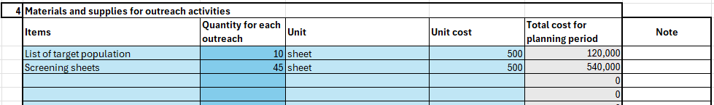
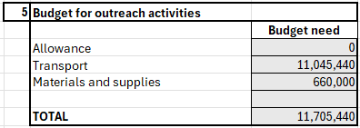
8. Outreach activities – Table 4 & 5
In Table 4, users fill in the need for materials, supplies, consumables for outreach activities such as printouts of screening sheets or list of target population. Users can add more items as needed to the table.
If the lists and sheets are printed using the facility’s printer, users do not need to fill out “Unit cost” as the budget for these will be calculated from the costs for printer, cartridges and printing papers in Sheet “10. Microplanning”. Users can add notes about outreach activities as needed.
Table 5 will automatically summarize the budget need for outreach activities.

Slide 36
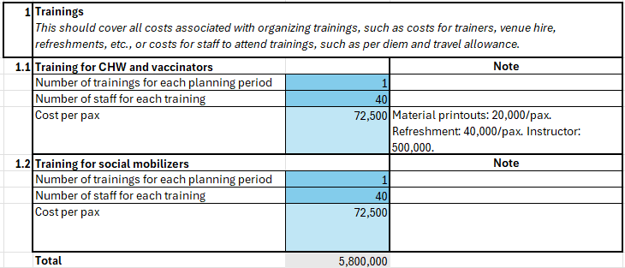
9. Training & social mobilization – Table 1
In Table 1, users fill in training plan during planning period, which can be trainings organized by the facility or other trainings attended by their staff elsewhere.
Trainings can be about immunization for vaccinators (Table 1.1) or communications for social mobilizers (Table 1.2). In both tables, users fill in number of trainings planned (to organize or to attend) in each planning period and number of staff participating in each training.
Cost per person may include:
  If the facility organizes the training: include material printouts, refreshment, payment for instructor, etc.
  If the staff attend training elsewhere: include per diem and travel allowance (if any). NOTE: if costs to support staff attending training elsewhere is included in other sheets (e.g. Sheet “7. Transportation), do not repeat them in this table.

Slide 37
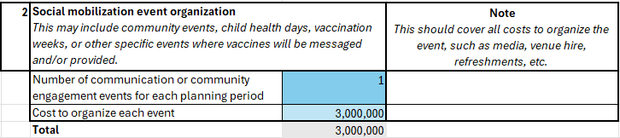
9. Training & social mobilization – Table 2
In Table 2, users fill in the plan for social mobilization during planning period. These events may include community events, health days for mothers and children, vaccination weeks or any other events in which immunization information, education, communication (IEC) materials are provided.
Users fill in number of events planned for the planning period and cost to organize each event.
Cost to organize the event is a lump sum of all expenses including cost for mass media, venue hire, refreshment, backdrop and banners, etc.
Users can add notes about cost to organize or other details of the event as needed.

Slide 38
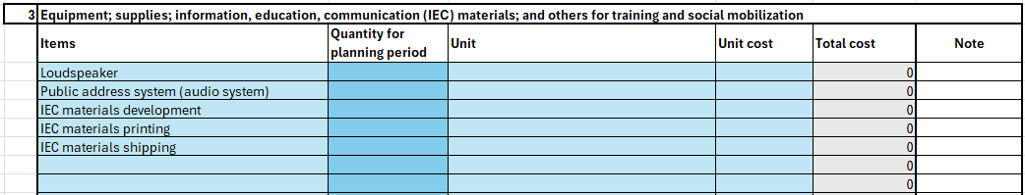
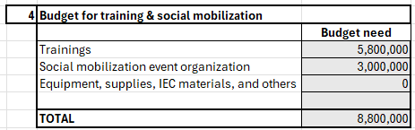
9. Training & social mobilization – Table 3 & 4
In Table 3, users fill in the need for equipment, supplies, IEC materials and other costs for training and social mobilization which have not been listed in table 1 and 2.
Users can leave the row blank if the listed item is not applicable. Users can add other items to the list as needed.
Users fill in the quantity of items needed for the planning period, unit of the items and unit cost. Total cost will be automatically calculated.
Users can add notes about the items as needed.
c

Slide 39
10. Microplanning
Routine immunization microplanning includes a set of activities to:
Enlist and map all villages/hamlets/hard-to-reach areas under your community health center administrative area.
Identify all beneficiaries (pregnant women, infants, children) for RI services via house-to-house survey.
Estimate and plan the vaccine and logistic requirements, including modes of delivery (facility-based, outreach, etc.)
Develop detailed plans for a strong RI service delivery.
Microplanning is key to having a strong, effective RI program that can reach every community. The process can only be conducted if budget is allocated for it.

Slide 40
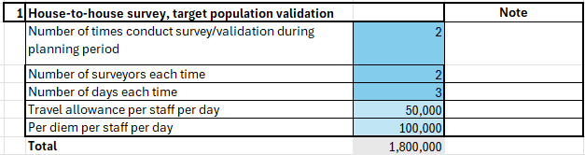
10. Microplanning – Table 1
Table 1 includes plan and budget need for house-to-house survey to validate target population. This activity is critical to have the precise number of target population to project vaccine demand and immunization budget, especially for hard-to-reach areas. It also provides the precise denominator for coverage estimation and other monitoring and evaluation indicators.
Users fill in: number of times the survey is conducted during the planning period, number of surveyors for each time, total number of days for each time, travel allowance and per diem (if any) per person per day.
Users can add notes about this activity for further details as needed.
The total budget need for this activity will be automatically calculated in Total.

Slide 41
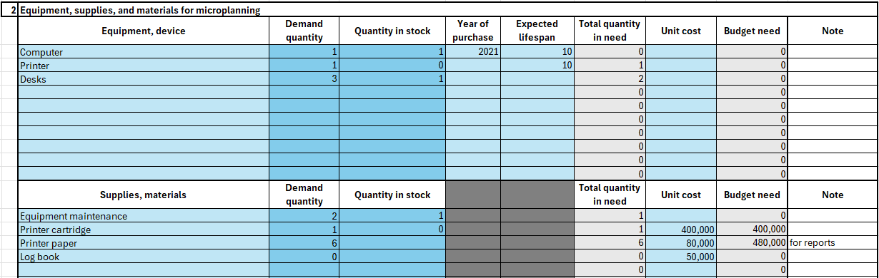
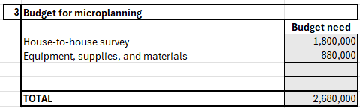
10. Microplanning – Table 2 & 3
Table 2 includes projected need for equipment, supplies, materials, stationaries, consumables, etc. for microplanning activities (including vaccination at the facility or outreach if not planned in any other sheet).
Users can leave the row blank if the listed item is not applicable. Users can add other items to the list as needed.
After listing all needed items, users fill in the quantity of items in need, quantity in stock and unit cost. For equipment and devices, users fill in year of purchase and expected lifespan to have plan for procurement when expiration is approaching.
If the facility uses its printer for printing lists of target population, screening sheets, temperature monitoring sheets, IEC materials, etc. and costs have not been included in any other sheet, users fill in need for cartridge, printing paper, printer maintenance, etc. in this Table 2.
Users can add notes about costs of these items as needed.
Table 3 will automatically summarize budget need according to inputs from table 1-2.

Slide 42
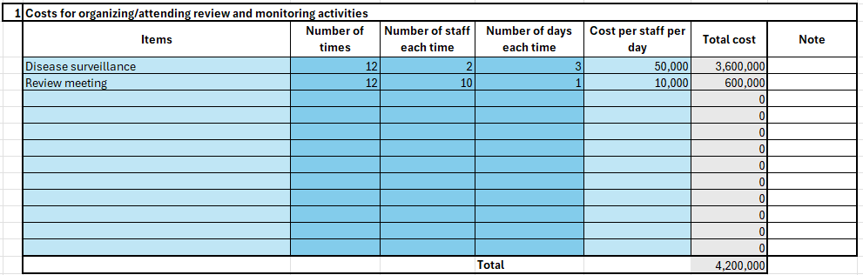
11. Quality assurance – Table 1
Quality assurance may include supervision activities, organizing and attending review meetings to ensure vaccination quality, vaccine supplies, disease surveillance, and monitoring AEFIs.
In Table 1, users fill in supervision and quality assurance activities in the column “Items”.
Next, users fill in number of times these activities are planned to conduct during the planning period, number of staff for each activity, number of days each time, and cost per staff per day. Cost per staff per day may include per diem, travel allowance, refreshment cost, etc. if applicable. The total cost will be automatically calculated.
Users can add notes for further details on cost per staff per day or other information as needed.
AEFIs: adverse events following immunization

Slide 43
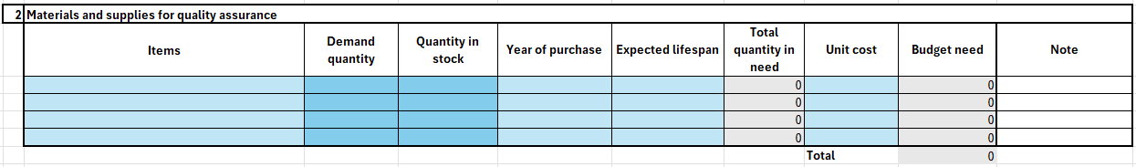
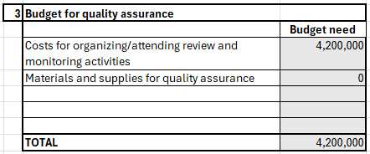
11. Quality assurance – Table 2 & 3
Table 2 includes projected need for equipment, supplies, materials, stationaries, consumables, etc. for quality assurance activities. If these costs have been planned in other sheets, users can leave table 2 blank.
Users list items and quantity in need, quantity in stock and unit cost. For equipment and devices, users fill in year of purchase and expected lifespan to have plan for procurement when expiration is approaching..
Users can add notes on unit, unit cost, or other details as needed.
Table 3 will automatically summarize budget need according to inputs from table 1-2.

Slide 44
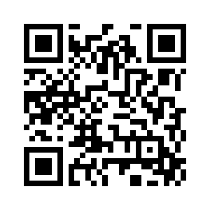
NOTICE
Completing this budget tool does not ensure the budget will be allocated as projected, but it is a critical foundation for budget reviewers and approvers at different levels to understand the real budget need for practice of immunization so that they can have plan accordingly to ensure key activities be implemented to optimize immunization and improve coverage.
Facilities should use the tool regularly to update the real allocated funding to plan accordingly.
Health officers at upper levels (provincial or district) can prefill the form with local cost norms to unify them across the region and reduce the work for health staff at community level.
Scan QR or go to the link to give feedback to the budget tool and training.
https://forms.gle/aF79DrtNc21HU1FKA

Slide 45
For questions or support, contact PATH's Health Economics & Outcomes Research team: HEOR@path.org

