Slide 1
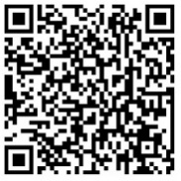
Global & regional RSV disease burden
a huge, under-recognized public health problem in infants and young children
Access these and additional slides offered as part of an RSV communications toolkit at:
bit.ly/RSVInfoToolkit
Version: February 2026

Slide 2
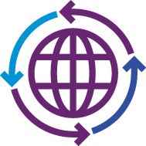


Agenda
 | Global RSV mortality & morbidity estimates for infants & young children
 | Age distribution of RSV disease among children data from low- and middle-income countries (LMICs) by WHO region
 | Regional RSV mortality & morbidity estimates for infants & young children
Notes:
Today's talk will address the global burden of RSV disease starting with global estimates of RSV mortality and morbidity then we will show some data on regional estimates of RSV mortality and morbidity.

Slide 3
Global RSV mortality & morbidity
estimates for infants & young children

Slide 4
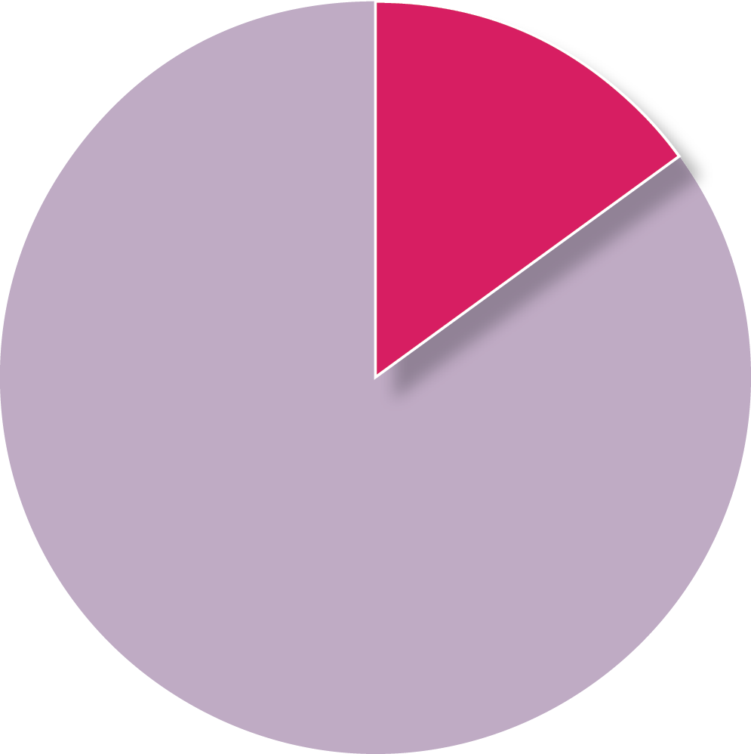
Pneumonia is the #1 cause of child mortality worldwide
killing more children than malaria, measles, and diarrhea combined
PNEUMONIA IS RESPONSIBLE FOR
15% OF ALL-CAUSE <5 MORTALITY
(> 700,000 deaths per year)¹
Controlling RSV is critical in the larger pneumonia fight because it
is the most common cause of infant pneumonia and bronchiolitis
is a leading cause of pneumonia deaths in the first 6 months of life
causes up to 40% of severe pneumonia cases before 1 year of age²
increases vulnerability to pneumonia caused by other viruses and bacteria
Pneumonia
15%
Other causes
¹ Interim WHO-MCEE cause of death for children under-5 years (September 2019) updated using cause fractions from 2017 and applying them to UN-IGME estimates for 2018.² Pneumonia Etiology Research for Child Health (PERCH) Study Group. Lancet. 2019.
Notes:
The world has long been embroiled in the fight against pneumonia, which continues to be the #1 killer of children before their fifth birthdays each year worldwide.
That’s 15% of all-cause child mortality—or a life lost every 43 seconds.
As a leading cause of infant pneumonia, RSV is a big part of the pneumonia equation requiring solutions.
RSV causes up to 40% of all pneumonia cases before 1 year of age and is the leading cause of pneumonia deaths before 6 months of age worldwide.

Slide 5
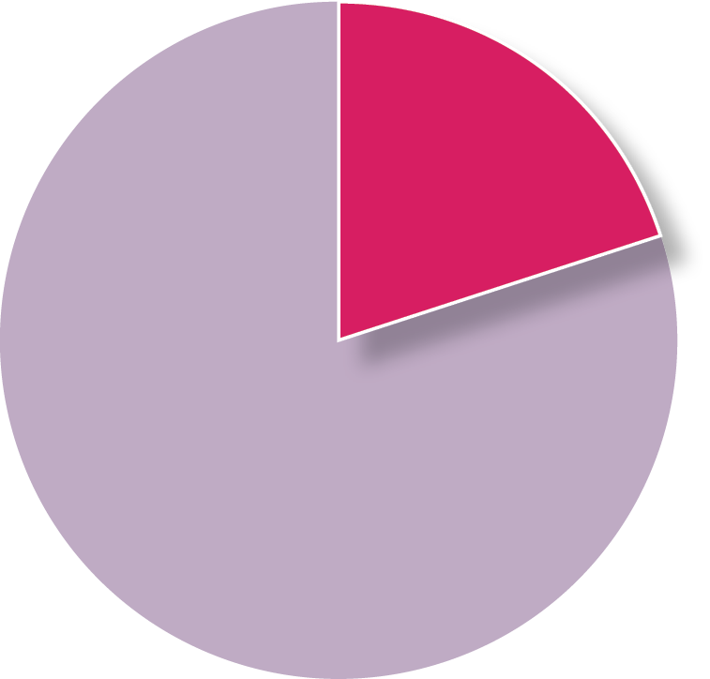
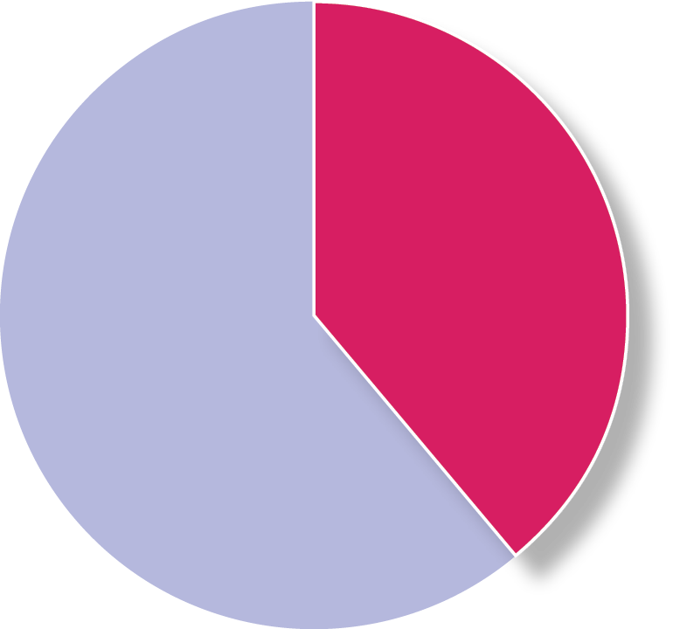
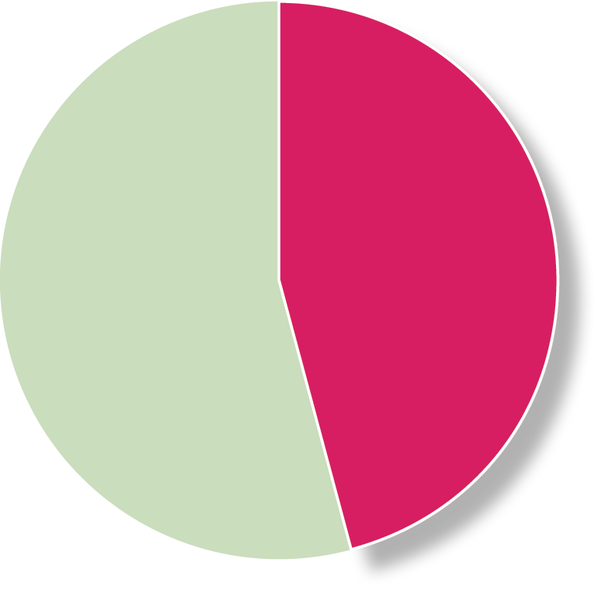
Annual global pediatric RSV disease burden (< 5 years of age)
LEADING CAUSE OF SEVERE RESPIRATORY INFECTION
LEADING CAUSE OF PEDIATRIC HOSPITALIZATION
IMPORTANT CAUSE OF PEDIATRIC MORTALITY
33 million
episodes
3.6 million
hospitalizations
101,000
deaths
< 6 months
20%
< 6 months
39%
< 6 months
46%
Nearly half of RSV deaths are before 6 months of age
6 months to 5 years
80%
6 months to 5 years
61%
6 months to 5 years
54%
TOTAL GLOBAL CHILD MORTALITY DUE TO RSV
3.6%
< 6 MONTHS
2.3%
< 5 YEARS
Reference: Li Y, et al. Lancet 2022.
Notes:
In 2022, the global annual RSV burden estimates were updated and published in the Lancet.
These estimates found that, in 2019, RSV was responsible for a staggering 33 million episodes of acute lower respiratory tract infection, approximately 3.5 million hospitalizations, and over 100,000 RSV deaths among children less than five years of age worldwide.
Overall RSV accounts for 2% of the global mortality burden in children under 5 years of age and 3.6% among children under 6 months of age.
RSV in children under 6 months of age accounts for 20% of acute lower respiratory infection episodes and almost half of all RSV deaths in children under 5 years of age.

Slide 6





RSV’s biggest risks are in the youngest children
6 months
1 IN EVERY 28 DEATHS
before 6 months of age globally is due to RSV¹
Most severe in first few months of life due to easily blocked small airways.
Reference: PERCH Study Group. Lancet. 2019.
Notes:
The first few months of life are the most vulnerable to RSV due to the ease with which an infant’s small airways can be blocked.
Serious complications of RSV include bronchiolitis and pneumonia and can lead to long-term complications for lung health.
To put things in perspective, RSV is responsible for 1 in every 28 deaths that occur before six months of age—a tragedy destined to continue until we do something about it.

Slide 7
98% of pediatric RSV mortality occurs in low- and middle-income economies¹
In children < 6 months of age, RSV is responsible for:
HIGH-INCOME
LOW-INCOME
Many children in low-income economies never make it to a hospital.²
4x
as many children
die from RSV
in the community than
in the hospital
24
hospital deaths
/ 1,000 RSV cases
109
community deaths
/ 1,000 RSV cases
<1
hospital deaths / 1,000 RSV cases
<1
community deaths / 1,000 RSV cases
The disparity in RSV mortality between
low- and high-income contexts is substantial.
¹ Li Y, et al. Lancet. 2022; ² Srikantiah P, et al. Clin Infect Dis. 2021.
Notes:
Over 98% of RSV deaths occur in low- and middle-income countries.
As this graphic shows, children in low-income countries are less likely to have access to adequate medical care, so are far more likely to die from RSV than children in high-income nations—an unacceptable disease burden disparity.
To break it down further, RSV deaths among children 6 months of age and younger in low-income settings are 4 times more likely to occur in the community than they are to occur in the hospital.
This is because the vast majority of children with severe RSV don’t make it to the hospital where they can receive supportive care, increasing their likelihood of dying.
Causes of deaths in the community are often unknown or unreported, and as such, RSV morbidity and mortality in these contexts is thought to be even greater than current estimates suggest.

Slide 8
Two studies shed light on the role of RSV in infant mortality in LMICs¹
A high, unmeasured burden of community RSV mortality,
particularly among infants <6 months of age
Community mortality study
RSV detected in:
Argentina 12/44 (27%)
India 10/168 (5.9%)
Pakistan 14/377 (3.7%)
Zambia 112/1,412 (7.9%)
CHAMPS study
Across 7 countries:
RSV detected in 28/321 (9%) histopathology samples
RSV determined to be in causal pathway or play a contributory role in 5% of all deaths
2
Pakistan
2
Bangladesh
Mali
India
Sierra Leone
Ethiopia
Kenya
Zambia
Mozambique
South Africa
Argentina
These data indicate global RSV-associated mortality in infants <6 months old may be as high as 100,000 deaths annually.
Notes: Projected RSV-associated mortality calculated using the IHME-estimated all-cause deaths in infants aged 7 days̵-6 months (1.1 million).
Abbreviation: CHAMPS = Child Health and Mortality Prevention Surveillance
¹ Various articles. CID. 2021;73(Suppl 3).
Slide adapted from content courtesy of the Bill & Melinda Gates Foundation.
Notes:
Findings from RSV surveillance studies funded by the Bill & Melinda Gates Foundation reveal a high unmeasured burden of community RSV mortality, particularly among infants <6m who are the target for new RSV immunization products.
A study of community deaths in children under six months of age in which a nasopharyngeal swab was taken within 48 hours of death was undertaken in four LMICs: Argentina (an impoverished peri urban setting); India; Pakistan; and Zambia.
The percent positive of swabs for RSV ranged from 3.7% in Pakistan to 27% in the peri-urban slums of Argentina.
While all of the detected RSV may not have been in the causal chain of death, these findings do suggest a significant role for RSV in community mortality and young infants.
Another study called CHAMPS undertook minimally invasive tissue sampling in children who died in several LMICs in Africa and South Asia.
CHAMPS detected RSV in 9%of all deaths among infants less than six months of age and a panel of experts deemed RSV to be in the causal chain of 5% of all deaths.
If the results of these studies are consistent in other LMICs, that suggests that the burden of mortality in children under six months of age due to RSV could be as high as 100,000 deaths a year.

Slide 9

Pneumonia Etiology Research for Child Health (PERCH) study
Top 10 causes of severe pneumonia before 5 years of age in 7 countries in Africa and Asia
RSV
31.1%
(28.4, 34.2)
Sites in Bangladesh, Gambia, Kenya, Mali, South Africa, Thailand, Zambia
Rhinovirus 7.5%
(5.3, 10.1)
hMPV 7.5%
(5.9, 9.5)
Parainfluenza 7.4%
(5.8, 9.3)
Influenza 2.0%
(1.1, 3.2)
Pneumococcus 6.7%
(5.1, 8.5)
H. influenzae
5.9%
(3.8, 8.5)
Staph
2.7%
(1.5, 4.3)
TB 5.9%
(3.9, 8.3)
P. Jirovecii
2.0%
(0.9, 3.3)
VIRUSES
BACTERIA
TB
FUNGI
Reference: PERCH Study Group; Lancet, 2019.
Notes:
Most information on the burden of RSV comes from prospective surveillance studies, PERCH being one of the largest studies of pediatric pneumonia in LMICs every conducted.
Conducted from 2011-2014, the PERCH study set out to determine the etiology of pneumonia in children hospitalized in 7 countries: 5 in Africa and 2 in Asia.
The study enrolled over 4,000 (4,232) children hospitalized with cases of severe and very severe pneumonia, and collected many specimens and performed multiple diagnostic tests.
The study included over 5,000 controls (5,325).
A unique analytic algorithm was used to identify the etiology of each pneumonia episode.
RSV was found to be the most common etiology among both severe and very severe pneumonia by orders of magnitude.
Although it may not look so at first glance, the area of the RSV circle is proportionally correct in comparison to the other disease circles. RSV makes up a staggering percentage of the pneumonia pie.
It was the most common etiology in children of all ages but particularly infants in the first year of life, where it accounted for close to 40% of all pneumonia cases.

Slide 10
Aetiology of Neonatal Infections in South Asia (ANISA) study
top 10 causes of community-acquired serious infections in neonates in 3 countries in South Asia
RSV
6.48% (5.81-7.59)
Ureaplasma spp
2.82% (1.93-3.77)
Other blood culture
2.57 % (2.05-3.11)
Klebsiella pneumonaiae
1.79 % (1.17-2.49)
Escherichia coli
1.71 % (1.05-2.62)
Enterovirus or rhinovirus
1.36 % (0.83-2.37)
Salmonella spp
1.28 % (0.53-2.52)
Streptococcus pneumoniae
1.15 % (0.70-1.98)
Group B Streptococcus
1.12 % (0.65-1.71)
Sites in Bangladesh, India, and Pakistan
Staphyloccocus aureus
1.05 % (0.63-1.68)
0
1
2
3 4 5
Proportion of pSBI episodes (%)
6
7
8
Reference: Saha, S. et al. Lancet, 2018.
Notes:
Another large study called ANISA took place from 2011 to 2014 at 5 sites in 3 South Asian countries, Bangladesh, India, and Pakistan.
The purpose was to estimate proportions of specific infectious causes of possible severe bacterial infections in children <2 months of age in comparison to healthy controls.
Surprisingly, RSV was identified as the most detected pathogen in children with possible serious bacterial infection in the first two months of life, identified in 6.5% of all infections.

Slide 11
Age distribution of RSV disease among children
data from LMICs by WHO region

Slide 12
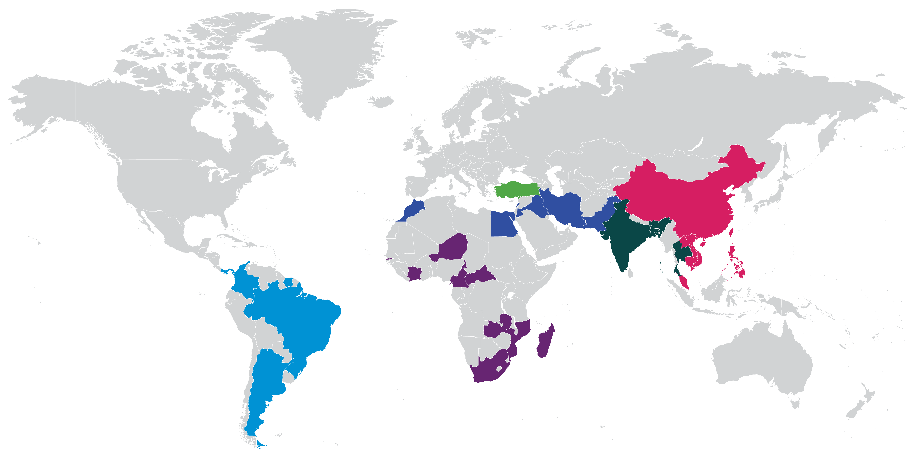
RSV-positivity among children admitted to hospital with acute respiratory illness (ARI)
Egypt (2)
Iran (1)
Iraq (1)
Jordan (4)
Lebanon (1)
Morocco (1)
Pakistan (1)
Turkey (4)
Cambodia (1)
China (16)
Laos (2)
Malaysia (1)
Philippines (2)
Vietnam (1)
Africa Region
Region of the Americas
Eastern Mediterranean region
European region
South East-Asia region
Western Pacific region
Bangladesh (2)
Bhutan (1)
India (6)
Thailand (2)
Cameroon (1)
Central African Republic (1)
Côte d'Ivoire (1)
Gambia (1)
Madagascar (1)
Mozambique (1)
Niger (2)
South Africa (10)
Zambia (1)
Argentina (1)
Brazil (1)
Colombia (1)
Panama (1)
Suriname (1)
Systematic review of published literature
2010-2019 in LMICs (high-income countries excluded)
73 studies in 32 countries
Source: Systematic review and meta-regression analysis, International Vaccine Access Center (IVAC), Johns Hopkins Bloomberg School of Public Health​. 2024.
Notes:
I would now like to share with you results from another project that is looking at global burden of RSV disease, which focuses on the years 2010 through 2019 (pre-COVID-19 pandemic) and is only looking at lower- and middle-income countries.
This is a systematic review and meta-analysis of countries in which at least one study looks at the percentage of children hospitalized with acute respiratory illness who tested positive for RSV.
The study includes 73 studies in 32 countries. You can see from this map that all WHO regions are well represented in this study.
From this study, we’ll look in the next few slides at the RSV disease burden across age distributions among children.

Slide 13
1/4 to 1/3 of all ARI hospital admissions among children < 5 years of age are
due to RSV in all WHO regions
37.5%
[19.1%, 57.8%]
60
34.8%
[20.7%, 50.4%]
50
40
27.5%
[22.9%, 32.5%]
27.0%
[23.8%, 30.3%]
23.8%
[21.6%, 26.0%]
23.6%
[19.7%, 27.7%]
Percent RSV positive (%)
30
20
10
0
Africa
(19)
Americas
(4)
Eastern Mediterranean
(12)
European
(4)
South East-Asia
(11)
Western Pacific
(23)
WHO Region (Number of studies)
Source: Results from systematic review and meta-regression, International Vaccine Access Center (IVAC), Johns Hopkins Bloomberg School of Public Health​. June 2024.
Notes:
This graph shows the percentage of children <5 years old admitted to hospital with acute respiratory infection testing positive for RSV by WHO region.
It depicts a large disease burden, with 1/4 to 1/3 of all respiratory illness hospital admissions among children < 5 years of age are due to RSV in all WHO regions.

Slide 14
1/3 to 1/2 of all ARI hospital admissions among children < 6 months old are
due to RSV in all WHO regions
new RSV immunization products protect in this age range
59.3%
[38.8%, 77.6%]
80
49.1%
[27.5%, 70.8%]
70
53.5%
[43.9%, 62.9%]
60
39.6%
[27.5%, 52.4%]
50
36.3%
[30.1%, 42.7%]
34.1%
[32.9%, 35.4%]
Percent RSV positive (%)
40
30
20
10
0
Africa
(4)
America
(1)
Eastern Mediterranean
(3)
European
(1)
South East-Asia
(2)
Western Pacific
(4)
WHO Region (Number of studies)
Source : Results from systematic review and meta-regression, International Vaccine Access Center (IVAC), Johns Hopkins Bloomberg School of Public Health​. June 2024.
Notes:
This graph shows the percentage of children <6 months old admitted to hospital with acute respiratory infection testing positive for RSV by WHO region.
The huge burden is evident, with between 1/3 to 1/2 of all hospital admissions for respiratory illness among children < 6 months old being due to RSV in all WHO regions.
What’s critical here is that the new RSV immunization products—both the maternal vaccine and long-acting mAb—protect in this age range, which underscores the urgency in advancing the availability of these products in low- and middle-income markets.

Slide 15
~ 1/4 of hospital admissions for ARI before 5 years of age are due to RSV, regardless of country income level
25.5%
[20.5%, 30.8%]
28.3%
[25.4%, 31.2%]
30
23.6%
[21.3%, 26.0%]
25
20
Percent RSV positive (%)
15
10
5
0
Low income
(4)
Lower-middle income
(1)
Upper-middle income
(1)
Income level (Number of studies)
Source : Results from systematic review and meta-regression, International Vaccine Access Center (IVAC), Johns Hopkins Bloomberg School of Public Health​. June 2024.
Notes:
This graph shows the percentage of children <5 years old admitted to hospital with acute respiratory infection testing positive for RSV by country income level.
It shows a broad-based burden of illness, with roughly a quarter of hospital admissions for acute respiratory infection before 5 years of age are due to RSV, regardless of country income level.

Slide 16
RSV disease burden by WHO region
more than you might think

Slide 17
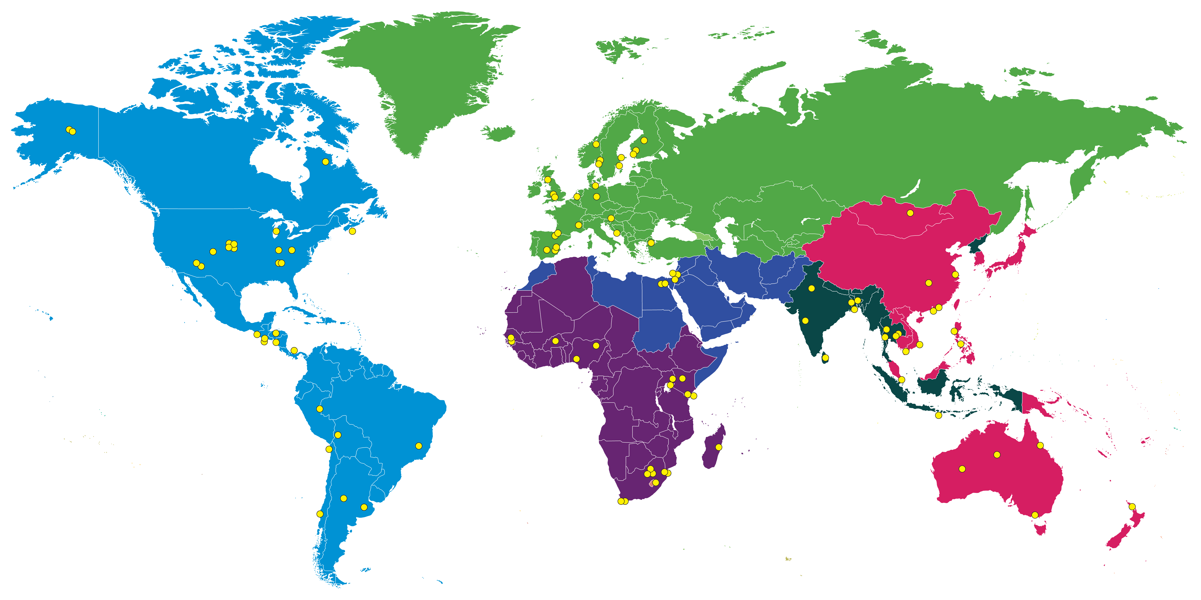
RSV mortality & morbidity data available from 107 studies across WHO regions
Africa Region
Region of the Americas
Eastern Mediterranean region
European region
South East-Asia region
Western Pacific region
Studies collecting information on RSV acute lower respiratory infection (ALRI) hospitalizations in children ranging from 0 to 60 months of age (n = 107)
Map courtesy of Nanjing Medical University. Data source: Li et al. Lancet. 2022. Personal communication with Dr. You Li.
Notes:
A reanalysis of a 2019 global RSV morbidity and mortality meta-analysis was done to look at RSV burden in WHO regions.
Data were available from 107 studies from all WHO regions as shown by the red dots on this map.

Slide 18
A high burden of community RSV-associated ALRI among infants (0-11 months) in all regions
  Number of annual episodes in thousands (% of global total)
Data source: Li Y, et al. Lancet. 2022. Personal communication with Dr. You Li.
Notes:
All regions have a high burden of RSV ALRI in the community, with the greatest number of cases among infants in Africa (over 4 million per year) and South EastAsia (over 2 million per year).

Slide 19
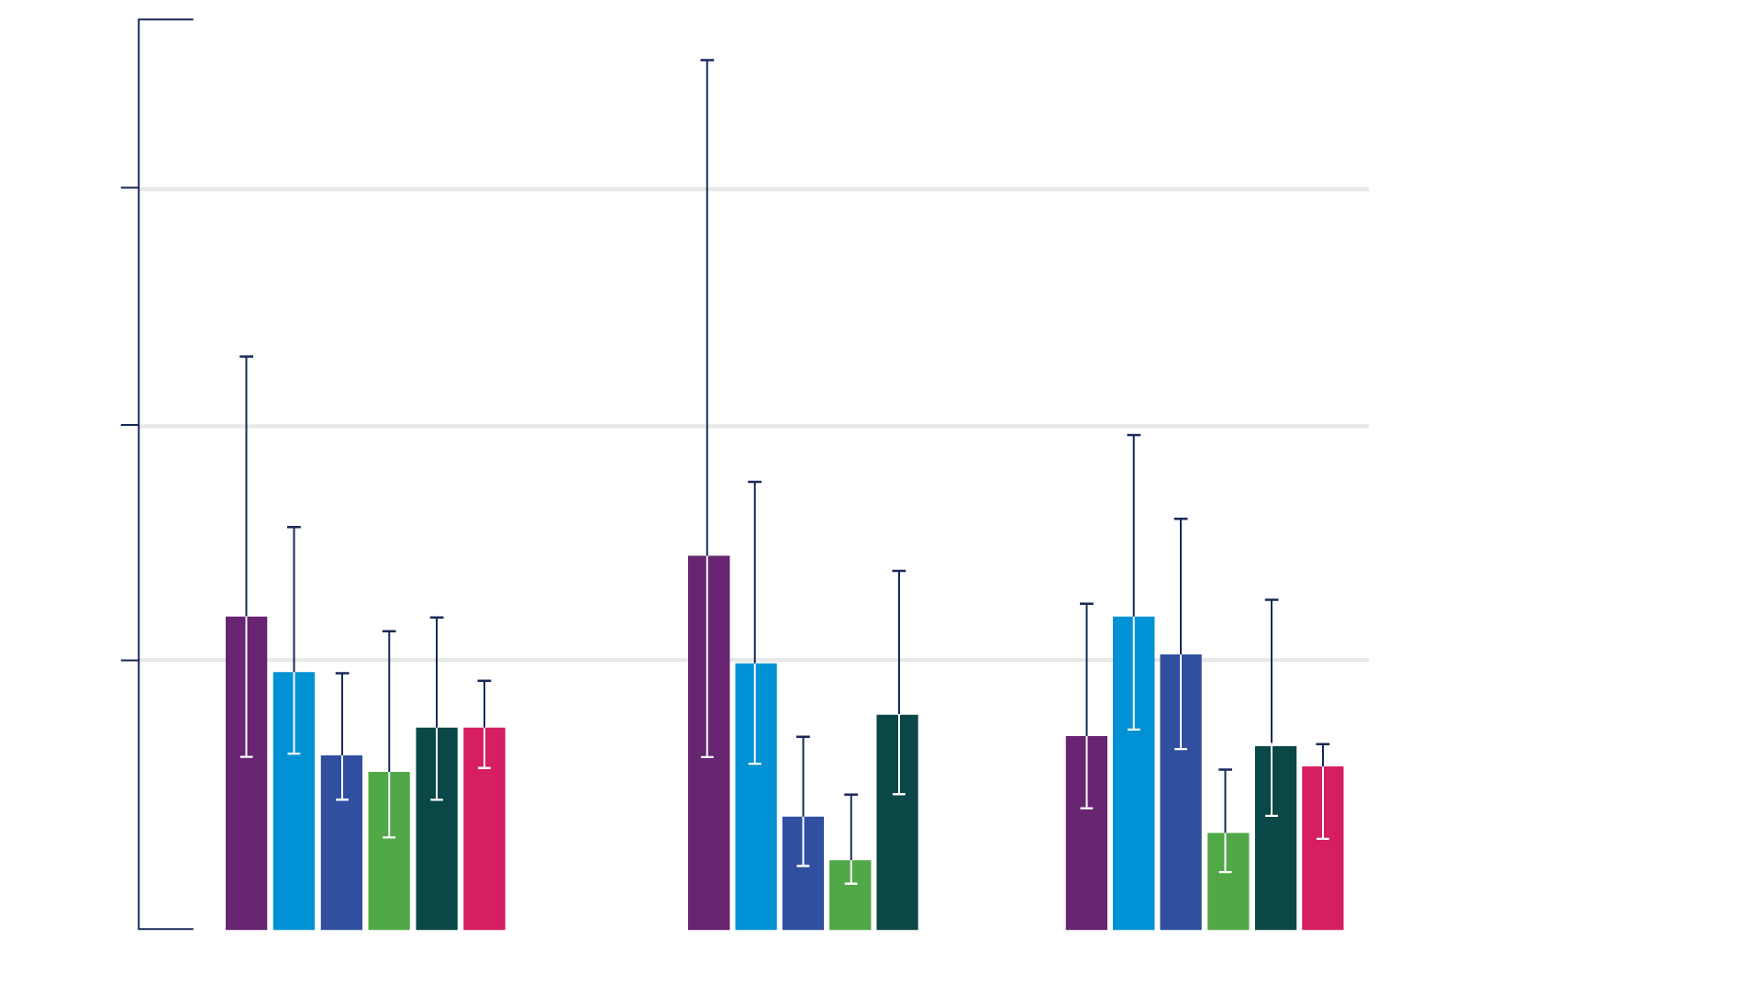
RSV-associated ALRI among infants in the community by age group & WHO region highest incidence rate is in Africa for children under 6 months of age
300
200
Incidence rate (case per 1000)
Africa Region
Region of the Americas
Eastern Mediterranean region
European region
South East-Asia region
Western Pacific region
100
0
0-<12m
0-<6m
6-<12m
Data source: Li Y, et al. Lancet. 2022. Personal communication with Dr. You Li.
Notes:
The number of ALRI cases in the community shown on the last slide is a combination of the number of children in a region and the incidence rate.
In this graph, you can see that the incidence rate is highest in Africa for children under 6 months of age; whereas, incidence is more equal across regions in children 6-12 months of age.
Note: No data available for 0-<6 months of age for Western Pacific region.

Slide 20
RSV-associated ALRI hospitalization among infants by WHO region
  Number of annual episodes
  in thousands
  (% of global total)
Data source: Li Y, et al. Lancet. 2022. Personal communication with Dr. You Li.
Notes:
The pie chart shows the number of RSV-associated ALRI hospitalizations among infants (0-11 months of age) by WHO region.
The largest number of hospitalizations are in South East-Asia and the Eastern Mediterranean, with over 500,000 hospitalizations per year in each region.

Slide 21
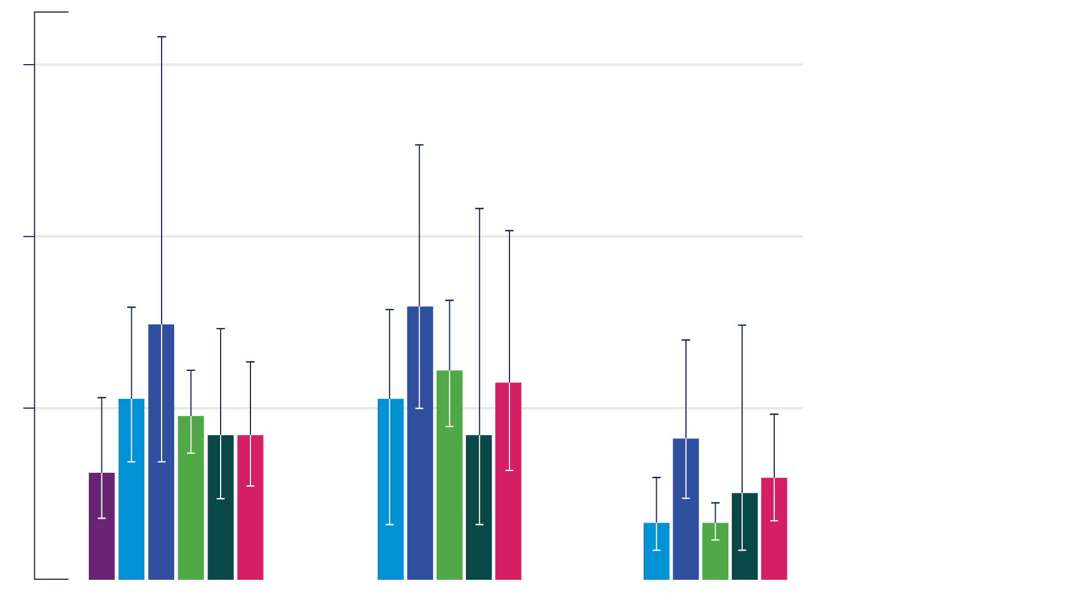
RSV-associated ALRI hospitalizations among infants by WHO region hospitalization rate per 1,000 infants
Note: Although Africa has the highest community RSV ALRI incidence rate in children < 6 months old,
it has the lowest hospitalization rate.
60
40
Incidence rate (case per 1000)
Africa Region
Region of the Americas
Eastern Mediterranean region
European region
South East-Asia region
Western Pacific region
20
0
0-<12m
0-<6m
6-<12m
Data source: Li Y, et al. Lancet. 2022. Personal communication with Dr. You Li.
Notes:
This graph shows the rate of hospitalizations for infants for RSV ALRI.
You will notice that unlike the incidence rate in the community where Africa had the highest rate in children < 6 months old, now Africa has the lowest rate of hospitalization across all age groups—showcasing the burden that RSV lower respiratory tract infection has in children in the community who never make it to the hospital.

Slide 22
RSV-attributable mortality among infants by WHO region the greatest mortality burden is in Africa
  Number of annual deaths
  (% of global total)
Data source: Li Y, et al. Lancet. 2022. Personal communication with Dr. You Li.
Notes:
Now, looking at the overall number of deaths due to RSV, the greatest burden is clearly in Africa, which accounts for over half of the RSV attributable deaths worldwide each year.

Slide 23
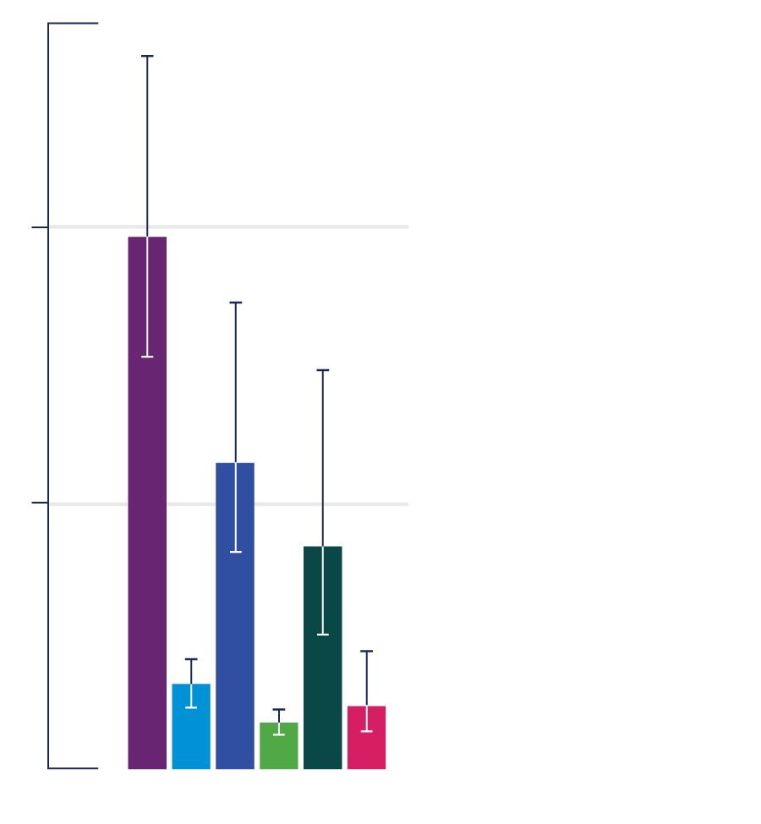
RSV-attributable mortality rates among infants by WHO region mortality rate (per 1,000 infants)
1
Mortality rate (case per 1000)
.5
Africa Region
Region of the Americas
Eastern Mediterranean region
European region
South East-Asia region
Western Pacific region
0-<12m
Data source: Li Y, et al. Lancet. 2022. Personal communication with Dr. You Li.
Notes:
The large number of deaths is related to Africa having a lot of children under one year of age, but also having the highest mortality rate as shown in this figure where it is approximately one per thousand infants dying annually from RSV.

Slide 24
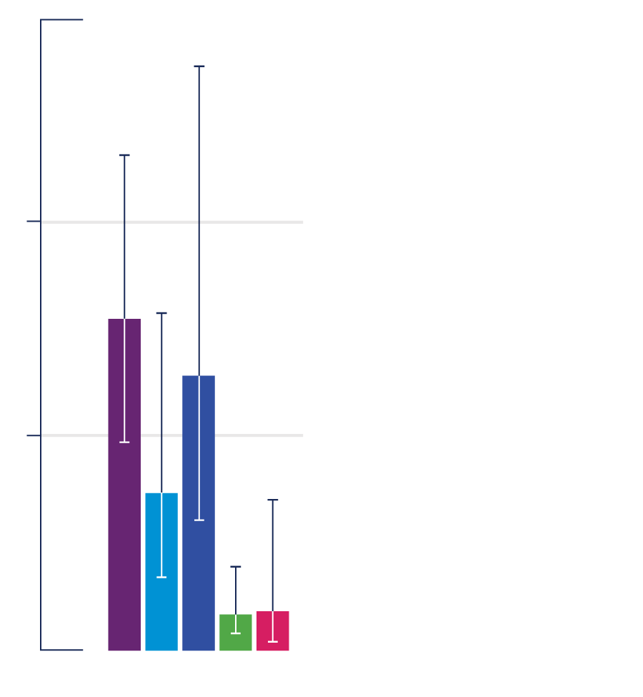
RSV-associated ALRI in-hospital infant case-fatality ratio by WHO region making it to a hospital substantially improves chances of survival
2
In-hospital case fatality ratio (%)
Africa Region
Region of the Americas
Eastern Mediterranean region
European region
South East-Asia region
Western Pacific region
1
0
0-<12m
Data source: Li Y, et al. Lancet. 2022. Personal communication with Dr. You Li.
Notes:
This graph shows the in-hospital case fatality ratio (CFR).
Some variation occurs by region with the highest in hospital case fatality in Africa at about 1.5%.
This is a relatively low CFR compared to some other causes of pneumonia (e.g., pneumococcus), emphasizing that if a child with RSV makes it to the hospital, they have a high chance of surviving.
Note that this is only capturing individuals making it to the hospital.
RSV deaths among children 6 months of age and younger in low-income settings are 4 times more likely to occur in the community than they are to occur in the hospital.
This is because the vast majority of children with severe RSV don’t make it to the hospital where they can receive supportive care, increasing their likelihood of dying.
Causes of deaths in the community are often unknown or unreported, and as such, RSV morbidity and mortality in these contexts is thought to be even greater than current estimates suggest.

Slide 25
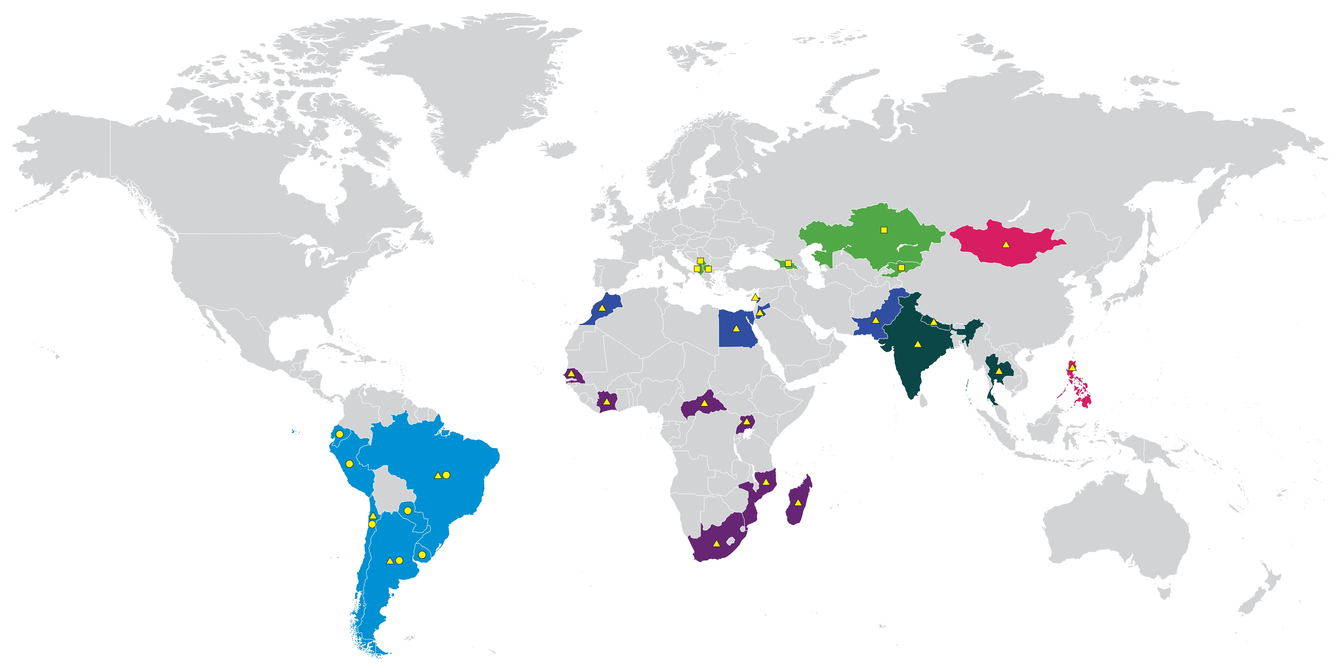
LMICs where ongoing RSV surveillance is taking place with WHO support
Kazakstan
Kosovo
Georgia
Mongolia
North Macedonia
Albania
Kyrgyzstan
Morocco
Lebanon
Pakistan
Jordan
Nepal
Egypt
Thailand
Senegal
India
Cote d’Ivoire
Central African Republic
Philippines
Ecuador
Uganda
Peru
Brazil
Mozambique
Africa Region
Region of the Americas
Eastern Mediterranean region
European region
South East-Asia region
Western Pacific region
Paraguay
Madagascar
Chile
Uruguay
South Africa
Argentina
Global Influenza Surveillance and Response System (GISRS) PAHO Severe Acute Respiratory Infections Network (SARInet) European SARI Vaccine Effectiveness Network (EUROSAVE)
NOTE: All references to “Kosovo” should be understood as
“Kosovo (in accordance with security council resolution 1244 [1999]).”
Notes:
So, we've showed you results of RSV surveillance studies that have taken place over the last couple decades. All WHO regions were well represented.
In this slide what we are showing you is where RSV surveillance is taking place today.
Because we we're not able to catalog all the RSV studies taking place we are only showing those in which WHO is involved.
As you can see there are many countries continuing to do RSV surveillance in children with good global representation.
The current RSV surveillance in which WHO is playing a role include the Global Influenza Surveillance and Response System (GISRS); PAHO’s Severe Acute Respiratory Infections Network (SARInet), and the European SARI Vaccine Effectiveness Network (Euro-SAVE).

Slide 26
RSV data are available from all parts of the globe… but more local RSV data may be needed in some countries for decision-making around introducing RSV prevention products.
Key takeaways
Data show that RSV LRTI occurs across the globe.
  RSV accounts for one- to two-thirds of all ALRI hospitalizations among children < 6 months old.
RSV mortality is highest in Africa, mostly due to children with severe RSV not accessing hospital care.
WHO-sponsored surveillance for RSV is ongoing across all WHO regions.
To understand local RSV burden, decision-makers in countries can either
  look to existing data from their own region
  establish RSV surveillance in their country
Notes:
In conclusion RSV burden data among infants and children is currently available from all WHO regions.
The data that do exist show that RSV associated LRTI is high in all parts of the world accounting for 1/3 to 2/3 of all acute lower respiratory tract infection hospitalizations in children under six months of age.
RSV mortality is the highest in Africa and is mostly due to children with severe RSV not accessing hospital care.
There is also ongoing RSV surveillance in all WHO regions.
For decision makers in countries that are deciding about introducing RSV prevention products, the local burden of RSV disease can be assessed by examining existing data from their own region. Establishing RSV surveillance in their own country is also possible. The types of RSV surveillance that can be done are covered in another roadshow module.

