Slide 1
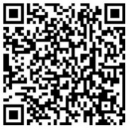
The economics of
RSV prevention
cost, health impact, and cost-effectiveness considerations for RSV maternal vaccines and monoclonal antibodies in low- and middle-income country contexts
Access these and additional slides offered as part of an RSV communications toolkit at:
bit.ly/RSVInfoToolkit
Version: September 2026

Slide 2




Agenda respiratory syncytial virus (RSV) health economics and primary questions
 | RSV prevention and health economics an overview
 | How much will RSV immunization cost? informing budgetary feasibility
 | What is the impact of RSV immunization? estimating effects on public health
 | What is the cost effectiveness of RSV immunization? analyzing public health value for amount paid
Original slide developed by PATH, UMC Utrecht, and the World Health Organization. Version: September 2026
Notes:
As countries weigh how RSV prevention could fit within their public health systems, a series of health economics questions will be important to consider.
In this presentation, we’ll discuss three of the major ones:
How much will an RSV immunization program cost? Including for maternal immunization and/or mAbs.
Is immunization impactful?
Is immunization cost-effective?
We’ll talk more about what information is available in relation to these questions and where additional data gathering would be helpful or may be in progress.

Slide 3
RSV prevention and health economics
an overview

Slide 4


Why focus on respiratory syncytial virus (RSV)? And why now?
RSV is the world's top cause of severe respiratory infections and hospitalization in infants and young children. New immunization tools could help change that.
New tools for preventing RSV in early life have been licensed in many countries and are recommended for global use by the World Health Organization (WHO).
vaccine given in pregnancy
long-acting monoclonal
antibodies given to
young infants
An overdue chance to address an under-recognized cause of
Adding RSV to the immunization toolkit could
keep children out of the hospital
save many young lives
free up resources for other health priorities
millions of hospitalizations
thousands of deaths
strain on health systems and livelihoods
Now is the time to raise awareness and support global, regional, and country decision-making around RSV prevention, policy, and implementation preparedness.
Original slide developed by PATH and the World Health Organization. Version: September 2026
Notes:
Today, I’m here to talk about progress in the fight against respiratory syncytial virus, or RSV.
RSV has long been a significant, yet under-recognized, public health problem—and we’ve never had a better opportunity to address it than now.
This common virus is responsible for more acute lower respiratory infections and hospitalizations in infants and young children worldwide each year than any other pathogen.
Yet, many people have never even heard of RSV, unless they’re parents or health providers that must care for the children sickened by it.
New products that can prevent severe RSV disease in young children are now approved in many countries and recommended for global use by the World Health Organization (WHO). Other products also continue to be in development.
This is exciting because of a historic lack of an RSV vaccine and only one prevention option during the last decade—a monoclonal antibody used in very few children due to its high cost and burdensome schedule of administration.
The new options are designed to induce passive immunity, which results when a person is given antibodies that are either derived from someone else or are manufactured. They include:
A maternal RSV vaccine for delivery during pregnancy.
Also, a long-acting monoclonal antibody (mAb) for delivery soon after birth or before/during first RSV season.
RSV immunization is an important step toward defeating a virus that puts millions of children in the hospital, causes thousands of deaths, and strains health systems and livelihoods.
Getting there will take work, coordination, and venturing into new territory in some cases.
Countries will need to consider how RSV prevention could fit within their public health agendas.
The time is now to raise awareness and support such decision-making around RSV prevention, policy, and implementation preparedness—at global, regional, and country levels.

Slide 5
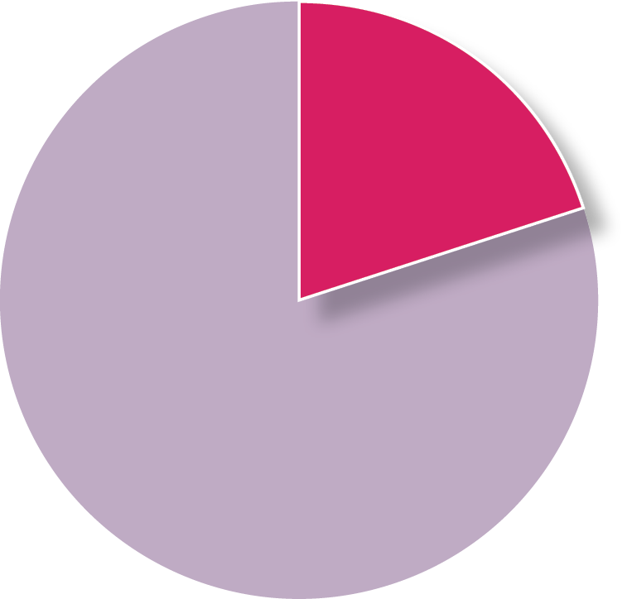
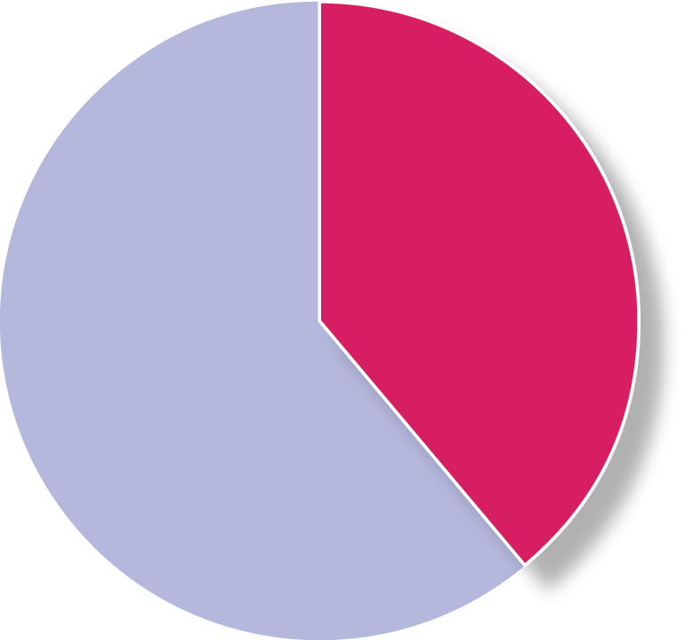
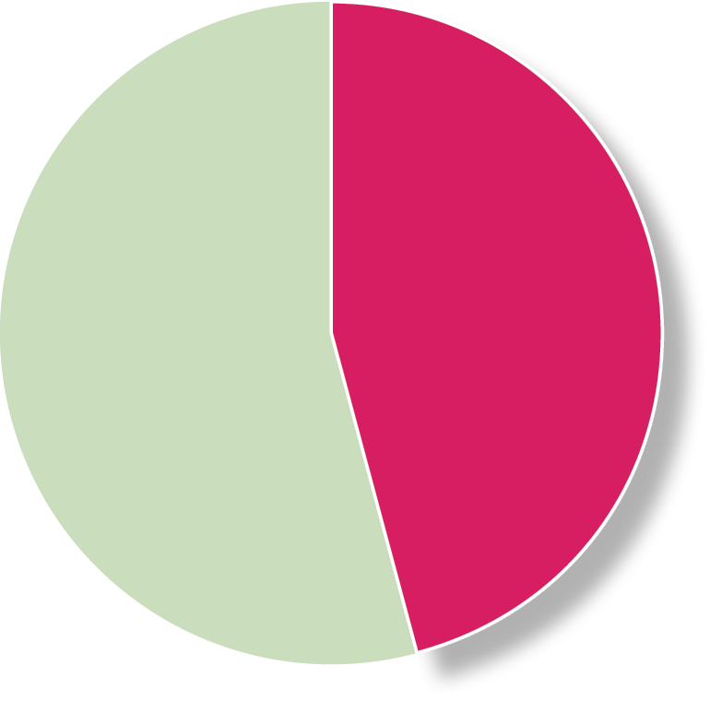
Annual global pediatric RSV disease burden (< 5 years of age)
LEADING CAUSE OF SEVERE RESPIRATORY INFECTION
LEADING CAUSE OF PEDIATRIC HOSPITALIZATION
IMPORTANT CAUSE OF PEDIATRIC MORTALITY
33 million
episodes
3.6 million
hospitalizations
101,000
deaths
< 6 months
20%
< 6 months
39%
< 6 months
46%
Nearly half of RSV deaths are before 6 months of age
6 months to 5 years
80%
6 months to 5 years
61%
6 months to 5 years
54%
TOTAL GLOBAL CHILD MORTALITY DUE TO RSV
3.6%
< 6 MONTHS
2.3%
< 5 YEARS
Reference: Li Y, et al. Lancet 2022.
Original slide developed by PATH and the World Health Organization. Version: September 2026
Notes:
In 2022, the global annual RSV burden estimates were updated and published in the Lancet.
These estimates found that, in 2019, RSV was responsible for a staggering 33 million episodes of acute lower respiratory tract infection, approximately 3.5 million hospitalizations, and over 100,000 RSV deaths among children less than five years of age worldwide.
Overall RSV accounts for 2% of the global mortality burden in children under 5 years of age and 3.6% among children under 6 months of age.
RSV in children under 6 months of age accounts for 20% of acute lower respiratory infection episodes and almost half of all RSV deaths in children under 5 years of age.

Slide 6

New immunization products emerging for RSV disease prevention in early life
 | Maternal vaccine | Long-acting monoclonal antibody
 | Vaccination in pregnancy can directly enhance the pregnant vaccinee’s immunity and increase natural antibody transfer to baby across the placenta for protection in early life. | Directly immunizing infants soon after birth provides antibodies for critical protection in early life.
 | Pre-F protein in the vaccine induces antibodies that neutralize the virus. | mAbs are manufactured antibodies to the RSV pre-F protein that neutralize the virus.
 | Vaccination during defined gestational age window to optimize transfer of antibodies to infant. (WHO recommends third trimester as defined in the local context.) | Soon after birth with other birth dose vaccinations (e.g., hepatitis B; BCG, OPV) or before/during first RSV season.
 | Given in one dose At least 5-6 months protection after birth | Given in one dose At least 5-6 months protection after administration (longer lasting than palivizumab)
RATIONALE
HOW IT WORKS
TIMING
PRODUCT CHARACTERISTICS
Original slide developed by PATH and the World Health Organization. Version: September 2026
Notes:
There are two approaches to protecting young infants against RSV—maternal immunization and long-acting monoclonal antibodies.
Both are designed to provide passive protection via antibodies to protect babies in the early, most vulnerable months of life. For both products, we use the term immunization in this presentation.
Maternal vaccines given during pregnancy help a mother’s body generate antibodies that can protect her and also be transferred to her baby. These antibodies can protect baby in the first few months after birth when the risk of RSV complications are greatest.
Maternal vaccines boost the concentration of neutralizing antibodies in the mother that are then naturally transferred across the placenta to directly protect infants for months after birth.
Vaccination should be timed during pregnancy to maximize the antibodies transferred to baby. WHO recommends vaccination in the third trimester of pregnancy as defined in the local context (starting at 28 weeks gestational age in most settings, but could be earlier in some place [e.g., 27 weeks]). Vaccination recommendation windows can vary by regulatory authority and country.
Monoclonal antibodies are laboratory produced antibodies that can be given to an infant to elicit protection. New long-acting monoclonal antibodies are starting to get licensed that can be delivered at birth or soon thereafter in one dose or before/during a baby’s first RSV season. The single-dose presentation improves delivery feasibility over predecessor mAbs. The long-acting mAb also protects in the first few months of a baby’s life after birth when RSV disease is particularly dangerous.

Slide 7
Presentation purpose
HEALTH ECONOMICS RESEARCH PROVIDES:
SUCH DATA FOR RSV ARE IMPORTANT NOW TO:
THIS PRESENTATION COVERS:
information to decision-makers on efficient use of available resources to maximize health benefits
evidence and tools for comparing costs and consequences of different interventions
clarify the economic and health impacts of new RSV prevention products
inform countries considering adding RSV prevention to public health programs amidst other priorities
the estimated costs of RSV immunization
RSV immunization’s potential impact and cost-effectiveness in low- and middle-income countries (LMICs)
gaps in knowledge and ongoing efforts to fill those gaps
* Information provided is based on current knowledge of the RSV disease burden, cost of illness, and product characteristics.
Original slide developed by PATH, UMC Utrecht, and the World Health Organization. Version: September 2026
Notes:
Health economic studies provide information to decision makers for efficient use of available resources for maximizing health benefits. Economic evaluation is one part of health economics and is a tool for comparing costs and consequences of different interventions.
RSV is a new disease target for many countries.
To make informed decisions around prioritizing, introducing, and delivering leading prevention products against this new disease target—including maternal vaccines and mAbs—countries need economic data to be able to weigh the public health costs and benefits amidst other competing priorities and scarce resources.
After reviewing this slide deck, viewers will better understand the cost of RSV immunization as well as their potential impact and cost-effectiveness in LMICs based on current knowledge of disease burden, cost of illness, and product characteristics.
You will also understand the gaps in knowledge and ongoing efforts to fill these gaps.

Slide 8
  The RSV health economics landscape
  overview of existing and emerging evidence
RSV Immunization and illness costs | Current RSV immunization program cost evidence appears similar to other vaccines in use. RSV illness and associated care costs can be very high in LMICs. Averting these costs could save significant healthcare resources. | Vaccine/mAb pricing and delivery cost data are needed. More country-specific data are expected in the near term.
health impact | RSV immunization can avert significant RSV cases, hospitalizations, and deaths in LMICs. | More country-specific model results available in the near term.
cost- effectiveness | RSV immunization is likely to be cost-effective in most LMICs and may be cost-saving in many. Tools exist to help countries evaluate impact and cost-effectiveness of RSV immunization in their setting (e.g., the UNIVAC RSV model).* | More country-specific model results in the near term. Cost-effectiveness results remain uncertain since product prices are unknown.
Existing evidence
Emerging evidence and
additional data needs
*Mahmud S. BMC Medicine. 2023;21(138).
Original slide developed by PATH, UMC Utrecht, and the World Health Organization. Version: September 2026
Notes:
In this presentation, we’ll talk in depth about the estimated costs of RSV immunization; health impacts; and cost-effectiveness pertaining to RSV maternal vaccines and long-acting mAbs.
Before we get into the details around these three areas, it’s useful to understand the overarching health economics landscape as it relates to RSV prevention currently.
In short, this is a swiftly moving field.
Important evidence has been generated over the years to help decision-makers better understand the cost, health impact, and cost-effectiveness implications of new RSV immunizations for low- and middle-income markets, but more is needed and is continuing to emerge.

Slide 9
How much will RSV immunization cost?
informing budgetary feasibility

Slide 10



Elements of immunization program costs and costs averted
Immunization program costs include the costs of immunization products and the costs of program delivery
  Illness costs averted by immunization offset immunization program costs.
Some countries may benefit from
  Tiered pricing (special pricing arrangements for LMICs)
  Pooled procurement mechanisms (e.g., the PAHO Revolving Fund)
  Donor co-financing from Gavi, the Vaccine Alliance
Costs
Cost of Immunization
Cost of
Program Delivery
IMMUNIZATION PROGRAM COSTS
Savings
Illness Costs Averted
Original slide developed by PATH, UMC Utrecht, and the World Health Organization. Version: September 2026
Notes:
Amidst tight public health budgets and competing priorities, an immunization program’s affordability or budgetary feasibility is an important consideration that countries must weigh when making adoption decisions.
But, before affordability can be assessed, the cost of the immunization program needs to be understood.
Immunization program costs are dependent on (1) the cost of the immunization, (2) the cost of program delivery and (3) the costs associated with caring for illness. Understanding illness costs are important for assessing costs that would be averted or saved due to immunization and resulting reductions in illness requiring care.
To be able to say whether or not immunization is “affordable” depends on what we know about the overall costs of the immunization program relative to the available budget.
For RSV, we do not have the full picture on these elements yet, but a lot of progress has been made over recent years.
For instance, more robust cost of delivery and cost of illness data are emerging from LMICs.
On the other hand, understanding immunization product pricing and country-by-country contexts, including immunization program costs relative to specific baseline public health budgets, has a ways to go.
Another important thing to keep in mind is that the cost of the immunization program may be borne by different payers/budgets than the cost of care.
Decision maker cost perspectives should determine the inclusion or exclusion of the cost of averted care.
For example, an Essential Program on Immunization (EPI) perspective may exclude the cost of averted care because the EPI budget is not typically influenced by the cost of care.
Conversely, a ministry of health perspective may include the cost of averted care.

Slide 11


  Cost of immunization products: RSV maternal vaccines and long-acting mAbs
  an incomplete picture awaiting information on product pricing and other factors
What do immunization product costs entail?
The cost of the maternal vaccine or mAb and any associated commodities (e.g., syringes and waste management materials).
Status
Pricing not yet announced by manufacturers for either product in most low- and middle-income settings.
Gavi has committed to supporting RSV immunization products for eligible countries.*
For maternal vaccine: Countries can include RSV in Gavi 6.0 holistic applications.
For maternal vaccine: A pricing agreement** for a multidose vial can help make maternal RSV vaccines more accessible to lower-income countries. (Countries can contact their Gavi counterpart for pricing information.)
For maternal vaccine: PAHO*** will provide access to countries in the Americas through its Revolving Fund.
No known mAb pricing agreement is in place for LMICs, which may preclude LMIC access for now.
Costs
Cost of Immunization
Cost of
Program Delivery
IMMUNIZATION PROGRAM COSTS
Savings
Illness Costs Averted
*Gavi, the Vaccine Alliance. Accessed at: https://www.gavi.org/news/media-room/gavi-and-partners-commence-design-rsv-maternal-vaccine-programme; 24-25-july08 - Respiratory Syncytial Virus Investment Case.pdf
** Media center announcement accessed at: https://www.gatesfoundation.org/ideas/media-center/press-releases/2022/09/gates-foundation-announces-grants-to-reduce-infant-mortality
*** Announcement accessed at: PAHO to facilitate access to maternal vaccines to protect babies in the Americas from respiratory syncytial virus - PAHO/WHO | Pan American Health Organization;
https://www.paho.org/sites/default/files/2025-07/prices-vac-2025-eng-2-july-2025-v3.pdf
Original slide developed by PATH, UMC Utrecht, and the World Health Organization. Version: September 2026
Notes:
- Overall, the cost of immunization program picture for both RSV maternal vaccines and long-acting mAbs is incomplete for now, with more information on the way.
Perhaps the most key piece of information we’re waiting for for both products is concrete information about pricing.
While we do not have hard pricing numbers yet, several mechanisms could help facilitate more affordable pricing for low- and middle-income markets—including Gavi support and a pricing agreement currently being facilitated with the manufacturer for the lead RSV maternal vaccine in a multidose vial presentation.
Gavi has said that its support is contingent on the availability of a licensed product, outcomes of regulatory and technical review processes (including World Health Organization [WHO] prequalification and Strategic Advisory Group of Experts [SAGE] recommendation),
and meeting the financial assumptions used as the basis for the RSV investment case.
In 2025, Gavi announced that it will open a funding window to support country RSV maternal immunization programs. Given changes to Gavi's operating model, countries will soon be able to apply for RSV vaccine support as part of their holistic applications. A pricing agreement for a multidose vial can help make maternal RSV vaccines more accessible to lower-income countries, though pricing and other details are not yet public.
No known mAb pricing agreement is in place for LMICs, which may preclude LMIC access for now.
PAHO is providing access to RSV maternal vaccine for member countries in the Americas via its Revolving Fund.

Slide 12

  Cost of program delivery
  the economics of administering RSV maternal immunization and mAbs
What do program delivery costs entail?
All non-commodity related costs to administer the immunization program.
  Program management, transportation, cold chain, staff salaries, social mobilization and training, etc.
How can this inform decision-making?
Program delivery costs can also be one of the largest cost components of an immunization program, especially for countries benefitting from Gavi support.
Lower costs enhance program affordability.
Costs
Cost of Immunization
Cost of
Program Delivery
IMMUNIZATION PROGRAM COSTS
Savings
Illness Costs Averted
Original slide developed by PATH, UMC Utrecht, and the World Health Organization. Version: September 2026

Slide 13
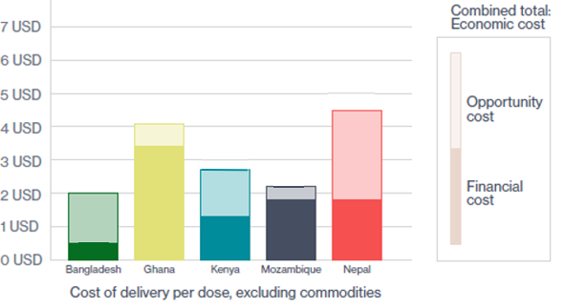





  A look at prospective maternal immunization cost of program delivery data
Maternal immunization cost of delivery (COD) data:
Bangladesh
Ghana
Kenya
Mozambique
Nepal
Financial costs are direct monetary expenditures; opportunity costs are the values of resources that are reallocated from other purposes.
References for recent cost of delivery studies
Baral R, et al. BMJ Open. 14(11);2024. (Kenya)
Baral R, et al. Vaccine. 49; 2025. (Ghana & Mozambique)
Baral R, et al. BMC Public Health. 26(1); 2025. (Bangladesh & Nepal)
References for relevant cost of delivery studies previously conducted:
Procter SR, et al. Vaccine. 2020;28(40).
Pecenka C, et al. PLoS One. 2017;12(12).
Vaughan K, et al. Vaccine X. v.2. 2019.
Original slide developed by PATH, UMC Utrecht, and the World Health Organization. Version: September 2026
Notes:
Some relevant cost of delivery studies were done years ago in LMICs that are worth mentioning because they specifically looked at either maternal immunization or childhood vaccine program delivery costs.
One 2015 study from Malawi,** for instance, provided some insights into the costs of administering maternal immunization for influenza—projecting financial costs of $0.52 per dose and economic costs of $4.58 per dose (2015 USD).
Interestingly, this is the only study identified that empirically assesses what a maternal immunization program might cost in a low-income economic context.
A literature review from 2016*** estimated mean and median economic costs of delivery of $0.84 and $0.61 per dose for childhood vaccines (2016 USD) across several different LMICs. RSV mAbs may be comparable to this.
Overall, existing cost estimates should be interpreted cautiously due to limited data, uncertain delivery strategies, and unknown product characteristics
The exciting news is that new cost of delivery data are emerging from 2024 onward (pictured here), which provide a more up-to-date picture of what RSV immunization cost of delivery might look like across different low- and middle-income contexts.
This graph shows a look at results from recent maternal RSV cost of delivery studies in Bangladesh, Ghana, Kenya, Mozambique and Nepal
A study in Kenya also looked at RSV maternal immunization and mAb cost of delivery study.
These studies prospectively (prior to program implementation) estimate program delivery costs to inform countries of the magnitude of costs likely to be encountered.
The Kenya study also looked at how maternal vaccine program delivery costs may differ from mAbs.
The data so far suggest that RSV maternal vaccines and mAbs may have similar program delivery costs, but additional evidence is still in development.

Slide 14
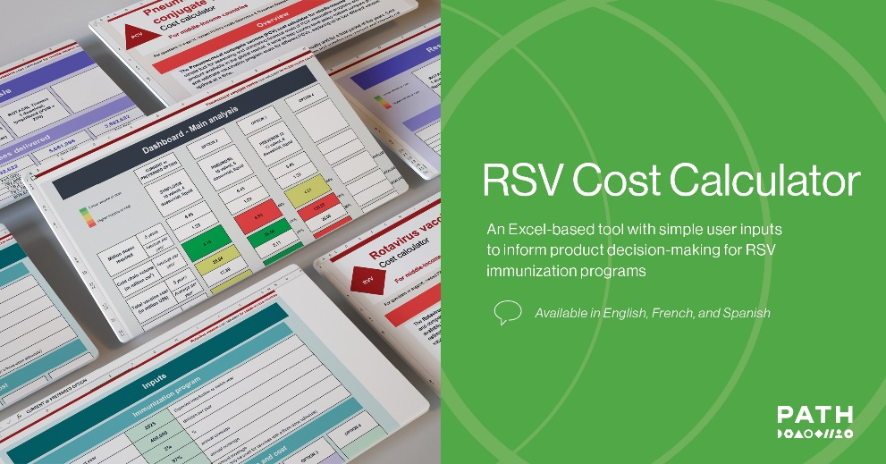
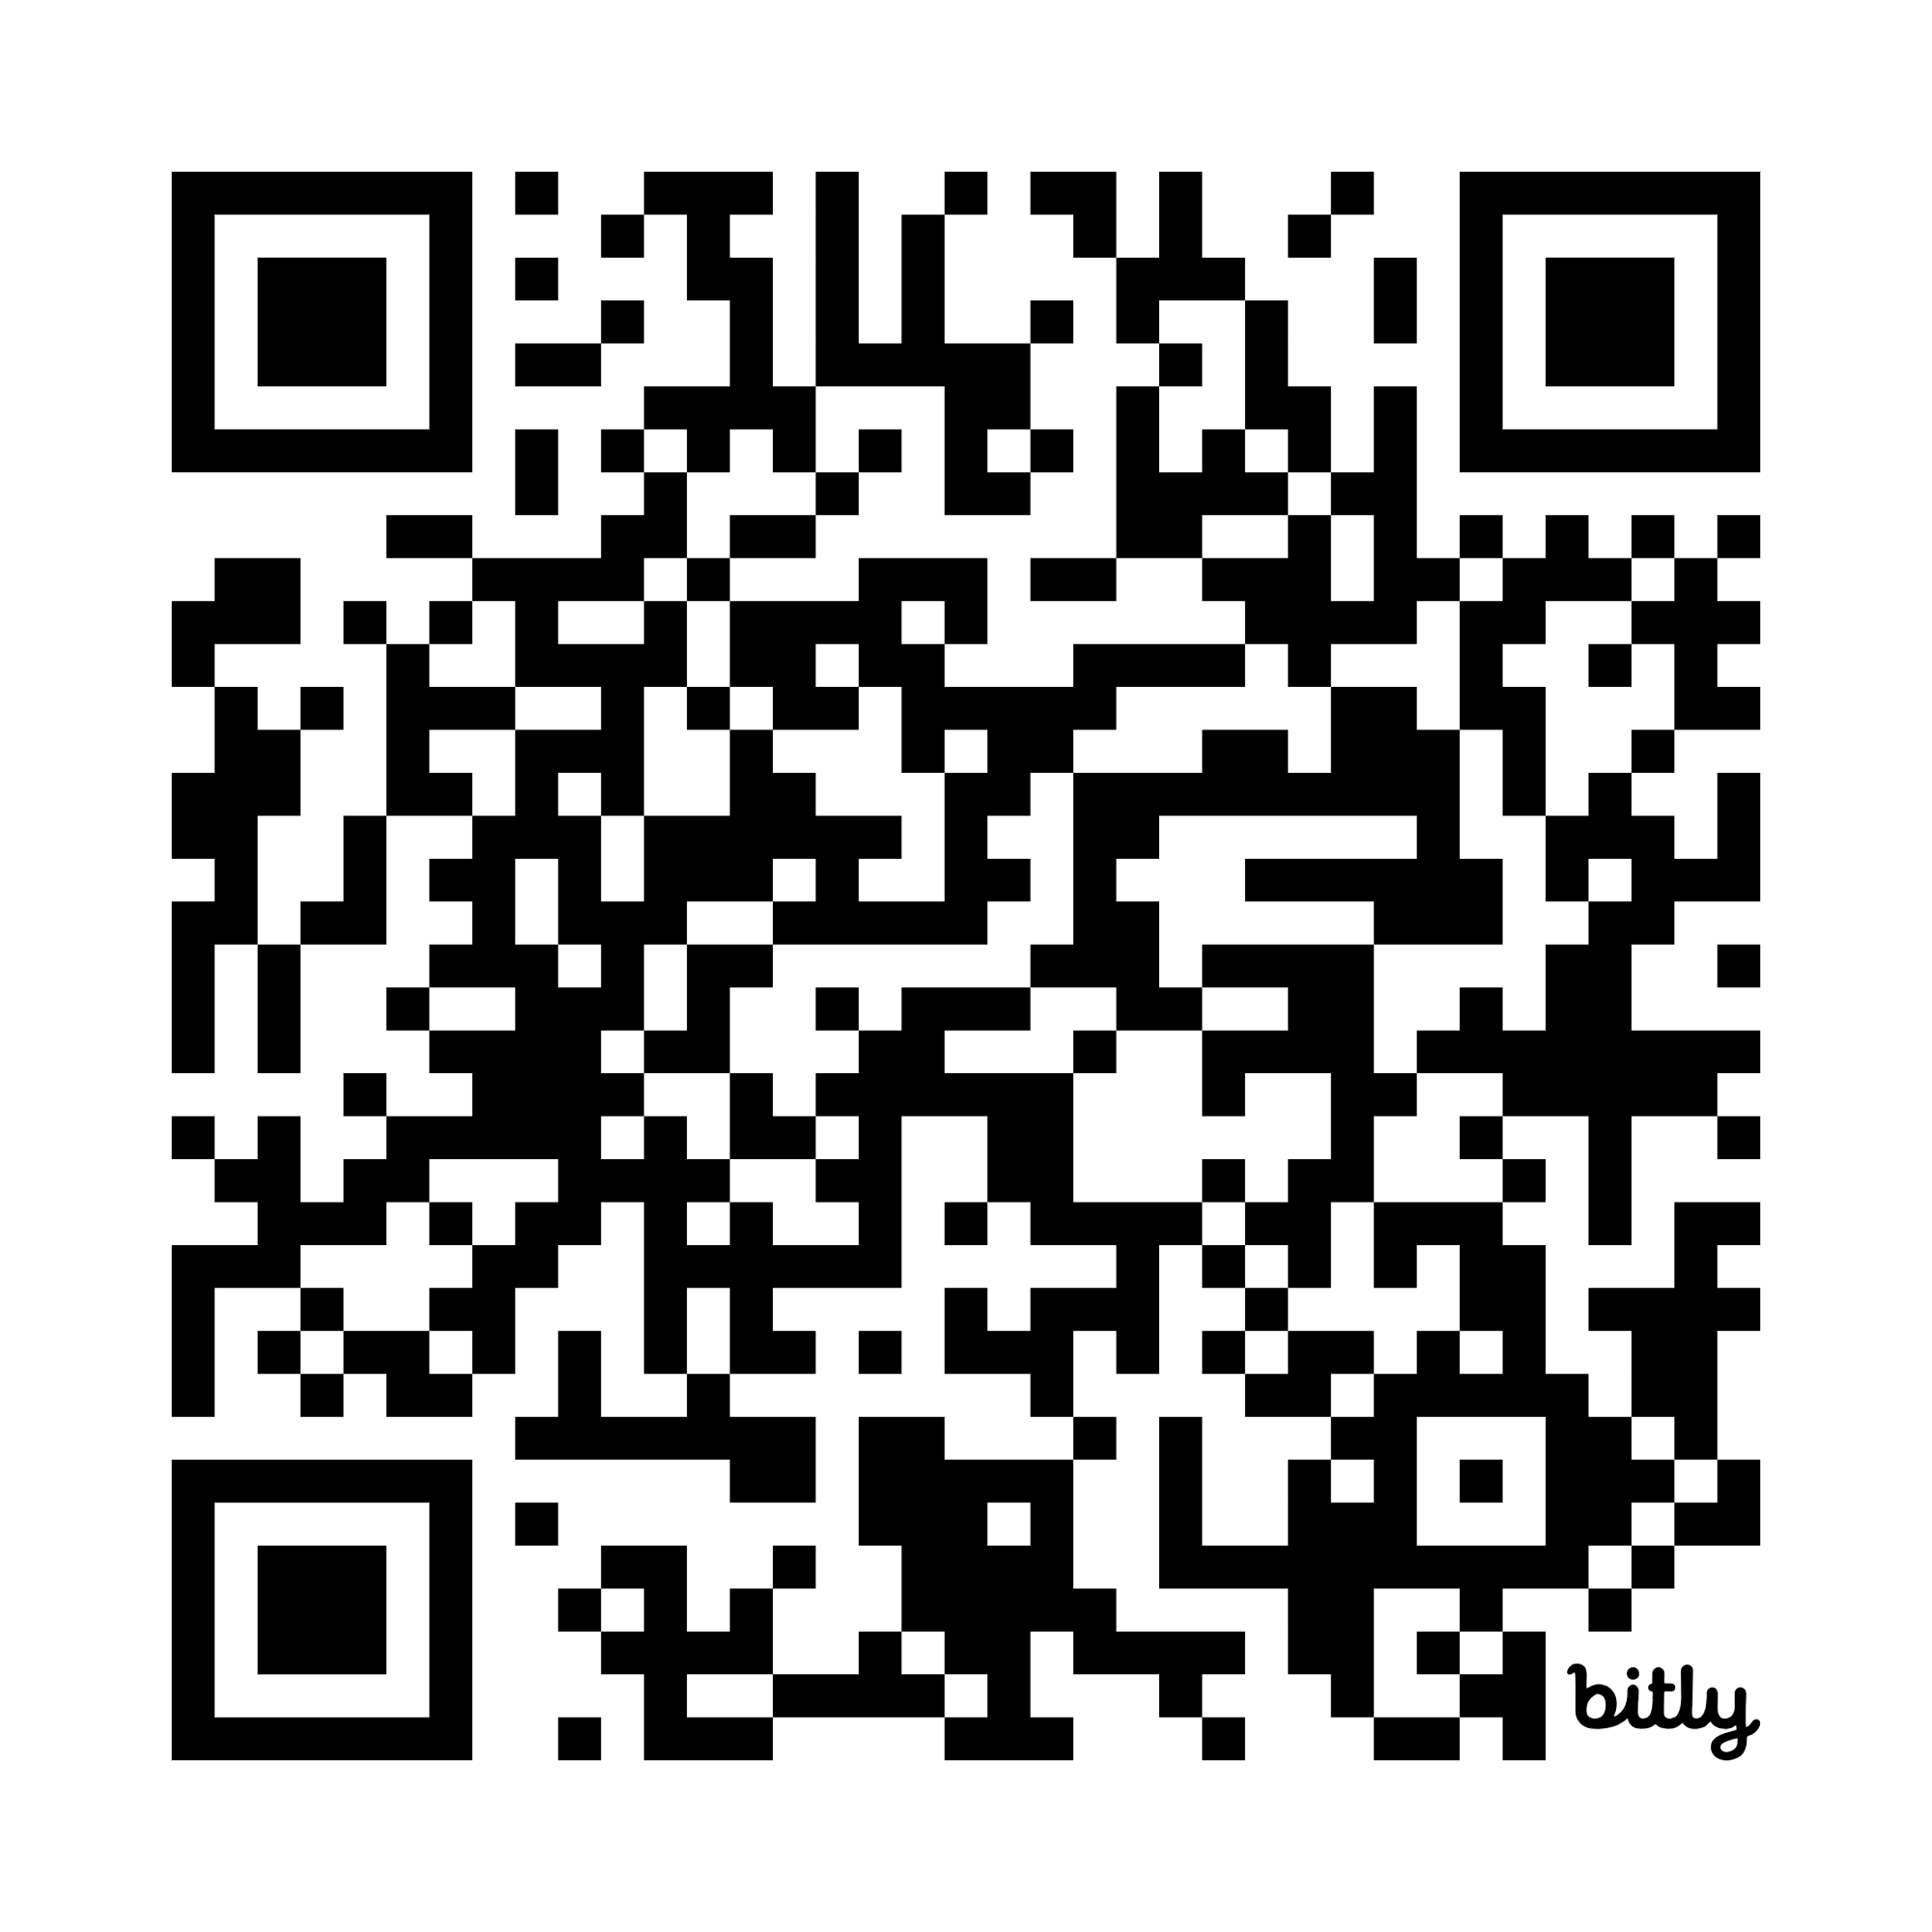
RSV immunization cost calculator—a tool to inform decision-making in low- and middle-income economies
bit.ly/RSV_costcalculator
Compare products and estimate intervention program costs for RSV maternal vaccine and mAbs.
Original slide developed by PATH, UMC Utrecht, and the World Health Organization. Version: September 2026
Notes:
PATH hosts a series of cost calculators for immunization products against a variety of diseases, including RSV.
The RSV cost calculator is a simple, Excel-based tool for assessing and comparing costs of RSV intervention programs annually and for a period of five years with RSV maternal vaccine and mAb products available in the global market.
It aims to help country-level policymakers compare products and estimate intervention program costs for both RSV maternal vaccine and mAbs.
The tool can be used by decision-makers, implementers, technical partners, and others in any country, whether or not the country is eligible for co-funding from Gavi, the Vaccine Alliance.
Product cost estimates (i.e., supplies procurement and international shipping) and immunization program costs (i.e., cost of delivery) are calculated separately for two perspectives: (1) the country perspective and (2) the combined country and donor/Gavi perspective (only relevant for Gavi-eligible countries).
The tool also calculates the estimated cold chain volume requirements, which can support operational planning and logistics.
It's important to note that cost is only one consideration when selecting an RSV intervention product, and users involved in decision-making around new vaccine introduction or product selection should always consider other dimensions as well. This model is meant to provide insights into the potential costs of alternative product choices and should not replace detailed budget planning once a product has been selected.

Slide 15





  What to know about program delivery costs for RSV immunization
What does existing evidence suggest?
What gaps will emerging data fill?
What does existing evidence suggest?
Program delivery costs for RSV and other childhood and maternal vaccines may be similar.
What are the caveats?
Generalizing existing program cost data for other childhood vaccines across settings / vaccines and applying these to RSV is difficult.
Older data from other maternal vaccines are less relevant to current landscape.
RSV immunization program cost data are currently prospective because few LMICs are currently using RSV vaccines.
What gaps will forthcoming data fill?
Identify potential differences in RSV program delivery costs compared to existing vaccine programs.
How can countries use this information?
Evaluate prospective RSV program delivery activities and costs in relation to existing activities and program costs.
Additional considerations
  Seasonal RSV immunization (if feasible) could result in similar health impact as year-round immunization, at lower cost.*
Caveats?
How can countries use this information?
Additional considerations
*References: Li Y, et al. Lancet ID. 21(9): 2021;
Guiñazú G et al. Vaccine. 42(23): 2024.
Original slide developed by PATH, UMC Utrecht, and the World Health Organization. Version: September 2026
Notes:
-RSV program delivery cost estimates are currently uncertain but we will learn much more soon.
-Based on early evidence from ongoing research, experts anticipate that maternal vaccines and mAbs may have program delivery costs that are similar to other vaccines, though it is difficult to generalize.

Slide 16
  Costs of RSV illness
  understanding current treatment costs that could be averted through RSV immunization
What do costs of illness/care entail?
All the costs associated with treating RSV such as,
  medicines, staff salaries, laboratory tests, transportation to the health care facility, and time lost by patients and caregivers.
How can this inform decision-making?
Governments and households in every country in the world incur significant RSV illness costs.
Understanding the magnitude or RSV illness costs helps decision makers grasp
  the scale of the current problem
  how RSV immunization can reduce or avert the costs of RSV illnesses for the government and households.
Costs
Cost of Immunization
Cost of
Program Delivery
IMMUNIZATION PROGRAM COSTS
Savings
Illness Costs Averted
Original slide developed by PATH, UMC Utrecht, and the World Health Organization. Version: September 2026
Notes:
Each case of RSV illness comes with costs to the health system and households.
The purpose of immunization is to improve health and reduce those costs by reducing cases of illness.
It’s important for healthcare decision-makers to understand the magnitude of the current problem, RSV illness costs, and the degree to which illness cases can be averted by an immunization product, thereby, also averting costs and strains on healthcare systems and households.

Slide 17
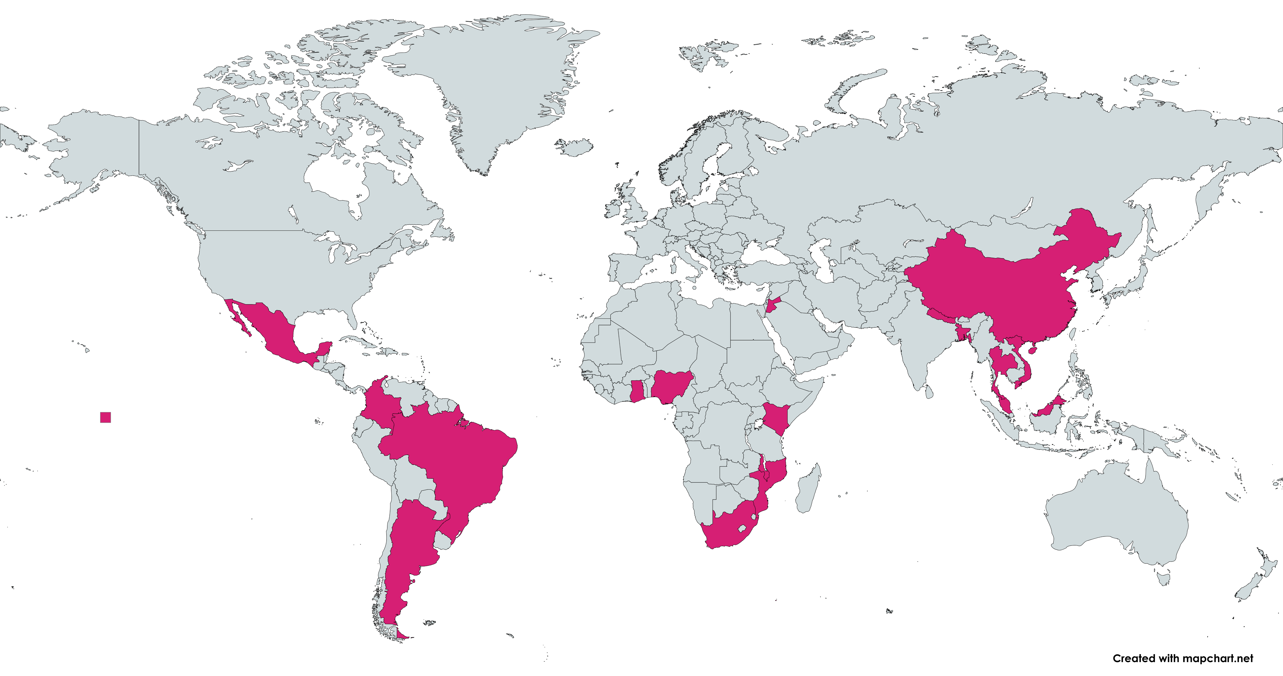
  LMICs with RSV cost of illness data existing
Jordan
China
Data existing
Nepal
Mexico
Nigeria
Vietnam
Thailand
References
Rave N, et al. Journal of Global Health. 2025.
DOI: 10.7189/jogh.15.04092
Rave N, et al. Rave N, et al. Journal of Global Health. 2025. DOI: 10.7189/jogh.15.04076
Shabaan FL, et al. Journal of Global Health. 2025. DOI: 10.7189/jogh.15.04307
Ponce LJ, et al. eClinicalMedicine. 2025. DOI: 10.1016/j.eclinm.2025.103350
Abu-Helalah M, et al. Viruses. 2024. DOI: 10.3390/v16121867
Khuri-Bulos N, et al. Scand J Infect Dis. 2010. DOI:10.3109/00365540903496544
Guiñazú GG, et al. Lancet Regional Health – Americas. 2026. DOI: 10.1016/j.lana.2026.101601
Ghana
Kenya
Bangladesh
Malaysia
Brazil
Malawi
Mozambique
South Africa
Original slide developed by PATH, UMC Utrecht, and the World Health Organization. Version: September 2026
Notes:
Evidence on cost of illness is available across a good number of LMICs, with more coming soon.
This map shows where studies have already generated data.
What’s helpful is the geographic and income-level diversity of these studies, which is giving us an ever-improving picture of what RSV costs of illness look like in different contexts.
New data came out in 2025 and additional data are still being generated.

Slide 18
  RSV illness costs can be very high for households and health systems
  estimates range widely across LMICs
On average, 32% of total monthly household income for lowest income households
On average, 24% of total monthly household income
References
Wittenauer R, et al. BMC Medicine. 2023. DOI: 10.1186/s12916-023-02792-z.
Guiñazú GG, et al. Lancet Regional Health – Americas. 2026. DOI: 10.1016/j.lana.2026.101601
Rave N, et al. Journal of Global Health. 2025. DOI: 10.7189/jogh.15.04092.
Rave N, et al. Journal of Global Health. 2025. DOI: 10.7189/jogh.15.04076.
Shaaban FL, et al. Journal of Global Health. 2025. DOI: 10.7189/jogh.15.04307.
Shaaban FL, et al. Journal of Global Health. 2025. DOI: 10.7189/jogh.16.04040.
Notes: Figure adapted and simplified (see source studies for full details). Averages are presented in countries with multiple cost estimates, even if they represent different levels of care (e.g., inpatient wards and intensive care unit).
Inpatient costs range from $51 in Malawi to up to $2,123 in Malaysia (2025 USD).
Original slide developed by PATH, UMC Utrecht, and the World Health Organization. Version: September 2026
Notes:
So, what are these studies telling us?
Depicted here are results from a review of cost of illness studies in various low-, lower-middle-, and upper-middle-income countries.
These data are important because they show that RSV illness costs can be high and have large economic implications in LMICs
They show a wide range of RSV illness costs across countries and, in many places, the costs can be high--with thresholds ranging from $51 to $2,000+ (2025 USD) depending on the country.
These costs can consume a burdensome proportion of a family’s household income.
For instance, in an inpatient RSV illness cost of $51 USD in Malawi amounts to around one-third of total monthly household income for the lowest income households.
In Bangladesh, $114 USD in RSV illness costs amounts to around a quarter of total monthly income—requiring more than half of households to take out loans to pay for care.
Other RSV illness cost data from South Africa and Vietnam published in 2023 also show similarly wide ranges with high cost thresholds.
Many of these costs could be averted by RSV maternal vaccines or mAbs.

Slide 19
What to know about RSV illness costs
What does existing evidence suggest?
What gaps will emerging data fill?
What does existing evidence suggest?
RSV illness and associated care costs can be very high in LMICs.
Averting RSV illness and costly care could save significant healthcare resources.
What are the caveats?
Healthcare resources saved by immunization vary by country and depend on current RSV burden and associated costs.
What gaps will forthcoming data fill?
Broader evidence on RSV illness costs borne by governments and households.
How can countries use this information?
Understanding RSV economic burden informs how RSV immunization can reduce such costs.
Additional considerations
Where highly seasonal RSV burden is high, averting RSV could:
  mitigate seasonal demands on the health system.
  free up resources for other health priorities.
How can countries use this information?
Caveats?
Additional considerations
Original slide developed by PATH, UMC Utrecht, and the World Health Organization. Version: September 2026
Notes:
So, what is the key takeaway here.
RSV illness and care can be very high in LMICs.
Remember, illness costs include treatment costs to health systems and costs to households (e.g., transportation and lost wages).
That means that averting RSV illness could mean significant health care savings for countries that could really use it.
Of course, such savings vary by country and depend on the RSV disease burden and associated costs.
While the body of country-specific evidence is growing and could be useful for neighboring countries, additional data will also be needed on a case by case basis as countries go through the decision-making process.
With the growing evidence base will come a better understanding of country-level economic burdens due to RSV and how immunization can avert these costs.
Another consideration that not yet touched on is that some places experience RSV in seasonal waves, which can stress health systems intermittently.
Averting RSV could relieve some of these pressures and free up valuable resources for other health priorities.

Slide 20
What is the impact of immunization?
estimating effects on people’s health

Slide 21



What do we mean by the ‘impact’ of immunization?
HEALTH IMPACT
The degree to which immunization has positive effects
on the health of individuals and the population.
What do health impacts entail?
How can this inform decision-making?
Often includes number of the following averted by immunization:
cases
facility/hospital visits
deaths
Better understanding of the potential benefit of RSV immunization on population health.
Original slide developed by PATH, UMC Utrecht, and the World Health Organization. Version: September 2026
Notes:
-Immunization can have a variety of economic impacts, but for the purposes of this presentation, we’ll be focusing on the impact of RSV immunization on people’s health.
- When we say impact, we mean the degree to which immunization has positive effects on people’s health.
- When deciding to introduce and implement an RSV immunization product, it’s helpful to understand the potential benefits of RSV immunization on public health.
-NOTE: Immunization can also have economic impacts, but this presentation focuses on health impacts.

Slide 22
Efficacy determines potential health impact efficacy data for RSV prevention products for protecting infants informing health economics modelling
Maternal vaccine: Phase 3 clinical study results¹
EFFICACY (%) BIRTH THROUGH 90 DAYS
(CONFIDENCE INTERVAL)
EFFICACY (%) BIRTH THROUGH 180 DAYS
(CONFIDENCE INTERVAL)
Severe medically attended RSV lower respiratory tract infection (LRTI) | (95% CI, 57.5% to 93.9%) | (95% CI, 50.6% to 82.5%)
Medically attended RSV-LRTI | (95% CI, 31.1% to 74.6%) | (95% CI, 31.4% to 62.8%)
82.4%
70.0%
57.6%
49.2%
Long-acting mAb: Pooled Phase 2b/3 clinical study results^{2,3}
EFFICACY (%) (95% CONFIDENCE INTERVAL [CI])
OUTCOME MEASURED
78.5% (48.8–91.0)
Severe hospitalized RSV LRTI
80.6% (62.3–90.1)
Hospitalized RSV LRTI
78.6%
79.0% (68.5– 86.1)
Medically attended LRTI
¹ Munjal I. Oral presentation at ReSViNET, February 15, 2024.. ² Jones JM, et al. MMWR Morb Mortal Wkly Rep. 2023. ³ Simões EAF, et al. Lancet Child Adolesc Health. 2023.
Original slide developed by PATH, UMC Utrecht, and the World Health Organization. Version: September 2026
Notes:
A preliminary consideration for health impact is the performance of the immunization products.
In this figure, we see the actual Phase 3 efficacy results the Pfizer maternal vaccine candidate and the nirsevimab mAb.
The Pfizer Phase 3 included 19 countries (7 LMICs). The AstraZeneca/Sanofi Pasteur Phase 3 trial involved 21 countries (3 LMICs).
In general, efficacy data are important considerations when estimating how much disease products could prevent.
Later in this talk, we’ll discuss how certain modelling studies were done and which efficacy data inputs they used as assumptions.
What’s key to understand for now is that both RSV immunization products have been shown to be efficacious in preventing RSV-LRTI events in modelling studies.
We’ll talk more about the particulars of these studies and how health economists are figuring this out.
Overall, the modelling results we will talk about in subsequent slides are promising and will inform impact modeling studies beyond the settings in which the efficacy trials were conducted.

Slide 23
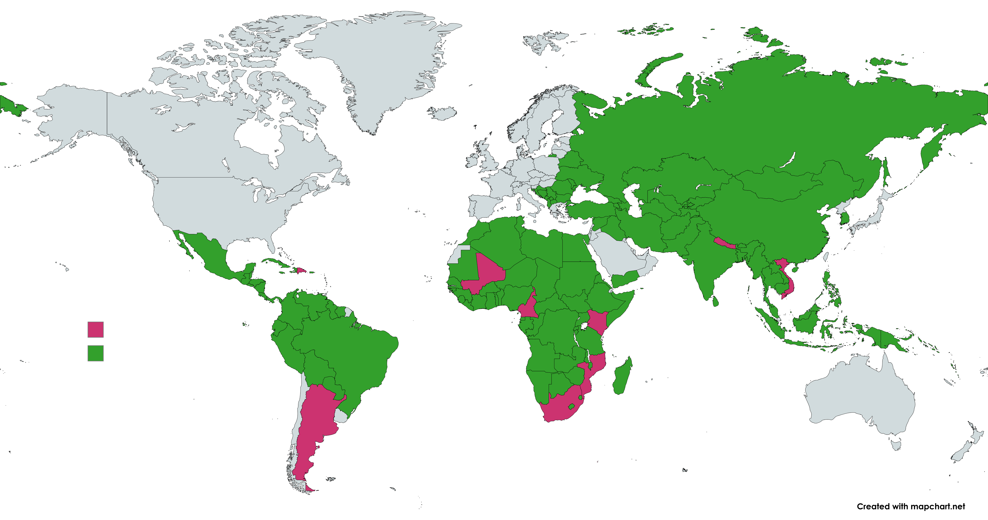
Recent RSV health impact modelling studies in LMICs
Completed country-specific analyses
Completed cross-country analyses
NOTE: Country-specific analyses may also be included in cross-country studies .
References
Rave N, et al. Journal of Global Health. 2025. DOI:10.7189/jogh.15.04292
Mahmud S, et al. BMC Medicine. 2023. DOI: doi.org/10.1186/s12916-023-02827-5
Guiñazú G, et al. Vaccine. 2024. DOI: doi.org/10.1016/j.vaccine.2024.126234
Anh Ha Do, L. et al, Vaccine. 2023. DOI: doi.org/10.1016/j.vaccine.2023.09.003
Laufer R, et al. PLOS Glob Public Health. 2023. DOI: 10.1371/journal.pgph.0001432
Ordoñez J, et al. Value in Health. 2026. DOI: https://doi.org/10.1016/j.jval.2026.03.702.
Guimarães EL, et al. Journal of Global Health Economics and Policy. 2025. DOI: doi.org/10.52872/001c.137870
Original slide developed by PATH, UMC Utrecht, and the World Health Organization. Version: September 2026
Notes:
This slide displays analysis of RSV interventions around the world. This evidence base is has evolved rapidly in recent years and continues to do so.

Slide 24
RSV immunization can be highly impactful
substantial annual RSV cases, hospitalizations, and deaths in LMICs can be averted
A recent health impact analysis across 133 LMICs demonstrates substantial potential for impact.
A maternal vaccine could avert
A long-acting mAb could avert
4.2M
cases
1.8M
hospitalizations
22k
deaths
7.2M
cases
2.3M
hospitalizations
38k
deaths
  Results are estimated based on:
    a maternal vaccine efficacy of 69% against severe RSV and 6 months duration of protection.
    a mAb efficacy of 77% against severe RSV and 5 months duration of protection.
References: Mahmud S, et al. BMC Medicine. 2023;21(138); Baral R, et al BMJ Open. 2021;11:e046563.
Original slide developed by PATH, UMC Utrecht, and the World Health Organization. Version: September 2026
Notes:
Years ago, the first, robust modelling data started coming out showing what seemed to be relatively large potential health impact for RSV prevention in infants.
Since these models were done, however, more recent models are now available with updated data inputs and more up-to-date results … and the numbers are even higher!
As this graphic shows from modelling data generating by Mahmud et al, a maternal vaccine could avert over 4 million RSV cases, nearly 2 million hospitalization, and 22 thousand deaths.
Likewise, mAbs could avert over 7 million cases, 2 million hospitalizations, and 38 thousand deaths.
An RSV model developed for use in and by LMICs, quantifies the impact of RSV immunization across 133 LMICs for the 2025 birth cohort
A preprint study** for in-hospital and out-of-hospital RSV cases in 51 Gavi-eligible countries showed maternal vaccination could avert 55% to 63% of the RSV-related in-hospital mortality below 6 months of age
**https://papers.ssrn.com/sol3/papers.cfm?abstract_id=4399151

Slide 25
What to know about the potential health impacts of RSV immunization
What does existing evidence suggest?
What does existing evidence suggest?
The health impacts of RSV maternal vaccines and long-acting mAbs could be large.
What are the caveats?
Cross-country impact analyses may not perfectly represent potential impact in specific countries.
What gaps will forthcoming data fill?
Need for updated / expanded RSV health impact evidence with country-specific inputs and from different geographies / income groups.
How can countries use this information?
Gauge the potential scale of RSV immunization impact to inform public health agendas and prioritization.
Additional considerations
RSV immunization may also reduce
  all-cause lower respiratory tract infection (LRTI), recurrent LRTI hospitalization, and wheeze.
  antibiotic prescribing.
  burden on the healthcare system.
Providing maternal immunization through antenatal care (ANC) could enhance demand for ANC services.
How can countries use this information?
Caveats?
Additional considerations
What gaps will forthcoming data fill?
Original slide developed by PATH, UMC Utrecht, and the World Health Organization. Version: September 2026

Slide 26
What is the cost effectiveness of immunization?
analyzing public health value for amount paid

Slide 27
  What is cost-effectiveness?
What does calculating cost effectiveness in a model entail?
Assessing cost-effectiveness involves getting data on
  disease burden
  the impact of immunization
  the costs of the immunization product and its delivery; treatment for the disease; and other parameters.
A calculation then helps identify differences in costs and benefits to produce a cost-effectiveness ratio.
In LMICs, results are often presented as the cost to avert one Disability Adjusted Life Year (DALY).
  DALY = measure of losses in years of healthy life due to early death and/or illness, disability, and other long-term disease impacts.
How can this inform decision-making?
Helps discern if a product has good value compared to other vaccines, the status quo, or countries’ value thresholds.
COST-EFFECTIVENESS
The comparative analysis of the costs and benefits of an intervention to determine whether it is a good use of resources.
Original slide developed by PATH, UMC Utrecht, and the World Health Organization. Version: September 2026
Notes:
- Cost effectiveness analysis involves gathering data on disease burden, the impact of immunization as well as the costs of the immunization product, its delivery, and treatment for the disease in addition to other parameters.
- Using these inputs, a cost-effectiveness ratio is calculated in a model by taking the differences in costs and benefits with and without immunization and dividing costs by benefits:
- Cost effectiveness ratio = (Costs with immunization – Costs without immunization)/(Benefits with immunization – Benefits without immunization)
- In LMICs, results are often presented as the cost to avert one Disability Adjusted Life Year (DALY).
- A DALY is a measure of losses in years of health life due to early death and/or illness, disability and other long-term disease impacts.

Slide 28
  Cost-effectiveness studies in LMICs
Completed country-specific analyses
Completed cross-country analyses
NOTE: Country-specific analyses may also be included in cross-country studies .
References
Rave N, et al. Journal of Global Health. 2025. DOI:10.7189/jogh.15.04292
Guimarães EL, et al. Journal of Global Health Economics and Policy. 2025. DOI: doi.org/10.52872/001c.137870
Mahmud S, et al. BMC Medicine. 2023. DOI: doi.org/10.1186/s12916-023-02827-5
Guiñazú G, et al. Vaccine. 2024. DOI: doi.org/10.1016/j.vaccine.2024.126234
Anh Ha Do, L. et al, Vaccine. 2023. DOI: doi.org/10.1016/j.vaccine.2023.09.003
Laufer R, et al. PLOS Glob Public Health. 2023. DOI: 10.1371/journal.pgph.0001432
Ordoñez J, et al. Value in Health. 2026. DOI: https://doi.org/10.1016/j.jval.2026.03.702.
Original slide developed by PATH, UMC Utrecht, and the World Health Organization. Version: September 2026
Notes:
- RSV immunization cost effectiveness studies have been conducted in these LMICs around the world.
- We’ll talk about the particulars in the next few slides.

Slide 29


  Interpreting results on RSV immunization cost-effectiveness in LMICs
  Cost saving means:
    Immunization generates health benefits AND averts more treatment costs than an immunization program incurs.
  Lower values for cost per DALY averted correspond to better cost-effectiveness.
  No single cost per DALY threshold is available to demonstrate cost-effectiveness.
    Although, a cost per DALY averted below 0.5 Gross Domestic Product (GDP) per capita could be considered cost-effective in LMICs.
  Cost-effectiveness is best assessed with respect to a country's current investments.
    For example, the least cost-effective health intervention already in use.
more expensive
Adoption (including affordability) should be considered when interventions are more effective and more expensive.
Do not Adopt!
Analysis needed
less effective
more effective
Adopt!
cost saving
Analysis needed
less expensive
Lower effectiveness is a concern, but sometimes countries decide to invest in fewer or lower cost interventions when budgets are constrained.
Willingness-to pay (WTP) threshold (depicted illustratively)
Actual orientation will depend on each country’s specific threshold and the scale of the axes.
Original slide developed by PATH, UMC Utrecht, and the World Health Organization. Version: September 2026
Notes:
- This graphic provides an illustrative way to think about how countries can think about RSV immunization cost effectiveness.
- In an ideal world, an intervention is cost saving, which means that that immunization generates health benefits AND averts more treatment costs than an immunization program incurs.
- Sometimes, however, less effective or more expensive products require more nuanced analysis to understand the product’s fit within a particular country context and willingness to pay threshold.
-

Slide 30
  Multiple models estimate RSV immunization cost-effectiveness across LMICs and in specific countries
Recent RSV immunization cost-effectiveness analyses in LMICs—key data used for modelling
IMMUNIZATION PRODUCT
VACCINE
EFFICACY (OUTCOME)
DURATION OF PROTECTION
PRICE PER DOSE ASSUMPTION (USD)
133-country study* | RSV maternal vaccine | 69% (severe RSV) | 6 months | $3.50 in Gavi countries, $7 in non-Gavi eligible
Mahmud et al. 2023 | RSV mAb | 77% (severe RSV) | 5 months | $3.50 in Gavi countries, $7 in non-Gavi eligible
Kenya and South Africa** | RSV maternal vaccine | 82% (severe RSV) | 90 days | $5
Mozambique, Nepal, Cameroon*** | RSV maternal vaccine | 69% (severe RSV) | 6 months | $5
  Ongoing studies will provide additional insight in the near term.
* Mahmud S, et al. BMC Medicine. 21(138): 2023. DOI: doi.org/10.1186/s12916-023-02827-5
** Koltai M, et al. BMC Medicine. 21(120):2023. DOI: 10.1186/s12916-023-02806-w
*** Guimarães EL, et al. Journal of Global Health Economics and Policy.5: 2025. DOI: doi.org/10.52872/001c.137870
Rave N, et al. Journal of Global Health. 2025. DOI:10.7189/jogh.15.04292
Shaaban F, et al. Journal of Global Health. 16: 2026. DOI: 10.7189/jogh.16.04040
NOTE: RSV mAb analyses were conducted in individual country studies shown. These analyses are excluded from this slide because mAb pricing assumptions used in these studies are unlikely to be realized for LMICs.
Original slide developed by PATH, UMC Utrecht, and the World Health Organization. Version: September 2026
Notes:
-Additional LMIC country studies include China, Mali, Turkey but these studies examine older immunization products or use older data inputs
-An important note is that data included in Koltai et al. Point to severe acute respiratory infection (SARI) hospitalizations peaking in the second month of life. This implies the duration of protection for both products are well aligned with period of greatest need.

Slide 31
RSV interventions are cost-effective or cost-saving (study in 133 LMICs)
more expensive
Willingness-to-pay threshold
0.5 GDP per capita
Do not Adopt!
Consider adopting
cost-effective
Placement of points on figure are illustrative and reflective of model results and assumptions showing cost savings in ~1/3 of countries and cost-effective in ~2/3 of countries.
less effective
more effective
Adopt!
cost saving
less expensive
Original slide developed by PATH, UMC Utrecht, and the World Health Organization. Version: September 2026
Reference: Mahmud S, et al. BMC Medicine. 2023;21(138).
Notes:
Per Mahmud et al's study in 133 LMICs, RSV maternal vaccine and long-acting mABs are likely to be cost-effective in 2/3 of countries and cost saving in the remaining 1/3.

Slide 32
RSV vaccine cost-effective or cost-saving (various countries)
more expensive
Willingness-to-pay threshold
(illustrative)
Studies looked at costs per DALY averted.
Do not Adopt!
Consider adopting
cost-effective
Mozambique: $288/DALY
Cameroon: $500/DALY
Nepal: $387/DALY
Kenya: $179/DALY
less effective
more effective
South Africa:
Cost saving
Adopt!
cost saving
Adopt!
RSV maternal vaccine
Reference: Koltai M, et al. BMC Medicine. 21(120):2023.
Guimarães EL, et al. Journal of Global Health Economics and Policy.5: 2025.
Rave N, et al. Journal of Global Health. 15: 2025.
Shaaban F, et al. Journal of Global Health. 16: 2026.
less expensive
Original slide developed by PATH, UMC Utrecht, and the World Health Organization. Version: September 2026

Slide 33
What to know about the cost-effectiveness of RSV immunization
What do the models suggest?
What data gaps will forthcoming studies fill?
What do the models suggest?
RSV immunization is likely to be cost-effective in LMICs and may be cost-saving in many.
What are the caveats?
Product prices are unknown, so cost-effectiveness results remain uncertain.
Results may vary by country based on varying data such as disease burden, costs and other data inputs.
What data gaps will forthcoming studies fill?
Expand health impact evidence with updated modelling data and country-specific data inputs.
Tools are available to help countries determine the impact and cost-effectiveness of RSV immunization in their settings (e.g., UNIVAC model).
Understand that RSV immunization is likely to be cost-effective in most LMICs as well as a good use of public health resources.
Consider using cost-effectiveness results from cross-country studies or studies from neighboring countries / similar income groups to inform decision making.
Caveats?
How can countries use this information?
Original slide developed by PATH, UMC Utrecht, and the World Health Organization. Version: September 2026
Notes:
The evidence on RSV immunization cost-effectiveness is promising and growing. However, product prices are not yet known so it is difficult to make firm conclusions at this time or in specific geographies.
New studies are forthcoming, results from neighboring countries can also be informative. Finally, tools such as UNIVAC are available to help inform country decision making. For more information on UNIVAC and the potential for international support for country-specific studies, please contact UNIVAC.MODEL@GMAIL.COM

Slide 34
Conclusion and additional considerations

Slide 35
Pricing and seasonality
Product pricing
RSV maternal vaccines and mAbs are likely both cost-effective at “moderate” prices
mAbs are anticipated to cost more to produce
There is no current mAb pricing agreement potentially making LMIC access difficult in the medium term
Countries should carefully consider potential product prices and economic implications during introduction decision making
Seasonal administration
While RSV is often a seasonal virus, many countries have year-round circulation or variable seasons within a country.
Yet, seasonal administration has potential to lower costs in seasonal settings
May result in similar or lower health impact depending on administration timing relative to RSV season.
Should be weighed against logistical challenges of starting and stopping; may be “easier” for mAbs than maternal vaccination.
Original slide developed by PATH, UMC Utrecht, and the World Health Organization. Version: September 2026

Slide 36
Scenarios that would change economic assumptions
Ongoing studies may change economic assumptions as we learn more about real world safety and effectiveness of products.
An impact study is planned in four African countries
Post-market surveillance and effectiveness studies are ongoing
If RSV prevention products prevent long-term airway disease …
Higher impact and enhanced cost-effectiveness
If RSV prevention products prevent all-cause lower-respiratory tract infection …
Higher impact and enhanced cost-effectiveness
Original slide developed by PATH, UMC Utrecht, and the World Health Organization. Version: September 2026

Slide 37
Key takeaways
The burden and cost of RSV illness and associated care are high in LMICs.
The cost of RSV program delivery may be similar to costs for other childhood vaccines.
The cost of RSV maternal vaccines may be similar to other childhood vaccines, especially for Gavi-eligible countries; however, RSV mAbs may be more costly since no LMIC pricing agreement has been reached.
RSV maternal immunization is likely to be cost-effective in LMICs and may be cost-saving in many.
RSV mAbs could be cost-effective in LMICs at moderate product prices.
Forthcoming and future studies will continue to enhance our knowledge of RSV health economics!
Original slide developed by PATH, UMC Utrecht, and the World Health Organization. Version: September 2026

Slide 38
  Summary
 | The burden and cost of RSV illness and associated care can be very high in LMICs.
 | Averting this burden and cost through RSV immunizations could have large health impacts and save significant healthcare resources.
 | RSV immunization program costs may be similar to costs for other childhood vaccines. RSV immunization is likely to be cost-effective in LMICs and may be cost-saving in many.
Original slide developed by PATH, UMC Utrecht, and the World Health Organization. Version: September 2026
Notes:
RSV health and economic burden is high in LMICS.
RSV interventions could have large impact and may be similar in cost to other childhood vaccines.
In this scenario, RSV immunization is likely to be cost-effective or even cost saving in LMICs.

