Slide 1
March 2024 (minor revisions July 2025)
Developability assessment for next-generation, "non-infectious" poliovirus vaccines

Slide 2
Use case assumptions
Initial use case: Non-infectious poliovirus vaccine will directly replace traditional IPV used in current schedules. This use case is assumed for the current developability assessment.
Routine immunization schedule for infants with infrequent boosters in older children and adults.
Combination vaccines are likely needed (e.g. Hexavalent) to increase delivery efficiency.
Other use cases to be evaluated:
Use of vaccine in older infants or only young children (e.g. one dose at 6 months, one dose at 5 years old) with either no or only one booster dose needed.
Reduce number of doses needed to be considered fully vaccinated for polio disease.
Use of vaccine in different schedules.
Platform’s potential for mucosal responses considered, either for routine use or narrower use cases (outbreak response, SIAs in high-risk geographies).
Out of scope is consideration of major investments in vaccines against other pathogens, which could change the assessment herein (e.g. novel multi-pathogen mRNA combination vaccines).

Slide 3
Outline
Executive Summary
Background on three platforms: pre-clinical/clinical evidence informing PTRS and timelines
CMC: yields/productivities and qualitative view on costs
CMC: evaluation of hexavalent formulation development
Considerations for mucosal immunity
Anticipated product development pathway (clin/reg/CMC) and considerations
S19-IPV as base case
Differences for VLP, mRNA
Impact of containment (GAPIII/IV and beyond)
Opportunities to improve PTRS or financial efficiency of platform switches
Recommended next steps

Slide 4
Executive Summary: Developability Dashboard
Consideration | S19-IPV | VLP | mRNA | Scoring considerations
Clinical POS: standalone | +++ | ++ | + | +++: like follow-on sIPV/cIPV; ++: moderate uncertainty; +: high uncertainty
CDP/regulatory complexity | +++ | ++ | + | +++: like follow-on sIPV/cIPV; ++: modestly more complex; +:significantly more complex (complexity likely adds both cost and time to PDP)
Formulatability in hexavalent | +++ | ++ | - | +++: straightforward for experienced hexa mfgrs; ++: some challenges expected, uncertainties; +low POS; -very unlikely to be feasible
Clinical POS: hexavalent | +++ | ++ | - | +++: like follow-on sIPV/cIPV; ++: moderate uncertainty; +: high uncertainty; -very unlikely to be feasible
Preliminary CoGs | ++ | ++⁽¹⁾ | + | +++: lower than IPV; ++: similar to IPV; +higher than IPV
Containment Risk | ++ | +++ | ++ | +++: negligible risk; ++: hypothetical risk; +: credible risk (sIPV-like)
(1) Potential for lower cost than IPV, but not verified as of March 2025
Conclusions
S19-IPV viewed as highest POS and most streamlined development; anticipated to be strongly preferred by current IPV/hexa manufacturers.
Points of differentiation in favor of VLPs relate to uncertainty about containment requirements for handling of S19 strains in future and possibility of lower drug substance cost.

Slide 5
Pre-clinical background: S19-IPV
Genetically stable, hyperattenuated S19 strains developed
at MHRA (Macadam 2006; Knowlson 2015).
Design is based on the type 3 Sabin vaccine strain with
a further modified domain V in the 5’ non-coding region.
The type 3 backbone serves as a “cassette” into which
capsids of other serotypes can be introduced.
Produces comparable yields of antigenically and immunogenically relevant viruses to that reported for conventional IPV strains in cell culture (Sanders 2015), with limited mutation during replication.
Cell culture produced S19 viruses lack any measurable neurovirulence (TgPVR mice) and fail to replicate in non-human primates under conditions where the Sabin strains will do so.
Hypothesized lack of replicative capacity in the gut of humans further enhances safety profile for IPV production, even in comparison to Sabin-based IPV.
Potential for use in combination vaccine platforms should be similar to that of other IPV platforms (Salk, Sabin).
Induction of mucosal immunity would be reliant on adjuvants or other strategies similar to those under investigation for other IPV platforms.

Slide 6
Clinical background: S19-IPV
Clinical testing of S19 IPV with Al(OH)₃ adjuvant has advanced to Phase II (Biological-E).
Age de-escalation into the target population was achieved in Phase II clinical studies.
Stand-alone trivalent S19 IPV as standalone vaccine is proceeding ahead of hexavalent candidate
The phase 1 clinical safety and immunogenicity data for standalone S19-IPV with full and half dose currently exists at BioE (unpublished data).
No trial results for S19 based hexavalent are in the public domain.
S19-IPV/alum studies (Biological-E):
Ph 1 in male adults, n=24 (2019): (Thuluva 2021a)
Ph 1 in male adults, n=24 (2019): (Thuluva 2021b)
Ph 2 in infants, n=120 (2023-recruitment complete): (Thuluva 2024)
Hexavalent combination in healthy toddlers (Bhupathiraju 2022) product has advanced to clinical (Biological-E)
Notes:
Unable to locate results or any evidence of hexavalent or Ph 3 IPV study in public domain

Slide 7
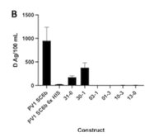
Pre-clinical background: VLP Consortium
Prior work aimed at producing poliovirus empty capsids (in baculovirus-infected insect cells (Urakawa et al 1989), and in yeast (Rombaut & Jorge 1997) produced immunogenic VLPs, but suffered from capsid instability of the antigenic conformation.
A strategy to address instability was devised, and it was shown that the resulting VLPs were stable, highly immunogenic relative to IPV, and protected transgenic mice from challenge (Fox et al 2017).
Additional work was performed to evaluate suitable expression platforms:
A plant-based platform demonstrated successful production of antigenic and immunogenic stabilized VLPs which protected transgenic mice from challenge (Marsian et al 2017).
A mammalian (MVA vector in BHK-21 cells) expression system demonstrated the ability to produce antigenic VLPs which were highly immunogenic (Wistar rats) (Bahar 2021).
A yeast-based platform demonstrated production of VLPs with comparable antigenicity to current IPV (Sherry et al 2022a). It was subsequently demonstrated that antigenic, thermostable VLPs could be produced on this platform without the potentially cytotoxic protease, 3CD, albeit with lower productivity (Sherry et al 2022b).
All platforms demonstrated VLPs with increased thermostability.
~10 D-Ag per mL from Pichia (presumably research process) for PV-1

Slide 8
Related work
(Xu et al 2019) demonstrated successful production of immunogenic PV VLPs in a baculovirus expression vector system, which had enhanced thermostability.
(Pan et al 2016) demonstrated that a recombinant protein formed by PV1 epitopes fused to rotavirus VP6, expressed in E. coli, were immunogenic (NAb) in guinea pigs.
(Gullberg et al 2013) demonstrated the assembly and characterization of empty capsid virus like particles of foot and mouth disease virus in mammalian cells.

Slide 9
CMC background: VLPs
Monovalent VLPs comprising of the entire poliocapsid for either type 1, 2 or 3 are expressed as precursor P1 protein or as individual proteins (VP0, VP1 and VP3). Expression of P1 precursor capsid or capsid proteins is in yeast or through the use of a vector such as baculovirus with Sf9 insect cells.
Use of Alum (Al(PO4) or Al(OH)3) as adjuvant is useful for higher immunogenicity and for dose sparing.
Since there is no infectious poliovirus, the GMP manufacturing of polio VLPs is completely without GAPIII/IV containment.
Since there is no virus inactivation step in the manufacturing of VLPs, the manufacturing loss in this step is avoided.
Registration for CanSino Ph 1 trial in adults

Slide 10
Pre-clinical and clinical background: mRNA
No literature identified describing mRNA-based poliovirus vaccines.
Moderna claims poliovirus vaccines (among long list) in LNP patent applications, but no evidence of reducing to practice found.
Use of T7 polymerase to generate infectious RNA from cDNA followed by transfection of permissive cells is well described (Van der Werf et al 1986).
Used for generation of nOPV strains and molecular clones thereof.
But creation of poliovirus via delivery of full-length genome is incongruent with “non-infectious” vaccine goal and will be prohibited post-eradication.
Preferred approach would be in vivo production of VLPs.
Pre-clinical concept established with Newcastle Disease Virus vectored polio VLPs (Viktorova et al 2018) --described in next slide.
mRNA options include two transgene (P1 plus 3CD) as done for NDV vector, or separate expression of VP0, VP3, and VP1 [A. Macadam, personal communication].
Either option requires co-delivery of more than one mRNA expression cassette to cells.
CBER has conducted research with unmodified mRNA in cell culture; D-antigen produced at levels similar to viral infection [K. Chumakov, personal communication].

Slide 11
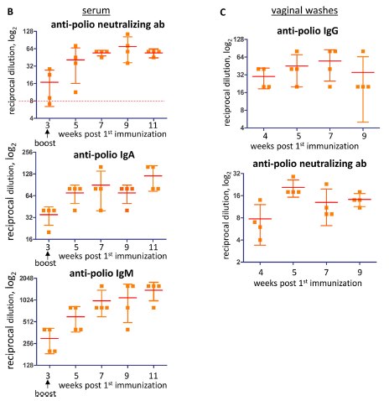
Related pre-clinical background: NDV-vectored polio vaccine [Viktorova et al. 2018]
NDV vector was replication-competent.
Two expression cassettes inserted into NDV genome for capsid precursor (P1 from Mahoney [type 1]) and protease 3CD which is required for P1 processing.
Location in NDV genome selected to produce more P1 and less 3CD, since 3CD has a toxic effect on cellular metabolism.
Infection in animal cell culture showed VLP formation in cells; lytic infection.
A12 antibody binding, suggesting adopting functional conformation.
Intranasal delivery to guinea pigs in two dose regimen showed 3/4 responders PD1 and 4/4 PD2 by serum neutralization.
Mucosal responses also observed.
Conclusion: In vivo VLP production generating neutralizing response from a vectored vaccine is feasible.
A similar approach was taken for EV71 using an adenovirus vector by National Health Research Institutes of Tawain, with protection from lethal challenge demonstrated in transgenic mice [patent US1000479B2]

Slide 12
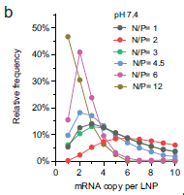
Pre-clinical and clinical background: co-delivery of multiple mRNAs
As noted earlier, two or three expression cassettes would be needed to produce non-infectious poliovirus particles in vivo.
Co-delivery of the 2 mRNAs to individual cells could be required.
LNPs can be "tuned" to encapsulate varying number of mRNAs, allowing high POS of co-delivery (Li et al 2022) — example at right].
Moderna CMV vaccine, mRNA-1647 includes 6 mRNAs, 5 of which encode pentamer complex (Panther et al 2023).
Pentamer requires co-expression from 5 mRNAs for formation: can infer that they must be able to deliver to same cells.
Phase 2 results shows positive immunogenicity in healthy adults: doses of 50, 100, or 150 mcg at 0, 2, 6 month schedule.
Currently in Phase 3 at 100 mcg dose.
Conclusion: co-delivery of two mRNAs should be feasible.
Adjustment of molar ratio of amine groups on ionizable lipids to phosphate groups on mRNA changes mRNA payload per LNP
Li et al. 2022

Slide 13
Pre-clinical background: potential 3CD toxicity
3C protease (and its 3CD precursor) are involved in cleavage of poliovirus polypeptide into capsid proteins (VP1-4).
Picornavirus 3C proteases interfere in numerous host cell processes including transcription* and translation, and can induce apoptosis (Mondal, Sarvari & Boehr 2023).
Vectored 3CD expression (e.g. through mRNA) could be viewed as a safety concern, with potential to kill transfected cells independent of immune response.
Self-replicating approaches (saRNA, replicating viral vectors) may require closer scrutiny of safety.
In VLP production systems, overexpression of 3CD may cause toxicity and limit VLP production.
Unclear impact of concern on POS for mRNA (or vectored) vaccine; however, inclusion of 3CD delivery likely to require attention in non-clinical tox and more cautious clinical development.
*Impact on transcription (in nucleus) is counterintuitive, given PV replication in cytoplasm​.
in PV infected cells, 3C protease cleaves TATA-binding protein and other transcription factors​
3CD precursor enters nucleus using nuclear localization sequence from 3D, but only in presence of PV infection (Sharma, Raychaudhuri, Dasgupta 2004)
May be related to 3D binding to phospholipids induced by viral infection which are involved in protein trafficking

Slide 14
Pre-clinical background: overall conclusions for mRNA
Feasible to generate polio VLPs in vivo through vectored approaches like mRNA, adeno, or NDV.
Approach involving delivery of polio capsid P1 polyprotein and 3CD mRNAs has stronger pre-clinical evidence than only expressing capsid proteins, but would require more consideration of potential safety issues.
Approach of expressing capsid proteins individually may circumvent risk from 3CD but is less proven and appears less productive in VLP efforts.
Both approaches require delivery of multiple mRNAs expression cassettes; however, co-packaging mRNAs in LNPs is feasible.
Non-replicating mRNA approaches (COVID, RSV, CMV) generally appear to require 30-100 mcg and 3 doses for adolescents and adults, with lower doses likely for infants.
Spikevax® 25 mcg, Pfizer Comirnaty® 3 mcg for 6 months to 4 years
Moderna now studying Spikevax in infants 12-26 weeks - NCT05584202
Dose levels not specified, but dose escalation is part of design

Slide 15
CMC considerations: yields/qualitative cost considerations (S19-IPV)
(Sanders et.al, 2015):
Using PER.C6 cell, D-antigen yield and productivities in doses/ml using rationally-attenuated strains (S19) were in line with yields reported for conventional IPV strains.
Average D-antigen yields for S-19 strain were 3211, 584, and 1465 DU/ml for types 1, 2, 3, respectively, in 10L PER.C6® cells.
Assume 40/8/32 DU per dose and 10% yield: at least 1 dose trivalent per mL culture.
(Okayasu etal. 2016):
The estimated production cost of sIPV can be comparable to that of conventional IPV (Salk) at a similar scale of production.
Conclusion: S19 IPV costs anticipated to be similar to cIPV/sIPV.
Notes:
The high productivity of the rationally-attenuated strains demonstrated here, may further increase the affordability of the vaccine as compared to sIPV’s, which typically require more DU per vaccine dose of serotypes 2 and 3 (10/16/32 DU/dose)---J and J Sanders study

Slide 16
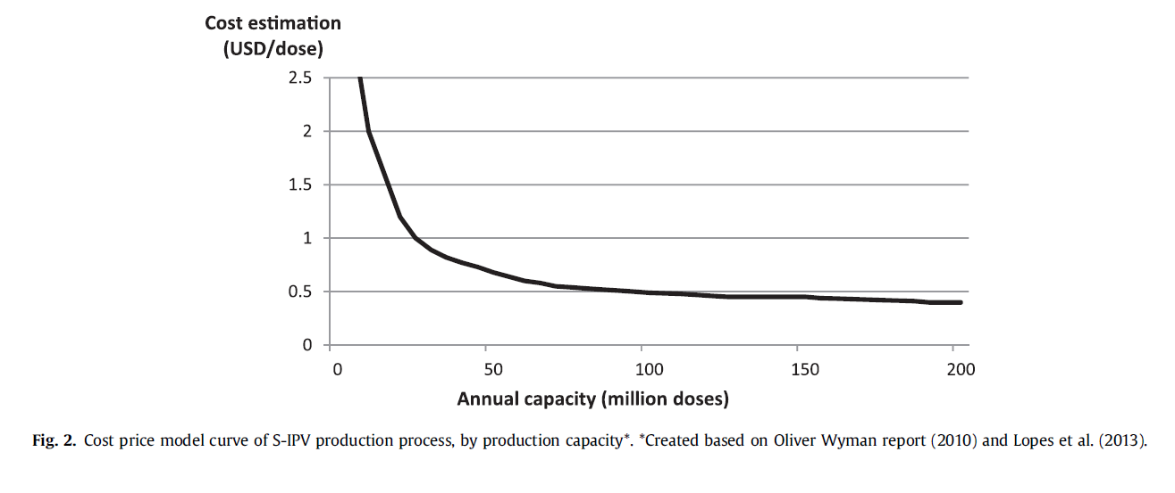
Sabin IPV cost
Development of inactivated poliovirus vaccine from Sabin strains: A progress report (Okayasu etal. 2016): $0.5/Dose
There are three ongoing developments in sIPV technology with promising preliminary results and potential to further increase production yield and reduce manufacturing costs: 1) new cell lines; 2) animal component free (ACF) media; and 3) adjuvants.

Slide 17
CMC considerations: yields/qualitative cost considerations (VLP)
(Okayasu et al 2016): reported 0.5 dose trivalent sIPV /mL culture.
(Yang et al 2019):
EV71 VLP expressed in Pichia, yield 270mg/L
Immunization with EV71-VLPs of 1–5 μg/dose and adjuvant of 225 μg/dose induced robust neutralizing antibody responses in mice.
Assume 40% yield (108ug/mL): at least 10 doses/mL culture.

Slide 18
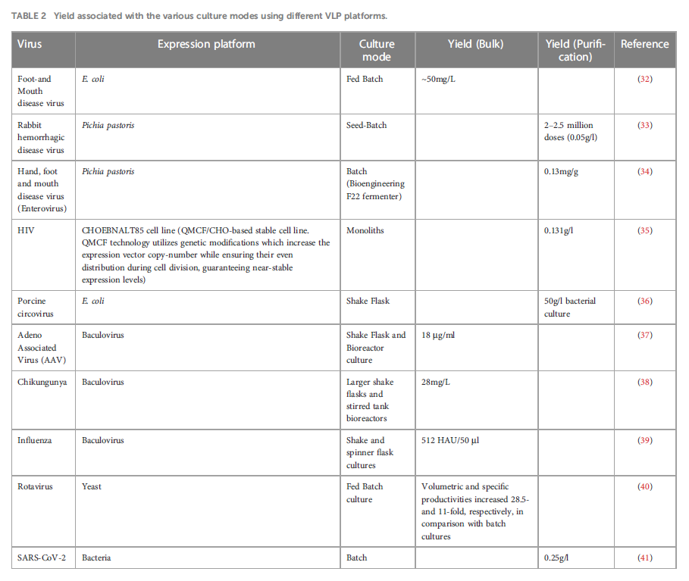
(Gupta et al 2023):
Yield varied between different vaccines and expression systems (BV, yeast, and E.coli)
At least 10 doses per mL culture
Overall VLP yield/cost is similar to S19-IPV

Slide 19
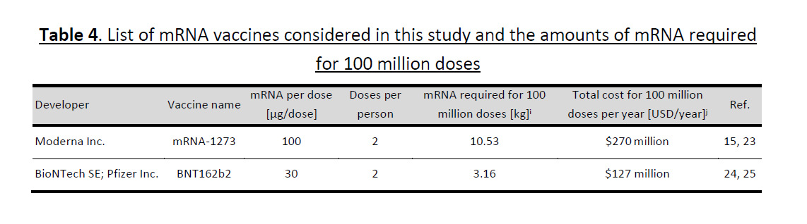
mRNA vaccine cost
(MSF Access Campaign 2021)
Process-cost modelling for producing 100 million COVID-19 mRNA vaccine doses per year
1-3 dollars/dose
Notes:
Imperial college of London

Slide 20
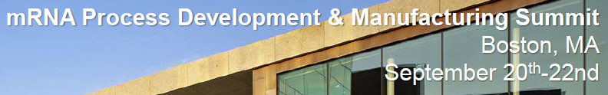
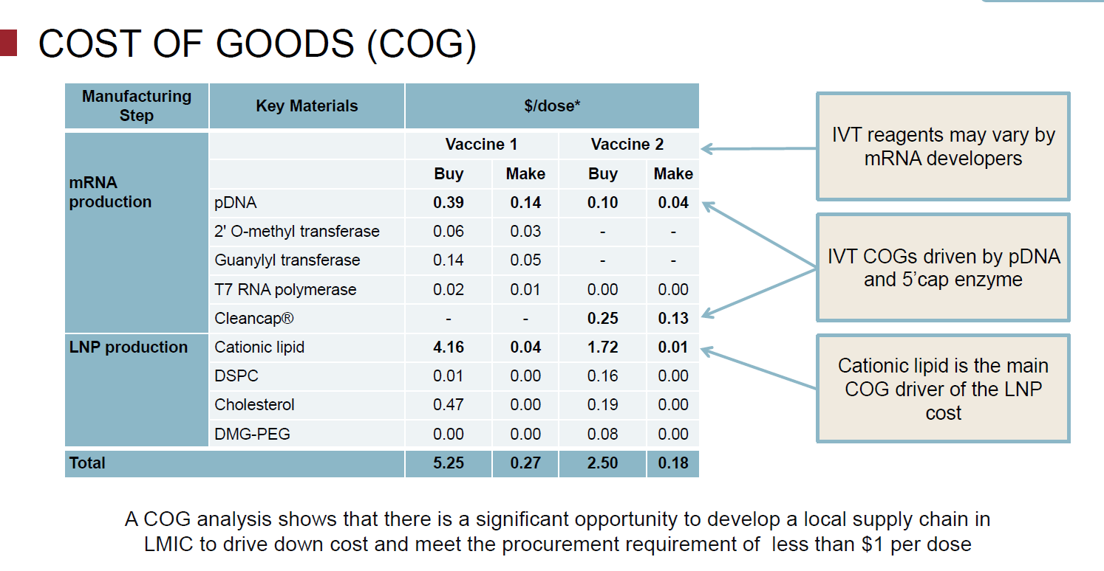
mRNA vaccine cost
presented by Philippe-Alexandra Gilbert in Sep 2022
Notes:
Cost wise, The least expensive is VLP
The most expensive is mRNA

Slide 21
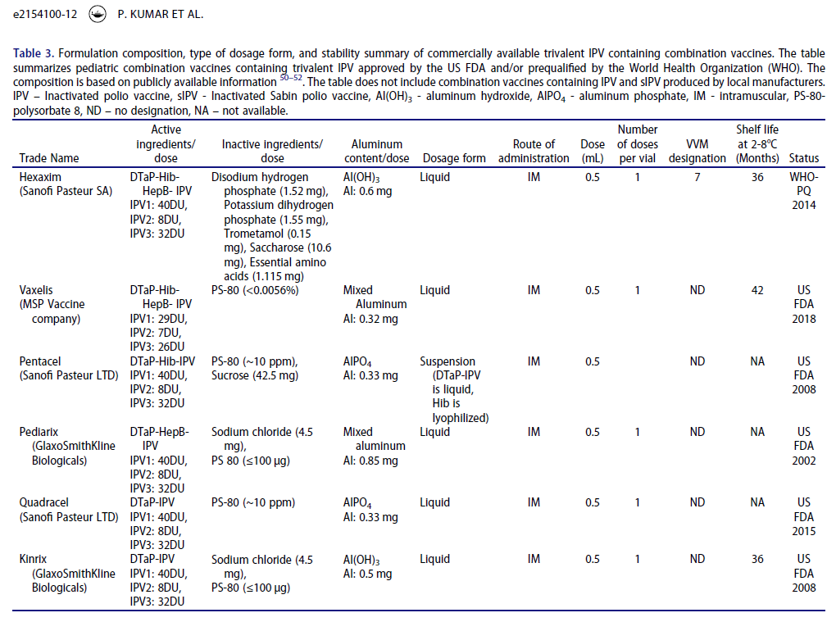
“Formulatability” as hexa/Penta/Quadravalent (Examples from 2022 review paper)
Notes:
All use IPV
All use aP, single dose

Slide 22
Formulatability into hexavalent
The preferred pertussis component for LMICs is wP due to lower cost and better protection of wP (Mahmood et al 2013).
As reported by (Sawyer et al 1994), wP-containing thimersol destabilizes IPV and thimerosal cannot be used for hexavalent formulation.
Several manufacturer used chemical and/or heat inactivation and 2PE as preservatives for wP based vaccines. For example, Panacea Biotec, EasySix is a licensed hexavalent vaccine with wP. BioE also has a wP based hexavalent formulation in development.
The following hexavalent vaccines are in clinical development using heat/HCHO inactivated wP which are thimerosal free
SSI hexavalent 2017 patent filed (Rakesh et al 2019)
LG Chem hexavalent 2017 patent filed (Choi, Noh & Kim 2017)
Sanofi India (SHAN6) (phase ½ data) (Somnath et al 2022)
Using aP in the hexavalent formulation would result in marginally higher vaccine costs, which are mostly offset by the lower costs associated with improved logistics, fewer separate vaccines, and a reduction in adverse events (Olivera et al 2023) - it is likely that HICs would continue with aP based hexavalents.
Based on the adjuvant used for pentavalent, either aluminum hydroxide or aluminum phosphate was used to avoid mixed adjuvant in the formulation.
Formulation method: A. In the SII 2017 patent: D, T wP and HepB are adsorbed separately with aluminum adjuvant then combine with liquid IPV and Hib conjugate B. In the LG Chem 2017 patent: D, T wP are adsorbed separately with aluminum adjuvant then combine with Hep B, Hib conjugate and sIPV.
Notes:
1. aP vs WP
2. adjuvant
3. formulation method; S19 IPV is straight forward
Objectives: Challenges for addition into hexavalent formulations with aluminum adjuvants (Kutub, Shwu-Maan)

Slide 23
Formulatability into hexavalent (Continued)
VLP stability may be impacted by the other hexavalent components. Stability data for standalone VLP (adsorbed or non-adsorbed) and in the hexavalent formulation are not available. The following 2 VLP commercial vaccines are adsorbed and stored at 5°C:
Merck Gardasil: aluminium hydroxyphosphate sulfate
GSK Cervarix: MPL/aluminum hydroxide (AS04) as adjuvant
B. Formulation of mRNA/LNP with aluminum containing pentavalent vaccines would be a tremendous challenge.
Temperature compatibility: Aluminum cannot be frozen but mRNA/LNP needs –70°C for long term storage. (At 5°C, at most a few months).
Aluminum ions show a strong and pH-dependent binding affinity to calf thymus DNA (Wu et al 2005), aluminum binding to RNA has also been reported (Rodriguez et al 2015).
Aluminum adjuvant settles during storage, which require vigorous mixing for homogeneity before injection, however, vibration affected the stability of mRNA/LNPs by increasing aggregation and polydispersity and leaking mRNA (Kamiya et al 2022).
Conclusion: for hexavalent formulation: S19-IPV is straightforward, VLP needs stability data (uncertain POS, but no red flags) and mRNA/LNP is technically difficult.
Notes:
Kamiya 2022 paper evaluated LNP in terms of Biophysical characterization (particle size, poly dispersity, zeta potential) and protein expression
(Bullet 2: The effect of combining unloaded LNPs and Al in a single formulation has been tested in animal immunogenicity studies (doi:10.3390/vaccines4040047 ), however, the expected T cell response was not achieved
Merck paper (the above): B cell response ok but T cell response dropped(expected by LNP)Ag: Hep B
Zhang etal (2020) claimed LNP is stable at Room temperature for 1 week (DOI: 10.1016/j.cell.2020.07.024) Pfizer mRNA vaccine has been approved for 5C storage for a month.

Slide 24
Mucosal immunity (S19-IPV)
(Kraan et al 2017) demonstrated that intranasal (IN) and sublingual delivery of sIPV adjuvanted with Cholera toxin produced mucosal responses in mice.
(Kraan, Willems, Soema 2022) studied mixed IM/IN prime/boost sIPV inoculations mice with and without CpG and Poly(I:C), concluding that heterologous prime-boost schedules can enhance mucosal responses.
Several adjuvants in development, for example, CAF01 (phase I), flagellin (phase II), saponins (phase II), CpG oligonucleotides (phase III), or poly(I:C) (phase III), or outer membrane vesicles (phase I) are worthwhile to test in combination with IPV delivered via mucosal routes. (Kraan, Willems, Soema 2022).
(Dietrich et al 2014) report that mice administered IPV adjuvanted with CAF01 (ID+IM), a novel adjuvant composed of cationic liposomes DDA (dimethyldioctadecylammonium) stabilized with the synthetic immunomodulator TDB (trehalose 6,69-dibehenate), produced markers of intestinal immune response (fecal IgA).
(Erdem et al 2023) reported that addition of dmLT to IPV administered intramuscularly affected neither humoral nor intestinal immunity. The mucosal adjuvant dmLT did not decreased fecal virus shedding following bOPV challenge. Higher dose of dmLT may be needed.
Notes:
1-4 mice
5 human
IPV may boost immunity in the intestinal mucosa among individuals previously immunized with oral poliovirus vaccine. Indeed, mucosal protection appears to be stronger following a booster dose of IPV than oral poliovirus vaccine, especially in older children. (Parker et al 2015)

Slide 25
Mucosal immunity (VLP and mRNA+)
VLPs
VLP alone would be low POS – generally adjuvantation considerations are similar to IPVs.
(Blazevic et al 2016) saw an adjuvant effect of RV VP6 on anti-norovirus responses in mice (IM) Rotavirus capsid VP6 protein acts as an adjuvant in vivo for norovirus VLP in a combination vaccine.
(Cimica & Galarza 2017) Adjuvant formulations for virus-like particle (VLP) based vaccines
(Jain et al 2015) Formulation and stabilization of recombinant protein-based virus-like particle vaccines.
mRNA (and vectored vaccines)
The development of an effective delivery system remains a major challenge to the successful exploitation of mucosal mRNA vaccination. Nonetheless, a number of delivery vehicles have been experimentally harnessed with different degrees of success in the mucosal delivery of mRNA vaccines. (Hameed et al 2022)
Example: mRNA-H1HA-LNP vaccine delivered intranasally induced protective immunity in mice.(Zhuang et al 2020)
(Viktorova et al. 2018) Newcastle Disease Virus-Based Vectored Vaccine against Poliomyelitis - poliovirus VLPs are produced in the cells of vaccine recipients and are presented to their immune systems in the context of active replication of Newcastle virus, which serves as a natural adjuvant. Intranasal administration of the vectored vaccine to guinea pigs induced strong neutralizing systemic and mucosal (vaginal) antibody responses. (more details on an earlier slide in mRNA section )
Conclusion: All platforms including S19-IPV, VLPs and mRNA have potential to induce mucosal immunity, but may require adjuvant and/or mucosal delivery mechanism

Slide 26
S19-IPV Clinical Development: Guiding Principles
A large portion of the experience with IPV, alum-adjuvanted IPV, sIPV applicable to S19
Can likely move more swiftly towards target population
Evaluation of immuno can be “standard” (not expanded beyond customary endpoints)
Assumes separate manufacturers for wP-based vs aP-based
wP-first vs aP-first likely driven by manufacturer/market interest
Assume need for 3-4 doses
Product most desirable/viable if co-formulated with penta antigens, +/- coadminister with PCV & RV (i.e. can be given on 6/10/14 schedule)
Assume bOPV cessation remains on track, no mixed/sequential regimen evaluation necessary
Comparators will be licensed hexa or standalone IPV, depending on age group
Assume no need to develop relative efficacy/effectiveness data for all antigens, e.g. pertussis
Basis for licensure is non inferiority to licensed comparator
Primary evaluation for polio component: NAb SCR after early RI schedule
Persistence: compare SPR at 1 year
Choice of comparator IPV: might not be Salk, but desirable to avoid "tolerance stackup", herein generically labelled as "conventional IPV" (cIPV)
Base-case development objectives:
Demonstrate immunobridge of S19-containing hexa to existing hexa in representative early RI regimen; including co-admin w/ PCV, rota
Enable standalone S19 for late RI, boost dose; may require coadministration w/ (M)MR, YFV, Men
Interchangeability with cIPV
Additional objectives:
Development:
Standalone S19 in early RI schedule (e.g., 6/10/14w)
Delayed/extended RI regimens (e.g., 2/4/6m)
Reduced number of doses (persistence thereof)
Co-admin of standalone S19 with all relevant antigens
Possibility of beneficial mucosal adjuvantation, antigen-sparing adjuvantation
Policy:
Fractional and/or ID administration
Adults, e.g. travel; pregnancy/lactation
Immune-compromised

Slide 27
VLP Clinical Development: Guiding Principles
Less is known about platform, likely need to move more cautiously
FIH in adults preferably in a HIC, more cautious age de-escalation / dose escalation
Evaluation of immuno should examine breadth and possibly persistence more closely
Likely more dose-ranging work needed
Need to address number of doses needed more explicitly
Assumes bOPV cessation remains on track, no mixed/sequential regimen evaluation necessary
Comparators will be licensed hexa or IPV, depending on age group, early success w/ coadmin study
Basis for licensure is NI to licensed comparator
Primary evaluation: NAb SCR after 6/10/14 schedule
May incur evaluation of firmer criterion around SPR at 1 year relative to S19
More likely than S19 to incur post-licensure effectiveness study (e.g., case-control) in settings where cVDPVs continue to circulate
More likely to require formal non-inferiority of all hexavalent antigens than S19
Base-case development objectives:
Same as for S19, plus firmer criteria around persistence (possibly also breadth/persistence combination)
Due to increased risk of failure of coformulation (vs S19-IPV), carry standalone in early RI later into development
Additional objectives:
Development:
Persistence after fewer doses in RI
Interchangeability
Possibility of beneficial mucosal adjuvantation, antigen-sparing adjuvantation
Co-admin of standalone VLP w/ other antigens; MR/MMR, YFV, Men
Policy:
Fractional and/or ID admin?
Adults, e.g. travel; pregnancy/lactation
Immune-compromised

Slide 28
S19-IPV or VLP clinical development plans
Further ideas on prospective CDPs available by request

Slide 29
mRNA Clinical Development: Guiding Principles
Differences from VLP:
Slower entry into youngest cohorts; possibly include adolescents prior to descending to 5 years of age.
More likely to need to establish a formal immunobridge of persistence than S19.
Potentially larger safety database requirements compared to S19, VLP for licensure and PQ.
Potentially more onerous post-deployment monitoring required, slowing entry into some markets where safety surveillance is most challenging.
This might be reflected in tighter focus of ClinDev on HIC RI regimens until data support reduced safety surveillance requirements.
Base-case development objectives:
Same as VLP.
Additional objectives:
Development:
Future co-formulation with other similar-platform vaccines
Policy:
Presume acceptability a greater challenge

Slide 30
Impact of containment: GAPIII/IV and beyond
Modality | Current considerations | Opportunities
sIPV* | Sabin strains are subject to containment requirements. More flexibility remains in GAPIV for S1 and S3 while bOPV remains in use; however, some countries treat all Sabin strains as same as wild-type now. | N/A
S19-IPV | S19 strains, regardless of capsid insert, are under a temporary waiver from containment requirements for specific purposes, including IPV production [CAG TC6 NFR] N.B. nOPV strains have this same status Adoption for some uses (e.g. titers) likely to remain under waiver, with appropriate risk mitigation No evidence in humans for lack of replication of S19 strains (pre-inactivation) Strains likely can bind and enter cells (pre-inactivation); even without replication the genome may enter cytoplasm allowing possibility of recombination with EV-C Higher risk operations (e.g. bulk production) may be closely scrutinized; Salk capsids may be viewed as higher risk | Small experimental medicine study on non-inactivated S19 virus to show that it does not replicate significantly
VLP | Currently, no notable concerns
mRNA | Currently, no notable concerns unless full P1 is delivered in location where other EV-C may be present (e.g. oral capsule with intended intestinal delivery)
*sIPV status provided for context
CAG meeting Note for the Record found at https://polioeradication.org/tools-and-library/policy-reports/advisory-reports/containment-advisory-group/​

Slide 31
Contributors
Bill Hausdorff
Carlie Anderson
Chris Gast
Farzana Muhib
Jenn Anstadt
John Konz
Kutub Mahmood
Margaret Toher
Ryan Tuttle
Shwu-Maan Lee

Slide 32
References p.1
Bahar MW, Porta C, Fox H, Macadam AJ, Fry EE, Stuart DI. Mammalian expression of virus-like particles as a proof of principle for next generation polio vaccines. npj Vaccines. 2021;6(1):1-11. doi: https://doi.org/10.1038/s41541-020-00267-3
Bhupathiraju, V B S S S. New Drug or Investigational New Drug: DTwP-HepB-IPV-Hib Vaccine (Liquid Hexavalent Vaccine).Central Drugs Standard Control Organization, Ministry of Health, Government of India. Identifier: Protocol No.: BECT078/LHV-PI/CTP-02, Verion no.: 2.0. Dated December 28, 2022. 03. DTwP-HepB-IPV-Hib Vaccine (Liquid Hexavalent Vaccine).pdf (cdsco.gov.in)
Blazevic V, Malm M, Daisuke Arinobu, Suvi Lappalainen, Timo Vesikari. Rotavirus capsid VP6 protein acts as an adjuvant in vivo for norovirus virus-like particles in a combination vaccine. Human Vaccines & Immunotherapeutics. 2015;12(3):740-748. doi: https://doi.org/10.1080/21645515.2015.1099772
Choi S, Noh Y, Eun K. Combination Vaccine Composition for Multiple-Dosage. 2017;(W02017048038). https://patentscope.wipo.int/search/en/detail.jsf?docId=WO2017048038
Cimica V, Galarza JM. Adjuvant formulations for virus-like particle (VLP) based vaccines. Clinical Immunology. 2017;183:99-108. doi: https://doi.org/10.1016/j.clim.2017.08.004
Dietrich J, Andreasen LV, Andersen P, Agger EM. Inducing Dose Sparing with Inactivated Polio Virus Formulated in Adjuvant CAF01. Rodrigues MM, ed. PLoS ONE. 2014;9(6):e100879. doi: https://doi.org/10.1371/journal.pone.0100879
Erdem R, De Coster I, Withanage K, et al. Safety, tolerability, and immunogenicity of inactivated poliovirus vaccine with or without E.coli double mutant heat-labile toxin (dmLT) adjuvant in healthy adults; a phase 1 randomized study. Vaccine. 2023;41(10):1657-1667. doi: https://doi.org/10.1016/j.vaccine.2023.01.048
Fox H, Knowlson S, Minor PD, Macadam AJ. Genetically Thermo-Stabilised, Immunogenic Poliovirus Empty Capsids; a Strategy for Non-replicating Vaccines. Semler BL, ed. PLOS Pathogens. 2017;13(1):e1006117. doi: https://doi.org/10.1371/journal.ppat.1006117
Gullberg M, Muszynski B, Organtini LJ, et al. Assembly and characterization of foot-and-mouth disease virus empty capsid particles expressed within mammalian cells. Journal of General Virology. 2013;94(8):1769-1779. doi: https://doi.org/10.1099/vir.0.054122-0
Gupta R, Arora K, Roy SS, et al. Platforms, advances, and technical challenges in virus-like particles-based vaccines. Frontiers in Immunology. 2023;14. doi: https://doi.org/10.3389/fimmu.2023.1123805
‌
‌
‌
‌
‌
‌
‌
‌
‌
‌
‌
‌
‌
‌
‌
‌
‌
‌
‌
‌
‌
‌
‌

Slide 33
References p.2
Hameed SA, Paul S, Dellosa GKY, Jaraquemada D, Bello MB. Towards the future exploration of mucosal mRNA vaccines against emerging viral diseases; lessons from existing next-generation mucosal vaccine strategies. npj Vaccines. 2022;7(1). doi: https://doi.org/10.1038/s41541-022-00485-x
Jain N, Sahni N, Kumru O, Joshi S, Volkin D, Middaugh C. Formulation and stabilization of recombinant protein based virus-like particle vaccines. Advanced Drug Delivery Reviews. 2015;93:42-55. doi: https://doi.org/10.1016/j.addr.2014.10.023
Kamiya M, Matsumoto M, Yamashita K, et al. Stability Study of mRNA-Lipid Nanoparticles Exposed to Various Conditions Based on the Evaluation between Physicochemical Properties and Their Relation with Protein Expression Ability. Pharmaceutics. 2022;14(11):2357. doi: https://doi.org/10.3390/pharmaceutics14112357
Knowlson S, Burlison JG, Giles E, Fox HC, Macadam AJ, Minor PD. New Strains Intended for the Production of Inactivated Polio Vaccine at Low-Containment After Eradication. 2015;11(12):e1005316-e1005316. doi: https://doi.org/10.1371/journal.ppat.1005316
Kraan H, Willems GJ, Soema PC. Defining the optimal intranasal administration strategy for inactivated poliovirus vaccine. bioRxiv (Cold Spring Harbor Laboratory). Published online July 29, 2022. doi: https://doi.org/10.1101/2022.07.28.501816
Kraan H, Soema P, Amorij JP, Kersten G. Intranasal and sublingual delivery of inactivated polio vaccine. Vaccine. 2017;35(20):2647-2653. doi: https://doi.org/10.1016/j.vaccine.2017.03.090
Li S, Hu Y, Li A, et al. Payload distribution and capacity of mRNA lipid nanoparticles. Nature Communications. 2022;13(1). doi: https://doi.org/10.1038/s41467-022-33157-4
Macadam AJ, Ferguson G, Stone DM, et al. Rational design of genetically stable, live-attenuated poliovirus vaccines of all three serotypes: Relevance to poliomyelitis eradication. Journal of Virology. 2006;80(17):8653-8663. doi:10.1128/jvi.00370-06 (https://doi.org/10.1128/jvi.00370-06)
Mahmood K, Pelkowski S, Atherly D, Sitrin R, Donnelly JJ. Hexavalent IPV-based combination vaccines for public-sector markets of low-resource countries. Human Vaccines & Immunotherapeutics. 2013;9(9):1894-1902. doi: https://doi.org/10.4161/hv.25407
Marsian J, Fox H, Bahar MW, et al. Plant-made polio type 3 stabilized VLPs—a candidate synthetic polio vaccine. Nature Communications. 2017;8(1). doi: https://doi.org/10.1038/s41467-017-00090-w
Mondal S, Sarvari G, Boehr DD. Picornavirus 3C Proteins Intervene in Host Cell Processes through Proteolysis and Interactions with RNA. Viruses. 2023;15(12):2413. doi: https://doi.org/10.3390/v15122413

Slide 34
References p.3
Okayasu H, Sein C, Hamidi A, Bakker WAM, Sutter RW. Development of inactivated poliovirus vaccine from Sabin strains: A progress report. Biologicals. 2016;44(6):581-587. doi: https://doi.org/10.1016/j.biologicals.2016.08.005
Olivera I, Carlos Grau Pérez, Lazarov L, Lopez E, Oddo C, Dibarboure H. Cost minimization analysis of a hexavalent vaccine in Argentina. BMC Health Services Research. 2023;23(1). doi: https://doi.org/10.1186/s12913-023-10038-0
Pan X, Wang J, Xia W, et al. Immunogenicity and antigenicity of a recombinant chimeric protein containing epitopes of poliovirus type 1. Acta Virologica. 2016;60(3):234-241. https://www.elis.sk/index.php?page=shop.product_details&flypage=flypage.tpl&product_id=4912&category_id=131&option=com_virtuemart&vmcchk=1&Itemid=1
Panther L, Sandeep Basnet, Fierro C, et al. 2892. Safety and Immunogenicity of mRNA-1647, an mRNA-Based Cytomegalovirus Vaccine in Healthy Adults: Results of a Phase 2, Randomized, Observer-Blind, Placebo-Controlled, Dose-Finding Trial. Open Forum Infectious Diseases. 2023;10(Supplement_2). doi: https://doi.org/10.1093/ofid/ofad500.2475
‌Parker EP, Molodecky NA, Pons-Salort M, O’Reilly KM, Grassly NC. Impact of inactivated poliovirus vaccine on mucosal immunity: implications for the polio eradication endgame. Expert Review of Vaccines. 2015;14(8):1113-1123. doi: https://doi.org/10.1586/14760584.2015.1052800
Process-cost modelling for producing 100 million COVID-19 mRNA vaccine doses per year at injectable medicines manufacturing sites. MSF Access Campaign. Published September 2021. https://www.msfaccess.org/sites/default/files/2021-09/COVID19_TechBrief_Process_cost_modelling_ENG.pdf
Rakesh K, Inder S, Anil S, Manohar D, Hitt S. An Immunogenic Composition Having Improved Stability, Enhanced Immunogenicity and Reduced Reactogenicity and Process for Preparation Thereof. 2019;(WO2019016654). https://patentscope.wipo.int/search/en/detail.jsf?docId=WO2019016654
Rodriguez BV, Pescador J, Pollok N, Beall GW, Maeder C, Lewis LK. Impact of size, secondary structure, and counterions on the binding of small ribonucleic acids to layered double hydroxide nanoparticles. Biointerphases. 2015;10(4):041007. doi: https://doi.org/10.1116/1.4936393
Rombaut B, Jore J p.m. Immunogenic, non-infectious polio subviral particles synthesized in Saccharomyces cerevisiae. Journal of General Virology. 1997;78(8):1829-1832. doi: https://doi.org/10.1099/0022-1317-78-8-1829
‌

Slide 35
References p.4
Sanders BP, Isabel, Vladimir van Hoek, et al. Production of high titer attenuated poliovirus strains on the serum-free PER.C6® cell culture platform for the generation of safe and affordable next generation IPV. Vaccine. 2015;33(48):6611-6616. doi: https://doi.org/10.1016/j.vaccine.2015.10.091
SAWYER L, MCINNIS J, PATEL A, HORNE A, ALBRECHT P. Deleterious effect of thimerosal on the potency of inactivated poliovirus vaccine. Vaccine. 1994;12(9):851-856. doi: https://doi.org/10.1016/0264-410x(94)90296-8
Sharma R, Raychaudhuri S, Dasgupta A. Nuclear entry of poliovirus protease-polymerase precursor 3CD: implications for host cell transcription shut-off. Virology. 2004;320(2):195-205. doi: https://doi.org/10.1016/j.virol.2003.10.020
Sherry L, Grehan K, Swanson JJ, et al. Production and Characterisation of Stabilised PV-3 Virus-like Particles Using Pichia pastoris. Viruses. 2022;14(10):2159. doi: https://doi.org/10.3390/v14102159
‌Sherry L, Swanson JJ, Grehan K, et al. Protease-Independent Production of Poliovirus Virus-like Particles in Pichia pastoris: Implications for Efficient Vaccine Development and Insights into Capsid Assembly. Richard M, ed. Microbiology Spectrum. Published online December 12, 2022. doi: https://doi.org/10.1128/spectrum.04300-22
Somnath Mangarule, Sonali Palkar, Mitra M, et al. Safety and immunogenicity of a hexavalent DTwP-IPV-HB-PRP∼T vaccine versus separate DTwP-HB-PRP∼T and IPV vaccines in healthy infants in India. Vaccine: X. 2022;10:100137-100137. doi: https://doi.org/10.1016/j.jvacx.2021.100137
Thuluva, S. A phase-I clinical study to assess the safety of Biological Es Inactived Polio vaccine in 18-45 year old healthy male adults. CTRI. Identifier: CTRI/2019/04/018656. Updated November 24, 2021. https://trialsearch.who.int/Trial2.aspx?TrialID=CTRI/2019/04/018656.
Thuluva, S. A phase-I clinical study to assess the safety of Biological Es Inactived Polio vaccine in 18-45 year old healthy male adults. CTRI. Identifier: CTRI/2019/04/018474. Updated November 24, 2021. https://trialsearch.who.int/Trial2.aspx?TrialID=CTRI/2019/04/018474
Thuluva, S. Biological E’s Polio vaccine clinical study for protection against Polio disease in 6-8 weeks old infants. CTRI. Identifier: CTRI/2023/08/055993. Updated March 04, 2024. ps://trialsearch.who.int/Trial2.aspx?TrialID=CTRI/2023/08/055993

Slide 36
References p.5
‌Urakawa T, Ferguson M, Minor PD, et al. Synthesis of Immunogenic, but Non-infectious, Poliovirus Particles in Insect Cells by a Baculovirus Expression Vector. Journal of General Virology. 1989;70(6):1453-1463. doi: https://doi.org/10.1099/0022-1317-70-6-1453
Van Der Werf S, Bradley J, Wimmer E, Studier W, Dunn J. Synthesis of infectious poliovirus RNA by purified T7 RNA polymerase. Biochemistry. 1986;83:2330-2334. https://www.ncbi.nlm.nih.gov/pmc/articles/PMC323290/pdf/pnas00312-0056.pdf
Viktorova EG, Khattar SK, Kouiavskaia D, et al. Newcastle Disease Virus-Based Vectored Vaccine against Poliomyelitis. Journal of Virology. 2018;92(17). doi: https://doi.org/10.1128/jvi.00976-18
Wu J, Du F, Zhang P, Izhar Ahmed Khan, Chen J, Liang Y. Thermodynamics of the interaction of aluminum ions with DNA: Implications for the biological function of aluminum. Journal of Inorganic Biochemistry. 2005;99(5):1145-1154. doi: https://doi.org/10.1016/j.jinorgbio.2005.02.010
Xu Y, Ma S, Huang Y, et al. Virus-like particle vaccines for poliovirus types 1, 2, and 3 with enhanced thermostability expressed in insect cells. Vaccine. 2019;37(17):2340-2347. doi: https://doi.org/10.1016/j.vaccine.2019.03.031
Yang Z, Gao F, Wang X, et al. Development and characterization of an enterovirus 71 (EV71) virus-like particles (VLPs) vaccine produced in Pichia pastoris. Human Vaccines & Immunotherapeutics. 2019;16(7):1602-1610. doi: https://doi.org/10.1080/21645515.2019.1649554
Zhuang X, Qi Y, Wang M, et al. mRNA Vaccines Encoding the HA Protein of Influenza A H1N1 Virus Delivered by Cationic Lipid Nanoparticles Induce Protective Immune Responses in Mice. Vaccines. 2020;8(1):123. doi: https://doi.org/10.3390/vaccines8010123

