Slide 1
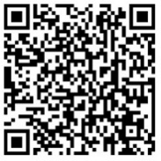
New RSV prevention products
the development journey
Access these and additional slides offered as part of an RSV communications toolkit at: bit.ly/RSVInfoToolkit
Up to date as of January 2026

Slide 2
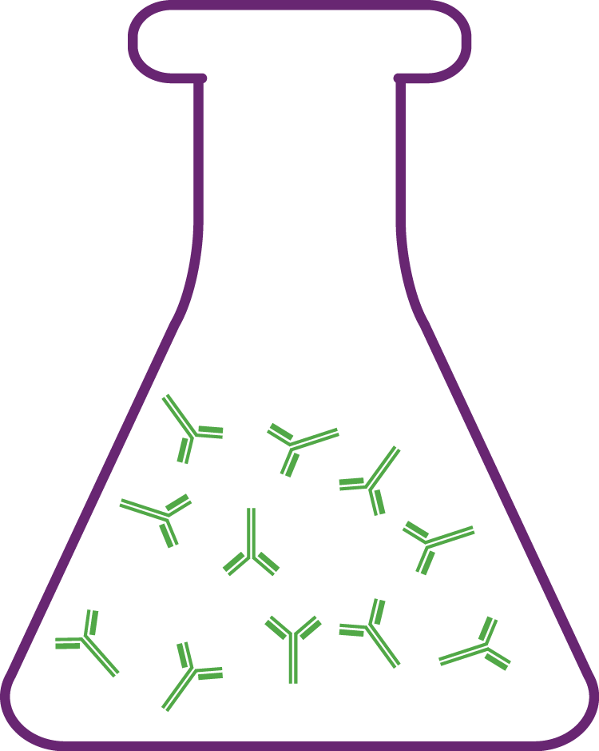


Agenda
 | A history of RSV product development how a scientific breakthrough turned stall into success
 | New RSV maternal vaccine for protecting infants product information and evidence
 | New long-acting RSV monoclonal antibodies given to young infants product information and evidence
Notes:
In this presentation, we will talk about the journey scientists took to develop immunization products against RSV, specifically maternal vaccine and long-acting monoclonal antibodies.
We will discuss products administered to pregnant women to prevent RSV in their infants and products given to infants themselves—covering how both work to prevent RSV disease in early life.

Slide 3
A history of RSV product development
how a scientific breakthrough turned stall into success

Slide 4
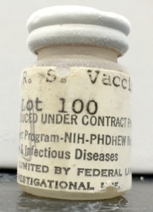
The early days of RSV vaccine development
In the 1960s, direct immunization of children with formalin-inactivated RSV vaccine in clinical trials resulted in enhanced respiratory disease (ERD) upon subsequent natural RSV infection.
The children with ERD experienced an inflammatory immune response that
clogged the lungs.
was not effective at clearing the RSV virus.
led to increased severe disease and hospitalization.
AS A RESULT, RSV VACCINE DEVELOPMENT STALLED FOR DECADES.
We’ve learned a lot since then.
Notes:
Products targeting RSV have been in development for over half a century.
In the 1960s, a clinical trial of a formalin-inactivated RSV vaccine had disastrous results.
The vaccine only elicited relatively weak antibodies and children vaccinated with that vaccine had a paradoxically severe reaction when they experienced their first natural RSV infection after being immunized.
Something called Enhanced Respiratory Disease (ERD) created an effect like a severe allergic reaction in those children’s lungs and they got very sick and there were two deaths.
As a result, RSV vaccine development stalled for many decades as scientists worked to understand what went wrong and how to prevent it in the future.
Science has come a long way since then and new immunization products have emerged that avoid the pitfalls of the 1960s, which we’ll talk about in more depth.

Slide 5
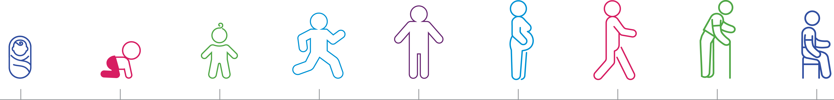
What mattered? Whether a baby already had an RSV infection
0-24 months
RSV naïve → risk of vaccine-induced ERD with direct vaccination
School age children through older adulthood
High likelihood of multiple exposures to RSV → ERD not a risk factor with direct vaccination
Notes:
Scientists have since learned that the prime distinction between individuals experiencing ERD after direct vaccination with the formalin-inactivated RSV vaccine and those who didn’t hinged on whether the individual had ever had a natural infection with RSV before receiving the vaccine.
It was RSV-naive individuals who had not yet had a natural infection with RSV, such as young babies, that were potentially susceptible to ERD when given this formalin-inactivated vaccine.
The antibodies that the infants’ immune system produced did not sufficiently neutralize naturally occurring virus and, in fact, caused the immune system to overreact.
The vaccine development community needed to find a way to protect infants without the risk of ERD.
The solution was passive immunization – transfer of robust protective antibodies to infants, so they don’t have to make their own immune response.
Of note, besides protecting young infants, the other target group for RSV prevention is older adults, who often have underlying health issues that cause RSV to be serious or life-threatening.
But older adults were never at risk of ERD from direct vaccination since they have been exposed to natural RSV infection many times over the course of their lives.

Slide 6
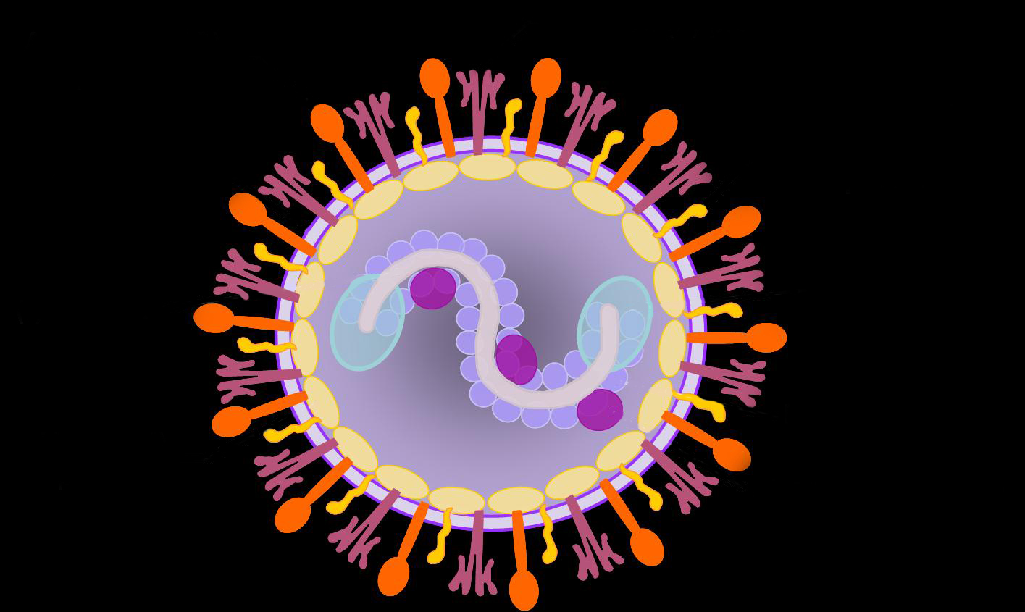
The vaccine immune target: RSV fusion (F) protein
What is the RSV fusion (F) protein?
The part of the virus that fuses to cells in the body, enabling the virus to invade the cells and cause infection.
The opportunity
If a vaccine can help the body create antibodies to the F protein that interrupt this process, disease can be prevented.
The challenge
The RSV F protein is very unstable and undergoes dramatic structural changes between a pre-fusion and post-fusion state, making it a difficult antigen to use in a vaccine.
Fusion (F) protein
Notes:
Besides gaining an understanding of the risk of ERD, the scientific community has learned a lot about the RSV virus itself since the 1960s.
Scientists knew that the most promising part of the virus to target with a vaccine was the fusion (or F) protein, which is a component on the surface of the RSV virus that fuses to host cells, enabling the virus to infect the cell and eventually lead to disease.
Neutralizing the F protein was found to be a key element to preventing infection, but for a long while, scientists didn’t have a detailed enough understanding of the intricate structure of the RSV F protein to develop a vaccine that could induce robust neutralizing antibody responses.
Eventually, though, the science caught up and important structural elements of the F protein became more clear.

Slide 7
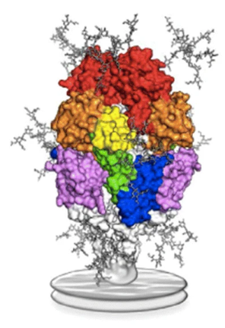
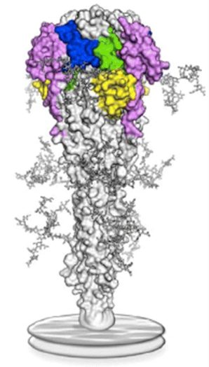



The key scientific breakthrough stabilizing the RSV F protein in a pre-fusion (pre-F) state
Colors represent different neutralizing sites on the F protein
Pre-F displays more, better neutralizing sites than post-F
Vaccines containing stabilized pre-F protein induce robust neutralizing antibodies that protect against disease.
Pre-F
Post-F
Image: Graham B, Current Opinion in Virology. 2017.
Notes:
Some vaccines work by introducing a modified version of a virus protein, or antigen, that prompts the body to develop protective antibodies, without causing disease.
The immune system needs to learn how to create antibodies that can neutralize the active components of the virus so that it can’t cause infection.
In the case of RSV, protection is needed against what’s called the pre-F form of the Fusion protein on the virus, which is the active form of the protein that fuses to cells and results in infection.
The F protein also has another form called post-F, but it is inactive and cannot fuse to cells to cause infection--so is therefore an inferior RSV vaccine antigen.
The difficulty that vaccine developers have historically faced, however, is that the pre-F form is naturally unstable.
To create an effective vaccine, what needed to happen was the difficult job of locking the protein into a pre-F state.
In doing so, vaccination could prompt the immune system to create specifically tailored antibodies in sufficient numbers and strength to neutralize the virus against natural infection.
The breakthrough came in the 2010s when scientists finally discovered how to lock the fusion protein into the pre-F form so it could be used as a vaccine.
Now, inducing robust neutralizing antibodies to protect against RSV disease is possible.
And this success has triggered a cascade of new prevention product development.

Slide 8
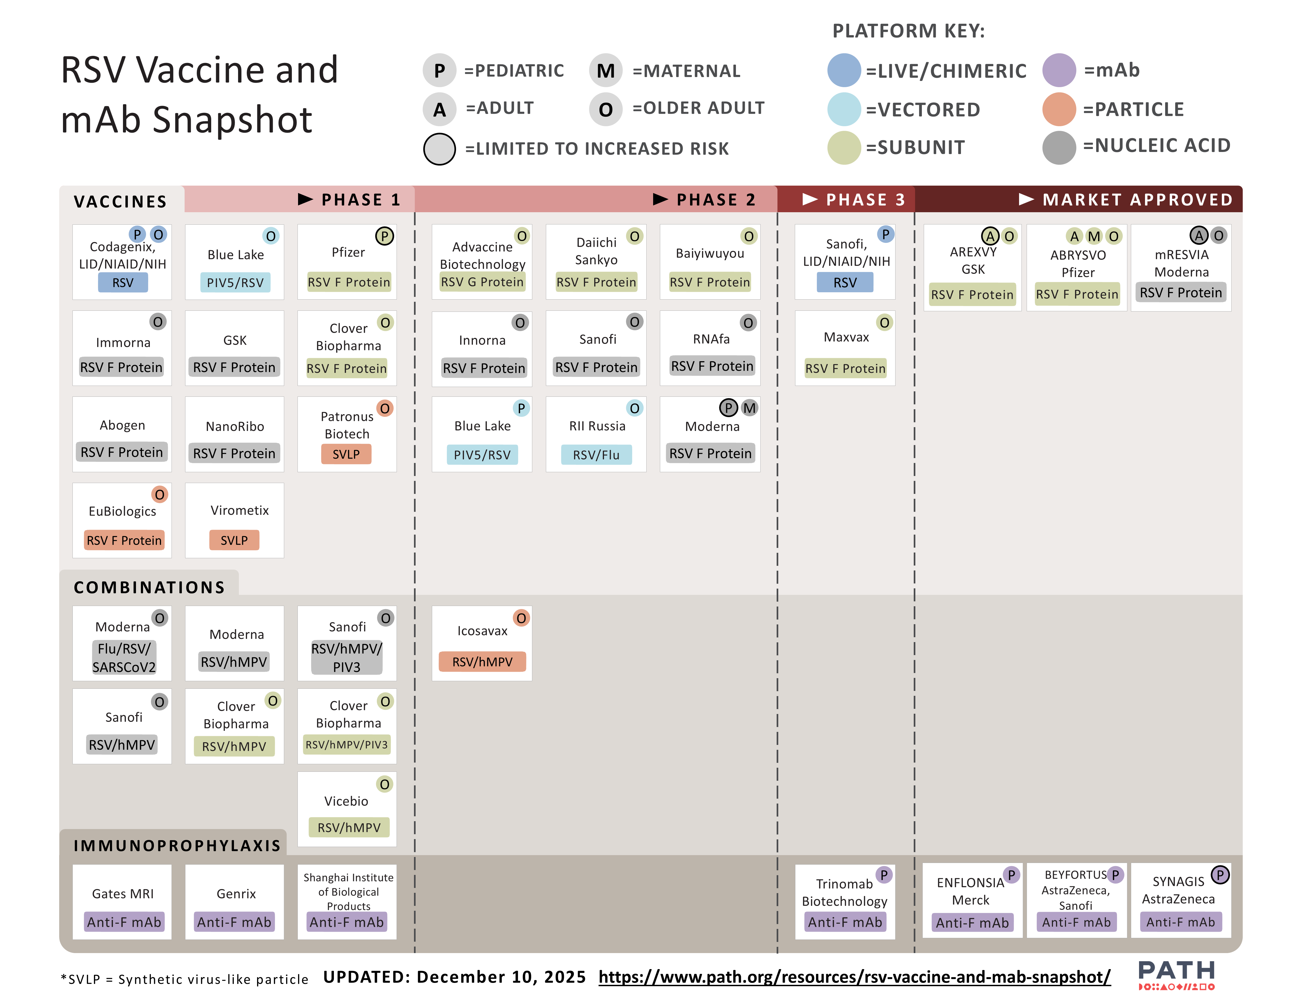
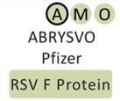
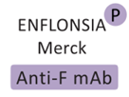
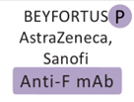
New hope of preventing RSV in infants—a product development renaissance
New pre-F technologies appropriate for protecting infants
Maternal vaccine
Long-acting monoclonal antibodies (mAbs)
Maternal vaccine
WHO recommended and prequalified; Gavi-supported
Long-acting mAb US Food and Drug Administration approval
Long-acting mAb licensed by various regulatory authorities and WHO recommended
www.path.org/resources/rsv-vaccine-and-mab-snapshot/
Notes:
A development renaissance of RSV prevention products was spurred by the pre-F scientific breakthroughs to protect infants, children, and older adults.
New options for protecting infants (beyond the short-acting palivizumab) include a long-lasting monoclonal antibody and a maternal vaccine for delivery in pregnancy—both of which are based on the pre-F technology.
Pfizer has a vaccine given in pregnancy that has been licensed by many regulatory authorities. WHO recommended the vaccine for global market use in 2024. It is also recommended in the PAHO region.
In July 2025, Gavi committed to opening a funding window for establishing an RSV maternal vaccine program, paving the way for country introductions to begin.
AstraZeneca’s long acting mAb, nirsevimab, is licensed in a number of countries, recommended by PAHO, and recommended by WHO for global use—though this product is expected to require market shaping for global access to be possible.
Another long-acting RSV mAb candidate developed by Merck (MSD) called clesrovimab (trade name ENFLONSIA) received US Food and Drug Administration approval in June 2025.
Other intended populations for vaccines in development are older adults and older infants/toddlers.

Slide 9



RSV disease prevention for young infants
PALIVIZUMAB Short-lasting mAb that can prevent severe RSV in high-risk infants Use is limited to high-income countries Requires up to 5 monthly doses Expensive/ impractical for low- and middle-income markets Neutralizes a single site found on both pre- and post-F proteins NIRSEVIMAB & CLESROVIMAB (NEW) Long-acting mAb given to infant soon after birth or before/during first RSV season (WHO recommended) Price and supply may be early barriers to global access, requiring market shaping to overcome Only 1 dose needed Neutralizes a single site found on pre-F protein only | MATERNAL VACCINE (NEW) Vaccination in pregnancy can prevent RSV disease in infant’s early months of life (WHO recommended and prequalified; recommended by Pan American Health Organization (PAHO) Technical Advisory Group; Gavi, the Vaccine Alliance to support). Progress is underway toward introduction in LMICs
MONOCLONAL ANTIBODY (MAB) PREVENTION
VACCINE PREVENTION
Notes:
Up until recently, the only RSV product licensed was a monoclonal antibody called palivizumab.
Palivizumab targets a single neutralizing site on the fusion protein
It is short acting because the antibody doesn’t include the mutation that extends circulation time in the body, so it requires up to five monthly doses to protect throughout RSV season—an expensive and impractical prospect for most countries.
As such, palivizumab has only been available in high-income markets.
Now, with the knowledge of the importance of the pre-F protein, new RSV immunization products achieve longer-acting protection than what was possible before, including maternal vaccines and longer lasting mAbs.
We’ll explain these in more detail in the next couple of slides.

Slide 10
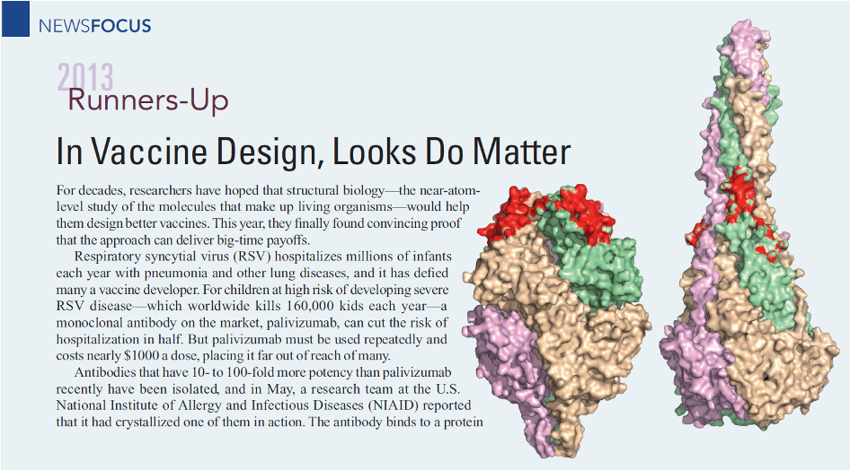

New is not like the old
OLD PRODUCTS
The old 1960s formalin-inactivated RSV vaccine candidate used a post-F antigen, so is a different product than the pre-F immunization products achieving licensure today.
NEW PRODUCTS
New pre-F products offer longer-lasting protection than palivizumab.
RSV pre-F technology receives Science
runner-up technology of the year in 2013
Notes:
To be clear, the new pre-F immunization products that are licensed are NOT the same products as the formalin inactivated vaccine candidate of the 1960s that included predominantly post-F components.
In short, in the pre-F prevention products of today targeting the protection of RSV-naïve individuals, namely infants, the vaccine antigen is locked into a pre-F state, prompting the immune system to create specifically tailored antibodies capable of neutralizing naturally occurring virus.
These products have favorable safety profiles, because the right protective antibodies are transferred to the newborn instead of requiring baby’s immune system to develop them on its own—avoiding the vaccination pitfalls of the 1960s.
This breakthrough made the cover of Science as the runner up scientific breakthrough of the year in 2013.

Slide 11
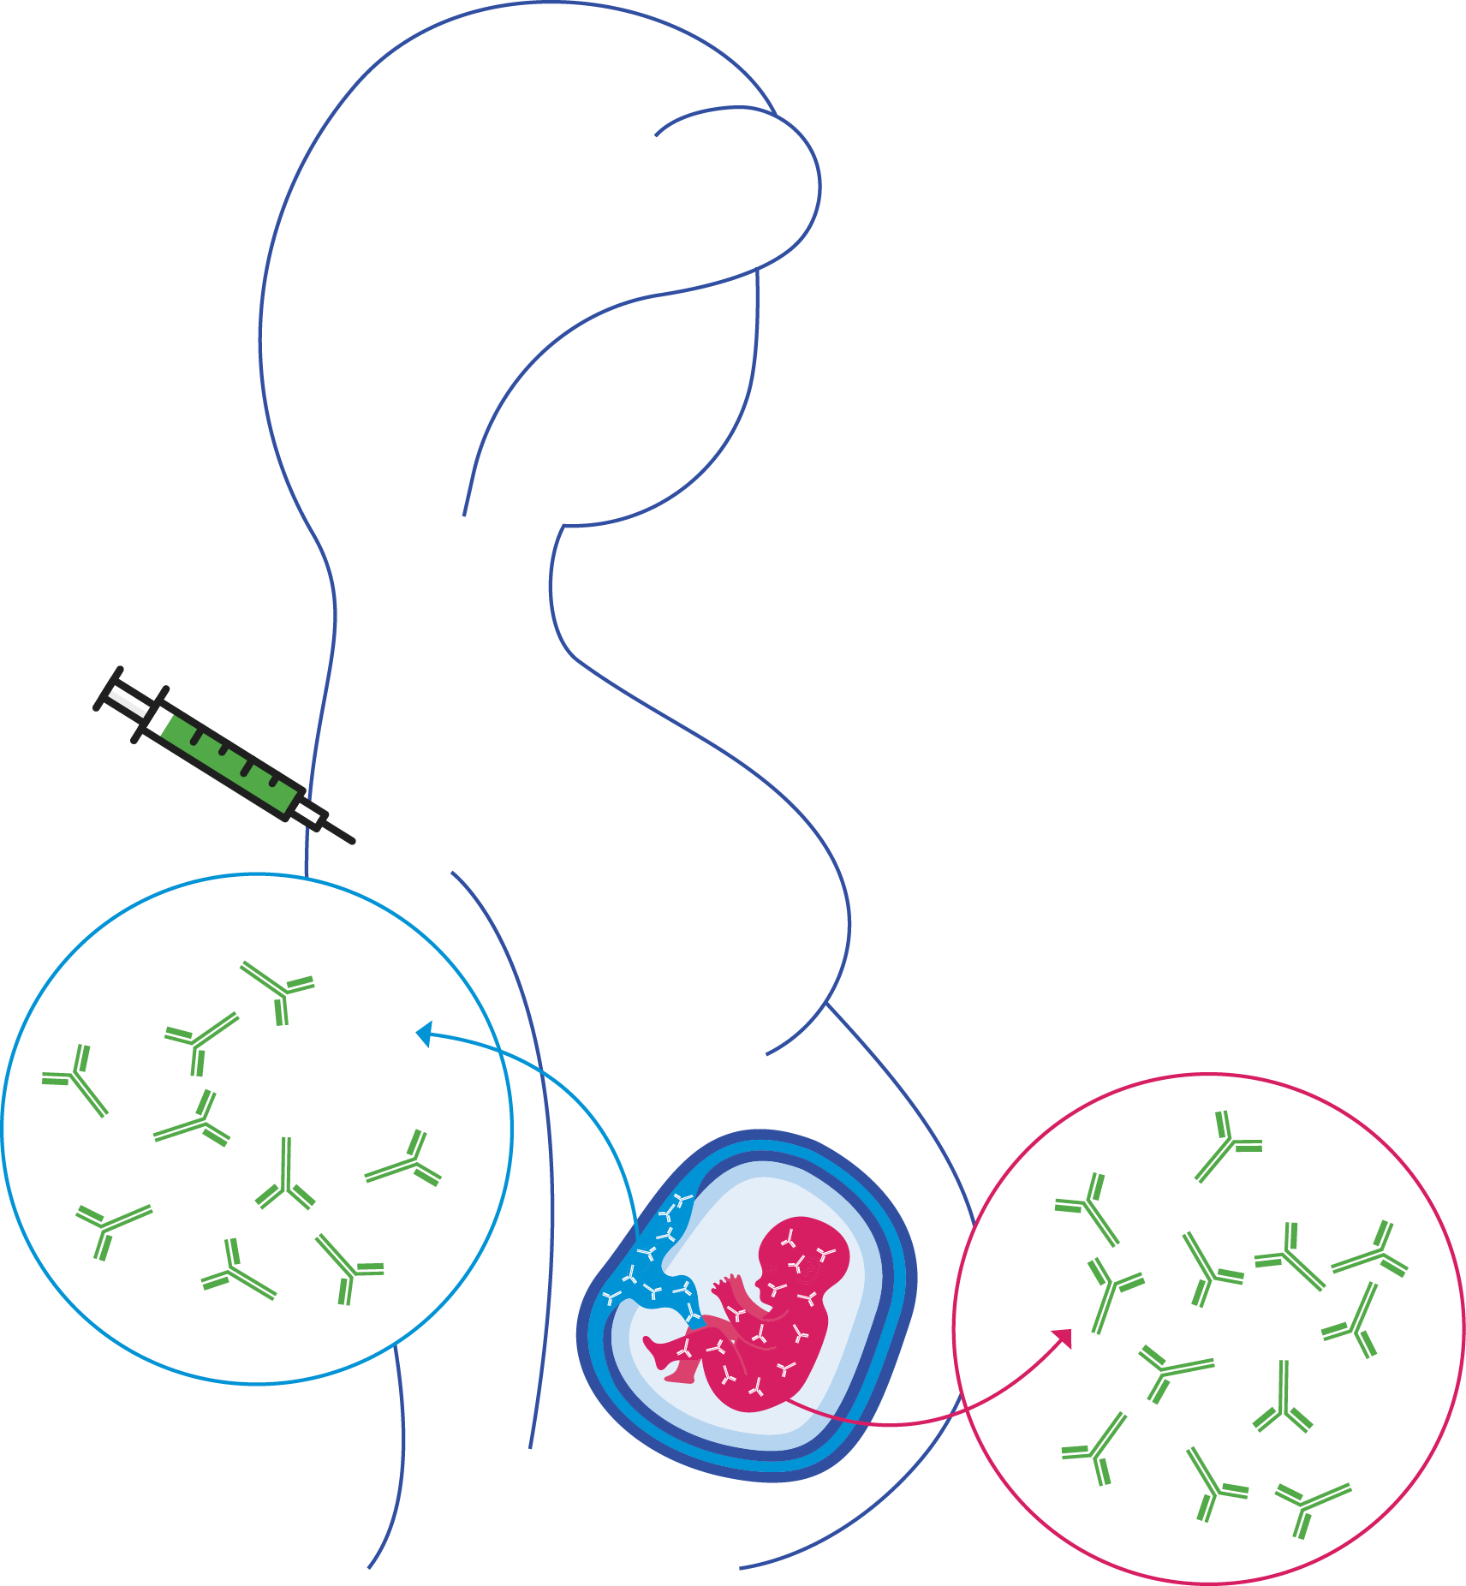

What is a maternal vaccine?
AFTER vaccination
Maternal vaccines are:
given in pregnancy to help protect mother, baby, or both from serious infections.
active immunization for the mother.
passive immunization for the baby because the mother’s antibodies naturally transfer across the placenta to provide protection at birth and for months thereafter.
Why are maternal vaccines needed?
Serious infections can occur when babies are very young and their immune systems are too immature to mount an adequate immune response of their own.
RSV antibodies
Notes:
Maternal immunization is a way to help protect a pregnant woman, her baby, or both from serious infections.
It is a type of active immunization for the mother, because the body makes its own antibodies.
Conversely, maternal immunization is a form of passive immunization for the baby. This means that already formed antibodies are transferred to the individual; in this case, the mother’s antibodies naturally transfer across the placenta to the baby.
With passive immunization, antibody levels are expected to have limited duration because the body is receiving antibodies, not continually making ones itself.
The key for a successful RSV maternal vaccine is to ensure that the maternal antibody levels are robust enough to last through the most critical 6 months after birth when the infants is a greatest risk of severe RSV disease.
Serious infections can occur when babies are very young and their immune systems are too immature or multiple immunizations would be required to mount an adequate active immune response.
[NOTE: Other relevant slides are available in the “Maternal immunization and mAb approaches” deck as part of this toolkit.]

Slide 12
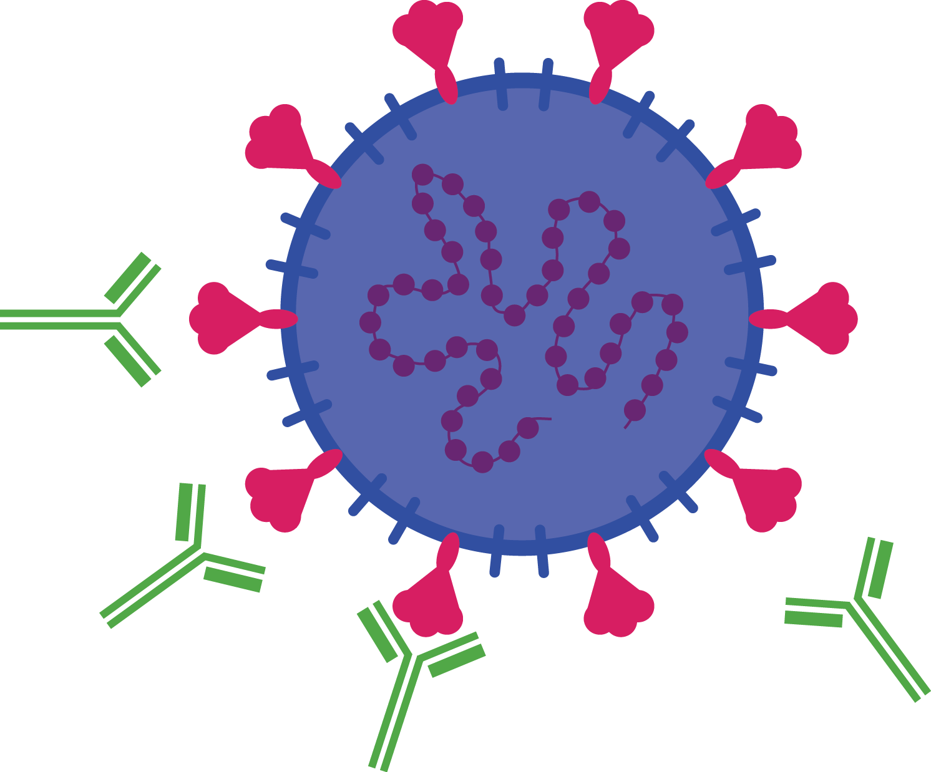

What are mAbs ?
mAbs are:
manufactured antibodies given at birth or soon thereafter that can kill a virus or other pathogen
Protect immediately and don’t require infants to produce their own antibodies
similar to other birth dose vaccines (e.g., hepatitis B, BCG)
Why are mAbs needed?
They provide protection when a newborn's immune system is still too immature to respond to vaccines.
They avoid the need for infants to produce their own antibodies.
mAbs mimic human antibodies but are created in labs and tailored to a specific condition
Like human antibodies, mAbs attach to harmful pathogens and antigens, alerting the immune system to a threat
This immune response helps to neutralize the threat and overcome illness
Notes:
Mimicking the natural antibodies that our immune systems produce, mAbs are antibodies specifically engineered in laboratories to fend off a targeted disease or infection.
MAbs are a form of passive immunization, and offer protection immediately, since they don’t require infants to actively produce their own antibodies.
Like human antibodies, they work by attaching themselves to harmful pathogens and alerting the immune system to the threat, helping neutralize the foreign invader and prevent illness.
Sometimes infections occur when babies are very young, before a vaccine given to a baby would have a chance to work or when a baby’s immune system is too immature to mount a sufficient or safe immune response.
mAbs provide the antibodies needed without the baby’s immune system needing to generate antibodies of its own.

Slide 13
New RSV maternal vaccine for protecting infants
product information and evidence

Slide 14
Phase 3 clinical study (Matisse) evidence for the pre-F RSV maternal vaccine pre-F RSV maternal vaccine efficacy and safety in infants born to women vaccinated during pregnancy
 | Study product: Abrysvo® Developer: Pfizer, Inc.
 | 7,420 pregnant participants ≤49 years between ≥ 24 and ≤ 36 weeks gestation
 | 7,307 infants enrolled
Study sites in 18 countries
Reference: Kampmann B, et al. New England Journal of Medicine. 288(16):2023.
Original slide developed by the World Health Organization and PATH. Last updated: January 2026..
Notes:
Let’s talk about the new maternal RSV vaccine and the supportive clinical evidence.
MATISSE was a randomized, double-blinded, placebo-controlled phase III study.
It was designed to assess the efficacy, safety, and immunogenicity of Pfizer’s maternal RSV pre-F vaccine against medically-attended and severe lower respiratory tract infection in infants born to healthy women vaccinated during pregnancy.
The study enrolled around 7,400 pregnant women.
Pregnant women received a single dose of either Pfizer’s vaccine or placebo during the late second to third trimester.
The women were followed for safety through vaccination and for 6 months after delivery.
Their infants were followed for at least 1 year for safety and efficacy, with over one-half of the infants followed for 2 years.
This was a global study in 18 countries starting in June 2020, so it spanned multiple RSV seasons in both the northern and southern hemispheres.

Slide 15
Pre-F RSV maternal vaccine efficacious against severe medically attended RSV in infants through 6 months of age
EFFICACY (%)
FROM BIRTH THROUGH 90 DAYS
(CONFIDENCE INTERVAL)
EFFICACY (%)
FROM BIRTH THROUGH 180 DAYS (CONFIDENCE INTERVAL)
Severe medically attended RSV-LRTI | (95% CI, 57.5% to 93.9%) | (95% CI, 50.6% to 82.5%)
Medically attended RSV-LRTI | (95% CI, 31.1% to 74.6%) | (95% CI, 31.4% to 62.8%)
82.4%
70.0%
57.6%
49.2%
Efficacy remains high through first, most critical 6 months after birth—
when infants are at greatest risk.
Reference: Munjal I Oral presentation at ReSViNET, February 15, 2024.
Notes:
Pfizer’s maternal vaccine demonstrated positive results in the trial.
Notably, the Phase 3 trial infant data showed the vaccine’s efficacy against severe medically attended lower-respiratory tract infection to be more than 82% in the first 3 months after birth and 70% 6 months after birth.
These results show that the vaccine is able to provide protection to infants against severe RSV disease during the highest period of risk.
Given the high burden of RSV and that the virus is so widespread, such efficacy means that a large number of cases could be prevented, promising high potential for impact.

Slide 16
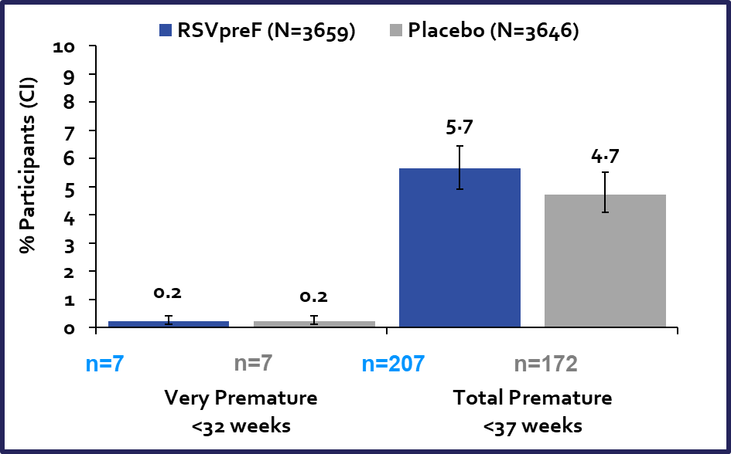
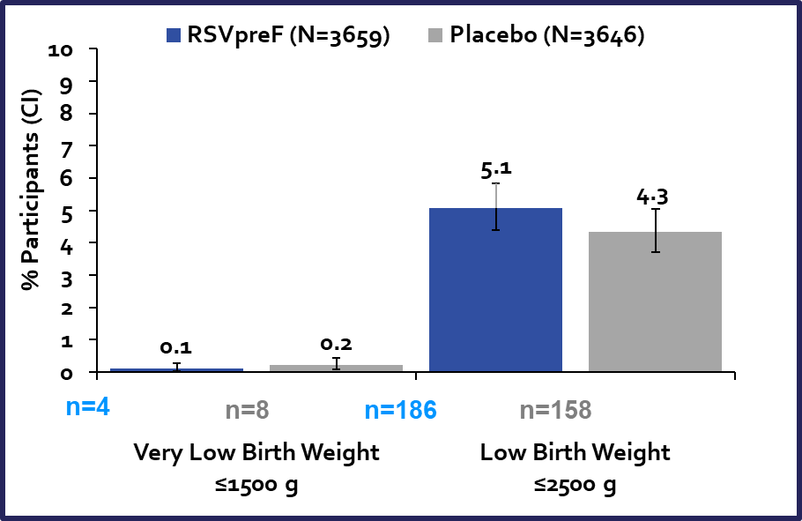
Pre-F maternal RSV vaccine Phase 3 safety results
No difference in adverse events among mothers between vaccine and placebo
Numerical imbalance among babies for premature births and low birth weight
Mostly observed in two middle-income countries, South Africa and Argentina
No temporal relationship between vaccine and preterm birth
No increase in deaths was seen with prematurity; fewer infant deaths in vaccinated arm compared to placebo.
Multiple regulatory approvals, modelling studies, and WHO SAGE confirms that benefits outweigh potential risks of vaccination
Emphasize the importance of post licensure safety surveillance to monitor safety and effectiveness.
Graph provided by Pfizer
Original slide developed by the World Health Organization and PATH. Last updated: January 2026.
Notes:
Adverse events in infants were similar in placebo and vaccine arms .
No safety concerns overall were statistically significant; however, numerical imbalances with more premature births in the vaccine group compared to placebo group were observed in two upper-middle-income study countries.
Majority of preterm births were late preterm
No association with timing of vaccination and preterm births – most > 30 days after vaccination
No increase in deaths was seen with prematurity; fewer infant deaths in vaccinated arm compared to placebo.
WHO SAGE confirms the importance of post licensure safety & effectiveness studies.
Multiple regulatory approvals, modeling studies, and WHO SAGE recommendation support that maternal RSV vaccine benefits outweigh potential risks.

Slide 17
WHO’s global recommendation summary—maternal RSV vaccine
SAGE/WHO recommended that all countries introduce passive immunization for the prevention of severe RSV disease in young infants.
In May 2025, WHO published its first-ever position paper outlining these recommendations to protect children from RSV.
For countries deciding to use the maternal vaccine:
Give a single dose in the 3rd trimester of pregnancy, as defined in local context.
3rd trimester starts at 28 weeks gestation in most settings but could be earlier in some places.
No upper gestational age limit for vaccination, except for pregnant people in active labor
Can be given concomitantly with other vaccines in pregnancy
Notes:
Overall, WHO’s recommendation in September 2024 and published in a position paper in May 2025 supports that all countries introduce passive immunization for the prevention of severe RSV disease in young infants—via maternal vaccine and/or long-acting mAb.
Here are some of the nuances specific to the maternal vaccine in that recommendation. There are other more cross-cutting aspects of the recommendation, which I’ll cover later.
Regarding the maternal vaccine, it’s important to know that WHO recommends a single dose in the third trimester of pregnancy, as defined in local context.
In most settings, the third trimester starts at 28 weeks gestational age.
The recommendation allows for some flexibility if the third trimester is defined differently in a certain context. For instance, in some contexts, it’s as early as at 27 weeks.
WHO also recommends no upper gestational age limit for vaccination, except for pregnant people in active labor.
The vaccine can also be delivered concomitantly with other vaccines given at that time.

Slide 18
New RSV maternal vaccine—additional details Pfizer, Inc. (Abrysvo®)
 | Globally recommended by WHO in 2024; recommended by Pan American Health Organization (PAHO). First regulatory approvals in 2023 (United States & European Union), with other high- and upper-middle-income countries following suit thereafter. Gavi has committed to supporting introduction.
 | Vaccination during defined gestational age window optimizes protection for the infant. Global WHO recommendation is third trimester of pregnancy, usually from 28 weeks, but as defined in local context.
 | A year-round immunization approach is preferable in most countries, especially in tropical and sub-tropical regions where RSV circulates most of the year. Where RSV seasonality is clear and immunization program capacity exists, a seasonal approach may be appropriate with vaccination starting several months before RSV season.
 | One dose; can be given with other maternal vaccines For intramuscular injection Lyophilized (freeze-dried) prefilled syringe; Single-dose vial / multi-dose vial presentation in development Standard cold chain
RECOMMENDATIONS & APPROVALS
VACCINATION NUANCES
SEASONALITY
PRODUCT
Original slide developed by the World Health Organization and PATH. Last updated: January 2026.
Notes:
So, let’s bring this picture together a bit more.
The maternal vaccine was first approved in Europe and US (August 2023).
Since then, many countries have approved ABRYSVO from a regulatory standpoint, and a have a policy for use.
Most are high income countries, except a few upper middle-income countries.
Though a number of countries are using the vaccine to save lives, the product is not yet globally available.
The WHO SAGE recommendation is an important step in the policy pathway to scale and support use of this vaccine, especially in low- and middle-income markets where need is greatest.
In July 2025, Gavi committed to opening a funding window for establishing an RSV maternal vaccine program, which is great progress because it paves the way for country introductions to begin.
Defined vaccination windows by gestational age are necessary to maximize protection for the infant.
We’ve already discussed that the global recommendation is to vaccinate in the third trimester as defined in the local context.
But, it’s also important to mention that recommended vaccination windows can vary by country.
Of the countries that have approved and are using the vaccine, most NITAGs recommend use of vaccine from 24-36 weeks or 32-36 weeks, except Australia and UK recommend it from 28-36 weeks. One region in Italy recommends use in the 3rd trimester.
The takeaway here is that countries will be making decisions based on their context.
In settings using only maternal vaccination, RSV vaccine can be given during subsequent pregnancies as there is potential benefit and no expected harm from revaccination. However, no data are currently available on the efficacy or safety of additional vaccine doses in subsequent pregnancies.
In terms of seasonality, WHO notes that a year-round immunization approach is preferable, especially in tropical and sub-tropical contexts where RSV circulates most of the year.
Where RSV seasonality is clear and immunization program capacity exists, a seasonal approach may be appropriate with vaccination starting several months before RSV season
That said, most of the countries introducing so far are taking a seasonal approach to vaccination except UK and Australia, who are vaccinating year-round.
For countries choosing seasonal administration, considering gestational age during pregnancy in relation to RSV season will be important.
Lastly, shown here are some details about the product.
What’s important to know for low- and middle-income markets is that the vaccine is given in a single dose, uses standard cold chain, and a multi-dose vial presentation is in development for improved implementation suitability.

Slide 19

Will RSV pre-F maternal vaccine be available for low- and middle-income markets and when?
Gavi agrees to support maternal RSV vaccine programs
Vaccine roll-out in Gavi-eligible countries
UNICEF tender & Gavi co-financing
MDV available & WHO prequalified
SDV WHO prequalified
Estimated 2027 onwards
WHO (SAGE)
policy recommend- ation
First product rollout in some HICs & UMICs
First regulatory approvals HICs of PFS
Estimated 2026
2025
MATERNAL
VACCINE
2024
2022-2023
2023-2024
Development of an affordable multi-dose vial presentation is underway to
support delivery in low- and middle-income economies.
Definitions: HIC = high-income country; PFS = pre-filled syringe; UMIC = upper- and middle-income country;
WHO SAGE = World Health Organization Strategic Advisory Group of Experts; SDV = single-dose vial; MDV = multi-dose vial
Notes:
The green line shows where we are currently. Initial licensure is in. WHO recommended RSV maternal vaccine in 2024 and prequalified it in the single-dose vial presentation in March 2025.
WHO prequalification is the process that facilitates registration of immunization products in low- and middle-income countries. It is required for UNICEF to procure and Gavi to fund vaccines on behalf of these countries.
WHO prequalification for the RSV maternal vaccine in a single-dose vial presentation occurred in early 2025. Prequalification in a form suitable for LMICs with a multi-dose vial presentation could be possible by as soon as 2026.
Gavi announced its approval to open a funding window for the establishment of maternal RSV vaccine programs in July 2025.
This progress is reason to get excited, but also to begin preparations for putting the maternal vaccine to lifesaving use and minimizing the lag between when product is available in HICs and in LMICs.

Slide 20
New long-acting RSV monoclonal antibodies given at birth
product information and evidence

Slide 21
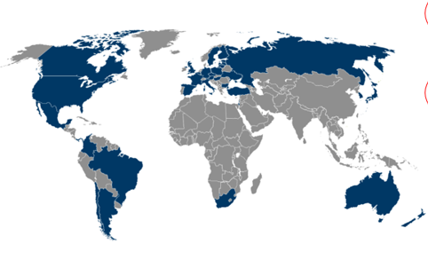
Long-acting mAb clinical development (nirsevimab) Beyfortus® by AstraZeneca/Sanofi
Phase 2b, Study 03
Preterm infants ≥ 29 to <35 weeks gestational age (GA)
1,453 participants
23 countries / 163 sites
50 mg dose only
POOLED EFFICACY
MELODY Phase 3
Term and late preterm infants born ≥ 35 weeks GA
3,015 participants
31 countries / 211 sites
50 mg & 100 mg dose only
MEDLEY Phase 2/3
Infants at high risk of severe RSV disease
925 participants
25 countries / 126 sites
MUSIC Phase 2
Immunocompromised infants and children
100 participants
8 countries / 28 sites
Efficacy
Slide content provided by Sanofi and AstraZeneca.
Original slide developed by the World Health Organization and PATH. Last updated: January 2026..
Notes:
Nirsevimab was evaluated in several thousand infants in pivotal clinical trials shown here on this slide with inclusion of sites in both the northern and southern hemisphere as well as some sub-tropical and tropical sites in central and south America.
During their Phase 2b clinical trial among moderate preterm infants, all nirsevimab recipients received a single 50 mg dose; however, it was found that among infants who weighed ≥ 5 kg at the time of administration, nirsevimab concentrations and efficacy estimates were lower.
So, in the Phase 3 trial among preterm and full-term infants, they opted to evaluate two different doses; a 50 mg dose given to infants < 5kg and a 100 mg dose given to infants who weighed 5 kgs or more, and you can see those trials boxed in green.
I’ll present the pooled efficacy results from those trials in the next slide.
The product was also evaluated in high-risk infants and young children in the MUSIC and MEDLEY trials shown on the slide.

Slide 22
Protection against disease high against RSV in infants at 150 days
Pooled Phase 2b (optimal dose) + Phase 3 results^{1,2}
EFFICACY (%)
(95% CONFIDENCE INTERVAL)
OUTCOME MEASURED
78.5% (48.8–91.0)
Severe hospitalized RSV LRTI⁴
80.6% (62.3–90.1)
Hospitalized RSV LRTI
78.6%
79.0% (68.5– 86.1)
Medically attended LRTI³
43·8% (95% CI, 18·8–61·1) reduction in hospitalizations for respiratory illness of any cause
35.4% (95% CI, 21·5–46·9) fewer medically attended LRTI of any cause
41.9% (95% CI, 25·7–54·6) fewer LRTI outpatient visits
23·6% (95% CI, 3·8–39·3) reduction in antibiotic prescribing
No safety concerns across clinical trials.
Pragmatic clinical trial (HARMONIE, real-world setting, 8,000 infants)⁵
83% (95% CI, 67.8.92.0) against RSV-LRTI hospitalizations
58% (95% CI, 39.7-71.2) against all-cause LRTI hospitalization
Jones JM, et al. MMWR Morb Mortal Wkly Rep. 2023.
Simões EAF, et al. Lancet Child Adolesc Health. 2023.
MA-LRTI: RSV PCR-positive ≥1 documented physical examination findings localizing to LRT: Rhonchi; Rales; Crackles; Wheeze. And also must have ≥1 of the following: Increased respiratory rate (*≥60 breaths/min for <2-month-old; ≥50 breaths/min for 2–6-month-old, ≥40 breaths/min for 6–24month-old; Hypoxemia in room air: O2 <95% at ≤1800 m; O2 <92% at >1800 m; Clinical signs of severe respiratory disease: New-onset apnea, Retractions, Grunting, Nasal flaring, Acute hypoxic or ventilatory failure, Dehydration due to respiratory distress requiring IV hydration, Intercostal, subcostal, or supraventricular retractions
MA-LRTI with hospitalization and supplemental oxygen or IV fluids
Drysdale SB, et al. N Engl J Med. 2023.
Notes:
A pooled analysis of Phase 2b and Phase 3 results study showed the vaccine’s efficacy, or vaccine protection against RSV disease, over the first 150 days post vaccination to be 78.5% for severe hospitalized medically attended RSV LRTI, 80.6% for hospitalized RSV LRTI, and 79% for medically attended RSV LRTI.
Also important to note are the reductions in all cause respiratory illness hospitalizations and medically attended LRTI of any cause.
Also, there were fewer LRTI outpatient visits reported and a reduction in antibiotic prescribing.
In another clinical trial called HARMONIE, the mAb was tested in a real world setting with around 8,000 infants.
There efficacy was 83% against RSV LRTI hospitalizations and 58% against all-cause LRTI hospitalizations.
Sanofi / AstraZeneca also reported a positive safety profile in clinical trials with no safety concerns.
The mAb has a normal side effect profile similar to many other vaccines in widespread use.

Slide 23
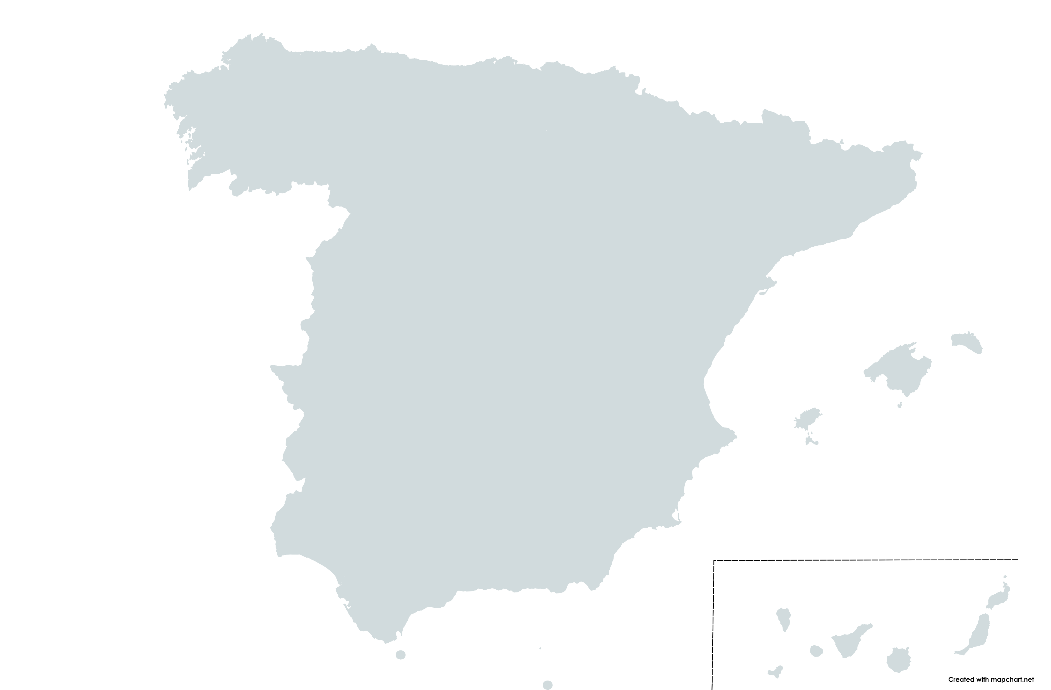

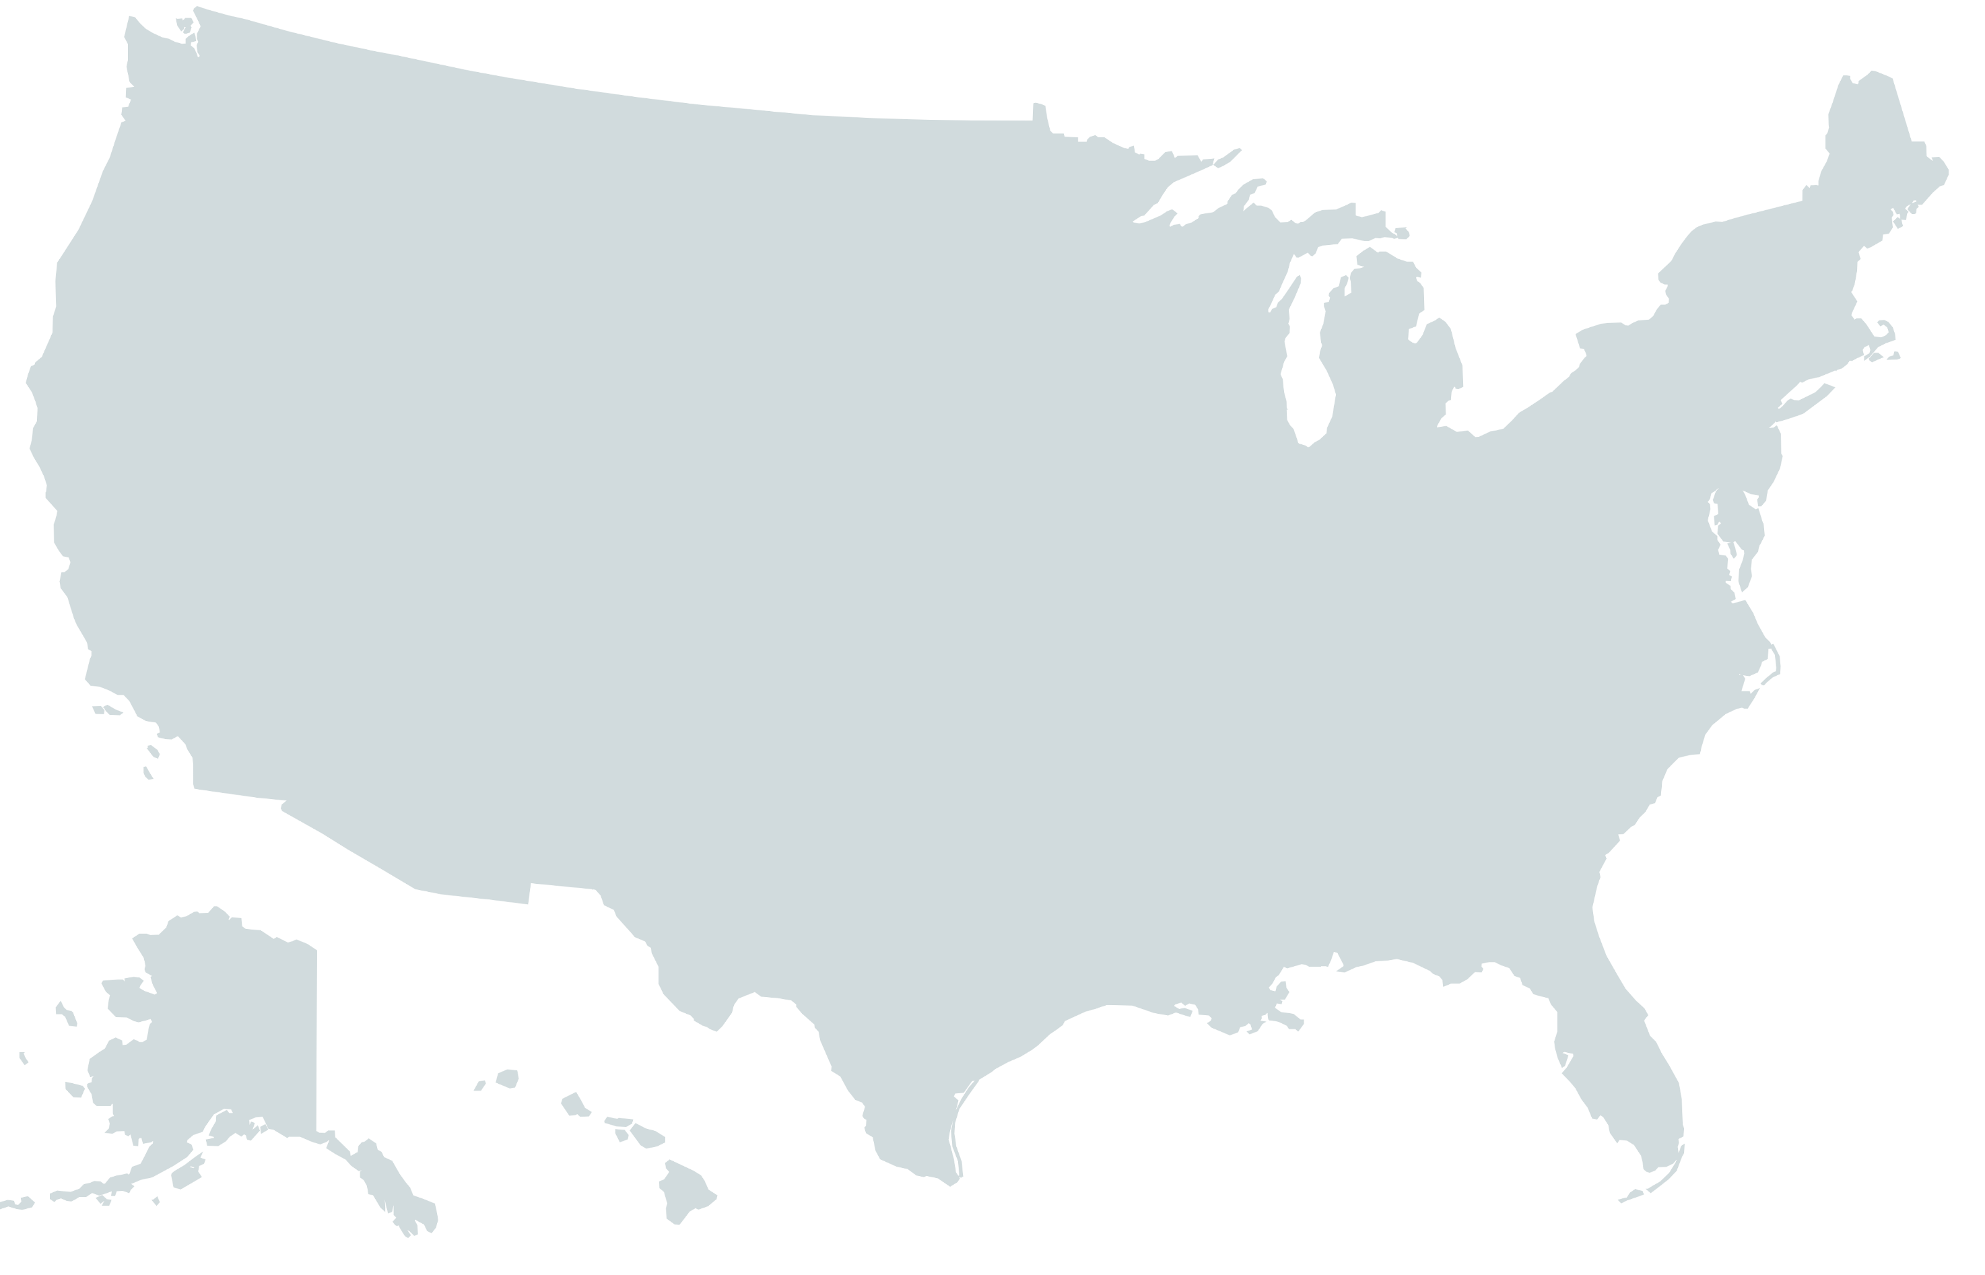
Summary of nirsevimab real-world effectiveness on RSV-related hospitalization
Effectiveness on RSV-related hospitalization Effectiveness on RSV-related intensive care hospitalization
88.7% (69.5–95.8)³
85.9% (13.2–97.7)³ Navarre
83% (73.4–89.2)⁴
91% (79–96)⁵ NVSN
69.6% (42.9–83.8)⁴
82% (65.6–90.2)⁶ Galicia
UNITED STATES
SPAIN
81% (60.9–90.7)⁸
FRANCE
85.6% (41.7–96.4)⁸ Cataluña, Andorra
98% (95–99) ⁵ VISION
84.4% (76.8–95.9)¹ Murcia, Valencia, Valladolid
87.76% (82.1–91.4)²
90.1% (76.3–95.9)² Cataluña
75.9% (48.5–88.7)⁷
(All 95% confidence intervals)
References 1. López-Lacort M. et al Euro Surveill. 2024. 2. Coma E, et al. Arch Dis Child 2024. 3. Ezpeleta G, et al. Vaccines. 2024.
4. Assad Z, et al. N Engl J Med 2024.
5. Payne A., Summary of effectiveness of nirsevimab in infants, ACIP presentation, June 28, 2024, Available at: https://www.cdc.gov/vaccines/acip/meetings/downloads/slides-2024-06-26-28/04-RSV-Mat-Peds-Payne-508.pdf.
6. Ares-Gómez S et al. Lancet Infectious Diseases, 2024. 7.Paireau J et al. Influenza and Other Respiratory Viruses, 2024.
8. Agüera M, et al, Pediatr Allergy Immunol. 2024.
Original slide developed by the World Health Organization and PATH. Last updated: January 2026..
Notes:
Since the Phase 3 of nirsevimab, post marketing studies are corroborating the positive data picture in the real world.
Here’s a snapshot of some of the data that’s being generated in the US and Europe.

Slide 24
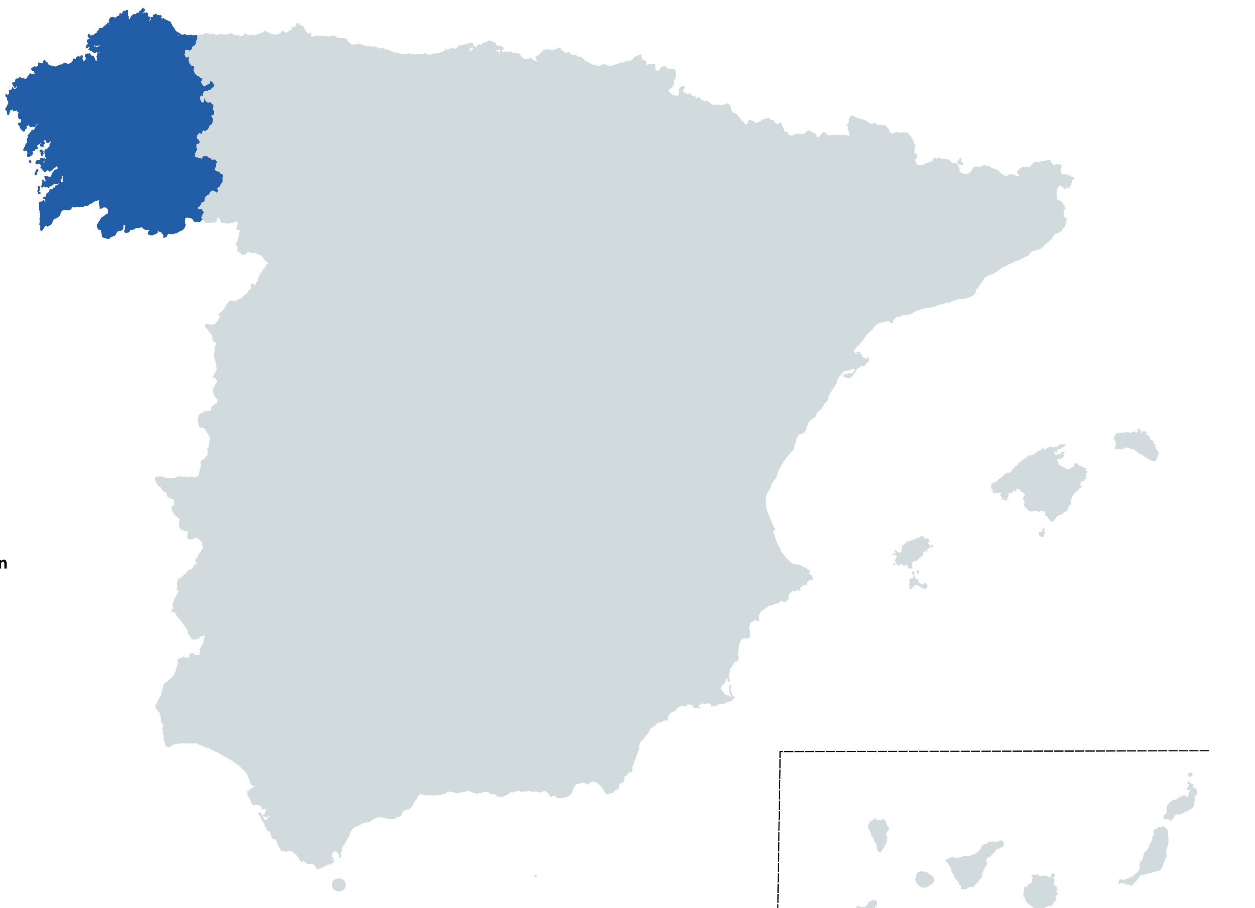
Post-marketing effectiveness example—nirsevimab initial results of a population-based longitudinal study in Galicia, Spain
Effectiveness (95% confidence interval)
Severe RSV-related lower respiratory tract infection (LRTI) with oxygen support
RSV-related LRTI hospitalization
All-cause LRTI hospitalization
All-cause hospitalizations
86.9% (69.1–94.2)
~10,000 infants followed in first 3 months of 2023-2024 vaccination campaign
82.0% (65.6–90.2)
69.2% (55.9–78.0)
66.2% (56.0–73.7)
Reference: Ares-Gómez S, et al. Lancet Infect Dis. 2024.
Original slide developed by the World Health Organization and PATH. Last updated: January 2026.
Notes:
Digging into the data a little more, this example from Galicia, Spain is helpful--showing very high efficacy for severe RSV-related LRTI and RSV-related LRTI hospitalization.
What’s also interesting to point out is the estimated impact of this long-acting mAb on ALL CAUSE LRTI and hospitalizations.

Slide 25
Another long-acting RSV mAb—clesrovimab (Merck/MSD) Phase 2b/3 clinical study efficacy results summary (MK-1654-004)
Phase 2b/3 clinical study in ~ 3,614 healthy preterm and full-term infants
RSV associated endpoint | Efficacy through 6 months (180 days) (95% confidence interval)
Severe medically-attended lower respiratory infection (MALRI) | 91.7% (62.9–98.1)
Hospitalization | 81.3% (62.5–90.7)
MALRI requiring ≥ 2 indicators of LRI/severity | 87.2% (75.1–93.4)
MALRI requiring ≥ 1 indicator of LRI/severity | 59.5% (43.3–71.1)
Acute respiratory infection | 50.0% (37.4–60.1)
Increasing disease severity
One dose protected against mild, moderate and severe RSV through 5 months, with enduring efficacy through 6 months.
ClinicalTrials.gov identifier: NCT04767373 . Slide content provided by MSD. Reference: Zar H, Presentation World Vaccine Congress Barcelona 2024.
Original slide developed by the World Health Organization and PATH. Last updated: January 2026.
Notes:
In more exciting news, another long-acting RSV mAb candidate developed by MSD (Merck) called clesrovimab was approved for infants by the US FDA in June 2025, following positive Phase 2b/3 placebo-controlled study results.
The mAb met its primary safety and efficacy endpoints.
The efficacy data show that it significantly Reduced Incidence of RSV Disease and Hospitalization in Healthy Preterm and Full-term Infants.
It’s particularly interesting to note here that the efficacy increased as severity of disease increased.
Having a second available monoclonal antibody may lead to broader global market access for these effective products.

Slide 26

WHO’s global recommendation summary—long-acting RSV mAbs
All countries are recommended to introduce passive immunization for the prevention of severe RSV disease in young infants.
For countries deciding to use the mAb:
Give a single birth dose to all infants born in RSV season or where a year-round approach is considered.
If cannot be given at birth, should be given at earliest opportunity thereafter (e.g., routine vaccination visits) or prior to RSV season​.
Key notes
SAGE noted with concern the limited availability and high cost of the current mAb, which will limit global access and equity.
Notes:
All countries are recommended to introduce passive immunization for the prevention of severe RSV disease in young infants -- RSV maternal vaccine and/or long-acting mAb.
For countries deciding to use the monoclonal antibody, SAGE recommends a single birth dose to all infants born in RSV season or where a year-round approach is considered.
If a long-acting monoclonal antibody cannot be given at birth, it should be given at the earliest opportunity thereafter (e.g., routine vaccination visits)​.
SAGE also noted with concern the limited availability and high cost of the monoclonal antibody, which will seriously limit global access and equity.

Slide 27
New long-acting RSV mAbs—additional details
 | Nirsevimab – Astrazeneca and Sanofi (Beyfortus®) | Clesrovimab – Merck (ENFLONSIA™)
 | Globally recommended by WHO; recommended by PAHO First regulatory approvals in European Union (2022) and United States (2023), with other high- and upper-middle-income countries following suit thereafter. | Approved by U.S. Food and Drug Administration in 2025.
 | Year-round immunization preferred where RSV circulation is year-round. Where RSV seasonality is clear, a seasonal approach may be appropriate. Administration soon after birth during the RSV season OR before RSV season for babies born before the RSV season (i.e., at routine immunization visit). A seasonal approach could be particularly cost-effective, where mAb costs are higher and the required number of months of administration are likely fewer than for year-round programs. | Designed to provide direct, rapid and durable protection through 5-6 months, a typical RSV season. Administration soon after birth during the RSV season OR before the RSV season for babies born before the RSV season (i.e., at routine immunization visit).
 | One dose; can be given with other infant vaccinations. Intramuscular injection in thigh, similar to a vaccine. Standard cold chain Sterile liquid / pre-filled syringe 50 mg (0.5 mL) for infants <5 kg or 100 mg (1.0 mL) dose for infants ≥5 kg. | One dose; can be given with other infant vaccinations. Intramuscular injection in thigh, similar to a vaccine. Standard cold chain Dosage: 105 mg (0.7 m)L in a single-dose prefilled syringe.
RECOMMENDATIONS & APPROVALS
SEASONALITY
ABOUT THE
PRODUCT
References: Sanofi web page. “Beyfortus™: Dosing and Administration.”Accessed on December 15, 2023.
Merck web page. “ENFLONSIA™: Prescribing Information.” Accessed on August 12, 2025.
Original slide developed by the World Health Organization and PATH. Last updated: January 2026.
Notes:
So, let’s bring this picture together too.
The long acting mAb nirsevimab was first approved in Europe (2022) and US (2023), with many other countries in high- and upper-middle income markets following suit..
Though many country rollouts are underway, the product is not yet globally available.
Like for the maternal vaccine, the WHO SAGE recommendation is an important step in the policy pathway to global access; however, for the mAb, WHO has noted with concern the limited availability and high cost.
In terms of seasonality, WHO notes that a year-round immunization approach is preferable in most tropical and sub-tropical contexts where RSV circulates most of the year.
Where seasonality is clear, however, a seasonal approach may be appropriate.
This is where administration becomes nuanced.
Administration in a seasonal approach would need to occur either soon after birth during their first RSV season OR before RSV season for babies born before the RSV season (i.e., at routine immunization visit).
It’s interesting to note that in the US, approval goes up to 24 months of age through a child’s second RSV season when risk of severe disease is high.
Lastly, shown here are some details about the product.
What’s important to know for low- and middle-income markets is that the vaccine is given in a single dose, uses standard cold chain, and can be given with other infant vaccines.
Also, dosages will depend on infant weight.
Another long acting mAb, clesrovimab, was approved in the US in 2025.
Clesrovimab is designed to provide protection through 5-6 months, a typical RSV season.
Like nirsevimab, administration is soon after birth or before the RSV season for infants born before the RSV season.
The injection is given in a single dose, and the dosage does not depend on weight.
Safety and effectiveness have not been established in children older than 12 months of age.

Slide 28
Long-acting mAb development, approvals, and market entry status
Nirsevimab is not expected to be globally accessible in the near term due to price and supply barriers.
HOWEVER
It sets the stage for other RSV long-acting mAbs becoming more widely available in the future (e.g., Merck).
Estimated 2027 onwards
mAb roll-out in Gavi-eligible countries
Estimated 2026
UNICEF tender & Gavi co-financing (contingent on affordable pricing & supply)
2025
2024
2022-2023
2023-2024
Needs: Product presentation suitable for Gavi-eligible countries & price commitments made
WHO (SAGE)
policy recommend- ation
First product rollout in some HICs
First regulatory approvals HICs of PFS
MONOCLONAL ANTIBODIES
Definitions: HIC = high-income country; PFS = pre-filled syringe; UMIC = upper- and middle-income country; WHO SAGE = World Health Organization Strategic Advisory Group of Experts; SDV = single-dose vial; MDV = multi-dose vial
Notes:
For the mAb, initial licensures are in and a WHO SAGE policy recommendation occurred in September 2024.
For the long-acting mAbs, it is not yet clear if the companies will submit the products for WHO prequalification, so this metric is not on the timeline at this time.
Prequalification will hinge on product presentation being suitable for Gavi-eligible countries and eligible price commitments for Gavi markets.
Although this product is not expected to be globally accessible in the near term due to price and supply barriers; it sets the stage for licensure and recommendations for use for other long-acting RSV mAbs in the future.

Slide 29
Additional considerations

Slide 30
Aspects of WHO SAGE recommendation across both products
All countries are recommended to introduce passive immunization for the prevention of severe RSV disease in young infants.
Introduction decisions
Consider cost, financing, supply, anticipated coverage and feasibility of implementation within the existing health system.
Co-administration
Both products can be co-administered with vaccines normally given at the same time.
Post-marketing
SAGE reinforced the importance of manufacturer-led post-marketing surveillance.
Seasonality
Year-round immunization preferable in most tropical/ sub-tropical locations where RSV circulates for much of the year without clear seasonality and seasonality patterns are not well-described.
Where RSV circulation has clearly documented seasonal peaks, seasonal immunization may be considered per program and cost considerations.
Notes:
Some aspects of WHO’s recommendations are applicable across products.
For one, decisions to include either product in an immunization programme should consider cost, financing, supply, anticipated coverage and feasibility of implementation within the existing health system.
Also, both products can be co-administered with vaccines normally given at the same time.
For both products, manufacturer-led post-marketing surveillance is important.
And, just to reiterate, that countries will need to look at RSV seasonality epidemiology and other programmatic factors to decide on year-round or seasonal immunization approaches.
WHO notes that year-round will likely be most preferable in most low- and middle-income markets where RSV has more year-round activity due to tropical and sub-tropical climates.

Slide 31
Both products protect infants via passive immunization, but have differences
 | Maternal vaccine | Long-acting mAb
 | Maternal antibodies protect infant for at least 5-6 months after birth. | mAbs protect for at least 5-6 months after administration, whenever given.
 | Given to pregnant women Induces antibodies against multiple neutralizing sites on the Fusion protein in the mother and passed to infant. Much less likely that a virus mutation would render induced antibodies ineffective. | Given to infants soon after birth or before/during first RSV season Antibodies against a single potent neutralizing site on the Fusion protein. A virus mutation could render the antibody ineffective.
 | Gavi will support a maternal RSV vaccine for eligible countries.* A pricing agreement** on multidose vial can make RSV maternal vaccine more accessible for Gavi-eligible countries. | Gavi will consider a long-acting mAb when an affordable product is available for eligible countries.*
 | Estimated availability for low- and middle-income settings in 2027 onwards. | Uncertain timing of availability in low- and middle-income settings due to price and supply barriers.
PROTECTION
HOW IT WORKS
COST
AVAILABILITY
*Gavi, the Vaccine Alliance. Review of Decisions: Board Meeting, 24-25 July 2025. Geneva, Switzerland. Accessed at: https://www.gavi.org/news/document-library/gavi-alliance-board-review-decisions-24-25-july-2025
** Media center announcement accessed at: https://www.gatesfoundation.org/ideas/media-center/press-releases/2022/09/gates-foundation-announces-grants-to-
reduce-infant-mortality
Notes:
Both products avoid the safety pitfalls of previous vaccine candidates in the 1960s because they provide protection through passive immunization and don’t require an active immune response from the infant.
The pre-F maternal vaccine induces antibodies against many neutralizing sites and is, therefore, less susceptible to virus mutations rendering it ineffective.
Pre-F long-acting mAbs, on the other hand, work against a single neutralizing site on the virus, meaning they could be rendered ineffective if the virus mutates.
Also, maternal antibodies protect in the first 6 months after birth, while mAbs protect for 6 months after administration, whenever given. So, there could be slight differences in the age ranges of protection.

