Slide 1
ArtificiaI Intelligence -
Care Beyond Boundaries
// Add facilitator’s name//

Slide 2
Artificial intelligence has the potential to revolutionize global health and development by providing powerful tools for predicting and managing diseases, optimizing resources, and delivering personalized healthcare to the most vulnerable populations.

Slide 3

Insights
Decisions
Data
As data becomes pervasive, we can provide a better picture of the patient, and to enhance the patient care continuum.
Precision Health & Population Health, powered by data, and continuously enhanced by analytics and AI insights, will drive the future of discovery, treatment, and better outcomes

Slide 4
Genomics
Artificial Intelligence
The Convergence of people, process and technologies is creating opportunities for extreme advances for the human race
Informatics & Analytics
Machine Learning

Slide 5
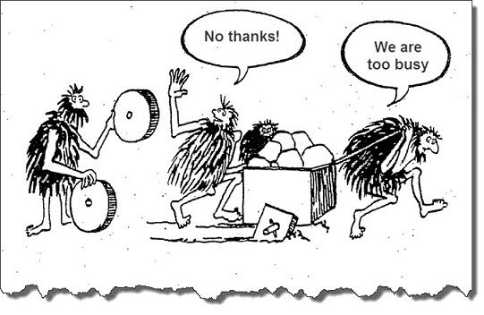

Slide 6



Applications of AI
Healthcare:
Finance:
Customer Service:
Diagnostics: AI algorithms analyze medical images to detect diseases.
Personalized Medicine: Tailors treatment plans based on individual patient data.
Algorithmic Trading: Uses AI to execute trades at optimal times.
Fraud Detection: AI systems identify and flag fraudulent transactions.
Chatbots: Provide automated customer support, handling inquiries and issues.
Personalization: AI analyzes customer data to provide personalized recommendations and services.

Slide 7
Where do you think we are?
Artificial Intelligence
“Can machines think and act like humans?
NLP, Alexa, Autonomous cars
Machine Learning
“How can we make it happen?”
Image recognition, Search
Predictive Analytics
“What might happen?”
Forecasting sales, Risk assessments
Analytics
“What happened?”
Dashboards, data visualization

Slide 8

Definition and Basics
Artificial Intelligence (AI): The simulation of human intelligence processes by machines, especially computer systems.
Key Functions: Includes learning (acquiring information and rules), reasoning (using rules to reach conclusions), and self-correction.
Types of AI:
  Narrow AI: Designed for a specific task (e.g., voice assistants like Siri, Alexa).
  General AI: A theoretical form of AI that would have the ability to perform any intellectual task that a human can do.

Slide 9


AI in Healthcare
Diagnostic Imaging
Predictive Analytics
Enhanced Accuracy: AI algorithms excel at analyzing medical images, such as X-rays, MRIs, and CT scans, identifying abnormalities like tumors, fractures, and infections with high precision.
Speed: AI expedites the diagnostic process, providing quick and accurate results, which is crucial in emergency settings.
Disease Forecasting: AI models predict disease outbreaks and patient health risks by analyzing large datasets, including genetic information, lifestyle factors, and environmental data.
Preventive Healthcare: Enables early intervention and preventive measures, reducing the overall burden on healthcare systems.

Slide 10


AI in Healthcare (Continued)
Personalized Treatment Plans
Remote Patient Monitoring
Tailored Therapies: AI uses patient-specific data, including genetic information and medical history, to design personalized treatment plans.
Improved Outcomes: Personalized treatments lead to better patient outcomes and minimize adverse reactions to medications.
Real-Time Data: AI-powered wearable devices and mobile apps monitor vital signs, providing real-time data to healthcare providers.
Chronic Disease Management: Facilitates continuous monitoring of chronic conditions like diabetes and hypertension, allowing for timely interventions and adjustments in treatment.

Slide 11


AI in Healthcare (Continued)
Operational Efficiency
Telemedicine and Virtual Care
Resource Optimization: AI optimizes hospital operations, including staff scheduling, inventory management, and patient flow.
Cost Reduction: Streamlines administrative processes, reducing costs and allowing healthcare providers to focus more on patient care.
Remote Consultations: AI-powered telemedicine platforms enable patients to consult with healthcare professionals remotely, increasing access to care.
24/7 Support: Virtual assistants and chatbots handle routine inquiries and initial patient assessments, providing continuous support and triage.

Slide 12

AI in Healthcare (Continued)
Drug Discovery and Development
Robotic Surgery and Automation
Accelerated Research: AI accelerates the drug discovery process by predicting molecular interactions and identifying potential drug candidates.
Cost Efficiency: Reduces the time and cost of bringing new drugs to market.
Precision Surgery: AI enhances the precision of robotic surgery, resulting in minimally invasive procedures with quicker recovery times.
Laboratory Automation: Automates routine tasks in labs and pharmacies, improving accuracy and efficiency in medical testing and medication dispensing.

Slide 13
Future Trends
IoT Integration: Combining AI with Internet of Things (IoT) devices for comprehensive health monitoring and real-time data analysis.
Advances in NLP: Improving doctor-patient communication through natural language processing (NLP) technologies.
Mental Health Applications: AI's growing role in mental health for predictive diagnostics and personalized therapy recommendations.

Slide 14


The Role of AI in International Development Programs

Slide 15
Key Opportunities
Efficiency and Reach: AI has the potential to significantly enhance the efficiency and reach of development programs by automating routine tasks, improving data analysis, and providing predictive insights.
Personalized Solutions: AI can help tailor solutions to individual needs, making interventions more effective in areas like healthcare, education, and agriculture.
Resource Allocation: AI-driven tools can optimize resource allocation, ensuring that aid and services are delivered where they are needed most.

Slide 16
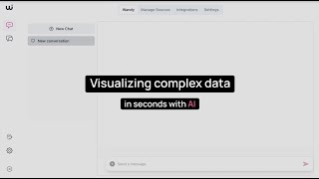

Slide 17
Ethical Challenges
Bias and Fairness: AI systems can perpetuate or even exacerbate existing biases if not properly managed, leading to unfair treatment of marginalized communities.
Privacy Concerns: The use of AI often involves the collection and processing of vast amounts of personal data, raising significant privacy concerns.
Accountability and Transparency: There is a need for clear accountability and transparency in AI decision-making processes to build trust and ensure ethical standards are maintained.

Slide 18



How to Avoid Ethical Pitfalls
Incorporate Ethical Guidelines:
Enhance Data Practices:
Build Capacity:
Develop Standards: Establish international standards and guidelines for the ethical use of AI in development, focusing on fairness, transparency, and accountability.
Stakeholder Engagement: Involve a broad range of stakeholders, including local communities, in the development and implementation of AI solutions to ensure their needs and perspectives are considered.
Data Governance: Implement strong data governance frameworks to manage data responsibly, ensuring privacy and security.
Bias Mitigation: Use techniques to identify and mitigate biases in AI models, and ensure datasets are representative of the populations they are meant to serve.
Training and Education: Invest in training and education for local communities and development professionals to build AI literacy and empower them to use AI responsibly.
Collaboration: Foster collaboration between governments, NGOs, and the private sector to share knowledge, resources, and best practices for ethical AI deployment.

Slide 19
Opportunities
​
  Improved Diagnosis and Treatment: AI can detect diseases faster and more accurately than humans in some cases, enabling earlier interventions.​
  Personalized Care: Tailoring treatments based on individual patient data can improve outcomes and reduce unnecessary interventions.​
  Operational Efficiency: AI can optimize resource allocation, streamline workflows, and support public health planning.​

Slide 20
Challenges/Risks:
Data Quality and Bias: AI is only as good as the data it’s trained on, and poor or biased data can worsen health inequities.​
Ethical and Privacy Concerns: Handling sensitive health information requires strict governance and transparency.​
Dependence and Oversight: Overreliance on AI without human oversight could be risky, especially in complex clinical decisions.​
  AI is a powerful enabler for healthcare, especially in diagnostics, personalized medicine, and population health. However, its success depends on careful implementation, robust data governance, and integration with human expertise.

