Slide 1
Meeting Country HIS Needs with Global Goods in the Context of Sustainability
// Add facilitator name //

Slide 2
Objectives
By the end of the session, participants will be able to….
Define build, adapt, buy approaches to software development
Articulate the pros and cons of build, adapt, buy, open source, proprietary
Describe global goods and digital public goods and their differences
Identify uses of the global goods guidebook

Slide 3
Build, buy or adapt conundrum
Build – develop internally based on your requirements
Buy – licensed proprietary off the shelf tool and configure or adapt to meet your requirements
Adapt – modify an existing open-source software tool to your needs, based on your requirements
Central to all these decisions is a comprehensive and detailed set of user and system requirements which should be documented prior to any decision making about technology

Slide 4
Build, buy or adapt conundrum
Issues that come up
  Lack of awareness and knowledge
    What is available to you?
    Tool features and capabilities based on vendor’s ‘point of view’ - how to assess software objectively?

Slide 5
Build, buy or adapt conundrum
Issues that come up
  How do you define what you want from a software application / service?
  Software requirements
    Lack of well defined and detailed requirements / strength of requirements
Notes:
Need to : Make sure there is a comprehensive and detailed set of user and system requirements that is well-documented – use this to assess software applications that may be candidates for use.

Slide 6
Build, buy or adapt conundrum
Issues that come up
  Capacity
    Limited MOH HR capacity to support tools at technical and implementation levels
    Infrastructure challenges – power, connectivity, existing systems and existing hardware at facility level and national level
Consider long-term implementation and maintenance needs over the full system life

Slide 7
Build, buy or adapt conundrum
Issues that come up
  Cost (short term vs. long term, etc.)
Consider total cost of ownership throughout the system life – life span of successful system
https://digitalsquare.org/tco-tool
Notes:
Resource: Digital Square's Total Cost of Ownership Model https://digitalsquare.org/tco-tool
NOTE: This is being transitioned to APTH website so will need to update link

Slide 8
Building software
Pros | Cons
Tailored to your unique needs | Much longer timeline
 | Typically, more expensive
Control of roadmap | Creates opportunity costs and can distract from “core business”
 | It takes significant investment and specialist skills to build good robust and secure quality system
Provides complete control & use of data | Responsible for fixing bugs, managing dependencies (security patches) and adding new features
 | Must provide internal support
Notes:
Start from the bottom and build it exactly like you want it (depending on your level of skill) but it doesn’t come with a service plan or guarantee so you have to do all the upkeep etc yourself
Analogy: Build a car – even if using a kit – takes a lot of skill, experience and expense

Slide 9
Buying software
Pros | Cons
Typically, faster to implement | Risk of vendor lock-in
Requires fewer developer resources | May still developer resources with system specific skills
Feature rich from beginning | Less customized to your specific needs
Proven expertise | Don’t have local context, particularly for LIMCs buying software developed for high income countries
Well established proprietary software should be able to provide evidence of quality assurance practices meaning that you have confidence in the system's ability to process data | Typically, high cost with ongoing annual license fees often payable in foreign currencies
Roadmap influence by multiple parties | Limited influence over roadmap priorities and decisions
Technical support for the software is often provided through a service level agreement (SLA) | SLAs may be high cost and providers may lack knowledge of local implementation environment. Local user helpdesk may still be needed
Notes:
Buying a car - drive away today! no control over the details! but let’s say you buy a car that can only be serviced by an authorized dealer, and the spare parts are difficult to source and expensive ….

Slide 10
Adapting software
Pros | Cons
Relatively mature and feature rich from the beginning, with the ability to customize more to your specific needs | Can lead to divergence from the core software product, that bring with it the same challenges as build software.
More influence over the roadmap | Requires maintenance of customizations over time.
Typically less expensive because you’re taking advantage of prior investments.
Often higher quality resulting from input from multiple implementations. | Requires developer skills and therefore specific human resources.
Notes:
You buy a car and make modifications - new engine, new seats. Butttt you realize because you changed the engine, it’s not compatible with other things from the same manufacturer

Slide 11
Software licensing
 | Open-source license | Proprietary license
Usage | Free to use | Paid (one-time or subscription) Free trial, Free with limited functions With advertisements
Technical support | Limited | Extensive
Advantages | Low cost Flexible and innovative- allows for customization No vendor lock-in Global community feeds improvement | Compatibility Customizable Limited to vendor
Disadvantages | Must determine service providers Potential security risks | Lock-in vendor contracts Lack of transparency
Common examples | Ubuntu operating system, DHIS2, Open Data Kit (ODK) | MS Windows operating system, MS Office 365, Tableau

Slide 12
Governments and organizations often use a mix of open source and proprietary digital health solutions that best fits their needs.

Slide 13
Global Goods…
Global goods
Software
A software tool that is free and open source (FOSS) and used to manage, analyze, or transmit health-related data, with proven utility in several settings
Content
A resource, toolkit, or data standard that is available under an open license and that is used to improve or analyze the capabilities required to manage health data.
Capabilities include those related to resource allocation, people, hardware, software, infrastructure, and operations.
are available under an open source or open open content license – this means there is no annual fee payable.
are supported by an anchor organization /strong community, with clear governance structures,
have been deployed at scale, are used across multiple countries,
have demonstrated effectiveness,
are designed to enable interoperability.
Notes:
You are given a free car! But you need to maintain it – however you have access to manuals and spare parts !
A mature digital health software global good is software that is Open Source Software, is supported by a strong community, has a clear governance structure, is funded by multiple sources, has been deployed at significant scale, is used across multiple countries, has demonstrated effectiveness, and is designed to be interoperable.

Slide 14
Digital Public Infrastructure vs. Digital Public Goods vs. Global Goods
Digital Public Infrastructure (DPI)
Digital Public Goods (DPGs)
DPIs are digital systems, standards, and governance frameworks that enable the secure, interoperable, and scalable exchange of health information for delivering equitable, efficient, and person-centered healthcare services.
DPGs are the building blocks used to make DPI an operational reality.
Open-source software.
Open data.
Open artificial intelligence models.
Open standards.
Open content.
Global Goods are a subset of DPGs: mature software and digital content for climate and health.
Notes:
It can be confusing when the terms DPI, DPG and global goods are used.
Digital Public Infrastructure (DPI) for Health refers to the foundational components for delivering effective, person-centered healthcare services in the public and private sectors. This includes identity systems, facility registries, terminology services, etc. DPI is a set of interoperable digital systems and foundational building blocks that enable the effective delivery of services and support governance that benefits the public/population as a whole and is NOT limited to health.
Digital Public Goods (DPG) are technology components or building blocks that can be used to create systems, and these components can be in the form of software, services, content and models. This includes code, standards, or specifications. They are important because they enable countries and communities, especially in low-resource settings, to build resilient digital systems without relying on proprietary solutions, promoting local ownership, collaboration, and scalability. DPGs support all the Sustainable Development Goals (SDGs) and are not limited to health.
The DPGs listed in the Digital Public Goods Alliance Registry https://www.digitalpublicgoods.net/registry
must meet the DPG standard, https://www.digitalpublicgoods.net/standard but they are not assessed for their level of maturity.
Global Goods are a mature sub-set of DPGs that support SDG3 Good Health and Well-being and 13 Climate Action. They are assessed for maturity using the Global Goods Maturity Model throug a peer revie wprocess managed by PATH. You can find out more about them in the https://globalgoodsguidebook.org/

Slide 15
Benefits of global goods
For country government stakeholders: The interoperable and open-source nature of global goods supports an ecosystem of choice in which decision-makers can select the tool that is most appropriate for implementation in a specific country or context.
For implementers: Global goods are mature software and content tools that adaptable to different contexts and designed to be interoperable with existing systems. Consider adopting and adapting a global good to meet your digital health needs.

Slide 16
Benefits of global goods
For developers: The source code for global goods is available and modifiable, creating more choice and more opportunities for collaboration across organizations and health program areas.
For donors: By strengthening the coordination among funders, the digital health marketplace is better placed to match tools and approaches to the needs of countries and communities.

Slide 17
How many of you have heard myths or misconceptions about open-source software or global goods?

Slide 18
Open Source & Global Goods Myths
“Global goods are free”
“Only the developers of global goods can implement them” (i.e., Ona for OpenSRP2)
“Local vendors do not have the capabilities to implement global goods”
“Global goods are worse/better quality than proprietary software”
“Global goods have worse/better cybersecurity than proprietary software”
Notes:
Free: yes, there is no license fee payable BUT you need to pay for the maintenance and customisation.
How many of you own a car? What are costs you have to pay for your car? New tires, gas, washing fluid, if you want a driver, tolls, replacement parts, customizations

Slide 19
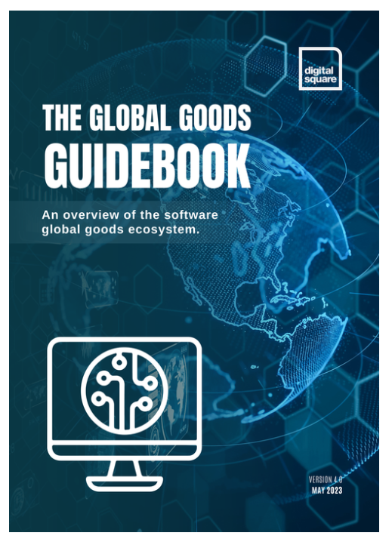
Interactive Global Goods Guidebook
Showcases global goods that are approved through a peer review process managed by PATH. Available as :
a downloadable PDF
an online interactive website
that allows you to search according to a range of criteria to find exactly what they are looking for.
www.globalgoodsguidebook.org
Includes a new category for global goods for climate data informed health services!
Notes:
The GGG serves as a trusted source of information for anyone seeking to implement a digital health system – providing guidance on a wide range of software and other tools and digital health content – and aiming to sustain an ecosystem of choice.
All global goods published in the GGG have been approved through a rigorous peer review process and assessed using the Global Goods Maturity Model

Slide 20
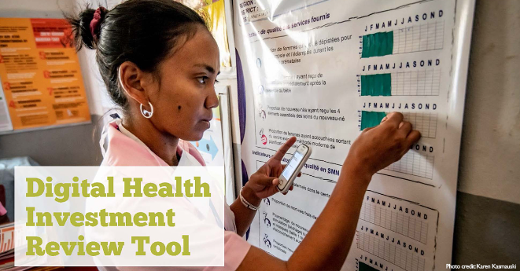
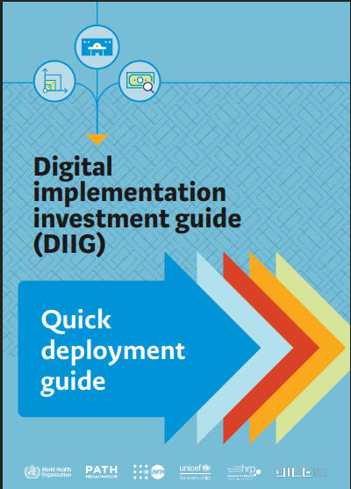
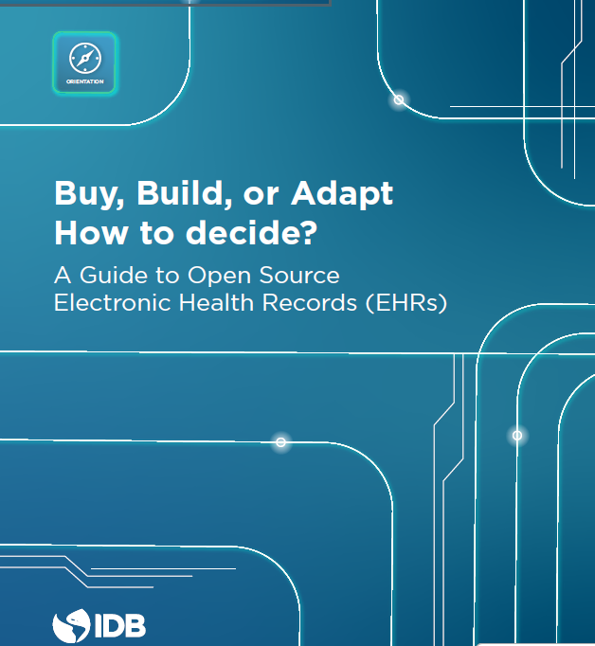
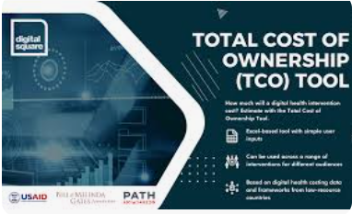
More resources to support decision making
Digital Health Investment Review Tool
(MEASURE Evaluation)
Digital Health Implementation Investment Guide (WHO)
TCO Tool (PATH)
Build, buy, or adapt? How to decide? A Guide to Open Source Electronic Health Records (EHRs)
Notes:
DHIRT https://www.measureevaluation.org/his-strengthening-resource-center/his-tools/tool%3FToolId=68.html
DIIG https://iris.who.int/bitstream/handle/10665/363577/9789240056572-eng.pdf?sequence=1
TCO https://digitalsquare.org/tco-tool

Slide 21
Discussion: Build, buy or adapt
Can existing software meet our critical needs?
Do we need heavy customization or will off-the-shelf work?
Do we have the skills, time, and budget to build/adapt?
How does each option affect security, compliance, and risk?
Can it integrate with current systems and standards?
Which option ensures the best user adoption and experience?
Notes:
Facilitators to guide a 20 minute discussion – in plenary or in breakout groups – to discuss these questions in the context of the work of the ISHO assessment findings, the current to future state discussion and plan i.e. should these global goods or DPGs be considered as potential solutions?

Slide 22
Key Takeaways
Deciding whether to build, buy or adapt is a complex decision – each comes with pros and cons.
Global goods are open source software and content that can be adopted and adapted to meet country needs : consider them as an option when deciding what software will meet your needs.
There are many myths and mis-conceptions about open source global goods.
There are many useful resources to support decision-making.

