Slide 1

Informatics-Savvy Health Organization (ISHO)
Pre I-LEAD Session
[DATE]

Slide 2













Learning Objectives
What is ISHO?
How does ISHO improve digital health processes/provide evidence of operational quality and efficiency?
How can you apply it in your own contexts before you attend I-LEAD in [training location] on [date of training]?

Slide 3
Agenda
Introduction to the ISHO framework
How to conduct an ISHO assessment
  Inclusive of assessment tool overview
Q&A
Poll: What are your expectations?

Slide 4









Background
Establishes a systematic basis of measurement of progress
Informatics-Savvy Health
Organization
Baseline to build an effectively-used information system
Vision, Policy, and Governance
Effective Information system
Skilled Workforce
Participatory tools that build relevant evidence-based action
Ministries of Health and National Public Health Institutes need to be Informatics-Savvy if we are to measurably and sustainably strengthen health systems for digital health to control the epidemic and improve patient and population health outcomes!

Slide 5
ISHO Capability Maturity Levels
Level Name | Generic Description | Sample Descriptions for CEE 1.1 “Does the organization have a defined, documented, and adopted eHealth/Digital Health Strategy and costed plan?”
1 – Absent | No capability is evident; “starting from scratch.” | There is no eHealth/Digital Health strategy.
2 – Initial | No organized, systematic efforts to build informatics capacity, only ad hoc efforts and isolated, individual heroics. | There is an awareness of the need for an eHealth/Digital Health Strategy and M&E Plan.
3 – Managed | Some organized efforts begun or completed, but not systematically documented or institutionalized. | Strategic plans are drafted or in various stages of completion and adoption and are siloed within specific subdomains of eHealth/Digital Health.
4 – Defined | Systematic, ongoing efforts underway, including greater attention to documentation, standardization, and integration but no overall method to measure progress or to ensure coordination. | There is an established eHealth/Digital Health strategy and costed plan that is adopted officially by the organization which all relevant stakeholders participated in developing.
5 – Measured | Systematic, ongoing efforts underway to measure progress and ensure coordination. | The organization has a budgeted eHealth/Digital Health strategy and action plan aligned with and integrated in the national health plan and established a method to monitor and evaluate its implementation.
6 – Optimized | Systematic, ongoing efforts underway with quality improvement activities to align results with guiding vision, strategies, and performance metrics. -- processes are constantly being improved through monitoring feedback | The eHealth/Digital Health governing body employs a continuous improvement process and uses monitoring and evaluation findings to improve its information capabilities and optimize resource allocation.

Slide 6



The ISHO METHOD
Gather the team to conduct the ISHO assessment
Choose your flavor!
1
Expedited Assessment
  Assess the current status of core capabilities across 3 ISHO pillars
2
~2-hour meeting
  Identify and prioritize gaps in informatics areas that need further development
3
In-depth Assessment
  Design a roadmap to develop informatics capabilities
4

Slide 7

How to conduct the expedited ISHO assessment

Slide 8
1. Gathering the assessment team
Select date and engage team members with as much notice as possible!
Leadership and management: crucial role in fostering a culture of data quality, use, and innovation. Their support is essential for prioritizing informatics and allocating resources for capacity development. E.g., MOH, program managers
Public health organization: primary users who take ownership of the self-assessment process, engage their staff, and lead the informatics capacity development efforts. E.g., National public health institutions, clinicians
Informatics experts: guide the assessment process, provide technical assistance, and support organizations in the development of their informatics roadmap. E.g., Software developers
Public health professionals: participate in the self-assessment process contributing valuable insights into the organization’s information needs, informatics capabilities, and areas that require improvement. E.g., M&E staff
Technical partners and donors: support the organization’s informatics capacity development initiatives providing financial and technical resources and aligning their investments with national digital health strategies. E.g., implementing partners, USG agencies, academic institutions
Notes:
Good day everyone - thank you for your time and attention today, my name is Kendi Mburu - I work with the Center for Digital and Data Excellence at PATH and alongside several colleagues and partner institutions across the PEPFAR-funded CDC Technical Assistance Platform Project, or TAP as we call it. Today we will be discussing a framework that TAP has developed, implemented and enhanced over the past 4 years – the Informatics Savvy Health Organization.
We would like for you to leave this session with an understanding of what the ISHO is, how it serves to improve digital health processes and provide evidence of the quality and efficiency of their operations, and how you can apply it in your own contexts before you attend the ILEAD session.

Slide 9
2. Assess current informatics capabilities
Download and use the ISHO Assessment Tool [link to ISHO Tool]
Total Core Essential Elements (CEEs) = 31
  Policy and governance = 12
  Skilled workforce = 7
  Information systems = 12
Score on a 6-level Capability Maturity Model (CMM) continuum
Actual assessment time: Roughly 2 hours
  Populating the tool: ~30 mins
  Consensus-building: ~90 mins
Conducting the assessment: In-person meeting recommended

Slide 10

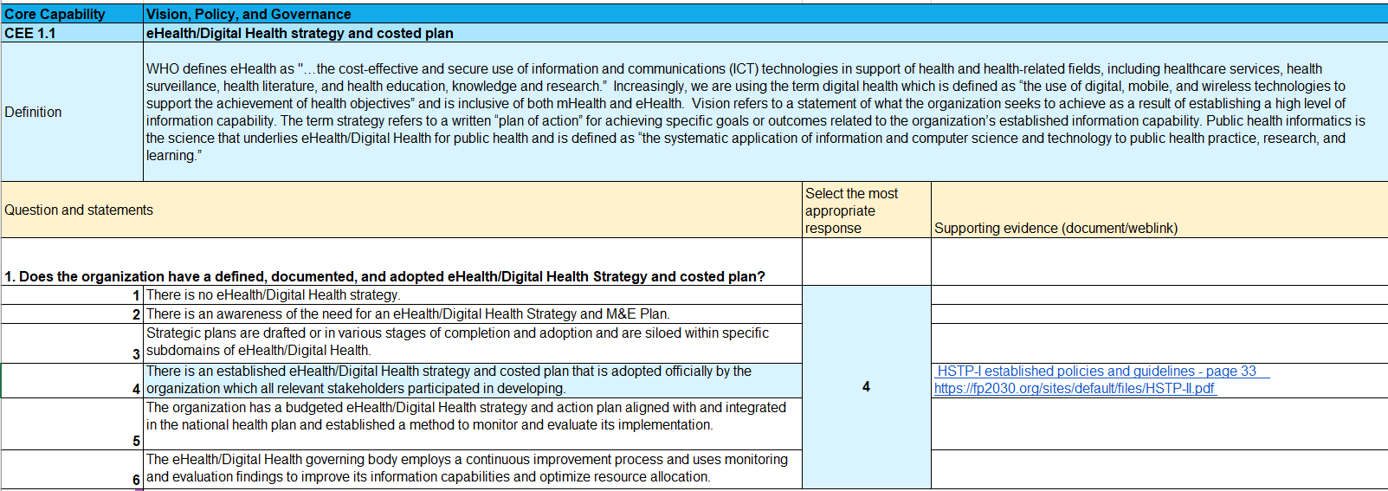
e.g.: ISHO Expedited Above-site Assessment
Core Essential Element 1.1*
* Informatics Savvy Health Organization (ISHO) Above Site-level Assessment Excel Tool

Slide 11
3. Prioritize informatics gaps for strengthening
Use the process outlined in the Assessment tool to streamline inputs through the following stages (tool tabs are named in brackets):
  Individual scoring [ISHO Above Site Level Assessment]
  Consensus scoring and priority level assignment [Strategic Priorities Worksheet]
  Identification of Key Priority Areas [Priority Areas (Updated)]
Use the Priority Areas compiled from the Assessment tool to complete a Country Presentation template and submit by [due date]
  The assessment exercise will help you fill in your scores, your key gaps and your recommendations
  Complete a country presentation using [link to “Template_Country Presentation Part 1”] (download and save your own copy)
  To help highlight the efficacy of the tool, please complete slides 1-10 of the country presentation before you conduct the assessment
  Submit Expedited ISHO country presentation [link to submission folder].

Slide 12

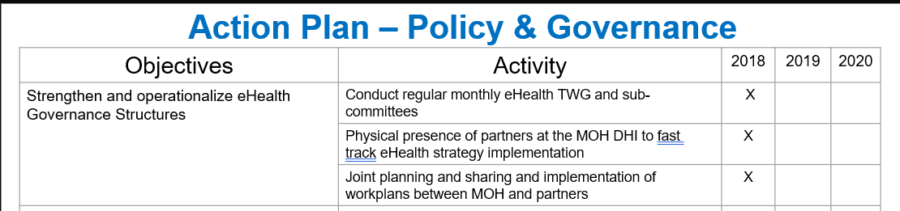
4. Design a roadmap to develop informatics capabilities
Looking ahead to I-LEAD!
Priority issues/gaps identified
ASSESSMENT
Recommendations gathered
[link to “Template_Country Presentation Part 1”]
Develop an action plan to implement the solutions
ROADMAP

Slide 13
Q & A

Slide 14
Next Steps
  Complete slides 1-10 of the [link to “Template_Country Presentation Part 1”], taking note of any national digital health strategy priorities or other strategies that may be considered for alignment in implementation
  Choose an ISHO assessment date and engage assessment team
1
  Conduct rapid ISHO assessment using the [link to ISHO Tool]
  Note and discuss the digital health systems gaps highlighted by the assessment
  Establish priorities among the ISHO assessment gaps
2
  Complete your country presentation using the template you started in Step #1 and inputs from Step #2
  [Due date] is the deadline for each Country Delegation POC to submit their Expedited ISHO Assessment presentation [link to submission folder]. Remember to give feedback on using the tool!
3

Slide 15
Country Focal Point
[add country focal points]

Slide 16
Learning Objectives
What is ISHO?
How does ISHO improve digital health processes/provide evidence of operational quality and efficiency?
How can you apply it in your own contexts before you attend I-LEAD in [training location] on [date of training]?

Slide 17





Thank you!

