Slide 1

[Add dates and location]
Information Session
Notes:
Good morning / afternoon / evening
Welcome to the orientation for the ___ regional I-LEAD.

Slide 2
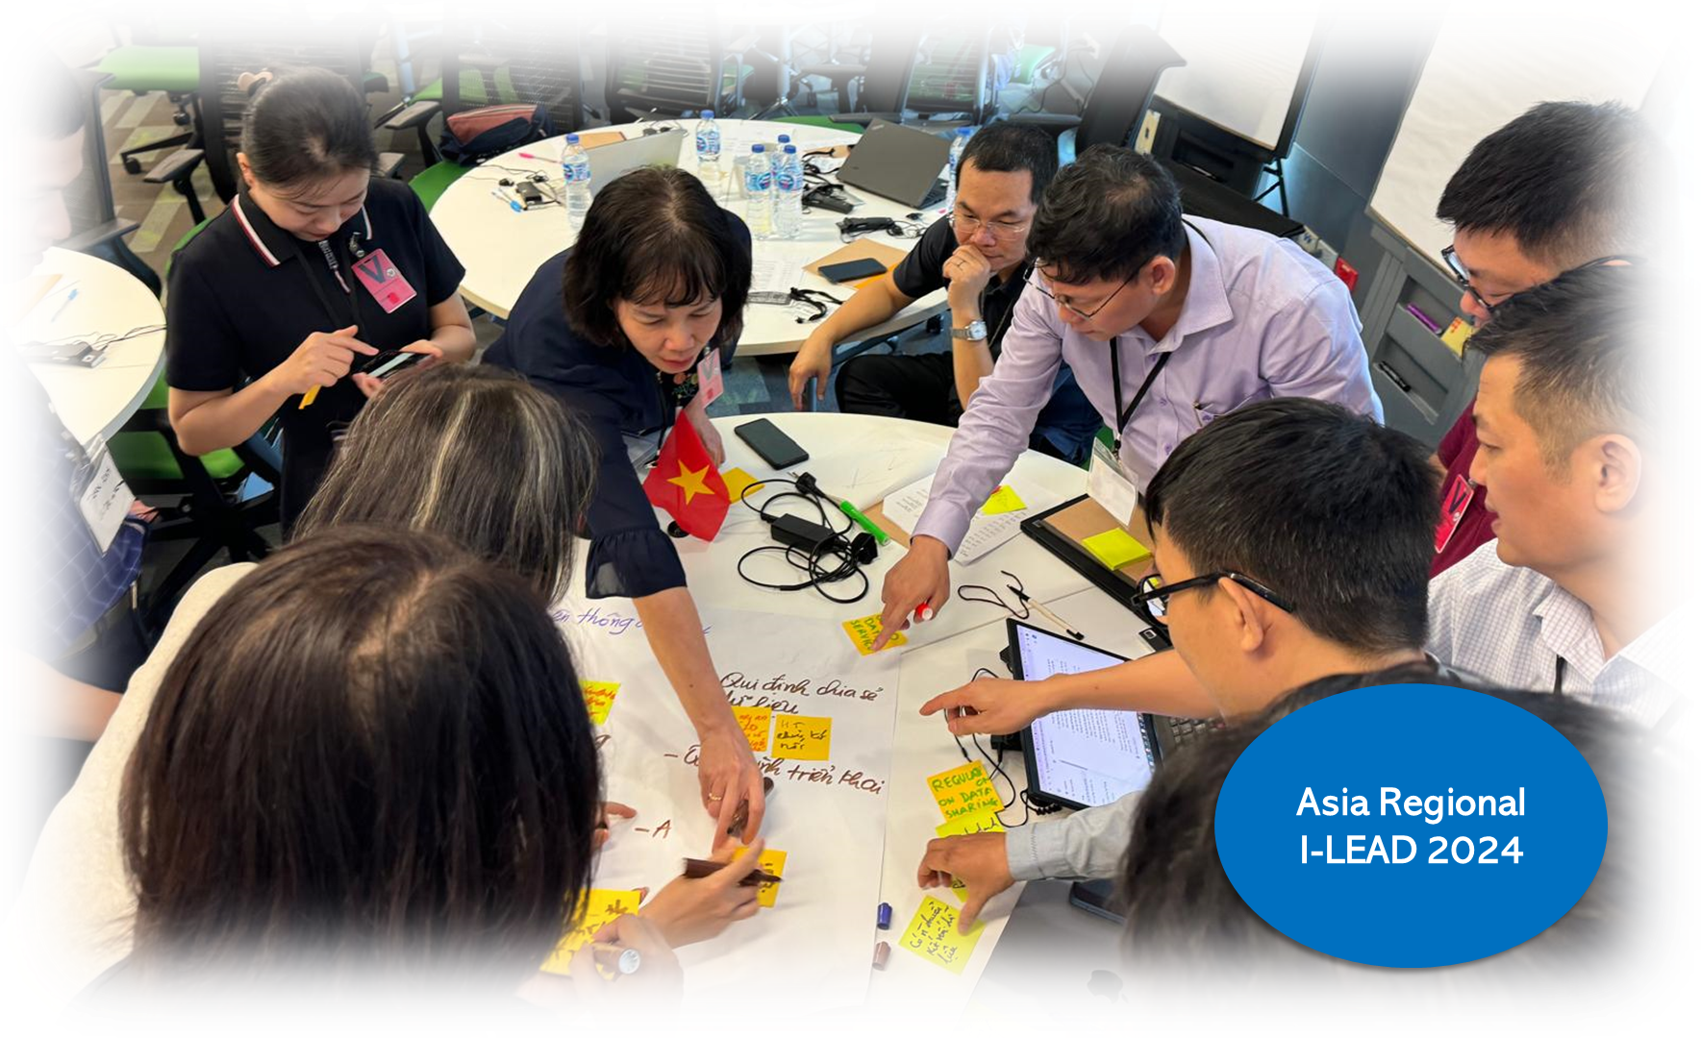
Information Session Overview
Roll Call
History and Introduction
Stakeholder Roles, Responsibilities, and Benefits
I-LEAD Preparation
  Shared Priorities
  Difficult Decisions
  ISHO Assessment
  Country Presentations
Logistics
Next Steps

Slide 3
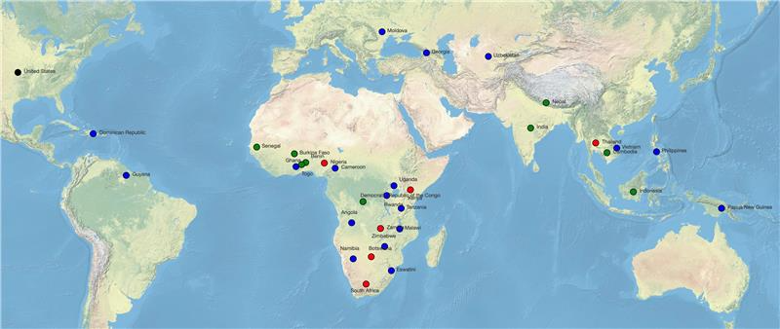
Past and Future Implementations
Notes:
This slide indicates all the countries and organizations that have participated in I-LEAD to date (as of June 2024). The blue dots represent countries that participated in one workshop, red dots, for those that have done at least 2, and the green dots are new and upcoming countries.

Slide 4
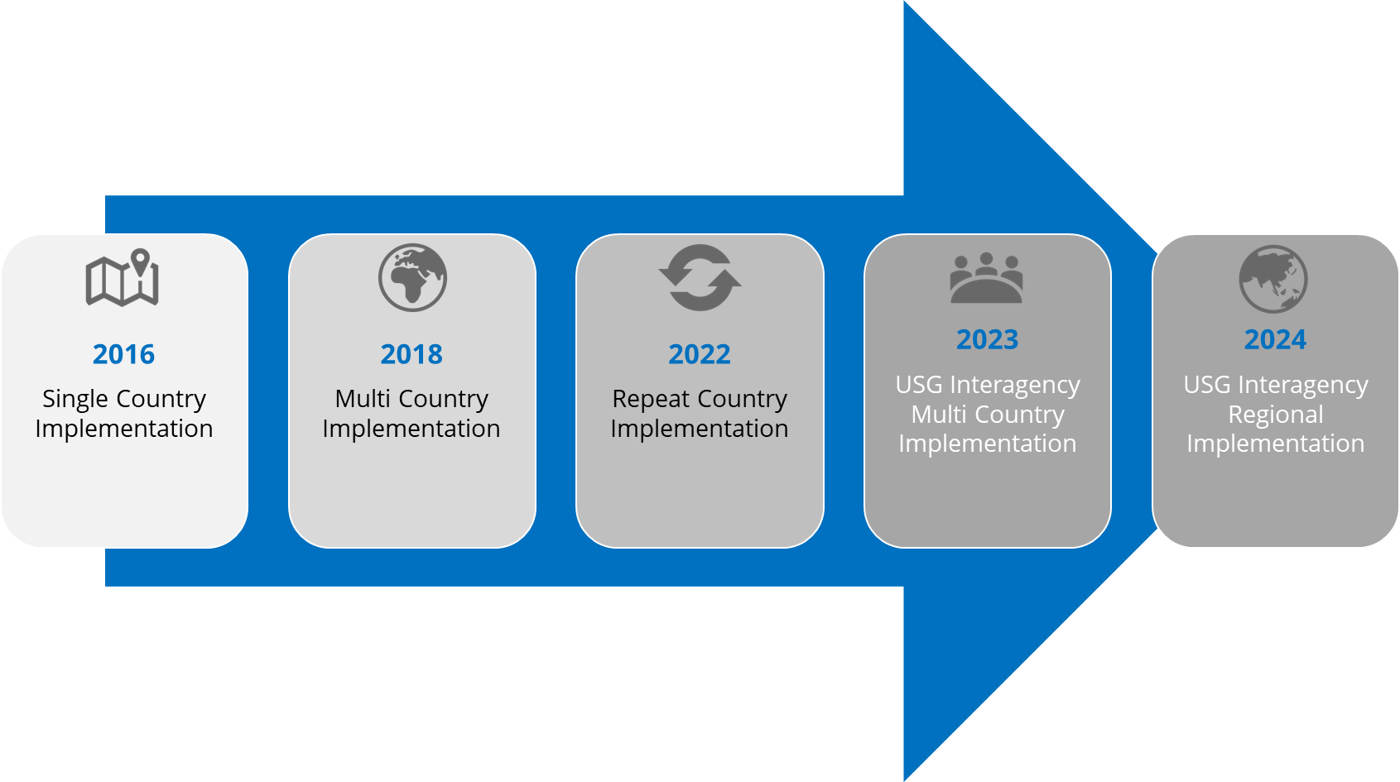
The Evolution
2025
Adaptable
I-LEAD
Notes:
2016 – CDC DGHT held initial I-LEAD for Thailand in Atlanta. 3 more single-country implementations.
2018 – began multi-country implementations
2022 – countries began attending I-LEAD multiple times. So far, 5 countries have attended more than once with 2 more planning to do so in 2024.
2023 – Began all-of-PEPFAR approach. Co-implementing with USAID and DOD
2024 – Held first regional I-LEAD in Istanbul for Georgia, Moldova and Uzbekistan, co implementing with WHO. 2-3 more regional I-LEADs planned in 2024. We are moving to a regional, interagency approach to align goals, strategies and resources across the digital health landscape.

Slide 5
What is it?
I-LEAD is an immersive, problem-solving set of interactive activities that engages participants in the generation of knowledge, and development of skills, needed to facilitate the successful implementation of an effective and sustainable national digital health ecosystem.
I-LEAD facilitates the initial phases of a multi-stakeholder, multi-sectoral and enterprise approach to design, implementation and ongoing operationalization of effective and sustainable national digital health systems.
I-LEAD will enhance participants’ capacity to develop strategies and approaches to address essential informatics problems facing their countries related to: 1) effective digital health governance and leadership; 2) development of a skilled informatics workforce, and 3) the meaningful design, development, implementation, and evaluation of health information systems.
Pre-workshop webinars + 5-day workshop consisting of a blend of activities, didactic content, and working sessions
Target audience: Individuals and institutions championing I-LEAD adoption, such as ministries of health or implementing partners
Notes:
First let me describe to you what I-LEAD is.
I-LEAD stands for “Intergovernmental Learning Exchange to Advance Data-Driven Decision-Making”. It is an event, a workshop, that enables MOHs, USG Agencies, HIS implementing partners & other stakeholders to come together to develop & execute informatics strategies around country’s HIS priorities & needs​.
(Can read the rest of the slide)

Slide 6
Reimagined approach: Adaptable I-LEAD
Adaptable I-LEAD is a comprehensive, customizable capacity strengthening package designed to support governments and implementing partners, including national and regional health informatics associations, in adopting and implementing the I-LEAD program independently.
It includes technical course content, an implementation guide to support the entire process, from initial engagement and workshop logistics to post-course evaluation, as well as facilitation guides aimed at strengthening the capacity of course facilitators.

Slide 7
Governing Principles
Training as an approach to problem solving
Beginning with the end in mind
Guide problem solving with frameworks and tools
Stakeholder needs drive workshop planning and implementation
Get the right people to solve the right problem
Encourage collaboration by design
Design workshop to build “muscle” memory
Adapt workshop to emergent needs
Notes:
I-LEAD implementation is governed by the following principles, in short this is how I-LEAD works:
We use training as an approach to problem solving. We want the participants to leave I-LEAD knowing they have begun to solve some of their problems, not just sit in classroom training. Think of training as the means, problem solving as the end.
Because of number 1, we design I-LEAD to help countries, you, solve your problems.
To achieve number 2 systematically, we share problem solving frameworks and tools – participants walk out of I-LEAD with the right mindset, skillset and toolset. These may not be comprehensive but enough to get started. And we make stakeholder needs the driver of I-LEAD planning and implementation.
With the right foundations, we now bring the right people and the right problems, number 5. Digital health transformation is like a big elephant – how do we swallow a big one?
That questions brings us to numbers 6, 7 and 8. We encourage collaboration by design, we build in activities to build muscle memory, and we continuously adapt, every day of the workshop to ensure emergent country needs are met.

Slide 8
Goal: Champion the advancement of digital health capacity and drive digital transformation across the health sector
Objectives:
Develop the mindset, skillset and toolset to collaboratively develop, design and implement digital health strategies aligned with country-specific strategic objectives
Address country priorities using knowledge of country gaps and lessons learned from the workshop in addressing country priorities
Incorporate lessons learned from other countries to improve strategy and implementation
Notes:
The essence of I-LEAD is to learn from and work with others and solve problems together using data.
In I-LEAD, we think big with our goal – champion the advancement of digital health capacity, and while building that capacity, drive digital transformation across the health sector.
But we also provide opportunities for participating countries to apply knowledge and practice skills needed to address the challenges related to this goal in a systematic way.
Here are some of the objectives.

Slide 9
Vision and Strategy
VSOT = Vision, Strategy, Operations and Tactics
I-LEAD focuses on Shared Vision and Strategy
Encourages discussion of challenging issues, difficult decisions, gap assessment results, national priorities, digital health strategies and roadmaps
Includes leaders and managers who will champion informatics in their own country (i.e., MoH, implementing partners)
Blends foundational and problem-based content, practice exercises and group work to create a workshop unique to each cohort
Mintzberg H (2018). Strategic Thinking as Seeing. URL: http://www.mintzberg.org/blog/strategic-thinking-as-seeing.
Notes:
To accomplish many things in digital health at the national level, we often aspire to have a shared vision, shared strategy, and then effective and efficient operations and tactics. In short, Vision, Strategy, Operations and Tactics or VSOT.
I-LEAD focuses mainly on vision and strategy but we also begin to think about how to execute those strategies systematically.
When solving informatics problems at the national level, we need to bring in the right problems to solve as well as the right people to solve them. Think of it as a cyclical process – the right people begin to discuss what would be the right problems to bring into the workshop. The right problems can be identified using different inputs – country's health systems strengthening and digital health strategies, what the right people know to be the right problems to solve, and an assessment of gaps in the three pillars of an informatics savvy health organization or ISHO. Gaps can be discovered within each of the three pillars – in governance, leadership and policy, in the skilled or competent workforce, and in effective information systems.
The right people can include leaders, managers, and partners who will champion working together to solve problems in their own countries.
I-LEAD shares foundational content needed for problem solving, activities to develop and enhance collaborative problem solving skills, and specific subject matter content related to country priorities.

Slide 10
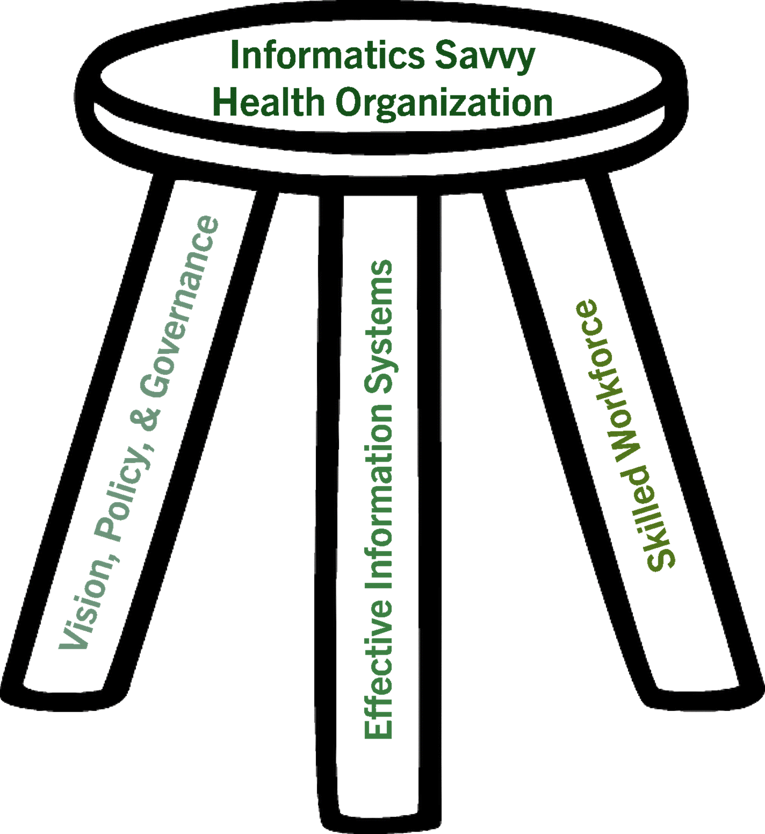
Framework and Tools
We will be utilizing a variety of strategic frameworks and tools to streamline our collaborative problem-solving efforts.
This will include 4 thinking hats:
Systems thinking
Design thinking
Strategic thinking
Evaluative thinking
ISHO strategic framework with three pillars:
Effective Information Systems
Skilled Workforce
Vision, Policy, and Governance
Source: (1) Laventure M, Brand B, Ross DA, Baker EL. Building an Informatics-Savvy Health Department: Part I, Vision and Core Strategies. Journal of Public Health Management Practice, 2014, 20(6), 667–669. (2) Laventure M, Brand B, Ross DA, Baker EL. Building an Informatics-Savvy Health Department Part II: Operations and Tactics. J Public Health Management Practice, 2014, 00(00), 1–4; (3) Puttkammer N, Vumbugwa P, Liyanaarachchige N, Wuhib T, Woldehanna D, Zagar T, Salih EMN, and Brand B. “Creating One Health, Integrated, and Informatics-Savvy Health Organizations” in Modernizing Global Health Security to Prevent, Detect, and Respond. McNabb SJN, Shaikh AF, and Haley CJ (Eds). Elseveir, October 2023. https://doi.org/10.1016/C2020-0-02797-0
Notes:
We came across frameworks and tools in the previous slide.
Some of them are the 4 thinking hats, and the informatics savvy health organization. We will dive into the 4 thinking hats during the workshop.
Another one is vision, strategy, operations and tactics or VSOT. I-LEAD focuses on V and S but you will learn also how to do the O and T during the latter part of the workshop.
We use the ISHO concept as a framing tool because of its simplicity - to become an informatics savvy health organization, we need to address gaps and increase maturity in three areas – will you remember them?

Slide 11
Adaptable I-LEAD: Implementation Phases
Phase 1: Inception & Adoption |
Month 1–2
Stakeholder engagement
Feasibility & needs analysis
Operationalize I-LEAD
Phase 2: Orientation & planning | Month 3–4
Align and adapt
Prepare for implementation (rapid ISHO, trainers, budget, logistics)
Phase 3: Implementation |
Month 5
Pre-I-LEAD (orientation, rapid ISHO assessment, workshop planning)
I-LEAD workshop delivery (didactic and problem solving)
Phase 4: Coach & Sustain | Month 6+
Implement action plans.
Long-term sustainability integration
Connect with GEEKS
Post-I-LEAD review & updates
Notes:
Implementation phases
I-LEAD's roadmap consists of four implementation phases. It details the steps to utilize I-LEAD in a Box which is a complete toolkit of guides, course materials, and resources designed to help you plan, organize, and deliver a full I-LEAD course.
Phase 1: Inception & Country Adoption (Month 1 - 2)
Phase 2: Orientation and Planning (Month 3 – 4)
Phase 3: Implementation of I-LEAD (Month 5)
Phase 4: Coach & Sustain (Month 6+)

Slide 12
3IG Strategic Framework
GEEKS Training
Engage stakeholders
Establish strategic partnerships
Train project teams
Value-oriented projects
Share lessons learned
Build relationships
Advanced I-LEAD, Tier 2
I4L Course
Digital health savvy leaders
Strategic decisions
Strategic investments
Health System Goals
Digital Health Maturity
Sustainable Quality Capacity
Health System Strengthening
Health Security
Implement projects
Engage Leadership
Shiriki Community
eHealth Leaders Forum
I-LEAD Workshop
Identify key strategies
Develop GEEKS projects
Build cross-country connections
ISHO Assessment
ISHO assessment
Country discussions
I-LEAD prep
Country digital health needs
Develop shared vision and strategies
Know gaps, partners, resources
3IG = I4L, ISHO, I-LEAD, GEEKS
Notes:
Zooming out a little bit, think of I-LEAD as one of the trees in the sea of trees in a forest.
There are other important related trees that contribute to the health and sustainability of this forest – to understand the relationship among these trees, we organize them as a series of cyclic or repeating actions, which when repeated enough can begin to contribute to systematically improving informatics problem solving skills among the health workforce while addressing a country’s top priorities, enabling a determined group of leaders to eat the big elephant piece by piece, increasing the scope and scale of digital health development, over time.
This is a cycle where you can start from any step.
CLICK Here we are starting from I-LEAD. We develop vision and strategy
CLICK translate them to GEEKS projects to get to operational and tactical levels, and generate results that contribute to piece by piece addressing a set of gaps identified during I-LEAD.
Then we feed the results back to national leadership to provide them with continuing assessments and situation, strategic awareness of what is being accomplished.
CLICK If leadership needs to increase awareness of digital health we make them more digital health savvy through Informatics for Leaders training or I4L. For example, in the EECA region, there will be a ministerial level I4L training taking place this week, implemented in collaboration with WHO Euro. Through I4L training we hope to have national leadership that can make or guide strategic digital health decisions and investments.
CLICK We implement an expedited ISHO assessment during I-LEAD to enable 2 things to happen: (1) enable key players in each country to begin to come together and (2) develop a shared and strategic awareness of the countries gaps, partners and resources. The ISHO assessments can also be conducted in a more rigorous manner that can potentially cover a wider swath of and administrative levels of a country, enabling us to truly know the gaps at a granular level and if implemented regularly progress or lack thereof over time. There are many other sources of gaps for I-LEAD but ISHO assessments are the kind collaboratively implemented by the participants themselves – think of this as collaborative sense-making.
And back to I-LEAD to continue to address those gaps. It is important to point out that although I-LEAD and by extension GEEKS have been primarily used to address HIS needs in PEPFAR, they were designed to be domain agnostic and can contribute to health systems strengthening using digital health interventions.
We call this framework, the triple I and G. 3IG.

Slide 13
Stakeholder Benefits
Stakeholder | Benefits
Government (Ministries / Departments of Health and other Ministries) | Cultivates change leaders capable of managing digital health investments to strengthen systems (e.g., UHC initiatives). Creates a shared vision and strategy across ministries to close digital health gaps. Embeds experiential learning directly into country and institutional contexts, ensuring relevance and immediate applicability. Builds inter-governmental innovation capacity and cultural competency for regional collaboration.
Implementing Partners | Improves dialogue and partnerships among ministries, government agencies, and implementing bodies.
Regional / National Health Informatics Networks | Strengthens communication channels and coordination mechanisms among regional and national informatics networks. Empowers networks to share best practices, harmonize standards, and scale successful digital health interventions.
Notes:
These are the intended benefits of the I-LEAD program to various stakeholders.
There will be many more stakeholders for I-LEAD but for this orientation, these are the ones at a very high level.

Slide 14
Country Delegation Preparation Activities “Homework”

Slide 15
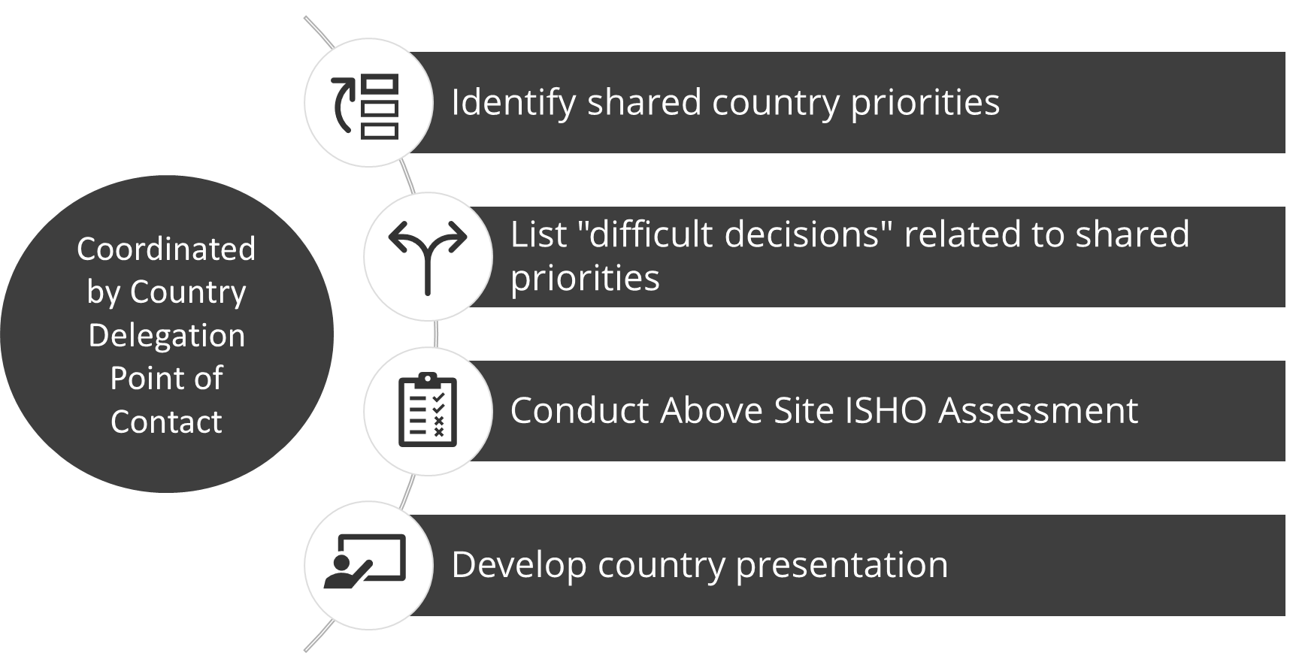
Country Homework Components

Slide 16
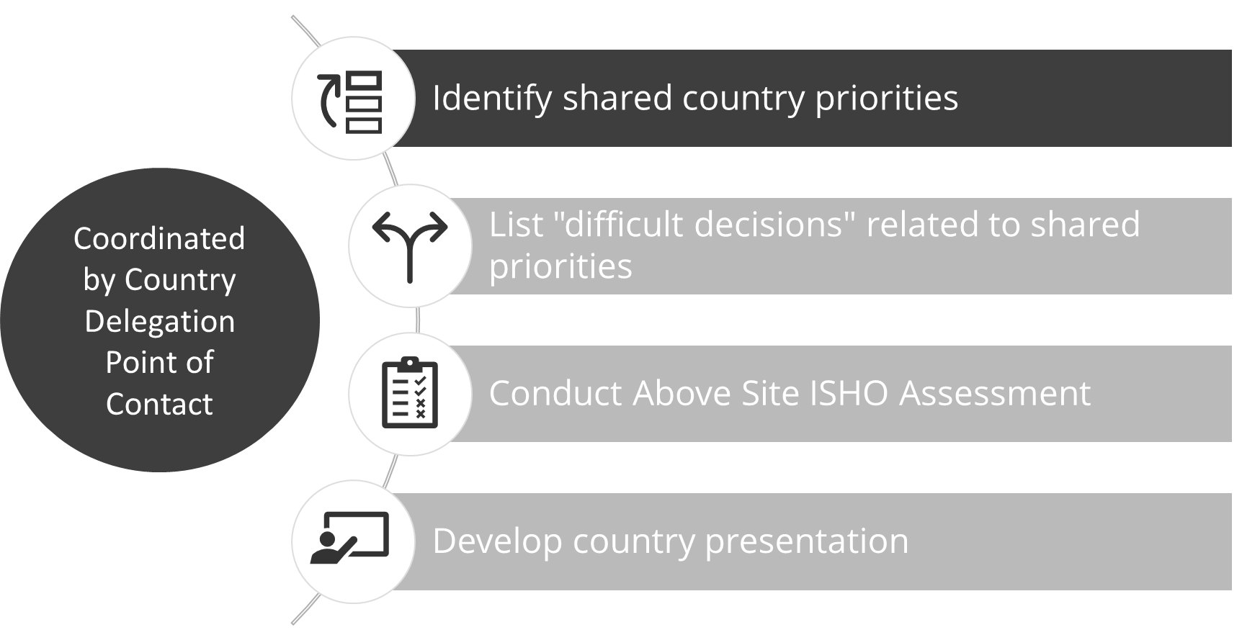

Slide 17
Identify Shared Country Priorities
Facilitate a discussion with all relevant stakeholders to identify your country’s shared priorities and assign them to an ISHO pillar
Pick from among the ISHO core essential elements (CEEs) or list priority issues that are not included in the CEEs​
From these priority issues, select one or two that your delegation feels are the most impactful and feasible to address collaboratively during the I-LEAD workshop week

Slide 18
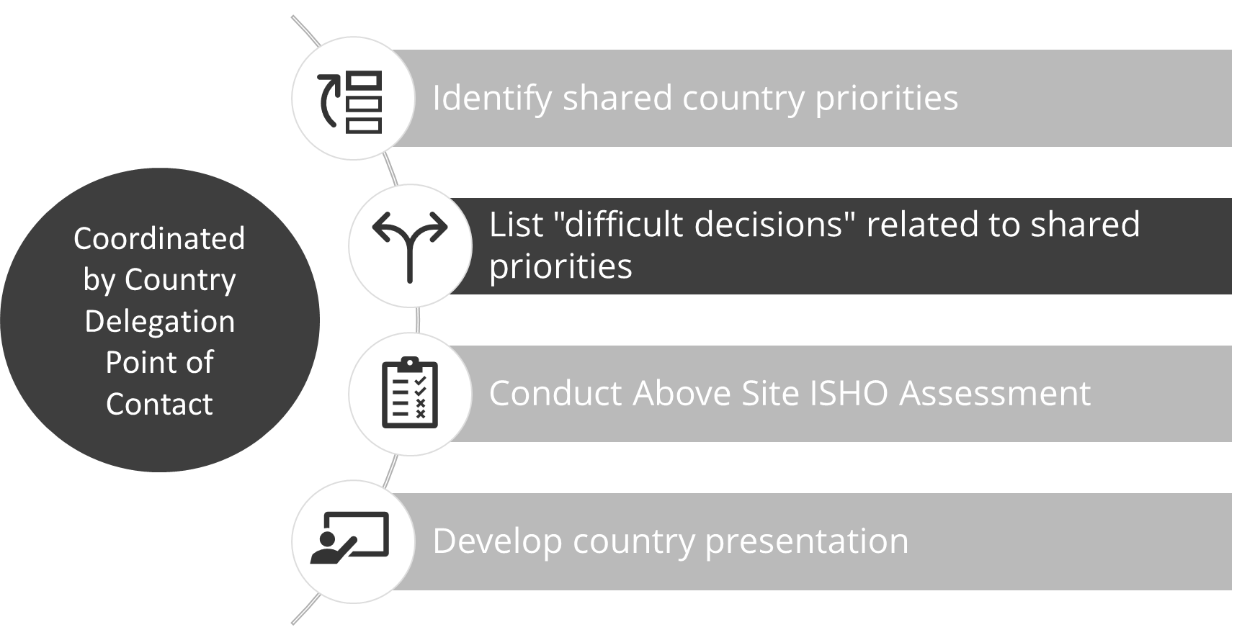

Slide 19
Brainstorming on Difficult Decisions
For your selected priority issue(s), think about the goal you are trying to reach and difficult decisions you will need to resolve to reach the goal
Participants should brainstorm a few “difficult decisions” for each priority issue you plan to work on during I-LEAD
Difficult decisions require an action, and they are difficult because there are several possible actions which will need to be analyzed before a decision is made
For the brainstorm of “difficult decisions”, start by asking yourselves - “In order to make progress on this priority issue, what decisions do we need to make?”
Your list of “difficult decisions” does not need to be final or perfect; treat it as an initial brainstorm; your country team will have time to refine your analysis and ideas during I-LEAD

Slide 20
Brainstorming on Difficult Decisions: Examples
Priority Issue | Difficult Decision
Vision, Policy, and Governance: Health information systems do not use a common standard for identifying health facilities, so it is difficult to exchange data or link data from different sources | What standard should we adopt?
Skilled Workforce: Training for health workers to use digital HIS is not routinely available | How do we ensure training is available for health workers in our country?
Effective Information systems: The national integrated disease surveillance system, which uses a mix of digital and manual processes for capturing data, suffers from late and incomplete reporting | What investments should we make in digitization to improve completeness and timeliness?
Notes:
Here are some examples of difficult decisions.

Slide 21
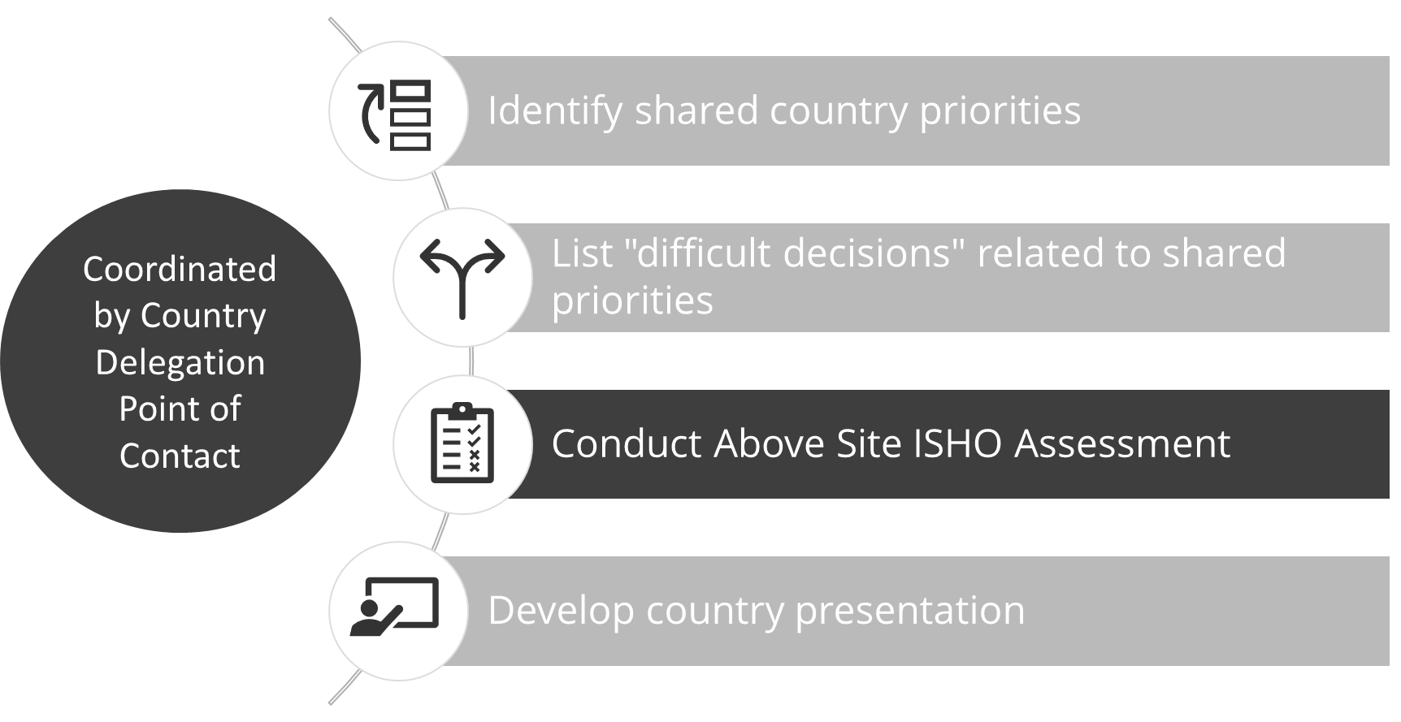

Slide 22
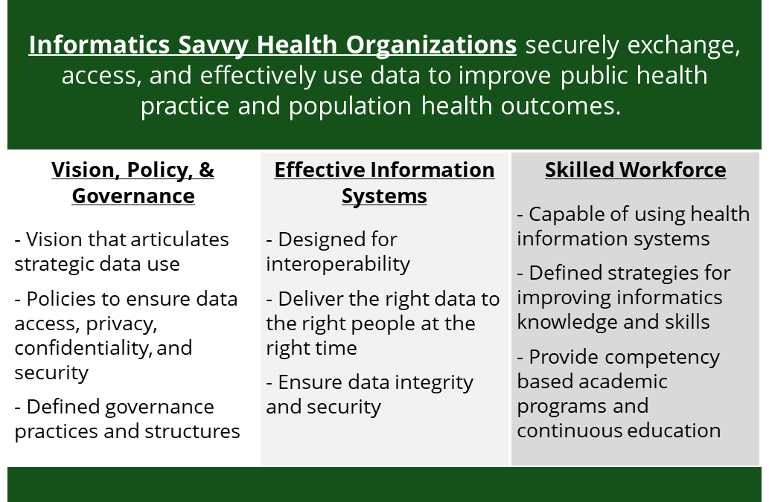
Using Above Site ISHO Assessment for
Notes:
One way to identify shared priorities across organizations in your country is to conduct an above site ISHO assessment.
The above assessment provides a structured way to identify and come to a consensus on areas of need or potential growth.

Slide 23
Conducting Above Site ISHO for
Identify stakeholders (MOH, NPHI, etc.)
Who has the information needed to complete the ISHO assessment?
MOH and other Ministries SMEs
Relevant implementing partners
Initiate Introductory Discussion with Stakeholders
Select a coordinator to manage the assessment process & logistics (venue/virtual meeting, invitations, etc.)
Provide the tool to stakeholders to review and prepare information
Agree on the process for expedited assessment
Meeting plan and the notetaking arrangements
Initiate Introductory Discussion with Stakeholders
Process
Individual assessment (typically 1 hour) – participants review and score individually
Group assessment and consensus-building activity (typically 2-3 hours)
Discuss and agree on the final score
Identify key discussion points and document them for the discussion during I-LEAD
Identify stakeholders
Agree on the scores and the key discussion points
Collaboratively formulate priorities (Typically 1-2 hours)
Notes:
Here’s a typical process for conducting an above ISHO assessment quickly for the purpose of I-LEAD. Once your delegation agrees upon a plan, it usually takes between 4-6 hours to complete.

Slide 24
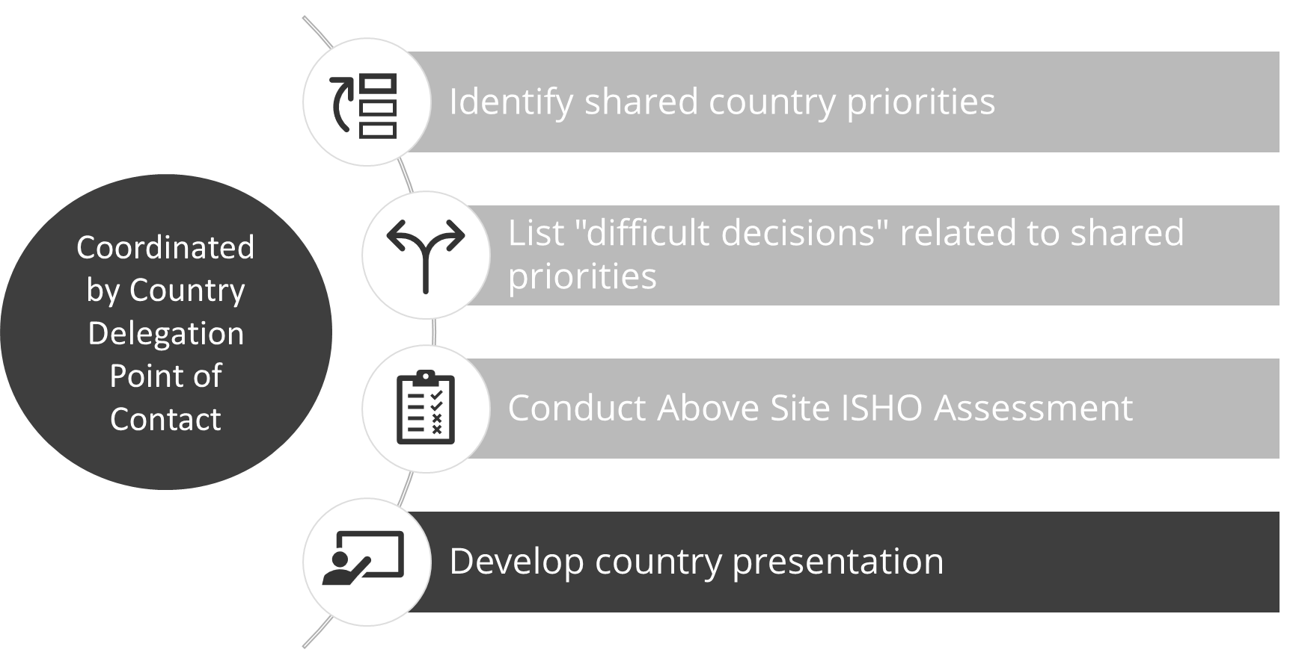

Slide 25
Country Presentations
On Day 5 of I-LEAD, participants will give a country presentation, sharing the priority country issues identified and the plan developed to address them
Before I-LEAD - Prepare the initial draft of your country presentation covering:
  Background on your country
  Overview of strengths and challenges across 3 ISHO pillars in your country
  Priority issues (1-2) you picked, why you picked these, and your country’s desired goal for resolving the issue
  Difficult decisions your country may need to make to achieve your goals
During I-LEAD - Develop the strategy and plans to address the priority issues identified and enhance your presentation with these for final delivery

Slide 26
Next Steps
Stakeholder Sensitization - Please plan to hold a meeting with your country’s I-LEAD stakeholders to share this presentation and orient them to I-LEAD and the expectations
Participant Identification - Work with stakeholders to identify individuals suited for I-LEAD participation and submit the list to I-LEAD organizers
Participant Information Form - In the next couple of months, identified participants will receive a Google form to fill out that allows you to provide a brief self-written bio to introduce yourself to other participants (Note: by sending your bio sketches and photo, you consent to us sharing them)
ISHO Assessment - An additional session will be held to provide training on use of the ISHO Above Site Assessment Tool, so please be on the lookout for an invitation
Notes:
Emphasize this is only for selected participants

Slide 27
Logistics
Dates (proposed) and Daily Schedule
  [add info]
Logistics Point of Contact
  [add info]

Slide 28
QQu
Thank you!
We welcome your questions and reflections!

