Slide 1
Project Management Training
Notes:
PREPARATION:
You will need large post-it notes, pens and sweets (as "prizes" for some activities).
2. You will need to print out the case study printouts and the printouts for all the activities listed below – one of each for each person:
Slide 27 Fill in the gaps
Slide 38 Mini board game
Slide 58 Good governance role play (user persona cards)
Slide 93 Risk Matrix
Slide 118 Software Requirements checklist
Slide 122 Hardware and Infrastructure checklist
3. You will need to set up Mentimeter for the Quick start survey and for the Key takeaways for each of the 8 modules.
4. You will need to print out the post course evaluation sheets.
Suggest that you provide the course participants with an electronic version of the PDFs of the slide deck , the 4 CDC document templates (Word) and the HIS-PM Toolkit Tool Pack (spreadsheet).

Slide 2
Welcome
// TRAINERS: Please add the details of the speakers who will welcome participants once these have been agreed. Suggest that you also provide a time limit for the welcome speeches. //

Slide 3
Admin
// TRAINERS: Please add. Things to include:
  Bathroom location
  Emergency exits
  Starting and finishing times
  Food and accommodations
  Per diem information
  Etc.//

Slide 4

Ice breaker
(see speaker notes)
Image by brgfx at Freepic
Notes:
Step 1: ask all individuals participants to write down the name of an item. Something physical.
Step 3: split participants into groups of 4 or 5
Step 4: describe scenario: your team is stranded on a deserted island. Device and share how you are going to use the items you have in your group to get off the island.

Slide 5
Course structure
Day 1:
  Module 00 Introduction to terms and concepts
  Module 01 Lifecycles
Day 2:
  Module 02 Planning for success
  Module 04 Monitoring & Evaluation (M&E)
Day 3:
  Module 06 Design & develop phase
Day 4:
  Module 07 Test & implement phase
Day 5:
  Module 03 Compliance
  Module 08 Project transition and closeout

Slide 6

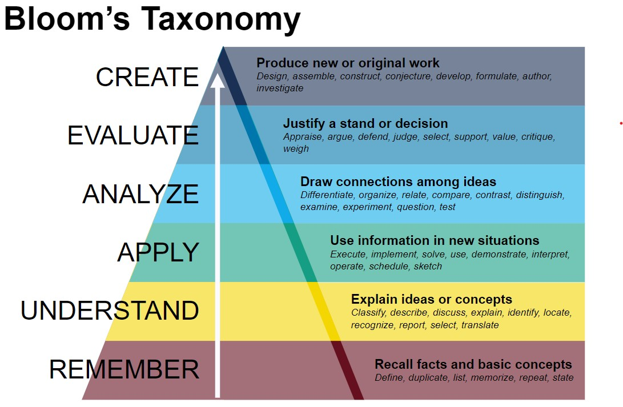
Core competencies
Understand the core functions of successful project management, the software development life cycle, the implementation lifecycle, and the project management lifecycle.
Apply project management processes and techniques throughout the project lifecycle
Analyze governance, planning, and communications requirements for appropriate use throughout the project management process.
Evaluate and justify project management decisions throughout the project management lifecycle.
Create and curate key project management documentation (example templates provided)

Slide 7
Module 00
Terms and concepts
Learning outcomes:
Describe the value of strong project management in successful project delivery
Describe the knowledge areas and core functions of project management
Identify and describe three different types of digital health projects
Describe the difference between digitization and digital transformation

Slide 8
Module 00: Quick starting survey
Instructions:
Using the QR code below to access the quick course start survey.
<<Add Mentimeter poll QR code here – Trainers will need to generate on the day>>
The aim of this survey is to give us some quick, first-glance information about your current level of knowledge about project management core concepts, theory, and practice.
Notes:
Survey questions to add to the Mentimeter poll:
What is your job title?
Have you ever received project management training before?
How would you rate your knowledge of general project management?
(Expert, High, Medum, Low)
Have you been involved in managing a digital health project before?
If yes, how many years have you been managing digital health projects?
How would you rate your knowledge of digital health project management? (Expert, High, Medum, Low)
What area of digital health are you most familiar with?
(Digital health strategy and policy, Software development, System implementation, System support; System monitoring and evaluation; None of the above; Other)
If other, please specify

Slide 9
Definition of project management
Project management is the application of knowledge, skills, tools, and techniques to project activities to meet project requirements. It’s the practice of planning, organizing, and executing the tasks needed to turn an idea into a tangible product, service, or deliverable.
Ref: Project Management Institute (pmi.org)

Slide 10
Why is strong project management important?
Notes:
Say: to the group 'why is strong project management important?
Do: Encourage members of the group to share their thoughts around this question.
Say: Thank you for your thoughts. In this session we are going to look more at the core terms and concepts that are central to strong porject management. This will give us a strong base on which to build the rest of the course.

Slide 11
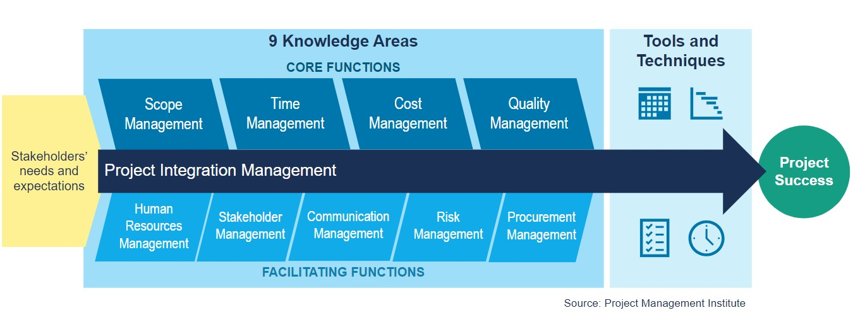
Project Management Knowledge Areas
Notes:
Say: project management can be seen as the place where five core functions for any project be completed successfully:
Scope management
Time management
Cost management
Quality management
Say: All of these functions need to be managed through the project management process, using relevant tools in order for a project to be completed successfully
Say: a project manager can successfully manage these functions by facilitating collaboration and activities of the following facilitation functions:
Stakeholder management
Human Resource management
Communication management
Risk management and procurement management

Slide 12
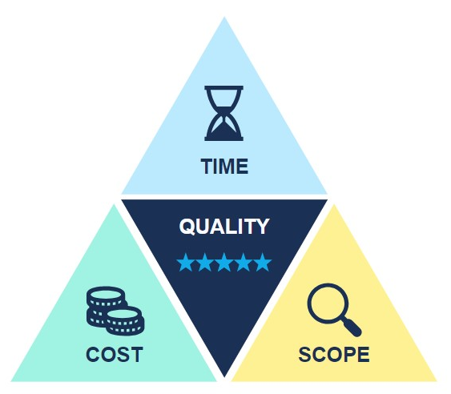
The Iron Triangle
Notes:
The Iron triangle is a way of describing and understanding the relationship between time, scope, cost and quality. It is also sometimes called the Triple Constraint.
As you can see from this diagram if you change the size of either the project time, cost, or scope sides of the triangle, it has an impact on the other two sides. This means, you cannot increase the scope of the projec (i.e. do more ) if you do not also increase the budget available, or increase the time available, or both. Similarly, if you want to reduce the time, then you will have to either increase the budget (i.e. add more people to get the work done faster) or reduce the scope (do less of the planned work) or both. If you need to reduce the budget, you will have to reduce the scope or change the timelines, or both.
Changing any of these factors also has an impact on the quality of what will be delivered, and that is why quality is shown in the centre.
This diagram highlights that once the project has an agreed budget, timeline and scope it is impossible to make changes on one aspect without having to consider what changes must be made to the other aspects.

Slide 13
How does the iron triangle relate to core functions
Scope Management:
  Moving the goal post / changing the definition of success
    Example: if you have a digital health tool implementation and your provider informs you that they can no longer produce the user manual, and you switch this responsibility to your team, either the time or cost for additional staff time must increase to avoid issues with quality of capacity strengthening and implementation.
Time management:
  Scheduling and delays
    Example: heavy rains delay deployment by 2 weeks of the 5 weeks assigned to deployment. In order to deploy to a high quality, you must either increase the cost to staff more teams to deploy in 3 weeks or push out the end date in order to still have 5 weeks for deployment.
Notes:
Say: what do we mean when we're talking about core functions of project management?
Scope management is the process of demarcating and managing the process of defining (setting definition of success) and redefining the scope of a project. For example:

Slide 14
How does the iron triangle relate to core functions
Cost management:
  Developing and monitoring
    Example: the local currency suddenly strengthens dramatically. As a result, there is significantly less funding available for your activities in Q3 than planned. You must either reduce the scope to cover what is achievable or push activities out into Q4 in the hope that the USD strengthens and your available funding increases.
Quality Management:
  Defining what quality means for your project and monitoring quality of deliverables
    Example: if you want higher-quality devices, you are going to have to increase the cost of the project or decrease the scope of the project (fewer devices) to free up funds to cover more high-quality devices
    Example: if you want a software system that is suitable for deployment in a live environment, this will require more resources and cost more than if you are building a quick prototype application to do some field testing.

Slide 15
What do we mean by facilitating functions
Facilitating functions are sets of activities that can be done to facilitate the management of the core functions: These are:
  Stakeholder management
  Human resource management
  Communication management
  Risk management
  Procurement management (specialized and not focused on in this training)
Project integration management refers to how all the other knowledge areas (functions) are integrated to manage the project effectively.
Notes:
Trainers: please emphasize that this course does not go into any detail on procurement management as it is a specialized area and varies depending on context.

Slide 16
Stakeholder management
This is one of the core facilitating functions of a project manager's role. Stakeholder management includes:
  Curating a stakeholder list
  Coordinating communications with stakeholders
    Formal reports, information meeting updates etc.
  Facilitating discussions between stakeholders and the team
    Online and face-to-face forums for project governance discussions and decisions
More detailed information about stakeholder management will follow in Module 2 of this training

Slide 17
Human Resource (HR) management
This is one of the core facilitating functions of a project manager's role. HR management includes:
  Setting job descriptions and team recruitment
  Administrative management of staff
    i.e. leave applications
  Managing staff performance against key performance indicators set in the job description
There are as many ways to manage people as there are people. Two schools of thought:
  Micromanagement - focused on how someone's time is spent every day. It's time-intensive for the manager and often not very successful as workers don't feel trusted and valued.
  Deliverables-based management - worry less about what people’s activities are every day and more about whether they are completing their deliverables on time and to a high quality.

Slide 18
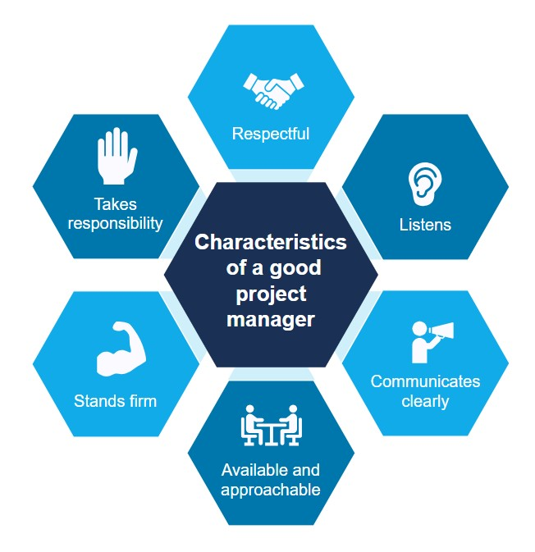
What makes a good project manager

Slide 19
Communications management
Another core facilitating function of a project manager's role is communication management. This includes:
  Developing and implementing a communications plan
  Selecting types, tools, and timelines for project communications
  Selecting communications types for different stakeholders
  Drafting or checking communications materials
More detailed information about communications management will follow in Module 2 of this training

Slide 20
Risk management
Being aware of and planning for risks to your project's success is a core facilitating function of a project manager. This includes:
  Internal project risks – within the control of the project team/stakeholders.
  External project risks – outside the control of the project team/stakeholders.
Knowing exactly what is in and out of scope of your project and the spheres of influence of your stakeholders is an important part of risk management.
More detailed information about risk management will follow in Module 2 of this training

Slide 21
Definition of digital health
Digital health is the systematic application of information and communications technologies, computer science, and data to support informed decision-making by individuals, the health workforce, and health systems, to strengthen resilience to disease and improve health and wellness.
"Taken from the Digital Health: Planning National Systems course developed by United States Agency for International Development (USAID), Digital Square, and TechChange, based on content compiled by the World Health Organization (WHO) and the International Telecommunications Union (ITU) under Creative Commons Attribution-ShareAlike 4.0 International (CC BY-SA 4.0) license."

Slide 22
Digital health as a component of health systems strengthening
SYSTEM BUILDING BLOCKS
OVERALL GOALS / OUTCOMES
SERVICE DELIVERY
HEALTH WORKFORCE
ACCESS COVERAGE
IMPROVED HEALTH (LEVEL AND EQUITY)
HEALTH INFORMATION SYSTEMS
RESPONSIVENESS
ACCESS TO ESSENTIAL MEDICINES
SOCIAL & FINANCIAL RISK PROTECTION
QUALITY SAFETY
FINANCING
IMPROVED EFFICIENCY
LEADERSHIP / GOVERNANCE
THE SIX BUILDING BLOCKS OF A HEALTH SYSTEM: AIMS AND DESIRABLE ATTRIBUTES
WHO, 2010, MONITORING THE BUILDING BLOCKS OF HEALTH SYSTEMS:
A HANDBOOK OF INDICATORS AND THEIR MEASUREMENT STRATEGIES
Notes:
Link digital health term to health information system term in the diagram above
Health information systems as one of six building blocks for health system strengthening (as depicted on the right)
In order to achieve the goals of HIS and HSS HIS need to includes of other sectors their plan governance and delivery [e.g. MOF, MoTAI]
Modern focus on patient centered care

Slide 23
Digitization vs Digital Transformation
Digitization
The process of converting existing processes and tools to digital form
Digital Transformation
The strategic use of digital technologies, data insights, and a supportive enabling environment to strengthen health systems by increasing their efficiency and improving the reach, quality, and affordability of health services, thereby contributing to the achievement of health equity.

Slide 24
Characteristics of the four types of digital health implementation projects
Implementation of existing software
Adapting software
Configuration of software for implementation
Developing new software / major new modules from scratch
Notes:
TRAINERS: If you have examples of these types of projects that the participants will be familiar with in the local context please describe here.

Slide 25
Reflecting on the four types of digital health project:
What types of projects are you currently involved in?
What types of projects will you be involved in the future?

Slide 26
Activity: fill in the gaps
The following diagram is missing content. It is your job to fill in the gaps.
This activity will be timed. The winners will be:
The participant who completes the exercise first
The participant who completes the exercise most accurately

Slide 27




9 Knowledge Areas
Time Management
Stakeholders’ needs and expectations
Project Integration Management
Project Success
Human Resources Management
Communication Management
Procurement Management
Source: Project Management Institute

Slide 28
Module 00: Quick survey
Mentimeter poll
  What are your top 3 take aways from this session
Notes:
TRAINERS: you will need to set up this poll in advance of the session

Slide 29
Module 00
Terms and concepts
Key terms and take aways:
Managing scope, time, cost, and quality are the four key functions of a project manager
Project managers must master the following knowledge areas in order to successfully deliver their projects:
There are 4 key types of digital health projects
  Implementation of existing software
  Adapting software
  Configuration of software for implementation
  Developing new software / major new modules from scratch
Human Resources Management
Stakeholder
Management
Communication Management
Risk Management
Procurement Management

Slide 30
Module 01
Software development, implementation, and project lifecycles
Learning outcomes
Participants can describe the software development and implementation lifecycles and the rationale for each step
Participants can identify the software development and implementation lifecycles and project lifecycle, and understand how these are interrelated.

Slide 31
Software development life cycle (SDLC)
Analyze (requirements gathering)
Design
Develop
Test
Deploy
Maintain
1
Analyze
3
Develop
4
Test
5
Deploy
2
Design
6
Maintain
Software
Development
Lifecycle
Notes:
Whatever type of software development methodology you follow the processes will still include the same SDLC steps
Analyze and gather requirement,
Design the application
Develop the application i.e. coding
Test the application
Deploy in the production environment
Maintain the application going forward.
However, there are some differences in the way in which these steps happen depending on the type of methodologies used by development teams.

Slide 32
Software development:
Waterfall vs. Agile methods
Requirements
Design
Build
Test
Review
Analysis
Design
Coding/ implementation
Testing
Operation/ deployment
Analyze & Plan
Launch
Maintenance
Linear and sequential vs. Iterative cycles
Notes:
The Waterfall method is a traditional methodology that is linear with sequential steps : it requires formal sign-off at each step. One of the downsides of this approach is that it is inflexible and does not accommodate changes well.
The various Agile methodologies were developed in response to this and aim to be very responsive to changing requirements and user feedback whilst also managing the scope in a structured way. The agile approach is iterative and requires feedback from user testing throughout the development cycle.
Waterfall method works well when there are:
fixed requirements;
ample resources;
an established timeline;
well-understood technology; and
unlikely to require significant changes.
However the waterfall method does not work so well there is a need for revision and flexibility.
Design isn't adaptive; when a flaw is found, the entire process often needs to start over.
Method doesn't incorporate midprocess user or client feedback, and so does not makes changes based on results.
Waterfall model delays testing until the end of the development lifecycle.
It doesn't consider error correction.
The methodology doesn't handle requests for changes, scope adjustments and updates well.
Waterfall doesn't let processes overlap for simultaneous work on different phases, reducing overall efficiency.
No working product is available until the later stages of the project lifecycle.
So Waterfall isn't ideal for complex, high-risk ongoing projects because:
:
Requirements can become outdated before development even begins.
New technologies can force changes to even the best designs.
Revised stakeholder priorities can shift development timelines and efforts.
Agile methods
Agile encourages testing and validation earlier in the software development lifecycle.
Continuous delivery in Agile is consistent with the DevOps' continuous deployment model.
The Agile feedback loop more directly involves stakeholders in the development process.
Agile makes it easier to adapt to changing requirements midway through development.
Agile projects can start earlier because development doesn't depend on complete requirements and analysis cycles.

Slide 33
Software development:
Blended approach using waterfall and agile
Hybrid Waterfall and Agile Approach
Waterfall Phases
Agile Sprints
Scrum
Scrum
Scrum
Planning
Initial Requirements Analysis & Design
Initial Project Backlog
&
Sprint Plan
Iteration Planning
Update Project Backlog
&
Define Iteration Backlog
Design
Review Working Software
Quality Assurance (QA)
Deployment
Build
Scrum
Test
Review Process
Partial UAT
Daily Meetings
Notes:
Remember that whatever software development methodology is followed the same things need to happen i.e. analyze and define requirements, design, develop, test, deploy and maintain. However, there are some differences in the way in which these steps happen.
In practice, most software projects use a combination of both Agile and Waterfall. We call this a blended or hybrid approach.
For digital health projects working with many stakeholders and governments, there is a tendency to perform upfront requirements gathering and analysis upfront.
The scope and budget is well-defined and budgets and it is vital to get sign-off from various stakeholders. That's very Waterfall in nature.
Then, when development begins, the development teams use an Agile process to do iterative development. This allows for user feedback during the process and changes to the plan are allowed. This is the essence of agility
Blending the preferred traits of both waterfall and agile development methodologies leads to to decreased risk and increased stakeholder feedback and impact throughout the project.
The model leverages five phases - planning and initial requirements and design, iterative agile sprints, and quality assurance (QA) and deployment.
The traditional waterfall development and test phases are replaced by agile sprints. Each sprint includes activities for additional design elaboration, development, and testing, including some user testing. Using a hybrid approach allows for early and frequent feedback from the client/users which is critical for confirming the solution throughout the project - verses waiting until the final QA phase.
REF: IMAGE: https://www.pmi.org/learning/library/outcomes-hybrid-approach-waterfall-environment-5839

Slide 34
PM checklist: SDLC
There is understanding and agreement amongst all stakeholders about which software development approach will work best for the project. (typically a blended waterfall + agile approach).
All the high-level activities throughout the SDLC are represented in the project management plan and Gantt chart.
The right people with the right skill-sets have been identified for the activities planned.
All stakeholders understand the level of effort and commitment needed to participate effectively in the requirements gathering, design, and software testing phases.
Notes:
A blended project that combines some elements of waterfall (well-scoped, sign-off gates) and agile methods (iterative feedback cycles) is generally the best approach for digital health information systems.
A blended analysis and design phase that uses both of the business analysis and human centred design methods is generally considered to be the best approach as it more comprehensive and reflects a more holistic viewpoint.
From the project manager's perspective it is important to understand what resources are available, what skills sets are available, and then plan to be able to achieve the best blended approach within your project constraints.
For a project manager it is important to:

Slide 35

Implementation life cycle
Software development lifecycle
Project Handover
Production version ready for deployment
Deployment
Installation qualification
Capacity strengthening of implementation team
Standard Operating Procedure (SOP) review and workflow integration
Operational qualification
User training
Performance qualification
GO-LIVE
Mentorship and support
System monitoring and evaluation
Implementation begins when User Acceptance Testing (UAT) is complete and authorization to proceed has been given.
Implementation ends when the handover process to the system recipients has been completed.
Core activities of the implementation process are:
Pre go-live
  Deployment, Validation, Training
Go-Live
Post go-Live
  Support, System monitoring and evaluation
Notes:
Implementation is a term that is sometimes used in different ways. For this course we define " Implementation" as:
Implementation begins when UAT is complete and authorization to proceed to implement has been given.
Implementation ends when the handover process to the system recipients has been completed.
There are typically 3 phases and the core activities are:
Pre-go live
Deployment, Validation, Training
Go Live
When the users start using the new software system as part of their normal operations.
Post Go-Live
Support, System monitoring and evaluation

Slide 36
Project management life-cycle
Initiate
Plan
Execute
Monitor & maintain
Close
A project is finite: it has a clear beginning and end.
The five phases of a project are:
Initiate
Plan
Execute
Monitor and maintain
Closeout
Notes:
By definition, a project has a clear beginning and an end, particularly in the digital health domain where projects are typically donor-funded and start when the agreement/contract has been signed and are closed out at the end of the agreement/contract period.
The project management life cycle – no matter what type of project it is - consists of five distinct phases:
Initiate – start the project
Plan – refine the objectives and plan the activities and what resources will be needed to carry out the activities
Execute - carry out all the project activities that have been planned
Monitor and maintain – monitor the activities as the project progresses to keep it on track and adjust as needed if and when changes occur
closeout - formally end the project.

Slide 37
Project management life-cycle
Initiate
Plan
Execute
Monitor & maintain
Close
A digital health project may include:
Software development (which typically uses a blended approach to design, build, and test the software)
OR it may include the implementation of the software
OR it may include both the software development and implementation
OR it may not include either - e.g., a landscape analysis across many countries delivering a final report; research project, etc.
Notes:
Remember, a project has a beginning and an end. It may include software development or implementation of the software or both or none.

Slide 38
Activity: mini board game
Divide into groups for 4 or 5
Take the provided pieces of the mini board game and create the software and project lifecycles correctly without looking at the previous slides
This is a timed activity you have 5 mins:
  Winner 1: quickest finished
  Winner 2: most accurate

Slide 39
Module 01: Quick survey
Mentimeter poll
  What are your top 3 take aways from this session

Slide 40
Module 01
Software development, implementation, and project lifecycles
Key Takeaways
The software development lifecycle, the implementation lifecycle, and the project lifecycle are three distinct lifecycles that overlap.
Most digital health projects use a blended(hybrid) approach that combines the best aspects of waterfall and agile methods to design, develop, and test software.
A project has a beginning and an end. It may include software development or implementation of the software, or both, or none.

Slide 41
Module 02
Planning for success
Learning outcomes
Participants can describe the value of defining project success, when this is done, and the process undertaken to do this.
Participants can describe the key features of a good project governance structure and governance process, as well as their value.
Participants can list key challenges with facilitating multi-stakeholder discussions.
Participants can describe the difference between a project plan and a Gantt chart and identify the key differences between them.
Participants can define key cost categories for digital health project budgets and use the template provided for high level budgeting.
Participants can identify and evaluate different communication types and tools.
Participants can describe the key differences between change management in implementations and change management at a project management level.

Slide 42
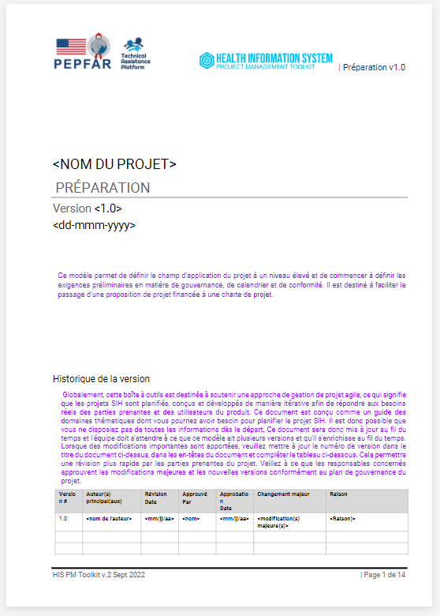
Preparation template
Use this template to outline the high-level project scope and begin getting preliminary governance, schedule and compliance requirements outlined. It is intended to support the transition from a funded project proposal towards a Project Charter.
Notes:
In order to understand if and how a digital health intervention can effectively address a health system challenge, we must first understand the current state. There are two effective and complementary ways to do this:
Analytical Development (aka Business Analysis) (Our context = the "Business" of delivering healthcare )
Human-Centered Design
The Business Analysis method looks at the way in which "business" is currently conducted: what current processes in place, which roles/type of people work in the current process and what do they do, what data collected, what data is used and needed. Using this information to analyze where there are barriers and bottlenecks that exist within these processes that the digital health interventions could address. The role that typically carries out this work is known as Buisness Analyst or a Business Systems Analyst. The type of outputs of this process that you may be familiar with are Business Process Maps, System and user requirements specifications, concept diagrams, etc.
Human-centered design method looks at:
Problem definition
Critical reflection
Field research
Prototyping (Experimental solutions)
Continous learning
The role that typically carries out this work is known as human-centred designer, HCD practitioner, user interface designer (UI), User Experience (UX) designer, or a design researcher.
.The type of outputs of this process that you may be familiar with are User personas, user journeys, prototypes, etc.
Although these two approaches look very different there are in fact a number of overlaps and they complement each other very well. A blended approach that uses both of these methods is generally considered to be the best approach as it more comprehensive and reflects a more holistic viewpoint.

Slide 43
Defining success
This is project specific and tied to the type of digital health implementation projects you are managing
The definition of success will be different for proof of concept vs pilot vs health change interventions
  Proof of concept: enough data from the field testing to evaluate that the wearable technology is practical for use in the field (easy transfer of data, robust enough for people to wear)
  Proof of concept: data from field testing to see if an innovative digital platform can overcome the power and connectivity challenges in last-mile settings
  Pilot: implementation of a community health worker tool in a specific context to gather information to refine the model for implementation, to prepare for the broader rollout of the tool.
  Health change: Increase incidence of identification and referral of TB patients to district level health facilities for MDR testing and treatment

Slide 44
Activity:
Pick one of the following and write a definition of project success for it:
  Proof of concept: enough data from the field testing to evaluate that the wearable technology is practical for use in the field (easy transfer of data, robust enough for people to wear)
  Proof of concept: data from field testing to see if an innovative digital platform can overcome the power and connectivity challenges in last-mile settings
  Pilot: implementation of a community health worker tool in a specific context to gather information to refine the model for implementation, to prepare for the broader rollout of the tool.
  Health change: increase incidence of identification and referral of TB patients to district level health facilities for MDR testing and treatment

Slide 45
Possible answer
Proof of concept:
  enough data from the field testing to evaluate that the wearable technology is practical for use in the field (easy transfer of data, robust enough for people to wear)
Definition of success:
  completed field testing run for 9 month in 5 facilities in Goma district to produce data to evaluate whether a device consistently works in a field setting.

Slide 46
Why is documentation key to successful project management?
Documentation is a critical part of the planning/project management process:
It's a record of agreement
A way of communicating to all stakeholders
Helps with onboarding people onto a project
Helps to identify gaps and areas of misalignment in your planning
Clarifies pathways to change and how to measure achievement of definition of success

Slide 47
The Project Charter
Is the initial document created to help define the project and gain agreement amongst stakeholders during the project initiation phase.
Core components of the project charter are:
  Stakeholder roles and responsibilities definition and project governance structure.
  Stakeholder communications plan
  Project change management process
  Scope and main deliverables definition
  High-level deliverables schedule
  High-level budget
Initiate
Plan
Execute
Monitor & maintain
Close

Slide 48
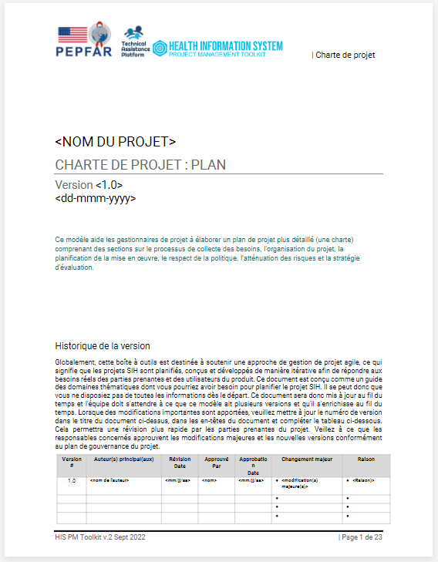
CDC TAP: Project Charter template
CDC TAP has created a Project Charter template to help government and implementing partners to structure their thoughts in a common way that makes them easy to shareable
The template can be found here: Project Plan/Project Charter template
Notes:
This Project Plan / Project Charter template is used to develop the project charter during the initiation phase of the document and is typically high level as there is limited knowledge at this stage. Later on during the planning phase, the same template can be used to develop the more detailed Project Plan as more information becomes available.

Slide 49
PM Checklist: Project charter
The project scope is clearly stated: the reader can easily understand what product, service, or result will be delivered by the project and which high-level activities will be performed.
The project schedule and timelines are clear.
The major risks have been identified and assessed.
A draft governance process has been agreed upon: this will be used to approve this initial project scope and plan, support solving issues when required, approve changes to the project (scope, artifacts, budget, schedule), and review deliverables.
The high-level project roles and responsibilities have been defined and assigned to groups, organizations, or key individuals.
Prior to starting the planning phase, the Project Charter has been signed off by key leadership representatives (e.g., government, implementers, and/or sponsors)
NOTE:
When major changes are made to this document, the version number must be updated, and key stakeholders must sign off on the new version.
Notes:
The project scope is clearly stated: the reader can easily understand what product, service, or result will be delivered by the project and what high-level activities will be performed.
The project schedule is clear with deliverables spread over the duration of the project, following a phased approach composed of decision gates.
Strategic risks are identified and assessed.
Define a governance process to approve this initial project scope and plan, to support solving issues when required, to approve changes to the project (scope, artifacts, budget, schedule), and to review deliverables.
Project roles and responsibilities are defined and assigned to individuals or groups.
Authority relationships between team members and organizations are clearly presented
Prior to starting the Design and Develop phase, ensure Project Charter /Project plan has appropriate sign offs from key leadership (e.g. government, implementers, and/or sponsors)
If major changes are made to this document, please update version number and ensure key stakeholders sign off on the new version

Slide 50
Key aspects of governance in project management that contribute to project success
Stakeholder definition
Coordination of multiple stakeholders
Scope management

Slide 51
Good governance: stakeholder definition
Strong digital health projects bring together multisectoral stakeholders who represent all facets of the project: infrastructure, finance, health, funder, implementing partners, workforce unions, workers, etc.
Stakeholders should be a mix of those with leadership/political clout and technocrats who have a high level of specialist knowledge in relevant areas.
Roles and responsibilities must be clearly defined, particularly who authorizes what changes to scope, time, and budget

Slide 52
Good governance: RACI
Project or Governance Activity or Document | RESPONSIBLE performs work | ACCOUNTABLE checks in & can veto/approve | CONSULTED asked for input | INFORMED decision or output shared
Project changes that may have a budget impact (amount threshold or days) | Project Manager | Funder | Ministry of Health | All parties
Major changes to the prepare document
RACI table from the Project Charter template.

Slide 53
Good governance: coordination of multiple stakeholders
Maintaining and curating a stakeholders list the includes name, contact details, organization, and role is an important part of stakeholder coordination as it makes communications easier.
CDC TAP has a template stakeholders list in the Project Charter template.
Stakeholder Name & Organization | Project Role | Project Responsibilities
<Name of Person> <Org> <Email> | Project Sponsor or Client Organization that is identifying/writing the business need/defining the project. Examples include CDC writing the Notice of Funding Opportunity (NOFO) – Or can be the MOH, identifying a need and writing a contract for the project. | Person responsible for oversight of the investment or project in its entirety Coordinates with appropriate staff (e.g., management and operations office, activity managers, etc.) for funding approval Approves schedule, cost, and changes in scope (requirements) May establish project performance measures to be used and ensures performance within acceptable ranges Approves investment/project documentation Ensures compliance with host country security standards and requirements (as an alternative adopting the Security Assessment and Authorization (SA&A))
<Name of Person> <Org> <Email> | Government Monitor | Government employee who provides interface between the project team and project sponsor, and likely the Governance structure Serves as the single point of contact for the Project Manager to manage Project Sponsor’s day-to-day interests and reporting needs Works with project manager to ensure project/investment processes and decisions meet government policies and practices Reviews results and provides recommendations to investment/project team according to Information Resource (IR) governance charter Refer to your CDC Health Informatics Team (HIT) and CDC CGH governance for technical assistance

Slide 54
Tools available to support stakeholder coordination
The following are tools that can be used for stakeholder coordination:
  Calendar invites
  Doodle polls rather than email for establishing meeting times
  Meeting summaries and action point
  Value of shared repository of knowledge/documents/resources
  Excel or Google spreadsheets are your friend

Slide 55
Good governance: scope management
Your project scope should be tied to the definition of success
Clarifies in-scope and out-of-scope, i.e., what you are doing and what you are NOT doing.
  Example: The implementing partners on the EMR project will provide training of trainers, but not direct user training
  Example: The project will define the interoperability requirements between the Immunization Register module and the Logistics Management Information System (LMIS) but the actual integration is out of scope for this project.

Slide 56
Good governance: decision making
Decisions with Funding Implications
Decisions without Funding Implications
See section 2.1 in the Prepare template
Provide a workflow to think through decisions that have and do not have funding implications
HIS Director
HIS Director
Final Recommendation
Final Recommendation
TWG
TWG
Approval
Present Changes
Approval
HIS Decision Making
Present Major Changes
Project Manager
Project Manager
Funder
Implementing Partner
Technical Team
Technical Working Group
Ministry of Health
Project Director
Make Request to Funder
Project Director
CDC

Slide 57
Introducing our case study
The national digital health agency in the Democratic Republic of Congo (DRC) is planning to introduce a new electronic medical record (EMR) system to replace the existing paper system used across the country. The system will be used at the point of care in the outpatient and antenatal clinics.
Before implementing across all health care facilities, they want to conduct a pilot phase in a few busy health centers: one urban, two peri-urban, and three rural. The goal is to ensure that the EMR system functions effectively, meets the needs of the health care providers, and improves patient care.
There are existing IT staff in the urban and peri-urban centers who are responsible for using and supporting another system used for aggregate data reporting. These are used by the data manager in one room of each facility.
Notes:
The national digital health agency in the Democratic Republic of Congo (DRC) is planning to introduce a new electronic medical record (EMR) system to replace the existing paper system used across the country. The system will be used at the point of care in the out-patients and antenatal clinics..
Before implementing across all healthcare facilities, they want to conduct a pilot phase in a few busy health centers; one urban, two peri-urban and three rural. The goal is to ensure that the EMR system functions effectively, meets the needs of the healthcare providers and improves patient care.
There are existing IT staff in the Urban and peri-urban centers who are responsible for using and supporting another system use for aggregate data reporting. These are used by data manager in one room of each facility.
The four roles that will be used throughout the case study are below (more details on each role on the role cards):
The nurse represents the frontline health care workers who will use the EMR system daily.
The software development company representative ensures alignment between the technical aspects of the software and the users’ requirements.
The government representative considers the policy implications, funding, and overall governance for the activity.
The project manager coordinates efforts, manages timelines, and bridges the gap between the technical and operational aspects of the project.
The success of the EMR pilot depends on effective collaboration among these roles. These four roles should work together to define success criteria and governance structures for the pilot phase.

Slide 58
Activity: good governance role play
  The facilitators will divide you into groups of four.
  Each member of the group will be given a card identifying them as one of the following personas:
The nurse
The software development company representative
The government representative
The project manager (PM)
Each card will explain what role the persona plays in the project and what their agenda is related to the successful implementation of the pilot implementation.
      Based on these persona the PM will facilitate a discussion between the three stakeholders where they need to agree on the definition of success and governance structure for the case study.
      REMEMBER: each stakeholder will have a different perspective, and you must represent this perspective in the discussion (15 minutes)
Notes:
TRAINERS: If you have an odd number of participants and you end up with a group of 5 , then ask the 5th participant to act as the 2nd government representative - perhaps from another department of ministry.

Slide 59
Activity: feedback on role play (10 mins)

Slide 60
Project planning
  Your Project Plan details HOW you are going to achieve the project scope, on time, and on budget
  It build on your project charter using the same CDC TAP template, which now becomes known as your project plan
Initiate
Plan
Execute
Monitor & maintain
Close

Slide 61
Project planning:
Project Plan vs Gantt Chart
Project Plan
A comprehensive document that answers basic questions about the project, including scope, objectives, resources, and timelines.
Gantt Chart
A tool that visually represents the project schedule, showing tasks and their dependencies.

Slide 62

Project Plan template
The Project Plan is the main planning document that describes how all the major aspects of the project will be managed. It refines and elaborates on the information documented in the initiation phase. It is a living document and should be updated continually throughout the project.
Link to Project Plan template

Slide 63
Project Plan
It includes:
  Detailed stakeholder list and RACI
  Project scope and detailed activities, i.e., detailed implementation approach, design, and activities plan
  Communications plan
  Project risk management plan
  M&E plan
  Project sustainability / closeout plan
  Project budget
Remember, it is the project manager's responsibility to update the project plan when there are major changes to the project approach, design or processes.

Slide 64
PM Checklist: Project plan
The plan includes:
A clear and documented definition of success
A clear and agreed governance structure and decision tree
A clear and documented scope of work, budget, and timeline, including a detailed implementation approach and a design and activities plan
A documented and curated stakeholder list and RACI
Communications plan
Project risk management plan
M&E plan
Project sustainability/closeout plan
Project budget

Slide 65
Gantt Charts
A tool that visually represents the project schedule, generally created in basic tools like Excel and Google Sheets or specialized software like MS Project or Smartsheet.
They list tasks, timelines, and dependencies
Must be regularly reviewed and updated based on activities progress
Gantt Chart
Task Name | Q1 2019 |  |  | Q2 2019 |  | Q3 2019
 | Jan 19 | Feb 19 | Mar 19 | Apr 19 | Jun 19 | Jul 19
Planning
Research
Design
Implementation
Follow up

Slide 66
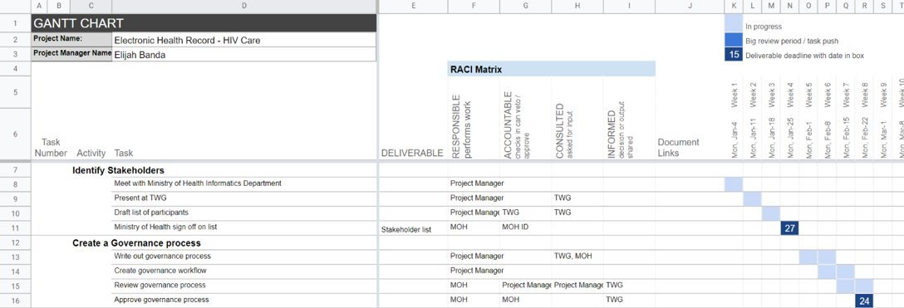
Gantt Chart template
Link to template in the HIS PM Toolkit tool pack
Notes:
This image can be left as a dead image

Slide 67
PM Checklist: Gantt chart
Timeline reflects the granularity of the activities in the Gantt chart and the length of time of the project (Quarters, Months, Weeks, Days)
  Typically, this is shown in quarters and months at the earlier stages of a project and is refined to weeks and days as the project progresses.
Highlighted dependencies and critical decision points
Gantt charts are reviewed on a regular basis
  Typically, this is on a monthly basis at the earlier stages of a project and then on a weekly or even daily basis closer to the delivery of key milestones

Slide 68
Budget Planning
Identify potential and existing funding sources for all project component costs for the preferred system.
Include consideration of items such as capital costs, operating costs, total cost of ownership, impact on other projects, funding requirements, etc.
Develop an initial plan using budget scales with best case, worst case, and most likely case - see CDC TAP template here HIS PM Toolkit_Tool Pack_June2024.xlsx

Slide 69
Budgeting: Quotes / estimates
Quotes have an expiry data - usually 30 - 90 days depending on the goods or services to be procured.
When gathering quotes for goods and services that are a long way off, always build in a buffer based on the time until procurement and the inflation rate.

Slide 70
Budgeting: exchange rates and inflation
Exchange rate fluctuations can cause increases or decreases in actual cashflow for your project. When budgeting your project in USD use a median exchange rate from the last year
When planning multi-year projects, inflation should always be taken into consideration. Look at what your Ministry of Finance says is the inflation rate in your country (median over the last 12 months) and plan your inflationary increases accordingly

Slide 71
Budgeting: cost categories
  Accurate budgeting and financial management are critical to ensuring that your project is delivered on time and on budget.
  Initial high-level budgeting, done during the project initiation phase and included in the project charter, is usually based on cost categories.
  Detailed budgets are created under each of these cost categories based on organization's salary information and estimated staff requirements as well as quotes for activities and procurement that fall under the project's scope.
Categories
Personnel
Fringe Benefits
Travel
Consultants (Contractuals)
Sub-agreements/Subcontracts (Contractuals)
Equipment
Supplies
Workshops & Training
Other Project Costs
Overhead

Slide 72
CDC budget template
CDC has guidance on how to prepare a budget here: Budget Preparation Guidelines (cdc.gov)
A template budget can be found here: AttA BudgetTemplate Arts RFP.xlsx (live.com)

Slide 73
PM Checklist: budgeting
You have followed the allowable CDC cost categories or other requirements in line with other funder regulations
All aspects of your project and project activities are included in your project budget (infrastructure, hardware, staff time, data, maintenance of hardware and software, travel, deployment, and workshop expenses, etc.)
All quotes are valid or include a buffer for inflation
Inflation is included in multi-year budgets
There is provision for exchange rate fluctuations if your budget is in a different currency to the one you spend in.

Slide 74
Basic risk management
Being aware of, and planning for, risks to your project's success is a critical part of project management.
Project risks can be both within your control to mitigate as a project manager or governance structure or they can be broader and outside of the control of those involved in the project
When identifying what your project risks are you should also look at:
  What they are
  How likely they are to happen
  How big of an impact will they have on the project if they happen

Slide 75
Basic risk management template
The CDC TAP program has developed a project risk management plan template to help project managers deal with risks, issues, and changes.
The aim is to identify, mitigate, and manage project risks.
It can be broken into three sections:
  An issues log
  An action plan
  A resolution log
See the Risk Management log in the HIS PM Toolkit

Slide 76
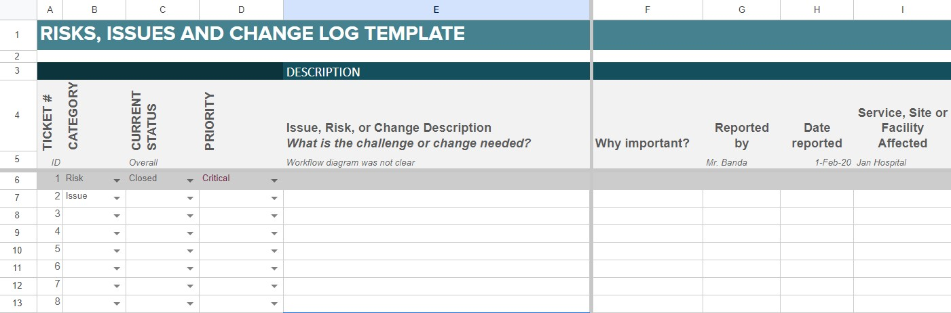
Risk management
Notes:
This image can be left as a dead image.
Risks are always identified along-side a level of priority with a justification for why it's important (sometimes likelihood and severity are also identified – although not in the CDC TAP template).
If is also always important to log who the risk was identified by, when and where

Slide 77
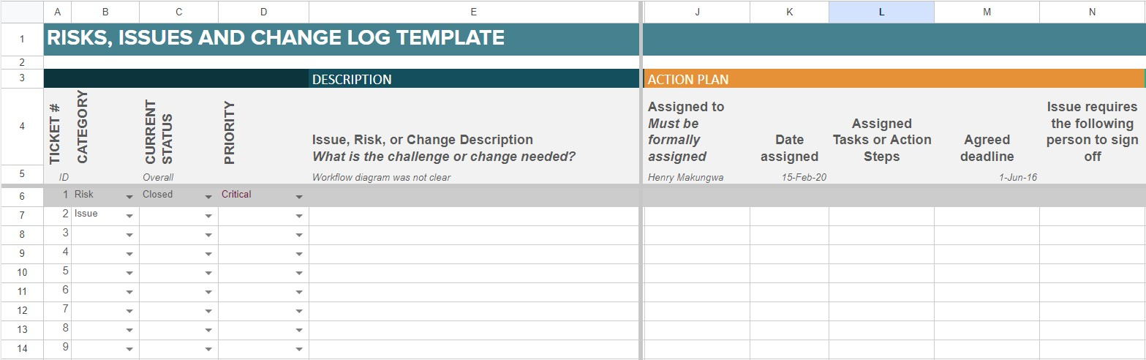
Risk management
Notes:
Once risks have been identified and logged mitigation activities can be assigned with dates assigned and deadlines
It's important to note that not all risks are controlled by the project nor can be mitigated against. Be realistic when assigning action plans.

Slide 78
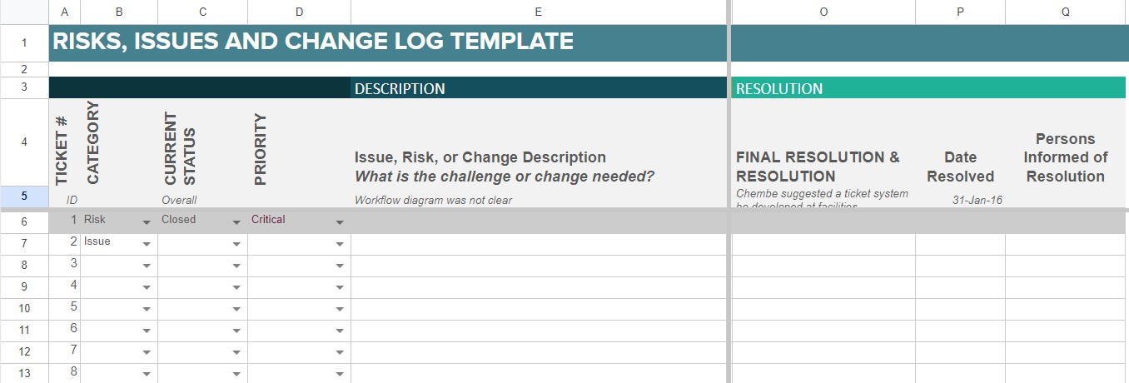
Risk management
Notes:
The third step with risk management is capturing resolutions as well has information as to when and by whom the risk was resolved.

Slide 79
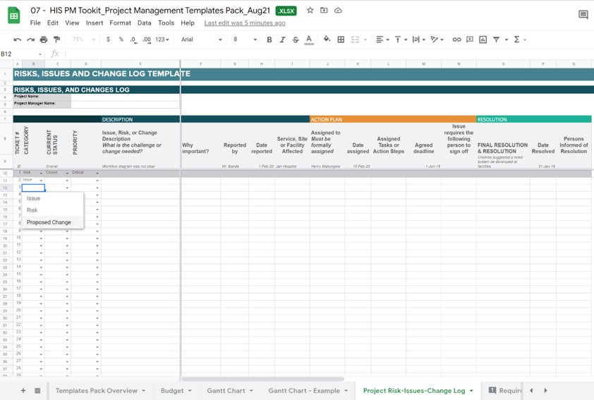
Change Management template
See the project change log in the HIS PM Toolkit

Slide 80
Documentation change management
Document control is an important part of change management. Any time there are significant changes, you want to update the version control of your document.
Make sure to also update the versions on diagrams and spreadsheets.
Document version control should have an agreed:
process flow
folder structure
file naming convention

Slide 81
Quality documentation
Always use consistent terms based on a glossary of terms available to all project team members and stakeholders
Be consistent in language (English vs American spelling)
Documents should always have an executive summary so that high-level stakeholders don't need to read the whole document to have a clear understanding of the key points.
Write in simple, clear language with as little jargon as possible – the easier to read the document the more likely people will read it!

Slide 82
Activity: filing
Individually design your own folder structure and file naming convention [5 mins]
Break into groups of 4
Feedback to group your structure and rationale

Slide 83
Communication
Deciding on what type of communications to use when is always important, including what needs to be said in written communications vs what can be agreed through verbal communications
When unsure always err on the side of written communications, especially when decisions are required.
Should decisions be made verbally, always follow up with a confirmation of the decision in writing
Different types of communications commonly used:
  meeting minutes
  summaries
  status reports
  donor reporting
  blog posts (social media)
  webinars

Slide 84
Communication
  The way and tools you use for communications will probably differ for inward (project team) communications and external communications. Select your communication type based on how formally or informally you need to address your audience.
  Here are some ideas of types of communications that can be used for these two types of communication:
  Inward
        Email
        Teams chat or Slack
        Zoom
        Shared drive / closed Wiki
    External communications: disseminating information
        LinkedIn
        Facebook
        Instagram
        Twitter / X
        Webinars
        Open Wiki / open website

Slide 85
Communications plan
see section 2.2 in the Prepare template
2.2. PROJECT COMMUNICATION PLAN
The following table outlines what meetings and/or communications materials are required for this project.
What | Purpose | Frequency (When) | Who | How Will Meet
Notes:
Explain the value of a well-documented communications plan, referring to section 2.2 in the Prepare template

Slide 86
PM Checklist: communications plan
There is a complete stakeholders list and is it regularly reviewed and updated to ensure contacts and contact details are current.
There is a documented communications plan that details who receives what type of communications when
The right tools are available to carry out your communications plan i.e. Wiki page, Zoom account, MS-Teams or Slack, etc.

Slide 87
Module 02: Quick survey
Mentimeter poll
  What are your top 3 take aways from this session

Slide 88
Module 02
Planning for success
Key terms and take aways
Governance structures are critical
It is important to establish Roles and Responsibilities on HIS projects at the onset and continually revisit roles
Communication is key and one of the PM's main responsibilities
Risk management is key aspect the PM coordinates and tracks
HIS PM toolkit has many tools to support documentation and communication

Slide 89



Module 04
Project monitoring & evaluation
Learning outcomes
Participants can describe the distinction between monitoring and evaluation
Participants can carry out a basic project health check (example template provided)
Participants can create and curate a basic risk management log (example template provided)
Participants can identify a logframe and theory of change and describe the key characteristics of each
Participants can describe the meaning of SMART indicators and identify them.

Slide 90
Monitoring vs evaluation
Internal to the implementing agency
External to the implementing agency
MONITORING
Is the project yielding the desired effect?
Inputs
Processes
Outputs
Outcome
Impact
Is the project working as intended?
EVALUATION
Source: Adapted from Pritchett et al. 2013 (4).
Source: WHO Monitoring and Evaluating Digital Health Interventions: practical guide 9789241511766-eng.pdf;sequence=1 (who.int)
Notes:
project management monitoring and corrective actioning - how well is your project doing
outcomes and impact evaluation - are you meeting your definition of success

Slide 91
Project health checks
Project health checks combine a review of all the components of the project plan and Gantt chart described in this training.
Activity and work area status can be graded based on a traffic light system
  Green - on track
  Amber - at risk (below optimal but not yet critical – need to take preventative action)
  Red - critical (requires immediate attention)
Project health checks can be as complex or as simple as needed (depending on your communications target audience
Depending on your type of project you could do this on a monthly basis or what there are upcoming milestones.

Slide 92
Project health checks
Budget
  Underspending
  On budget
  Overspending
Scope and activities
  Anything new or no longer needed
Time
  All one track/plan
  Anything ahead of schedule
  Anything behind schedule
Quality
  Are the deliverables of suitable quality, and if not, what needs to be done to improve them
Stakeholders
  Are all your key stakeholders happy with progress, etc.
Team
  Workload balance
  Team member changes
Notes:
Aim to get people to understand that they must keep reviewing project activities and documentation and revising as necessary

Slide 93
Activity
Below is a list of risks. As a group, please categorize these risks according to the traffic light scale provided and indicate whether they were in or out of the project manager's control. Make note of your rationale to share with the group. (15 mins)
# | Item | Green (low risk) | Amber (medium risk) | Red (high risk) | In or Out of PM control
1 | Donor pulls funding (showstopper but can be avoided through good reporting etc.
2 | Nurses' union stops nurses from using the EMR system because it’s adding to their workload
3 | Uninsured car gets in an accident and has to be replaced
4 | Project manager gets COVID-19 and is out of the office for 3 weeks
5 | Staff taking annual leave over Christmas halts deployment
6 | Software partner’s lead developer resigns and leaves
7 | There is a change in the ministry of health and the new head refuses to sign the MOU with the implementing partner halfway through the implementation project
8 | The power (electricity) situation in the country deteriorates and daily system use is affected in half your sites
Notes:
donor pulls funding (showstopper but can be avoided though good reporting etc.)
nurses union stops nurses from using the EMR system because it’s adding to their workload.
uninsured car gets in an accident and has to be replaced at project expense
project manager gets covid and if out of office for 3 weeks.
staff taking annual leave over christmas halts deployment
software partner’s lead developer resigns and leaves immediately
there is a change in the ministry of health and the new head refuses to sign the MOU with the implementing partner half way through the implementation project.
the power situation in the country deteriorates and daily system use is affected in half your sites

Slide 94
Activity feedback (10 mins)
Which items did you classify as green and why?
  Do others agree?
Which items did you classify as orange and why?
  Do others agree?
Which items did you classify as red and why?
  Do others agree?
What items did you classify as outside of the project managers control and why?
  Do others agree?

Slide 95
Logframes
Logframes are a commonly used tool for demonstrating the link between the inputs, processes (actions), outputs, outcomes, and impact of policies, programs, and projects.
The follow a linear pattern and can be used for monitoring activities as well as project evaluation using SMART indicators.
It should be:
  clear, readable, and jargon-free
  designed ideally with input from beneficiaries
  the basis for M&E later and hence kept under constant review
  filled in initially with the data you expect to find from the project
  completed at the half-way point and end of your project with the actual data collected
In some cases, it may include:
Inputs
Activities
Outputs
Outcome
Impact
In other cases, it may simply include:
Activities
Outputs
Outcome
Goals
The Logical Framework | (thetoolkit.me)

Slide 96
Logframes
Sample Logic Model
INPUTS OR RESOURCES | ACTIVITIES | OUTPUTS | SHORT-TERM OUTCOMES | INTERMEDIATE OUTCOMES | LONG-TERM OUTCOMES
Resources available to the program that allow and support service delivery, including money, staff, volunteers, clients, materials, or equipment | The methods of service delivery carried out by staff | The product delivered or unit of service provided, usually described numerically, such as number of people served or number of hours of service delivered | The first changes that occur for the individuals, families, organizations, or community as a result of the program | The subsequent benefit for people during or after their involvement in a program | The eventual impact on individuals, families, organizations, or community for which the program is accountable
People: Project Manager TA Coordinator Evaluation Consultant $200,000 in financial assistance Training facility Capacity building library | Training One-on-one technical assistance (TA) Financial assistance sub-awards | 10 hours of training per organization 40 hours of TA per organization 18 sub-awards ranging from $10,000 - $25,000 | Organizations gain new knowledge about best practices in nonprofit management Organizations obtain new equipment or infrastructure | Organizations implement new practices in nonprofit management, or improve existing practices Organizations use new equipment and infrastructure to manage their operations | Organizations serve more people Organization’s services are more effective
This table has six columns and three rows. The table should be read from left to right and from top to bottom.
Inputs: Resources used to deliver the project (e.g., human resources, funding, equipment).
Activities: These are the tasks carried out to achieve specific outputs.
Outputs: Tangible products, goods, or services resulting from activities.
Outcomes: Primary results that a project aims to achieve, often related to changes in knowledge, attitudes, or practices.
Goals (Impact): High ideals beyond project control but directly influenced by project efforts.
35+ Sample Logic Model Templates - Free & Premium Templates (templatet.com)

Slide 97
Logframes
Benefits:
Helps organize ideas and ensures a logical flow from activities to outputs, outcomes and impact
Expresses in a easily readable way to stakeholders i.e. governments, donors etc.
Shows you what you should be measuring to determine if you are achieving your goals
Facilitates the collection of concrete evidence to demonstrate project process, success or failure
Problems are analyzed systematically and risks and assumptions are made explicit
Facilitates comparisons between projects/programs and documentation of best practices
Limitations:
Does not consider the larger community and context within which your project operates
It is ‘one size fits all’ approach which does not always capture complexity and nuances
It can overemphasize measurable indicators and planning, and can require pre-defined datasets that are unattainable in resource-limited contexts or require statistical analysis that is not implementable.
Indicators can often be forgotten about until such time as a report is required by funders.
It reflects a bias towards planning rather than monitoring

Slide 98
Theory of change
A
B
A comprehensive description and illustration of how and why a desired change is expected to happen in a particular context.
Focused in particular on mapping out or “filling in” what has been described as the “missing middle” between what a program or change initiative does (its activities or interventions) and how these lead to desired goals being achieved.
Theories of change documents are unique to a project can look very different from each other.
Long-Term Employment at Livable Wage for Domestic Violence Survivors
C
D
Survivors have marketable skills in non-traditional jobs
Survivors know and have appropriate workplace behavior
Survivors attain coping skills
Survivors know how to get help and deal with their issues
Women serve internships
Survivors attend peer-to-peer counseling
Counseling and practical support for crises
Women attend training about expectations in the workplace
Women attend training classes in non-traditional skills
Employers are educated as to how to use interns
Center for Theory of Change Backwards Mapping and Connecting Outcomes - Theory of Change Community

Slide 99
Theory of change
The theory of change (TOC) process maps out your initiative through 6 stages:
Identifying long-term goals
Backwards mapping and connecting the preconditions or requirements necessary to achieve that goal and explaining why these preconditions are necessary and sufficient.
Identifying your basic assumptions about the context.
Identifying the interventions that your initiative will perform to create your desired change.
Developing indicators to measure your outcomes to assess the performance of your initiative.
Writing a narrative to explain the logic of your initiative.
Center for Theory of Change
How Does Theory of Change Work? - Theory of Change Community

Slide 100
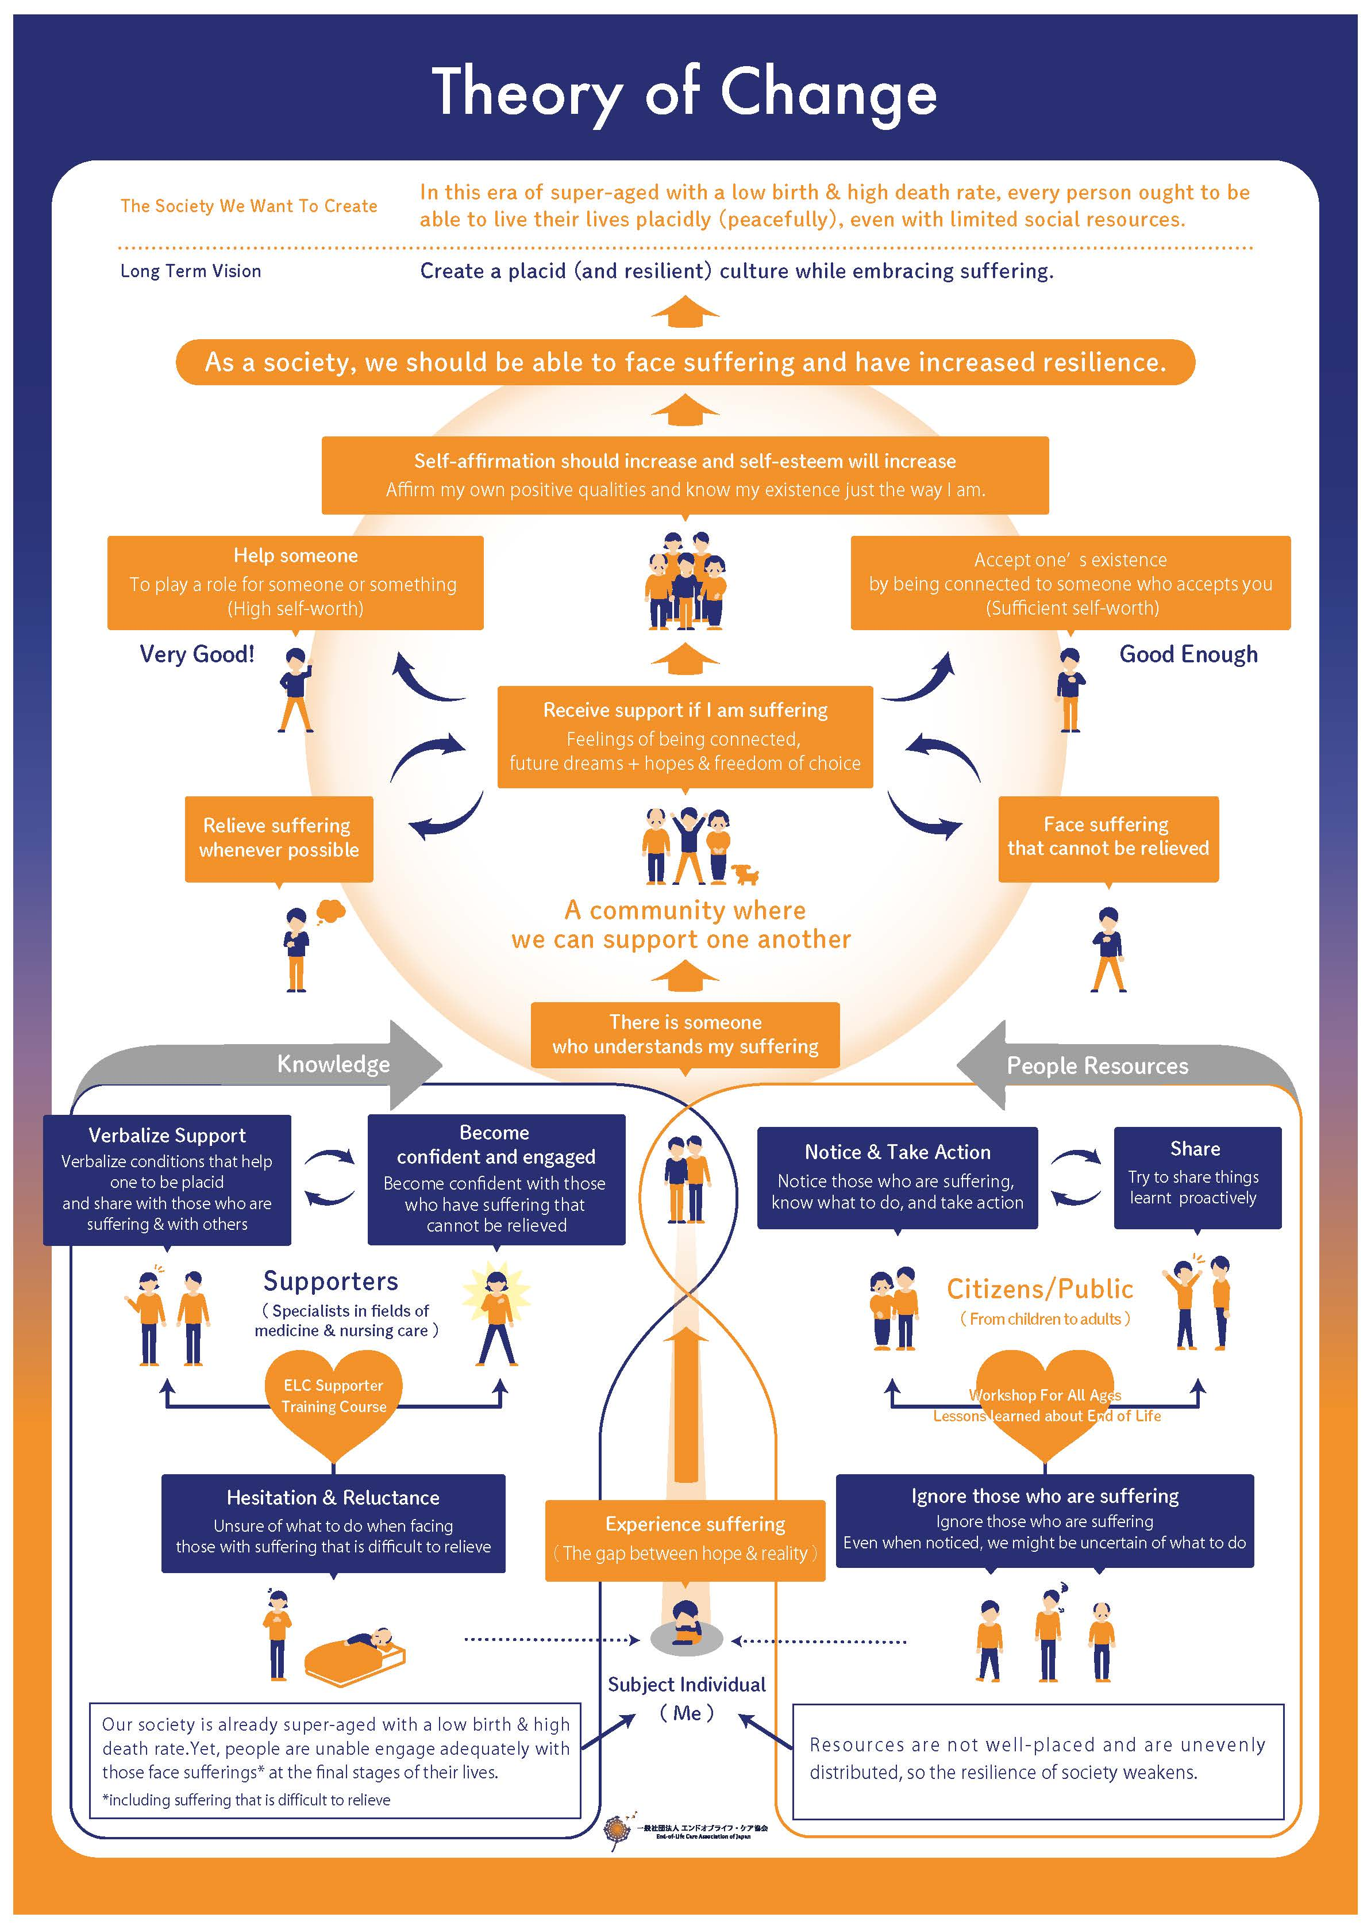







Theory of Change
The Society We Want To Create
In this era of super-aged with a low birth & high death rate, every person ought to be able to live their lives placidly (peacefully), even with limited social resources.
Adapted from End-of-Life Care Association of Japan
Long Term Vision
Create a placid (and resilient) culture while embracing suffering.
Center for Theory of Change
Toc Examples - Theory of Change Community
As a society, we should be able to face suffering and have increased resilience.
Self-affirmation should increase and self-esteem will increase
Affirm my own positive qualities and know my existence just the way I am
Help someone
To play a role for someone or something
(High self-worth)
Accept one’s existence
by being connected to someone who accepts you
(Sufficient self-worth)
Very Good!
Good Enough
Receive support if I am suffering
Feelings of being connected, future dreams + hopes & freedom of choice
Relieve suffering whenever possible
Face suffering that cannot be relieved
A community where we can support one another
Knowledge
There is someone who understands my suffering
People Resources
Verbalize Support
Verbalize conditions that help one to be placid and share with those who are suffering & with others
Become confident and engaged
Become confident with those who have suffering that cannot be relieved
Notice & Take Action
Notice those who are suffering, know what to do, and take action
Share
Try to share things learnt proactively
Supporters
(Specialists in fields of medicine & nursing care)
Citizens/Public
(From children to adults)
ELC Supporter
Training Course
Workshop For All Ages
Lessons learned about End of Life
Experience suffering
The gap between hope & reality
Hesitation & Reluctance
Unsure of what to do when facing those with suffering that is difficult to relieve
Ignore those who are suffering
Even when noticed, we might be uncertain of what to do
Our society is already super-aged with a low birth & high death rate. Yet, people are unable to engage adequately with those who face suffering* at the final stages of their lives.
*including suffering that is difficult to relieve
Subject Individual
(Me)
Resources are not well-placed and are unevenly distributed, so the resilience of society weakens.

Slide 101
SMART indicators
An indicator is a thing that indicates the state or level of something (Oxford dictionary).
  Measurable evidence of meeting a goal. Indicators are visible signs, (e.g. reading scores, attendance) that demonstrate that the outcomes are achieved.
  Indicators tend to be something that can be counted (quantitative), but sometimes evidence will be something more descriptive (qualitative).
SMART indicators are indicators which are:
  Specific: Indicators should be focused on a specific aspect of the EMR implementation.
  Measurable: Indicators should be quantifiable and trackable.
  Achievable: Indicators should be realistic and attainable.
  Relevant: Indicators should align with the project’s goals.
  Time-Bound: Indicators should have a defined timeframe
NOTE: This is a different acronym and shouldn’t be confused with the SMART in the WHO's digital health SMART guidelines (Standards-based, Machine-readable, Adaptive, Requirements-based, and Testable).

Slide 102
SMART indicators
Are these indicators for an mHealth system implementation SMART?
  % of target population reached: Measure the proportion of the intended audience (e.g., patients, health workers) who engage with the mHealth intervention.
  Geographic coverage: Assess the extent to which mHealth services are available across different regions or areas.
  Timeliness of service delivery: Evaluate how quickly mHealth interventions provide health services.
  Accuracy of data: Verify the correctness and reliability of health information collected through mHealth tools.
  Adherence to clinical guidelines: Determine whether mHealth interventions align with evidence-based guidelines.
  User satisfaction: Collect feedback from users (patients, health workers) to assess their satisfaction with mHealth services
  Cost per user: Calculate the expenses associated with implementing and maintaining the mHealth system per user.
  Cost savings: Compare the costs of mHealth interventions to traditional methods (e.g., face-to-face consultations).
.

Slide 103
Activity: SMART indicators (15 mins)
Part 1: Using the checklist provided mark off the SMART indicators
Part 2: As a group of 4, create a list of potential indicators related to the EMR rollout case study. Make sure they're SMART!
Notes:
Examples of SMART indicators for EMR system implemtation:
“Number of physicians trained on using the EMR system.”
“Percentage of patient records successfully migrated to the new EMR.”
“Average time taken to complete a patient encounter using the EMR.”
“Number of medication errors reduced after EMR implementation.”
“Percentage of patient appointments scheduled electronically within the first month of EMR adoption.”
“Improvement in patient outcomes (e.g., reduced hospital readmissions) due to better data access through EMR.”
“Enhanced communication between healthcare providers using the EMR system.”
“Achieve 90% adoption rate among physicians within six months of EMR rollout.”
“Reduce paper-based documentation by 50% within the first year of EMR implementation.”

Slide 104
Module 04: Quick survey
Mentimeter poll
  What are your top 3 take aways from this session

Slide 105
Module 04
Project monitoring & evaluation
Key takeaways
The difference between monitoring and evaluation is that:
  Monitoring focuses on inputs, processes, and outputs – aim is corrective action
  Evaluation focuses on outputs, outcomes, and impact – aim is to measure change over time
Logframes follow a linear pattern and can be used for monitoring activities as well as project evaluation using SMART indicators
Theory of Change focus on mapping out or “filling in” what has been described as the “missing middle” between what a project does (its activities or interventions) and how these lead to desired success being achieved.
SMART indicators are used to demonstrate change created by your project. They should be: Specific, Measurable, Achievable, Relevant and Timebound

Slide 106
Module 05
Design and develop phase
Learning outcomes
Participants can describe key characteristics of business systems analysis and human-centered design, and the value of a blended approach.
Participants can identify and describe the key roles and skill sets needed for the design and develop phase
Participants can identify and describe some of the tools used to define system and user requirements
Participants can describe the main activities for the design and develop process that a project manager needs to plan for and monitor progress
1
Analyze
3
Develop
4
Test
5
Deploy
2
Design
6
Maintain
Notes:
This training course is NOT intended to provide in-depth training about requirements gathering and design and development practices. It IS intended to provide project managers with an understanding of the basics of different types of software development methodologies, roles and outputs so that they can better manage activities during the design and develop phase. Participants will learn to:
describe key characteristics of business systems analysis and human centered design and the value of a blended approach.
identify and describe the key roles and skills sets needed for the design and develop phase
identify and describe some of the tools used to define system and user requirements
describe the main activities for the design and develop process that a project manager needs to plan for and monitor progress

Slide 107
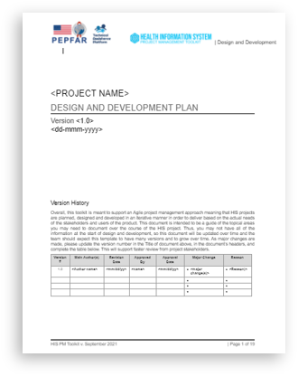
Design and development plan
Use this template to plan for and monitor the analysis, design and development activities of the project. Remember to update this document as needed if there are significant changes to the plan.
Notes:
In order to understand if and how a digital health intervention can effectively address a health system challenge, we must first understand the current state. There are two effective and complementary ways to do this:
Analytical Development (aka Business Analysis) (Our context = the "Business" of delivering healthcare )
Human-Centered Design
The Business Analysis method looks at the way in which "business" is currently conducted: what current processes in place, which roles/type of people work in the current process and what do they do, what data collected, what data is used and needed. Using this information to analyze where there are barriers and bottlenecks that exist within these processes that the digital health interventions could address. The role that typically carries out this work is known as Buisness Analyst or a Business Systems Analyst. The type of outputs of this process that you may be familiar with are Business Process Maps, System and user requirements specifications, concept diagrams, etc.
Human-centered design method looks at:
Problem definition
Critical reflection
Field research
Prototyping (Experimental solutions)
Continous learning
The role that typically carries out this work is known as human-centred designer, HCD practitioner, user interface designer (UI), User Experience (UX) designer, or a design researcher.
.The type of outputs of this process that you may be familiar with are User personas, user journeys, prototypes, etc.
Although these two approaches look very different there are in fact a number of overlaps and they complement each other very well. A blended approach that uses both of these methods is generally considered to be the best approach as it more comprehensive and reflects a more holistic viewpoint.

Slide 108
Analyze
Understanding the current and future state
Business analysis
Business process analysis
(How do we work now)
Business process re-design
(How should we work in future)
Requirements definition
(What does an HIS need to do to enable that)
Human-centered design
Problem definition
Critical reflection
Field research
Prototyping (experimental solutions)
Continuous learning
Blended approach
Combines the best practices, tools, and techniques of both for a comprehensive and holistic understanding of the digital intervention needed.
Notes:
In order to understand if and how a digital health intervention can effectively address a health system challenge, we must first understand the current state. There are two effective and complementary ways to do this:
Analytical Development (aka Business Analysis) (Our context = the "Business" of delivering healthcare )
Human-Centered Design
The Business Analysis method looks at the way in which "business" is currently conducted: what current processes in place, which roles/type of people work in the current process and what do they do, what data collected, what data is used and needed. Using this information to analyze where there are barriers and bottlenecks that exist within these processes that the digital health interventions could address. The role that typically carries out this work is known as Buisness Analyst or a Business Systems Analyst. The type of outputs of this process that you may be familiar with are Business Process Maps, System and user requirements specifications, concept diagrams, etc.
Human-centered design method looks at:
Problem definition
Critical reflection
Field research
Prototyping (Experimental solutions)
Continous learning
The role that typically carries out this work is known as human-centred designer, HCD practitioner, user interface designer (UI), User Experience (UX) designer, or a design researcher.
.The type of outputs of this process that you may be familiar with are User personas, user journeys, prototypes, etc.
Although these two approaches look very different there are in fact a number of overlaps and they complement each other very well. A blended approach that uses both of these methods is generally considered to be the best approach as it more comprehensive and reflects a more holistic viewpoint.

Slide 109
Roles and skillsets:
Business Analysts and Human Centered-Design practitioners
​
Business Analysts​ /
Business Systems Analysts (BA/BSA)
Analytical skills, business process modelling, use cases, analytical skills, gather, document and manage requirements, technical writing, business case
development, testing
Human-centered design practitioner,
User Experience (UX) or User Interface (UI) designer, Design Researcher
User research, persona development, wireframing and prototype design, interaction design, usability testing
​
Domain
(digital health) knowledge, communication and interpersonal skills, facilitation skills, collaboration, UX principles, knowledge of agile methods.
Notes:
These are the roles and skill sets needed for the analysis and design phase. Ideally you will have specialists in both areas, however many people also have a combination of both types of skills sets.
A Business Analyst (BA) aka Business Systems Analyst (BSA) plays a crucial role in bridging the gap between business needs and technology solutions.
The core skills required for a Business Systems Analyst include a mix of technical, analytical, and interpersonal abilities. Here are some of the essential skills:
Analytical Skills
Problem-Solving: Ability to identify issues, evaluate solutions, and implement the most effective ones.
Critical Thinking: Evaluate information from multiple sources and determine the best course of action.
Attention to Detail: Precision in understanding and documenting business processes and requirements.
Business Knowledge
Business Process Modeling: Expertise in creating business process diagrams and models (e.g., BPMN, flowcharts) to represent processes.
Domain Knowledge: Understanding the specific industry or business domain in which they are working.
Project Management: Basic understanding of project management principles and practices.
Interpersonal Skills
Communication: Excellent verbal and written communication skills to interact effectively with stakeholders at all levels.
Facilitation: Ability to lead meetings, workshops, and discussions to gather requirements and build consensus.
Collaboration: Strong teamwork skills to work effectively with cross-functional teams.
Documentation Skills
Technical Writing: Proficiency in creating clear and concise documentation, such as business requirements documents (BRDs), functional specifications, and user stories.
Process Documentation: Ability to document business processes, workflows, and system interactions comprehensively.
Soft Skills
Adaptability: Flexibility to adapt to changing business environments and requirements.
Conflict Resolution: Skills to manage and resolve conflicts that may arise during the analysis and implementation phases.
There are many different terms for Human-centered design practitioners incuding User Experience (UX) or User Interface (UI) designer, Design Researcher. Here are some of the essential skills:
Empathy and User Understanding
Empathy: Ability to understand and share the feelings and perspectives of users.
User Research: Proficiency in conducting various types of user research, including interviews, surveys, observations, and usability testing.
Persona Development: Creating detailed user personas to represent different user types.
Design and Prototyping
Sketching and Wireframing: Skills in quickly sketching ideas and creating wireframes to visualize design concepts.
Prototyping: Proficiency in building low to high-fidelity prototypes using tools like Figma, Sketch, Adobe XD, or InVision.
Visual Design: Basic understanding of visual design principles, including layout, color theory, and typography.
Analytical and Problem-Solving Skills
Design Thinking: Expertise in applying design thinking methodologies to solve complex problems.
Critical Thinking: Ability to analyze user data and feedback to identify problems and opportunities.
Iterative Design: Skills in iterating on designs based on user feedback and testing.
Technical Proficiency
Usability Testing: Conducting and analyzing usability tests to gather user feedback on prototypes and designs.
Interaction Design: Understanding of how users interact with products and designing intuitive interfaces.
Areas of overlap between are:
Domain knowledge – of digital health and health systems.
User Experience (UX) Understanding: Basic knowledge of UX principles to ensure that systems meet user needs effectively.
Collaboration and Communication
Collaboration: Ability to work effectively with cross-functional teams, including developers, product managers, and other designers.
Facilitation: Skills in leading workshops, brainstorming sessions, and design sprints.
Communication: Excellent verbal and written communication skills to articulate design concepts and decisions clearly.
Agile Methodology: Familiarity with Agile methodologies and practices, including Scrum and Kanban.

Slide 110

HCD tools and techniques: User Personas
 | Sena, Community Health Volunteer (CHV) who lives in a community
 | Demographics | Sena is a 45-year-old woman living in a community in Ghana. She has 12 years of experience working in community health services, where she received training.
Responsibilities | Community mobilization Community health education Client follow up Client referrals Immunization, nutrition, HIV/AIDS Community services including family planning Provides community health services to people in catchment communities
Challenges | Low awareness and demand for vaccines among community members CHV may have limited knowledge on immunization CHV may have inadequate tools and resources to support provision of services and follow-ups
Connectivity and eHealth | Expected to have a personal mobile phone CHV may have challenges in accessing/paying for airtime/data for the mobile health applications used in the course of his/her work Has limited access to connectivity
A user persona describes the general background, demographics, work environment, motivations, and key challenges for various country stakeholders that interact with the health information system.
Used to engage with stakeholders to better understand their context and needs.
Describes different type of end users in a way that is relatable, leading to a better understanding of who the team is designing a system for.
Notes:
A human centered designer uses a wide range of different tools and techniques to gather information about the HIS system users and what they need. One of the tools that you may be familiar with and which is very widely used is a USER PERSONA.
A user persona describes the general background, demographics, work environment, motivations, and key challenges for various country stakeholders that interact with the health information system. It is a method for enhancing engagement with stakeholders and building context for prototyping and implementation efforts. The purpose of creating user personas is to enable team members and stakeholders to better understand and relate to end-users with visuals about users, so team members are designing for someone specific.

Slide 111
BA tools and techniques: Process diagrams
Business process diagram /swim lane diagram is:
A visual representation of the steps, activities, and decisions involved in a specific process or workflow. Business process diagrams help stakeholders understand how a process works and at what points in the process data is collected, generated, or used. It can be used to identify areas for optimization.
See diagram on next slide.
Notes:
A Business Analyst also uses a wide range of different tools and techniques to gather information about the HIS system users and what they need.
One of the tools that you may be familiar with and which is very widely used is a BUSINESS PROCESS DIAGRAM.
A business process diagram is a visual representation of the steps, activities, and decisions involved in a specific process or workflow. Business process diagrams help stakeholders understand how a process works and identify areas for optimization. It is used to document, analyze, and improve processes within an organization

Slide 112
BA tools and techniques process diagrams
Start
HCW
1. Register Birth
Create Newborn Record
X
Record doesn’t exist
2. Receive Birth Dates
3. Create New Record
Stop
RS Staff
Record already exists
4. Update Client Record

Slide 113
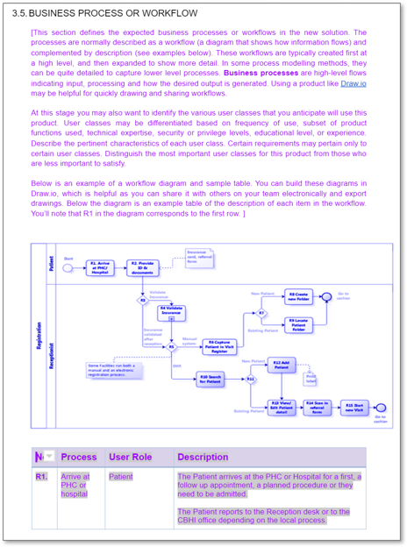
BA tools and techniques: Process diagrams
Example from the Design and Development plan template
Notes:
A Business Analyst also uses a wide range of different tools and techniques to gather information about the HIS system users and what they need.
One of the tools that you may be familiar with and which is very widely used is a BUSINESS PROCESS DIAGRAM.
A business process diagram is a visual representation of the steps, activities, and decisions involved in a specific process or workflow. Business process diagrams help stakeholders understand how a process works and identify areas for optimization. It is used to document, analyze, and improve processes within an organization

Slide 114
The importance of good requirements
Comprehensive software system requirements are critical for the success of any software project. They serve as the foundation that guides the entire development process and ensures that the final product meets the intended needs and expectations. Requirements:
Provide a shared understanding of WHAT the system needs to do.
Helps to avoid ambiguity and misinterpretation
Define the scope of the technical development work for planning purposes
Provide detailed specifications for developers
Provide the base for testing criteria, verification, and validation
Notes:
Well defined, detailed and comprehensive software system requirements are critical for the success of any software project. They serve as a foundational element that guides the entire development process and ensures that the final product meets the intended needs and expectations.
Software system requirements are vital for ensuring that a project is completed on time, within budget, and to the satisfaction of all stakeholders. They provide a structured framework that guides the entire software development lifecycle, from initial planning and design to development, testing, and maintenance.
Requirements:
Provide a shared understanding of WHAT the system needs to do.
Helps to avoid ambiguity and mis-interpretation
Define the scope of the technical development work for planning purposes
Provide detailed specifications for developers
Provide the base for testing criteria, verification and validation

Slide 115
The risk of bad requirements
Without clear and well-documented requirements, projects are at a higher risk of failure due to miscommunication, scope creep, and unmet user needs!
!

Slide 116
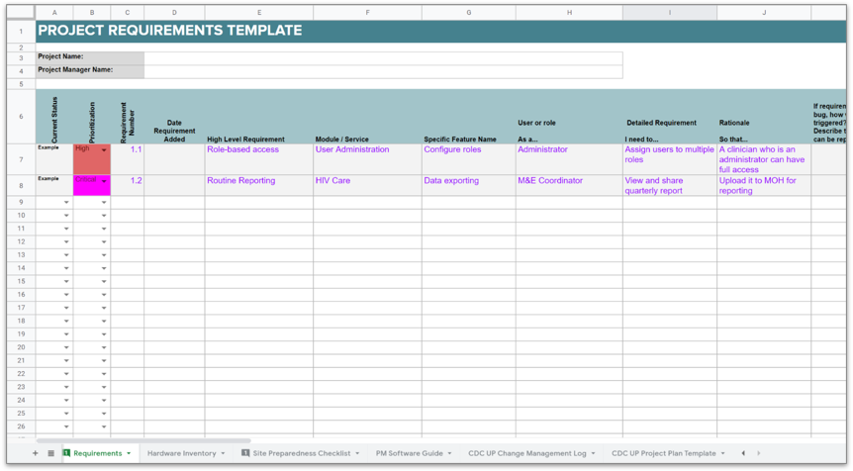
Requirements template
Link to template
HIS PM Toolkit_Tool Pack
This is a simple and useful way to document and keep track of requirements.

Slide 117
Software: User vs system requirements
User requirements describe what the end users need and expect from the system. They focus on the goals, tasks, and interactions that users will have with the system.
Intended for: end users, stakeholders, and non-technical team members.
Example: A user should be able to log in using their email and password.
System requirements describe the functionality and constraints of the system from a technical perspective. They specify what the system must do to meet the user requirements.
Intended for: developers, system architects, and technical team members.
Example: The system shall support authentication using OAuth 2.0.
Notes:
User requirements are user-centric and describe what the system must do from the users perspective. inform and shape the system requirements. The process typically starts with gathering user requirements to understand what users need from the system. These user requirements are then translated into system requirements that provide the detailed specifications necessary for building the system.
In summary, user requirements are about understanding and documenting what the users need, while system requirements are about defining how the system will meet those needs from a technical standpoint. Both are essential for the successful development of a software system.

Slide 118
Software requirements
Functional requirements describe the specific functions of the system: what it must do and how it should react to inputs.
Often expressed as: "The system must/shall do something"
Example: The system must generate a monthly report of children under 5 due for vaccination.
Non-functional requirements describe the qualities and constraints of the system. They detail how the system performs its functions. Focus on performance, usability, reliability, security, and other quality attributes.
Often expressed in measurable terms to ensure they can be tested and validated.
Example: The system shall encrypt all user data in transit and at rest.
Notes:
Functional Requirements
Definition: Functional requirements describe the specific behaviors or functions of the system. They detail what the system should do and how it should react to particular inputs. Often expressed as "The system must/shall [do something]."
There are generally two main categories of requirements:
Functional Requirements: Functional requirements describe the specific behaviors or functions of the system. They detail what the system should do and how it should react to particular inputs. Often expressed as "The system must/shall [do something]."
Examples:
The system shall allow users to log in using a username and password.
The system shall send a confirmation email upon successful registration.
The system shall generate a monthly report of children under 5 due for vaccination.
2. Non-Functional Requirements: Non-functional requirements describe the qualities and constraints of the system. They detail how the system performs its functions and define the system's overall attributes.
Characteristics:
Focus on performance, usability, reliability, security, and other quality attributes.
Often expressed in measurable terms to ensure they can be tested and validated.
Examples:
The system shall handle up to 10,000 simultaneous users.
The system shall load the homepage within 2 seconds under normal conditions.
The system shall encrypt all user data in transit and at rest.

Slide 119
Activity:
Software requirements (15 mins + 10mins)
Group Exercise: break into groups of 4
Using the case study, review the list of software requirements from the list provided and identify which requirements are well-defined and which are not.
For the requirements that are not well-defined, re-write them in a way that is more effective
Feedback to the group

Slide 120
Hardware & infrastructure requirements
Hardware
Servers
Workstations
Tablets
Mobile phones
Scanners
Medical devices to integrate with the system, e.g., laboratory analyzers
Infrastructure
Power
Network
Internet connectivity
Physical security
Cloud computing services
Notes:
When designing and deploying a digital health system, it is crucial to consider both hardware and infrastructure requirements to ensure the system is reliable, scalable, secure, and efficient. Below are the type of things you will need to consider:
Hardware:
Servers
Workstations
Tablets
Mobile phones
Scanners,
Medical devices to integrate with the system eg: laboratory analysers
Infrastructure:
Power
Network
Internet connectivity
Physical security
Cloud computing services

Slide 121
Hardware and infrastructure requirements
5. HARDWARE REQUIREMENTS
[Describe hardware requirements and any related processes. Include a detailed description of specific hardware requirements and associate them to specific project functionality/deliverables. Include information such as type of hardware, brand name, specifications, size, security, etc. Account for any back-up devices that may be needed if one breaks down etc. Here are some example requirements:]
The system must run on active (powered) equipment operating on specified voltage. All active equipment must include power plugs standard for the country/area.
The system hardware components must have UPS that will enable equipment to be able to be powered down over a 15 minute time frame after loss of power.
Unless otherwise specified, all equipment must operate in environments of 10-30 degrees centigrade, 20-80 percent relative humidity.
5.1. HARDWARE DEPLOYMENT AND MAINTENANCE PLAN
[Describe plan to deploy hardware and any associated costs. Will there need to be any training? Will hardware deployment need to hire technical experts? What kind of supportability and maintainability is required?]
5.2. AVAILABILITY REQUIREMENTS
[Describe all of the technical requirements that affect availability such as hours of operation, level of availability required, down-time impact, support availability, etc. If there are performance requirements for the product under various circumstances, state them here and explain their rationale, to help the developers understand the intent and make suitable design choices. Specify the timing relationships for real time systems. Make such requirements as specific as possible. You may need to state performance requirements for individual functional requirements or features. Assign a unique ID number to each requirement.]
Section 5 in the Design and development plan template
Notes:
For more information, can refer to section 5 in the CDC Design and Development Plan template

Slide 122
HIS PM Toolkit template
Link to template
HIS PM Toolkit_Tool Pack
Useful for planning purposes and to keep track of hardware as it is procured / installed
HARDWARE INVENTORY TEMPLATE
HARDWARE INVENTORY
Project Name:
Project Manager Name:
Name/ ID | Type | Model/ Version | Physical Location | Equipment Owner (Person or Dept) | Maintenance Contract? Y/N | Maintenance Contact Point | Maintenance Type/ Level of Coverage | Maintenance Period Expiration Date | Required Licenses
Notes:
In the HIS PM Toolkit Tool Pack there is a tab for maintaining a hardware inventory. This is useful for planning purposes and to keep track of hardware as it is procured / installed.

Slide 123
Activity:
Hardware and infrastructure requirements
Individual exercise:
Based on the case study, review the list of hardware and infrastructure requirements from the list provided and tick off what you think should be included.
Key slide with answers

Slide 124
Activity feedback:
Hardware and infrastructure requirements

Slide 125
Design
Using the documented requirements as the blueprint, during the design phase the development team will design HOW the system will be built or HOW the existing system will be adapted or enhanced.
Technical: System architecture design, database design, ​integration design
Roles and skillsets needed: System architects, lead developers/software engineers, database engineers
User-focused: User interface design, look and feel, information architecture
Roles and skillsets needed: UX and UI designers
1
Analyze
3
Develop
4
Test
5
Deploy
2
Design
6
Maintain
Notes:
Now that there are well-defined and documented requirements that describe WHAT the system needs to do,
during the design phase the development team will design HOW the system will be built or HOW the existing system will be adapted or enhanced.
Technical : System architecture design, database design,
User focused: UI design, UX design.
Technical Skills
Systems Analysis and Design: Understanding of how systems work and the ability to design solutions that meet business requirements.
Data Analysis and Modeling: Proficiency in analyzing data to make informed decisions and creating data models to support business processes.
Technical Proficiency: Familiarity with relevant software, tools, and technologies, such as databases, ERP systems, and business intelligence tools.
Requirements : Ability to gather, document, and manage requirements effectively.

Slide 126
Develop
1
Analyze
3
Develop
4
Test
5
Deploy
2
Design
6
Maintain
Input = requirements and system specifications
Agile development process consists of iterative cycles of development, testing, and feedback.
The development team writes and tests the code.
When there is a feature that is ready, the team demonstrates this to the user representatives, who provide feedback.
This feedback is incorporated back into the next development cycle, ensuring that any potential issues are caught as soon as possible while there is still time to make corrections easily.
Design
Build
Test
Review
Analyze & Plan
Launch
Notes:
Using the requirements and system specifications created during the analysis and design phase the Development phase then begins.
In practice development and testing go hand in hand, although we will learn more about testing in the next course module.
In a blended waterfall-agile approach, once the requirements have been signed off by the authorized stakeholder (typically a MOH representative) the development process begins and the development teams will use an agile approach that goes through several iterations of development, testing and user feedback.
For each iteration, the development team write and test the code and then demonstrate whatever is ready to the select user representative, who provide feedback – either through testing or in response to the demonstration. This feedback is then incorporated back into the next development cycle, ensuring that any potential issues are caught as soon as possible while there is still time to make corrections easily.

Slide 127
PM Checklist: Design and Develop
All of the activities for the requirements gathering and analysis and design phases are represented in the PM plan and Gantt chart.
  Details of how (e.g. interviews, workshops) and from whom (e.g. clinicians, data managers, IT personnel) requirements be gathered are included.
The right people with the right skill-sets have been identified for the activities planned,
It is clear who is responsible and who is authorized to sign off the user and system requirements.
For the agile testing process, the user representatives have been identified and they are willing and able to participate in the iterative process.
Notes:
● Clearly documented and approved set of requirements that includes stakeholder, functional, non-functional and informational requirement
Create a Use Case or set of Use Cases that help to validate software requirements and test new software
● Develop and validate a set of documented Business Process or Workflow Models that help to extract requirements and communicate processes to stakeholders: these are especially
helpful for developers and UX designers.
● Ensure team has considered the following features or needs in the requirements, where appropriate: Authentication and Authorization, Usability, Encryption, Audit, Interoperability,
Data Validation, Scalability, Availability, Performance, Configuration, Backups, Support, Printing, Duplicate checking, Data migration
● Ensure that requirements for software, hardware and infrastructure security has been considered as part of the design
● Develop a documented high level technical design that describes the technical solution being proposed. This usually includes a diagram and a description.
● Develop a Technical Specification that describes how the requirements will be translated into technical pieces of work.
● If different software tools are being considered for use, develop a Software Evaluation Matrix / checklist that describes the criteria you will use for evaluation.
● Define Hardware specifications and infrastructure requirements needed for the solution
● Ensure that there are documented User Acceptance Criteria and the stakeholders who will perform acceptance testing have been identified.
● Define a documented Quality control process and standards.
● For the validation and approval of design requirements, ensure that key stakeholders are willing and able to participate in the iterative process, this is particularly important for end
users of the project deliverables
● Ensure that the project design requirements are reviewed and approved by project Governance board prior to beginning developmen

Slide 128
Module 05: Quick survey
Mentimeter poll
  What are your top 3 take aways from this session

Slide 129
Module 05
Design and develop phase
Key takeaways
The analysis and requirements gathering phase is a foundational part that is critical to the project success.
Business analysis and human centered design skills are complementary and when used together are very effective
There are different types of requirements, and all requirements define what the system needs to do in order to satisfy the needs of the users.

Slide 130
Module 06
Test and implement phase
Learning outcomes
Participants can describe the different types of testing, when this occurs and who is involved
Participants can describe the purpose of a test plan
Participants can describe the contents of a test case
Participants can describe what User Acceptance Testing is, who is involved, and why it is important
1
Analyze
3
Develop
4
Test
5
Deploy
2
Design
6
Maintain

Slide 131

Testing and Implementation Plan
Use this template to plan for and monitor the testing and implementation activities of the project. Remember to update this document as needed if there are significant changes to the plan.

Slide 132
Quality Assurance (QA) vs Testing
Testing is a subset of QA that focuses on evaluating the actual product to identify defects. It involves executing the software to find errors, bugs, and other issues.
Focus: Testing is product-oriented. It aims at identifying defects in the actual software product to ensure it meets the required standards and performs as expected.
Examples:
Unit testing
User acceptance testing (UAT)
Quality Assurance is a broad term that encompasses methods and practices designed to monitor the software engineering processes and methods used to ensure quality.
Focus: QA is process-oriented. It aims at preventing defects in the process rather than identifying defects in the product. It ensures that the right processes are in place to produce a high-quality product
Examples:​
Defining coding standards.​
Training programs for testers
Notes:
Quality Assurance (QA) and testing are both crucial components of the software development process, but they are not the same.
Here is a comparison:
Quality Assurance (QA): QA is a proactive process that starts at the beginning of a project. It involves the entire software development process and aims to prevent defects before they occur. It's about ensuring the quality of the software processes that are used to create a quality product. It focuses on improving the processes to deliver Quality Products to the customer. An important point to note is that QA is a preventive process.
Testing: Testing, on the other hand, is a reactive process that begins with the detection of defects and issues. It is a subset of QA that specifically investigates the quality of the product itself, focusing on identifying defects and issues. It involves the operation of a system or application under controlled conditions and evaluating the results. Testing is a corrective process.
In simple terms, QA is process-oriented and focuses on preventing defects, whereas testing is product-oriented and focuses on identifying and fixing defects.
Quality Assurance (QA) and Testing are both crucial components of the software development lifecycle, but they serve different purposes and encompass different activities. Here’s a breakdown of each to clarify their roles and differences:
Quality Assurance (QA)
Definition: QA is a broader concept that encompasses all activities aimed at ensuring the quality of the software product. It focuses on improving the processes used to create the final product to prevent defects.
Key Activities:
Process Definition and Implementation: Establishing standards and procedures to be followed during software development.
Process Monitoring: Continuously observing and analyzing the development processes to ensure adherence to defined standards.
Process Improvement: Regularly updating and refining processes based on feedback and performance metrics to enhance efficiency and effectiveness.
Audits and Reviews: Conducting formal assessments of processes and work products to ensure compliance with standards.
Focus: QA is process-oriented. It aims at preventing defects in the process rather than identifying defects in the product. It ensures that the right processes are in place to produce a high-quality product.
Examples:
Defining coding standards.
Conducting process audits.
Implementing training programs for the development team.
Testing
Definition: Testing is a subset of QA that focuses on evaluating the actual product to identify defects. It involves executing the software to find errors, bugs, and other issues.
Key Activities:
Test Planning: Creating detailed plans that outline the scope, approach, resources, and schedule of testing activities.
Test Design: Developing test cases, scenarios, and scripts based on the requirements and design documents.
Test Execution: Running the software with test cases to verify that it behaves as expected.
Defect Reporting and Tracking: Identifying, logging, and monitoring defects found during testing.
Focus: Testing is product-oriented. It aims at identifying defects in the actual software product to ensure it meets the required standards and performs as expected.
Examples:
Unit testing individual components.
Integration testing combined components.
System testing the complete system.
User acceptance testing (UAT) by end-users.
Key Differences
Scope:
QA: Encompasses the entire process of software development, including process improvements, training, and audits.
Testing: Focuses specifically on evaluating the product to identify defects.
Orientation:
QA: Process-oriented, aiming to prevent defects by improving the development process.
Testing: Product-oriented, aiming to detect defects in the software product.
Activities:
QA: Includes activities like process definition, process monitoring, audits, and process improvement.
Testing: Includes activities like test planning, test design, test execution, and defect tracking.
Goal:
QA: To improve and ensure the overall quality of the process used to create the software.
Testing: To identify and fix defects in the software product.
In summary, QA and Testing are complementary practices that, when combined, contribute to the development of high-quality software. QA ensures that the development process is effective and efficient, while Testing ensures that the final product is free of defects and meets user requirements.

Slide 133
Quality Assurance (QA) vs Testing
Quality Assurance ensures that the development process is effective and efficient, while Testing ensures that the final product is free of defects and meets user requirements.
Notes:
In summary, QA and Testing are complementary practices that, when combined, contribute to the development of high-quality software. QA ensures that the development process is effective and efficient, while Testing ensures that the final product is free of defects and meets user requirements.

Slide 134
Testing phases
Testing during development
Develop test plan
Develop test cases and test data
Testing by development team
  unit tests, integration tests, automated and manual testing
Testing by users during agile development
  functional testing
  usability testing
Testing during implementation
Test the infrastructure is working
Test that the software is correctly deployed
Test that the software is correctly configured and functions as expected
Test that the software works in the real world environment and that users know how to use it.
User Acceptance Testing (UAT)
Notes:
Testing is something that happens all the way through the project.
During the development phase:
A test plan is developed so that it is clear who will be testing, what methods they will use and what tools they require.
Test cases are created : These are derived from the requirements.
Test data is generated.
Testing is carried out by the development team
Testing is carried out by end user representatives
During the implementation:
Test the infrastructure is working
Test that the software is correctly deployed
Test that the software is correctly configured and functions as expected
Test that the software works in the real world environment and that users know how to use it.
The User Acceptance Testing is an important activity that is the gateway to implementation.
User Acceptance Testing is a critical step in the software development lifecycle. It ensures that the software meets the needs of its intended users and is ready for deployment. By validating business requirements, identifying issues, and building user confidence, UAT plays a vital role in delivering high-quality, user-friendly software that meets business objectives and user expectations.

Slide 135
Testing roles and skill sets
Developers: unit tests, debugging, integration tests, API testing, performance testing, security testing.
Testers (test analysts/QA testers): functional, debugging, API testing, performance testing.
Often use a mix of automated and manual testing tools
BA: functional testing: does the system meet the user needs and defined requirements
HCD practitioners including UI / UX designers: functional and usability testing
End User representatives: functional and usability testing, User Acceptance Testing (UAT)
ICT staff / implementors- Test the infrastructure is working and software is correctly deployed
End user representatives: Test that the software is correctly configured and functions as expected
Test that the software works in the real-world environment
Trainers: Test that all users know how to use the system
Notes:
There are many people who are involved in testing.

Slide 136
Tester roles and skill sets
Testers (test analysts/QA testers) are primarily responsible for designing, implementing, and evaluating tests to ensure that software applications meet the specified requirements and are free of defects.
Requirements review
Risk analysis to determine how to prioritize testing
Develop test plan, test cases, and prepare test data
Defect reporting and tracking
Use automated and manual methods
Interact with end users during user acceptance testing to gather feedback and ensure the software meets user needs.
Notes:
Dedicated testing staff are a great asset to the project.
Testers (test analysts/QA testers) are primarily responsible for designing, implementing, and evaluating tests to ensure that software applications meet the specified requirements and are free of defects.
Requirements review
Risk analysis to determine how to prioritze testing
Develop test plan, test cases and prepare test data
Defect reporting and tracking
Use automated and manual methods
Interact with end users during user acceptance testing to gather feedback and ensure the software meets user needs.

Slide 137
Test plan and schedule
A test plan describes:
  The roles/ individuals involved in testing and their responsibilities
  The tools or templates and other resources they will need to carry out the testing e.g. test server, test data, test tracking tool such as JIRA
Also includes:
A detailed project Testing Schedule.
  Activities should be laid out in chronological order. Include any testing milestones.
  Include any periodic review meetings or review periods that will be required so that sufficient time is allocated and accounted for.
Notes:
A test plan includes a description of the individuals involved in the testing, their responsibilities, and the tools or templates or other resources they will need to carry out the testing e.g. test server, test data, test tracking tool such as JIRA.
It should also include a detailed project Testing Schedule.
Activities should be laid out in chronological order. Include any testing milestones.
Also include any periodic review meetings or review periods that will be required so sufficient time is allocated and accounted for

Slide 138
Test case
2.2 TEST CASE TEMPLATE
[Describes in detail how each test will be carried out. The test cases are very closely related to the requirements: for each requirement there should be an associated test case. ]
2.2.1 ID and DESCRIPTION
[A unique ID to reference the test case. Describe the test case(s) and the individuals involved in the testing.]
2.2.2 PRECONDITIONS
[Describe the preconditions for the test case. A precondition is the state of the system that must exist before a test case can be performed.]
2.2.3 POST CONDITIONS (EXPECTED RESULT)
[Describe the post conditions for the use case. A post condition is a list of possible states the system can be in immediately after a test case has finished.]
2.2.4 STEPS (FLOW OF EVENTS)
[Describe the flow of events that would be expected in normal conditions as well as any potential alternate flow of events, and exceptions/errors that may be expected.]
2.2.5 SPECIAL REQUIREMENTS
[Describe any special requirements necessary to perform the test case.]
2.2.6 RESULT (WHAT ACTUALLY HAPPENED)
[Describe what actually happened when the test was performed. ]
2.2.7 PASS/FAIL
[Note if the test passed or failed.]
2.2.8 EVIDENCE
[Provide evidence of the test e.g., a screenshot.]
Based on requirements
Test case includes:
  ID and name
  Description
  Resources needed
  Pre-condition
  Steps (flow of events)
  Test data needed
  Post condition/expected result
  Pass/fail
  Evidence of test (e.g., screenshot)
Link to test case template here

Slide 139
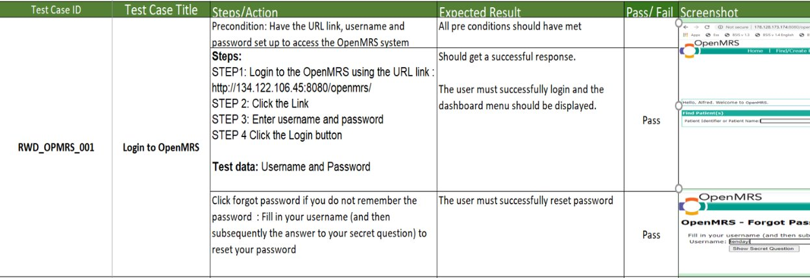
Test case example: login to system

Slide 140
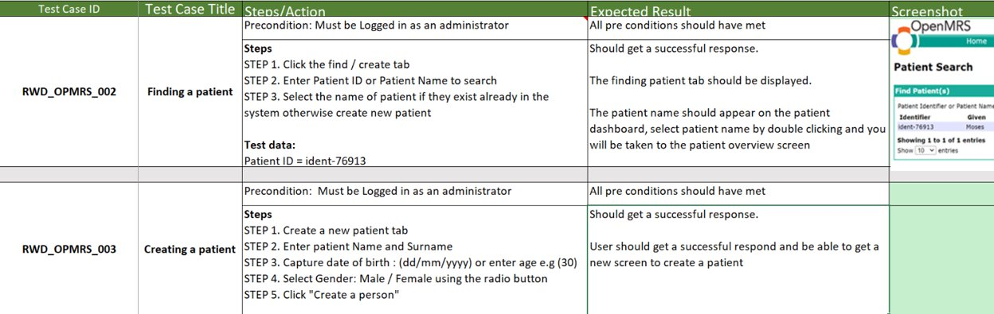
Test case example: search for and create a patient record

Slide 141
User Acceptance Testing (UAT)
UAT serves as the final verification step before the software is deployed to the production environment to ensure everything is in order.
Identifies any discrepancies or defects that were not caught during earlier testing phases.
Mitigates the risk of major issues post-deployment.
Builds confidence and trust in the software as users have been involved in testing it.
Notes:
UAT serves as the final verification step before the software is deployed to the production environment to ensure everything is in order.
It allows tester to identify any discrepancies or defects that were not caught during earlier testing phases.
It mitigates the risk of major issues post-deployment. Catching and addressing issues during UAT reduces the likelihood of costly fixes and downtime after the software goes live.
By involving end users in the testing process, UAT builds confidence and trust in the software. Users are more likely to adopt and effectively use the software if they have been involved in validating it

Slide 142
Who is involved in UAT
Roles involved in the UAT:
UAT Team: A group of testers who include end users (e.g., health care workers, data clerks, data managers), business analysts, QA testers.
Project manager: Their role is to coordinate activities and monitor and track progress.
Key stakeholder: Those who are authorized to approve the criteria and do the final sign-off.
Support for UAT:
Developers: address any defects or issues identified during UAT
IT support: set up and monitor the UAT environment
Notes:
WHO
Multiple stakeholders to ensure the software meets business requirements and is ready for release.
Each participant plays a crucial role in validating the system and ensuring it is fit for purpose in a real-world environment.
The UAT Test Team: A group of testers who may include business analysts, quality assurance (QA) professionals, and end users. They execute the test cases and report any issues found.
There are also a number of people who provide support to the UAT process.
End Users
Users: These are the actual users who will be using the software once it is deployed. They test the system to ensure it meets their needs and functions correctly in real-world scenarios.
Subject Matter Experts (SMEs): Individuals with deep knowledge of the business processes and requirements. They provide critical input on whether the software meets the business needs.
2. Business Analysts
Requirement Review: Business analysts often assist in reviewing requirements and ensuring that test cases cover all business scenarios.
Test Case Development: They may also help in developing and reviewing test cases to ensure they align with business requirements.
3. Project Managers
Coordination: Project managers coordinate the UAT process, ensuring that all necessary resources are available and that the testing follows the planned schedule.
Monitoring Progress: They track the progress of UAT, manage any issues that arise, and ensure that testing stays on track.
5. Quality Assurance (QA) Team
Support and Guidance: QA professionals provide support and guidance during UAT, helping to design test cases and ensuring proper test coverage.
Defect Management: They assist in tracking and managing defects reported during UAT.
6. Development Team
Issue Resolution: Developers address any defects or issues identified during UAT. They work closely with testers to reproduce and fix reported problems.
Clarifications: They provide clarifications on the system's functionality and assist in understanding technical aspects of issues.
7. Product Owners/Stakeholders
Acceptance Criteria: Product owners or other key stakeholders review and approve the UAT test plans and acceptance criteria.
Final Sign-off: They provide the final sign-off on whether the software meets the business requirements and is ready for deployment.
8. IT Support/Operations Team
Environment Setup: The IT support team ensures that the UAT environment is correctly set up and mirrors the production environment as closely as possible.
Technical Support: They provide technical support during UAT, helping to resolve any infrastructure or environment-related issues.

Slide 143
How: UAT activities
Planning: UAT strategy, scope, objectives, and criteria for acceptance.
Designing Test Cases: Develop test cases and scenarios
Preparing the Test Environment: This should mimic the real world environment as closely as possible
Executing Tests: End users execute the test cases and scenarios
Logging Issues: Record any defects or issues
Retesting: Verify if reported defects are resolved
Sign-off: Upon successful completion of UAT, stakeholders formally accept the software
Notes:
HOW it is carried out:
Planning: Define the UAT strategy, scope, objectives, and criteria for acceptance.
Designing Test Cases: Develop test cases and scenarios based on real-world business processes and user stories.
Preparing the Test Environment: Set up an environment that mimics the production environment as closely as possible.
Executing Tests: End users execute the test cases and scenarios, interacting with the software as they would in their daily tasks.
Logging Issues: Record any defects or issues encountered during testing.
Retesting: Verify that any reported defects have been resolved.
Sign-off: Upon successful completion of UAT, stakeholders formally accept the software, giving the green light for deployment.

Slide 144
Activity: UAT (15 mins)
Group exercise: Using the case study, select your role as a
1) nurse
2) software partner
3) government representative
4) project manager
5) tester
and describe your role in the UAT process
Feedback to the wider group. 10 mins

Slide 145
The risk of not having UAT
Without an agreed plan for UAT projects are at a higher risk of failure due mis-matched expectations, unmet user needs and software that is not ready for use!
!

Slide 146
PM Checklist: Testing and UAT
All main testing activities have been defined in the project plan and Gantt chart.
The deliverables for the testing activities have been well defined.
There are the right testing resources (people and skill sets, tools) available.
There is agreement on how the UAT activities and results will be communicated.
For testing during the agile development process, all key stakeholders who will be responsible for testing have been identified and are willing and able to participate in the iterative process.
There is a plan for formal User Acceptance Testing and it has been agreed that this will be the decision gate for the go-live of the system
  The person/s authorized for signoff of UAT has been identified and they have availability to do so when needed
  All the necessary resources for UAT have been planned for
  The place/environment where the UAT will be conducted has been decided.
  A person from the project team has been identified to lead the UAT activity.
Notes:
Are there documented User Acceptance Criteria and the stakeholders who will perform acceptance testing have been identified.
Define a documented Quality Assurance plan that defines quality control processes and standards.
Document that the software complies with legal, regulatory, standards and policy requirements.
Ensure there is a clear Issues log to document and prioritize change requests, bugs, or other issues with the software.
Ensure that there are detailed develop test cases for each requirement and documented results for each test run.

Slide 147
Implementation
Software development lifecycle
Project Handover
Production version ready for deployment
Deployment
Installation qualification
Capacity strengthening of implementation team
Standard Operating Procedure (SOP) review and workflow integration
Operational qualification
User training
Performance qualification
GO-LIVE
Mentorship and support
System monitoring and evaluation
Main implementation activities are:
Deployment of the software
Installation qualification (testing / validating that the infrastructure and software installation are working)
Adapting standard operating procedures (SOPs) to include the use of the new/enhanced system
User training
Go-live: users start working on the new system during normal operational use
Support and mentorship post go-live
Monitoring post go-live

Slide 148
Implementation schedule
Major Task Name | Task Purpose | Responsible Person | Criteria for Successful Completion
Planning and Coordination Meetings
Software Installation
Personnel Training
Implementation Manual Creation
Hardware Purchasing
Site Surveys before Implementation
Site preparation
Transition plan from old to new system
User training
Develop user manual
Develop SOPs
Security Compliance
The implementation schedule describes the activities and resources needed to deploy and test the system and train and support users so that they can use the system in a real-world environment
It considers
  Site assessments
  Software installation (deployment)
  Hardware
  Standard Operating Procedures (SOPs) / user documentation
  Personnel
  Training requirements
All are needed for a successful implementation.
Notes:
The implementation plan describes the activities needed to deploy, test and train users so that they can use the system in a real world environment..
It includes the hardware, software, support staff, facilities, and materials required for the implementation, as well as the documentation, necessary personnel and training requirements.

Slide 149
Capacity strengthening requirements
Capacity needs assessment
  Assess capacity of users and identify skills and knowledge gaps
Training plan
  How will training be carried
  Who will attend
  Who will carry out the training
  Who will assess effectiveness of training
  What training materials are needed and who will develop them

Slide 150
Training considerations
Define the target audience/s
How will the training be delivered?
  Training of Trainers approach
  End user training
  Online versus in-person training
Some more tips:
  Ensure that training will not interrupt clinical care or daily work, so you may need to do training in phases
  Take folks off-site for focusing on training, noting it will cost more
  Make sure the training is interactive and engaging
  Make sure you have secured the required personnel and reserved facilities
  Create a checklist of training materials needed

Slide 151
Training plan
Should include:
Format of the training program
List of topics to be covered, materials required
Time
Space requirements
Proposed schedules
Checklist of activities the organizers should do to prepare for the training
Plan for quality
  testing or dry runs
  course evaluation
  feedback from trainers
  process for course modification/enhancement

Slide 152
Activity: 10 mins + 10 mins
  Group exercise: Using the case study, list the capacity strengthening audience(s) and the top 3 key things (knowledge and/or skills) they need to develop through capacity strengthening activities.
  Feedback to main group

Slide 153
PM Checklist: Implementation
The main implementation activities are defined in the project plan and Gantt chart.
It is clear who is responsible for each of the main implementation activities, such as :
  ensuring implementation sites are ready (e.g., internet connectivity, hardware, etc.).
  development of training plans and materials based on a training needs assessment.
  confirmation that the security requirements for software, hardware, and infrastructure are met at implementation sites, including physical security for any equipment.
There is a clear process to document bugs, issues, and change requests for the software, and a process to prioritize these after go-live.
There is documentation available and ready to use (e.g., user manual for end-users, installation guides for implementers, etc.).
There is a detailed plan for backups and disaster recovery.
There is a plan for the continued support and maintenance of the solution after handover.
Notes:
Establish detailed Implementation Plans that describes how the solution will be deployed and the go-live plan, including details on training, technical support, and at-the-elbow support during and post go-live.
D Are the main implementation activities defined in the project plan and Gantt chart?
Is it clear who is responsible for each of the main implementation activities, such as :
Who will ensure implementation sites are ready (e.g. internet connectivity, hardware etc.).
Who will develop training plans and materials based on a training needs assessment.
Who will confirm that the security requirements for software, hardware, and infrastructure are met at implementation sites, including physical security for any equipment.
There is a clear process to document Issues and prioritize change requests, bugs, or other issues with the software after go-live.
There is documentation (e.g. user manual for end-users, installation guides for implementers, etc.)
There is a detailed plan for backups and disaster recovery.
There is plan for the continued support and maintenance of the solution after handover.

Slide 154
Module 06: Quick survey
Mentimeter poll
  What are your top 3 take aways from this session?

Slide 155
Module 06
Test and implement
Key takeaways
A project manager needs to plan and monitor testing activities throughout the project
There are different types of testing and many different roles are involved in testing
User testing during the agile development process is essential for making sure that feedback is provided as early and often as possible
User Acceptance Testing is critical for ensuring a system is ready for deployment
A project manager needs to plan and monitor training activities throughout the project

Slide 156
Module 07
Compliance
Learning outcomes
Participants can describe the meaning of compliance
Participants can describe different types of compliance that should be taken into account when planning and implementing a digital health project and can assess when and where they are key to introduce to the project.

Slide 157
What do we mean by compliance
When we talk about compliance, we refer to the carrying out of project and project management activities in line with relevant laws, rules, standards, and policies.
This includes reporting, confidentiality, procurement etc.

Slide 158
Core areas of compliance in digital health projects
Core areas for compliance across digital health project areas are:
  International standards
    i.e., interoperability-related standards like FHIR
  Government data privacy and security
    i.e., personal information protection laws or data storage policies
  Government digital health strategy
    i.e., plan for digital health systems development in country
  Government capital planning and investment strategy and plan
    i.e., plan for rollout of infrastructure in the country or financing plan for digital transformation
  Donor policies/funding requirements
    i.e., procurement, financial, and narrative reporting requirements

Slide 159
High priority government compliance for project managers
Government data privacy and security
  Personal information protection laws or data storage policies
    How is it collected, who has access to what data, how and where is it stored?
    Applicable to project management documentation as well as the system requirements.
Government capital planning and investment strategy and plan
  Plan for the rollout of infrastructure in the country or a financing plan for digital transformation
  Procurement criteria and processes

Slide 160
Funder compliance
Donor policies / funding requirements
  Procurement
    Good and services
    Sub-contracting
    LOE allocations (limit is 40 hours a week per individuals across all funded projects)
  Financial reporting
    Budget and justifications
    Expenditure management and reporting
  Narrative reporting requirements
    Look carefully at funder requirements and templates
  Disposition
    Look carefully at funder requirements, i.e., what counts as equipment vs supplies.

Slide 161
Activity (15 mins + 10 mins)
As a group discuss:
  nurse
  software partner
  government representative and
  project manager
Which areas of compliance are a priority for which stakeholders.
Name one thing that will be covered under each area of compliance

Slide 162
Module 03: Quick survey
Mentimeter poll
  What are your top 3 take aways from this session

Slide 163
Module 07
Compliance
Key takeaways
Compliance refers to carrying out project and project management activities in line with relevant laws, rules, standards and policies.
Key areas of compliance for digital health: international standards; government data privacy and security, government digital health strategy; government capital planning and investment strategy and plan; donor policies / funding requirement
Difference areas of compliance impact on difference stakeholders differently. Keys areas of compliance for project managers to play special attention to are:
  government data privacy and security,
  government capital planning and investment strategy and plan
  donor policies / funding requirement

Slide 164
Module 08 System transition and project closeout
Learning outcomes
Participants can describe the difference between system transition and project closeout
Participants can list key characteristics of a sustainable system transition
Participants can list the four major activities of the closeout phase

Slide 165
System transition and project closeout
  System transition
    Handing over the use, management, and maintenance of the system to the Ministry of Health or other local institution responsible for the ongoing functioning of the system.
  Project closeout
    The operational and administrative process of formally ending a project. Bringing to an end the project and ensuring that all information is correctly collated, stored, and handed over at the end of the project
  (Remember a project is by its nature designed to be for a limited time period.)
Notes:
what do we mean by handover and project closeout
when does planning for project planning and close out start (answer: at the very beginning of the project)
what do we mean by project sustainability
how does this relate to the type of project and the project’s definition of success?

Slide 166
Activity:
What are the key characteristics of a sustainable system transition?
Notes:
Question posed to the room in general - focus on getting ideas. Possible answers on the following slide – not an exhaustive list

Slide 167
Key characteristics of a sustainable system transition
All system users have the capacity to use the system, and an effective plan for training new users locally.
There is a well-managed user support desk with clear troubleshooting processes that are well understood by the user and support desk staff.
The government or the other local institution taking on the management and maintenance for the system has the human resource (HR) capacity to carry out ALL the tasks required to sustain the system.
The government has built the cost of the ongoing use of the system into its financial planning: this includes the cost for data, replacement hardware, software maintenance, updates, etc.
There is a clear, documented transition plan, with clear timelines, that all stakeholders are aware of and have access to.
All documentation from the beginning of the project (technical and project management) is well collated and stored and is easily accessible to the new owner of the system.
Notes:
Possible answers slide – not an exhaustive list. Compare with those raised in earlier discussion.

Slide 168
System transition
  Planning for system transition and project closeout should begin in the planning phase of the project and be documented in the Memorandum of Understanding (MOH) between implementing partners and the government.
  System transition requirements should be in line with the project definition of success.
  The criteria for a successful system transition could include things like:
    The system is stable and in operational use before transition
    All user groups should have the capacity to use that system
    There is local technical and user support available to all users
    The ongoing use of the system has been included in the ongoing financial planning of the institution to which the system is being transitioned
    An agreed-upon maximum project duration timeline before transition
Notes:
What is meant by project sustainability and how does this relate to the type of project and the project’s definition of success

Slide 169
PM Checklist: system transition
System evaluation and planning
  Has a formal system transition plan that documents all activities been completed?
  Has the impact of the system transition on all stakeholders been assessed?
  Have all technical interdependencies with other systems been identified and the transition of these included in the plan?
  There is a detailed plan for backups and disaster recovery (including regular testing of disaster recovery protocols).
Communications
  Have all stakeholders been informed of the system transition and it's timelines?
  Has the user community been notified of any related changes in support pathways?
Human resource planning
  Has the team completed a clearly documented capacity-building approach?
  Has the team developed materials to support new users, user refresher training, and ongoing capacity strengthening?

Slide 170
PM Checklist: system transition
Data transition
  Data collected during the project has been formally transitioned to the new institution.
  All system data held by the project been archived in the agreed-upon format.
  All system data has been evaluated to identify all applicable legal requirements for records retention.
Technical documentation transition
  A copy of all current information system documentation has been transitioned to the new institution, in the agreed-upon format.
  There is a clear process for reporting bugs, change requests, and other issues, and a system for prioritizing these after the software transition.
  All the system technical documentation has been stored in the agreed-upon archive location.
Equipment transition
  There is a plan and budget for ongoing maintenance of infrastructure, hardware and consumables.

Slide 171
Project closeout process
  The project closeout refers to the operational and administrative process of formally ending a project.
  The four core steps of this process are:
    System transition
    Archive and disseminate project documentation
    Collate evaluation information and lessons learnt
    Final funder reporting

Slide 172
Project closeout: archive and disseminate project documentation
  Project documentation differs from technical documentation archived during the transition phase. It is a history of the project from a management perspective (project plans, risk logs, etc.)
  Like technical documentation, this project management documentation should be archived and stored after the project, for later reference, if required.
  Relevant documentation should be shared with the institution to which the system is being transitioned via appropriate channels (e.g., risk logs, project plans detailing the implementation approach, etc.)

Slide 173
Project closeout: documentation
Examples of
project-related documentation
Project charter
Project plan and Gantt chart (baseline and updated versions)
Sub-contracts/consultant contracts
Status/progress reports
Lessons learned reports
Final narrative reports
Presentations
Client Acceptance Form
M&E plan and final report
Should be archived but accessible so that this information can inform future projects
Examples of product-related documentation
System and user requirements (versioned)
System specifications
Test plan, test cases, and documented test results for each software release
Installation guides
Training guides and user manuals
Should be made available to the system owners so that these "living documents" can be updated by the new team

Slide 174
Project closeout: collate evaluation information and lessons learned
Project evaluation:
  All projects should have an evaluation component that focuses on assessing delivery against the definition of success. This should be agreed upon during the project's planning phase.
  This evaluation should happen at least at the mid and end points of the project, and should be driven by SMART indicators
Collate and report lessons learned. This should include:
  Outcomes of the project evaluations
  An internal project review and reflection with the project team
  An external key stakeholder project review and reflection (governance members, service providers, users, funders, etc.)

Slide 175
Project closeout: why is collating, documenting, and disseminating lessons learned important
Lessons learned from both the project implementation and project management perspectives are important as they allow us and others to learn from our successes and challenges, making future projects more robust, effective, efficient, and impactful
To really get a full picture of the project, include:
  An internal project review and reflection with the project team
  An external key stakeholder project review and reflection (governance members, service providers, users, funders etc.)
Sharing where you went wrong is as important has sharing where things went right when it comes to learning!
Share lessons learned wherever you can so we can improve as a digital health community!

Slide 176
Project closeout: final funder administration and reporting
  Final funder administration and reporting
    Disposition requests for equipment procured by the project.
      This will enable you to transition or dispose of equipment purchased by the project
    Narrative evaluation report
      Approach, process, outputs, outcomes, and impact (where possible)
      Based on the project's logframe or theory of change and SMART indicators.
      Sustainability plan
      Lessons learnt
    Financial reporting
      Include all expenses for project close out activities as well as project delivery activities.
      Should line up with the project budget
  Read your funder(s) close out administration and reporting requirements carefully!

Slide 177
Project closeout: final narrative report
  The funder may provide a report template for you to use.
  Final reports typically include:
  Project objectives
  Summary of project results
  Original and actual start and end dates
  Original and actual budgets
  Project Assessment - why did you do this project? What did you produce? Did you meet your definition of success?
  Summary of transition plan and handover

Slide 178
Project closeout: CDC awards
  For CDC awards specifically,
  All closeout reports are due 120 days after the period of performance end date. Failure to submit timely and accurate reports may affect future funding to the organization!
  Grant closeout does NOT automatically cancel any requirements for property accountability, record retention, or financial accountability. Following closeout, the recipient remains obligated to return funds due as a result of later refunds, corrections, or other transactions.
  Required closeout reports will be listed in the terms and conditions of the Notice of Award (NOA)

Slide 179
PM Checklist: project closeout
There is project management documentation that is archived and safely stored (i.e. risk logs, project plans etc.)
Relevant project documentation is available to transition institution
All stakeholders have been informed of the project closeout and its impact on them
Disposition requests for all equipment purchased under the project have been submitted to funder(s) and approved.
Monitoring and evaluation activities that fall under the scope of the project are completed
Final narrative reports have been submitted to funder(s) and other relevant key stakeholders
Final financial reports have been submitted to the funder(s) in line with their specific requirements

Slide 180
Module 07: Quick survey
Mentimeter poll
  What are your top 3 take aways from this session?

Slide 181
Module 08
System transition and project closeout
Key takeaways
The difference between system transition and project closeout is:
    System transition: handing over of the use, management and maintenance for the system to the Ministry of Health or other local institution responsible for the ongoing functioning of the system.
    Project closeout: the operational and administrative process of formally ending a project. Bringing to an end the project and ensuring that all information is correctly collated, stored, and handed over at the end of the project
The four core steps of project closeout are:
  System transition
  Archive and disseminate project documentation
  Collate evaluation information and lessons learned
  Final funder administration and reporting (narrative, financial, disposition requests)

Slide 182
Module 08
System transition and project closeout
Key takeaways
Documenting lessons learned is an important part of project management and project closeout. It should include:
  An internal project review and reflection with the project team
  An external key stakeholder project review and reflection (governance members, service providers, users, funders etc.)

Slide 183
Course Evaluation
// to be added here //

Slide 184
Reflection (45 mins)
What did you learn?
What was most interesting to you?
What aspects will you use going forward?
Notes:
Participants to share reflections on the course: what they learnt, what was most interesting, what will they use going forward.

Slide 185

Thank you!

