Slide 1
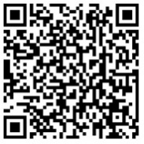
The RSV immunization pipeline to global policy
an overview for low- and middle-income markets
Access these and additional slides offered as part of an RSV communications toolkit at:
bit.ly/RSVInfoToolkit
February 2026

Slide 2





Agenda
 | The policy road to low- & middle-income markets drivers that affect vaccine introduction timelines & the RSV products moving forward
 | Getting to a global recommendation WHO’s Strategic Advisory Group of Experts (SAGE)
 | Evaluating RSV products for global use WHO prequalification & impact study
 | Immunization financing for RSV Gavi, the Vaccine Alliance and other mechanisms to support affordability & access
 | Country decision-making mechanisms NRAs, RITAGs, & NITAGs
Notes:
In this module, we discuss global and country policy and financing issues related to RSV prevention in young infants.
We will first discuss the drivers affecting vaccine introduction timelines and explain why prevention products are often introduced later in LMICs compared to HICs.
Next, we will describe the global policy process and introduce a key group that advises WHO.
We will explain how RSV products are evaluated for global use and will discuss immunization financing
We will wrap up with country policy making.

Slide 3
The policy road to low- & middle-income markets
drivers that affect vaccine introduction timelines & the RSV products moving forward

Slide 4
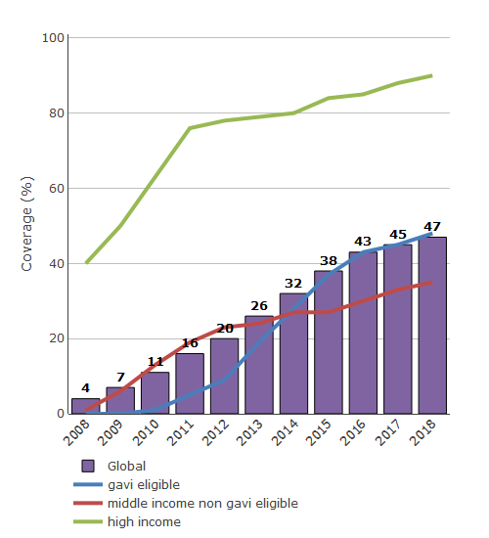
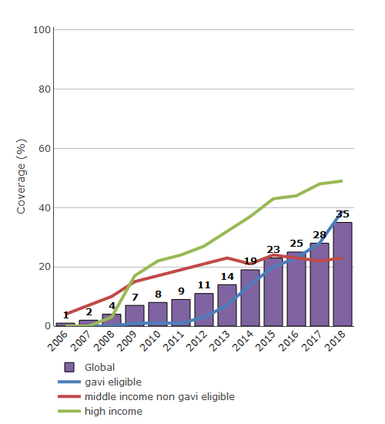
The historic gap in introduction of new vaccines
EXAMPLE
PNEUMOCOCCAL VACCINE INTRODUCTION
by country strata
EXAMPLE
ROTAVIRUS VACCINE INTRODUCTION
by country strata
Source: WHO/UNICEF coverage estimates 2018 revision, July 2019. Immunization Vaccines and Biologicals, (IVB), World Health Organization (WHO). 194 WHO Member States. Date of slide: July 8, 2019.
Notes:
An historic challenge in introducing a new vaccine has been the gap between introduction of new vaccines into high-income and low- and middle-income countries (LMICs).
Historically, new vaccines have taken many more years to be introduced in LMIC’s than in high-income countries (HICs).
On the lefthand graph, you see the example of pneumococcal conjugate vaccines (PCVs).
The green line is the percentage of HICs that introduced PCVs since the vaccine’s first availability in 2008. Within a few years, it was over 50%.
In contrast, in middle-income countries (MICs) in red and LICs in blue, the percentage of countries that introduced PCV remained under 50% after over a decade of their first introduction.
In the right-hand graph, we see the pace of introduction of rotavirus vaccines. The gap between HIC introductions in green and MIC and Gavi country introductions in blue and red is still evident, although the disparity in timing of uptake by countries by income level is not as great as with PCV.
RSV immunization risks following a similar course of delayed introduction into LMICs as PCV and rotavirus, as well as other new vaccines like Hib and human papillomavirus (HPV) vaccines.
The reasons for this historical gap are likely multifold, and include cost, supply, and lack of demand at the regional and national level.
There are also policy challenges in introducing new vaccines like RSV into LMICs. It is these policy challenges, and the pathway to reaching a policy decision on RSV that we would like to discuss in this talk today.

Slide 5

Reasons for this historic delay
Competing immunization and health priorities
Cost
Delayed introduction in low- and middle-income countries (LMICs)
Knowledge gap
Protracted policy process
Notes:
Several factors contribute to the historic gap between vaccine introduction in HICs and LMICs.
The first is the cost of the vaccine, which might be too high for some countries.
This is often the case when a vaccine has a dual market in HICs and LMICs and the manufacturer sets a high price in the early years to recuperate high costs of vaccine development.
A second reason can be a gap in knowledge or awareness of the disease that the vaccine prevents and/or its local burden.
This is often due to lack of testing.
This is particularly true for a disease like RSV that causes a syndrome (respiratory disease) that is similar to that caused by other pathogens.
Another reason for the lag between HIC and LMICs is that many countries have stretched human and financial resources as well as many competing health priorities.
Right now, countries are dealing with priorities such as catching up on measles vaccination that slipped during the pandemic, reviving stalled HPV vaccine introduction, and managing campaigns for vaccine-derived polio or cholera outbreaks.
A final reason for the delay has been that the policy process for vaccine introduction is often more protracted in LMICs.

Slide 6
A more protracted policy pathway in LMICs
Pre-clinical
Clinical
Licensure
MOH approval
Country decision*
Higher-income markets
* Higher-income countries are self-financing. Cost-effectiveness analysis might influence country decisions.
Pre-clinical
Clinical
Licensure
SAGE recommendations
WHO
PQ
MOH approval
Financing support
Country decision
LIC/LMIC markets
Efforts to minimize delays to LMIC markets are critical.
MOH = ministry of health
SAGE = World Health Organization (WHO) Strategic Advisory Group of Experts
WHO PQ = WHO prequalification
Notes:
The two timelines here visualize the difference in the policy pathways between higher-income and low- and middle-income markets.
While the early clinical development steps, shown in dark blue, are the same, there are often extra steps in LIC/LMICs after that shown in the lighter blue color.
These steps can often involve external stakeholders besides the country decision-makers, such as the World Health Organization; Gavi, The Vaccine Alliance; the PAHO revolving fund, and regional advisory groups.
In this talk, we will discuss some of the extra steps and who is involved in each of these to be able to get vaccines into LMICs.

Slide 7


New products for RSV disease prevention in early life
 | Maternal vaccine | Monoclonal antibody
 | Vaccination in pregnancy can directly enhance the pregnant vaccinee’s immunity and increase natural antibody transfer to baby across the placenta for protection in early life. | Directly immunizing infants soon after birth or before/during first RSV season provides antibodies for critical protection in early life.
 | Pre-F protein in the vaccine induces antibodies that neutralize the virus. | mAbs are manufactured antibodies to the RSV pre-F protein that neutralize the virus.
 | Vaccination during defined gestational age window to optimize antibody transfer to infant. (Third trimester as defined in local context [WHO]; other recommended windows vary by country and regulatory authority) | At birth with other birth dose vaccinations (e.g., hepatitis B; BCG, OPV) or before/during first RSV season.
 | Given in one dose At least 5-6 months protection after birth | Given in one dose At least 5-6 months protection after administration (longer lasting than palivizumab)
RATIONALE
HOW IT WORKS
TIMING
PRODUCT CHARACTERISTICS
Notes:
Both approaches are designed to provide passive protection via antibodies to protect babies in the early, most vulnerable months of life.
The immune target for both approaches is the RSV surface fusion, or F, protein—the protein responsible for mediating fusion of the viral membrane with a host-cell membrane.
Maternal vaccines, designed to provide protection during pregnancy, is a way to generate antibodies for newborns and also enhance maternal immunity.
Maternal vaccines boost the concentration of neutralizing antibodies that are then naturally transferred across the placenta to directly protect infants for months after birth.
Vaccination should be timed during pregnancy to maximize the antibodies transferred to baby.
WHO globally recommends vaccination in the third trimester of pregnancy, as defined in the local context, which starts at 28 weeks gestational age in most settings but can be earlier in some places (e.g., 27 weeks).
The newly licensed maternal vaccine was recommended in Europe for use during a gestation window of 24-36 weeks and, in the US and in the PAHO region for a window of 32-36 weeks.
Monoclonal antibodies are laboratory produced antibodies designed to attach to the F protein that the virus uses to infect the body.
What’s new about nirsevimab and other mAbs in development is that they have extended half-lives—so are longer lasting than their predecessor, palivizumab.
They are also designed to be given in one dose at birth or before/during first RSV season, improving delivery feasibility.

Slide 8

Potential RSV immunization product availability for Gavi-eligible countries*
Gavi agrees to support maternal RSV vaccine programs
Vaccine
roll-out in Gavi-eligible countries
UNICEF tender
& Gavi
co-financing
MDV available & WHO prequalified
SDV
WHO prequalified
Estimated 2027 onwards
WHO (SAGE)
policy recommend-
ation
mAb
roll-out in Gavi-eligible countries
First product rollout in some HICs & UMICs
UNICEF tender
& Gavi
co-financing (contingent on affordable pricing & supply)
First regulatory approvals HICs of PFS
Estimated 2026
2025
MATERNAL
VACCINE
2024
2022-2023
2023-2024
Needs: Product presentation suitable for
Gavi-eligible countries &
price commitments made
WHO (SAGE)
policy recommend-
ation
First product rollout in some HICs
First regulatory approvals HICs of PFS
MONOCLONAL ANTIBODIES
Definitions: HIC = high-income country; PFS = pre-filled syringe; UMIC = upper- and middle-income country; WHO SAGE = World Health Organization Strategic Advisory Group of Experts; SDV = single-dose vial; MDV = multi-dose vial
Notes:
This slide shows how we expect RSV immunization products to become available to Gavi-eligible countries. The green dotted lines show where each product is in the process currently. So, since 2022 we've seen many HICs and some UMICs license and start to use the products, as of Sept 2024 we saw global WHO policy recommendations, and the maternal RSV vaccine received WHO prequalification in March 2025 for the single-dose vial presentation.
On the top in blue you see the timelines for maternal vaccine availability and on the bottom in dark pink the timelines for long-acting mAbs.
As shown, it is likely that the maternal vaccine will be available in a form suitable for LMICs first.
This is because Pfizer is developing a multi-dose vial (MDV) with affordable price commitments for Gavi.
In June 2025, Gavi re-confirmed their commitment to supporting introduction of the maternal vaccine.
To ensure that this product can be eligible for global procurement and made widely available, an important next step now is to accelerate the pathway to WHO prequalification for a multi-dose vial presentation that’s better suited for low- and middle-income markets, which could be as soon as 2026.
For the long-acting mAbs, it is not yet clear if the companies will submit the products for WHO prequalification, so this metric is not on the timeline at this time.

Slide 9
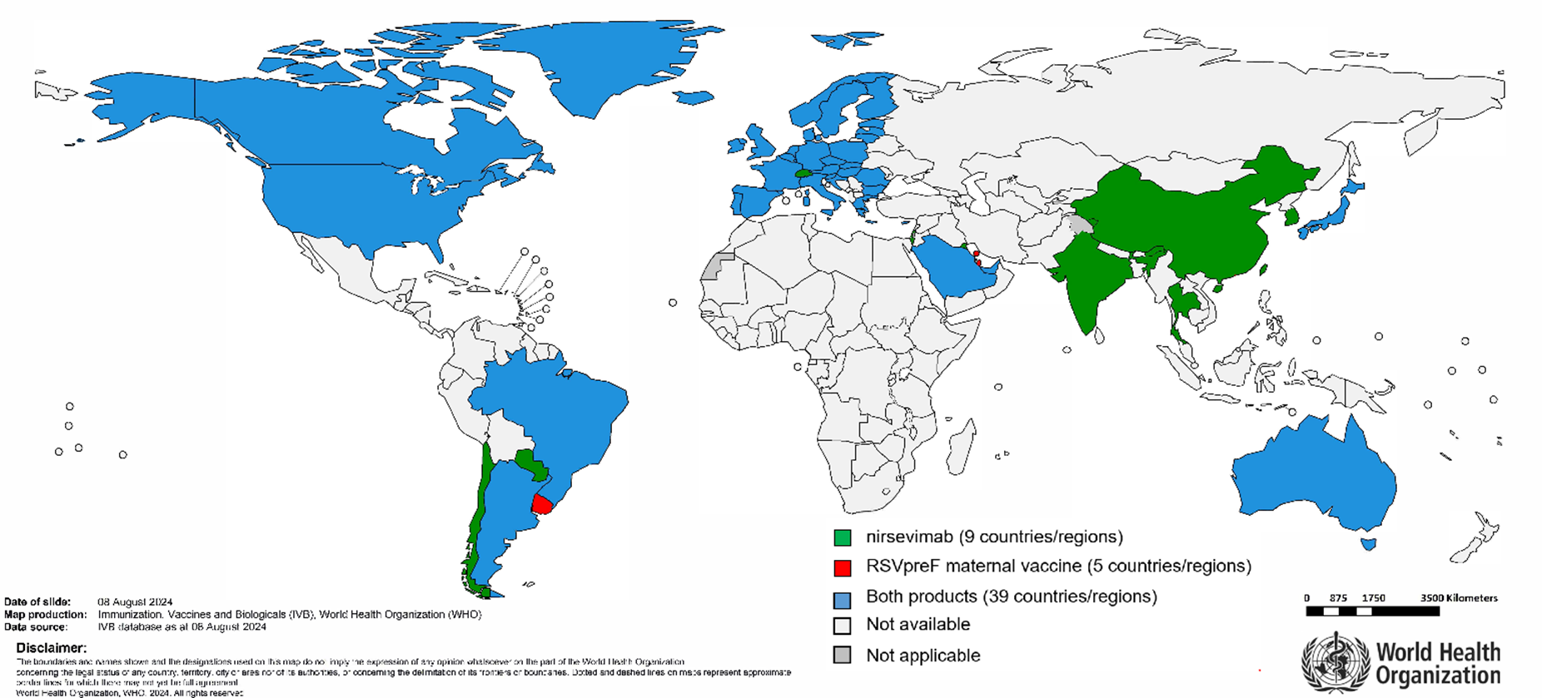
Global market authorizations of RSV immunization products to protect infants
as of August 2024
Notes:
An historic challenge in introducing new vaccines has been the time-lag between introduction of in high-income and low- and middle-income countries (LMICs) and historically, new vaccines have taken many more years to be introduced in LMIC’s.
This map shows RSV product market authorizations as of August 2024, and as you can see, it’s mostly high and some upper-middle income countries that have licensed the products. This figure showcases the need to accelerate access for areas in the world in gray.

Slide 10
Getting to a global recommendation
WHO’s Strategic Advisory Group of Experts (SAGE)

Slide 11
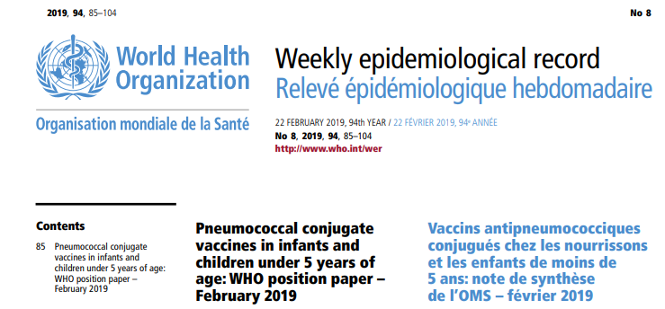
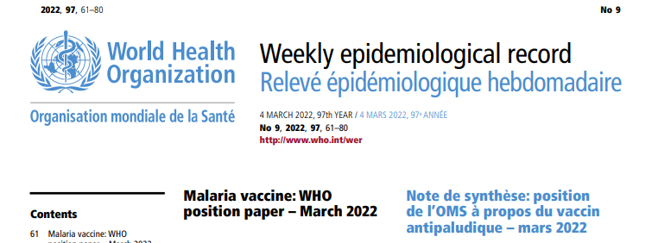
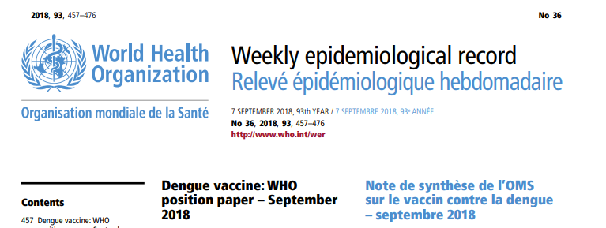
WHO’s Strategic Advisory Group of Experts on Immunization (SAGE)
Principal advisory group to WHO on vaccine policy.
Up to 20 independent members serving 3- to 6-year terms.
SAGE recommendations become WHO Vaccine Position Papers on optimal vaccine use.
A SAGE recommendation is required by Gavi, the Vaccine Alliance and UNICEF.
Notes:
Now let's move on to SAGE, which stands for the Strategic Advisory Group of Experts on Immunization
SAGE is the principal advisory group to WHO on vaccine policy.
The group consists of 15 rotating members who are not WHO employees.
Members represent a broad range of disciplines encompassing many aspects of immunization and vaccines, including epidemiology, pediatrics, immunology, drug regulation, program management, health-care administration, health economics, and vaccine safety.
SAGE’s recommendations are given to the WHO director general for final approval.
All SAGE decisions are published as WHO Vaccine Position Papers on the optimal use of vaccine in the Weekly Epidemiological Record.
A SAGE recommendation for a vaccine is a necessary step in the policy pathway for many LMICs.
It is also a requirement for Gavi and UNICEF to buy and supply vaccines, respectively.

Slide 12

A global recommendation to prevent severe RSV disease in young infants
SAGE engagements on RSV immunization
September 2024
2016
RSV Working Group
SAGE recommends RSV maternal and long-acting mAb immunization introduction for all countries.
October 2022
March 2024
Reference: Highlights from the Meeting of the Strategic Advisory Group of Experts (SAGE) on Immunization 23-26 September 2024
Notes:
SAGE was informed about an RSV immunization product for the first time in 2016.
SAGE also received updates on RSV in October 2022 and at that time, recommended the formation of an official RSV working group, which was subsequently organized.
In March 2024, SAGE was updated on the recent licensure and introduction of the long-acting monoclonal antibody (nirsevimab produced by AstraZeneca/Sanofi) and the maternal vaccine (produced by Pfizer, Inc.),
In September 2024, SAGE made a decision to recommend that all countries introduce RSV immunization—via maternal vaccination and/or long-acting monoclonal antibody—for the prevention of severe RSV disease in young infants.
In May 2025, WHO published its first-ever position paper outlining these recommendations to protect children from RSV.

Slide 13
Aspects of WHO SAGE recommendation across both products
All countries are recommended to introduce immunization products for the prevention of severe RSV disease in infants.
Introduction decisions
Consider cost, financing, supply, anticipated coverage and feasibility of implementation within the existing health system.
Co-administration
Both products can be co-administered with vaccines normally given at the same time.
Seasonality
Year-round immunization preferable in most tropical/ sub-tropical locations where RSV circulates for much of the year without clear seasonality and seasonality patterns are not well-described.
Where RSV circulation has clearly documented seasonal peaks, seasonal immunization may be considered per program and cost considerations.
SAGE meeting report, September 2024: https://www.who.int/publications/i/item/who-wer9949-719-740
Full WHO position paper, May 2025: https://www.who.int/publications/i/item/who-wer-10022-193-218
Notes:
So the overarching recommendation from SAGE is that all countries are recommended to introduce immunization products for the prevention of severe RSV disease in infants but that decisions to include either product in an immunization program should consider cost, financing, supply, anticipated coverage and feasibility of implementation within the existing health system.
Also, SAGE recommends that both products can be co-administered with vaccines normally given at the same time.
And, just to reiterate, that countries will need to look at RSV seasonality epidemiology and other programmatic factors to decide on year-round or seasonal immunization approaches.
WHO’s full position paper was published in May 2025.

Slide 14

WHO’s global recommendation summary—RSV immunization approach specifics
  For countries deciding to use the maternal vaccine:
  Give a single dose in the 3rd trimester of pregnancy, as defined in local context.
    Starting at 28 weeks gestation in most settings but could be earlier in some places.
  No upper gestational age limit for vaccination, except for pregnant people in active labor
  For countries deciding to use the mAb:
  Give a single birth dose to all infants at birth, or at the earliest opportunity after birth, if a year-round approach is adopted
  With a seasonal approach, administration of nirsevimab is recommended for all infants born just prior to, or during the RSV season, and can also be used for those aged up to 12 months entering the season.
Key notes
  SAGE noted with concern the limited availability and high cost of the current mAb, which will limit global access and equity.
Notes:
Regarding the maternal vaccine specifically, WHO recommends a single dose in the third trimester of pregnancy, as defined in local context.
In most settings, the third trimester starts at 28 weeks gestational age.
The recommendation allows for some flexibility if the third trimester is defined differently in a certain context. For instance, in some contexts, it’s as early as from 27 weeks.
WHO also recommends no upper gestational age limit for vaccination, except for pregnant people in active labor.
For countries deciding to use the monoclonal antibody, SAGE recommends a single birth dose to all infants at birth or at the sooner opportunity thereafter for countries opting to use a year round approach, but also recommends that for those countries who opt for a seasonal approach that the mAbs is administered to infants born just prior to the onset or during the RSV season.
The recommendations also include considerations for countries to also chose to immunize older infants who were born out of the RSV season up to 12 months of age, based on local context.
SAGE also noted with concern the limited availability and high cost of the monoclonal antibody, which will seriously limit global access and equity.

Slide 15
Evaluating RSV products for global use
WHO prequalification & impact study

Slide 16


What is WHO prequalification (PQ) for immunization products?
Started 1987, on request by UNICEF and PAHO to evaluate quality, safety, and efficacy of vaccines.
Facilitates immunization product registration in LMICs.
Countries rely on independence of PQ assessment.
UNICEF cannot buy and Gavi cannot fund immunization products without PQ.
  > 150 vaccines prequalified to-date
Notes:
What exactly is WHO prequalification, or “PQ”?
This is a process that started in 1987 on the request of UN procurement agencies like UNICEF and the Pan American Health Organization (PAHO) to evaluate the quality, safety, and efficacy of immunization products.
To date, the PQ process has been conducted for over 150 vaccines, including most recently for COVID-19 vaccines.
PQ facilitates registration of immunization products in LMICs and countries have come to rely on the independence and thoroughness of WHO PQ assessment.
Importantly, UNICEF cannot buy and Gavi cannot fund immunization products until after they have been prequalified.

Slide 17
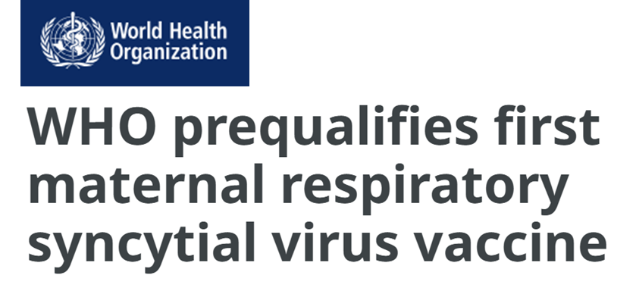
Maternal RSV vaccine now WHO prequalified a key step toward expanding access for low- and middle-income markets
Vaccine now eligible for financial support from Gavi, the Vaccine Alliance and for vaccine purchases by UN agencies such as UNICEF.
Single-dose vial presentation currently prequalified.
Multi-dose vial in development and will require prequalification in the future.
Reference: WHO. Prequalification of Medical Products: Abrysvo. March 2025.
Notes:
On 12 March 2025, the World Health Organization (WHO) prequalified the first maternal respiratory syncytial virus (RSV) vaccine to protect infants. The prequalification applies to the single-dose vial presentation for the vaccine.
Prequalification is a pre-requisite for financial support from Gavi, the Vaccine Alliance, and for vaccine purchases by UN agencies such as UNICEF.
In June 2025, Gavi committed to opening a funding window to support introduction of the maternal vaccine.
A multi-dose vial presentation of the maternal RSV vaccine is in development and will also need to undergo the WHO prequalification process on the road to global market entry.

Slide 18




What happens during the WHO PQ process?
 | Product dossier submitted by manufacturer.
 | Scientific review of manufacturing and clinical data.
 | Consult national regulatory authority(s) (NRA) that have licensed the vaccine. If licensed by stringent regulatory authority (SRA), PQ accepts assessment. If non-SRA-licensed, PQ process includes additional assessment: Testing of samples Site audit of manufacturing facilities
 | Timeline can span 120 days to 300 days.
Notes:
PQ starts with the manufacturer submitting a dossier of the vaccine to the PQ unit for scientific review.
This includes data such as how the dose of the product was selected and what the results of the pivotal clinical trial were in terms of efficacy and safety.
The PQ unit will consult with national regulatory authorities that have authorized the vaccine.
If the vaccine has been licensed by a so-called stringent regulatory authority (SRA) such as the US Food and Drug Administration or the European Medicines Agency, then PQ will often accept the assessment of the SRA.
If authorization has been by an NRA that is considered at Maturity Level 3 and above, reflecting a stable, well-functioning, and integrated regulatory system capable of effective oversight and quality assurance, but it is not considered an SRA, the PQ process will involve more extensive work, including testing of samples and auditing of the manufacturing facilities.
Depending on whether the vaccine was authorized by a SRA or not, the PQ process can take 120 to 300 days to complete.

Slide 19




Ensuring programmatic suitability
Ensure that vaccines used in LMICs can be used safely and effectively, given the constraints and conditions of their immunization systems
Mandatory criteria must be met; critical criteria reviewed on case-by-case basis
Common considerations for programmatic suitability:
 | autodisable syringe
 | vaccine vial monitors
 | standard dose volume
 | standard storage requirements
Notes:
While the main PQ process is similar to that of a regulatory authority, an additional step within the PQ process is called programmatic suitability for PQ.
The programmatic suitability component ensures that the vaccines can be used safely and effectively in LMICs given the constraints of their immunization systems.
Mandatory and critical criteria are involved in the programmatic suitability assessment .
For example, vaccines must be available in autodisable syringes in LMICs.
The current maternal RSV vaccine is a prefilled syringe that is not autodisable, so is, thereby, not yet programmatically suitable for PQ.
To address this, the manufacturer, Pfizer, has developed a single-dose vial formulation that can be used with an auto disable syringe to draw up the sterile water diluent for reconstitution. Then the needle is added to the same syringe to administer the vaccine.
This single-dose vial formulation is now authorized by various regulatory authorities and prequalified by WHO.
Pfizer has also partnered with the Gates Foundation to develop a multidose vial (MDV) formulation that will ultimately be the formulation preferred in LMICs. This MDV is anticipated to be ready for PQ in 2026.

Slide 20
A maternal RSV vaccine impact study is moving forward
documenting the full potential public health impact of RSV products on child health & health systems in LMICs
Study features
Requested by SAGE in October 2022 based on rationale:
Four African countries
Gambia, Ghana, Kenya & South Africa
More “real-world” than Phase 3
Individually randomized, controlled trial
Few exclusion criteria
Primary outcomes
RSV-associated & all-cause severe lower respiratory tract infections and hospitalizations
Preterm birth & low birth weight
To start in 2025, data available by the time a Gavi financing window opens
Enormous potential of these interventions
Many competing health priorities in LMICs
Pivotal trials might not provide sufficient evidence for decision-making in LMICs
Study conducted “in parallel with regulatory, policy and financing decisions …”
Notes:
Another important activity that will support country decision making is a maternal vaccine impact study that was requested by SAGE in October 2022. SAGE requested that such a study be conducted in low-income countries who were not well represented in the trial to better measure the full public health impact of RSV prevention in low-income contexts.
The study is being led by the Witswatersrand University in South Africa.
As well as including South African sites, the study will also include sites in the Gambia, Ghana, and Kenya.
It will take place in a more real-world population than the Phase 3 trial, with fewer exclusion criteria.
It will be individually randomized controlled trial to best assess the outcomes of interest, which will focus on severe RSV and all cause lower respiratory tract infections and hospitalizations.
It will also assess preterm births and low birth weight.
The study is expected to start in 2025 and should have data available by the time a Gavi financing window will open, to allow countries to make informed decisions

Slide 21
Immunization financing for RSV
Gavi, the Vaccine Alliance and other mechanisms to support affordability & access

Slide 22
Global access depends on support from Gavi, the Vaccine Alliance
Gavi is an international organization created in 2000 to improve access to new and underused vaccines for children living in the poorest parts of the world.
As of 2025, 54 countries are eligible for Gavi support.¹
In July 2025, Gavi’s board approved opening a funding window for RSV maternal immunization programs; first introductions into Gavi countries are expected late 2027/early 2028.
So far only the maternal vaccine is anticipated to be affordable within the predicted range.
GAVI SUPPORT FOR RSV MATERNAL IMMUNIZATION OR MAB
PRODUCTS CONTINGENT ON:
1. Availability of licensed product
WHO prequalification
SAGE recommendation
Cost within predicted range
Available funding
Renewed support for RSV in VIS 2025
¹ www.gavi.org/types-support/sustainability/eligibility ² https://www.gavi.org/news/media-room/gavi-board-focuses-health-impact-priority-guiding-principle-resource-constrained
Notes:
It is important to recognize that, due to RSV’s global nature, preventive products will have a dual market in both high- and low-income countries.
To afford these products in lower-income economies, Gavi, the Vaccine Alliance market shaping support is needed.
Since its inception, Gavi support has been instrumental in sharing the cost that countries pay for vaccines, resulting in more than 520 vaccine introductions and campaigns, dramatically boosting immunization against many important diseases.
54 countries are currently eligible for Gavi support.
Gavi voted in its 2018 vaccine investment strategy to support RSV maternal vaccines and/or long-acting mAbs pending a licensed product, a SAGE recommendation, and WHO prequalification—so long as the cost was within an anticipated price window.
In July 2025, the Gavi board approved the opening of a funding window to establish an RSV maternal vaccine program, paving the way for country introductions to begin in the near future.
It is not yet clear what the cost of these new products will be; however, we anticipate that the cost of goods for monoclonal antibodies will be higher than that of a vaccine.
To help bring the price of a maternal RSV vaccine down so that Gavi can afford to pay for it, the Gates Foundation has made a $27.5 million grant to Pfizer to support the development of a multidose vial for delivery of its RSV maternal vaccine in exchange for price and supply commitments to Gavi supported countries.

Slide 23




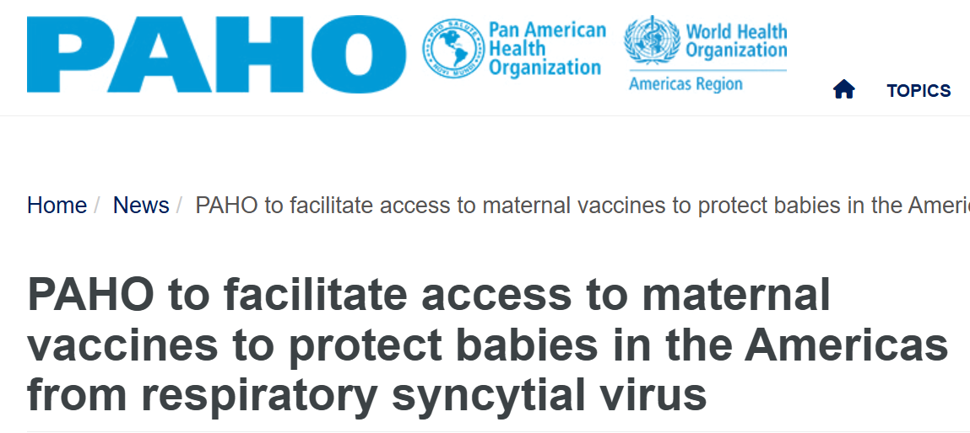
Pooled procurement can also bring down costs of vaccine combines the financial and other resources across countries to create greater purchasing power
Information sharing | Coordinated informed buying | Group contracting | Centralized procurement
Examples
UNICEF Supply Division – tender to open following PQ of maternal vaccine MDV
PAHO revolving fund – agreement reached for maternal vaccine in Nov 2024
Notes:
In addition to Gavi’s funding for vaccines in LMICs, another mechanism exists that can bring the costs of vaccines down for these countries.
While large countries can negotiate prices with vaccine manufacturers, small countries do not buy enough vaccine to have much negotiating leverage on vaccine prices. This is where the role of pooled procurement comes in.
Pooled procurement is when an organization bundles vaccine demands from many countries so there is a larger market when negotiating prices with vaccine manufacturers.
Two successful examples of pooled procurement are:
the UNICEF supply division, which is the primary supplier for Gavi countries and negotiates with suppliers on their behalf, but also supplies to non-Gavi LMICs as well. And as I mentioned a tender will open once there is the MDV vial ready.
And the PAHO revolving fund, which collectively buys vaccines for many countries in Latin America had already opened a tender and made a purchase agreement with Pfizer in November 2024.

Slide 24
Country decision-making mechanisms
NRAs, RITAGs, & NITAGs

Slide 25
Country decision-making bodies the role of NRAs, RITAGs, NITAGs and Governments
Governments
National regulatory authorities (NRAs) | Regional Immunization Technical Advisory Groups (RITAGs) | National Immunization Technical Advisory Groups (NITAGs)
NRAs, if available, must authorize the RSV preventive product for use in country Some countries may rely on WHO PQ or a stringent regulatory agency (SRA) (e.g., EMA or FDA) | RITAGs are multidisciplinary bodies of regional experts that provide evidence-based recommendations to NITAGs & ministries of health Six RITAGs provide their respective WHO Regional Directors & countries with recommendations | NITAGs are multidisciplinary bodies of national experts that provide evidence-based recommendations to policy-makers & immunization programs Not all countries have a NITAG (~120 countries) | Government will decide whether or not to introduce a new vaccine into their national program in the context of limited budgets and competing health priorities
Notes:
The final steps in the process of vaccine introduction will occur at the regional and national levels.
Ultimately, immunization products need to be authorized by the national regulatory authority (NRA) for use in that country.
These NRAs can rely on the authorization of WHO prequalification (PQ) or from the assessment of a stringent regulatory authority such as the Europea Medicines Agency, or they can make their own assessment.
The recommendations on how the product will be used falls to the regional, and then national immunization technical advisory groups, called RITAGs and NITAGs, respectively.
Each WHO region has a RITAG, that meets every year to discuss the portfolio of vaccines in the region. RSV immunization products have already been reviewed by some RITAGs, and will continue with other RITAGs over the next years.
In addition, countries have their own NITAGs that make recommendations in their countries, but ultimately the Government will decide whether or not to introduce a new vaccine into their national program and those decisions will be made in the context of limited budgets and competing health priorities.
Coordinating mechanisms for MNCAH programming, such as technical working groups and sub-groups, may also play a role in decision-making around maternal immunization, but will vary by country.
As RSV immunization moves into the implementation phase, engaging RITAGs, NITAGs, and ministries of health with RSV information to enhance decision making will be essential.

Slide 26
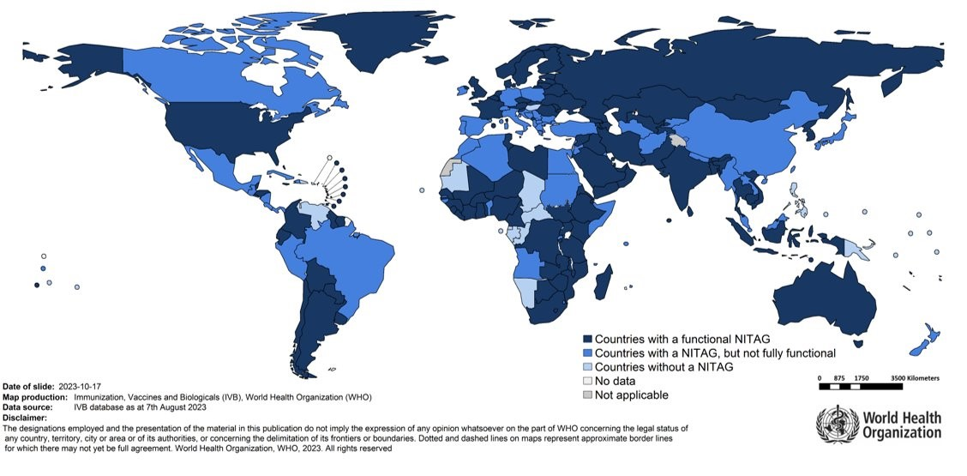
Global status of National Immunization Technical Advisory Groups (NITAGs)
(as of October 2023)
Notes:
This slide shows the status of NITAGs in countries. As you can see most countries do have a functional NITAG in dark blue or a semi-functional NITAG in medium blue.

Slide 27
Key takeaways
Historic lags in availability of new immunization products in LMICs is due, in part, to a more protracted policy pathway.
WHO plays a role in the policy pathway to introduction in LMICs.
  SAGE makes recommendation for optimal use in LMICs. (Achieved in September 2024)
  Prequalification evaluates the quality, safety and efficacy of immunization products for use (Achieved for the maternal RSV vaccine in March 2025)
Gavi has agreed to open a funding window for introduction of maternal RSV vaccine programs. (July 2025)
Procurement agencies (UNICEF and PAHO) support affordable prices through pooled procurement
Ultimately, NITAGs and governments must decide on new RSV immunization product introductions.
Notes:
Historic lags in availability of new immunization products in LMICs is due, in part, to a more protracted policy pathway.
WHO plays a role in the policy pathway to introduction in LMICs.
SAGE makes recommendation for optimal use in LMICs, which was achieved in September 2024.
WHO prequalification evaluates the quality, safety and efficacy of immunization products for use, which was achieved for the maternal RSV vaccine in March 2025.
Gavi will open a funding window for introduction of maternal RSV vaccine programs. (July 2025)
Ultimately, NITAGs and country decision-makers must decide on new RSV immunization product introductions.

