Slide 1
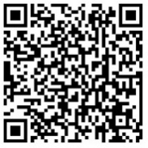
Respiratory syncytial virus (RSV) prevention in older adults
Access these and additional slides offered as part of an RSV communications toolkit at:
bit.ly/RSVInfoToolkit
Version: September 2025

Slide 2

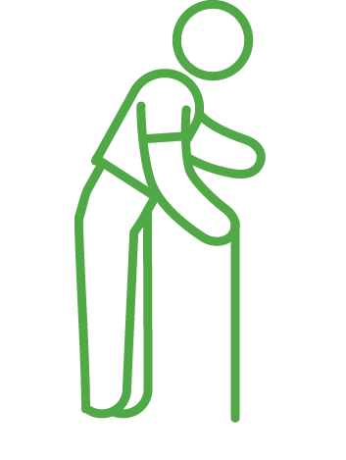



Agenda
 | RSV clinical presentation in older adults
 | RSV burden in older adults
 | RSV prevention in older adults
 | Vaccine handling and administration
 | Vaccine pathway to market

Slide 3
RSV clinical presentation in older adults

Slide 4




What is respiratory syncytial virus (RSV)?
Often mild, like a cold, but can be severe (or deadly) for high-risk populations | Sneezing, coughing, touching contaminated surface and then eyes, nose, or mouth | Infection-induced immunity not fully protective Repeat infections throughout lifespan | Children under 5 years Older adults People with comorbidities (e.g., immunocompromised, underlying heart or lung conditions)
PRESENTATION
TRANSMISSION
PARTIAL IMMUNITY
POPULATIONS AT HIGH RISK
Notes:
RSV is a common respiratory virus that can infect people multiple times throughout life.
Although it’s a familiar viral infection to pediatricians and nurses who take care of infants and children, many clinicians are less aware that RSV is an important cause of respiratory illness in adults.
RSV infection may be mistaken for influenza, COVID-19, allergies, or the common cold because symptoms overlap with those of these other respiratory illnesses.

Slide 5
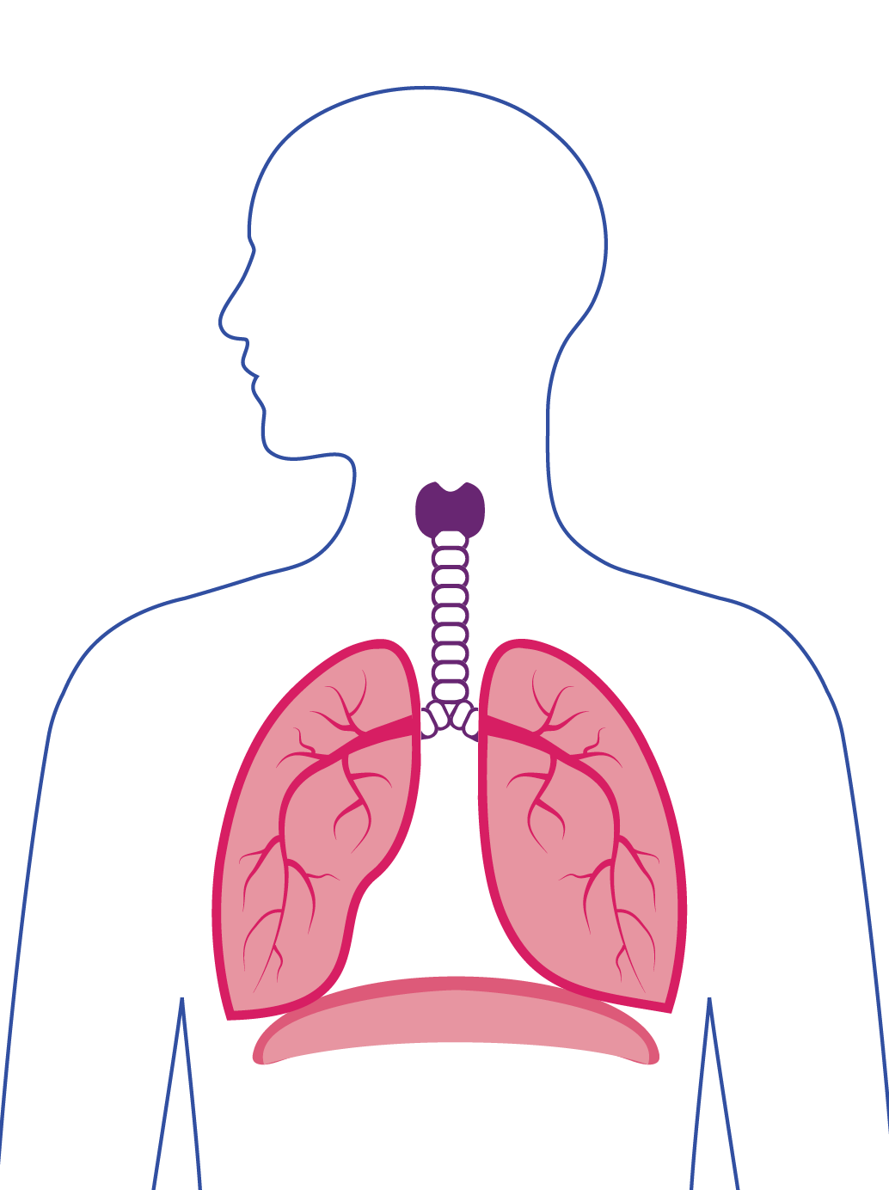
Clinical presentation of RSV in adults
Usually mild or no symptoms in healthy adults
Older adults, especially those with underlying medical conditions, are at increased risk for becoming seriously ill
Serious illness includes:
  Lower respiratory tract infection
  Exacerbation of existing medical conditions
Severe RSV disease can lead to hospitalization and death.
LOWER RESPIRATORY TRACT
Reference: US CDC. RSV (respiratory syncytial virus): For Healthcare Providers. (2023).
Notes:
Healthy adults who get infected with RSV usually have mild or no symptoms. Symptoms are usually consistent with an upper respiratory tract infection, which can include runny nose, sore throat, cough, headache, fatigue, and fever.
However, older adults have an increased risk of becoming seriously ill from RSV infection given their weaker immune systems, especially those with underlying medical conditions
Some adults might develop a lower respiratory tract infection like pneumonia; others may experience exacerbation of existing serious medical conditions like asthma, chronic obstructive pulmonary disease, and congestive heart failure.
Severe RSV disease can lead to hospitalization and death.

Slide 6


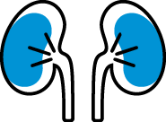



Underlying medical conditions associated with increased risk of severe disease
Lung disease | Neurologic or neuromuscular conditions
Cardiovascular disease | Kidney disorders
Moderate or severe immune compromise | Liver disorders
Diabetes | Blood disorders
Other conditions that might increase the risk for severe disease
Reference: Melgar M, et al. MMWR Morb Mortal Wkly Rep. 2023;72(29).
Notes:
What are the risk factors that increase an adult’s risk for severe RSV disease?
First, some chronic underlying medical conditions are associated with increased risk of severe RSV disease, which include:
• Lung disease—for example, chronic obstructive pulmonary disease or asthma
• Cardiovascular disease—for example, congestive heart failure or coronary artery disease
• Moderate or severe immune compromise—for example, HIV-positivity has shown to elevate risks in high-income countries.
Also, recipients of hematopoietic stem cell transplantation or patients taking immunosuppressive medications can have elevated risks.
Of note, there are many possible immunocompromising conditions. The link on this slide provides some examples, but immunocompromising conditions are not limited to these examples.
Determining degree of immune compromise is at the discretion of the treating provider, and factors to consider in assessing the general level of immune competence in a patient include disease severity, duration, clinical stability, complications, comorbidities, and any potentially immune-suppressing treatment.
• Diabetes
• Neurologic or neuromuscular conditions
• Kidney disorders
• Liver disorders
• Blood disorders – e.g. sickle cell disease
• Other underlying conditions that a health care provider determines might increase the risk for severe respiratory disease

Slide 7



Other factors associated with increased risk of severe RSV disease
Frailty | No consensus definition; however, common features include weight loss, weakness, and trouble walking.
Advanced age | Definitions can vary by country; however commonly defined as 65+ or 70+ years of age.
Residence in a nursing home or other long-term care facility | Long term care facilities house a high concentration of people who are frail, advanced in age, and have multiple chronic medical conditions.
Notes:
In addition to underlying medical conditions, there are other factors associated with increased risk of severe RSV disease in older adults. These include:
Frailty, which is a multidimensional geriatric syndrome and reflects a state of increased vulnerability to adverse health outcomes. There is no consensus definition, and there are many clinical frailty scores in use. However, common features include unintentional weight loss, weakness, and slow walking speed (or inability to walk).
Definitions of advanced age can vary by country. Common definitions include 65+ or 70+, but some parts of the world may consider advanced age to be younger.
Residence in a nursing home or other long-term care facility (LTCFs).
Residents may have many other risk factors, such as comorbidities, frailty, and advanced age.
RSV can also cause serious outbreaks in LTCFs.
Advanced age is also independently associated with increased risk of severe disease in older adults.

Slide 8


Clinical laboratory testing to confirm RSV diagnosis
Clinical symptoms of RSV disease are hard to discern from other respiratory infections—underscoring the need for testing to confirm RSV diagnosis
Laboratory tests are available for diagnosis
  Use real-time reverse transcriptase-polymerase chain reaction (rRT-PCR) assays for adults
  Antigen tests are commonly used for children to diagnose RSV, but not sensitive for use in adults
Notes:
It may be difficult to differentiate RSV from other infections based on symptoms alone.
Clinical symptoms of RSV are nonspecific and can overlap with other viral respiratory infections, as well as some bacterial infections.
Several types of laboratory tests are available for confirming RSV infection. These tests may be performed on upper and lower respiratory specimens.
When thinking about the adult population, real-time reverse transcriptase-polymerase chain reaction (rRT-PCR) assays should be used to test for RSV. These are tests also used broadly for influenza and COVID-19.
The sensitivity of these assays, though not perfect, exceeds the sensitivity of virus isolation and antigen detection methods.
rRT-PCR involve either nasopharygeal or nasal swabs.
More information is needed on the extent to which rRT-PCR testing is done for RSV overall, especially in LMICs.
Antigen tests are not sensitive for this population because they may have lower viral loads in their respiratory specimens.

Slide 9
RSV disease burden in older adults

Slide 10
The risk of severe illness increases with age
Estimated annual RSV-associated hospitalizations per 100,000 adults in the United States: 2016–2020
Number of hospitalizations
Reference: CDC RSV-NET data. Estimates are adjusted for under-testing and incomplete test sensitivity. Presented to the Advisory Committee on Immunization Practices 21 June 2023.
Notes:
When it comes to RSV’s disease burden in older adults, it really comes down to the older you are, the higher the risk.
Although we don’t have specific data for LMICs, this graph shows the age-stratified incidence of RSV hospitalizations per 100,000 population per year in the United States.
These data are from 4 RSV seasons of surveillance in CDC’s Respiratory Syncytial Virus Hospitalization Surveillance Network (RSV-NET) network** in the United States, predating the COVID-19 pandemic.
It shows that the incidence of RSV hospitalization increases substantially with increasing age, even within the age range of adults 65 and older (shown on the right side of the figure).
Target age groups vary across countries:
(US) Individual adults aged 60–64 years may receive a single dose of RSV vaccine, using shared clinical decision-making based on risk assessment.
(UK) Recommended for all adults aged 75+ years.
**The Respiratory Syncytial Virus Hospitalization Surveillance Network (RSV-NET) is a network that conducts active, population-based surveillance for laboratory-confirmed RSV-associated hospitalizations in children younger than 18 years of age and adults in the United States.

Slide 11
RSV disease burden in older adults
Most RSV burden data is from high-income countries, where RSV-associated lower respiratory illness hospitalizations and deaths are substantial.
Estimated RSV-associated acute respiratory illness (ARI) burden among persons ≥ 65 years of age from industrialized countries ¹
EPISODES
1.5M
HOSPITALIZATIONS
214,000
Global data remain poorly defined, particularly from LMICs.
Some global modelling estimates involve data from a limited number of LMICs, which suggest high rates of hospitalizations and deaths.
~ 336,000 hospitalizations (persons ≥ 65 years of age)¹
~ 22,000 deaths (persons ≥ 70 years of age)²
DEATHS
14,000
¹ Shi et al. JID, 2020; 222(S7).
² GBD 2016 Lower Respiratory Infections Collaborators. Lancet ID, 2018; 18.
Notes:
Global burden of RSV in older adults (aged 65 years and older) remains poorly defined as does data from low-income countries
As depicted on the right, recent estimates in industrialized countries found a high burden of RSV-associated ARI, hospitalizations, and deaths in adults aged ≥65 years.
The systematic review estimated:
~1.5 million episodes of RSV-associated ARI
~214,000 RSV-associated ARI hospitalizations
~14,000 in-hospital deaths from RSV-associated acute respiratory illness (ARI) in adults aged ≥65 years in industrialized countries
There are limited data on RSV burden in low-income countries
Global burden estimates that include both high-income and low- and middle-income economies estimate ~336,000 RSV-associated ARI hospitalizations in adults ≥65 years or older
And a global burden of disease study from 2016 estimated ~22,000 RSV-associated lower respiratory illness deaths in adults aged ≥70 years²
Inconsistency in RSV-associated death estimates in older adults are based on inclusion criteria, modelling assumptions, and inclusion of respiratory and circulatory deaths
Data on other respiratory viruses are also limited but data from high-income countries suggest substantial burdens of influenza and RSV in older populations²
The work on RSV in low- and middle-income countries has demonstrated that the seasonality and age of peak illness severity may vary based on geographic and climatic parameters and should be taken into consideration in the planning of trials and development of target product profiles.

Slide 12
RSV prevention measures in older adults

Slide 13
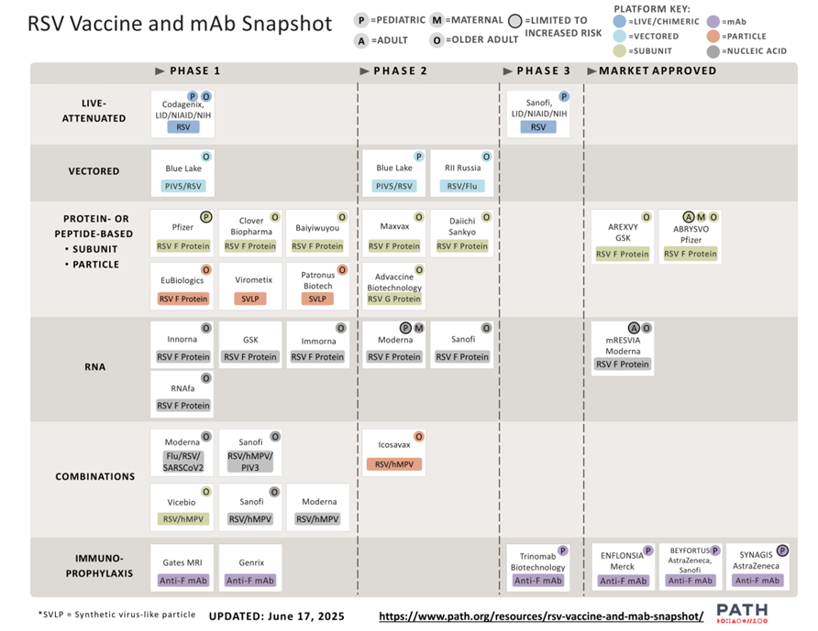
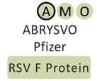
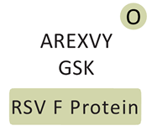
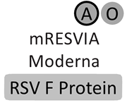
RSV vaccines in development and approved for use in older adults
Notes:
This is a snapshot of the current clinical development of RSV prevention tools, both vaccines and mAbs, highlighting products targeting older adults.
https://www.path.org/resources/rsv-vaccine-and-mab-snapshot/
RSV vaccines provide an opportunity to help protect older adults against severe RSV illness at a time when multiple respiratory viruses are likely to circulate. Several types of vaccines targeting different populations are in development today and two are licensed in high-income countries for use in older adult populations.

Slide 14
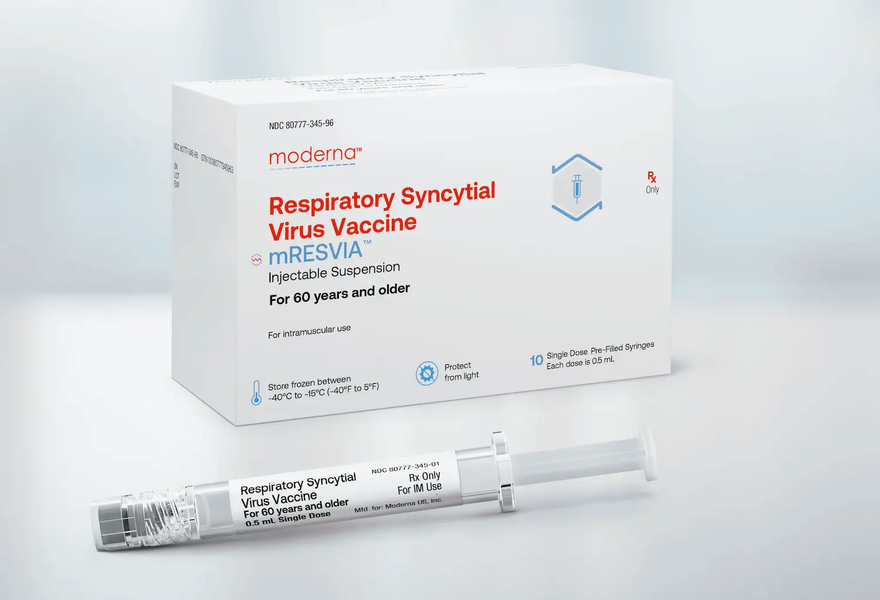
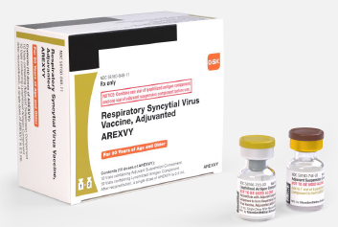
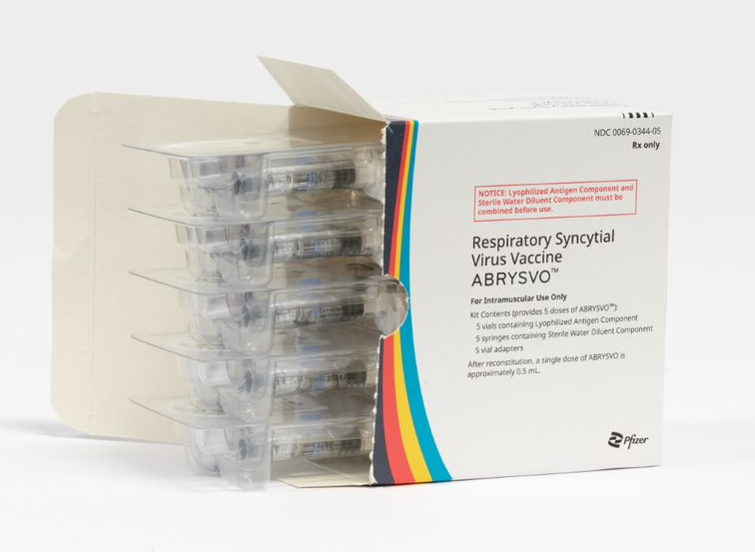
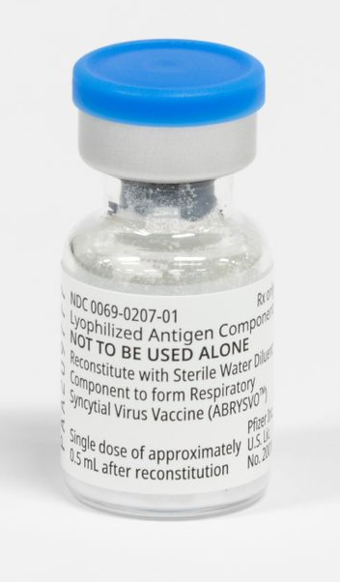
Approved RSV vaccines for older adults
No preferential recommendation across products by regulatory bodies
mRNA-RSVpreF
mRESVIA, Moderna
Recombinant RSVpreF3
Arexvy, GSK
Photo source: Moderna
Photo source: GlaxoSmithKline
Key vaccine characteristics
Single dose administration / intramuscular injection
One 0.5 mL dose per vial / reconstitution (GSK, Pfizer)
One 0.5 mL dose per pre-filled syringe / no reconstitution (Moderna)
Recombinant RSVpreF
Abrysvo, Pfizer, Inc.
Photo source: Pfizer, Inc.
References:
GSK package insert: https://www.fda.gov/media/167805/download
Pfizer package insert: https://www.fda.gov/media/168889/download
Moderna package insert: https://www.fda.gov/media/179005/download
Notes:
In May 2023, the U.S. Food and Drug Administration (FDA) approved the first vaccines for prevention of respiratory syncytial virus (RSV)-associated lower respiratory tract disease (or, LRTD) in older adults. Since then, three vaccines for use in adults 60 years of age and older are licensed.
RSVPreF3, trade name Arexvy, manufactured by GlaxoSmithKline [GSK])
RSVpreF, trade name Abrysvo, manufactured by Pfizer, Inc
mRNA-RSVpreF, trade name mRESVIA, manufactured by Moderna
For the GSK and Pfizer vaccines:
Are recombinant prefusion F protein vaccines. Instead of the entire pathogen, subunit vaccines include only the components, or antigens, that best stimulate the immune system.
Are administered as a single dose. At this time, only 1 dose is recommended.
For both vaccines, supplied vials contain only single doses of product (lyophilized powder or diluent). GSK provides 10-dose kits (i.e., 10 pairs of vials). Pfizer provides 1-, 5-, and 10-dose kits
Should be administered as a dose volume of 0.5 mL.
Require reconstitution. In other words, there will be a lyophilized, or powder component, and a diluent, or liquid component, that must be mixed prior to administration.
Should be administered intramuscularly into the deltoid muscle of the upper arm. If the deltoid muscle cannot be used, the anterolateral thigh is an alternative injection site.
For the moderna vaccine:
mRNA vaccine stabilized in the RSV pre-fusion conformation
Packaged as a single-dose 0.5 mL pre-filled syringe, so no reconstitutions is required.
Intramuscular administration.

Slide 15
Vaccines can prevent considerable RSV disease morbidity among older adults
Significant efficacy/effectiveness against RSV lower respiratory tract illness among older adults Particularly important for older adults with chronic medical conditions and/or frailty Protection extends into the second year after vaccination | Countries have opted for different minimum age eligibility for vaccine administration among older adults Decisions are informed by their population age structure and national burden data
EFFICACY/EFFECTIVENESS
ELIGIBILITY
Melgar M, et al. MMWR Morb Mortal Wkly Rep 2023;72.
Papi A, et al. NEJM. 2023 Feb 16;388(7)
Walsh EE, et al. NEJM. 2023 Apr 20;388(16).
Notes:
Overall, both vaccines were generally well-tolerated with an acceptable safety profile in clinical trials
In adults ages 60 and older, the Pfizer and GSK vaccines had similar and high vaccine efficacy and effectiveness against symptomatic lower respiratory tract disease. Data for Moderna is still coming in.
RSV vaccination has the potential to prevent considerable morbidity from RSV disease among older adults, particularly in those with chronic medical conditions and those who are frail.

Slide 16
RSV vaccines prevent significant disease in older adults in clinical trials
Clinical trial efficacy against symptomatic
lower-respiratory tract disease (LRTD)
(≥ 60 years of age)
GSK (Phase 3)¹ RSV-associated LRTD with ≥ 2-3 symptoms 17 countries | median follow up 6.7 months
Pfizer (Phase 3)² RSV-associated LRTD with ≥ 3 symptoms 7 countries | median follow up 7 months
Moderna (Phase 2/3)³ RSV-associated LRTD with ≥ 3 symptoms 22 countries | median follow up 112 days
82.6%
(95.88% confidence interval [CI]; 66–92.2)
85.7%
(96.66% CI; 32–98.7)
82.4%
(96.36% CI; 34.8–95.3)
Note: Each clinical trial had differences in design and definitions. For this reason, clinical trial efficacy cannot be directly compared between the various vaccines.
¹ Papi A, et al. Respiratory Syncytial Virus Prefusion F Protein Vaccine in Older Adults. N Engl J Med. 2023;388:595-608.
² Walsh EE, et al. Efficacy and Safety of a Bivalent RSV Prefusion F Vaccine in Older Adults. 2023;388:1465-1477.
³ Wilson E, et al. Efficacy and Safety of an mRNA-Based RSV PreF Vaccine in Older Adults. N Engl J Med. 2023;389:2233-2244.
Notes:
In adults ages 60 and older, all three vaccines had similar and high vaccine efficacy against symptomatic lower respiratory tract disease in late-stage clinical evaluation.
Those studies for all vaccines were conducted in multiple countries, most of which were high-income countries, but some LMICs were included.
It’s important to note that the clinical trials had differences (including a different case definition for lower respiratory tract disease), so the efficacy results cannot be compared across trials.

Slide 17
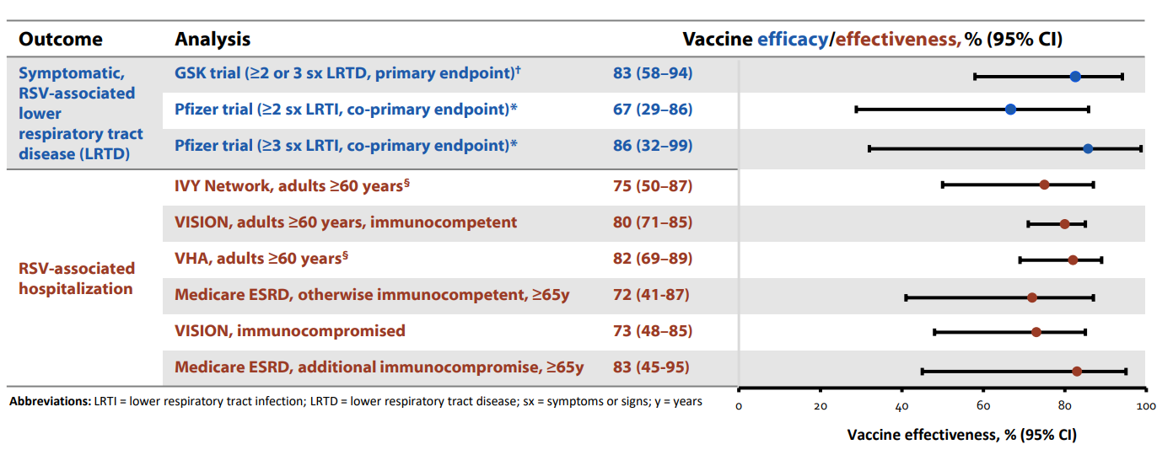
Pfizer/GSK vaccines protect against severe RSV disease in real-world US settings
Effectiveness similar to Phase 3 clinical trial efficacy, though different endpoints
† Papi A, et. al. Respiratory Syncytial Virus Prefusion F Protein Vaccine in Older Adults. N Engl J Med. 2023;388:595–608.
* Walsh E, et. al. Efficacy and Safety of a Bivalent RSV Prefusion F Vaccine in Older Adults. N Engl J Med. 2023;388:1465–77.
§ Includes patients with immunocompromising conditions in the displayed VE estimate
Slide sourced from presentation delivered by Dr. Diya Surie at Advisory Committee on Immunization Practices meeting dated June 26, 2024 Accessed at: https://www.cdc.gov/acip/downloads/slides-2024-06-26-28/07-RSV-Adult-Surie-508.pdf
Notes:
Now, we have data from real world use of the GSK and Pfizer vaccines from post-marketing research in the United States, which confirms what we saw in the clinical trials.
We’re seeing high effectiveness ranging from 72 to 83% across several different healthcare platforms in the US in populations 60 to 65 years of age and older. These estimates also include patients with immunocompromising conditions.
Given Moderna’s more recent market entry and developing market share, no post-marketing data is available for that vaccine yet.
Overall, what we’re seeing is that these vaccines are consistently able to prevent disease in clinical trial and real world settings.

Slide 18
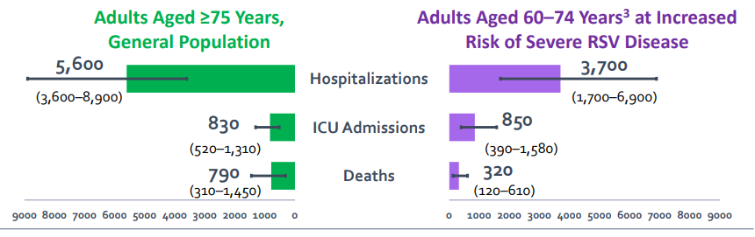
The benefits of RSV vaccination are estimated to outweigh potential risks.
Estimated RSV-associated outcomes preventable over 3 seasons with subunit RSV vaccines (GSK & Pfizer) per 1 million persons in the US
0-18 attributable cases of Guillain-Barré syndrome (GBS)
Overall, GBS rates after RSV vaccination remain low.
Graphic credit: David Hutton, University of Michigan. Sourced via Melgar M, Britton A. “RSV Vaccination in Adults: Work Group Interpretations.” US Advisory Committee on Immunization Practices. October 24, 2024. Available at: https://www.cdc.gov/acip/downloads/slides-2024-10-23-24/06-RSV-Adult-Melgar-508.pdf.
Other references
Lloyd PC, et al. Evaluation of Guillain-Barré syndrome following Respiratory Syncytial Virus Vaccination among Medicare Beneficiaries 65 Years and Older. medRxiv preprint. Posted January 6, 2025.
Wilson E, et al. Efficacy and Safety of an mRNA-Based RSV PreF Vaccine in Older Adults. N Engl J Med. 2023;389:2233-2244.
Notes:
All three licensed RSV vaccines for older adults are generally well-tolerated.
Most common side effects are similar to other vaccines
Pain at injection site
Fatigue
Headache
Muscle Pain
Joint Pain
Safety of Pfizer and GSK vaccines:
This graphic illustrates the estimated RSV-associated hospitalizations, ICU admissions, and deaths preventable over 3 seasons with subunit vaccines like the GSK and Pfizer products can prevent in older populations in the United States.
In the US, postmarketing real-world observational data do suggest an increased risk of Guillain-Barre Syndrome (GBS) during the 42 days following vaccination with both Pfizer and GSK RSV vaccines in Medicaid recipients 65 years of age and older.
Note that even with this observed increase, GBS rates after RSV vaccination are still relatively low, as this graphic shows 0-18 GBS cases following RSV vaccination per 1 million persons.
Overall, the key takeaway here is that the benefits of RSV vaccination outweigh potential risks.
Safety of Moderna vaccine:
The Moderna vaccine showed no safety signals in clinical trials.
As the most recent of the RSV vaccines for older adults to be licensed, post-marketing safety monitoring data is still being gathered.

Slide 19
Vaccine handling and administration

Slide 20
Vaccine storage and handling
BEFORE RECONSTITUTION |  | NO RECONSTITUTION
Store refrigerated 2◦C to 8◦C (36◦F to 46◦F) | Store refrigerated 2◦C to 8◦C (36◦F to 46◦F) | Freezer -40°C to -15°C (-40°F to 5°F) Refrigerator up to 90 days (2◦C to 8◦C (36◦F to 46◦F) Room temperature up to 24 hours 8°C to 25°C (59°F to 77°F)
Do NOT freeze | Do NOT freeze
Protect from light | Protect from light | Protect from light
AFTER RECONSTITUTION
Store refrigerated between 2◦C and 8◦C (36◦F and 46◦F) OR at room temperature [up to 25◦C (77◦F)] | Store at room temperature [15◦C to 30◦C (59◦F to 86◦F)]
Do NOT freeze | Do NOT refrigerate or freeze
Protect from light
Use within 4 hours | Use within 4 hours
GSK/Arexvy
Pfizer/Abrysvo
Moderna/mRESVIA
Notes:
The products have differences in terms of storage and handling that should be noted.

Slide 21



Vaccine presentation and packaging
GSK/Arexvy
Pfizer/Abrysvo
Moderna/mRESVIA
Supplied in 2 vials
Supplied in 3-component kit
Supplied in pre-filled syringe
Vial of lyophilized antigen component
Vial of diluent adjuvant suspension component
Packaged without syringes or needles
Vial of lyophilized antigen component
Syringe of sterile water diluent component
Vial adapter
Do not shake
Do not refreeze after thawing
Different countries will have different package inserts.
US Food and Drug Administration Package Inserts:
GSK: https://www.fda.gov/media/167805/download
Pfizer: https://www.fda.gov/media/168889/download
Moderna: https://www.fda.gov/media/179005/download
Notes:
Arexvy is supplied in two vials that must be reconstituted prior to administration. One vial is a lyophilized antigen component and the second is a liquid diluent adjuvant suspension. You MUST use the diluent provided by the manufacturer. The product is packaged without syringes or needles.
mRESVIA comes in a pre-filed syringe, so no reconstitution is necessary. As long as it’s properly stored, it is ready for administration.
Abrysvo is supplied in a kit with three components: a vial of Lyophilized Antigen Component (a sterile white powder), a prefilled syringe containing Sterile Water Diluent Component, and a vial adapter. In preparation for administration, the vial adapter should be attached to the top of the vial. This is where the syringe should connect and attach for reconstitution.

Slide 22
Vaccination co-administration
Recommendations around co-administering RSV vaccines with other vaccines can vary by country.
In the US, many people receive RSV vaccines at the same time as COVID-19 and influenza vaccines.
Vaccination timing
Adult RSV vaccines provide protection for at least 2 seasons,¹ enabling more flexible vaccination timing.
In the US, vaccination is recommended before the start of the RSV season in settings with defined seasonal peaks.
  Vaccination may be offered throughout the year to eligible adults that are unvaccinated.
Reference: Melgar M, et al. MMWR Morb Mortal Wkly Rep 2023;72.
Notes:
Several countries have issued differing recommendations on coadministration of RSV vaccines with other vaccines.
In practice, a large proportion of people in the US are getting their RSV vaccines at the same time as their COVID-19 and influenza vaccines.
Available data on immunogenicity of coadministration of RSV vaccines and other vaccines are currently limited.
Same-day administration of RSV vaccines with influenza vaccines have generally demonstrated a non-inferior immune response, compared with separate administration on different days. However, antibody titers against both pathogens tended to be numerically lower after same-day administration. The clinical significance of this finding is unknown.
Data are limited on the safety of coadministration with other vaccines that might be recommended for persons in this age group, such as COVID-19 vaccines; pneumococcal vaccines; adult tetanus, diphtheria, and pertussis vaccines; and the recombinant zoster vaccine
Different NITAGs have differing recommendations for coadministration
So far, RSV vaccines appear to provide some protection for at least two RSV seasons in older adults. (No data are available yet on protection beyond 2 seasons.)
Additional surveillance and evaluation activities are planned to assess how long the vaccines protect against RSV and whether additional doses will be needed.
Studies are ongoing to determine whether older adults might benefit from receiving additional RSV vaccines in the future.
Limited data exist on optimal timing for vaccination
A best practice is to time the vaccine to precede start of RSV season
Continue to offer vaccination throughout the RSV season to eligible adults who remain unvaccinated
Implications for countries with unknown or variable seasonality need to be further explored.

Slide 23


Vaccine delivery considerations
In general, data on care seeking behaviors in older adults are limited globally.^{1,2}
Older adults typically have lower rates of vaccination compared to children, especially in LMICs.³
For RSV and future vaccines, review of potential platforms for vaccine delivery for older adults should be considered (e.g., with influenza and COVID-19 vaccines).
Teo K, et al. Journal of Applied Gerontology. 41(5); 2022.
Roller-Wirnsberger R, et al. Aging Clin Exp Res. 2021;33.
Wong MK, et al. MMWR Morb Mortal Wkly Rep. 2023;72.
Notes:
Data are limited on care seeking behaviors in older adults globally
Older adults have limited interaction with health care system due to, but not limited to, comorbidities, accessibility, health beliefs¹
Generally, despite increased risk for negative outcomes, older adults have lower rates of vaccination compared to children, especially in LMICs.
Alternative platforms or methods for vaccine delivery can be considered (e.g., targeted immunization campaigns).

Slide 24
Vaccine pathway to LMIC markets

Slide 25


Considerations for broadening access to RSV vaccines for older adults
WHO’s Scientific Advisory Group of Experts (SAGE) may consider policy recommendations for RSV vaccines for older adults in the next few years. | RSV vaccines for older adults would need national regulatory agency approval and National Immunization Technical Advisory Group (NITAG) endorsement for optimal use in country (e.g., defining age threshold).
Notes:
The pathway to broader markets around the world is still being considered for RSV vaccines for older adults.
Therein, several considerations will affect the pathway forward, including:
What recommendations WHO’s SAGE might consider for these vaccines
And, national approvals for optimal use at the country level.
For now, more work is needed to further clarify and facilitate the policy and access pathways for these vaccines to become more widely available.

Slide 26
Key takeaways
RSV vaccines given to older adults are effective in preventing severe disease, as shown in post-licensure studies.
Benefits of vaccination outweigh potential risks.
Countries can consider adoption of RSV vaccine as fits into adult vaccination programs.
Notes:
Overall, the key takeaways around RSV vaccines for older adults are:
RSV vaccines given to older adults are effective in preventing severe disease, as shown via robust data from clinical trial and post-licensure studies.
The benefits of vaccination outweighing any potential risks.
Countries can consider adoption of RSV vaccine as fits into adult vaccination programs.

