Slide 1
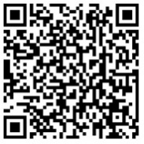
RSV immunization approaches for protecting infants
maternal immunization and monoclonal antibody strategies
Access these and additional slides offered as part of an RSV communications toolkit at: bit.ly/RSVInfoToolkit
Version: February 2026

Slide 2


Agenda
 | Why maternal immunization? how vaccination in pregnancy works to protect infants from RSV disease
 | Why long-acting monoclonal antibodies (mAbs)? how antibodies given at birth protect infants from RSV disease
Notes:
In this presentation, I will talk to you about the two flagship approaches that the global health community is pursuing to protect young infants from RSV disease – maternal immunization and long-acting monoclonal antibodies.
We’ll talk about why these approaches are important, how they work, and precedents that can be built upon to increase the chances of success.

Slide 3
Why maternal immunization?
how vaccination in pregnancy works to protect infants from RSV

Slide 4
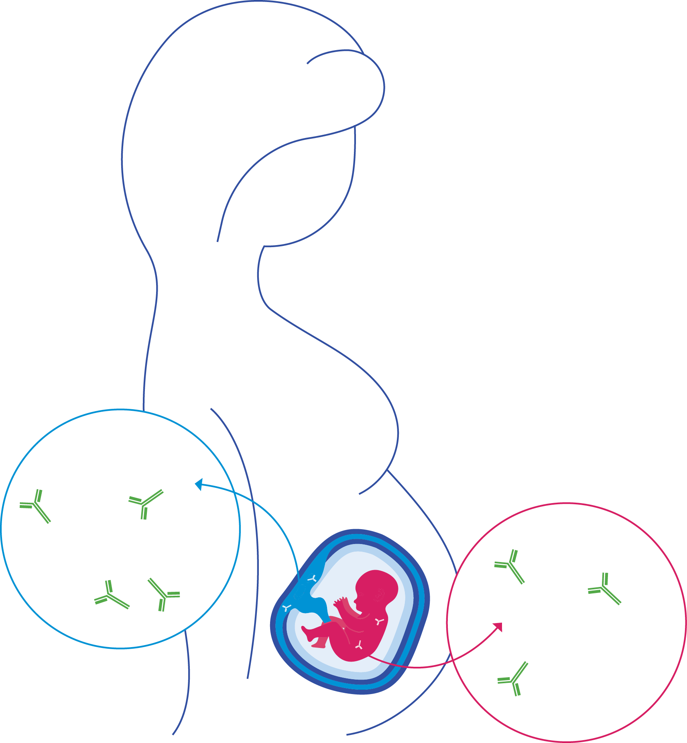
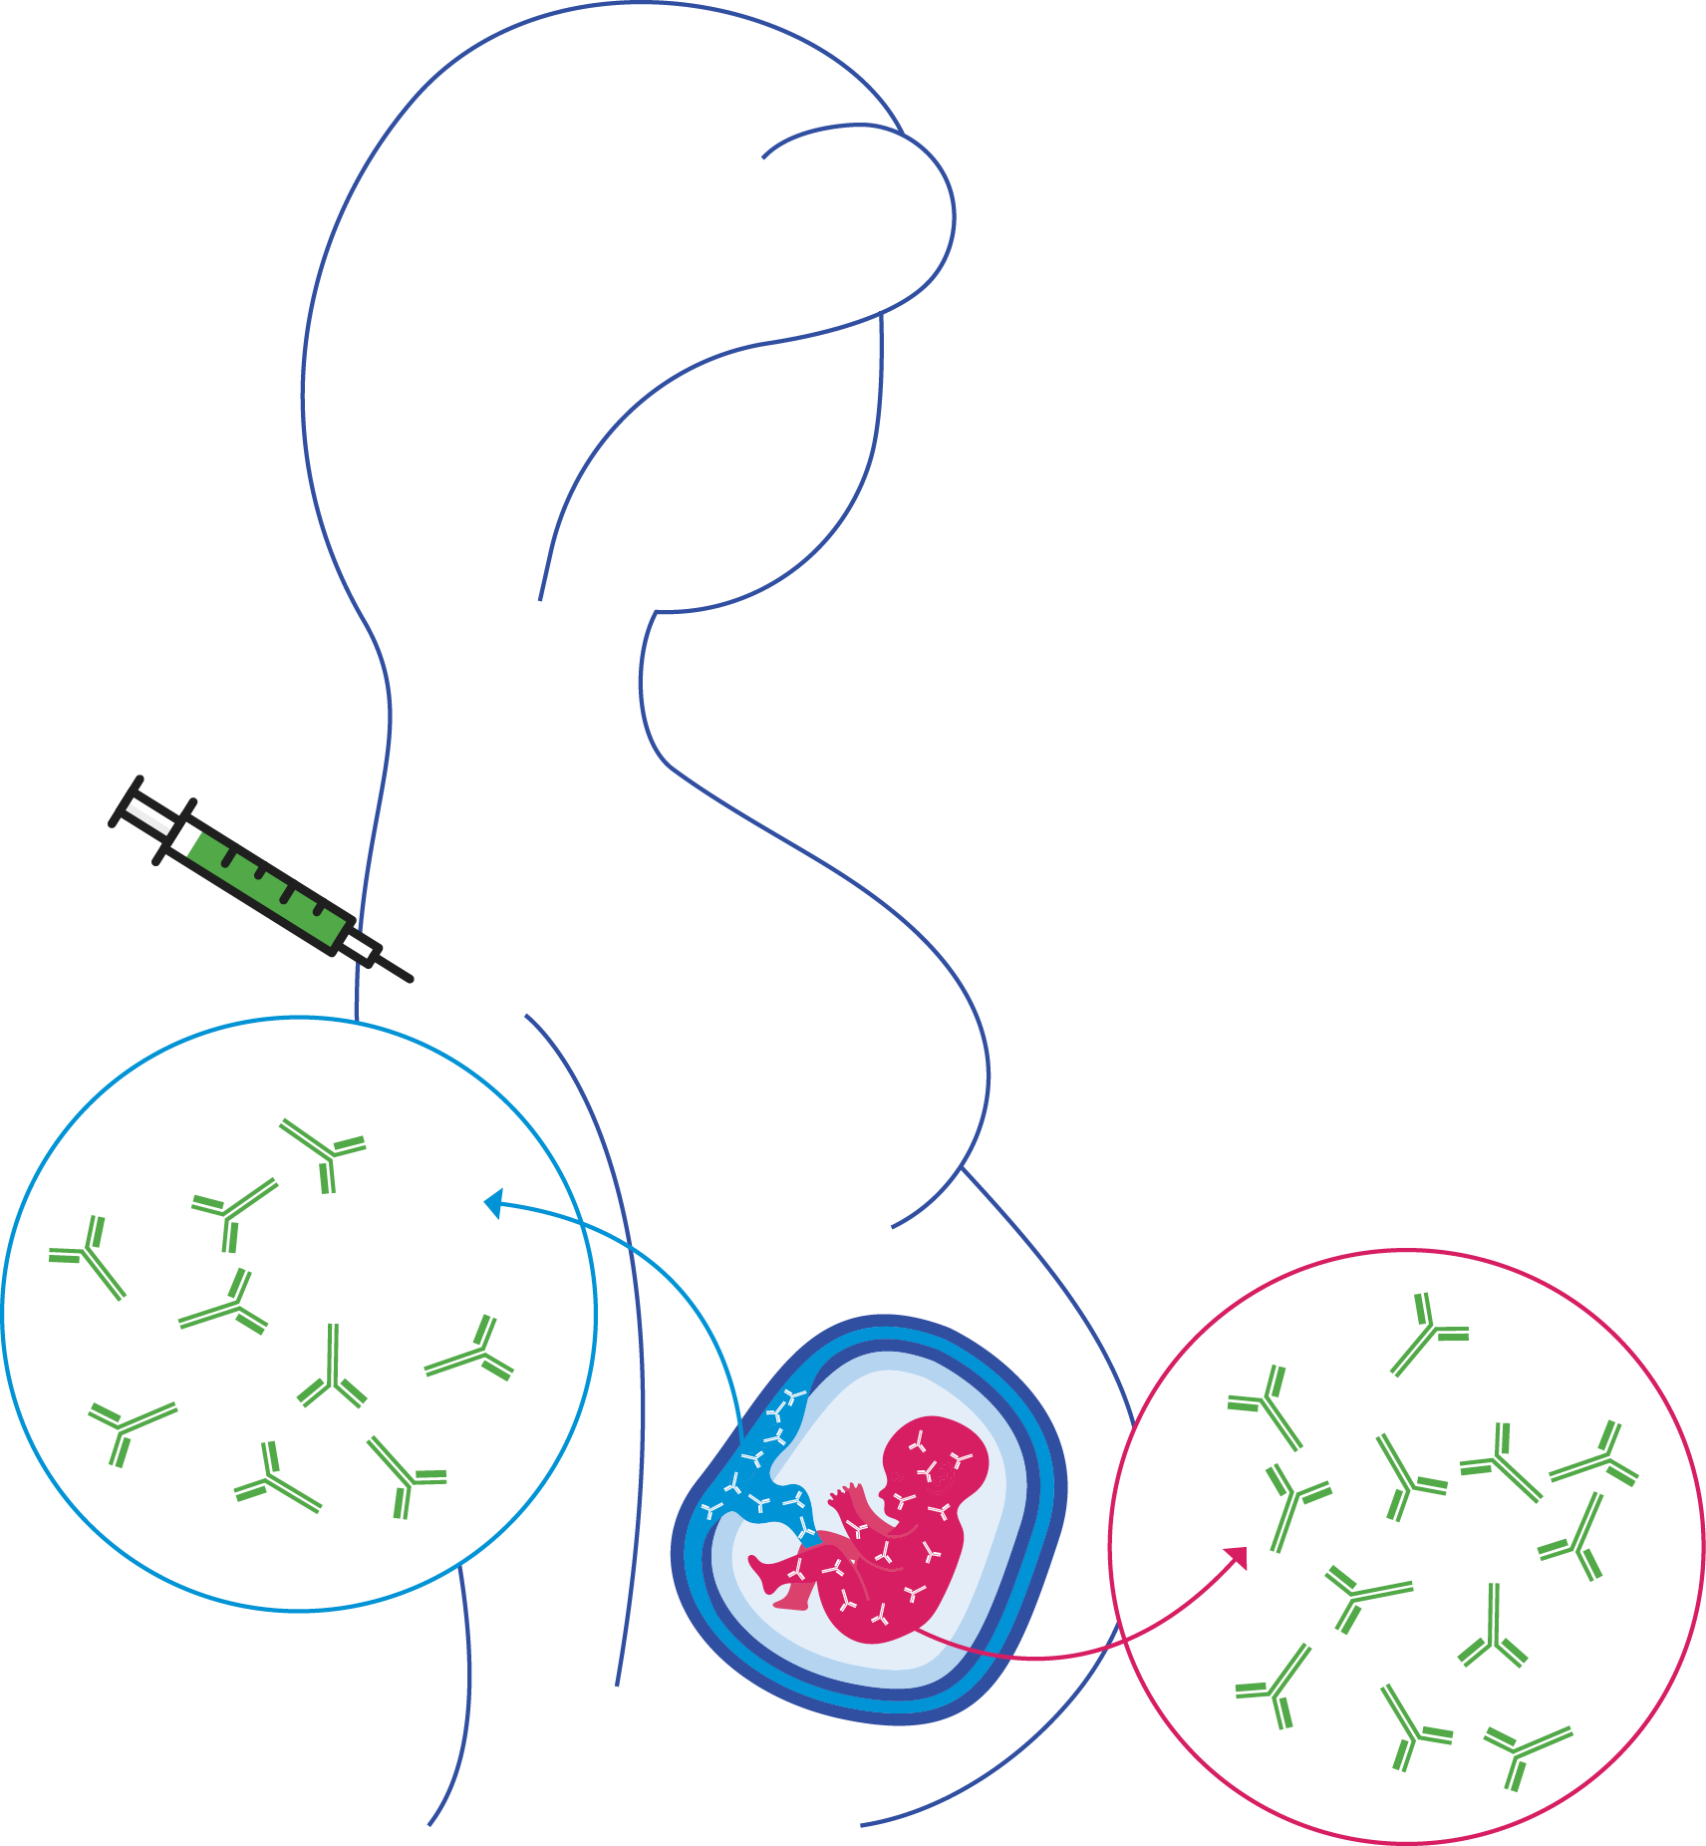

What is maternal immunization?
vaccination in pregnancy to protect mother, baby, or both from serious infections
Enhances protective antibodies for the mother, which naturally transfer to baby through the placenta and protect in the first critical few months after birth.
NO vaccination
WITH vaccination
= RSV antibodies
Last updated: January 2024
Notes:
Maternal immunization is a way to help protect a pregnant woman, her baby, or both from serious infections.
For instance, tetanus maternal immunization is used to protect mother and baby because tetanus can cause severe outcomes for both.
In the case of RSV, however, the benefit of protection is focused on the infant because RSV can occur when babies are very young when their immune systems are immature and would have an inadequate immune response to vaccination.
The mother has been exposed to RSV many times and she has built up antibodies and can most likely fight off new infections without the need of a vaccine.
Since young infants are the ones at risk, maternal immunization is an important strategy for protecting them.
Maternal immunization is a type of active immunization for the mother, but passive immunization for the baby.
Active immunity is developed when one’s own body develops the antibodies, while passive immunity is developed when the antibodies are produced elsewhere and then introduced into the body.
Maternal immunization works by antibodies naturally moving from mother to baby across the placenta
Maternal antibody transfer happens throughout pregnancy, but especially in the last few months and weeks of pregnancy. Maternal antibodies can also pass to baby via breastmilk.
When a mother is vaccinated, she makes even more antibodies to fight against a particular infection
These extra antibodies are passed from mother to baby and give greater protection against disease in the early months of life
The antibodies passed from mother to baby gradually wane over time but provide critical protection during the first 6 months of life when babies are at greatest risk of severe disease and death from pathogens like RSV.
For some infections, maternal immunization is a way to protect both mother and baby against diseases that put them both at risk.
For instance, maternal immunization has a great track record around the world against tetanus and in many countries against influenza—pathogens that pose high risks in pregnancy and infancy.
COVID-19 maternal immunization is recommended in many countries because the virus is a pathogen that poses increased risk of severe illness for pregnant women and complications in their newborns.
For other infections, the benefit of protection is focused on the infant. Serious infections can occur when babies are very young and their immune systems are too immature or multiple immunizations would be required to mount an adequate active immune response.
This is the case, for respiratory syncytial virus, or RSV, since over her lifetime, the mother has been exposed to RSV many times and she has built up antibodies and can most likely fight off new infections without the need of a vaccine.

Slide 5
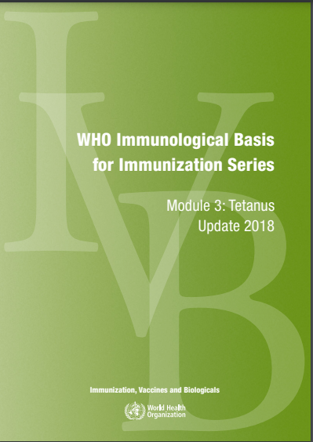
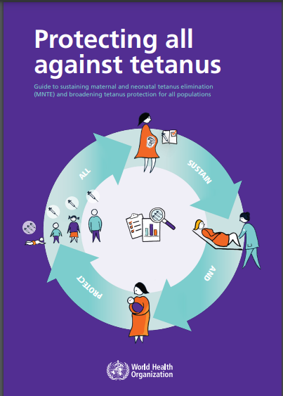
Maternal immunization is not new. We can build on experience.
EXAMPLE Maternal and neonatal tetanus (MNT) elimination
Vaccination safely used in pregnancy since the 1960s
Tetanus toxoid and tetanus-diphtheria vaccines
Maternal immunization pivotal in MNT elimination in most countries around the world
Strong WHO guidance / widespread acceptance
In low- and middle-income markets, delivered routinely or via campaigns & supplemental immunization activities
 | Vaccine
 | Tetanus
 | RSV Influenza (seasonal) COVID-19 Pertussis
 | Group B Streptococcus (GBS)
Widespread/ global use
Use in limited (mostly higher income) markets to date
New and emerging opportunities
Notes:
Maternal immunization has long been in used in many parts of the world, and in some cases worldwide.
For instance, tetanus vaccine has been given to tens of millions of women across the globe for decades and has been very successful at preventing maternal and neonatal tetanus.
Enormous progress was made in low- and middle-income markets in this regard via the Maternal Neonatal Tetanus Elimination Program, which helped 47 countries eliminate MNT.
We also saw some countries prioritize COVID-19 maternal immunization during the pandemic, in alignment with WHO interim recommendations.
Other vaccines, such as influenza and pertussis, are also in use, though in in fewer regions, often where economies are higher income.
Now, the first RSV maternal vaccine is licensed in a number of countries, with first use occurring during the 2023 RSV season. The vaccine has not yet been scaled up globally.
Starting in September 2024, WHO recommended that all countries introduce RSV immunization, including maternal vaccine, for the prevention of severe RSV disease in young infants.
Additionally, new maternal vaccines are in the development pipeline, including against Group B Streptococcus, a common cause of neonatal sepsis.

Slide 6
Maternal immunization’s importance for RSV prevention a way to protect very young infants
NO vaccination
Severe RSV disease occurs when infants are very young.
Young infants rely on maternal antibody transfer for protection.
By increasing a pregnant woman’s antibodies, maternal immunization can extend the duration of protection in the infant by closing the “window of vulnerability” during which
maternal antibodies wane
an infant’s immune system matures to make its own antibodies
Optimizing protection of infants requires vaccination during specified gestational age window.
WHO recommends 3rd trimester as defined in local context; windows can vary by regulatory authority and country.
Prevention is especially important for young infants in LMICs where RSV disease burden is highest and healthcare access is often limited.
WITH vaccination
= RSV antibodies
Notes:
It seems fairly obvious why disease prevention is important for very young infants. This population is amongst the most vulnerable to certain infections—and RSV is one.
Since newborns have immature immune systems, for protection, they rely on the transfer of maternal antibodies against infectious agents that the mother has been exposed to over her lifetime.
In the top figure, we see in the figure in BLUE, the antibody levels in the mother. If not exposed to the pathogen, antibody levels remain constant during pregnancy, just above a threshold level needed for protection.
In the same figure, the RED line indicates the levels of maternal antibody transferred to the fetus during each pregnancy trimester, culminating in a peak right around birth, offering protection to the baby at birth.
Note, however, that the level of maternal antibody in the newborn drops off quickly after just a few of weeks of life, which can be below the level of threshold of protection, leaving the young infant vulnerable to infectious diseases.
This opens up what is called a “window of vulnerability” in the infant, in which the level of maternal antibody is below the threshold needed for protection, but the infant’s own immune system is not yet mature enough to fend off pathogens or respond effectively to most vaccines.
Without a preventive intervention, the infant remains extremely vulnerable, particularly in low- and middle-income countries, where disease burdens are highest and health coverage is often limited
In the second graphic, you can see how maternal immunization acts to enhance the maternal antibodies in the mother, which then are transferred to baby. Since antibody levels are higher with vaccination, they last longer; this in turn, shortens the window of vulnerability in the infant.
To maximize antibody transfer for protection against RSV disease, the vaccine needs to be given in late the 2nd or 3rd trimester. Recommendations vary slightly across countries.
WHO recommends a single dose of vaccine in the third trimester of pregnancy, as defined in the local context. In most settings, the third trimester starts at 28 weeks gestational, but in some places it could be defined as starting earlier (e.g., 27 weeks).

Slide 7
Maternal immunization is evolving, with new considerations
 | Maternal tetanus vaccine precedent | New maternal RSV vaccine
 | Vaccines licensed for wider indications, then used in pregnancy | Designed & indicated for use in pregnancy (licensed in many countries, WHO recommended and prequalified)
 | Administered year-round with flexible timing during pregnancy | Specific gestational age window for administration Some countries might consider seasonal administration based on the RSV seasonal peak
 | Wide acceptance | Limited awareness of RSV and maternal vaccine’s potential
 | Given at routine antenatal care visits, but delivery enhanced via campaigns or supplementary immunization activities | Antenatal care / immunization program coordination needed for routine delivery
DEVELOPMENT
TIMING
ACCEPTANCE
DELIVERY
Notes:
Historically, vaccines used for maternal immunization have been licensed for other indications that are then later used in pregnancy.
Now, new vaccines are being developed, licensed, and globally recommended that are designed and indicated specifically for use in pregnancy.
In fact, Pfizer’s RSV maternal vaccine is the first vaccine specifically indicated for use in pregnancy ever to be licensed. It is also now WHO recommended and prequalified.
This new era of specifically indicated maternal vaccines is exciting in terms of vaccine equity because these tools are being tailored to meet needs of pregnant women and their newborns, two traditionally underserved populations when it comes to disease prevention.
What’s important to understand is that some of these new vaccines also come with new needs that must be accounted for.
While tetanus elimination is often credited with laying the foundation for other vaccines targeting pregnant women, for instance, there are some nuances to the tetanus story that are not completely transferrable to other existing and upcoming maternal vaccines.
For one, the new maternal RSV vaccine is recommended to be given during a certain time window in pregnancy as opposed to tetanus, which can be given throughout pregnancy.
RSV occurs seasonally in many areas of the world, which will influence when immunization is needed.
Campaigns and other supplemental immunization activities used for delivering tetanus vaccine in pregnancy, especially in low- and middle-income markets, are unlikely to be sufficient for some of the new and emerging maternal vaccines, including RSV.
Antenatal care and Expanded Program on Immunization programs may need to coordinate in new ways to ensure pregnant women are systematically reached at the right times.

Slide 8
Immunization with long-acting mAbs
how antibodies given at birth to protect infants against RSV disease

Slide 9
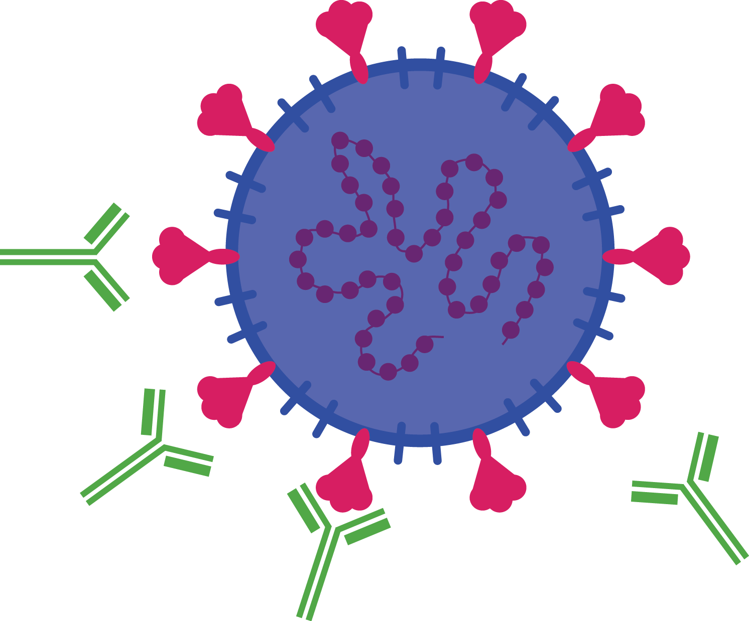
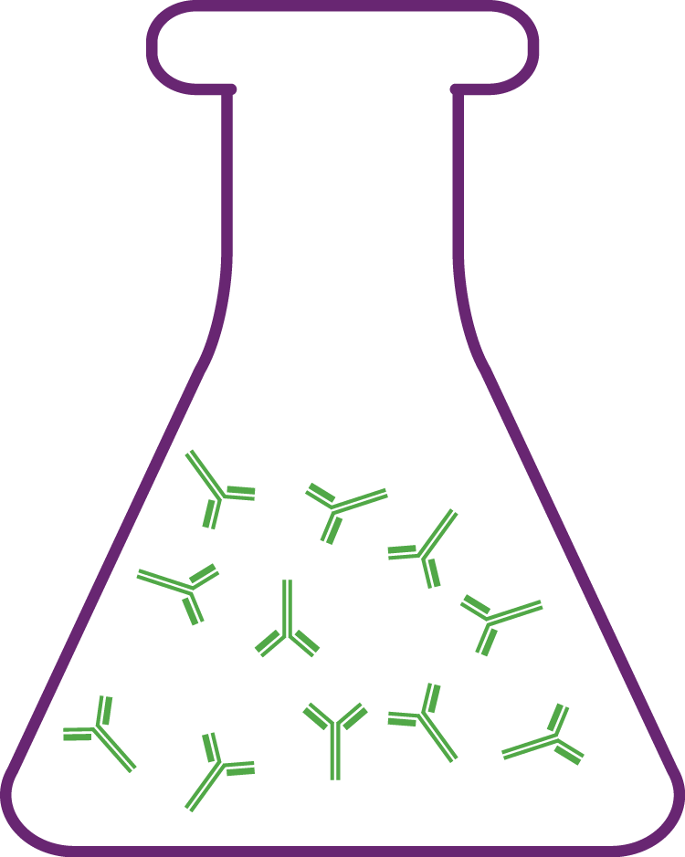

What are monoclonal antibodies (mAbs)?
Manufactured antibodies that can kill a virus or other pathogen
Protect immediately and don’t require infants to produce their own antibodies
Short acting RSV mAb Palivizumab (LICENSED since 1998) For limited use in at-risk infants and toddlers. Up to 5 monthly doses / costly and impractical for global market.
Long-acting RSV mAbs For broad-scale use in young infants and children. One dose at birth or prior to/during first RSV season. Can be used in second RSV season in high-risk children. | Nirsevimab (LICENSED since 2023; WHO recommended) Market shaping needed for global market access.
 | Clesrovimab (US Food and Drug Administration approved)
mAbs mimic human antibodies but are created in labs and tailored to a specific condition
Like human antibodies, mAbs attach to harmful pathogens and antigens, alerting the immune system to a threat
This immune response helps to neutralize the threat and overcome illness
Notes:
Let’s talk quickly about how monoclonal antibodies work.
Mimicking the natural antibodies that our immune systems produce, mAbs are antibodies specifically engineered in laboratories to fend off a targeted disease or infection.
They are a form of passive immunization and offer protection immediately.
Like antibodies our own bodies make, they work by attaching themselves to harmful pathogens and alerting the immune system to the threat, helping to neutralize the foreign invader and prevent illness.
mAbs are another powerful tool for preventing diseases like RSV in early life because, when delivered directly to a baby, they provide the antibodies needed without the baby’s immune system needing to generate antibodies of its own.
This technology is also not new.
For RSV, three mAbs are licensed to prevent disease, one short acting and two long acting.
Palivizumab gained licensure in 1998.
It is effective at preventing serious lower-respiratory tract disease leading to hospitalization for at-risk infants and toddlers but is short-acting and requires frequent dosing.
In fact, it requires up to five doses to obtain the desired protection—an expensive and impractical prospect for most countries.
As such, palivizumab has only been available in high-income markets.
A new, longer-acting mAb called nirsevimab is now licensed in several countries and recommended by WHO for global use.
It is longer-acting than palivizumab and can be given in one dose soon after birth or prior to/during first RSV season, enabling early protection and easier administration.
It can also be used in the second RSV season in high-risk children.
It’s indicated to prevent lower respiratory tract disease in young infants and children.
From a technical perspective, it’s the longer-acting mAb technology that opens the door for potential broad-scale up to meet global needs.
As things stand now, though, nirsevimab would require marketing shaping efforts for the product to be made available in non-wealthy countries.
Another long-acting RSV mAb candidate developed by MSD (Merck) called clesrovimab (trade name ENFLONSIA) received US Food and Drug Administration approval in June 2025.
Having a second available monoclonal antibody might lead to broader global market access for these effective products.

Slide 10
mAbs are not new, but using them is new territory for most countries
EXISTING
IN DEVELOPMENT
RSV
Certain cancers
COVID-19
Ebola
Rabies
Additional Ebola
HIV
Malaria
Notes:
mAbs have been in development since the 1970s; the first licensed was used to prevent kidney transplant rejection. They have also been used to fight certain cancers—mostly in high-income markets.
Aside from the RSV mAbs already licensed, mAbs have also been used as treatments to some infections and diseases, such as COVID-19 and Ebola and are being pursued for the prevention of other infections, such as malaria.

Slide 11
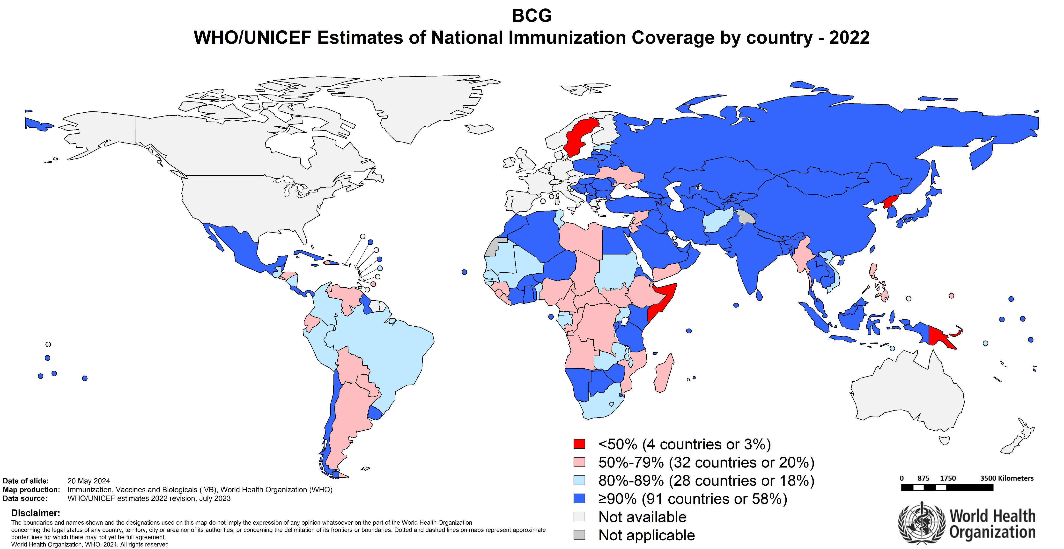
Many countries already deliver vaccines at birth the bacille Calmette-Guerin (BCG) vaccine example
Notes:
To look at what sort of coverage of a birth dose of RSV mAb might be expected, we can use BCG as the best predictor, since BCG is intended to be given as a birth dose.
As this map shows many countries already provide birth dose vaccines like BCG to young infants.
From BCG coverage in 2022, most of Asia has coverage over 90%., indicated by the dark blue.
In Africa, coverage is not as high.
Some countries in darker blue have coverage over 90%, more have coverage 80-89% in lighter blue, although almost all countries have coverage 50-79% as indicated in pink.
A limitation of this data is that we don’t know if BCG was truly given as a birth dose or sometime later.
The takeaway here is that vaccination at birth or soon thereafter isn’t new, and countries can leverage prior experience.
Still, as this map shows, achieving optimal coverage in some locations has a ways to go.

Slide 12
mAbs introduce new considerations for birth-dose vaccination
 | Precedent birth-dose vaccines (e.g., BCG, HepB) | New long-acting birth-dose mAbs (e.g., RSV)
 | Available & accessible on global market | Not yet available in LMICs; market shaping needed for equitable pricing & access
 | Traditional vaccine technologies | New policy and regulatory considerations may be necessary for mAb technologies
 | Wide acceptance | New acceptability considerations with adding another birth-dose immunization and new mAb technology to immunization schedule
 | Systems in place in most countries to vaccinate at birth | Health worker sensitization may be needed; extra time/capacity to administer additional product
MARKET
TECHNOLOGY
ACCEPTANCE
DELIVERY
Notes:
Any new product comes with new considerations.
The world is used to delivering vaccines like BCG and Hepatitis B at birth, so those systems are already in place and, for the most part, work well.
These vaccines are widely used and accepted and are based on traditional technologies that people are used to.
The new long-acting mAbs, though given at birth or soon thereafter, bring with them a need for evolution.
Overall, these technologies are a wave of the future for disease prevention but will require market shaping to ensure equitable pricing and access.
They can leverage existing systems widely established in most countries for delivering current birth-dose vaccines.
These are new technologies targeted for routine administration at birth, however, so introduction may require new regulatory and policy territory for some countries.
With new technologies and added jabs also come considerations related to time and capacity of health workers to administer the mAb and issues of acceptability, both within communities and among health workers.

