Slide 1
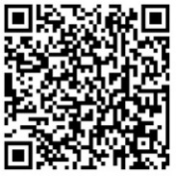
RSV surveillance in infants and young children tracking disease activity and informing vaccine deployment
Access these and additional slides offered as part of an RSV communications toolkit at:
bit.ly/RSVInfoToolkit
Version: September 2026
Notes:
We are going to talk about respiratory syncytial virus (RSV) surveillance in pediatric populations, particularly infants and young children in this session. We will also cover systems that can provide information on the burden of disease in a given context, identify high risk groups, or support RSV product deployment as products become available.

Slide 2



Agenda
 | Why disease surveillance? general concepts and options for RSV
 | Sentinel surveillance a core option for low- and middle-income countries (LMICs) to track RSV and other diseases
 | Additional surveillance approaches for RSV options for generating a fuller data picture
Notes:
Today, we’ll discuss the basic considerations around RSV surveillance
Key surveillance concepts as they pertain to RSV and informing public health action
Sentinel surveillance’s role as a key option for LMICs to track RSV and other disease activity
Additional surveillance options if more information is desired and extra resource allocation is feasible

Slide 3




What is respiratory syncytial virus (RSV)?
RSV is so common that almost all children contract the virus before 2 years of age.
Often mild, like a cold, but can be severe (or deadly) for infants. RSV can be hard to distinguish from other respiratory illnesses. Lower respiratory symptoms require medical attention and potentially hospitalization. | Sneezing, coughing, touching contaminated surface and then eyes, nose, or mouth | Infection-induced immunity not fully protective Repeated lifelong infections | Any infant or young child can get severely ill and be hospitalized. Most with severe disease are born full term and have no underlying health conditions The highest risk is in infants and young children Additional factors that increase risk: Premature birth Comorbidities (e.g., underlying heart or lung disease) Living in socioeconomically disadvantaged areas
PRESENTATION
TRANSMISSION
IMMUNITY
PEDIATRIC POPULATIONS
AT RISK OF SEVERE DISEASE
Notes:
RSV is a virus that is easily spread throughout a community.
Virtually everyone gets RSV at some point in their lives, usually by two years of age.
RSV disease is often mild, like a cold, but can be severe (or deadly) for infants.
Transmission can occur through sneezing, coughing, and transference from contaminated surfaces.
Repeated infections can occur over a lifespan since infections induce only partial immunity.
Although any child can get severely ill or hospitalized due to RSV, children are at highest risk if they are under 6 months of age, have co-morbidities like heart and lung disease and prematurity, or live in a socioeconomically disadvantaged area.

Slide 4
Why disease surveillance?
general concepts and options for RSV

Slide 5
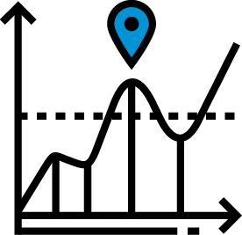

What is disease surveillance and why is it useful?
Tracking disease occurrence in defined populations via ongoing and systematic data collection and analysis.¹ | Public health action, such as setting vaccination policy, requires good surveillance data.
SYSTEMATIC TRACKING
INFORM POLICY
¹ Prucolli G, et al. Viruses. 15(2);2023.
Notes:
Disease surveillance is an ongoing process involving the systematic collection, analysis, interpretation, and dissemination of information regarding the occurrence of disease in defined populations.
Different kinds of surveillance can help enhance understanding disease activity at global, regional, and national levels, which is important for information public health action.

Slide 6
Why track disease activity for RSV?
RSV’s global disease burden is large, and surveillance is needed to fill geographic gaps in RSV burden data and inform regional and national prevention strategies.
Surveillance is critical for informing strategies to reduce RSV disease, particularly among at-risk populations (e.g., young children, older adults).
Global RSV surveillance currently prioritizes infants and young children given global financing for prevention strategies for these age groups.
New tools for preventing RSV in early life are now licensed in several countries and globally recommended by the World Health Organization, including:
vaccine given in pregnancy
long-acting monoclonal antibodies given at birth or before entering RSV season
¹ Li Y, et al. Lancet 2022.
² Melgar M, et al. MMWR Morb Mortal Wkly Rep 2023;72.
Notes:
Respiratory syncytial virus (or RSV) is a common respiratory virus with a large disease burden worldwide and urgently needs to be addressed.
Surveillance is critical for informing strategies to reduce RSV disease, particularly among at-risk populations (e.g., young children, older adults).
With such a large disease burden, understanding RSV’s disease activity is essential for information prevention programs—including the use of new RSV maternal vaccines and long-acting monoclonal antibodies.

Slide 7
RSV global disease burden in children
Annual global pediatric RSV disease burden (< 5 years of age)¹
In children < 6 months of age, RSV is responsible for:
LEADING CAUSE OF SEVERE RESPIRATORY INFECTION
HIGH-INCOME
LOW-INCOME
24
hospital deaths
/ 1,000 RSV cases
33 million
episodes
LEADING CAUSE OF PEDIATRIC HOSPITALIZATION
3.6 million
hospitalizations
109
community deaths
/ 1,000 RSV cases
IMPORTANT CAUSE OF PEDIATRIC MORTALITY
<1
community deaths / 1,000 RSV cases
<1
hospital deaths / 1,000 RSV cases
101,000
deaths
The disparity in RSV mortality between
low- and high-income contexts is substantial.
nearly half of RSV pediatric deaths occur before 6 months of age
¹ Li Y, et al. Lancet 2022.
Notes:
Respiratory syncytial virus (or RSV) is a common respiratory virus with a large disease burden worldwide.
In 2022, the global annual RSV burden estimates were updated and published in the Lancet.
These estimates found that, in 2019, RSV was responsible for a staggering 33 million episodes of acute lower respiratory tract infection, approximately 3.5 million hospitalizations, and over 100,000 RSV deaths among children less than five years of age worldwide.
Overall RSV accounts for 2% of the global mortality burden in children under 5 years of age and 3.6% among children under 6 months of age.
RSV in children under 6 months of age accounts for 20% of acute lower respiratory infection episodes and almost half of all RSV deaths in children under 5 years of age.
Young children are at particularly high risk of severe RSV infection because of lack of pre-existing immunity
The disparity in RSV mortality between low- and high-income contexts is substantial.

Slide 8
Understanding RSV activity in LMICs is important
98% of pediatric RSV mortality occurs in these settings¹
As RSV prevention product availability broadens, expanded surveillance is needed in LMICs, where RSV’s disease burden is disproportionately high.
Estimating burden of RSV can help countries justify introducing interventions and monitor impact.
Understanding RSV’s epidemiology can help inform when, where, how, and for whom vaccines can be introduced.
Ongoing surveillance can monitor impact and understand burden averted post introduction of interventions.
¹ Li Y, et al. Lancet. 2022
Notes:
As product availability broadens, expanded surveillance is needed in LMICs where RSV’s disease burden is disproportionately high.
Estimating burden of RSV can help countries justify introducing interventions and monitor impact.
Understanding epidemiology of RSV can help inform when, where, how, and for whom vaccines can be introduced (i.e., through understanding of the seasonality within the country, understanding the populations at highest risk).
Ongoing surveillance can monitor impact and understand burden averted post introduction of interventions.

Slide 9
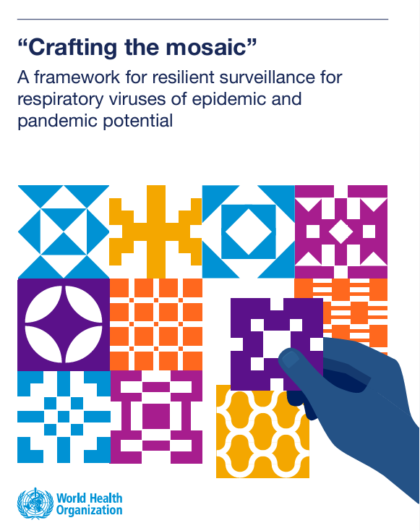
Surveillance can track multiple respiratory pathogens, including RSV
Respiratory surveillance requires multiple surveillance designs to address the multitude of objectives—from monitoring epidemiology to evaluating public health interventions.
RSV can be integrated into broader respiratory and other disease surveillance programs.
WHO’s mosaic framework for respiratory virus surveillance.
A helpful resource for countries considering how best to integrate RSV into their network of surveillance systems.
Reference: WHO. “Crafting the mosaic”: a framework for resilient surveillance for respiratory viruses of epidemic and pandemic potential. 2023.
Notes:
Tracking the activity of multiple respiratory pathogens is possible by integrating cross-pathogen surveillance (including for influenza, COVID-19, and RSV).
Before getting into the specifics of how RSV surveillance currently works and considerations for the future, it's good to first understand some general considerations that form the basis for any surveillance effort, including for RSV.
There are different surveillance designs available that can be used alone or together, providing complementary information.
Each design has different aims and resource requirements, which we will describe over the next few slides.
A national mosaic surveillance system, including for RSV, should be informed by clear national priorities and disease control objectives.
A good resource to learn more is via WHO’s “Crafting the mosaic” framework referenced here.

Slide 10
Different surveillance approaches & studies can be applied to inform RSV decision-making in LMICs
Routine data collection from a select number of sites applying a standard case definition. For most countries, monitoring seasonality, identifying at-risk groups, and characterizing burden of disease will be priorities for RSV surveillance. Sentinel surveillance is a core surveillance approach for many of these objectives. As a result, sentinel surveillance is a primary (but not the only) approach for monitoring RSV globally. | May be relevant for informing decision-making in some LMICs depending on public health priorities and resources/funds available.
SENTINEL SURVEILLANCE
OTHER SURVEILLANCE TYPES AND SPECIAL STUDIES
Electronic medical record surveillance
Longitudinal/ cohort
studies
Mortality surveillance
Health economics modelling studies
Syndromic surveillance
Burden estimation studies
Knowledge, attitudes, perceptions studies
Notes:
This slide shows some of the different surveillance approaches that are and could be leveraged for RSV.
The RSV objectives listed in Domain 2 on the previous slide are priority objectives.
For most countries, monitoring seasonality, identifying at risk groups, and characterizing burden of disease will be priorities of RSV surveillance.
Sentinel surveillance is a core approach for meeting Domain 2 surveillance objectives, and is the primary approach for monitoring respiratory diseases globally, most notably influenza and SARS-CoV-2 in recent times.
As a result, sentinel surveillance is a primary (but not the only) approach for monitoring RSV globally.
Sentinel surveillance can achieve a variety of aims depending on national priorities, including monitoring of seasonality and severity, especially in at-risk or target groups; tracking disease spread; and providing data to support disease burden estimation in hospitals, which can be extrapolated to regional or national levels.

Slide 11
Sentinel surveillance
a core option for LMICs to track RSV and other respiratory diseases

Slide 12







Sentinel surveillance overview primary approach used globally and in LMICs to monitor respiratory diseases
Routine data collection from a select number of sites applying a standard case definition.¹
QUALITY > QUANTITY
RECRUITMENT
KEY POPULATION
Collecting timely and high-quality data at sufficient numbers from a few but strongly representative health facilities rather than collecting data from many sites
Systematically select patients meeting a set case definition from a subset of participating health facilities.
Children <2 years of age
SPECIMEN COLLECTION & TESTING
EPIDEMIOLOGICAL DATA
RESOURCES REQUIRED
Nasal swab tested using reverse-transcriptase polymerase chain reaction (rRT-PCR) assay
Case level data collected, reported in aggregate globally
Informs seasonality, disease trends, spread, severity, & situational awareness
Medium
Low
High
Original slide developed by the US Centers for Disease Control and Prevention, World Health Organization, and PATH. Version: September 2026
Notes:
One widely used surveillance system for respiratory disease detection is sentinel surveillance
Sentinel surveillance is the systematic collection of data on a routine basis from a select number of “sentinel” sites by applying a standard case definition.
This slide provides an overview of some of the key components of sentinel surveillance, which we will dive into in the next few slides.
Sentinel surveillance can’t provide the entire RSV picture in a country, because it’s not tracking every single case, but if conducted well, it is a surveillance method with strong data quality and value for money that can leverage existing resources across pathogens.
Strengths include the ability to inform disease seasonality patterns, can also provide information on disease trends, spread, and severity, and inform situational awareness.
It can also provide data to evaluate the impact of disease control programs and act as a platform to support other surveillance and research efforts.
If a country is seeking country-wide burden of disease, mortality, vaccine impact, cost-effectiveness, virologic diversity, etc.—additional surveillance or studies would be needed.

Slide 13

How is sentinel surveillance for RSV conducted? quality over quantity
GOAL → timely and high-quality epidemiological data and specimens
Prioritizes quality over quantity
  well trained and supervised staff collect quality data and specimens from a subset of health facilities that are representative of the larger population.
Health facilities that serve pediatric populations should be selected for sentinel surveillance.
Data collected from a representative sample of cases enrolled, not all cases.
  Regular reporting of total tested is critical for monitoring percent positivity
  Regular reporting of total eligible is critical for estimating burden of disease
Existing sentinel surveillance systems (e.g., for other diseases) can be leveraged with adjustments for RSV.
Original slide developed by the US Centers for Disease Control and Prevention, World Health Organization, and PATH. Version: September 2026
Notes:
The goal of sentinel surveillance for RSV is to gather timely and high-quality epidemiological data and specimens to meet some of the objectives highlighted earlier
Sentinel surveillance prioritizes quality over quantity using well trained and supervised staff to collect quality data and specimens from a subset of health facilities that are representative of the larger population rather than collecting data from all health facilities
Given the burden of RSV on young children, health facilities that serve pediatric populations should be selected for sentinel surveillance
Data is collected from a representative sample of cases enrolled from those select sites, not all cases
If available, existing sentinel surveillance systems (e.g., for other respiratory diseases like influenza) can be leveraged with adjustments for RSV

Slide 14

Key population for RSV sentinel surveillance infants and young children
RSV surveillance should primarily aim to capture severe RSV infections requiring hospitalization.
The burden of severe RSV disease is highest in children less than 2 years of age, particularly in infants during their first six months of life.
Surveillance should be focused among children less than 2 years old, an age group that has often not been well covered by surveillance in all settings and is the priority target group for vaccination and prevention.
Collecting case-based data including age (in months), or stratifying by age (0-5 months, 6-11 months, 12-24 months), is recommended.
Original slide developed by the US Centers for Disease Control and Prevention, World Health Organization, and PATH. Version: September 2026
Notes:
RSV surveillance should primarily aim to capture severe RSV infections requiring hospitalization
The burden of severe RSV disease is high in children less than 2 years, particularly in infants during their first 3 months of life
Surveillance should be focused among children less than 2 years, an age group that has often not been well covered by surveillance in all settings.

Slide 15

Case definition for selecting cases for RSV surveillance
A commonly used case definition for capturing severe respiratory disease such as influenza or COVID-19, is the WHO SARI, or Severe Acute Respiratory Infection (SARI), definition.
SARI misses a large proportion of RSV cases because RSV often presents without fever, especially in young children.
  Additionally, many children under 6 months of age only present with apnea and/or sepsis.
TRADITIONAL CASE DEFINITION
WITH FEVER
NEW CASE DEFINITION
WITH OR WITHOUT FEVER
SARI
Severe (requiring hospitalization) AND
Acute (onset within the last 10 days) AND
History of fever or measured fever of
38°C or more AND
Respiratory Infection (having cough or shortness of breath)
Extended SARI
piloted in 25 countries
Severe (requiring hospitalization) AND
Acute (onset within the last 10 days) AND
Respiratory Infection (having cough or shortness of breath)
In infants <6 months old, also include:
Apnea OR
Sepsis, defined as:
fever (≥ 37.5°C) or hypothermia (< 35.5°C)
shock
seriously ill with no apparent cause
Original slide developed by the US Centers for Disease Control and Prevention, World Health Organization, and PATH. Version: September 2026
Notes:
A commonly used case definition for capturing severe respiratory disease such as influenza or COVID-19, is the WHO SARI, or Severe Acute Respiratory Infection, definition, which is described an acute respiratory infection with: history of fever or measured fever of ≥ 38 C° and cough; with onset within the last 10 days and requires hospitalization.
This case definition has been widely used for influenza surveillance but has some limitations for RSV surveillance.
A significant proportion (often >50%) of RSV-infected young children and elderly patients present without fever and RSV infection often presents with signs of apnea and / or sepsis in infants less than 6 months age.
Given that burden of severe RSV disease is high in children less than 2 years, and particularly so in infants during their first 3 months of life, surveillance should be focused among children less than 2 years, an age group that has often not been well covered by influenza surveillance using SARI.
To address this, an 'extended' definition has been proposed for RSV surveillance that is broader than the current SARI to efficiently capture severe RSV cases among those at highest risk
This extended case definition is currently in use by 25 countries participating in the WHO GISRS RSV surveillance pilots, which aims to establish a global system of integrated surveillance and response to influenza and other priority respiratory viruses with epidemic or pandemic potential.
The Extended SARI case definition for hospital-based surveillance for severe RSV infection is similar to the SARI case definition, with one key difference -- that fever is not required for a case to be considered. It should, however, be severe - defined as requiring hospitalization; and acute - defined as onset within the last 10 days; and a respiratory infection - defined as having cough or shortness of breath.
In infants less than 6 months of age, additionally include those who present with apnea - defined as temporary cessation of breathing from any cause, and/or sepsis - defined as
fever (37.5 °C or above) or hypothermia (less than 35.5 °C), and
shock (lethargy, fast breathing, cold skin, prolonged capillary refill, fast weak pulse), and
seriously ill with no apparent cause

Slide 16

How are RSV specimens collected, tested, and reported?
After meeting case definition, specimen sample collected by nasal swab.
rRT-PCR assay is the gold standard in RSV detection.
  Test for multiple pathogens; high sensitivity and specificity; rapid turnaround; adaptable to changing needs.
Recommended to test all cases less than 2 years (not just those influenza/SARS-COV-2 negative).
  Can use either an RSV-specific test or a multiplex that includes other respiratory viruses (e.g., influenza and/or SARS-COV-2).
  In some settings, typing of RSV (RSV-A v. RSV-B) is recommended.
Given that RSV does not evolve as quickly as other respiratory viruses, genomic sequencing on large numbers of specimens for RSV not needed.
  Sequencing a subset of RSV positive cases can be helpful for global monitoring of genetic drift.
Test respiratory specimen for RSV
RSV +
RSV -
RSV A/B+
RSV type not identified
Proceed to test for other pathogens like influenza, SARS-CoV-2, other
Sequence or submit a subset of specimens to WHO RSV reference laboratory (as appropriate)
Report data to public repository(s)
Original slide developed by the US Centers for Disease Control and Prevention, World Health Organization, and PATH. Version: September 2026
Notes:
After a patient is screened and has been determined to meet the case definition, a respiratory specimen is taken as outlined by the sampling strategy, a predetermined process for selection of patients/specimens to minimize selection bias.
The specimen is collected via a nasal swab (The optimal type of clinical specimens for the detection of RSV depends on the age of the patient. 2. For infants and young children, a nasal swab taken from the mid-turbinate of each nostril has been found to yield high recovery of respiratory viruses 3. Nasopharyngeal aspirates may also be collected particularly from young children)
Specimen is then sent to the laboratory for testing using a rRT-PCR assay (Real-Time reverse transcription–polymerase chain reaction assay), the gold standard in RSV detection, which has become more widely available following the COVID-19 pandemic
Can test for multiple respiratory pathogens.
High sensitivity and specificity
Rapid turnaround
Adaptable to changing needs
It is recommended to test all pediatric cases (not just those influenza/SARS-COV-2 negative)
Testing algorithms should be adapted based on country needs and resources.
May opt to use either an RSV specific test or a multiplex that includes other respiratory viruses (e.g., influenza and/or SARS-COV-2)
In some settings, typing of RSV (RSV-A v. RSV-B) is recommended
Genomic sequencing of RSV is recommended
While RSV does not evolve as quickly as other respiratory viruses, it is recommended to sequence 46 specimens a year

Slide 17

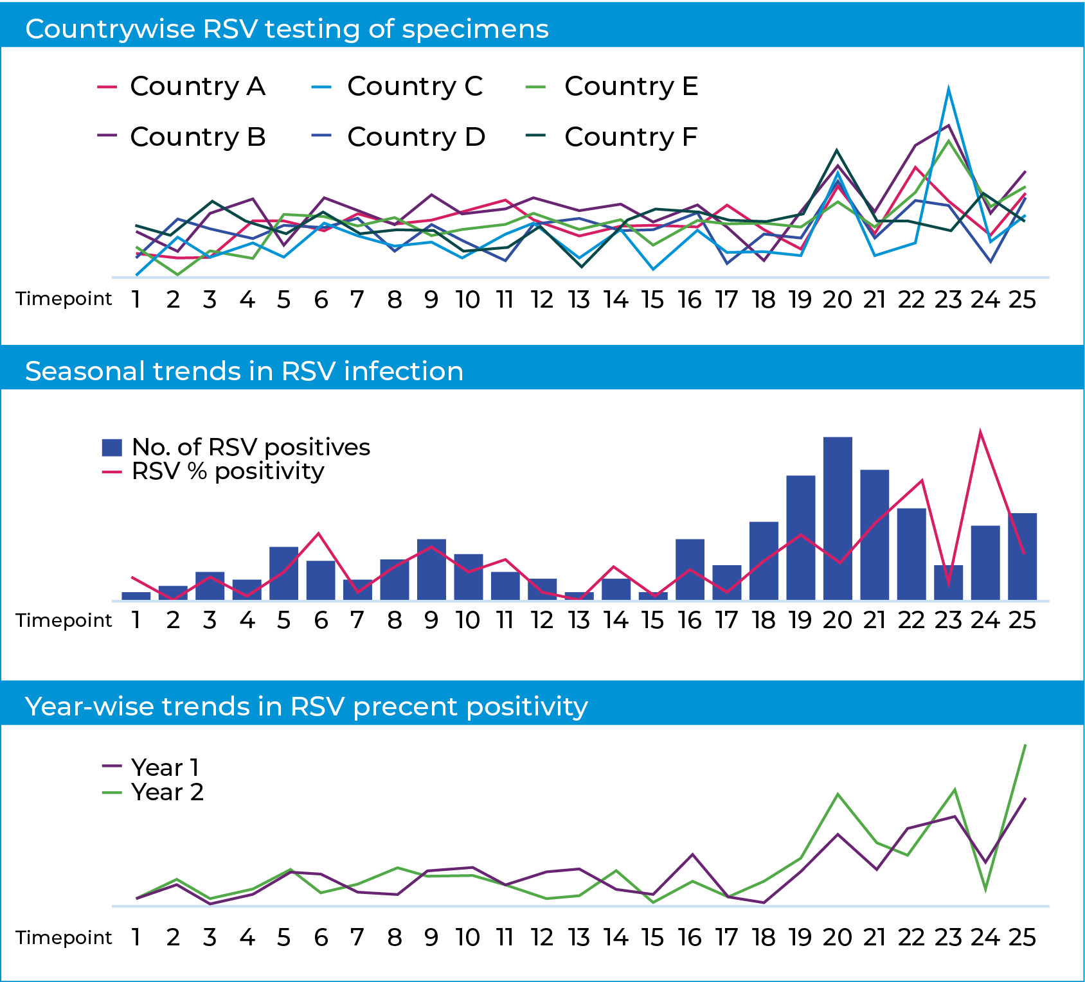
How and where should RSV data be reported?
Global RSV surveillance (illustrative)
Case-based, clinical, epidemiological and laboratory data should be reported to the national and global surveillance platforms (e.g., GISRS).
Given plans for seasonal vaccine administration in select countries, regular reporting enables monitoring of national seasonality to inform immunization strategies.
Genomic sequencing should be uploaded to global surveillance platforms twice a year.
Original slide developed by the US Centers for Disease Control and Prevention, World Health Organization, and PATH. Version: September 2026
Notes:
RSV data should be reported routinely.
Case-based, clinical, epidemiological and laboratory data should be reported to the national and global surveillance platforms (e.g., GISRS, a platform for global respiratory disease epidemiological and virological surveillance)
Regular reporting of data enables monitoring of seasonality to inform immunization strategies.
Genomic sequencing should be uploaded to global surveillance platforms twice a year.

Slide 18
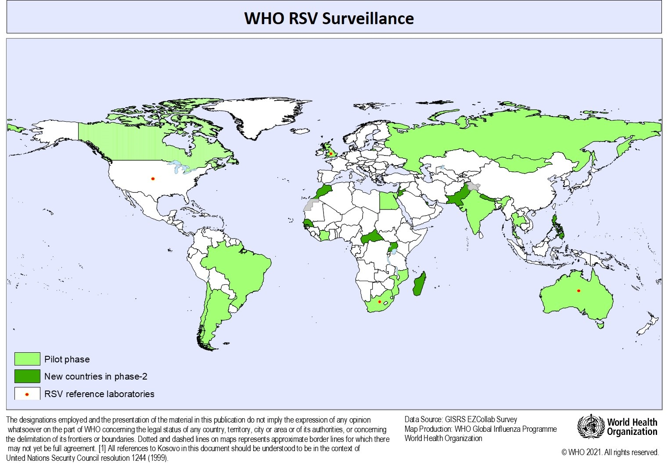
RSV surveillance can leverage existing respiratory disease sentinel surveillance systems
Sentinel surveillance is the likeliest system to already be in place and/or be set up in LMICs, making it a core option when considering RSV surveillance approaches.
WHO’s Global Influenza Surveillance and Response System (GISRS) is one such system.
  First established for influenza and expanded to include SARS-CoV-2 and RSV.
A WHO pilot study added RSV surveillance to a subset of GISRS sites, including in LMICs
  RSV monitoring can be achieved without adversely impacting sentinel influenza and SARS-CoV-2 surveillance.
RSV can also be built into other existing pediatric sentinel surveillance systems for other vaccine preventable diseases (e.g., rotavirus).
Integration piloted in 25 countries to
test feasibility of leveraging GISRS
for RSV surveillance
Original slide developed by the US Centers for Disease Control and Prevention, World Health Organization, and PATH. Version: September 2026
Notes:
RSV surveillance can leverage existing respiratory disease sentinel surveillance systems.
Sentinel surveillance is the likeliest system to already be in place and/or be set up in LMICs, making it a core option when considering RSV surveillance approaches.
WHO’s Global Influenza Surveillance and Response System (GISRS) is one such system
First established for influenza and expanded to include SARS-CoV-2 and RSV
A WHO pilot study added RSV surveillance to a subset of GISRS sites, including in LMICs
Monitoring of RSV can be achieved without adversely impacting sentinel surveillance of influenza and SARS-CoV-2.
RSV also has the potential to be built into other existing pediatric sentinel surveillance systems for other vaccine preventable diseases (e.g., rotavirus).

Slide 19
Key takeaways around sentinel surveillance
INTEGRATION
OPTIMIZATION
DETECTION
EXPANSION
WHO global guidance is to integrate RSV into existing surveillance for other diseases.
Many countries already have sentinel surveillance in place for other diseases.
Integrating RSV into sentinel surveillance requires optimizing design.
Optimizations should allow for prioritizing severe disease in pediatric populations.
A broader (more sensitive) case definition may be considered to inform vaccine introduction
For RSV detection, rRT-PCR is considered the gold standard.
Investments during the COVID-19 pandemic triggered progress in LMICs that use
rRT-PCR, allowing for more accurate detection than previously feasible.
Sentinel surveillance does not, however, answer all questions that countries may have about RSV.
Notes:
The global guidance is to integrate RSV into existing surveillance for other pathogens.
Many countries already have sentinel surveillance in place for other diseases.
Integrating RSV into sentinel surveillance requires adding, leveraging, and optimizing resources within existing systems.
Optimizations should allow for prioritizing severe, pediatric populations.
A broader (more sensitive) case definition may be considered to inform vaccine introduction.
For RSV detection, rRT-PCR is considered the gold standard.
Investments during the COVID-19 pandemic triggered progress in LMICs that use rRT-PCR, allowing for more accurate detection than previously feasible.
Sentinel surveillance does not, however, provide the complete picture of RSV in a country.
In the next few slides, we’ll talk about other kinds of surveillance and studies that can fill gaps in the data package but require additional resources.
Countries can decide which of these options are priorities and feasible within their specific contexts.

Slide 20
Additional surveillance & special studies for RSV
options for generating a fuller data picture

Slide 21
Additional surveillance designs can be used to generate a fuller picture of RSV disease in a given context
SYNDROMIC SURVEILLANCE
ELECTRONIC MEDICAL RECORDS (ICD-10) SURVEILLANCE
MORTALITY SURVEILLANCE
Report total cases with defined clinical features (syndromes).
Use existing administrative or electronic health records as data sources for disease surveillance.
Intentionally collect data on deaths as part of other surveillance platforms.
Notes:
Several surveillance and epidemiologic aims are critical for characterizing RSV and vaccine introduction but not addressed through routine surveillance.
This slide lists additional surveillance options that may be considered for additional understanding of RSV.
Syndromic surveillance - Report total cases with defined clinical features (syndromes)
Electronic medical records (ICD-10) surveillance - Use existing administrative or electronic health records as data sources for disease surveillance.
Mortality surveillance - Intentionally collect data on deaths as part of other surveillance platforms.
Some of these surveillance approaches can be built on top of existing sentinel surveillance platforms.
These designs are not required in all countries. Furthermore, they are resource intensive and may not be feasible or prioritized, especially in low- and middle-income economies.

Slide 22
Special studies can also help address other information gaps about RSV and inform decision-making
Illustrative examples
LONGITUDINAL / COHORT STUDY
BURDEN ESTIMATION
HEALTH ECONOMICS MODELLING
KNOWLEDGE, ATTITUDES, & PERCEPTION STUDIES
Ongoing follow up with populations of special interest (e.g., birth cohort of young children) can be used to look at population incidence.
Evaluating incidence among everyone - not just those seeking care - can be meaningful in evaluating the impact of the RSV preventative products.
Capturing all cases in a defined population to generate a burden of disease pyramid—total deaths, hospitalizations and mild cases.
Can be useful in communicating the need for introducing RSV preventative products (potential cases averted).
Once burden and cost of illness are estimated, health economics models can be used to estimate the cost effectiveness of RSV preventative products.
Identify uptake drivers and barriers among pregnant women and caregivers that may inform communication campaigns and impact adoption and coverage of RSV prevention products.
NOTE: These studies can add value but require additional resources that may be barriers for some countries.
Notes:
Several surveillance and epidemiologic aims are critical for characterizing RSV and vaccine introduction but not addressed through routine surveillance.
This slide lists additional surveillance options that may be considered in the context of vaccine introduction
Longitudinal studies, also known as cohort studies, allow for ongoing follow-up of populations of special interest that maybe under-represented in other surveillance designs.
For RSV, target populations of particular interest include young children (particularly premature babies and newborns).
Burden of disease studies
For routine surveillance, more specific case definitions are applied, enabling more efficient resource use by capturing a representative sample rather than all cases.
In contrast, burden requires exhaustively (or more sensitively) capturing cases.
Calculating burden typically involves modelling (and specialized expertise) of surveillance data – e.g., using data on number of hospitalized RSV cases to estimate total number of RSV cases (including those individuals with more mild symptoms or those not seeking care)
Characterizing burden of RSV and, therefore, the number of potential cases averted with preventative strategies, can be very compelling to policy makers as part of vaccine-introduction strategies
Health economics modelling
Helps inform the baseline of RSV disease’s impacts on public health, what immunization will cost, the effects of the intervention on public health, the cost effectiveness of the intervention.
Knowledge, attitudes, & perception
Assesses health-related beliefs and behaviors in the context of RSV prevention.
Some key aims best addressed in special studies are
Estimating burden in priority target groups
Estimating disease incidence
Understanding knowledge, attitudes, and practices related to interventions
Understanding the cost and cost-effectiveness of vaccine introduction
These designs are not required in all countries. Furthermore, they are resource intensive and may not be feasible or prioritized, especially in low- and middle-income economies.

Slide 23
Summary and considerations for the future
DISEASE BURDEN
SURVEILLANCE
SPECIAL STUDIES
INTEGRATION
RSV is the top cause of hospitalization and severe respiratory infection in infants and young children.
Surveillance is key to inform public health action, especially in LMICs where disease burden is greatest.
Sentinel surveillance is the primary system to detect RSV cases worldwide.
Informs on disease patterns and interventions and offers a balance between cost and usefulness/completeness of data.
Other surveillance systems and special studies can complement sentinel surveillance and provide a fuller data picture but require additional resources/cost.
Existing surveillance systems can be leveraged to integrate RSV disease monitoring but require special attention and investment.
Notes:
RSV is the leading cause of hospitalization and severe respiratory infection in infants and young children—underscoring the importance of surveillance to inform public health action.
More surveillance data are needed for RSV, especially in LMICs.
Some systems are already in place and tracking RSV disease, mostly in higher-income countries. Many of the surveillance systems in place can be leveraged to improve RSV disease monitoring, but require special attention and investment.
Sentinel surveillance is the primary system used where RSV cases are detected worldwide.
Offers balance between cost and usefulness/completeness of data.
Data from other surveillance systems should complement sentinel surveillance.
Can provide a fuller picture of RSV spread, burden of disease, and the impact of new RSV products.
Surveillance systems already in place can be leveraged to integrate RSV disease monitoring but require special attention and investment.
Countries should consider what modifications to case definition, target groups, and testing algorithms may be needed given national aims.

