Slide 1
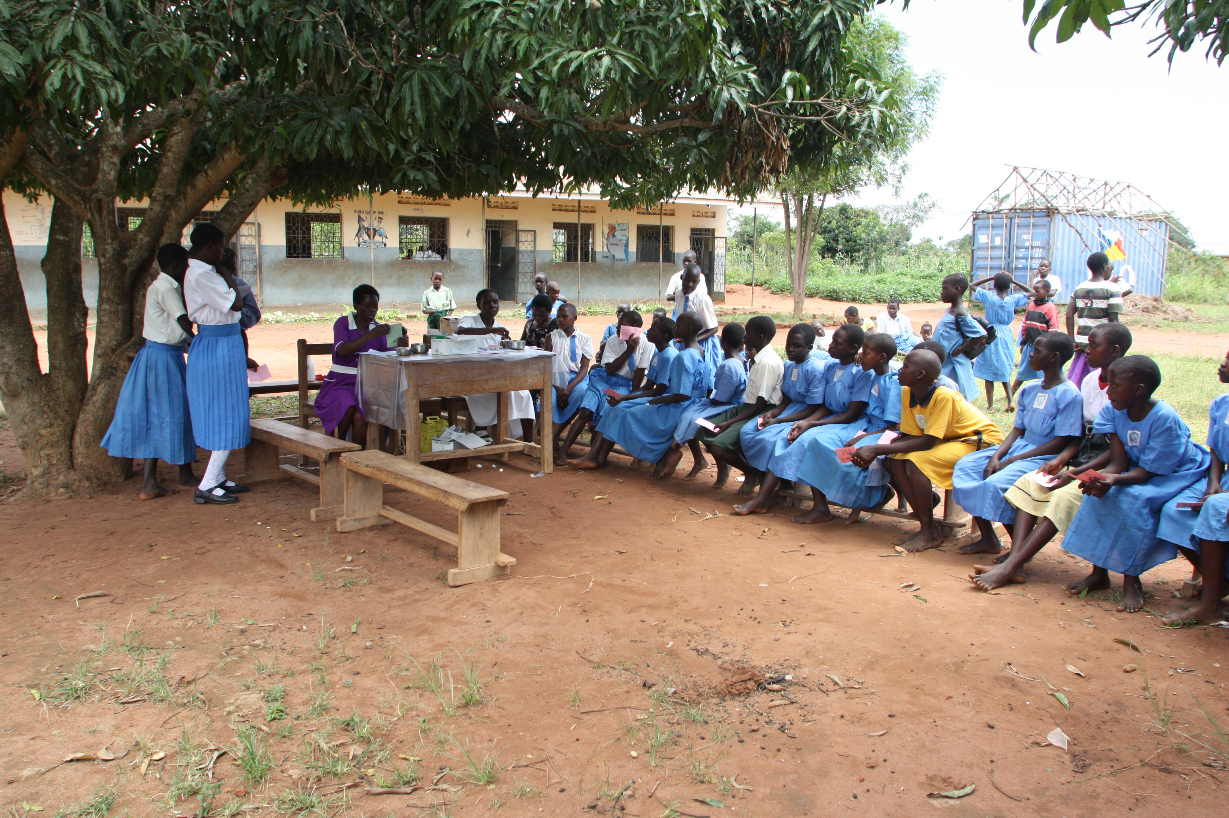
Review of
Existing Evidence on
Single-Dose HPV Vaccination
P
Photo: PATH.

Slide 2
About the Single-Dose HPV Vaccine Evaluation Consortium
Collates, assesses, and synthesizes existing published evidence from clinical trials, observational studies, and impact and economic modeling work on single-dose human papillomavirus (HPV) vaccination
Evidence summaries, slide decks, and other resources, including translations, are available at the Consortium website: www.path.org/singledosehpv
Consortium member institutions: PATH, Harvard University, London School of Hygiene & Tropical Medicine, New York University, Université Laval, University of British Columbia, US Centers for Disease Control and Prevention, US National Cancer Institute, Wits Reproductive Health and HIV Institute, Kirby Institute at University of New South Wales.

Slide 3
Single-dose HPV vaccination key messages

Slide 4
Executive summary
Problem statement
Potential solution
Overall case for
single-dose regimen
HPV causes almost all cases of cervical cancer, and the burden is disproportionate. Approximately 90% of cervical cancer deaths occur in low- and middle-income countries (LMICs).¹ Additionally, worldwide HPV vaccine coverage in girls under 15 years of age is only about 30%.²
Clinical studies provide high-quality data showing >95% efficacy³ and durable protection for a single-dose regimen. There is strong evidence that single-dose HPV vaccination could substantially reduce the incidence of HPV-attributable cervical precancer and cancer.
Adoption of a single-dose regimen has already increased vaccine uptake.² This will ultimately help decrease rates of cervical cancer and cervical cancer–related deaths⁴ in high-burden, low-income regions.
1. World Health Organization. Cervical Cancer Elimination Initiative. Accessed November 26, 2025. https://www.who.int/initiatives/cervical-cancer-elimination-initiative
2. Stuart R, Theopold N, Miall N, Kobayashi E, Vernam S, Taskin T, Dull PM. The role of HPV single-dose vaccination in expanding access in GAVI-supported countries during a period of supply constraints. Vaccine. 2026 Jan 22;75:128187. doi: 10.1016/j.vaccine.2025.128187. Epub ahead of print. PMID: 41576708.
3. Barnabas RV, Mugo N, Onono M, et al. A randomized crossover trial of single-dose HPV vaccination efficacy among young women: Durability and vaccine efficacy after 54 months. Abstract presented at 36th International Papillomavirus Conference; November 2024; United Kingdom.
Porras et al. A Randomized, double-blind, controlled Non-Inferiority Trial of One versus Two doses of HPV Vaccines: The ESCUDDO trial IPV 2025 Abstract O017/ #1208.
4. Kreimer AR, Watson-Jones D, Kim JJ, Dull P. Single-dose human papillomavirus vaccination: An update. JNCI Monographs. 2024. 2024(67):313–316. doi:10.1093/jncimonographs/lgae030

Slide 5







A single dose regimen could address implementation challenges¹
Fewer appointments
to schedule and service
Simplified campaign coordination
No need for scheduling
and tracking follow-ups
Human resources
Governance
Data and digital
Likely some improvement
Finances
Supply
Demand
Facilities/delivery
Likely significant improvement
Lowered cost of operations and vaccine vials
Lower supply of vaccines required for a given population
More palatable and easier for people to logistically plan and financially afford
Less inventory and fewer deliveries required
A single-dose regimen addresses several obstacles disproportionately felt by LMICs
by reducing the quantity of doses to be procured and subsequently distribute, store, track, and administer
1. Project Brief: Insights from Seven Low- and Middle-Income Countries on Reaching Out-of-School Girls with HPV Vaccination. PATH, on behalf of the HAPPI Consortium. Accessed November 2025. https://www.path.org/our-impact/resources/project-brief-insights-from-seven-low-and-middle-income-countries-on-reaching-out-of-school-girls-with-hpv-vaccination/.

Slide 6
HPV vaccination schedules
In December 2022, the World Health Organization issued an updated position paper¹ on the HPV vaccination schedule, aligning with the recommendation of Strategic Advisory Group of Experts on Immunization (WHO SAGE)²:
One- or two-dose schedule for the primary target of girls aged 9–14 years
One- or two-dose schedule for young women aged 15–20 years
One- or two-dose schedule for boys/men aged 9–20 years
Two doses with a 6-month interval for women over 21 years
Immunocompromised individuals, including those with HIV, should receive three doses if feasible, and if not, at least two doses
Some of the above schedules, including the single-dose schedule, are off-label options.
WHO urges all countries to introduce HPV vaccine for the primary target group of girls aged 9–14 years and, where feasible and affordable, prioritize catch-up in older cohorts and missed girls through multi-age cohort (MAC) vaccination up to the age of 18.
1. World Health Organization. Human papillomavirus vaccines: WHO position paper (2022 update). Weekly Epidemiological Record. 2022;97:645-672. http://apps.who.int/iris/bitstream/handle/10665/365350/WER9750-eng-fre.pdf
2. One-dose human papillomavirus (HPV) vaccine offers solid protection against cervical cancer. News release. WHO; April 11, 2022. https://www.who.int/news/item/11-04-2022-one-dose-human-papillomavirus-(hpv)-vaccine-offers-solid-protection-against-cervical-cancer

Slide 7
Cervical cancer, HPV, and HPV vaccines

Slide 8
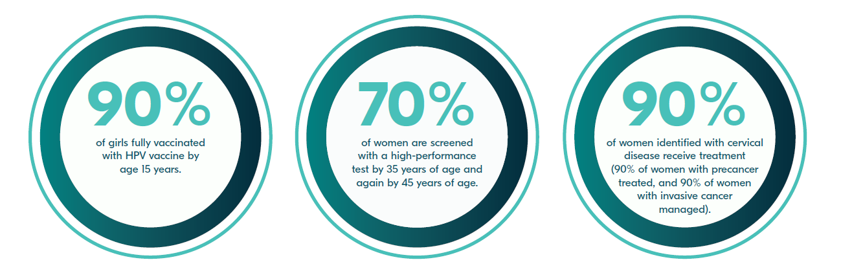
Cervical cancer elimination initiative
Cervical cancer is a leading cause of cancer deaths among women in LMICs.
More than 660,000 cases and 350,000 deaths occur annually, with more than 90% of deaths occurring in LMICs.¹
HPV is present in virtually all cervical cancers and is a necessary cause of cervical cancer.
In November 2020, WHO launched the global strategy to accelerate the elimination of cervical cancer as a public health problem with the following 2030 targets²:
1. Global Cancer Observatory. Cervix uteri. Accessed January 2025. https://gco.iarc.who.int/media/globocan/factsheets/cancers/23-cervix-uteri-fact-sheet.pdf
2. World Health Organization (WHO). Global strategy to accelerate the elimination of cervical cancer as a public health problem. Geneva: WHO; 2020. https://www.who.int/publications/i/item/9789240014107

Slide 9



HPV infection can progress to cervical cancer and untimely death, especially in lower-income countries
2021 age-standardized mortality rate (ASMR) for cervical cancer by socio-demographic index areas³
HPV is a common viral infection ​to which almost all cervical cancers can be attributed; most of the burden lies in LMICs*
High
High-middle
Middle
Low-middle
Low
2nd
~350K
~90%
ASMR (per 100,000 women)
most common cancer in Africa and 4th among women worldwide¹
annual deaths caused by cervical cancer²
of those deaths happen in LMICs²
*HPV types 16 and 18 are responsible for over 70% of cases
1. Sung H, Ferlay J, Siegel RL, et al. Global Cancer Statistics 2020: GLOBOCAN Estimates of Incidence and Mortality Worldwide for 36 Cancers in 185 Countries. CA: A Cancer Journal for Clinicians. 2021;71(3):209-249. doi:10.3322/caac.21660. 2. Global Cancer Observatory. Cervix uteri. Accessed January 2025. https://gco.iarc.who.int/media/globocan/factsheets/cancers/23-cervix-uteri-fact-sheet.pdf. 3. Cheng L, Zhao J, Zou T, Xu Z, Lv Y. Cervical cancer burden and attributable risk factors across different age and regions from 1990 to 2021 and future burden prediction: Results from the Global Burden of Disease study 2021. Frontiers in Oncology. 2025;15:1541452. doi:10.3389/fonc.2025.1541452.
Income level

Slide 10
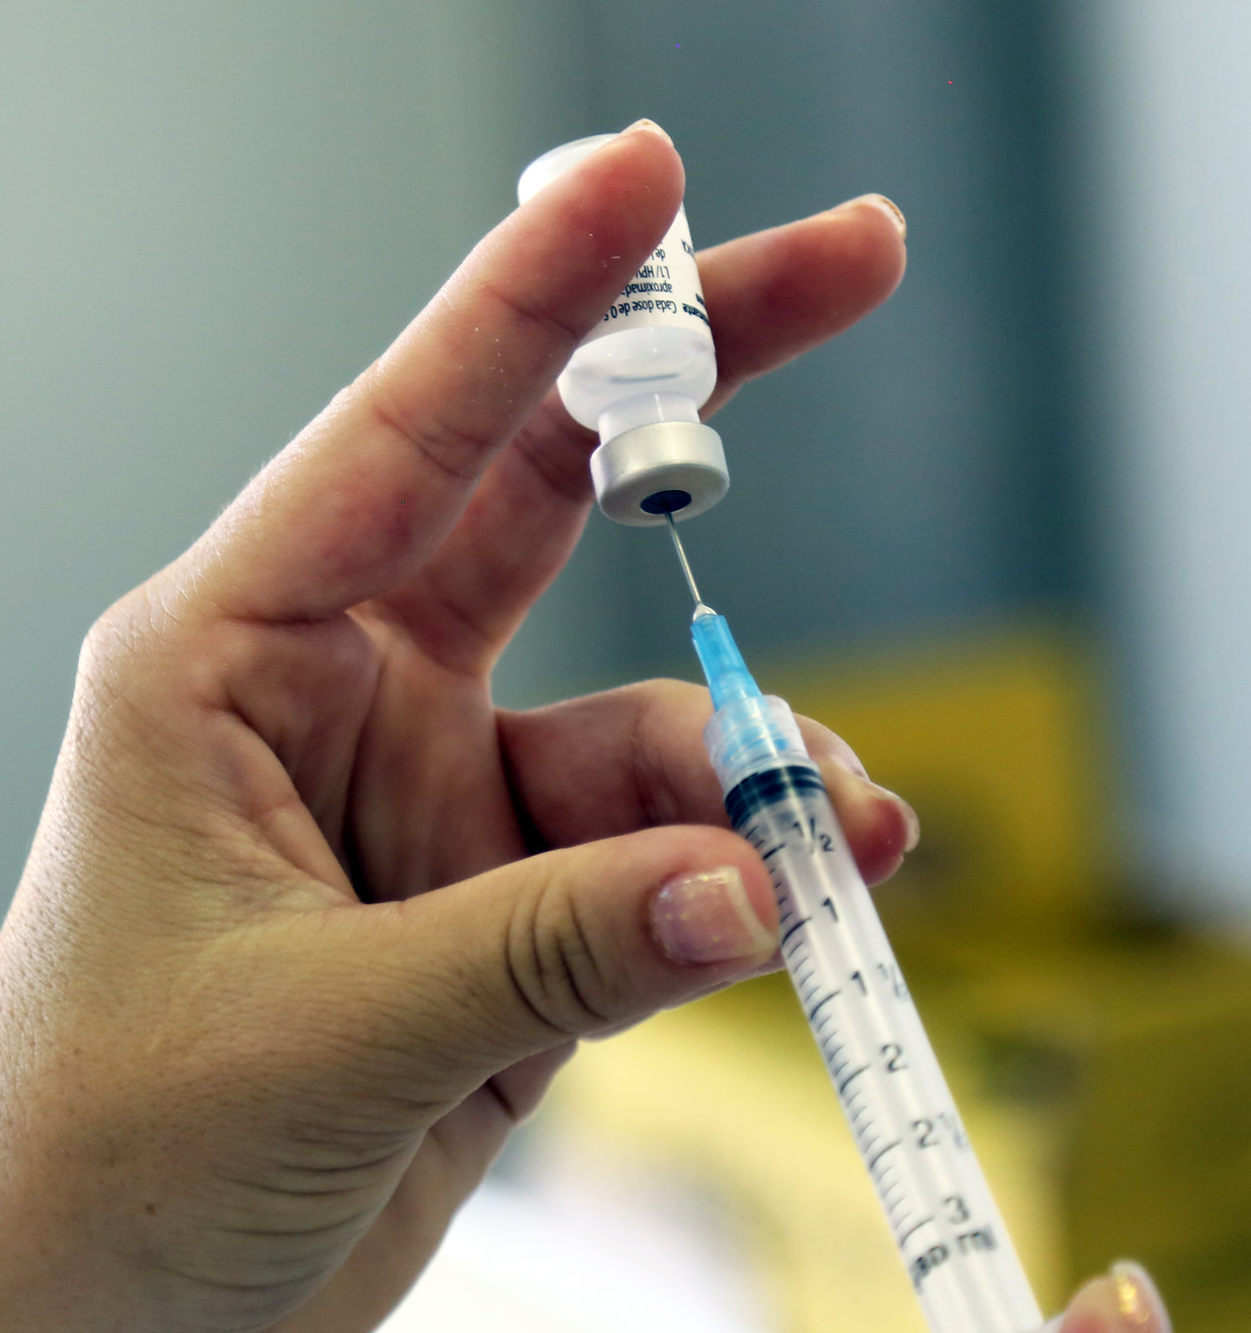
HPV vaccines
Current HPV vaccines are prophylactic and intended to be administered prior to exposure with HPV
HPV vaccines were first introduced in 2006 on a three-dose schedule
In 2014, WHO reduced the schedule from three doses to two in pre-adolescents/adolescents, following an evidence review by SAGE
Evidence today shows comparable efficacy and effectiveness between single- and multi-dose schedules in preventing HPV-16/18 infections, lasting up to 14 years following vaccination¹
In December 2022, WHO endorsed a single dose vaccine schedule based on the evidence suggesting solid protection against cervical cancer
1. Basu et al. Vaccine Efficacy of a single-dose versus Two or Three Doses of the HPV Vaccine, 15 years after Vaccination IPVC abstract O057/ #956

Slide 11
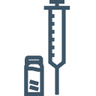
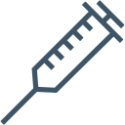


Five safe and highly efficacious HPV vaccines are WHO-prequalified
WHO-prequalified HPV vaccines^{1,2}
Walrinvax® (Zerun Bio HPV2)
Gardasil®, MSD HPV4)
Cervarix® (GSK, HPV2)
Gardasil®9 (MSD, HPV9)
Cecolin® (Innovax, HPV2)
HPV types covered
6, 11, 16, 18
16, 18
6, 11, 16, 18, 31, 33, 45, 52, 58
16, 18
16, 18
WHO-recommended dose
1 or 2
1 or 2
1 or 2
1 or 2
2
Year of initial registration
2006
2007
2014
2022
2019
WHO prequalification
2009
2009
2018
2021
2024
Distributed
by Gavi
Not yet available
Not yet available
1. List of WHO prequalified vaccines. https://extranet.who.int/prequal/vaccines/prequalified-vaccines.
2. World Health Organization. Considerations for Human Papillomavirus (HPV) Vaccine Product Choice, Second Edition. Geneva: WHO; 2024. Licence: CC BY-NC-SA 3.0 IGO.

Slide 12
HPV vaccine coverage

Slide 13
HPV vaccine coverage remains low and varies by national income level
High-income countries: ~55%
Low-income countries: ~25%
Source: WHO HPV vaccine coverage dashboard. Accessed November 26, 2025.

Slide 14
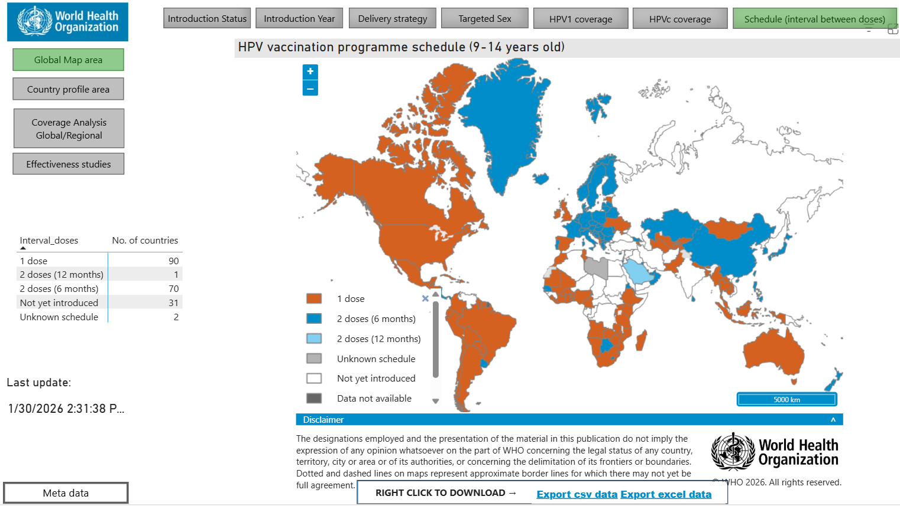
More than 1/2 of countries that have introduced HPV vaccines have adopted a single-dose regimen¹
1. World Health Organization. HPV vaccine dashboard: Schedule (interval between doses). Accessed February 17, 2026. https://app.powerbi.com/view?r=eyJrIjoiNDIxZTFkZGUtMDQ1Ny00MDZkLThiZDktYWFlYTdkOGU2NDcwIiwidCI6ImY2MTBjMGI3LWJkMjQtNGIzOS04MTBiLTNkYzI4MGFmYjU5MCIsImMiOjh9

Slide 15
HPV vaccine in national immunization programs
More than 160 WHO member states have introduced HPV vaccines in their national immunization programs. As of March 2026, more than 90 of these have adopted a single dose strategy.¹
In 2023-2024, an additional 18.5 million girls were reached due to the adoption of single-dose, averting about 300,000 cervical cancer cases.²
WHO HPV Vaccine Programme Schedule. Accessed March 6, 2026. https://app.powerbi.com/view?r=eyJrIjoiNDIxZTFkZGUtMDQ1Ny00MDZkLThiZDktYWFlYTdkOGU2NDcwIiwidCI6ImY2MTBjMGI3LWJkMjQtNGIzOS04MTBiLTNkYzI4MGFmYjU5MCIsImMiOjh9 | 2. Stuart R, Theopold N, Miall N, Kobayashi E, Vernam S, Taskin T, Dull PM. The role of HPV single-dose vaccination in expanding access in GAVI-supported countries during a period of supply constraints. Vaccine. 2026 Jan 22;75:128187. doi: 10.1016/j.vaccine.2025.128187. Epub ahead of print. PMID: 41576708.

Slide 16
Current evidence supporting
single-dose HPV vaccination

Slide 17
Key topics & questions for single-dose HPV vaccination
Biological plausibility
Single-dose level of protection
Is single-dose protection similar to multi-dose regimens?
Durability of protection after a single dose
Would a single-dose regimen be applicable to different populations?
Across geographies (data generated in different continents)
Across age groups
Males
People living with HIV

Slide 18
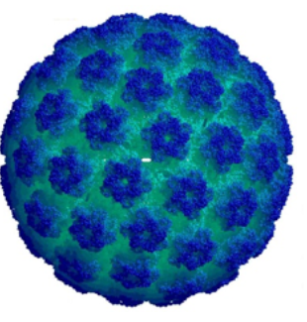
High potency of HPV vaccines
Antibodies are the prime mediators of protection for L1 HPV virus-like particle (VLP) vaccines.
Particle size (50–55 nm) and geometry (repetitive epitopes) of the VLPs are optimal for stimulating the immune system, including efficient generation of long-lived, antigen-specific antibody-producing cells.
Durable (>16 years) and stable antibody levels are indicative of induction of long-lived plasma cells.
HPV virus is exceptionally susceptible to antibody-inhibition at the site of infection.
A minimum antibody level required for protection has not been established yet.
Low level of antibodies are protective in vivo (animal models).
Schiller J, Lowy D. Explanations for the high potency of HPV prophylactic vaccines. Vaccine. 2018;36(32 Pt A):4768-4773. doi:10.1016/j.vaccine.2017.12.079
Befano B, Campos NG, Egemen D, et.al. Estimating human papillomavirus vaccine efficacy from a single-arm trial: Proof-of-principle in the Costa Rica vaccine trial. Journal of the National Cancer Institute. 2023;15(7):788–795. doi:10.1093/jnci/djad064

Slide 19
Key topics & questions for single-dose HPV vaccination
Biological plausibility
Single-dose level of protection
Is single-dose protection similar to multi-dose regimens?
Durability of protection after a single dose
Would a single-dose regimen be applicable to different populations?
Across geographies (data generated in different continents)
Across age groups
Males
People living with HIV

Slide 20
Data from clinical studies across multiple geographies suggest a single-dose regimen provides significant protection against HPV
A single dose delivers high levels of protection similar in magnitude to multi-dose regimens
Study*
KENya Single-dose HPV-vaccine Efficacy (KEN SHE)¹
Dose Reduction Immunobridging and Safety (DoRIS)^{2,3}
Estudio de Comparacion de Una y Dos Dosis de Vacunas Contra el Virus de Papiloma Humano (ESCUDDO)⁴
Start year
2018
2017
2017
Location
Kenya
Tanzania
Costa Rica
Key findings
Single-dose vaccination with HPV9 (Gardasil 9, MSD) or HPV2 (Cervarix, GSK) was >95% effective in preventing new-onset persistent HPV 16/18 infection among African adolescent girls and young women up to 54 months post-vaccination.
Antibody levels among girls receiving a single dose HPV9 (Gardasil 9, MSD) or HPV2 (Cervarix, GSK) were at least as high as those in women from the KEN SHE, CVT, or IARC studies where single-dose efficacy was shown.
Data suggest the efficacy of a single dose of HPV vaccine can be inferred to the targeted 9–14-year-old age group.
Single-dose of HPV9 (Gardasil 9, MSD) or HPV2 (Cervarix, GSK) is non-inferior to a 2-dose regimen in preventing persistent HPV-16/18 infection among adolescent girls. Either HPV vaccine provides >97% protection against HPV16/18 infection over 5 years.
1. Barnabas RV, Mugo N, Onono M, et al. A randomized crossover trial of single-dose HPV vaccination efficacy among young women: Durability and vaccine efficacy after 54 months. Abstract presented at 36th International Papillomavirus Conference, November 2024; United Kingdom.
2. Baisley K, Kemp TJ, Kreimer AR, et al. Comparing one dose of HPV vaccine in girls aged 9-14 years in Tanzania (DoRIS) with one dose of HPV vaccine in historical cohorts: An immunobridging analysis of a randomised controlled trial. Lancet Global Health. 2022;10(10):e1485–e1493.
3. Baisley K, Kemp TJ, Mugo NR, et al. Comparing one dose of HPV vaccine in girls aged 9-14 years in Tanzania (DoRIS) with one dose in young women aged 15-20 years in Kenya (KEN SHE): An immunobridging analysis of randomised controlled trials. Lancet Global Health. 2024;12(3):e491–e499.
4. Kreimer AR, Porras C, Liu D, Hildesheim A, Carvajal LJ, Ocampo R, Romero B, Gail MH, Cortes B, Sierra MS, Coronado K, Sampson J, Coto C, Dagnall CL, Mora D, Kemp TJ, Zuniga M, Pinto LA, Barrientos G, Schussler J, Estrada Y, Montero C, Avila C, Ruggieri D, Cyr JT, Chanock S, Lowy DR, Schiller JT, Herrero R. Noninferiority of One HPV Vaccine Dose to Two Doses. N Engl J Med. 2025 Dec 3. doi: 10.1056/NEJMoa2506765. Epub ahead of print. PMID: 41337735.
Notes:
HPV9 (Gardasil 9, MSD)

Slide 21
Data from clinical studies across multiple geographies suggest a single-dose regimen provides significant protection against HPV
A single dose delivers high levels of protection similar in magnitude to multi-dose regimens
Study*
International Agency for Research on Cancer (IARC)¹
Costa Rica HPV Vaccine Trial (CVT)²
Start year
2009
2004
Location
India
Costa Rica
Key findings
Single dose showed 92% efficacy with HPV4 (Gardasil, MSD) against persistent HPV 16/18 infection for at least 14 years.
Comparable vaccine efficacy regardless of the dose regimen with HPV4 (Gardasil, MSD) (1, 2 or 3 doses).
Comparable efficacy from 1 and 3 doses of HPV2 (Cervarix, GSK) in protecting against HPV 16/18 infection up to 10 years post-vaccination.
10X the level of antibody induced after a single dose, compared to natural infection for at least 16 years post-vaccination.
1 Basu et al. Vaccine Efficacy of a single-dose versus Two or Three Doses of the HPV Vaccine, 15 years after Vaccination IPVC abstract O057/ #9562
2. Kreimer AR, Sampson JN, Porras C, et al. Evaluation of durability of a single dose of the bivalent HPV vaccine: The CVT trial. Journal of the National Cancer Institute. 2020;112(10):1038–1046. doi:10.1093/jnci/djaa011

Slide 22
KEN SHE trial: Study schematic
Women 15–20 years old; N = 2,250
Sexually active, 1–5 lifetime partners, HIV negative, no history of HPV vaccination
Enrollment
Mo 0
Mo 1
Mo 3
Mo 6
Mo 12
Mo 18
Mo 24
Mo 30
Mo 36
Vaccines
HPV2 (GSK)
Vaccine
HPV9 (MSD)
Serology
Serology
Serology
Serology
Serology
HPV DNA
HPV DNA*
HPV DNA
HPV DNA
HPV DNA
HPV DNA
HPV DNA
HPV DNA
Pap smear
Pap smear
Delayed vaccination (Meningococcal vaccine)
HPV
Vaccine
Vaccine
Vaccine administration
Primary analysis
Final
analysis
Serology
Blood draw for serology - HPV-16/18/31/33/45/52/58/6/11 antibodies
HPV DNA
Cervical, vulval-vaginal swabs; testing for HPV-16/18/31/33/45/52/58/6/11; *: self sampling
Pap smear
Liquid-based cytology
Abbreviations: Mo, month; N, number of participants
A blinded crossover design was initiated at month 30–36, with a follow-up until month 54

Slide 23
KEN SHE: Vaccine efficacy mITT
 | Number of participants | Number of events | VE | VE 95% CI
 |  | Month 36
 | Incident persistent HPV 16/18 infections
Delayed vaccination | 473 | 72 | Referent
Single-dose HPV2 (GSK) | 489 | 2 | 97.5% | 90.0; 99.4
Single-dose HPV9 (MSD) | 496 | 1 | 98.8% | 91.3; 99.8
 | Incident persistent HPV 16/18/31/33/45/52/58 infections
Delayed vaccination | 290 | 84 | Referent
Single-dose HPV9 (MSD) | 325 | 5 | 95.5% | 89.0; 98.2
Abbreviations: CI, confidence interval; KEN SHE, KENya Single-dose HPV-vaccine Efficacy; mITT, modified intent-to-treat; VE, vaccine efficacy
mITT: seronegative at baseline and HPV-DNA negative at baseline and month 3 for types considered in analysis.
VE as function of time (initial + crossover periods)
HPV-16/18: 96.5% (95%CI 92.1–98.5) at month 6 and 99.6% (95%CI 98.0–99.9) at month 54
HPV-16/18/31/33/45/52/58: 93.5% (95%CI 86.2–96.9) at month 6 and 99.1% (95%CI 96.4–99.8) at month 54
Barnabas RV, Brown ER, Onono MA, et al. Durability of single-dose HPV vaccination in young Kenyan women: Randomized controlled trial 3-year results. Nature Medicine. 2023;29(12):3224-3232.
Barnabas R, Mugo N, Onono M, et al. A randomized crossover trial of single-dose HPV vaccination efficacy among young women: Durability and vaccine efficacy after 54 months. Abstract presented at International Papillomavirus Society Conference 2024.

Slide 24
KEN SHE trial: Conclusions
Single doses of GSK’s HPV2 and MSD’s HPV9 were highly effective in preventing incident-persistent oncogenic HPV infection among African adolescent girls and young women.
Efficacy in this randomized single-dose clinical trial appears similar in magnitude to multi-dose regimens.
Single-dose HPV vaccination was highly efficacious over 54 months without evidence of waning immunity. These results support the durability of single-dose HPV vaccination.

Slide 25
ESCUDDO trial – Study schematic
Non-Inferiority Evaluation 1- versus 2-dose regimens
20,330 girls 12-16 yo randomized
HPV2 (GSK)
N = 10,174
HPV9 (MSD)
N = 10,156
1 Dose HPV2 (GSK)
N = 4,880
2 Doses HPV2 (GSK)
N = 4,880
1 Dose HPV9 (MSD)
N = 4,851
2 Doses HPV9 (MSD)
N = 4,851
Cervical specimens every 6 months (Mo12 – Mo 60) in ≥ 15yo
Vaccine Effectiveness Evaluation
1 Dose HPV2 (GSK)
N = 4,068
2 Doses HPV2 (GSK)
N = 4,040
1 Dose HPV9 (MSD)
N = 4,109
2 Doses HPV9 (MSD)
N = 4,083
2990 unvaccinated women participated in the study survey (controls)
Mo: month; N: number of participants; yo: year of age

Slide 26
ESCUDDO: Non-Inferiority Evaluation PPP
 | Number of participants | Number of events | Cumulative Event Rate/100 Participants (95% CI) | Rate Difference (95% CI)
 | Persistent HPV 16/18 infections
One-dose HPV2 (GSK) | 4880 | 14 | 0.29 (0.15 to 0.52) | −0.13 (−0.45 to 0.15) p < 0.001
Two-dose HPV2 (GSK) | 4880 | 21 | 0.42 (0.23 to 0.71)
 | Persistent HPV 16/18 infections
One-dose HPV9 (MSD) | 4851 | 23 | 0.48 (0.28 to 0.75) | 0.21 (−0.09 to 0.51) p < 0.001
Two-dose HPV9 (MSD) | 4849 | 13 | 0.27 (0.12 to 0.51)
Abbreviations: CI, confidence interval; PPP, per protocol population
Kreimer AR, Porras C, Liu D, Hildesheim A, Carvajal LJ, Ocampo R, Romero B, Gail MH, Cortes B, Sierra MS, Coronado K, Sampson J, Coto C, Dagnall CL, Mora D, Kemp TJ, Zuniga M, Pinto LA, Barrientos G, Schussler J, Estrada Y, Montero C, Avila C, Ruggieri D, Cyr JT, Chanock S, Lowy DR, Schiller JT, Herrero R. Noninferiority of One HPV Vaccine Dose to Two Doses. N Engl J Med. 2025 Dec 3. doi: 10.1056/NEJMoa2506765. Epub ahead of print. PMID: 41337735.

Slide 27
ESCUDDO: Vaccine effectiveness PPP
 | Number of participants | Number of events | Event Rate/100 Participants (95% CI) | Effectiveness (95% CI)
 | Persistent HPV 16/18 infections
Unvaccinated | 2990 | 160 | 5.37 (4.55–6.17) | 98.2 (96.1–99.6) p < 0.001
One-dose HPV2 (GSK) | 4068 | 4 | 0.10 (0.02–0.21)
Unvaccinated | 2990 | 162 | 5.43 (4.56–6.24) | 97.8 (95.6–99.3) p < 0.001
Two-dose HPV2 (GSK) | 4040 | 5 | 0.12 (0.03–0.23)
 | Persistent HPV 16/18 infections
Unvaccinated | 2990 | 159 | 5.32 (4.49–6.17) | 97.0 (94.3–99.1) p < 0.001
One-dose HPV9 (MSD) | 4109 | 7 | 0.16 (0.05–0.30)
Unvaccinated | 2990 | 160 | 5.35 (4.54–6.22) | 98.5 (96.7–99.7) p < 0.001
Two-dose HPV9 (MSD) | 4083 | 3 | 0.08 (0.01–0.16)
Abbreviations: CI, confidence interval; PPP, per protocol population
PPP: per protocol population – received complete dosing regimen and without major protocol deviations
. Kreimer AR, Porras C, Liu D, Hildesheim A, Carvajal LJ, Ocampo R, Romero B, Gail MH, Cortes B, Sierra MS, Coronado K, Sampson J, Coto C, Dagnall CL, Mora D, Kemp TJ, Zuniga M, Pinto LA, Barrientos G, Schussler J, Estrada Y, Montero C, Avila C, Ruggieri D, Cyr JT, Chanock S, Lowy DR, Schiller JT, Herrero R. Noninferiority of One HPV Vaccine Dose to Two Doses. N Engl J Med. 2025 Dec 3. doi: 10.1056/NEJMoa2506765. Epub ahead of print. PMID: 41337735.

Slide 28
ESCUDDO: Conclusions
Single dose of either GSK’s HPV2 or MSD’s HPV9 provided similar protection to that of two doses in preventing persistent oncogenic HPV infection in adolescent girls.
Protection persisted over the duration of the trial (5 years).
Single-dose HPV vaccination effectiveness against HPV 16 or HPV 18 infection was at least 97%.

Slide 29
Key topics & questions for single-dose HPV vaccination
Biological plausibility
Single-dose level of protection
Is single-dose protection similar to multi-dose regimens?
Durability of protection after a single dose
Would a single-dose regimen be applicable to different populations?
Across geographies (data generated in different continents)
Across age groups
Males
People living with HIV

Slide 30
Efficacy/Effectiveness from studies with available data
Study/design | Primary objectives/timelines
ESCUDDO trial, Costa Rica Randomized, double-blind, controlled non-inferiority trial of 1 or 2-dose efficacy in females vaccinated at 12–16 yo 4 arms: N ~4,850/arm 1- or 2-dose HPV2 (GSK); 1- or 2-dose HPV9 (MSD); Epi survey (unvaccinated): 3,005 women 17–20 yo | Endpoint: Persistent HPV-16/18 Infections
India-IARC Follow-up of RCT of 2 vs 3 doses after suspension of Gardasil® Females 10-18 yo (~5,000 SD recipients) | Non-inferiority of 1- to 2-dose regimens efficacy (persistent HPV-16/18 infections) Vaccine efficacy in each arm compared to unvaccinated Final analysis at 5 years post-vaccination
IARC, India Follow-up of RCT of 2 vs 3 doses (after Indian MoH decision to suspend HPV vaccination in all trials); HPV4 (MSD); females 10–18 yo (~5,000 SD recipients) | Endpoint: Persistent HPV-16/18 Infections
CVT-extension trial, Costa Rica Females 18-25 yo; Cervarix® N = 3,727 (196 SD) | Vaccine efficacy in prevention of persistent infections up to 12 years post-vaccination with 1-, 2- and 3-dose regimens Follow-up to 15 years post-vaccination is ongoing
Abbreviations: : ESCUDDO, Estudio de Comparacion de Una y Dos Dosis de Vacunas Contra el Virus de Papiloma Humano; IARC, International Agency for Research on Cancer; MoH, Ministry of Health; N, number of participants; RCT, randomized-control trial; SD, single dose; yo, years of age

Slide 31
Efficacy/Effectiveness from studies with available data
Study/design | Primary objectives/timelines
CVT-extension trial, Costa Rica Long-term follow-up of vaccinated participants in RCT evaluating efficacy of HPV2 (GSK); females 18–25 yo; N=3,727 (196 SD) | Endpoint: Prevalent HPV-16/18 Infections
CVT-extension trial, Costa Rica Females 18-25 yo; Cervarix® N = 3,727 (196 SD) | Efficacy in prevention of prevalent infections at Y9 and Y11 (1-, 2- and 3-dose)
Thailand Impact Trial Cross-sectional surveys in girls grade 10/Y1 (N= ~2,600) and grade 12/Y2 (N=~2,000); females <15 yo; HPV2 (GSK) HPV vaccine 1 or 2 doses | Endpoint: Prevalent HPV-16/18 Infections
 | Effectiveness of single dose compared to 2-dose regimens in terms of reduction of vaccine type prevalence at Y4
Abbreviations: CVT, Costa Rica Vaccine Trial; N, number of participants; RCT, randomized-control trial; SD, single dose; Y, year; yo, years of age

Slide 32
IARC, India: >12-year vaccine efficacy (HPV4, MSD)
Persistent HPV 16/18 infections – 12-year data
 | Number of women assessed | Number of events | Crude attack rates (%) | Adjusted VE point estimate | Adjusted VE 95% CI
Unvaccinated | 1,273 | 35 | 2.7 | Referent
Single dose | 3,022 | 4 | 0.1 | 92.0 | 87.0; 95.0
2-dose (0,6 Mo) | 2,311 | 2 | 0.1 | 94.8 | 90.0; 97.3
3-dose | 2,172 | 2 | 0.1 | 95.3 | 90.9; 97.5
Abbreviations: CI, confidence interval; Mo, month; VE, vaccine efficacy
Up to 14 years post vaccination, no high-grade HPV-16/18 cervical lesions in vaccinated cohorts
Single-dose vaccine efficacy at 14 years: 92.4% (87.7; 95.3)
Abbreviations: IARC, International Agency for Research on Cancer; VE, Vaccine efficacy; CI, confidence interval; Mo, Month
Malvi SG, Esmy PO, Muwonge R, et al. A prospective cohort study comparing efficacy of 1 dose of quadrivalent human papillomavirus vaccine to 2 and 3 doses at an average follow-up of 12 years postvaccination. Journal of the National Cancer Institute. Monographs. 2024;2024(67):317–328. doi:10.1093/jncimonographs/lgae042. Basu et al. Vaccine Efficacy of a single-dose versus Two or Three Doses of the HPV Vaccine, 15 years after Vaccination IPVC abstract O057/ #956

Slide 33
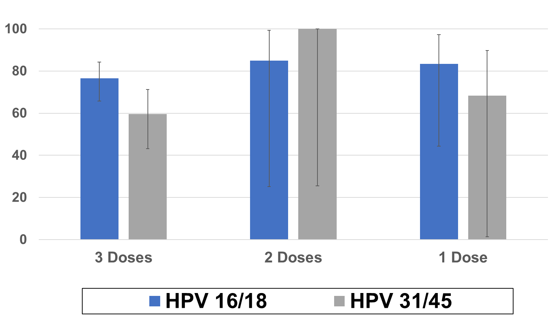
HPV vaccine trial, Costa Rica: Efficacy (final) HPV2 (GSK)
Prevalent infections >10 years post-vaccination (TVC)
Vaccine efficacy (%)
(N = 1,365)
(N = 112)
1
2
Abbreviations: N, number of participants; TVC, total vaccinated cohort
1. Kreimer AR, Sampson JN, Porras C, et al. Evaluation of durability of a single dose of the bivalent HPV vaccine: The CVT trial. Journal of the National Cancer Institute. 2020;112(10):1038–1046. doi:10.1093/jnci/djaa011
2. Tsang SH, Sampson JN, Schussler J, et al. Durability of cross-protection by different schedules of the bivalent HPV vaccine: The CVT trial. Journal of the National Cancer Institute. 2020;112(10):1030–1037. doi:10.1093/jnci/djaa010

Slide 34
Community intervention effectiveness study of one or two doses in female school students in Thailand
Study of bivalent (GSK) HPV vaccine administered to girls <15 years of age, with one province assigned to one-dose regimen and another to a two-dose regimen. Effectiveness of single dose compared to two-dose regimens in terms of reduction of HPV-16/18 prevalence at Y4 assessed through cross-sectional surveys in immunized cohort compared to historical HPV prevalence data of same age students.
HPV-16/18 prevalence
Province | n (cases)/ N (subjects) Unvaccinated | n (cases)/ N (subjects) Vaccinated | Prevalence unvaccinated (95% CI) | Prevalence vaccinated (95% CI) | Vaccine effectiveness (95% CI)
Udon Thani One dose | 83/1,824 | 8/1,856 | 3.98 (3.52, 4.49) | 0.37 (0.25, 0.56) | 90.6 (86.6, 94.6)
Buri Ram Two dose | 115/1,717 | 6/1,798 | 6.13 (5.56, 6.75) | 0.28 (0.18, 0.45) | 95.4 (93.2, 97.6)
High and similar vaccine effectiveness against prevalent HPV infections following one or two doses of vaccine; noninferiority of single-dose regimen compared to a two-dose regimen was demonstrated.
Jiamsiri, S, Rhee C, Ahn HS, et al. Community intervention of a single-dose or 2-dose regimen of bivalent human papillomavirus vaccine in schoolgirls in Thailand: Vaccine effectiveness 2 years and 4 years after vaccination. Journal of the National Cancer Institute. Monographs. 2024;2024 (67):346–357. doi:10.1093/jncimonographs/lgae036.

Slide 35
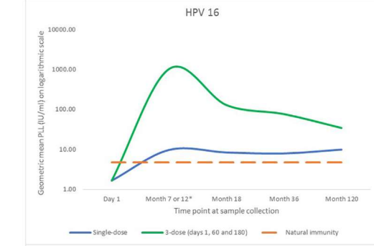
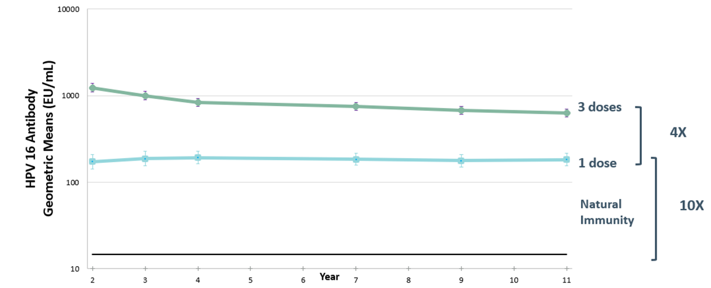
Stable HPV-16 and HPV-18 antibody levels for over a decade post-vaccination several times above natural immunity
IARC trial – HPV4 (MSD)
10-year immunogenicity
CVT – HPV2 (GSK)
11-year immunogenicity, sustained at
similar level up to 16 years post-vaccination²
Similar kinetic up to 16 years​
Post-vaccination
1. Joshi S, Anantharaman D, Muwonge R, et al. Evaluation of immune response to single dose of quadrivalent HPV vaccine at 10-year post-vaccination. Vaccine. 2023;41(1):236-245. doi:10.1016/j.vaccine.2022.11.044
2. Porras, C, Romero B, Kemp T, et al. HPV16/18 antibodies 16-years after single dose of bivalent HPV vaccination: Costa Rica HPV Vaccine Trial. JNCI Monographs. 2024;2024 (67): 329–336. doi:10.1093/jncimonographs/lgae032

Slide 36
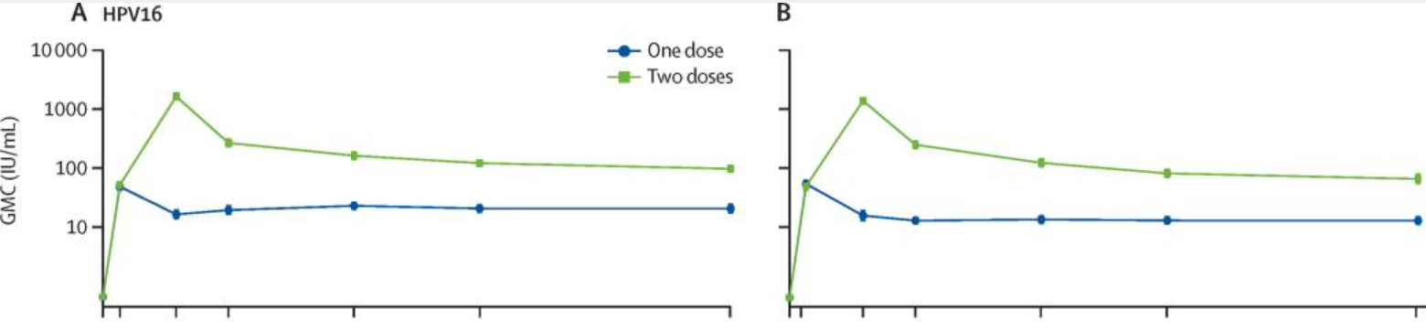
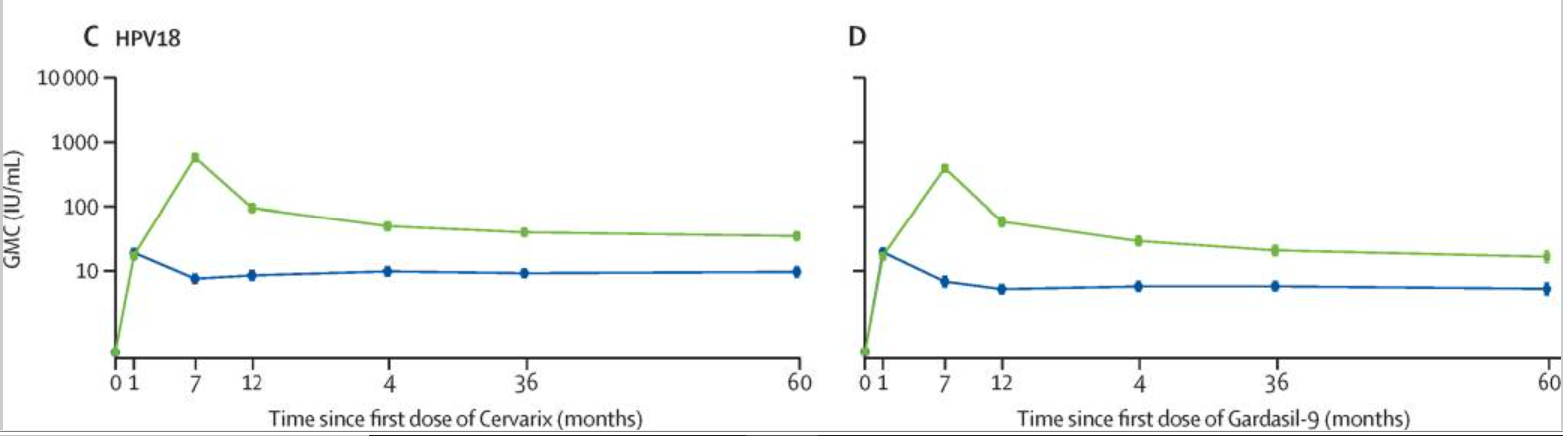
Stable antibody levels five years after single dose of HPV2 (GSK) and HPV9 (MSD) – DoRIS trial
Watson-Jones D, Changlucha J, Maxwell C et al. “Durability of immunogenicity at 5 years after a single dose of human papillomavirus vaccine compared with two doses in Tanzanian girls aged 9–14 years: results of the long-term extension of the DoRIS randomised trial.” The Lancet Global Health. 2025 Jan 29;13(2):e319–e328. doi: 10.1016/S2214-109X(24)00477-7

Slide 37
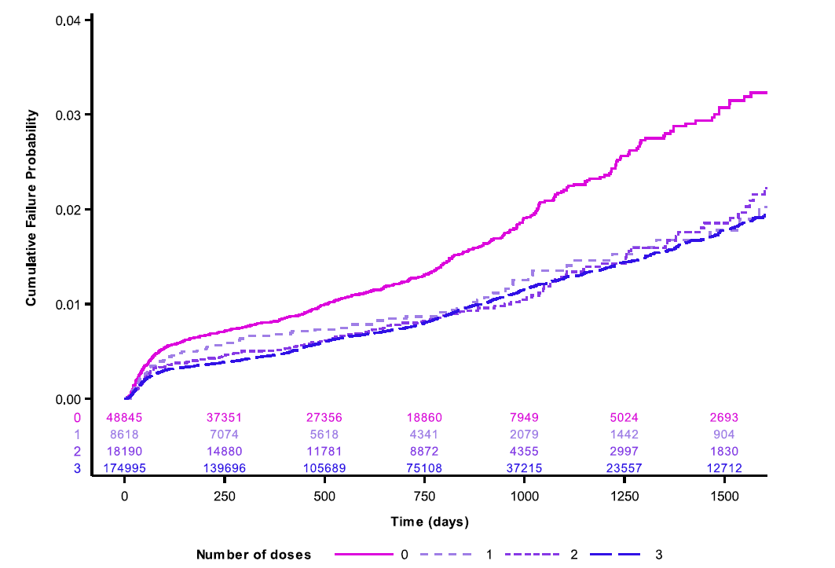
Effectiveness of single dose against cervical lesions (CIN2+)
in population-based cohort study in Australia
Cumulative failure probability plot for CIN2/AIS+ among 250,648 screening women
National data linkage study evaluating the effectiveness of 4vHPV (MSD) against high-grade cervical lesions (all HPV types) by number of doses in women vaccinated before age 15 years (up to seven years previously) in Australia
Hazard ratio for
1 dose compared to 3 doses: 1.01
(95% CI 0.81–1.26)
One dose had comparable effectiveness to two or three doses in preventing high-grade disease in a high-coverage setting in women vaccinated ≤ 15 yo
Abbreviations: AIS, adenocarcinoma in situ; CI, confidence interval; CIN, cervical intraepithelial neoplasia; yo, year of age
Brotherton JM, Budd A, Rompotis C, et al. Is one dose of human papillomavirus vaccine as effective as three?: A national cohort analysis. Papillomavirus Research. 2019;8:100177. doi:10.1016/j.pvr.2019.100177

Slide 38
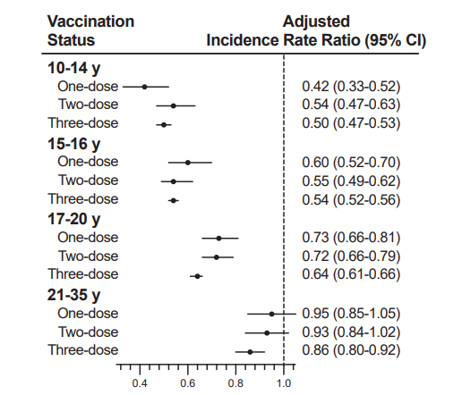
Effectiveness of a single dose against cervical lesions (CIN2+)
in population-based cohort study in Sweden
Registry-based cohort study evaluating the effectiveness of 4vHPV (MSD) against high-grade cervical lesions (by age at vaccination and number of doses) 17 years after the introduction of HPV vaccination in Sweden
The effectiveness decreased for all dosing regimens with increased age at vaccination
A buffer period of 12 months was used to exclude outcomes related to pre-existing infections at time of vaccination
High effectiveness in preventing high-grade cervical lesions up to 1 year after vaccine introduction
One- and two-dose regimens before age 17 shows a comparable effectiveness to 2 or 3 doses
Wu S, Ploner A, Astorga Alsina AM, et al. Effectiveness of quadrivalent human papillomavirus vaccination against high-grade cervical lesions by age and doses: A population-based cohort study. The Lancet Regional Health – Europe. 2025;49:101178. doi:10.1016/j.lanepe.2024.101178
Analyses were adjusted for age, calendar year, county of residence, and parental characteristics

Slide 39
Key topics & questions for single-dose HPV vaccination
Biological plausibility
Single-dose level of protection
Is single-dose protection similar to multi-dose regimens?
Durability of protection after a single dose
Would a single-dose regimen be applicable to different populations?
Across geographies (data generated in different continents)
Across age groups
Males
People living with HIV

Slide 40
DoRIS trial: Immunobridging
Efficacy population
Costa Rica – CVT
HPV2 (GSK): 18–25 yo
India – IARC
HPV4 (MSD): 10–18 yo
Kenya – KEN SHE
HPV2 (GSK): 15–20 yo HPV9 (MSD): 15–20 yo
Immunobridging population
Tanzania – DoRIS
HPV2 (GSK): 9–14 yo HPV9 (MSD): 9–14 yo
Primary immunobridging objective: Non-inferiority of HPV-16/18 GMC at month 24
Secondary immunobridging objective: Non-inferiority of HPV-16/18 seropositivity at month 24
Abbreviations: CVT, Costa Rica Vaccine Trial; DoRIS, Dose Reduction Immunobridging and Safety; GMC, geometric mean concentrations; IARC, International Agency for Research on Cancer; KEN SHE: KENya Single-dose HPV-vaccine Efficacy; NI, non-inferiority; yo, years of age

Slide 41
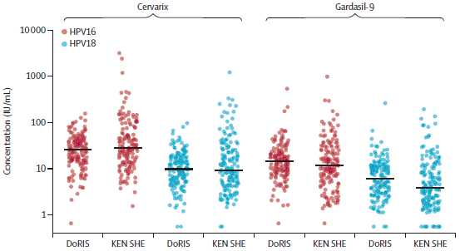
DoRIS trial: Immunobridging to CVT, India IARC, and KEN SHE trials
Non-inferiority met at month 24
Black horizontal bars are median antibody titers
Abbreviations: CVT, Costa Rica Vaccine Trial; DoRIS, Dose Reduction Immunobridging and Safety; IARC, International Agency for Research on Cancer; KEN SHE, KENya Single-dose HPV-vaccine Efficacy
Baisley K, Kemp TJ, Kreimer AR, et al. Comparing one dose of HPV vaccine in girls aged 9-14 years in Tanzania (DoRIS) with one dose of HPV vaccine in historical cohorts: An immunobridging analysis of a randomised controlled trial. Lancet Global Health. 2022;10(10):e1485–e1493. │ Baisley K, Kemp TJ, Mugo NR, et al. Comparing one dose of HPV vaccine in girls aged 9-14 years in Tanzania (DoRIS) with one dose in young women aged 15-20 years in Kenya (KEN SHE): An immunobridging analysis of randomised controlled trials. Lancet Global Health. 2024;12(3):e491-e499.

Slide 42
DEBS: 9vHPV vaccine delayed booster immunogenicity
Prospective, single-arm, open-label trial evaluating antibody persistence up to 24 months after a single dose of HPV9 (MSD) in healthy 9–11-year-old girls (N=143) and boys (N=58).
HPV-16 IgG antibody GMCs
 | N | GMCs | 95% CI | N | GMCs | 95% CI
 | Girls |  |  | Boys
Baseline | 130 | 0.72 | 0.68; 0.77 | 49 | 0.75 | 0.65; 0.87
6 month | 130 | 25.28 | 21.66; 29.49 | 49 | 24.99 | 19.91; 31.36
12 month | 130 | 15.59 | 13.25; 18.35 | 49 | 12.07 | 8.96; 16.25
18 month | 130 | 15.91 | 13.35; 18.95 | 49 | 12.88 | 8.67; 19.13
24 month | 130 | 15.73 | 13.08; 18.91 | 50 | 13.41 | 9.16; 19.63
Abbreviations: CI, confidence interval; GMC: geometric mean concentration; IgG, immunoglobulin G; N: number of subjects
One dose has similar immunogenicity in girls and boys 9–11 years of age
Zeng Y, Moscicki A-B, Woo H, et al. HPV16/18 antibody responses after a single dose of nonavalent HPV vaccine. Pediatrics. 2023;152(1):e2022060301.

Slide 43
HOPE study: HPV one & two-dose population effectiveness study
In a catch-up program in one South African district in adolescent girls 15–16 years of age , the impact of a single dose of GSK’s bivalent vaccine on HPV-16/18 prevalence was assessed using repeat cross-sectional surveys; overall vaccine coverage was 20%.
HPV-16/18 prevalence
 | Cases | Prevalence | aPR (95% CI) | Cases | Prevalence | aPR (95% CI)
 | People without HIV |  |  | People living with HIV
Pre- survey | 65/349 | 19% | 0.62 (0.46; 0.83) | 52/157 | 33% | 0.63 (0.41; 0.95)
Two years post-survey | 84/775 | 11% | 0.49 (0.39; 0.62 | 24/117 | 21%
Single-dose vaccine effectiveness (HPV-16/18 prevalence)
 | N (women) | n (cases) | % (95% CI) | Vaccine effectiveness | 95% CI
No vaccination | 717 | 99 | 14 (12; 17) | 64% | 30; 81
One dose | 175 | 9 | 5 (3; 10)
Evidence of population-level impact of a single-dose HPV vaccine on
HPV 16/18 prevalence irrespective of HIV status
Delany-Moretlwe, S, Machalek DA, Travill D, et al. Impact of single-dose HPV vaccination on HPV 16 and 18 prevalence in South African adolescent girls with and without HIV. JNCI Monographs. 2024;2024(67):337–345. doi:10.1093/jncimonographs/lgae041
Abbreviations: aPR, adjusted prevalence ratio; CI: confidence interval

Slide 44
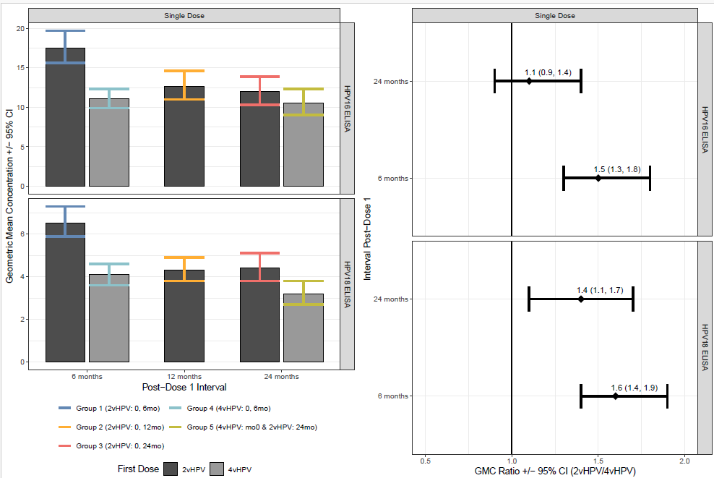
CHOISE study: Comparing HPV vaccine product options
Phase 3 randomized, active-comparator, open-label trial to assess safety and immunogenicity of one- and two-dose schedules in 9–14-year-old girls in LMICs of 2vHPV (Innovax) compared to 4vHPV (MSD)
HPV-16 and HPV-18 IgG geometric mean concentrations (ELISA) and ratios (2vHPV/4vHPV)
post one dose (per protocol population)
Immunogenicity following one dose of 2vHPV (Innovax) was comparable to 4vHPV (MSD) up to 24 months
Since single-dose efficacy has been established for the referent vaccine, comparable immunogenicity suggests the appropriateness of 2vHPV (Innovax) for single-dose use
Agbenyega T, Schuind AE, Adjei S, et al. 2025 Immunogenicity and safety of an Escherichia coli-produced bivalent human papillomavirus vaccine (Cecolin) in girls aged 9–14 years in Ghana and Bangladesh: A randomised, controlled, open-label, non-inferiority, phase 3 trial. Lancet Infectious Diseases. 2025;S1473-3099(25)00031-3. doi:10.1016/S1473-3099(25)00031-3

Slide 45
Summary of current evidence from clinical trials supporting single-dose HPV vaccination

Slide 46
Conclusions from available data from clinical trials
In a randomized control trial assessing single-dose vaccination versus no vaccination, one dose was shown to be highly effective in preventing persistent vaccine-type related oncogenic HPV infections for at least 54 months post-vaccination.
One dose elicited a level of protection similar to a two- or three-dose vaccination schedule in preventing HPV-16/18 infections; the level of protection was sustained up to 14 years post-vaccination.
High and similar vaccine effectiveness against prevalent HPV infections following one or two doses of vaccine (real world data).
Single-dose HPV vaccination 9–14 year-old girls elicits an immune response that was non-inferior to single-dose vaccination in historical cohorts at 24 months post-vaccination (shown for HPV2 [GSK] in 18–25 year-olds in CVT and in 15–20 year-olds in KEN SHE; shown for HPV4 [MSD] in 10–18 year-olds in IARC; and shown for HPV9 [MSD] in 15–20 year-olds in KEN SHE).
The immune response after a single dose of HPV vaccines is lower than after multi-dose regimens but remains stable up to at least 16 years post-vaccination.
Following one dose, immunogenicity is similar in girls and boys 9–11 years of age.
There is evidence of population-level impact of a single-dose HPV vaccine on HPV 16/18 prevalence irrespective of HIV status.
Single-dose data have been generated in different geographies.

Slide 47
Forthcoming evidence from ongoing clinical trials

Slide 48
Efficacy against persistent HPV infections: Ongoing studies
IARC trial, India Follow-up of RCT of 2 vs 3 doses after suspension of HPV4 (MSD) Females 10–18 yo (~5,000 SD recipients) | Vaccine efficacy (virological and histopathological endpoints) for 1-, 2- and 3-dose regimens up to 15 years post-vaccination Anticipated data: 2026
HOPE II, Botswana, Rwanda, South Africa Single dose of HPV vaccine prior to HIV diagnosis Double-blind RCT; Females ≥16 yo 2 arms: 1 dose 9vHPV (MSD); 1 dose meningococcal vaccine (delayed HPV vaccination at 18Mo) N overall = 750 | HPV 16/18 vaccine efficacy in terms of persistent HPV infections when vaccinated prior to HIV diagnosis Anticipated data: 2027
PRISMA-ESCUDDO trial, Costa Rica SD efficacy trial in females 18-30 yo RCT; 3 arms: 1 dose HPV2 (GSK); 1 dose 9vHPV (MSD); 1 dose dTaP (control) (N= approx. 1,650/arm) | Vaccine efficacy compared to unvaccinated in terms of HPV-16/18 persistent infections Anticipated data (Y4): 2026
Abbreviations: IARC, International Agency for Research on Cancer; HOPE: Human Papillomavirus One and Two Dose Population Effectiveness; RCT, randomized control trial; SD, single dose; yo, years of age; N, number of study participants

Slide 49
Ongoing impact studies
Study / design | Primary objectives/ timelines
ADD-VACC, Tanzania Cluster-randomized trial, girls only (9 yo) or female (9 yo) + boys (14-18 yo) 1 dose HPV4 (MSD) N~9,000 boys Survey pre- and three years post-vaccination | Impact of adding a one-time, single-dose male HPV vaccination strategy to national program (girls 14 yo). Impact on community HPV prevalence 36 months after vaccination. Immunogenicity in a subset up to Month 24 Anticipated data: impact on community HPV prevalence 2027; effectiveness of SD in males: 2027
ADD-VACC, Adding Male Single Dose HPV Vaccination to Female HPV Vaccination in Tanzania; N: number of participants; yo: year of age; SD, single dose

Slide 50
Ongoing immunogenicity trials
Study/design | Primary objectives/timelines
DoRIS trial, Tanzania Randomized, unblinded Females 9–14 yo; N=930 in 6 arms: 1, 2, 3, doses of HPV2 (GSK) or HPV9 (MSD) | Non-inferiority 1 dose vs 2–3 doses (seropositivity) at Mo 24 Non-Inferiority 1 dose vs historical controls 10–25 yo (GMTs) at Mo 24 (immunobridging to CVT and India IARC and KEN SHE) Immuno-persistence 9 years post vaccination for 1- and 2-dose regimens Anticipated data: 2027
CVT-extension trial, Costa Rica Females 18–25 yo; 2vHPV (GSK) N=3,727 (196 SD) | Immuno-persistence up to 20Y post vaccination (1-, 2- and 3-dose) Anticipated data: Y 20: 2026
HANDS trial,* The Gambia Females; HPV9 (MSD) 5 groups (N= 344 each): 1 or 2 doses 4–8 yo; 1 or 2 doses 9–14 yo; 3 doses 15–26 yo | Non-inferiority of 2 doses in 4–8 yo to 3 doses in 15–26 yo (GMT) Comparison of 1 dose in 4–8 yo to 3 doses in 15–26 yo (GMT) Non-inferiority of 2 doses in 9–14 yo to 3 doses in 15–26 yo (GMT) Anticipated data: 2025
SHINE trial, Philippines and Ghana Randomized, double-blind Females 9–14 yo (N=600) and 15–20 yo (N=660); 1 dose of HPV9 (Innovax) or HPV9 (MSD) | Immunological non-inferiority at Mo 24 in two age cohorts Anticipated data: 1Q2028
Abbreviations: DoRIS, Dose Reduction Immunobridging and Safety study; CVT, Costa Rica Vaccine Trial; : IARC, International Agency for Research on Cancer; KEN SHE, KENya Single-dose HPV-vaccine Efficacy GMT, geometric mean titer; Mo, month; N, number of participants; NI, non-inferiority: SD: single dose; yo: year of age ; SHINE: Single-dose HPV Immunobridging study with NEw vaccines.

Slide 51
Ongoing immunogenicity trials
Study/design | Primary objectives/timelines
SHIELD, Ghana Safety and immuno in a pediatric population Observer-blinded RCT; HPV2 (Innovax) N= 81 - 1 dose in 2-5 yo; 1 dose in 15-Month-old; 2 doses in 9-Month-old; 1 dose in 15-20 yo; Placebo N= 34; 1 dose; Concomitant (or not) MR vaccine | Safety of 2vHPV (Innovax) concomitant with MR in infants/toddlers Immuno of MR concomitant to 2vHPV in infants/ toddlers Immuno of 1 or 2 doses of 2vHPV in 9- and 15-month-old compared to immuno post dose 1 in 15-20 yo Qualitative acceptability assessment. Anticipated data: last follow-up 2Q2028
Cervavac single-dose study, India Immunobridging study to 4vHPV (MSD) Girls 9-14 yo; HPV4 (SII) and HPV4 (MSD); N= 504 | HPV 16/18 immunological non-inferiority Mo24 Anticipated data: 4Q2027
CIRN-HPV-ONE, Canada Immuno peristence 6 years after one dose 9-11 yo boys&girls; HPV9 (MSD) N=300 | Antibody persistence up to 6 years Anticipated data: primary completion date 1Q2026
Abbreviations: SHIELD, Strengthening HPV Immunization through EPI Leveraged Delivery; CIRN: Canadian Immunization Research Network; RCT, randomized controlled trial; Mo, month; N, number of participants; yo: year of age; MR, measles rubella vaccine

Slide 52
Single dose – Open questions
For new L1 VLP vaccines, a single-dose schedule should be considered for products with available data on efficacy or on immunobridging to vaccines with proven single-dose efficacy [i.e., currently HPV2 (GSK), HPV4 and HPV9 (MSD)]¹
  No data on non-cervical diseases (vulvar/vaginal infection, oral infection) following single-dose vaccination; cervical cancer has the highest HPV-related cancer burden in LMICs
1. World Health Organization. Human papillomavirus vaccines: WHO position paper (2022 update). Weekly Epidemiological Record. 2022;97:645-672. http://apps.who.int/iris/bitstream/handle/10665/365350/WER9750-eng-fre.pdf

Slide 53
Supportive evidence from modeling analysis

Slide 54
Why use modeling to understand HPV vaccine impact?
Clinical trial data
Safety
Immunogenicity
Efficacy vs. different endpoints
In a trial setting, within a follow-up period
Mathematical model
Integrates data to provide a formal framework for answering questions involving:
Impact in different settings
Issues of confounding in observational data
Community-level externalities (e.g., herd protection)
Long-term outcomes beyond a follow-up period
Combinations/options that may not be feasible/ethical to explore in trials
Surveillance/observational data
Background disease burden
Effectiveness in a particular setting
Impact in a particular setting
Brennan and Akehurst. Modelling in health economic evaluation. What is its place? What is its value? Pharmacoeconomics 2000;17(5):445–459. doi:10.2165/00019053-200017050-00004

Slide 55
Ranking efficiency of single-dose delivery strategies
Methods:
Study team modeled 162 vaccination strategies, varying target populations, age at vaccination, and number of doses (one or two doses for girls/boys up to 20 years old; two doses for individuals >20 years old).
Efficiency is based on the number of doses needed to prevent one cervical cancer (NNV):
  NNV = Number of doses given / Number of cervical cancers (CC) averted over 100 years.
  Lower NNV indicates a more efficient strategy.
Ranked all strategies from the lowest to the highest incremental NNV using the following process:
  Initial strategy: routine one-dose vaccination of nine-year-old girls.
  Estimated the incremental NNVs of all strategies vs the initial strategy.
  Kept the strategy with the next lowest incremental NNV compared to the initial strategy; this strategy then became the new comparator.
  Estimated incremental NNVs of all strategies vs this new comparator to identify the next most efficient strategy.
  Repeated this process.
Bernard E, Drolet M, Gingras G, et al. Prioritizing HPV vaccination strategies in 67 low- and middle-income countries (LMICs) based on efficiency at preventing cervical cancer: a modeling study. Abstract presented at 36th International Papillomavirus Conference, November 2024; United Kingdom.
Note: Researchers calculated the incremental NNVs of all vaccination scenarios versus the reference scenario, for each of the 50 parameter sets. The algorithm identified the vaccination scenario with the lowest incremental NNV for each of the 50 parameter sets. The scenario that was identified most often as producing the lowest incremental NNV over the 50 parameter sets was chosen as the most efficient scenario.

Slide 56
Ranking efficiency of single-dose delivery strategies (cont’d)
Scenario: single-dose non-inferiority to two-dose vaccination
.
: Country characteristics by country groupings
Assumes 80% vaccine coverage, 1-dose vaccine effectiveness of 100%, and lifelong duration of protection. All NNVs* are incremental.
Note: Same ranking result for a scenario that assumes a 30-year duration of protection.
1-dose girls routine at 9 yrs
(Reference)
Single-dose routine vaccination of nine-year-old girls is the most efficient strategy.
Note: The second dose is redundant.
Add 1-dose girls MAC 10–14 yrs
NNV 48
The next most efficient strategies are to add multi-age cohort (MAC) vaccination of girls up to 20 years old with one dose.
Note: In our model, MAC vaccination occurs in the first year of the program.
Add 1-dose girls MAC 15–20 yrs
NNV 64
Add 2-dose women MAC 21–25 yrs
NNV 369
The next most efficient strategies are to add MAC vaccination of women aged 21–25 years old with two doses.
Add 1-dose boys routine + MAC 10–20 yrs
NNV 511
Then add 1-dose routine vaccination of 9-year-old boys and MAC vaccination of boys aged 10–20 years old with 1 dose
*NNV=number of doses needed to prevent one cervical cancer.
Bernard E, Drolet M, Gingras G, et al. Prioritizing HPV vaccination strategies in 67 low- and middle-income countries (LMICs) based on efficiency at preventing cervical cancer: a modeling study. Abstract presented at 36th International Papillomavirus Conference, November 2024; United Kingdom.

Slide 57
Program cost savings with a single-dose HPV vaccination regimen
Delivery and procurement costs per adolescent for a full HPV vaccination regimen
Question: What are vaccine delivery and procurement cost implications of a one-dose compared to a two-dose HPV vaccination regimen?
Methods: Costs for a one-dose regimen were modeled based on primary data from a five-country study that evaluated HPV vaccine delivery costs and operational context for a two-dose regimen.
Key messages:
Across the countries studied, a one-dose HPV vaccination regimen could provide savings for delivery and procurement costs, compared to the two-dose regimen.
These program cost savings with a single-dose regimen could range from 40% to 49% per fully vaccinated adolescent.
Depending on the country context, there were differences in whether these savings could be largely for financial (direct monetary outlays) or opportunity costs (costs of using existing resources).
f = financial costs; o = opportunity costs
Slavkovsky R, Mvundura M, Debellut F, Naddumba T. Evaluating potential program cost savings with a single-dose HPV vaccination schedule: A modeling study. JNCI Monographs. 2024;2024(67):371–378. doi:10.1093/jncimonographs/lgae037

Slide 58
Summary of modeling literature on single-dose HPV vaccination
Compared to no vaccination, a single-dose HPV vaccination schedule yields substantial health benefits and is good value for money.^{1,2,3}
The impact and cost-effectiveness of adding a second dose are driven by the duration of single-dose protection and, possibly, the ability to achieve higher coverage with one dose versus multiple doses.^{1,2,3}
The second dose ceases to be cost-effective in many settings if one dose can give at least 20 years of protection.¹
Most health benefits associated with two-dose vaccination are achieved with single-dose vaccination, even with lower efficacy or duration of protection.¹
Alternative uses of the second dose, such as vaccinating older girls and women with a single dose, may have greater impact and cost-effectiveness.^{3,4}
Immediate implementation of a single-dose schedule leads to greater health benefits than postponing its adoption.⁵
If supplies are constrained, single-dose or extended interval strategies have greater health impact and are more efficient than two-dose strategies.^{6,7}
1. Prem K, Choi YH, Bénard É, et al. BMC Med. 2023;21(1):313. doi:10.1186/s12916-023-02988-3. | 2. Burger EA, et al. Vaccine. 2018;36(32):4823–4829. doi:10.1016/j.vaccine.2018.04.061. | 3. Bénard É, et al. Lancet Public Health. 2023; 8(10):e788–799. doi:10.1016/S2468-2667(23)00180-9. | 4. Bénard É, Drolet M, Gingras G, et al. Prioritizing HPV vaccination strategies in 67 low- and middle-income countries (LMICs) based on efficiency at preventing cervical cancer: a modeling study. Abstract presented at 36th International Papillomavirus Conference, November 2024; United Kingdom. 5. Burger EA, et al. Int J Cancer.2022; 151(10):1804-9. doi:10.1002/ijc.34054. | 6. Bénard É, et al. Lancet Global Health. 2023; 11(1):e48–58. doi:10.1016/S2214-109X(22)00475-2. | 7. Prem K, et al. EClinicalMedicine 2024; 74:102735. doi:10.1016/j.eclinm.2024.102735.

Slide 59
Conclusion

Slide 60




Substantial evidence supports the benefits of a single-dose HPV vaccine regimen
Evidence for a single dose:
A single dose delivers high levels of protection similar in magnitude to multi-dose regimens.
Single-dose schedules may present significant cost savings and can help with overall delivery challenges.
Single-dose regimens promote global health equity and will help increase access and uptake.
Reaching more girls with a single dose will avert more cervical cancer cases than vaccinating fewer girls with a second dose.

Slide 61
Back-up slides

Slide 62
IARC-India Trial – Study schematic
2009/2010 Cluster randomized trial 2- vs 3-dose HPV4 (MSD) 10-18 yo
2-dose (0,6 Mo): 10,000
3-dose (0,2,6 Mo): 10,000
April 2010: Indian MoH suspends HPV vaccination in all trials
=> Longitudinal, prospective cohort study
3-dose
4,348
2-dose (0,6 Mo)
4,980
2-dose (0,2 Mo)
3,452
1-dose
4,949
Yearly cervical specimen collection/
Luminex for 4 years (18 Mo after marriage/ 6 Mo post delivery)
1,541 matched unvaccinated cohort 1 (2013-2015)
CC screening (HCII) at 25 and 30 yo (married women);
if+, HPV genotyping/ colposcopy
3,631 matched unvaccinated cohort 2 (2017-2019)
Median duration of follow-up (vaccinated): 12 years
CC: Cervical cancer; HCII: hybrid capture II; Mo: month; MoH: Ministry of Health; yo: year of age;

Slide 63
Costa Rica HPV Vaccine trial – Study schematic
3-dose HPV2 (GSK)
(0,1,6 Mo)
3,727 females 18-25 yo
3-dose Hep A
(0,1,6 Mo)
3,739 females 18-25 yo
Follow-up for efficacy (virological and pathological EPs) and immunogenicity to Mo48
Y4: end of RCT | Cross-over vaccination
Long-term follow-up for prevalent infections and immunogenicity at Y7, 9 & 11 post-vaccination
N = 2,919 (includes 205 SD recipients)
2,836 Unvaccinated Screening-only
Control Group
Long-term follow-up for immunogenicity to Y20 post vaccination
Mo: month; N: number of participants; RCT: Randomized-control Trial; SD: Single Dose; Y: Year; yo: year of age

Slide 64
Combined analysis at Month 48 post-vaccination
Costa Rica HPV Vaccine trial & PATRICIA trial
Dose-stratified vaccine efficacy against incident persistent (at least 6 months) HPV-16/18 infections
 | Groups | Number of women | Number of events | Rate/ 100 person-years (95% CI) | VE (%) | VE 95% CI
3-dose | HPV | 11,104 | 114 | 0.26 (0.22; 0.31) | 89.1 | 86.8; 91.0
 | Control | 11,209 | 1,000 | 2.39 (2.24; 2.54)
Single-dose | HPV | 292 | 1 | 0.08 (0.00; 0.40) | 96.6 | 81.7; 99.8
 | Control | 250 | 24 | 2.36 (1.55; 3.46)
CI: confidence interval; PATRICIA: PApilloma TRIal against Cancer In young Adults; VE: vaccine efficacy
Kreimer AR, Struyf F, Del Rosario-Raymundo MR, et al. Efficacy of fewer than three doses of an HPV-16/18 AS04-adjuvanted vaccine: combined analysis of data from the Costa Rica Vaccine and PATRICIA Trials. Lancet Oncol. 2015;16(7):775-786. doi:10.1016/S1470-2045(15)00047-9.

Slide 65
DoRIS Trial – Study Schematic
Women 9-14 yo N = 930
non-blinded, individually-randomized trial,
with 6 arms
Start Date: Feb 2017
Vaccines
Arms
Mo 0
Mo 1
Mo 2
Mo 6
Mo 7
Mo 12
Mo 24
Mo 36
Mo 60
Three Dose (N=155)
Vaccine
Vaccine
Vaccine
Serology
Serology
Serology
Serology
Serology
Serology
Serology
HPV2 (GSK)
Two Dose (N=155)
Vaccine
Vaccine
Serology
Serology
Serology
Serology
Serology
Serology
Serology
One Dose (N=155)
Vaccine
Serology
Serology
Serology
Serology
Serology
Serology
Serology
Three Dose (N=155)
Vaccine
Vaccine
Vaccine
Serology
Serology
Serology
Serology
Serology
Serology
Serology
HPV4 (MSD)
Two Dose (N=155)
Vaccine
Vaccine
Serology
Serology
Serology
Serology
Serology
Serology
Serology
One Dose (N=155)
Vaccine
Serology
Serology
Serology
Serology
Serology
Serology
Serology
Vaccine
Vaccine administration
Serology
DoRIS: Dose Reduction Immunobridging and Safety; Mo: month; N: number of participants; yo: year of age
Blood draw for serology

Slide 66
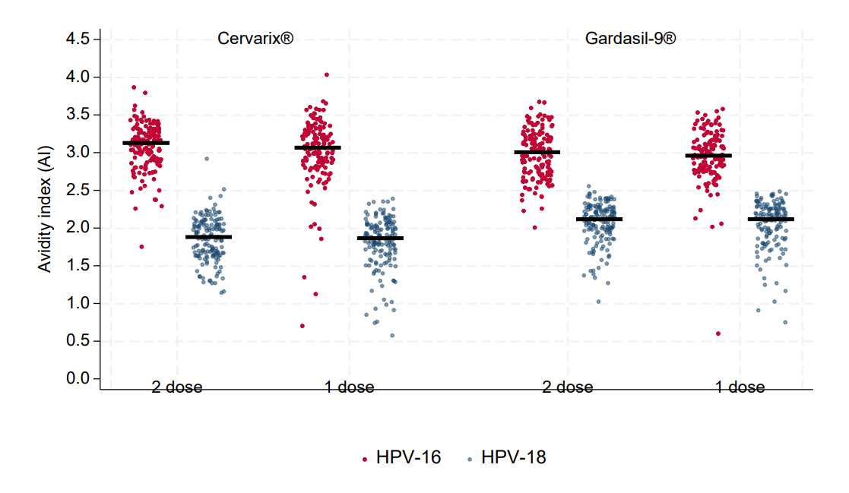
DoRIS Trial – Month 36 Avidity Index
Watson-Jones D, Changlucha J, Maxwell C et al. “Durability of immunogenicity at 5 years after a single dose of human papillomavirus vaccine compared with two doses in Tanzanian girls aged 9–14 years: results of the long-term extension of the DoRIS randomised trial.” The Lancet Global Health. 2025 Jan 29;13(2):e319–e328. doi: 10.1016/S2214-109X(24)00477-7

Slide 67
Observational studies – Effectiveness
A systematic review through September 2021 included HPV vaccine effectiveness studies by the number of doses
Results from 35 studies in 12 countries:
HPV infections [9]; anogenital warts [10]; cervical abnormalities [16]
Most of the studies found highest effectiveness with 3 doses, followed by 2 doses, and then 1 dose
Biases in many studies; most that would result in apparent lower effectiveness with fewer doses
Higher effectiveness estimates and decreased differences between dose groups in some studies, when analyses were limited to younger age at vaccination or when using longer buffer period
More recent studies with younger vaccine recipients, or with analyses stratified by age at vaccination, have found high effectiveness with one dose or similar effectiveness for one, two, and three doses

Slide 68
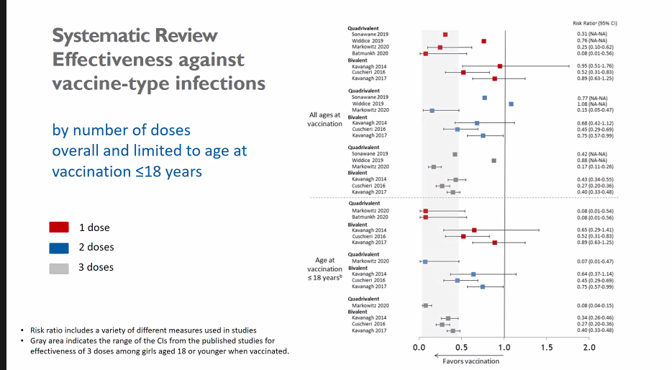
Observational studies – Effectiveness HPV Infections
CI: Confidence Interval
Markowitz Vaccine 2022
https:/ /doi.org/10.1016/j.vaccine.2022.06.065

