Slide 1

Driving Joint Advocacy Action to Accelerate Immunization Equity in Africa
Africa Regional Advocacy Strategy on Immunization
2025 - 2030

Slide 2
About the strategy
The Africa Regional Advocacy Strategy on Immunization brings together regional institutions, governments, global partners, civil society, and communities around one shared agenda—to ensure every child in Africa is reached with lifesaving vaccines.
By focusing on zero-dose and underimmunized children, the strategy places equity at the heart of Africa’s immunization agenda, ensuring the most vulnerable are not left behind.
By strengthening political leadership, securing sustainable financing, reinforcing accountability, building vaccine confidence, and advancing regional harmonization and manufacturing, the strategy charts a path to equitable immunization and a healthier, more self-reliant Africa.
This strategy is not just a framework; it is Africa’s call to action. By uniting governments, regional bodies, donors, civil society, and partners around clear objectives, bold priority actions, and robust accountability, it transforms commitments into measurable results, saves lives, and builds healthier, more resilient futures for generations to come.
Developed through a collaborative process facilitated by PATH, and co-created with the African Union (AU), Africa Centres for Disease Control (Africa CDC), World Health Organization (WHO), United Nations Children’s Fund (UNICEF), Gavi, Gavi CSO constituency, and Expanded Programme on Immunization leaders from 14 African countries, this strategy unites institutions and communities under a shared vision for immunization in Africa.

Slide 3
The strategy: a rallying call for collective action
AUC and Regional Economic Communities. As custodians of Africa’s continental priorities, the AUC and Regional Economic Communities can use this strategy to shape declarations, embed immunization in regional frameworks, and demonstrate leadership by keeping vaccine equity at the heart of Africa’s health and development agenda.
Africa CDC. As Africa’s technical health authority, Africa CDC can use this strategy alongside the Continental Immunization Strategy to anchor advocacy alongside emerging science, local evidence, and technical guidance to accelerate immunization progress and strengthen accountability across the continent.
Donors/external funders. Supporting this African-led strategy offers partners the opportunity to align investments with Africa’s priorities, strengthen domestic financing, and ensure resources help close the immunization gap for millions of children.
Global/regional civil society and advocacy coalitions and networks. This strategy can be used to foster stronger coordination among advocates, build solidarity across movements, and leverage collective resources to drive more effective, united action for immunization in Africa.
Communities. This strategy is a tool to engage with leaders, demand equitable services, and champion vaccine confidence, ensuring their voices are heard, their needs shape policies, and every child is protected by the power of vaccines.
Abbreviations: AUC, African Union Commission; Africa CDC, Africa Centres for Disease Control and Prevention.

Slide 4
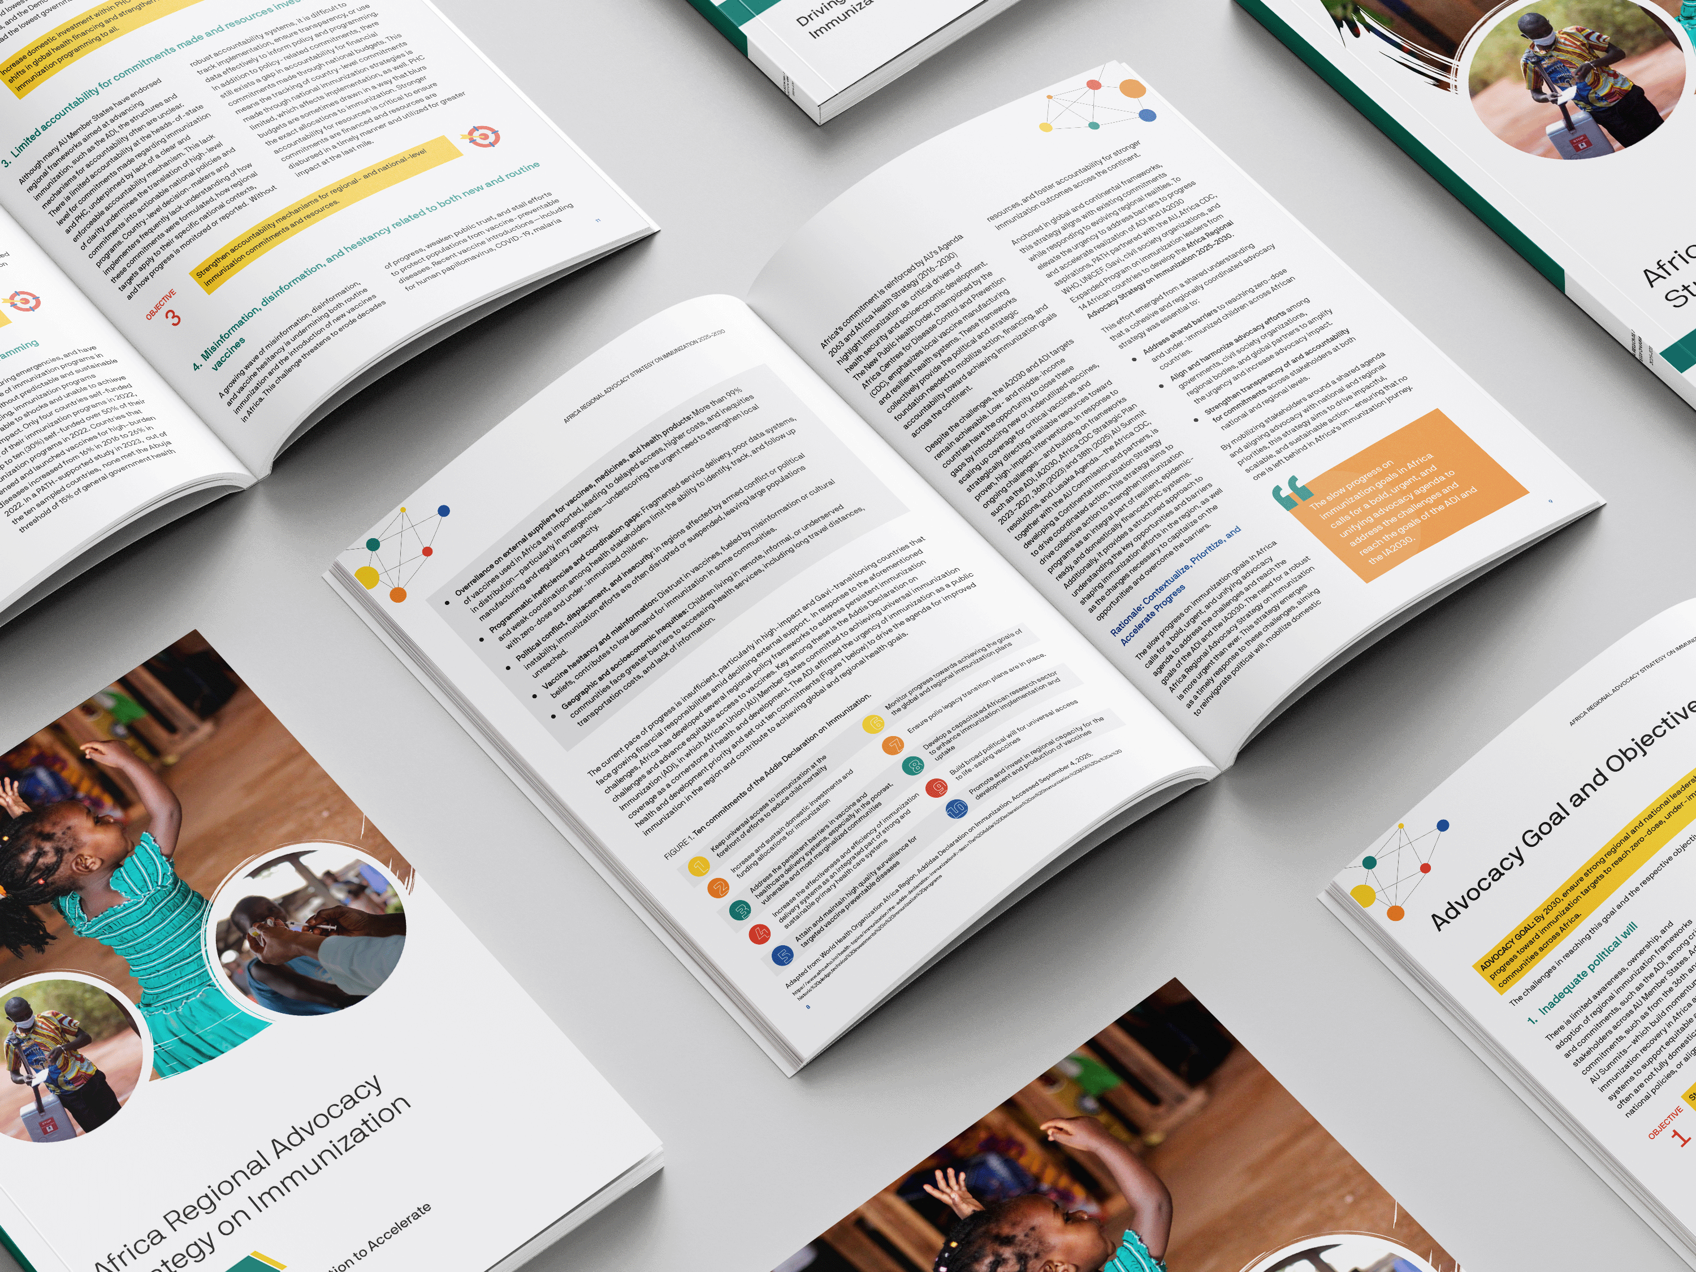
Africa Regional Advocacy Strategy on Immunization
2025–2030
Driving Joint Advocacy Action to Accelerate Immunization Equity in Africa

Slide 5
Global immunization landscape
Immunization is one of the most successful public health interventions, saving millions of lives every year. Globally, vaccines have prevented more than 20 life-threatening diseases and helped people of all ages live longer, healthier lives.
Despite strong global commitments, including the establishment of Gavi and the global vision and strategy for immunization (IA2030), the IA2030 Global Progress Report 2024 shows that global immunization efforts are still falling short of the IA2030 targets:
  While vaccine coverage has largely plateaued and progress remains uneven, outbreaks of vaccine-preventable diseases continue to rise, particularly in countries with fragile health systems and those affected by conflict.
Gavi 6.0 strategy (2026–2030) envisions Gavi vaccinating an additional 500 million children by 2030, with a strong focus on equity, country ownership, and sustainability.
The abrupt decline in official development assistance for immunization poses a grave threat to hard-won progress.
Without urgent renewal of both financial and political commitment, the world will fall short of IA2030 targets, risking a reversal of decades of gains in child survival and global health equity.
Abbreviation: IA2030, Immunization Agenda 2030.

Slide 6
Africa regional context
Despite two decades of progress, Africa’s immunization gains are under threat, highlighting the urgent need to reinvigorate political commitment, sustainable financing, and equitable access in line with IA2030 and ADI goals:
The lingering effects of the pandemic continue to exacerbate challenges attributed to a combination of structural, financial, geographic, and social factors.
The current pace of progress is insufficient, particularly in high-impact and Gavi-transitioning countries that face growing financial responsibilities amid declining external support.
Inadequate and unsustainable domestic financing as immunization programs are heavily reliant on external donors. Declining ODA and economic strain have deepened the funding gap, leaving national budgets insufficient to meet immunization needs.
Despite the challenges, the IA2030 and ADI targets remain achievable. Low- and middle-income countries have the opportunity to close these gaps by introducing new or underutilized vaccines, scaling up coverage for critical vaccines and strategically directing available resources toward proven, high-impact interventions.
Abbreviations: ADI, Addis Declaration on Immunization; IA2030, Immunization Agenda 2030.

Slide 7
Africa Regional Advocacy Strategy on Immunization 2025–2030
Why this strategy?
Slow progress on immunization goals in Africa demands a bold, urgent, and unifying advocacy agenda to achieve the ADI and IA2030 targets.
Co-created by partners
Developed by PATH, in collaboration with African Union, Africa CDC, WHO, UNICEF, Gavi, civil society organizations, and Expanded Programme on Immunization leaders from 14 African countries.
Strategic purpose:
Tackle shared barriers to reaching zero-dose and underimmunized children.
Harmonize advocacy efforts across governments, civil society organizations, and regional and global partners.
Strengthen accountability and transparency for national and regional commitments.
Aligned with key frameworks
IA2030, Gavi 6.0 Strategy, Africa CDC’s Continental Immunization Strategy, African Union Commission’s CARMMA+
Abbreviations: ADI, Addis Declaration on Immunization; Africa CDC, Africa Centres for Disease Control and Prevention; CARMMA, Campaign on Accelerated Reduction of Maternal Mortality in Africa; EPI, Expanded Programme on Immunization; IA2030, Immunization Agenda 2030; UNICEF, United Nations Children’s Fund; WHO, World Health Organization.

Slide 8
Advocacy goal and objectives
GOAL: By 2030, ensure strong regional and national leadership that accelerates progress toward immunization targets to reach zero-dose, underimmunized, and missed communities across Africa.
OBJECTIVE 1
Strengthen the political will of AU Member States to fully adopt, align with, and implement regional immunization commitments—specifically, ADI and national immunization strategies.
Increase domestic investment within primary health care systems to respond to current shifts in global health financing and strengthen health systems to deliver immunization programming to all.
Strengthen accountability mechanisms for regional- and national-level immunization commitments and resources.
Build and strengthen coordinated, evidence-based communication and community engagement systems to foster public trust and demand for both new and routine vaccines.
Advance Africa’s vaccine manufacturing and regulatory agenda to ensure timely, affordable, and equitable access to vaccines.
OBJECTIVE 2
OBJECTIVE 3
OBJECTIVE 4
OBJECTIVE 5
Abbreviations: ADI, Addis Declaration on Immunization; AU, African Union.

Slide 9
OBJECTIVES
Objective 1: Strengthen the political will of AU Member States to fully adopt, align with, and implement regional immunization commitments—specifically, ADI and national immunization strategies.
PRIORITIES ACTIONS | EXPECTED OUTCOME
1.1. Advocate for immunization to be a standing item on the agenda of AU Summits: Produce an immunization commitment tracker and annual reports. | Immunization is consistently elevated on AU Summit agendas and tracked through clear commitments.
1.2. Cultivate high-level, visible regional immunization champions: Identify, engage, and support influential leaders (e.g., heads of state, ministers, parliamentarians, and prominent public figures) as visible champions for immunization. | Visibility and engagement of high-level political and influential leaders as champions for immunization across Africa are increased.
1.3. Package and test messages to communicate evidence-based priorities effectively: Translate complex regional immunization frameworks into compelling advocacy messages for a unified regional call to action. Tailor communication for different audiences, ensuring alignment with national priorities and policy cycles. | Regional immunization commitments and goals are widely understood, clearly communicated, and aligned with national contexts.
1.4. Amplify regional voices and success stories: Create opportunities for champions and advocates to showcase progress, share lessons, and reinforce commitments through regional and global platforms. Establish platforms that elevate African leadership and ownership in advancing immunization equity. | Stronger regional ownership and visibility of African leadership and champions in advancing immunization equity.
Abbreviations: ADI, Addis Declaration on Immunization; AU, African Union.

Slide 10
OBJECTIVES
Objective 2: Increase domestic investment within primary health care systems to respond to current shifts in global health financing and strengthen health systems to deliver immunization programming to all.
PRIORITIES ACTIONS | EXPECTED OUTCOME
2.1. Promote innovative financing mechanisms in response to official development assistance shifts and meet co-financing obligations: Build the capacity of technical working groups to advocate for increased allocation. Identify and document innovative and context-specific approaches (e.g., ring-fenced budgets, sin taxes, results-based financing, public-private partnerships, local philanthropy). | Countries adopt context-specific innovative financing approaches to supplement declining official development assistance and strengthen sustainability of immunization programs. Momentum and political buy-in are established for a sustainable, Africa-led regional immunization financing platform.
2.2. Strengthen African engagement in global immunization financing processes: Coordinate and support African governments, civil society organizations, parliamentarians, and technical experts to engage meaningfully in global consultations and replenishments (Gavi, Global Fund, International Development Association, Coalition for Epidemic Preparedness Innovations, International Finance Facility for Immunisation, etc.). Develop unified African positions and advocacy asks that emphasize sustainability, equity, and domestic resource mobilization. Showcase African success stories and country-led solutions during global dialogues to influence donor and partner commitments. | African representation and visibility in shaping global vaccine financing decisions are stronger. African priorities (equity, sustainable domestic financing, supply resilience, and local manufacturing) are consistently reflected in the outcomes of global immunization financing processes.
Abbreviations: ADI, Addis Declaration on Immunization; AU, African Union.

Slide 11
OBJECTIVES
Objective 2: Increase domestic investment within primary health care systems to respond to current shifts in global health financing and strengthen health systems to deliver immunization programming to all.
PRIORITIES ACTIONS | EXPECTED OUTCOME
2.3. Conduct targeted technical budget advocacy for immunization with critical decision-makers: Develop country-specific immunization investment cases and cost-benefit analyses that clearly link vaccine coverage to health system performance, economic growth, and pandemic preparedness. Train CSOs, parliamentarians, and health officials in budget literacy and immunization financing tracking. Organize high-level technical briefings and closed-door meetings between advocates and budget decision-makers before key fiscal planning milestones (e.g., Medium-Term Expenditure Framework discussions, budget hearings) Advocate for the inclusion of ring-fenced budget lines for immunization within national health budgets. Engage in pre- and post-budget dialogues to influence and monitor allocation and disbursement of funds for immunization. | Strengthened political commitment and budgetary allocations for immunization exist at national and subnational levels. Transparency, tracking, and advocacy for domestic immunization financing commitments are improved.
Abbreviations: ADI, Addis Declaration on Immunization; AU, African Union.

Slide 12
OBJECTIVES
Objective 3: Strengthen accountability mechanisms for regional- and national-level immunization commitments and resources.
PRIORITIES ACTIONS | EXPECTED OUTCOME
3.1. Develop a commitment and accountability tracking tool: Create a tool to track financing and policy commitments by national and regional actors. Disseminate and popularize the tool with decision-makers, immunization champions, technical working groups, national and regional immunization technical advisory groups, and civil society organizations/coalitions. | Regional and national immunization commitments are systematically tracked, understood, and used by stakeholders to drive accountability.
3.2. Develop a dedicated immunization financing scorecard: Track domestic contributions, funding gaps, and co-financing performance. Use scorecards for performance reviews, tracking of allocations/disbursements, and documentation of learnings and best practices to inform policy and planning decisions. | Transparent tracking of immunization financing is strengthening advocacy and resource mobilization at country and regional levels.
3.3. Create an online dashboard for visibility of policy and financing commitments. | Commitment and financing data are publicly accessible, increasing transparency and visibility of progress and gaps.
Abbreviations: ADI, Addis Declaration on Immunization; AU, African Union.

Slide 13
OBJECTIVES
Objective 3: Strengthen accountability mechanisms for regional- and national-level immunization commitments and resources.
PRIORITIES ACTIONS | EXPECTED OUTCOME
3.4. Conduct multistakeholder convenings on accountability: Integrate accountability discussions into AU Summits, RECs, NEAPACOH, CPHIA, and AHAIC. Support AU and partners in developing position papers or side events focused on immunization financing in Africa to present at critical global convenings (e.g., World Health Assembly, Gavi Board meetings). | Accountability for immunization policy and financing is elevated in high-level regional and continental forums, reinforcing political commitment.
3.5. Establish media accountability platforms: Train journalists/influencers on immunization and financing. Build networks between champions and media. Use key moments (AU, CPHIA, budget cycles) to generate visibility. | Media actively monitors and reports on immunization commitments, fostering public accountability and informed demand.
Abbreviations: ADI, Addis Declaration on Immunization; AU, African Union.

Slide 14
OBJECTIVES
Objective 4: Build and strengthen coordinated, evidence-based communication and community engagement systems to foster public trust and demand for both new and routine vaccines.
PRIORITIES ACTIONS | EXPECTED OUTCOME
4.1. Identify, engage, and sustain high-level regional immunization champions: Engage heads of state, ministers, parliamentarians, African first ladies, AU envoys, public figures, and youth leaders to visibly advocate for immunization. Provide evidence, platforms, and support to amplify pro-immunization messages at national, regional, and global levels. | High-profile African champions consistently advocate for immunization as a political, social, and economic priority, influencing policies and public opinion.
4.2. Leverage regional and continental platforms for pro-vaccine narratives: Work with the AU, Africa CDC, and RECs to integrate vaccine confidence and misinformation countermeasures into resolutions. Use high-profile events (AU Summits, Africa Health Agenda, NEAPACOH) to showcase positive stories about and evidence of vaccine impact. | AU, Africa CDC, and RECs formally integrate vaccine confidence and misinformation countermeasures into resolutions, declarations, and strategic frameworks.
4.3. Address misinformation, disinformation, and vaccine hesitancy for both new and routine vaccines: Advocate for AU, Africa CDC, and ministries of health to invest in real-time social listening and risk communication. Strengthen culturally sensitive community engagement on routine and new vaccines. Showcase routine and new vaccine introduction success stories at national, regional, and global platforms. | Governments and regional bodies detect and respond quickly to emerging misinformation trends, leading to improved vaccine confidence and uptake. Vaccine confidence is increased through trusted, culturally relevant messengers..
Abbreviations: ADI, Addis Declaration on Immunization; AU, African Union.

Slide 15
OBJECTIVES
Objective 5: Build and strengthen coordinated, evidence-based communication and community engagement systems to foster public trust and demand for both new and routine vaccines.
PRIORITIES ACTIONS | EXPECTED OUTCOME
5.1. Secure political will for local vaccine manufacturing: Position manufacturing as a priority at AU and national levels. Advocate for enabling policies, long-term investments, and cross-sector coordination. | Local vaccine manufacturing is elevated as both a political and development priority at AU and national levels.
5.2. Mobilize sustainable financing: Urge governments, private sector, and donors to invest in Africa-based initiatives (e.g., AVMA). | Long-term, sustainable financing mechanisms are established to support Africa-based vaccine production.
5.3. Accelerate AMA operationalization and regulatory harmonization and create an enabling environment that boosts local vaccine and health product manufacturing in Africa: Build capacity of key decision-makers on AMA treaty provisions and benefits. Organize orientation sessions for parliamentarians, ministries of health, and ministries of foreign affairs. Promote harmonization across national frameworks. | The AMA has fully operational and harmonized regulatory frameworks that enable efficient, safe, and high-quality vaccine manufacturing in Africa.
Abbreviations: ADI, Addis Declaration on Immunization; AU, African Union.

Slide 16
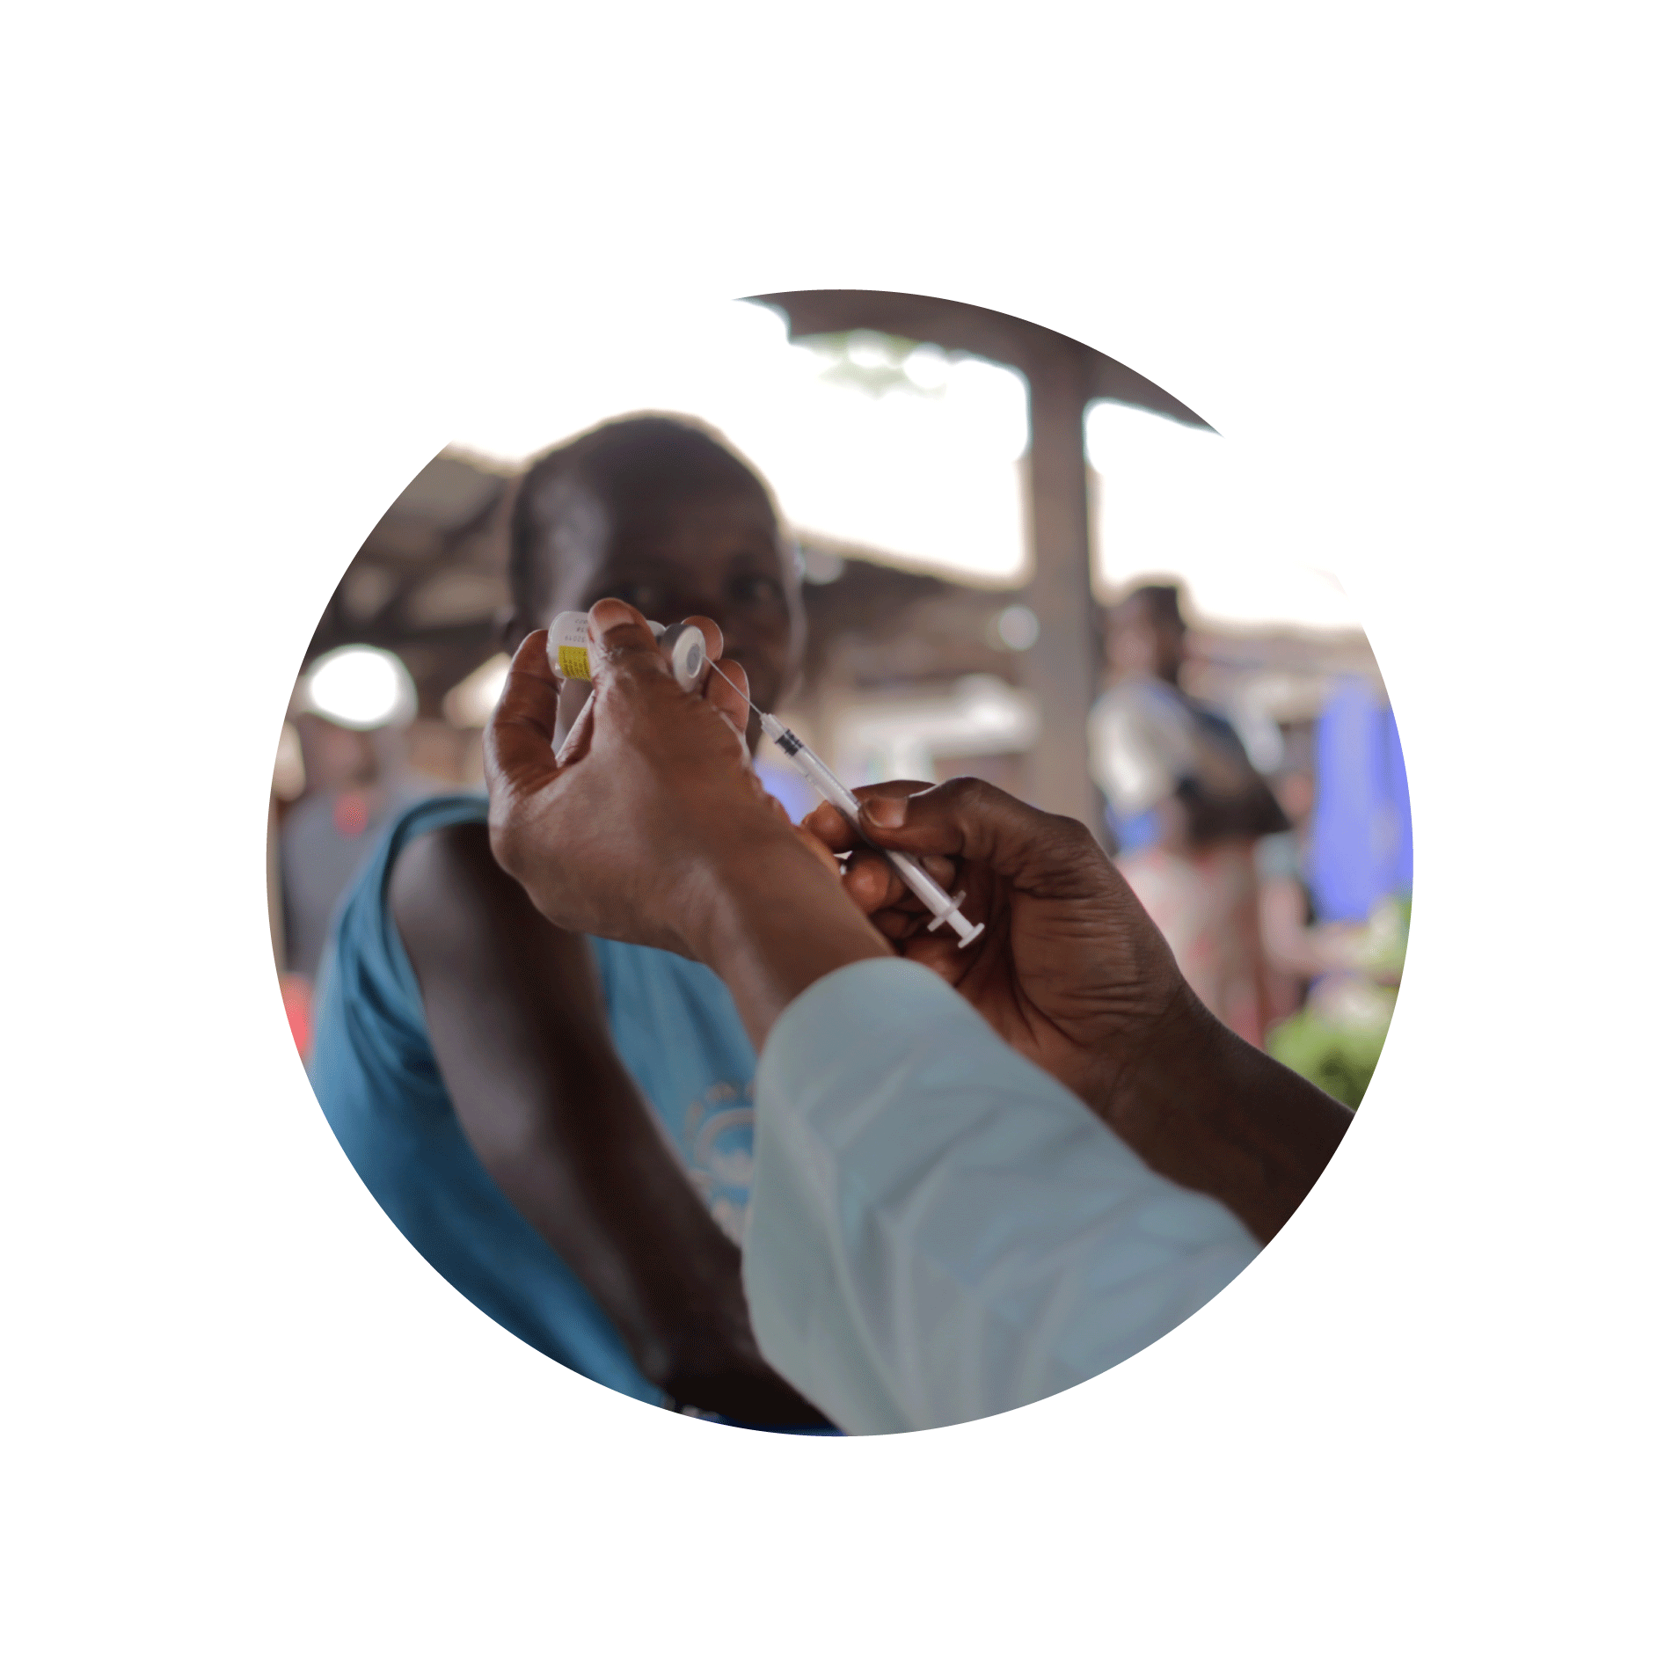
Conclusion
The Africa Regional Advocacy Strategy on Immunization 2025–2030 is both a call to action and a roadmap for impact.
No single actor can close the immunization gap alone; only by working together can we build political will, mobilize sustainable financing, strengthen accountability, ensure timely access to lifesaving vaccines, and advance regional harmonization and manufacturing.
Join us in this effort to galvanize support, take ownership, and amplify Africa’s voice so that together we can protect every child, strengthen our health systems, and secure a healthier future for generations to come.

