Slide 1
PLEASE DOWNLOAD or DUPLICATE YOUR OWN COPY
File>Download
or
File>Make a copy

Slide 2

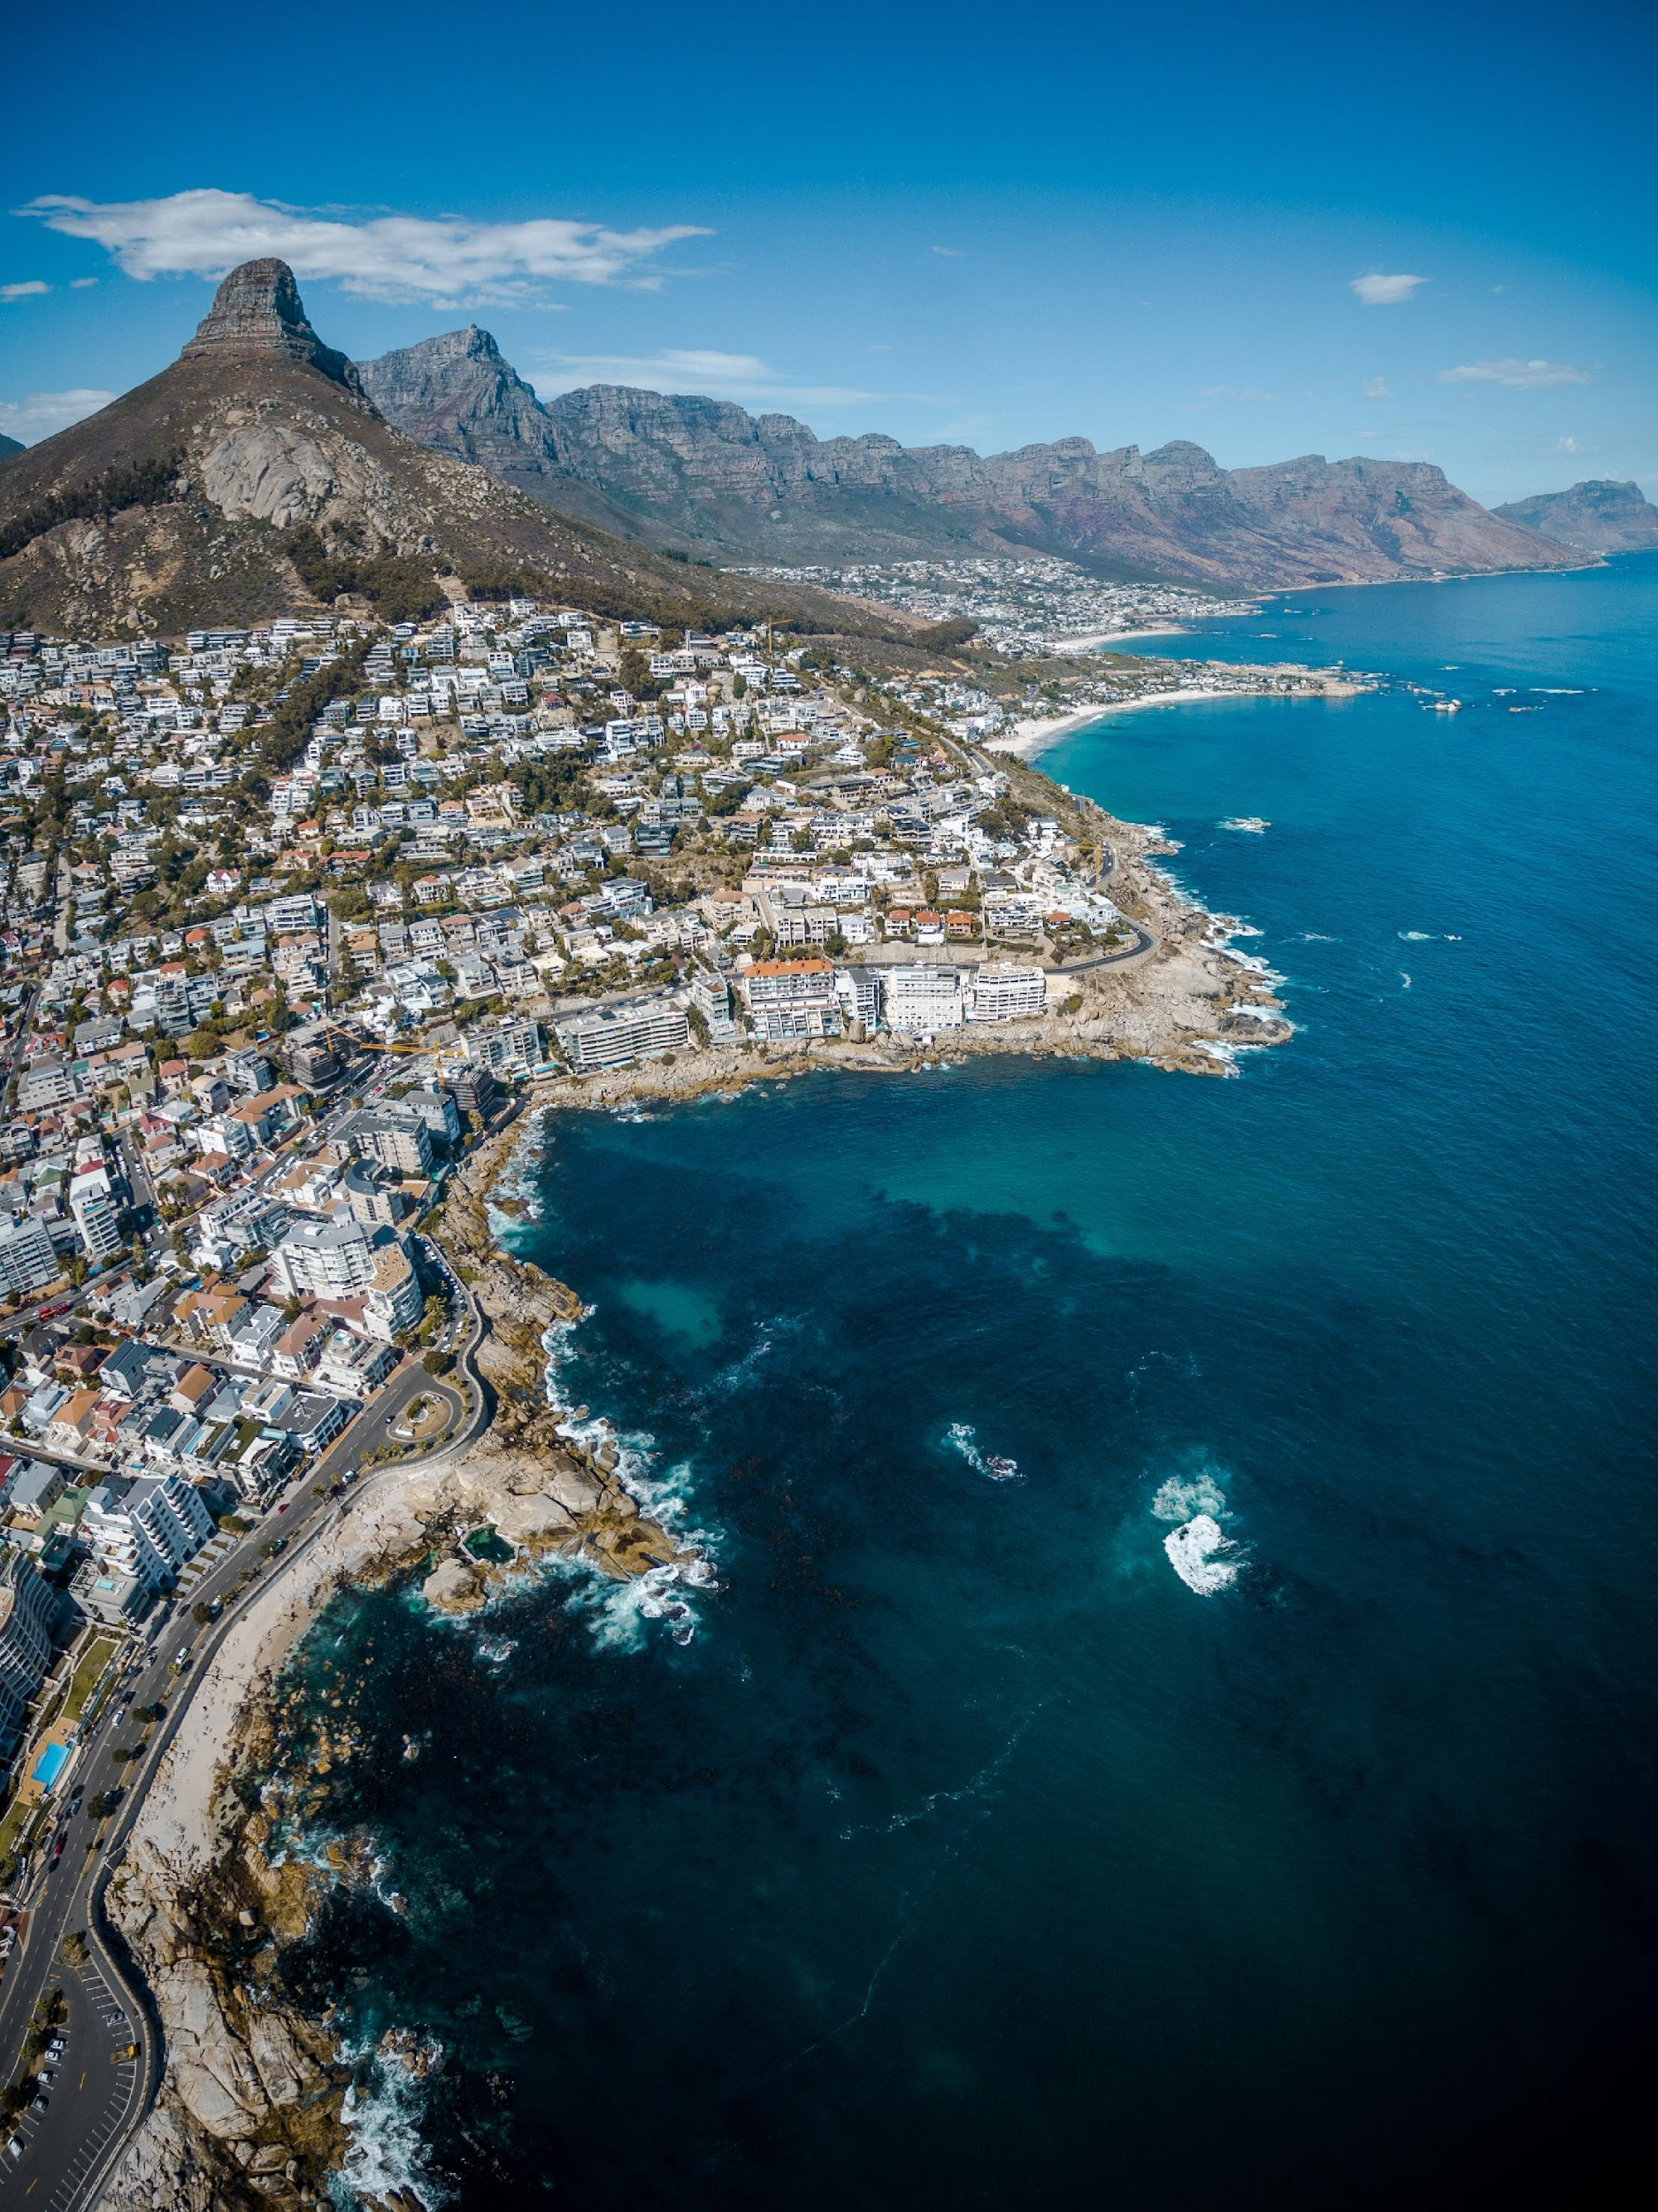
I-LEAD Country Presentation:
Highlights of Action Planning for Day 5 (Replace with Project Title(s) Here)
Country Name:
Country Team:
Use a Country Photo: Example is by Finding Dan | Dan Grinwis on Unsplash

Slide 3
Prioritized Key Issues/Gaps to be Addressed
Based on expedited ISHO Assessment – Will Inform Project(s) Selection
Issue/gap priority 1
Issue/gap priority 2
Issue/gap priority 3
Issue/gap priority 4
Issue/gap priority 5
Notes:
Please copy from the Country Presentation - Part I.

Slide 4
Narrative for the Comprehensive Recognized Issues/Gaps to be Addressed (from ISHO) + Project(s) Selection
The informatics problems, which are stated as a comprehensive narrative describing the all the issues/gaps between the current state and the desired future state in a context; which components/parts will you address with a GEEKS Tier 1 project if funds are available?
Narrative Area: Definition | Narrative Description
Current state: Describe current gaps, issues, deficiencies (e.g., informatics problems and potential root causes, consider ISHO results and key issues from pre-work)
Future state: If problem-solving is successful, we will have / see / achieve / deliver [value proposition statement] (what, where, when, for whom)
Context: Potential constraints or barriers (resources, capacity, governance and leadership, etc.)
Project 1 – Component Solution: Describe the component of the comprehensive issues/gaps Project 1 will address
Project 2 – Component Solution: Describe the component of the comprehensive issues/gaps Project 2 will address
Notes:
Add during the Tuesday group work (based on Current state to Future state)

Slide 5
Draw Toast Outputs: Process Steps
Important Note: Process steps identified as a part of the Draw Toast work can be translated to activities that you will use to populate the action plan.
Notes:
Add on Tuesday in group work
The draw toast outputs will not only describe the problem, but also help the team identify potential solutions.

Slide 6
Difficult Decision-Making Matrix
Did you encounter any difficult decisions during the problem solving and issue/gap prioritization process? If yes, include the results of your matrix here (copy and paste). If no, leave blank.
Difficult Decision (describe):
Options (list):
Criteria | Weight | Option 1 | Option 2 | Option 3 | Option 4 | Score Option 1 | Score Option 2 | Score Option 3 | Score Option 4
Notes:
If you encounter difficult problems (it becomes difficult when you have more than one possible decisions to make) the PDMP can help the team to make decisions using a structured and objective approach.
Please describe your PDMP results and how it helped you decide.

Slide 7
Project Title Development
Project | Component | Content
Case Based Surveillance and Interoperability (Example Project) | What (Goal) Who (Population) | Improving patient-level tracking of HIV sentinel events
 | How (Approach, Method) | Improving patient-level tracking of HIV sentinel events
 | Where (Setting, Location) | In selected health facilities in 11 regions in Ethiopia
 | Title | Improving patient-level tracking of HIV sentinel event in 11 Ethiopian regions through data exchange
Project 1 | What (Goal) Who (Population)
 | How (Approach/Method)
 | Where (Setting/Location)
 | Title
Project 2 | What (Goal) Who (Population)
 | How (Approach/Method)
 | Where (Setting/Location)
 | Title
Notes:
Fill out on Day 4

Slide 8

Action Plan
Take care of the minutes, and the hours will take care of themselves.

Slide 9
Project 1 Action Plan – Year 1
Project 1 Title:
ISHO Pillar | Objectives | Key Result* | Activities
Governance
Information Systems
Workforce development
* Key results – tangible, visible value claim OR metrics that measure the progress towards the objective

Slide 10
Project 2 Action Plan – Year 1
Project 2 Title:
ISHO Pillar | Objectives | Key Result* | Activities
Governance
Information Systems
Workforce development
* Key results – tangible, visible value claim OR metrics that measure the progress towards the objective

Slide 11
Other Critical Project(s) Considerations

